Slide 1
Gyro Logic
A Geometric Foundation for Context-Dependent Reasoning

Slide 2
Problem
Classical logic assumes context-independence
Real-world reasoning is observer-dependent
Mismatch between theory and reality

Slide 3
Research Gap
Non-monotonic logic → discrete
Modal logic → symbolic
Probabilistic models → statistical
No unified geometric model

Slide 4
Core Hypothesis
Truth is not a value
Truth is a geometric object
Meaning depends on observer and context

Slide 5
Formalization
Truth = point in manifold
Conflict = curvature
Inference = geodesic
Logic = geometry + dynamics

Slide 6
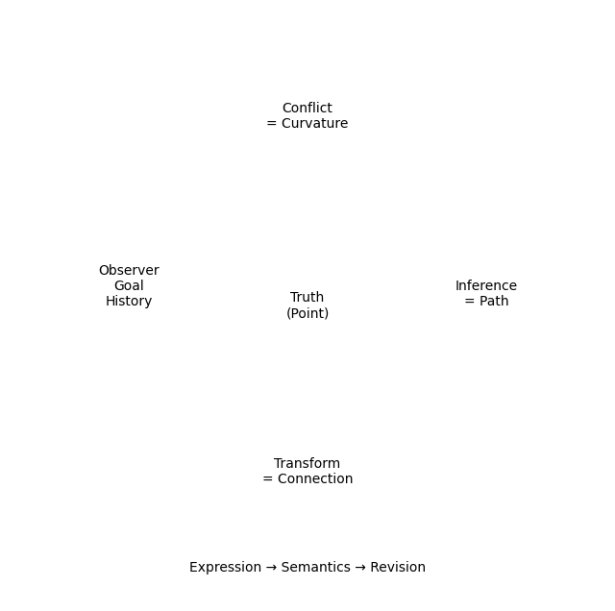
Core Model

Slide 7
Theoretical Properties
Non-monotonic
Observer-dependent
Non-commutative
History-aware

Slide 8
Relation to Existing Fields
Differential geometry
Category theory
Logic systems
Semantic modeling

Slide 9
Why It Matters
Toward AGI-level reasoning
Unified theoretical framework
Geometry × Logic integration

Slide 10
Vision
New foundation for reasoning systems
Beyond symbolic and statistical approaches
Toward general intelligence

Slide 11
Ask
Research collaboration
Theoretical exploration
Joint development of reasoning frameworks

