Slide 1
Liquid crystal
Simulation of a Nematic Liquid Crystal
Luuk Zonneveld
Miranda Naaktgeboren

Slide 2
Contents
Motivation
Background
Simulation
Results
Performance
Discussion
Conclusion

Slide 3
Motivation
5% of organic compounds [1]
Technology
LCD
Simulation

Slide 4


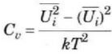

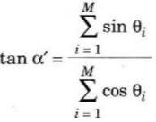

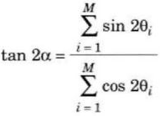
Background
Pair potential
Internal energy
Heat capacity
Long range order parameters
Polar
Apolar
[1]

Slide 5
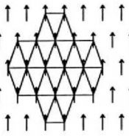
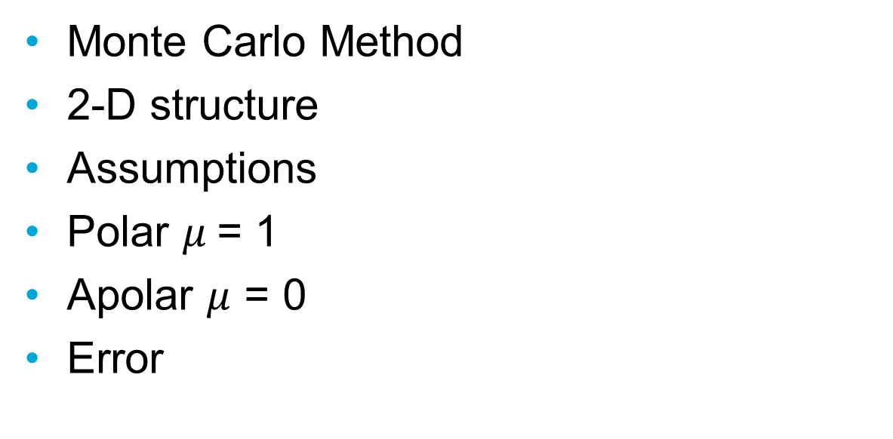
Simulation
Monte Carlo Method
2-D structure
Assumptions
Polar $μ$= 1
Apolar $μ$ = 0
Error

Slide 6


Algorithm
For every temperature and iteration
For every molecule
Calculate
Determine new Ui
Accept or decline based on Boltzmann distribution
New configuration
Calculate observables

Slide 7
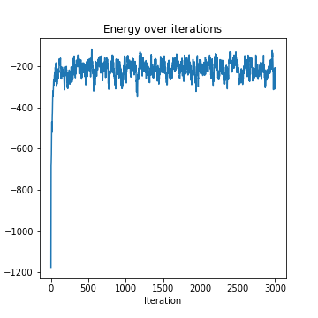
Stability

Slide 8
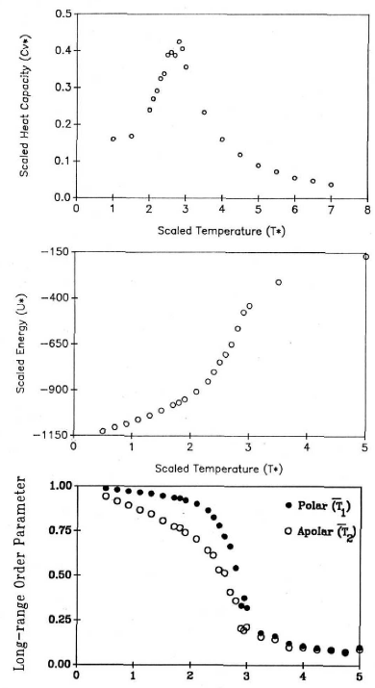
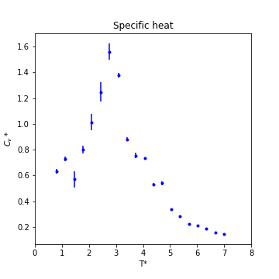
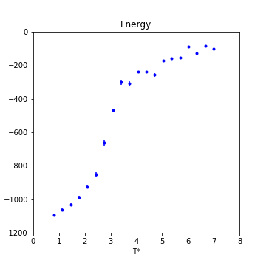
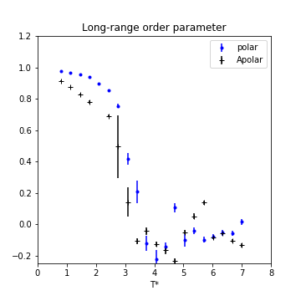

Results $μ=1$
[1]

Slide 9
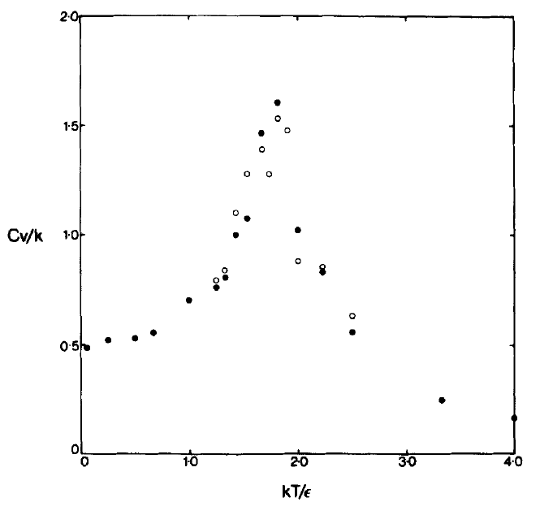
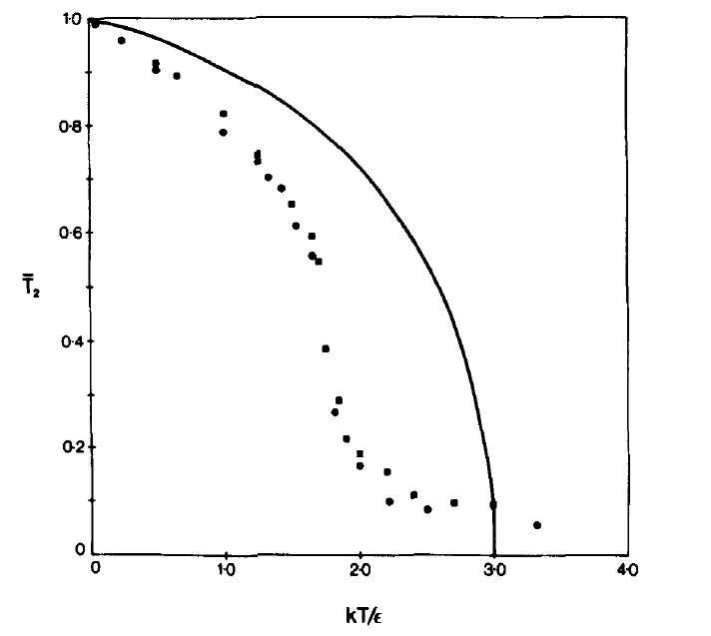
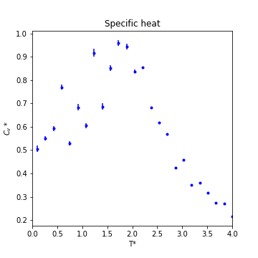
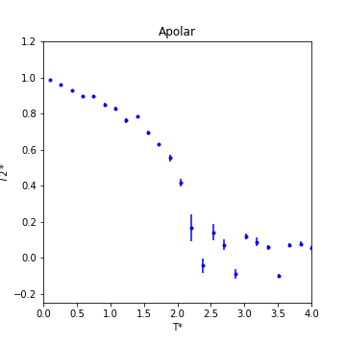

Results $μ=0$
[2]

Slide 10
Performance
Computationally suboptimal
Optimised with Booleans
3 minutes

Slide 11
Discussion
3-D
More interaction molecules
Translational

Slide 12
Conclusion
Basis for analyzation of liquid crystal behavior
Needs improvement to study phase change

Slide 13
References
[1] Hemenway, E. C., & Wade, A. P. (1992). A program to simulate a nematic liquid crystal in 2-D for use in computer-assisted education. Journal of chemical education, 69(2), 123.
[2] Denham, J. Y., Luckhurst, G. R., Zannoni, C., & Lewis, J. W. (1980). Computer simulation studies of anisotropic systems, iii. two-dimensional nematic liquid crystals. Molecular Crystals and Liquid Crystals, 60(3), 185-205.

