Slide 1
ST6103 - GLM - Session 4
Marc Henrion

Slide 2
Session 4: Generalised Linear Model - continued

Slide 3
Notation
$X,Y$ - random variables (here: X = predictor, Y = response)
$x,y$ - measured / observed values
$ϵ$ - random variable (here: error / residual)
$θ$ - a vector of parameters
$\overline{X}$, $\overline{Y}$ - sample mean estimators for X, Y
$\overline{x}$, $\overline{y}$ - sample mean estimates of X, Y
$\hat{T}$, $\hat{t}$ - given a statistic T, estimator and estimate of T
$P(A)$ - probability of an event A occuring
$f_{X}(.)$, $f_{Y}(.)$ - distribution mass / density functions of X, Y
$X∼F$ - X distributed according to distribution function F
$E[X]$, $E[Y]$, $E[T]$ - the expectation of X, Y, T respectively

Slide 4
Generalised linear model: confidence bands
Once we have fitted a GLM, we can predict new values.
Predicting response values for predictor values well outside the ones used to fit the model should be avoided!
Prediction uses estimates. Can we derive prediction confidence intervals? What we predict in a GLM is the mean response. We can actually consider 2 types of prediction confidence intervals:
for the mean response
for a new observation
The first one takes only the uncertainty of the model fit into account, the second one also takes the variability of the response values into account.

Slide 5
Generalised linear model: confidence bands
We have seen that the estimators $\hat{β}$ are asympotically normally distributed. This implies that, on the link function scale (i.e. for the linear predictor $η$), we can construct confidence intervals using the asympotic normal distribution, then back transform to the scale of the response variable.
For a 95% confidence interval for the mean response:
$$\hat{η}±1.96×SE(\hat{η})$$
And then, backtransforming
$${\hat{y}}_{low}=g^{−1}({\hat{η}}_{low})$$
$${\hat{y}}_{high}=g^{−1}({\hat{η}}_{high})$$

Slide 6
Generalised linear model: confidence bands
Example:
modPois<-glm(dist~speed,data=cars,family=poisson) newX<-data.frame(speed=seq(1,30,length=500)) pred<-predict(modPois,type="link",newdata=newX, se.fit=T) predFit<-exp(pred$fit) predLow<-exp(pred$fit-qnorm(0.975)*pred$se.fit) predHigh<-exp(pred$fit+qnorm(0.975)*pred$se.fit) plot(dist~speed,data=cars,cex=2,xlim=c(1,30),ylim=c(0,170)) lines(newX$speed,predFit,lwd=2,col="steelblue") polygon(x=c(newX$speed,newX$speed[nrow(newX):1]),y=c(predLow,predHigh[nrow(newX):1]),col=rgb(70,130,180,alpha=100,maxColorValue=255),border=NA)

Slide 7
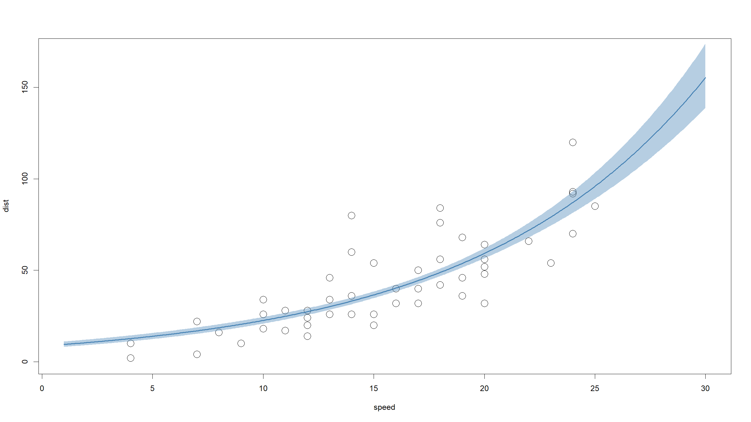

Slide 8
Generalised linear model: confidence bands
Confidence intervals for new observations are more tricky as we would need an estimate of the variability of the response variable on the link scale.
For some models, we cannot derive analytical solutions (e.g. Poisson) and for others (e.g. binomial), it would make little sense.
We can do this for general linear models however.

Slide 9
Generalised linear model: confidence bands
For Gaussian distribution with identity link GLMs, we can even derive exact prediction confidence intervals - for both the mean response and new observations.
Mean response confidence interval for a model with $p$ predictors:
$$\hat{y}±t_{α/2,n−p−1}SE(\hat{y})$$
where $SE(\hat{y})=\sqrt{MSE×x_{new}(X^{T}X)^{−1}x_{new}}$ and $x_{new}$ is the vector of predictors corresponding to $\hat{y}$.
Confidence intervals for a new observation for a model with $p$ predictors:
$$\hat{y}±t_{α/2,n−p−1}\sqrt{MSE+SE(\hat{y})^{2}}$$

Slide 10
Generalised linear model: confidence bands
Example:
set.seed(20190718) x<-rnorm(50) y<-1.5*x+rnorm(50) df<-data.frame(x=x,y=y) mod<-lm(y~x,data=df) xx<-seq(-3,3,length=500) predMean<-as.data.frame(predict(mod,newdata=data.frame(x=xx),interval="confidence")) predNew<-as.data.frame(predict(mod,newdata=data.frame(x=xx),interval="prediction"))

Slide 11
Generalised linear model: confidence bands
Example:
plot(y~x,data=df,cex=2) lines(c(-3,3),coef(mod)[1]+coef(mod)[2]*c(-3,3),lwd=2,col="steelblue") polygon(c(xx,xx[length(xx):1]),c(predNew$lwr,predNew$upr[length(xx):1]),border=NA,col=rgb(200,0,0,alpha=80,maxColorValue=255)) polygon(c(xx,xx[length(xx):1]),c(predMean$lwr,predMean$upr[length(xx):1]),border=NA,col=rgb(120,200,0,alpha=130,maxColorValue=255)) lines(c(-3,3),coef(mod)[1]+coef(mod)[2]*c(-3,3),lwd=2,col="steelblue")

Slide 12
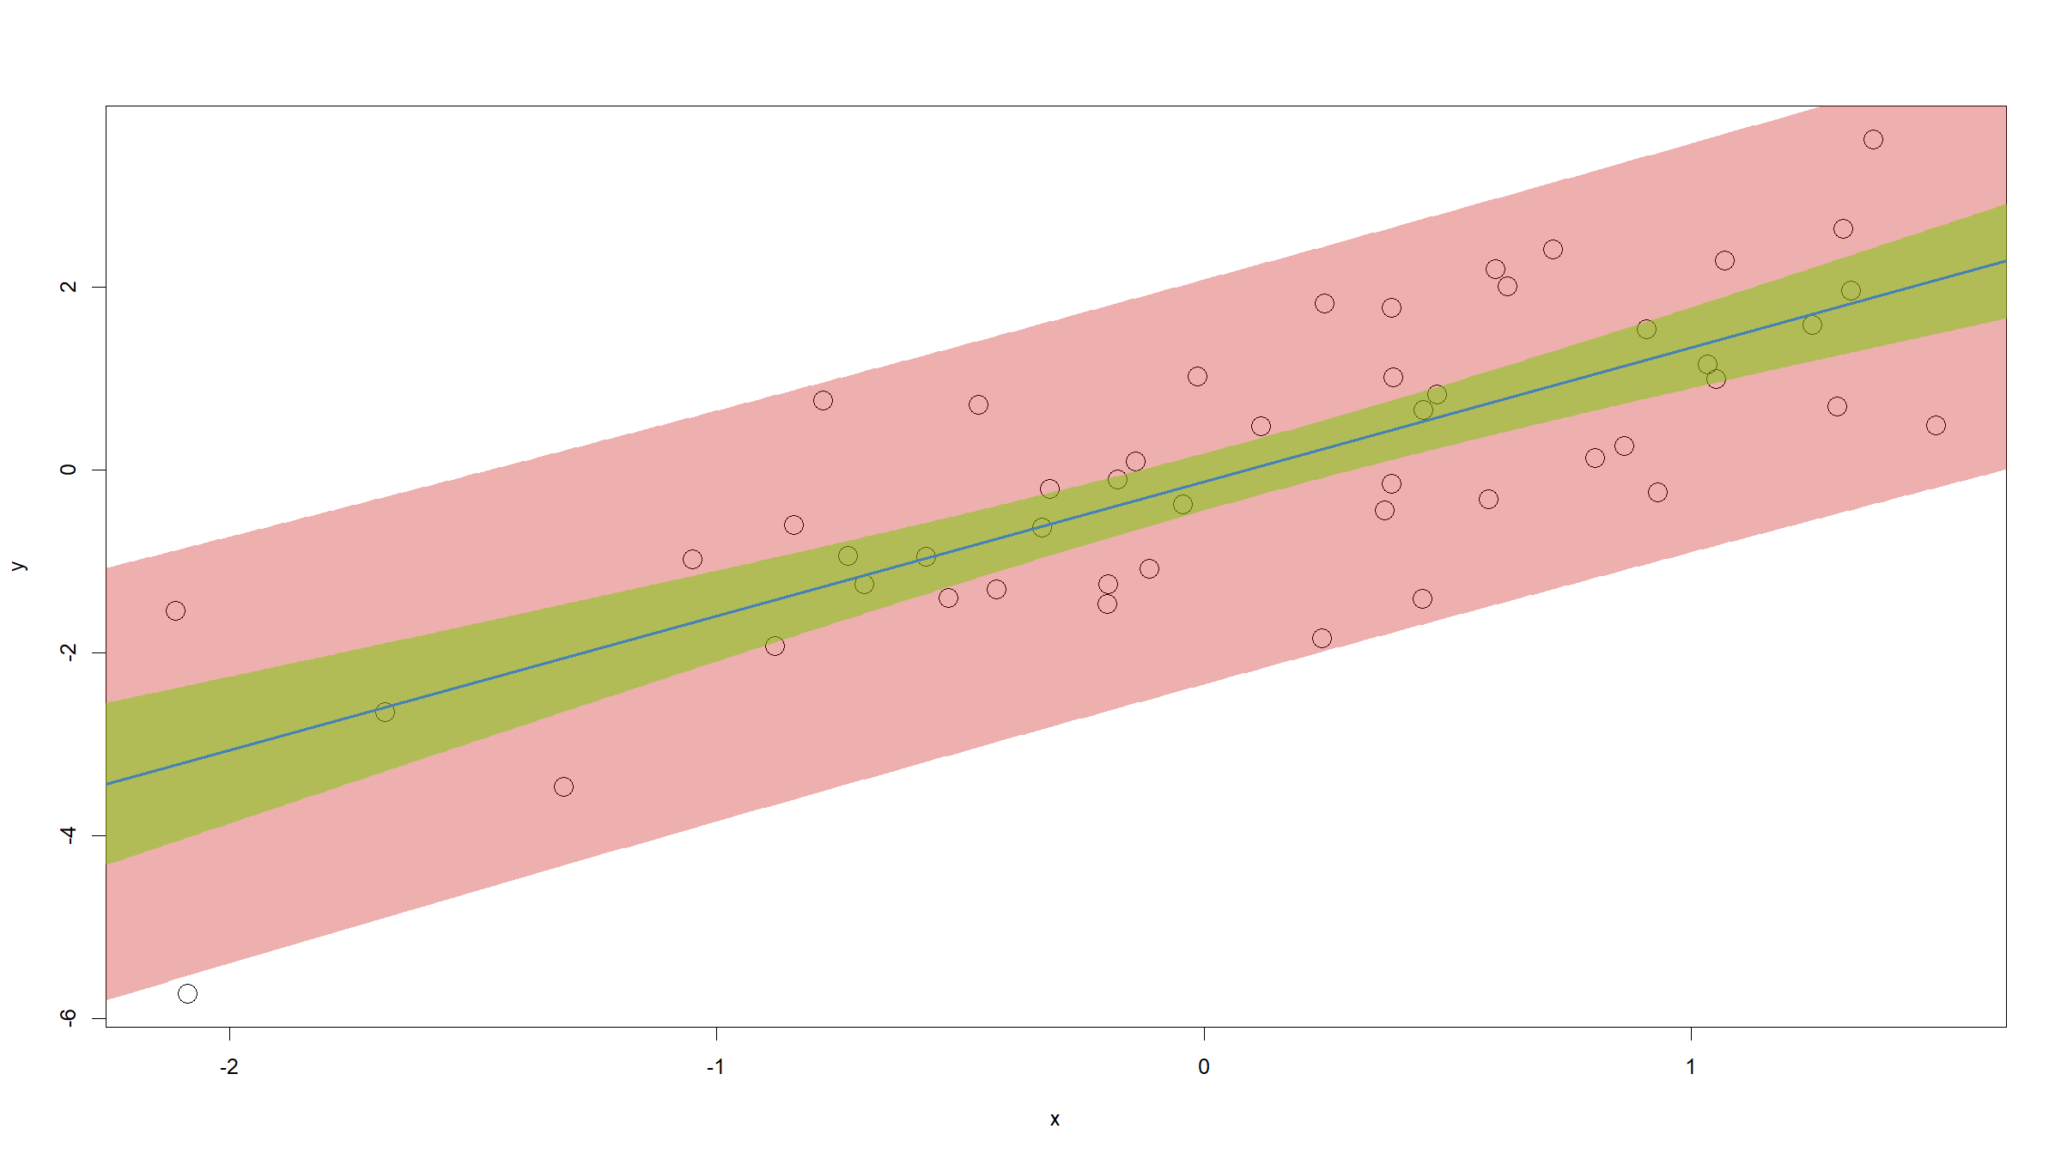

Slide 13
Generalised linear model: confidence bands
Exercise
For data as below, compute and plot 95% confidence intervals for the model fit:
set.seed(201907) x<-runif(50,min=1,max=4) y<-rpois(50,lambda=exp(x))

Slide 14
Generalised linear model: confidence bands
Solution
mod<-glm(y~x,family=poisson) newDat<-data.frame(x=seq(1,4,length=500)) pred<-predict(mod,newdata=newDat,type="link",se.fit=TRUE) predFit<-exp(pred$fit) predLow<-exp(pred$fit-qnorm(0.975)*pred$se.fit) predHigh<-exp(pred$fit+qnorm(0.975)*pred$se.fit) plot(x,y) lines(lwd=2,col="steelblue",newDat$x,predFit) lines(lwd=1.5,col="steelblue",newDat$x,predHigh,lty=2) lines(lwd=1.5,col="steelblue",newDat$x,predLow,lty=2)

Slide 15
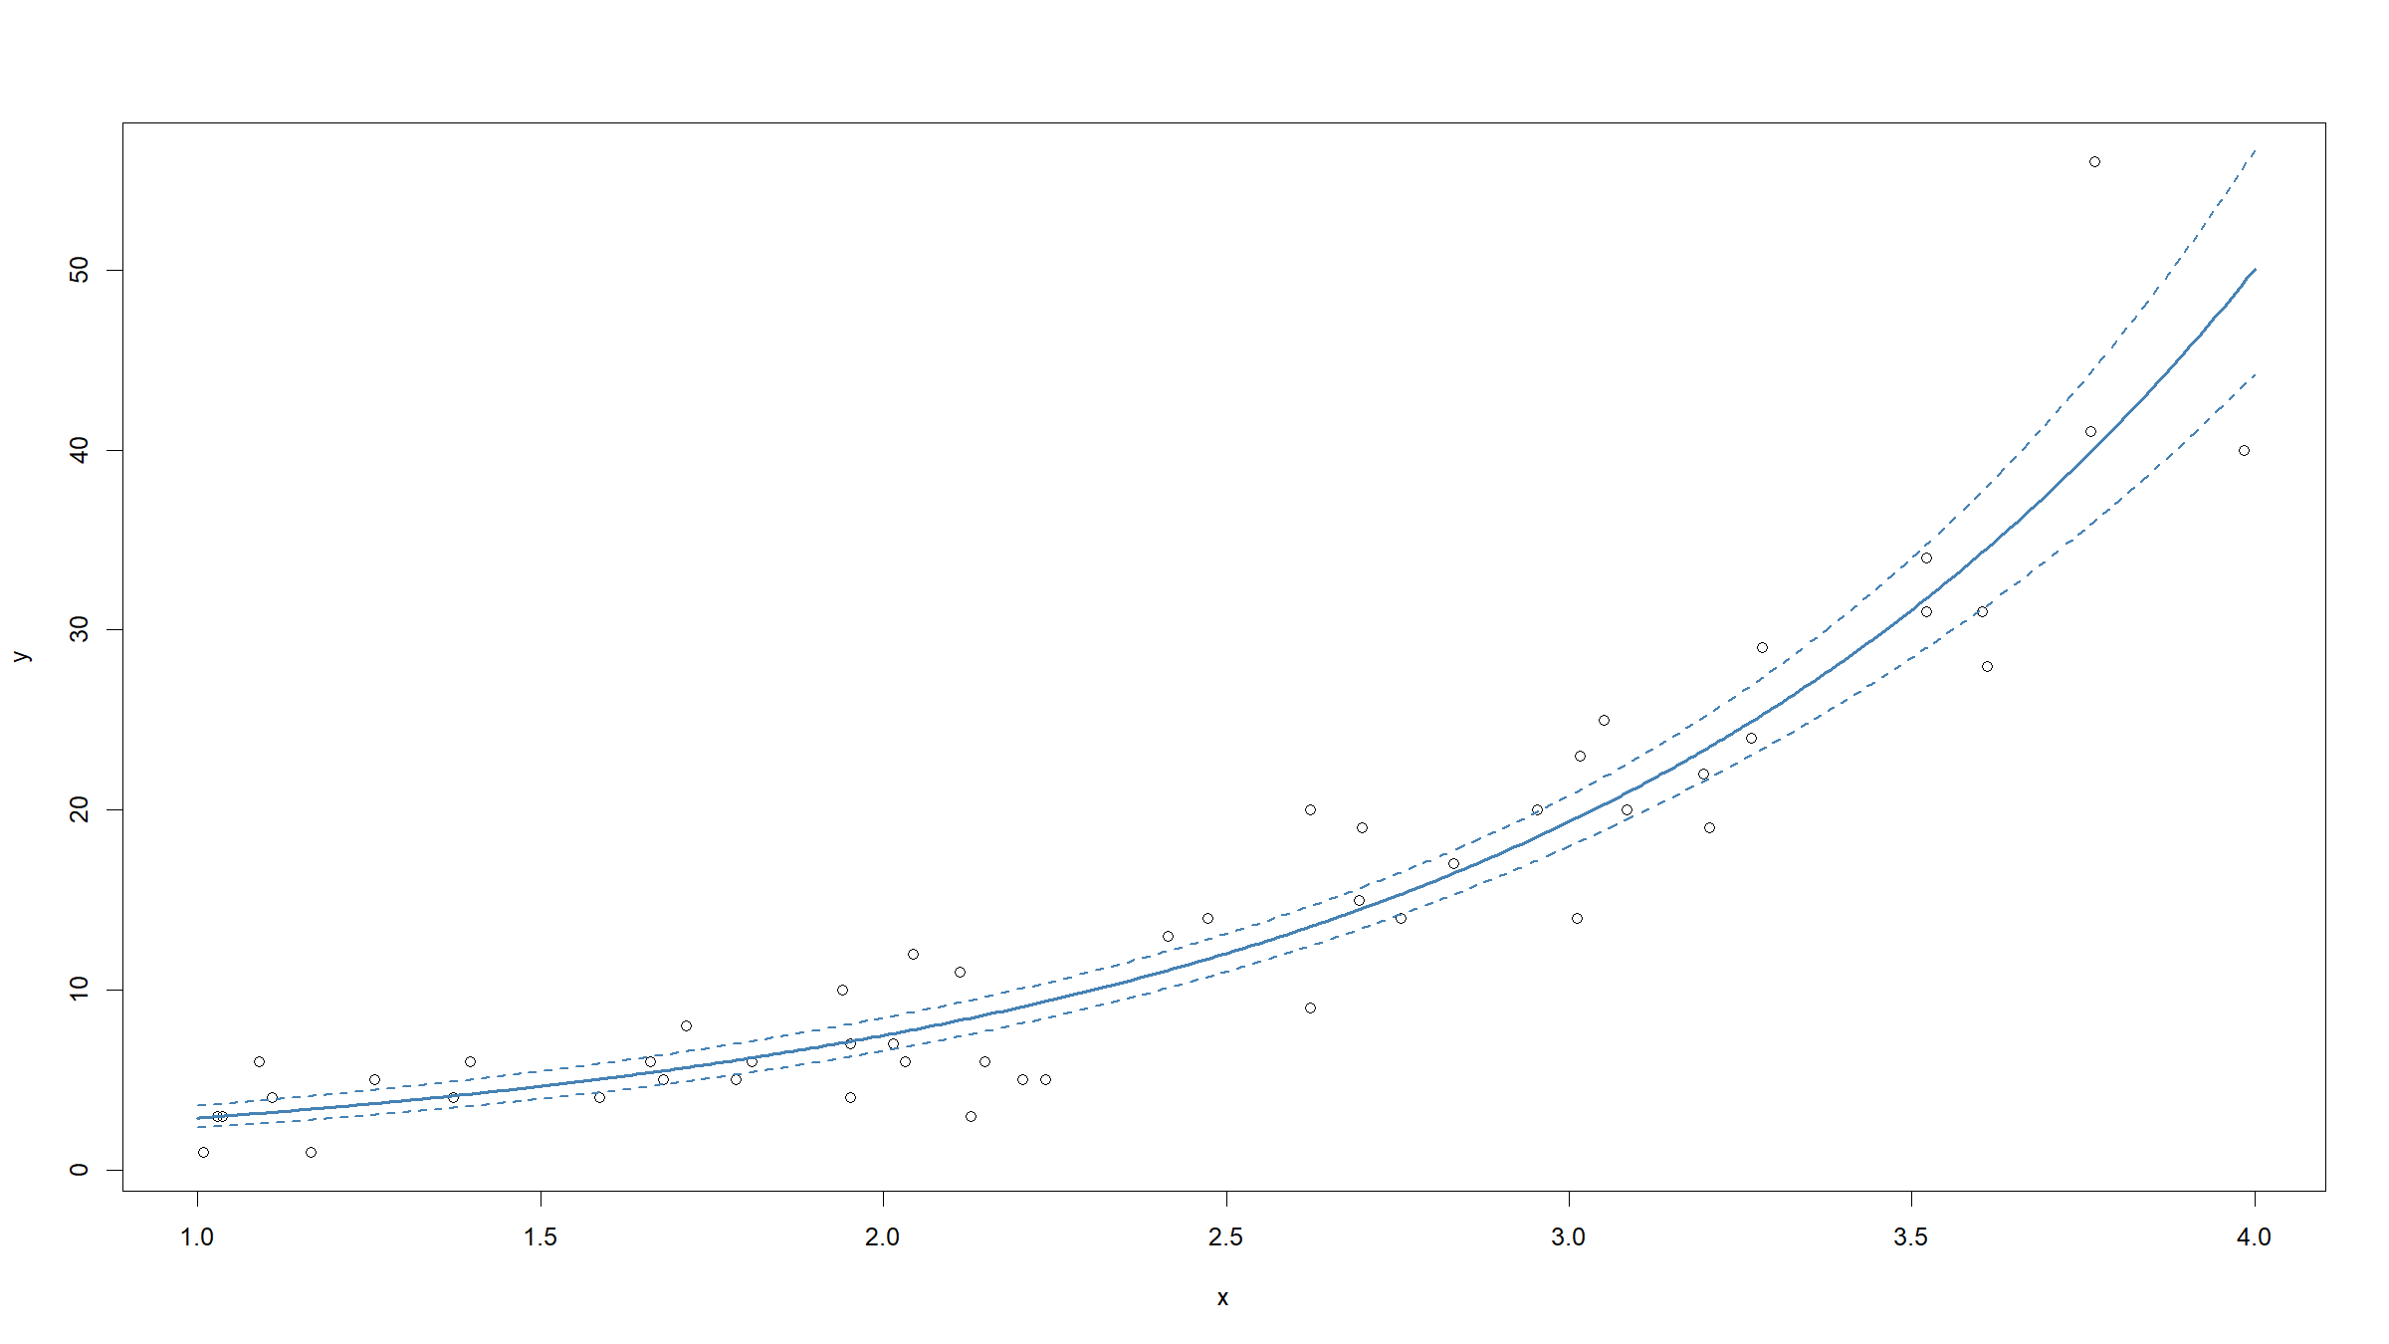

Slide 16
Generalised linear model
We can generalise the residual sum of squares (also known as the error sum of squares). We introduce the deviance:
$$D(y,\hat{μ})=2ϕ\left(l({\hat{θ}}_{s})−l(\hat{θ})\right)$$
where ${\hat{θ}}_{s}$ and $\hat{θ}$ refer to the MLE parameters of the saturated and the proposed model respectively and $l()$ is the log-likelihood function.
The saturated model is a model with 1 parameter for every observation. It is the model that fits the data exactly.

Slide 17
Generalised linear model
Exercise
Show that the deviance for the general linear model (Gaussian error distribution, identity link) is just the residual / error sum of squares ESS.
This implies that the deviance generalises the residual sum of squares to GLMs.

Slide 18
Generalised linear model
Solution:
The log likelihood is given by
l(θ)=logi​12πσ2exp−(yi−μi)22σ2=−i​(yi−μi)22σ2−n2log(2πσ2)
In a linear model with $p$ predictors, we have seen that the MLE is given by μi=j​xijβj=yi where the ${\hat{β}}_{j}$ are the MLE coefficients.

Slide 19
Generalised linear model
Solution:
For the saturated model, we have 1 parameter $θ_{i}$ for each observation $y_{i}$. Replacing $μ_{i}$ with $θ_{i}$ in the above expression for the log likelihood and solving the score equations
$$\frac{δ}{δθ_{i}}l(\hat{θ})=0⇔\frac{1}{σ^{2}}(y_{i}−θ_{i})=0⇔θ_{i}=y_{i}$$
And hence the log-likelihood of the saturated model is
$$l({\hat{θ}}_{s})=−\frac{n}{2}log(2πσ^{2})$$

Slide 20
Generalised linear model
Solution:
So finally, noting that $ϕ=σ^{2}$, we have:
D(y,μ)=2σ2−n2log(2πσ2)+i​(yi−μi)22σ2+n2log(2πσ2)=i​(yi−μi)2=i​(yi−yi)2=ESS
QED

Slide 21
Generalised linear model
The deviance is just a scaled likelihood ratio statistic (recall: differences of logs = log of ratio).
As we saw, the deviance generalises the residual / error sum of squares to GLMs. This means the deviance can be used as a measure of goodness of fit.
Under the null hypothesis of no difference between the saturated and the proposed model:
$$D(y,\hat{μ})∼χ_{n−p−1}^{2}$$

Slide 22
Generalised linear model
We can also compute the deviance for the worst model: the one where we include only an intercept.
This is called the null deviance and in the general linear model it is equal to the total sum of squares $TSS=SS_{y}$.
$$D_{0}(y)=D(y,\overline{y})=2ϕ\left(l({\hat{θ}}_{s})−l({\hat{β}}_{0})\right)$$

Slide 23
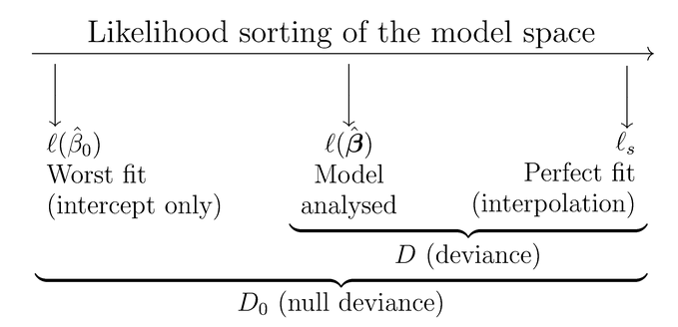
Generalised linear model
https://bookdown.org/egarpor/PM-UC3M/glm-deviance.html

Slide 24
Generalised linear model: diagnostics
You have fitted a GLM model. How do you know it’s any good?
Goodness of fit
Visual check
$R^{2}$, $R_{adj}^{2}$, proportion of deviance explained
AIC, BIC
Residuals
QQ plot
residuals vs. predicted values
Cook’s distance, DBETAS

Slide 25
Generalised linear model: diagnostics
Goodness of fit
We have already seen $R^{2}$, the coefficient of determination. It can be interpreted as the proportion of variance explained by the model.
$$R^{2}=\frac{RSS}{TSS}=1−\frac{ESS}{TSS}$$
For GLMs we need to generalise the $R^{2}$ however. We can compute the proportion of deviance explained:
$$R_{d}^{2}=1−\frac{D(y,\hat{μ})}{D_{0}(y)}$$

Slide 26
Generalised linear model: diagnostics
Goodness of fit
It is not wise to maximise $R^{2}$ (resp. $R_{d}^{2}$): you will end up with overfitted models with many parameters.
The adjusted $R^{2}$,
$$R_{adj}^{2}=1−(1−R^{2})\frac{n−1}{n−p−1}$$
is penalised for the number of parameters in the model (similarly for $R_{d}^{2}$).
Note: $R^{2}$ usually only reported for general linear models. In GLMs it is more common to directly state both the null deviance and the model deviance.

Slide 27
Generalised linear model: diagnostics
Goodness of fit
When maximum likelihood is used, you can also consider the likelihood itself as a measure of relative goodness of fit.
Again: better to penalise for the number of parameters in the model.
Akaike Information Criterion (AIC)
$$2⋅(p+1)−2⋅ln(\hat{L})$$
Bayesian Information Criterion (BIC)
$$ln(n)⋅(p+1)−2⋅ln(\hat{L})$$

Slide 28
Generalised linear model: diagnostics
Goodness of fit
Visually inspect the fit - if possible.
Tricky for, e.g. binary responses and/or large number of predictors.

Slide 29
[end of ST6103 GLM Session 4]

