Slide 1
ST6103 - GLM - Practical 2
Marc Henrion

Slide 2
Practical 2: Generalised Linear Models using R

Slide 3
Exercise 1
Download the file byHandExample1.csv from the GitHub repository.
Use read.csv() or read.table() to read this dataset into R.
Use the R functions lm() or glm() to fit the same linear model as we did yesterday when we calculated $β_{0}$ and $β_{1}$ by hand.
Convince yourself you get the same results.
What difference - if any - do you observe between using lm() and glm()?
Find out more about these r functions by typing ?lm and ?glm.

Slide 4
Exercise 1
dat <- read.csv("byHandExample1.csv") modLm <- lm(y ~ x, data = dat) summary(modLm)$coefficients ## Estimate Std. Error t value Pr(>|t|) ## (Intercept) 0.08206687 1.7712634 0.04633239 0.965266238 ## x 2.04863222 0.2958963 6.92348023 0.002284249
This is the same as what we calculated by hand.

Slide 5
Exercise 1
modGlm <- glm(y ~ x, data = dat) summary(modGlm)$coefficients ## Estimate Std. Error t value Pr(>|t|) ## (Intercept) 0.08206687 1.7712634 0.04633239 0.965266238 ## x 2.04863222 0.2958963 6.92348023 0.002284249
This gives us the same results.
If you display the full summary of the model (i.e. typing summary(modLm) and summary(modGlm)), then output presentation is slightly different (e.g. no $R^{2}$ reported for the modGlm, but therefore deviances), but that’s all.

Slide 6
Exercise 2
Manually code up the data from yesterday’s Exercise 2 in Practical 1.
Then refit the same model from yesterday using R.
Convince yourself you get the same results.
Calculate $R^{2}$.

Slide 7
Exercise 2
x <- c(-3, -1, 0, 2, 5, 6) y <- c(12, 9, 11, 9, 9, 6) dat <- data.frame(x, y) modLm <- lm(y ~ x, data = dat) modGlm <- glm(y ~ x, data = dat) summary(modLm)$coefficients ## Estimate Std. Error t value Pr(>|t|) ## (Intercept) 10.0650407 0.5834431 17.251109 6.625466e-05 ## x -0.4878049 0.1650226 -2.955988 4.172033e-02 summary(modGlm)$coefficients ## Estimate Std. Error t value Pr(>|t|) ## (Intercept) 10.0650407 0.5834431 17.251109 6.625466e-05 ## x -0.4878049 0.1650226 -2.955988 4.172033e-02
Same results as when we did this by hand and both lm and glm give the same coefficients and p-values.

Slide 8
Exercise 2
We can either directly extract $R^{2}$ from the lm model fit:
summary(modLm)$r.squared
## [1] 0.6859756
Or we calculate it directly:
yhat<-predict(modLm) tss<-sum((y-mean(y))^2) rss<-sum((yhat-mean(y))^2) r2<-rss/tss print(r2)
## [1] 0.6859756

Slide 9
Exercise 3
Load the mtcars dataset by typing data(mtcars). Get information about this dataset by typing ?mtcars.
Explore this dataset: produce histograms & scatterplots.
You want to find out which variables are most important to achieve a high miles per gallon rating in a car. Use R to build a GLM model regressing the mpg variables on hp (horsepower), disp (displacement),cyl (cylinders) and wt (weight). Interpret the model output.
Buid a model that would allow you to predict whether a car has manual or automatic transmission. Specifically, regress am (transmission) on hp (horse power) and wt (weight). Be careful to specify a binomial distribution with logit link! What about a log link? Identity link?
Discuss (and explore!) your model results. What other variables would you consider including into the models?

Slide 10
Exercise 3
data(mtcars) dim(mtcars) ## [1] 32 11 head(mtcars) ## mpg cyl disp hp drat wt qsec vs am gear carb ## Mazda RX4 21.0 6 160 110 3.90 2.620 16.46 0 1 4 4 ## Mazda RX4 Wag 21.0 6 160 110 3.90 2.875 17.02 0 1 4 4 ## Datsun 710 22.8 4 108 93 3.85 2.320 18.61 1 1 4 1 ## Hornet 4 Drive 21.4 6 258 110 3.08 3.215 19.44 1 0 3 1 ## Hornet Sportabout 18.7 8 360 175 3.15 3.440 17.02 0 0 3 2 ## Valiant 18.1 6 225 105 2.76 3.460 20.22 1 0 3 1

Slide 11
Exercise 3
hist(mtcars$mpg,xlab="mtcars")

Slide 12
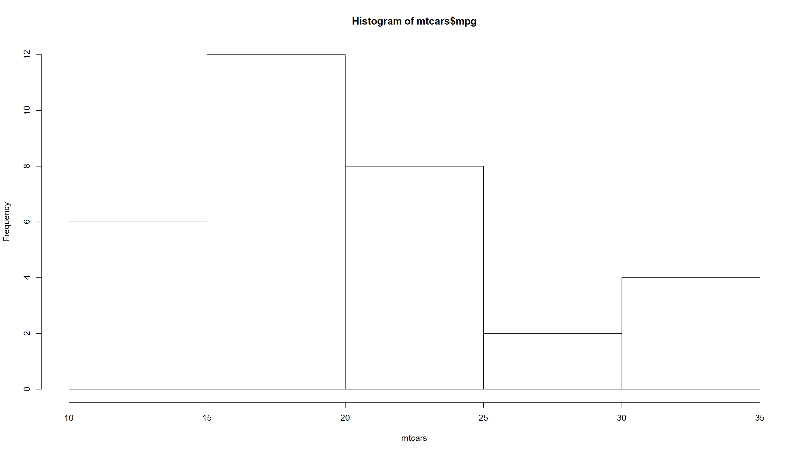

Slide 13
Exercise 3
barplot(table(mtcars$cyl),xlab="cyl")

Slide 14
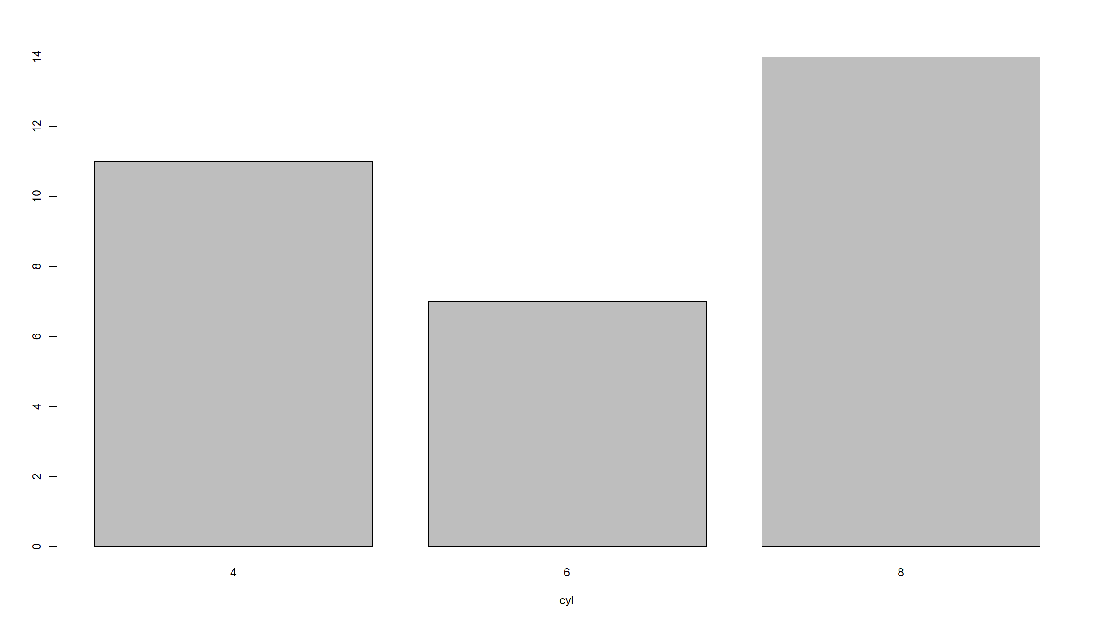

Slide 15
# Exercise 3
hist(mtcars$disp,xlab="disp")

Slide 16
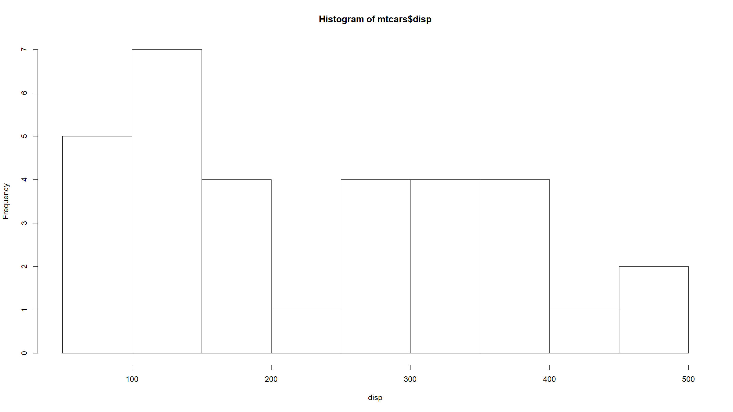

Slide 17
Exercise 3
hist(mtcars$hp,xlab="hp")

Slide 18
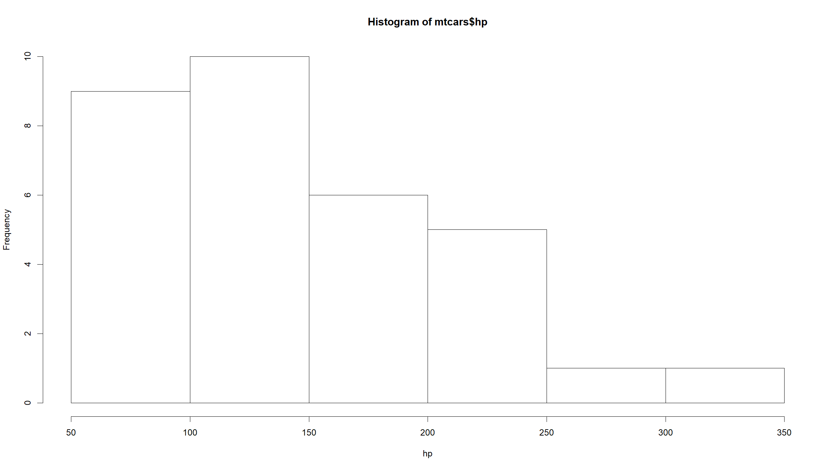

Slide 19
Exercise 3
hist(mtcars$drat,xlab="drat")

Slide 20
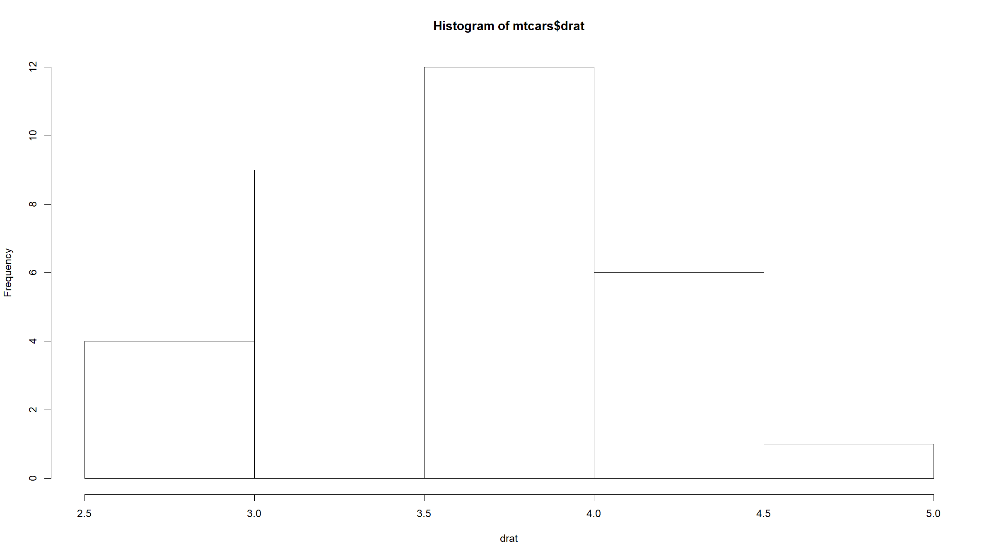

Slide 21
# Exercise 3
hist(mtcars$wt,xlab="wt")

Slide 22
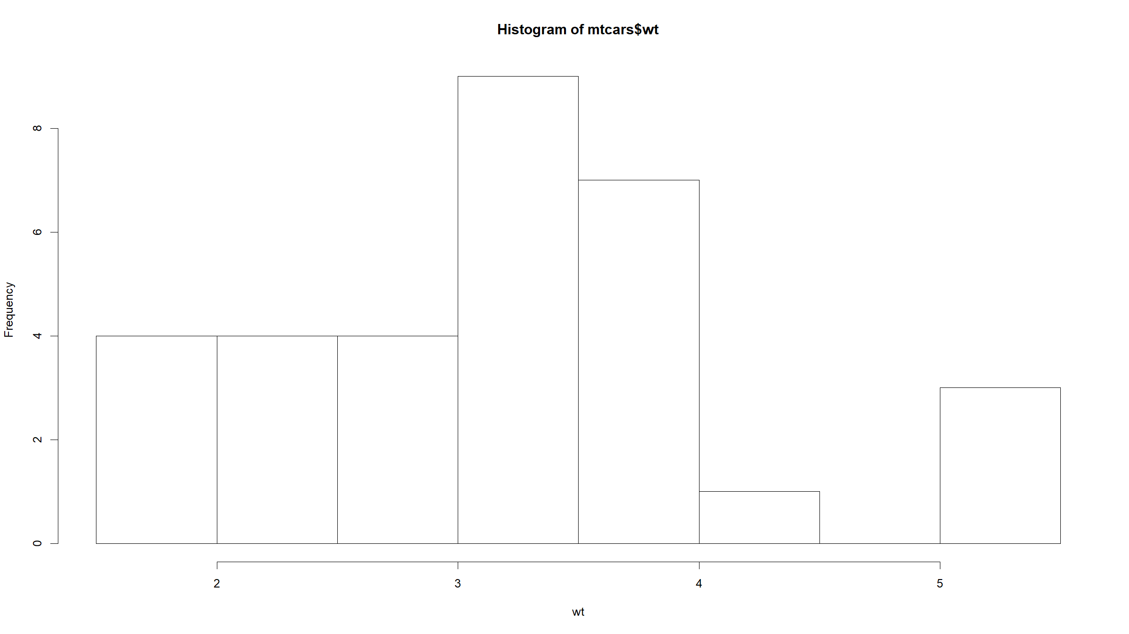

Slide 23
Exercise 3
hist(mtcars$qsec,xlab="qsec")

Slide 24
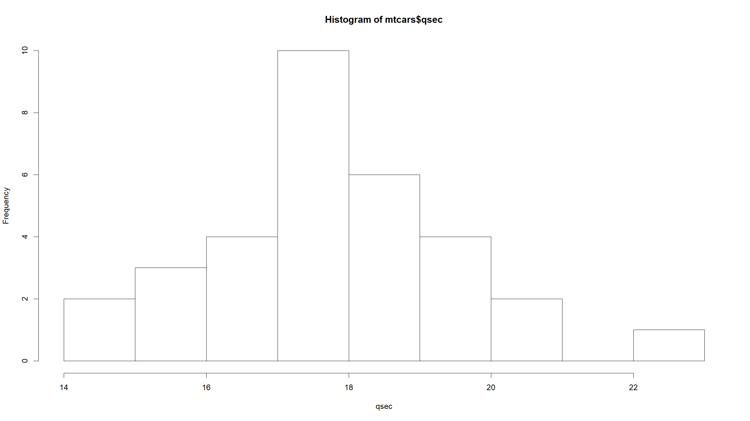

Slide 25
Exercise 3
barplot(table(mtcars$vs),xlab="vs")

Slide 26
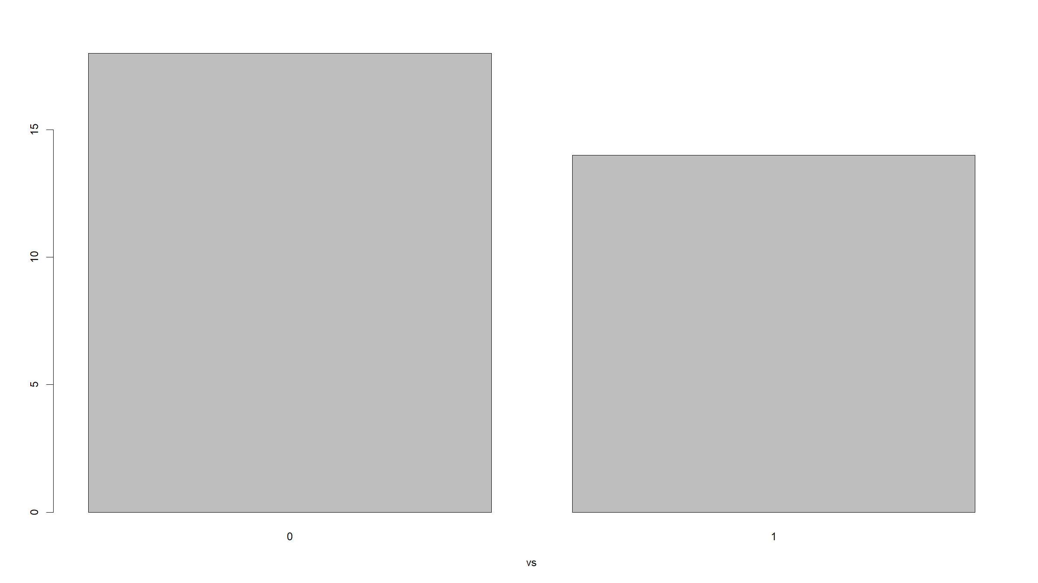

Slide 27
Exercise 3
barplot(table(mtcars$am),xlab="am")

Slide 28
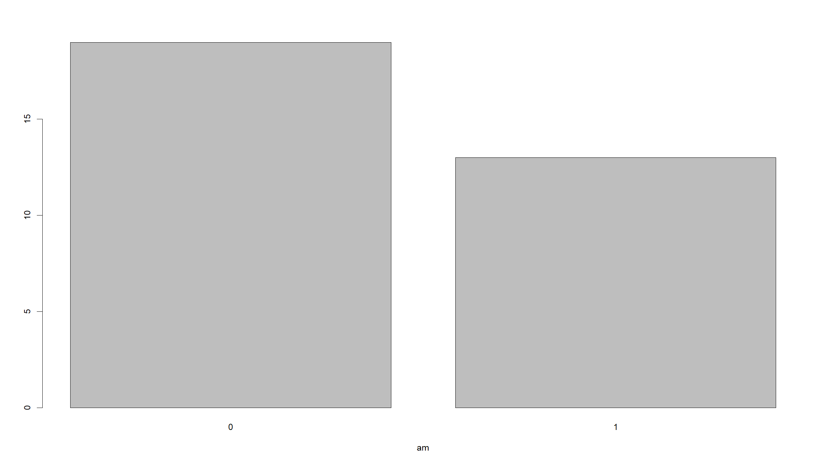

Slide 29
Exercise 3
barplot(table(mtcars$gear),xlab="gear")

Slide 30
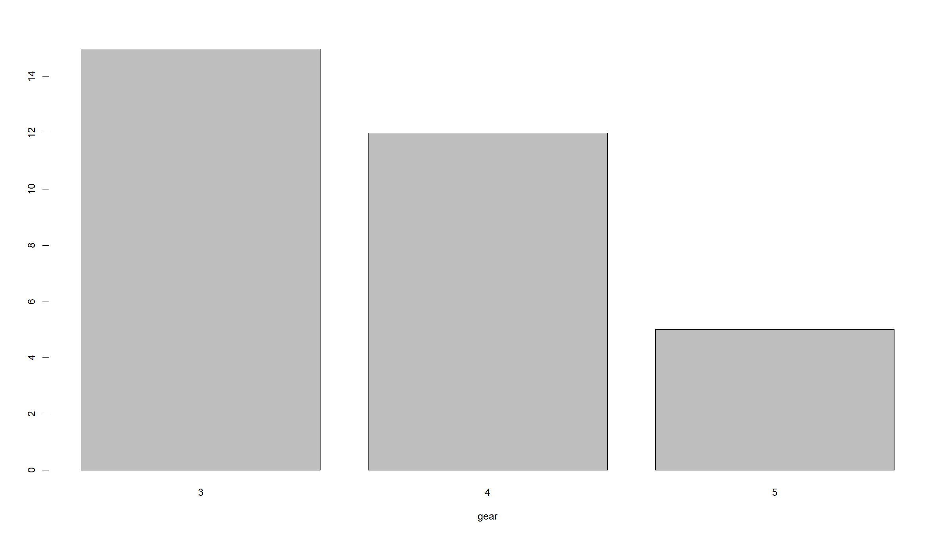

Slide 31
Exercise 3
barplot(table(mtcars$carb),xlab="carb")

Slide 32
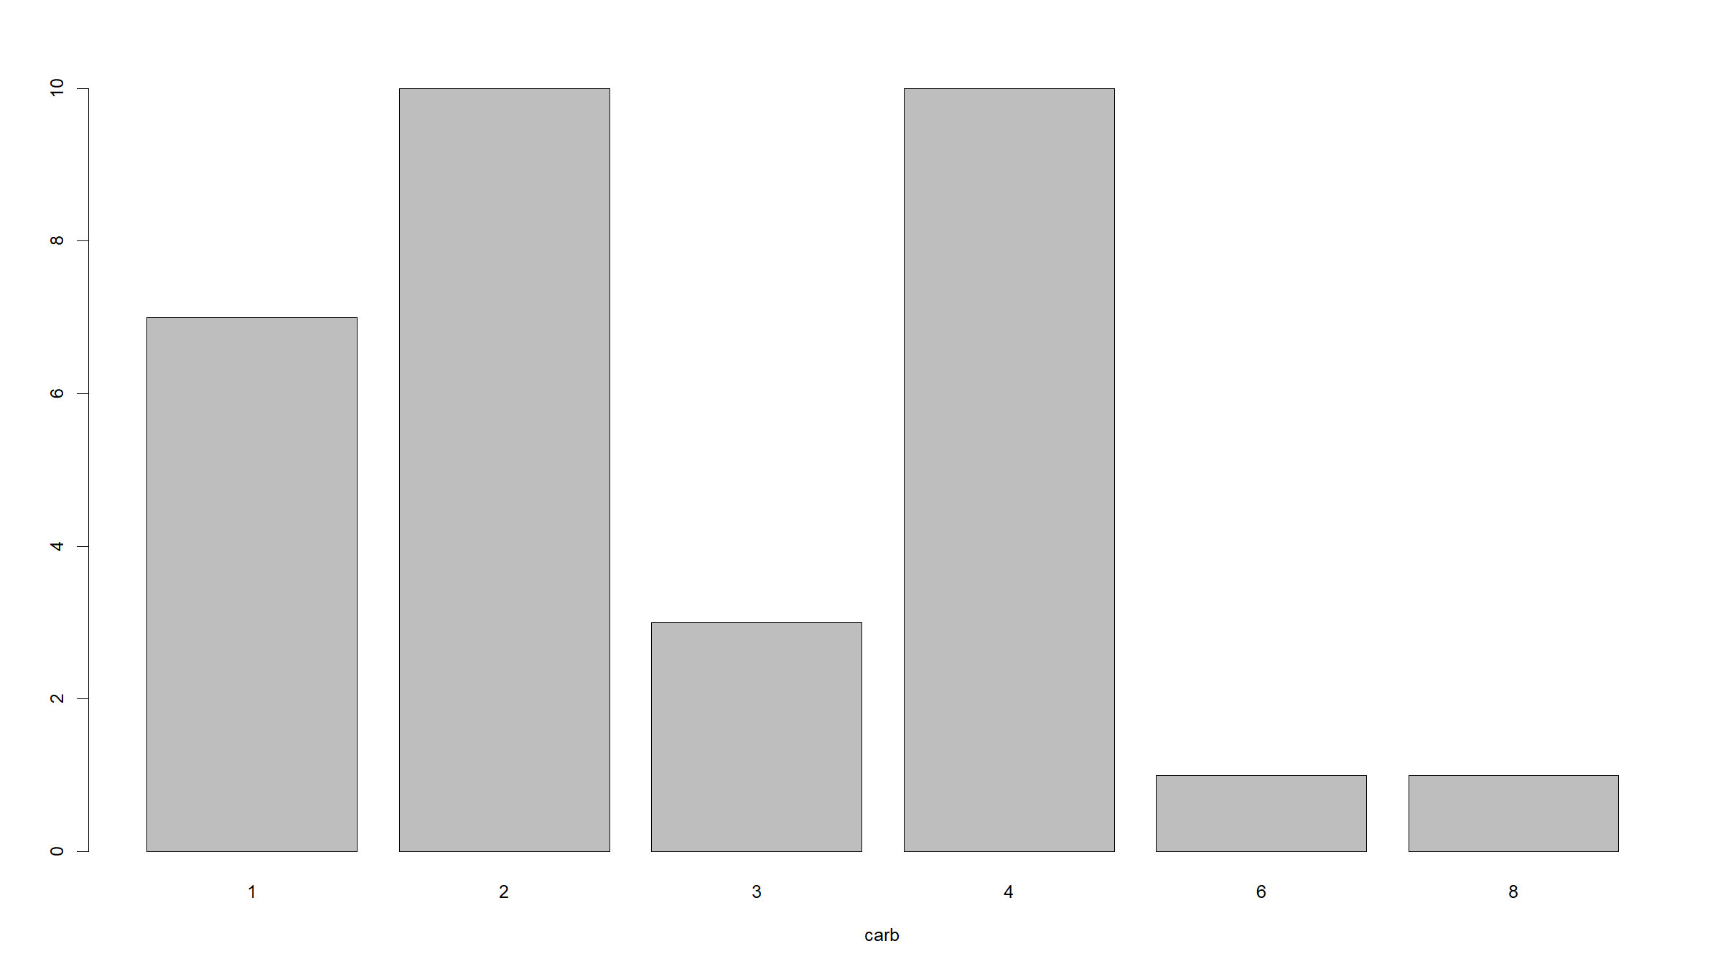

Slide 33
Exercise 3
pairs(mtcars)

Slide 34
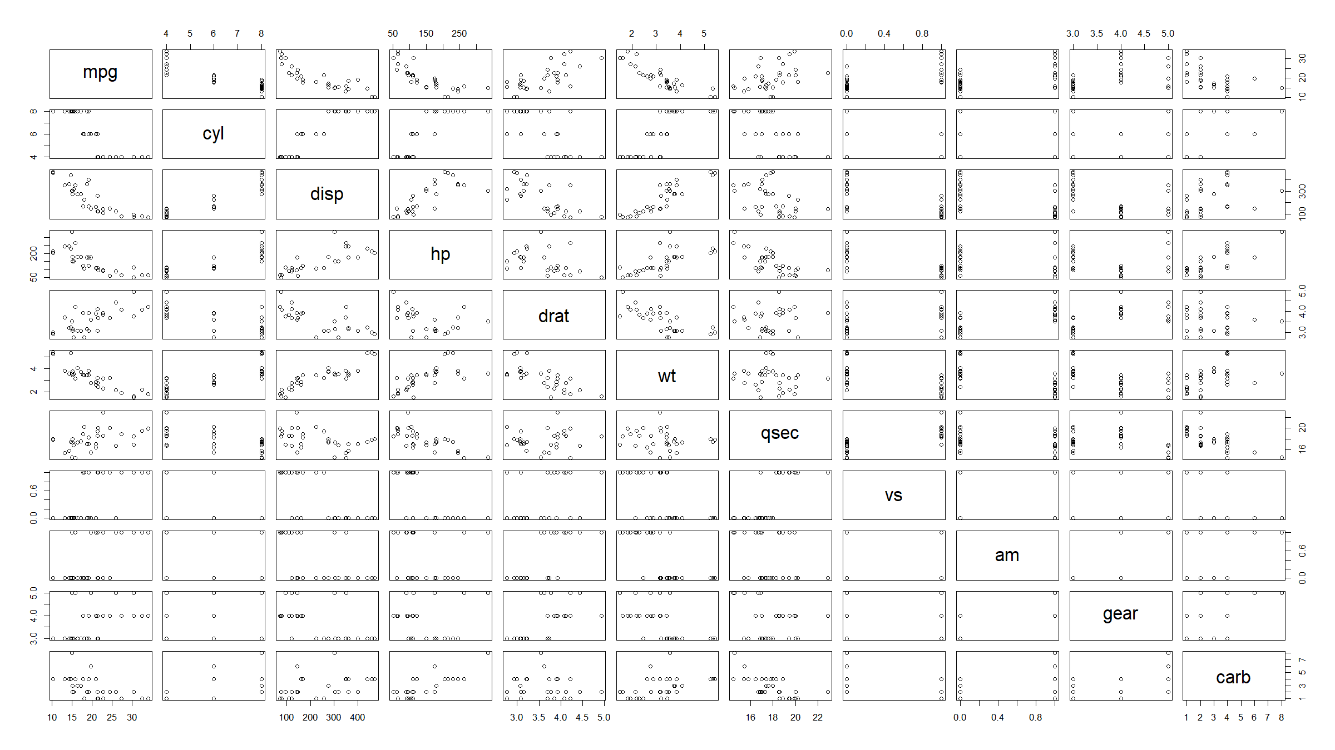

Slide 35
Exercise 3
GLM for mpg on hp (horsepower), disp (displacement),cyl (cylinders) and wt (weight).
modMpg <- glm(mpg ~ hp + disp + cyl + wt, data = mtcars) # family=binomial is default; no need to specify summary(modMpg) ## ## Call: ## glm(formula = mpg ~ hp + disp + cyl + wt, data = mtcars) ## ## Deviance Residuals: ## Min 1Q Median 3Q Max ## -4.0562 -1.4636 -0.4281 1.2854 5.8269 ## ## Coefficients: ## Estimate Std. Error t value Pr(>|t|) ## (Intercept) 40.82854 2.75747 14.807 1.76e-14 *** ## hp -0.02054 0.01215 -1.691 0.102379 ## disp 0.01160 0.01173 0.989 0.331386 ## cyl -1.29332 0.65588 -1.972 0.058947 . ## wt -3.85390 1.01547 -3.795 0.000759 *** ## --- ## Signif. codes: 0 '***' 0.001 '**' 0.01 '*' 0.05 '.' 0.1 ' ' 1 ## ## (Dispersion parameter for gaussian family taken to be 6.312754) ## ## Null deviance: 1126.05 on 31 degrees of freedom ## Residual deviance: 170.44 on 27 degrees of freedom ## AIC: 156.34 ## ## Number of Fisher Scoring iterations: 2

Slide 36
Exercise 3
Variables hp, cyl and wt have a negative coefficient in this model: i.e. cars with higher horsepower, more cylinders and that are heavier achieve, on average, less miles per gallon.
The coefficient for disp is positive, suggesting more miles per gallon for larger displacement. This seems to contradict the scatterplot of mpg against disp where the relationship is strongly the other way around. This contradiction is probably due to the fact that cars with higher displacement also have more cylinders, larger horsepower and are heavier…
Only the coefficient for wt achieves statistical significance, though the one for cyl is borderline.

Slide 37
Exercise 3
Logistic regression model for am (transmission) on hp (horse power) and wt (weight).
modAm <- glm(am ~ hp + wt, family = binomial, data = mtcars) # logit link defautl for binomial, no need to specify summary(modAm) ## ## Call: ## glm(formula = am ~ hp + wt, family = binomial, data = mtcars) ## ## Deviance Residuals: ## Min 1Q Median 3Q Max ## -2.2537 -0.1568 -0.0168 0.1543 1.3449 ## ## Coefficients: ## Estimate Std. Error z value Pr(>|z|) ## (Intercept) 18.86630 7.44356 2.535 0.01126 * ## hp 0.03626 0.01773 2.044 0.04091 * ## wt -8.08348 3.06868 -2.634 0.00843 ** ## --- ## Signif. codes: 0 '***' 0.001 '**' 0.01 '*' 0.05 '.' 0.1 ' ' 1 ## ## (Dispersion parameter for binomial family taken to be 1) ## ## Null deviance: 43.230 on 31 degrees of freedom ## Residual deviance: 10.059 on 29 degrees of freedom ## AIC: 16.059 ## ## Number of Fisher Scoring iterations: 8

Slide 38
Exercise 3
The coefficient for hp is positive: the more horsepower a car has, the more likely it is to have manual transmission. The coefficient for wt is negative: heavier cars tend to have automatic transmission.
The odds ratio for being a manual transmission car associated with each unit increase in horse power is $exp(0.03626)≈1.03$ and with each unit increase in weight (which is 1000lbs) is $exp(−8.08348)≈0.0003$. For the latter it is more meaningful to give the odds ratio associated with an increase by 100lbs: exp(-8.08348/10)\approx0.45.
Both coefficients are statistically significant.

Slide 39
Exercise 3
The binomial models with idenity or log link fail to converge.
You would specify these by:
modAmId<-glm(am~hp+wt,data=mtcars,family=binomial("identity"))
modAmLog<-glm(am~hp+wt,data=mtcars,family=binomial("log"))

Slide 40
Exercise 4
Still using mtcars, compare the miles per gallon ratings for automatic and manual cars using both ANOVA and a general linear model.

Slide 41
Exercise 4
# ANOVA aovMod <- aov(mpg ~ am, data = mtcars) # could also use anova(lm(mpg~am, data=mtcars)) summary(aovMod) ## Df Sum Sq Mean Sq F value Pr(>F) ## am 1 405.2 405.2 16.86 0.000285 *** ## Residuals 30 720.9 24.0 ## --- ## Signif. codes: 0 '***' 0.001 '**' 0.01 '*' 0.05 '.' 0.1 ' ' 1

Slide 42
Exercise 4
# GLM glmMod <- glm(mpg ~ am, data = mtcars) summary(glmMod) ## ## Call: ## glm(formula = mpg ~ am, data = mtcars) ## ## Deviance Residuals: ## Min 1Q Median 3Q Max ## -9.3923 -3.0923 -0.2974 3.2439 9.5077 ## ## Coefficients: ## Estimate Std. Error t value Pr(>|t|) ## (Intercept) 17.147 1.125 15.247 1.13e-15 *** ## am 7.245 1.764 4.106 0.000285 *** ## --- ## Signif. codes: 0 '***' 0.001 '**' 0.01 '*' 0.05 '.' 0.1 ' ' 1 ## ## (Dispersion parameter for gaussian family taken to be 24.02989) ## ## Null deviance: 1126.0 on 31 degrees of freedom ## Residual deviance: 720.9 on 30 degrees of freedom ## AIC: 196.48 ## ## Number of Fisher Scoring iterations: 2

Slide 43
Exercise 4
Note same p-values etc.

Slide 44
[end of ST6103 GLM Practical 2]

