Slide 1
ST6103 - GLM - Session 5
Marc Henrion

Slide 2
Session 5: Generalised Linear Model - continued

Slide 3
Notation
$X,Y$ - random variables (here: X = predictor, Y = response)
$x,y$ - measured / observed values
$ϵ$ - random variable (here: error / residual)
$θ$ - a vector of parameters
$\overline{X}$, $\overline{Y}$ - sample mean estimators for X, Y
$\overline{x}$, $\overline{y}$ - sample mean estimates of X, Y
$\hat{T}$, $\hat{t}$ - given a statistic T, estimator and estimate of T
$P(A)$ - probability of an event A occuring
$f_{X}(.)$, $f_{Y}(.)$ - distribution mass / density functions of X, Y
$X∼F$ - X distributed according to distribution function F
$E[X]$, $E[Y]$, $E[T]$ - the expectation of X, Y, T respectively

Slide 4
Generalised linear model
It is often helpful to express how the variance of $Y_{i}$ depends on the mean $μ_{i}$. To do this we can define the variance function $V(μ_{i})$:
$$Var(Y_{i})=a(ϕ)V(μ_{i})$$
where $ϕ$ is the dispersion parameter and $a(ϕ)$ the same function from the exponential family functional form equation.
We did encounter this function earlier, during the IWLS algorithm derivation.

Slide 5
Generalised linear model
Examples of variance functions:
Gaussian distribution:
$$V(μ)=1 since E(Y)=μ,Var(Y)=σ^{2}$$
Binomial distribution:
$$V(μ)=μ(1−μ) since E(Y/m)=μ,Var(Y/m)=\frac{1}{m}π(1−π)$$
Poisson distribution:
$$V(μ)=μ since E(Y)=λ,Var(Y)=λ$$

Slide 6
Generalised linear model: diagnostics
Residuals
We can calculate several different types of residulals in a GLM:
response $r_{i}=y_{i}−{\hat{y}}_{i}$
working $r_{i}^{W}$ obtained from the last iteration of the IWLS algorithm
Pearson response residuals standardised by the variance function $r_{i}^{P}=\frac{y_{i}−{\hat{y}}_{i}}{\sqrt{V({\hat{μ}}_{i})}}$
deviance $r_{i}^{D}$ so that i​(riD)2=D(y,μ)
Note: for normal models these are all equal.

Slide 7
Generalised linear model: diagnostics
Exercise
Derive the deviance residuals for Gaussian-identity and Poisson-log models. In the former case, show that these are equal to the response residuals.

Slide 8
Generalised linear model: diagnostics
Solution
Yesterday we showed that for the Gaussian-distribution, identity-link GLM, the deviance is just the residual sum of squares ESS:
D(y,μ)=i​(yi−yi)2
So this obviously implies that $r_{i}^{D}=y_{i}−{\hat{y}}_{i}$ and so the response and deviance residuals are the same for the Gaussian GLM.

Slide 9
Generalised linear model: diagnostics
Solution
For the Poisson GLM with log link we showed that the deviance is given by
D(y,μ)=2i​yilogyiμi−(yi−μi)
Obviously we can write this as
D(y,μ)=i​2yilogyiμi−(yi−μi)2

Slide 10
Generalised linear model: diagnostics
Solution
Taking square roots of these summed squares, and choosing the sign implied by whether $y_{i}$ is larger or less than the predicted value $\hat{μ}$:
$$r_{i}^{D}=sgn(y_{i}−{\hat{μ}}_{i})\sqrt{2\left(y_{i}log\frac{y_{i}}{{\hat{μ}}_{i}}−(y_{i}−{\hat{μ}}_{i})\right)}$$
Note: ${\hat{μ}}_{i}$ is just a different notation (highlighting that we always predict average values) for ${\hat{y}}_{i}$.

Slide 11
Generalised linear model: diagnostics
2 main reasons for computing residuals:
adjustment: eliminate a nuisance parameter; e.g. blood pressure adjusted for age, weight adjusted for height, …
model diagnostics: residuals are quite useful for checking model assumptions, identifying influential observations etc.

Slide 12
Generalised linear model: diagnostics
Model diagnostics: why do it?
There is a very simple & good reason: if the data violate the model assumptions, then all the inferential results we derived (coverage of CIs, p-values, …) no longer hold – we cannot really say anything about the process that generated the data from our model and the model predictions are likely to be very wrong.
The point of model diagnostics is to check that the model assumptions seem to be met.

Slide 13
Generalised linear model: diagnostics
QQ plot
This plots the empirical quantiles of the residuals against those from the theoretical distribution of the errors; such plots are called quantile-quantile plots or simply QQ plots.
For Gaussian response models, the theoretical distributions is just the normal distribution. For other response distributions, this can be a bit trickier and simulations may be needed needed to derive approximate theoretical quantiles. We know that the linear predictor estimates are approximately normally distributed, so we could compute residuals on that scale and then do a normal distribution QQ plot. However even this has its limitations.

Slide 14
Generalised linear model: diagnostics
QQ plot
Further, models like logistic regression are direct probability models and hence there aren’t really distributional assumptions for the errors.
For these reasons, in GLMs, as opposed to normal distribution linear models, QQ plots are not often used.

Slide 15
Generalised linear models: diagnostics
That said, if the residuals are distributed as implied by the model, then the points on the QQ plot should lie on a straight line.
data(iris) modLinReg<-glm(Petal.Length~Petal.Width,data=iris,family=gaussian) rmod<-resid(modLinReg) theoQ<-qnorm(order(order(rmod))/length(rmod)) # calculates theorectical normal quantiles plot(theoQ,rmod, xlab="theoretical normal quantiles", ylab="sample quantiles", main="QQ plot", cex=2) qqline(rmod) # just adds the line

Slide 16
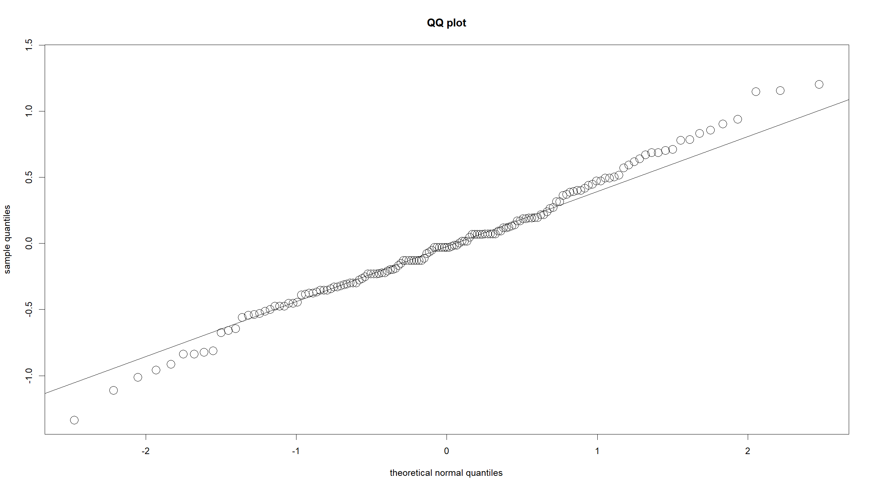

Slide 17
Generalised linear model: diagnostics
Residuals vs. fitted values
In a Gaussian errors, identity link GLM, you can easily verify whether:
residuals centered symmetrically around 0
residuals have constant variance
there are any outliers (conditional on the linear predictor)
plot(predict(modLinReg),resid(modLinReg),xlab="predicted values",ylab="residuals",cex=2) abline(h=0,lty=2,col="red")

Slide 18
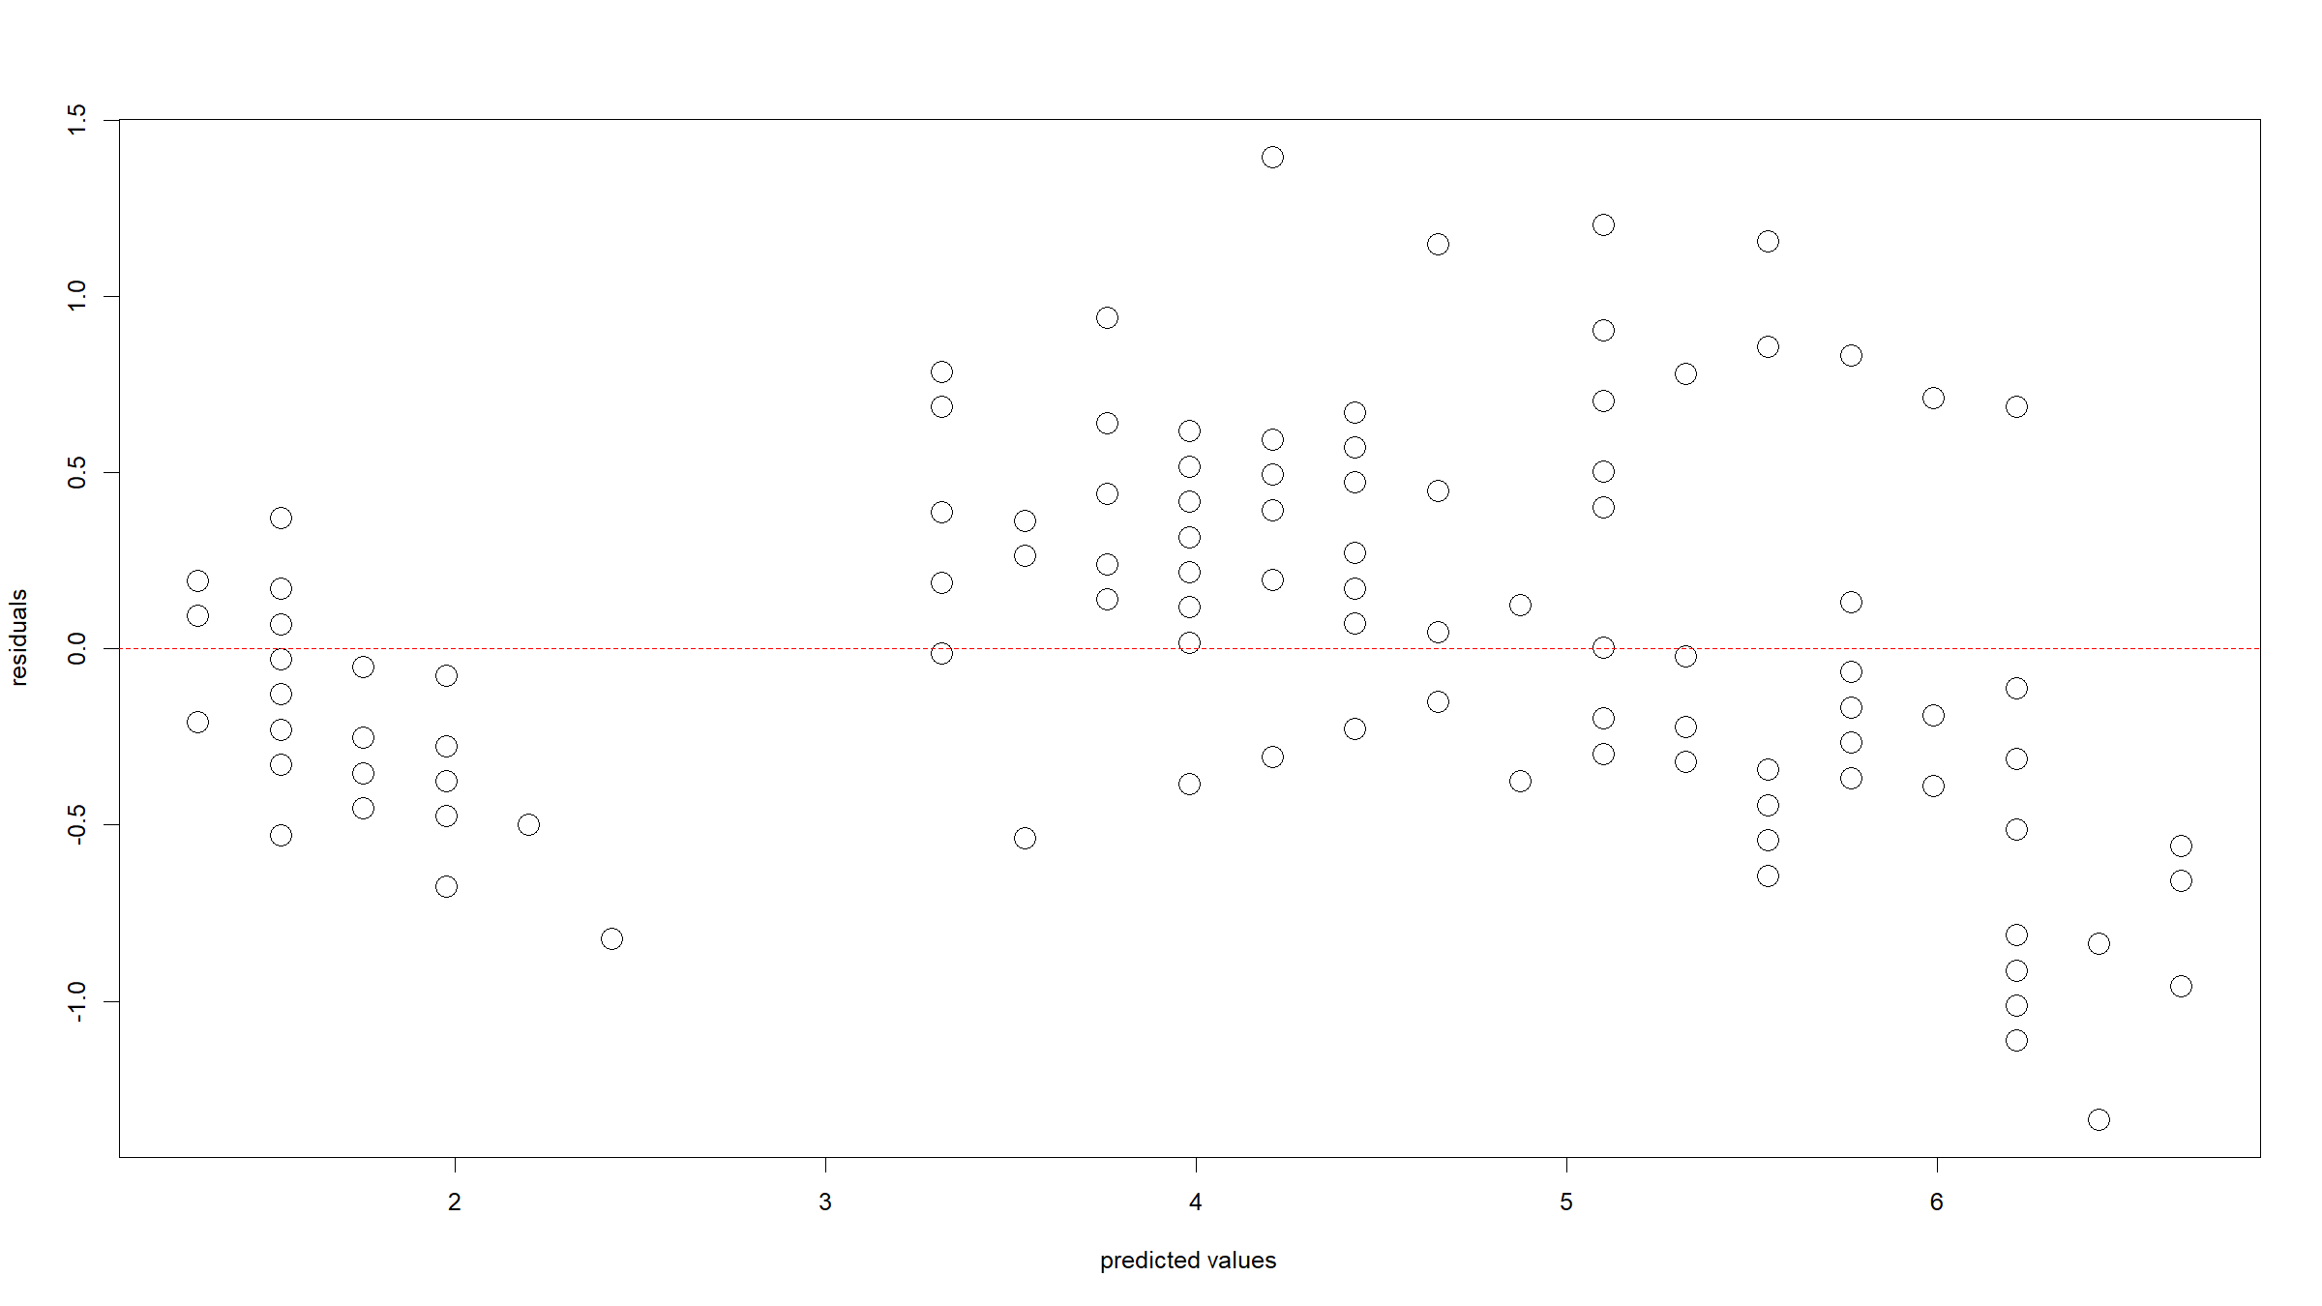

Slide 19
Generalised linear model: diagnostics
Residuals vs. fitted values
For non-normal GLMs, it is not as straightforward:
Which residuals to pick?
As we can have non-constant variance functions, we should not expect constant variance.
Residuals on the link scale or the data scale?

Slide 20
Generalised linear model: diagnostics
Residuals vs. fitted values
R will by default return deviance residuals (e.g. by typing resid(mod)). You can use the same R function to compute the other residuals: resid(mod,type="pearson") will compute the Pearson residuals.
Pearson residuals are very useful: these residuals are standardised by the estimated variance function. In other words, if the Pearson residuals exhibit non-constant variance, then this suggest we have misspecified the data distribution.
cuse<-read.csv("cuse.csv") modPois<-glm(cbind(using, notUsing) ~ age + education + wantsMore + education + age:wantsMore, data=cuse, family=binomial) plot(predict(modPois,type="response"),resid(modPois,type="pearson"),xlab="fitted values",ylab="Pearson residuals",cex=2)

Slide 21
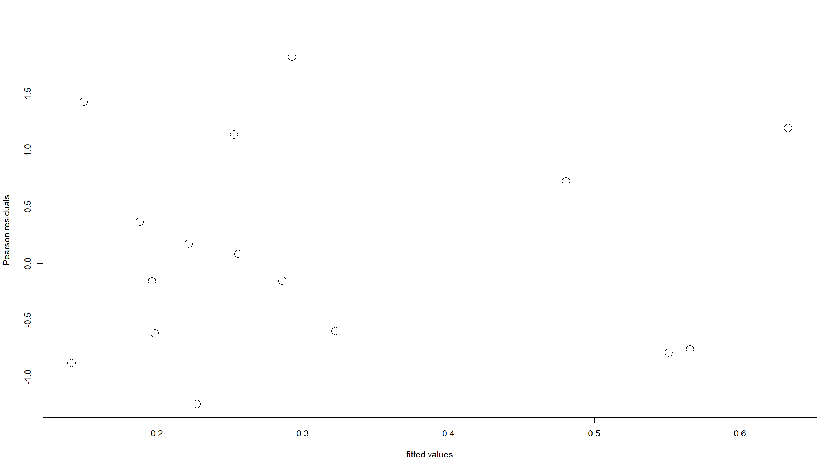

Slide 22
Generalised linear model: diagnostics
Residuals vs. fitted values
Also check the residuals for data points with large residuals. These observations have surprising observed response values given the values of their predictor values.
Observations with large residuals are outliers. Outliers at the extreme ends of the range of the predictor variables are highly likely to be influential data points (more later).

Slide 23
Generalised linear model: diagnostics
Residuals
R will compute 4 standard diagnostics plots for you if you type plot(mod).
par(mfrow=c(2,2)) plot(modLinReg)

Slide 24
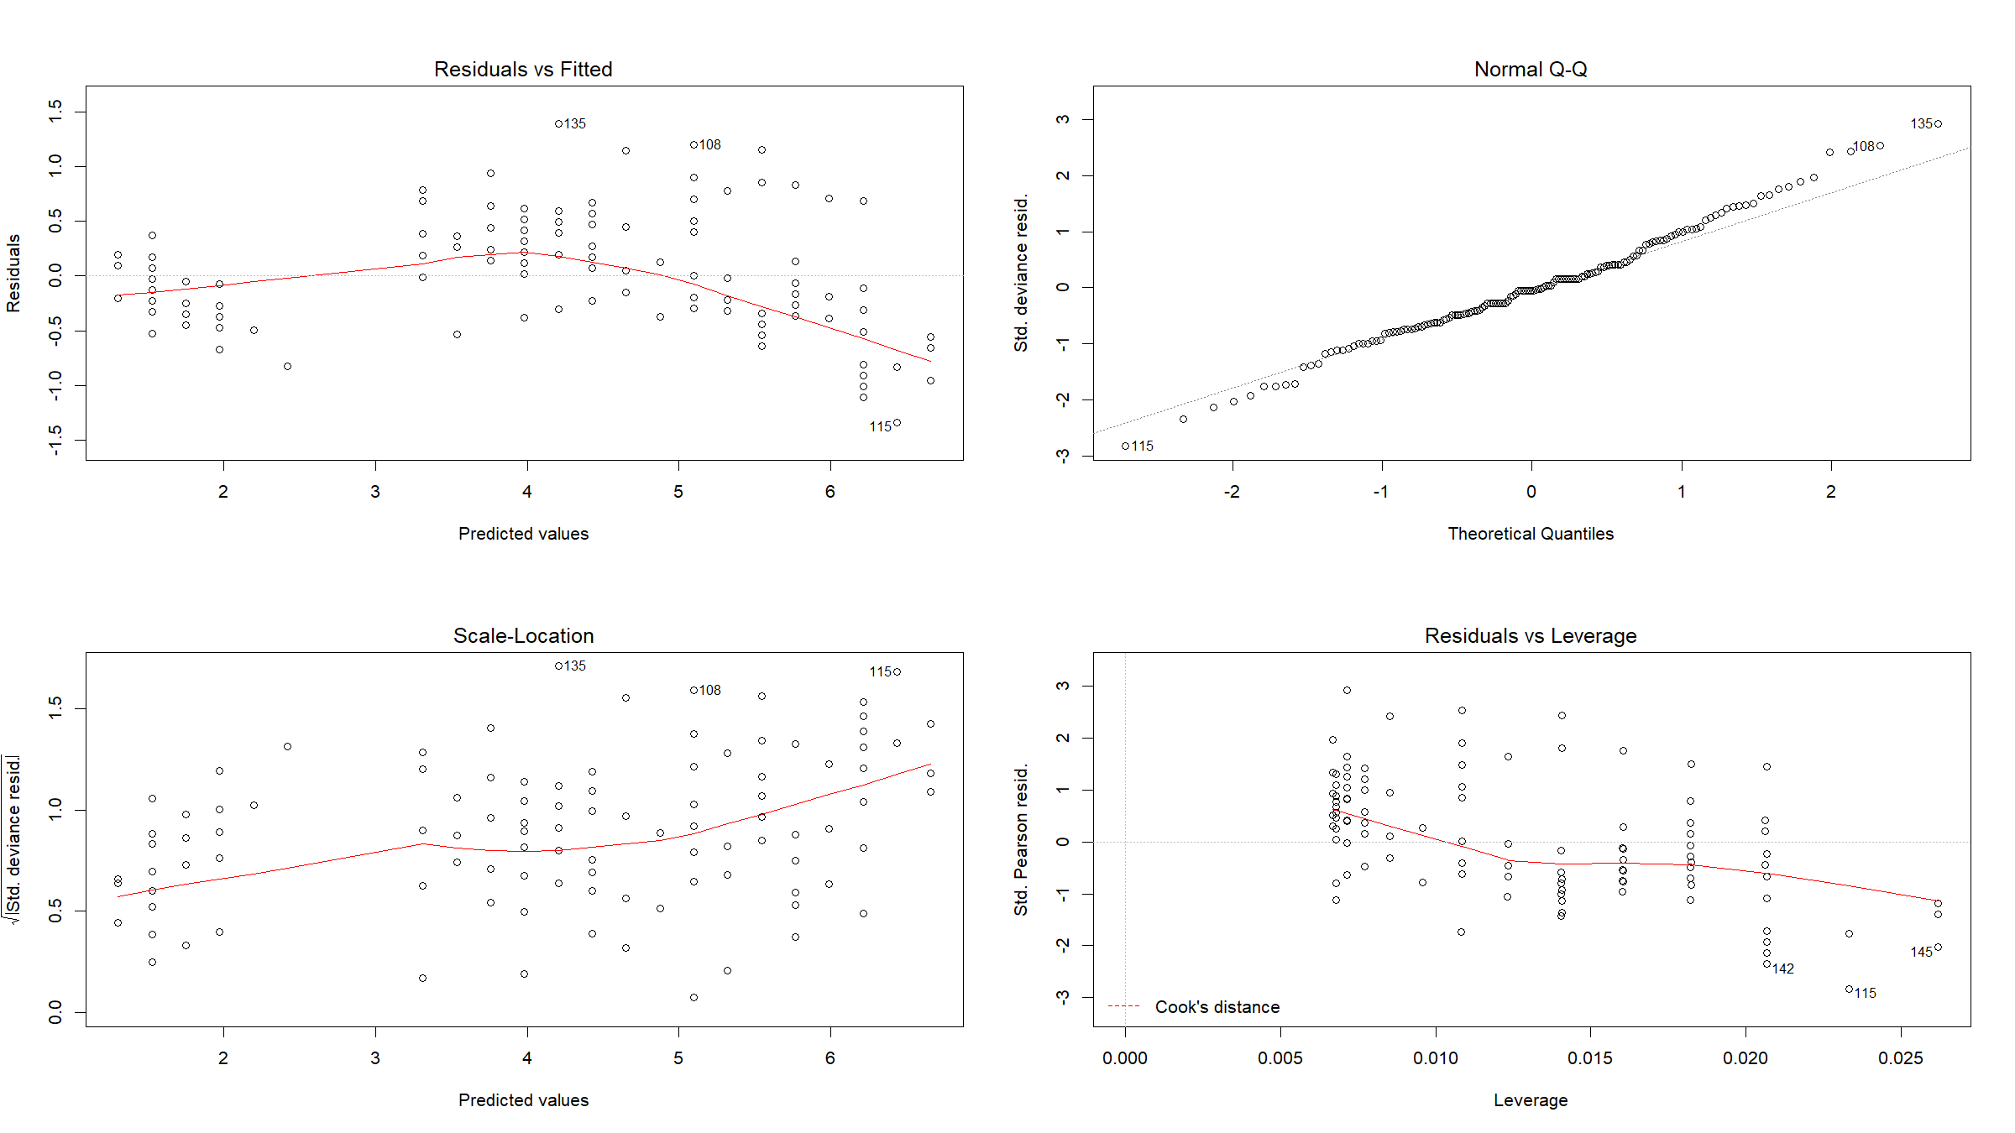

Slide 25
Generalised linear model: diagnostics
Checking the link function
There is a simple test one can do to check if the link function is correctly specified:
Fit the model.
Compute predicted values ${\hat{η}}_{i}$ for the linear predictor
Add ${\hat{η}}_{i}^{2}$ as another predictor into the model and re-fit.
If the coefficient for ${\hat{η}}_{i}^{2}$ is significant, this suggests that the link function may be misspecified.

Slide 26
Generalised linear model: diagnostics
Checking the link function
eta2 <- predict(modPois, type = "link")^2 modPoisEta <- glm(cbind(using, notUsing) ~ eta2 + age + education + wantsMore + education + age:wantsMore, data = cuse, family = binomial) summary(modPoisEta)$coefficients[, c(1, 4)] ## Estimate Pr(>|z|) ## (Intercept) -1.33532612 0.029772145 ## eta2 -0.02977876 0.909688824 ## age25-29 0.61037710 0.243424044 ## age30-39 1.59257167 0.017573077 ## age40-49 1.87456946 0.006124198 ## educationlow -0.32751691 0.055285613 ## wantsMoreyes -0.06050189 0.856494325 ## age25-29:wantsMoreyes -0.24579360 0.564355316 ## age30-39:wantsMoreyes -1.08382227 0.016557469 ## age40-49:wantsMoreyes -1.33288332 0.014782012

Slide 27
Generalised linear model: diagnostics
Influential observations
An influential observation is an observation which, if dropped from the dataset when fitting the model, would noticeably affect the model parameter estimates.
We have already alluded to one type of such influential observations: observations with high leverage - large residuals near the extremes of the predictor variables’ ranges.
There are many methods, most based on re-fitting models while leaving out individual observations. We will focus on 2 metrics: hat values (measuring leverage of observations) and Cook’s distance (measuring influence).

Slide 28
Generalised linear model: diagnostics
Influential observations
The hat matrix $H$ is the matrix that projects $y$ onto the subspace spanned by the columns of the design matrix $X$: $\hat{y}=Hy$. In the normal distribution linear model:
$$H=X(X^{T}X)^{−1}X^{T}$$
and in GLMs:
$$H=W^{1/2}X(X^{T}WX)^{−1}X^{T}W^{1/2}$$
The hat values $h_{ii}$ are the diagonal elements of this matrix and they indicate the leverage of observations.

Slide 29
Generalised linear model: diagnostics
Influential observations
The $h_{ii}$ are bounded between 0 and 1 (in models with an intercept, they are bounded between 1/n and 1), and their sum, i​hii, is always equal to $p+1$, the number of coefficients in the model, including the intercept. Problems in which there are a few very large $h_{ii}$ can be troublesome: in particular, large-sample normality of some linear combinations of the regressors is likely to fail, and high-leverage observations may exert undue influence on the results.
The R function hatvalues() will compute hat values for both lm and glm objects.
plot(hatvalues(modPois),cex=2)

Slide 30
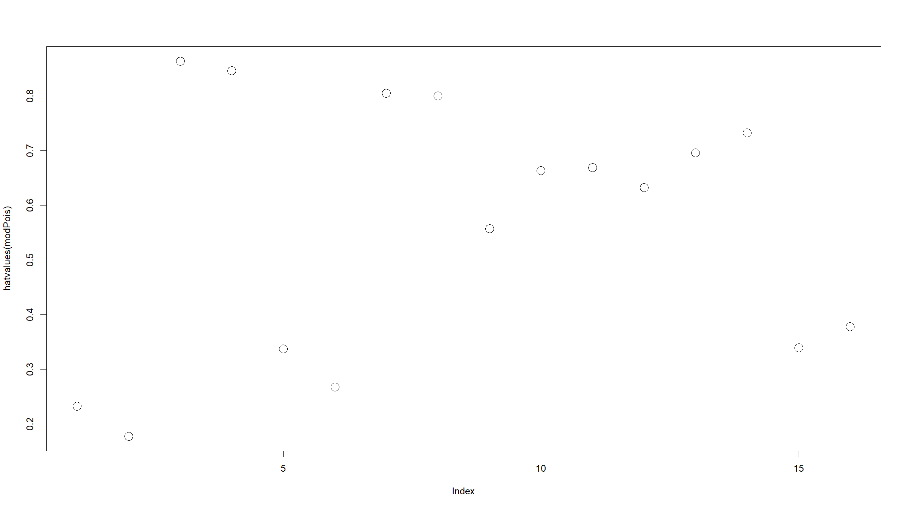

Slide 31
Generalised linear model: diagnostics
Influential observations
The most common influence measure is Cook’s distance. It is one of many leave-one-out / deletion methods for measuring influence of observations.
If $\hat{β}$ is the estimated coefficient vector from the full dataset, then let ${\hat{β}}_{(i)}$ be the vector of coefficient estimates obtained from fitting the model to the dataset with the $i^{th}$ observation removed.
The difference $\hat{β}−{\hat{β}}_{(i)}$ directly measures the influence of the $i^{th}$ observation: small / large difference = small / large influence.

Slide 32
Generalised linear model: diagnostics
Influential observations
This difference is a vector however, and it is more convenient to summarise the influence by a single number.
Cook’s distance is the weighted sum of squares of the differences between the individual vector elements. In matrix notation:
$$D_{i}=\frac{(β−{\hat{β}}_{(i)})^{T}(X^{T}WX)^{−1}(β−{\hat{β}}_{(i)})}{(p+1)s^{2}}$$

Slide 33
Generalised linear model: diagnostics
Influential observations
The R function cooks.distance() computes Cook’s distance for both lm and glm objects.
plot(cooks.distance(modPois),cex=2)

Slide 34
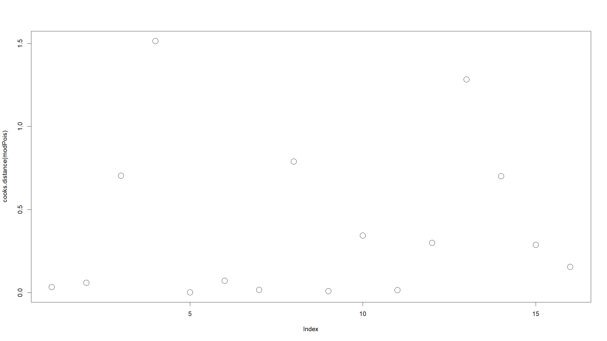

Slide 35
Generalised linear model: diagnostics
Influential observations
The R package car has a helpful plotting function for plotting both the hat values and Cook’s D (and also studentised residuals). Cook’s D is given by the size of the circles.
library(car) influencePlot(modPois)

Slide 36
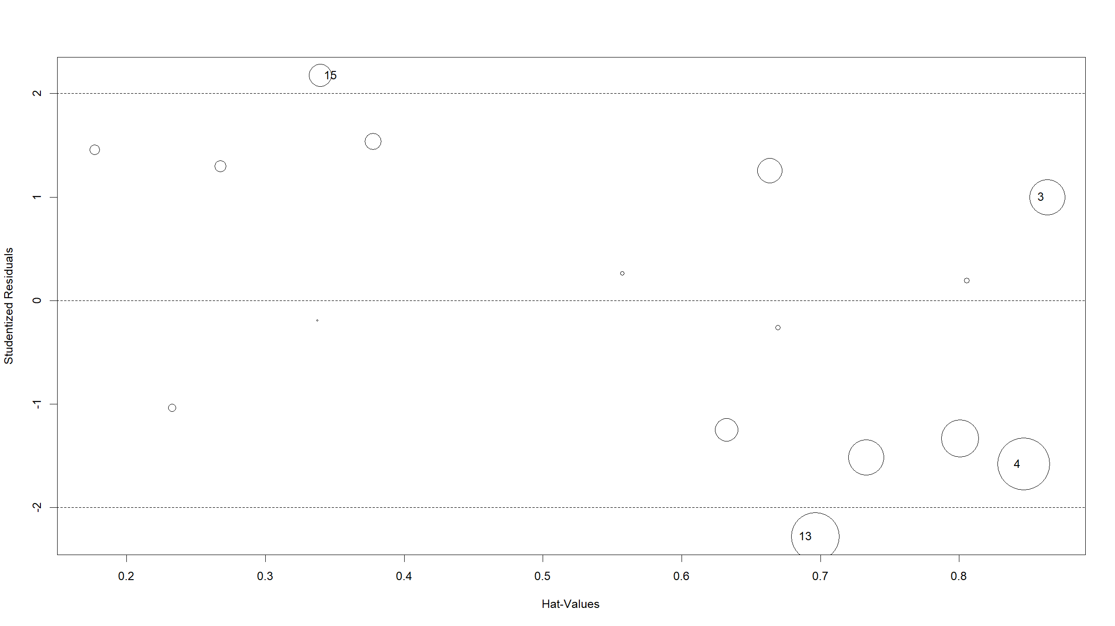

Slide 37
## StudRes Hat CookD ## 3 0.9998404 0.8636039 0.7044194 ## 4 -1.5780140 0.8463730 1.5140854 ## 13 -2.2799501 0.6962950 1.2832143 ## 15 2.1755471 0.3395831 0.2877967

Slide 38
Interaction terms
Consider the model
$$Y=β_{0}+β_{1} age+β_{2} male+β_{3} male⋅ age+ϵ$$
If you are female, the effect on $Y$ for age is $β_{1}$.
If you are male, the effect on $Y$ for age is $β_{1}+β_{3}$.
This is an interaction effect: age and sex are not independent. There are different slopes for age, depending on your sex.
You can have interaction terms for 2 categorical variables, 1 categorical & 1 continuous, 2 continuous variables.
Interpretation becomes more difficult for 2 continuous variables.
Always include both individual terms!

Slide 39
Collinearity
If two predictors $X_{1},X_{2}$ are correlated, then estimation of the GLM can become difficult and interpretation of coefficients also becomes tricky.
The numerical instability comes from the fact that MLE will involve matrix inversion and this will become singular the more $X_{1}$ and $X_{2}$ are correlated.
Centering correlated variables can help sometimes.
There are methods to help spotting collinearity: Variance inflation factors (VIF) are helpful. The main idea behind VIFs is to check whether standard errors in the model increase significantly when you add a variable suspected to be collinear with another variable.

Slide 40
Confounding
A confounder variable is a variable which simultaneously affects one or more predictors in your model and the response variable.
Confounding can be noticed when the inclusion of a suspected confounder affects the coefficients for other variables in the model.

Slide 41
Model selection
How to select variables for inclusion in a model?
This is not a trivial topic and a rigorous treatment of this topic is beyond the scope of this course.
Best to rely on expert knowledge and avoiding methods that are based on estimated effects such as (in decreasing order of badness)
significant variables from single predictor regressions
stepwise forwards selection
stepwise backwards selection

Slide 42
Model selection
If you choose variables to keep in the model by their p-values, then use a high threshold, e.g. $0.5$.
The best approach is to discuss a priori with experts in the field in which the data have been collected and ask them what should be included in the model. Then base your inference only on that single model you fitted. Keep variables even if they have non-significant coefficients. E.g. predictions can still benefit from non-significant variables in the model.
Regularisation techniques such as elastic net, ridge regression or the lasso have more desirable properties.

Slide 43
Relaxing linearity
Linear, cubic, restricted cubic, B-Splines and Generalised Additive Models (GAMs) can provide very flexible ways to model data.
This topic is beyond this course. 2 good references are:
Harrell, F.E. (2015), “Regression Modelling Strategies.”, 2nd ed., Springer
Hastie, T., Tibshirani, R., Friedman, J. (2009), “The Elements of Statistical Learning”, 2nd ed., Springer, https://web.stanford.edu/~hastie/Papers/ESLII.pdf

Slide 44
Correlated data
If your observations $y_{i}$ are not independent because of correlations, e.g. clustering of children within teachers within schools, or longitudinal data with multiple observations for the same individual over time, we cannot use GLMs.
Marginal models: General Estimating Equations (GEE)
library(gee)
Mixed models: [Generalised] Linear Mixed Models ([G]LMM)
library(nlme) library(lme4)

Slide 45
rms package
The rms package provides a full set of tools for all kinds of regression problems. It is a companion package to the Harrell book.

Slide 46
[end of ST6103 GLM Session 5]

