Slide 1
ST6103 - GLM - Practical 3
Marc Henrion

Slide 2
Practical 3: Generalised Linear Models

Slide 3
Exercise 1
Show that the Poisson distribution with probability mass function $f_{Y}(k)=\frac{λ^{k}e^{−λ}}{k!}$ belongs to the exponential family and derive its canonical link function.

Slide 4
Exercise 1
$$f_{Y}(k)=\frac{λ^{k}e^{−λ}}{k!}=exp\left(log\left(λ^{k}\right)−λ−log(k!)\right)=exp\left(\frac{klog(λ)−λ}{1}+(−log(k!))\right)$$
So this is an exponential family distribution with
$$θ=log(λ)$$
$$a(ϕ)=1$$
$$b(θ)=λ$$
$$c(k,ϕ)=−log(k!)$$
For the canonical link, we note that $E[Y|X]=λ$, so we need to find $g()$ such that $g(E[Y|X])=θ⇒g(λ)=log(λ)$. Hence the canonical link is just the natural logarithm.

Slide 5
Exercise 2
Show that the gamma distribution with probability mass function $f_{Y}(y)=\frac{β^{α}}{Γ(α)}y^{α−1}e^{−βy}$ belongs to the exponential family and derive its canonical link function. Recall that the mean of the gamme distribution $E[Y]=α/β$.

Slide 6
Exercise 2
$$f_{Y}(y)=\frac{β^{α}}{Γ(α)}y^{α−1}e^{−βy}=exp(αlog(β)−log(Γ(α))+(α−1)log(y)−βy)$$
Rearranging, we get
$$f_{Y}(y)=exp\left(\frac{−βy+αlog(β)}{1}+(α−1)log(x)−log(Γ(α))\right)$$
To get $α$ out of what will become $b(θ)$ we write:
$$f_{Y}(y)=exp\left(\frac{−y β/α−(−log(β))}{1/α}+(α−1)log(x)−log(Γ(α))\right)$$

Slide 7
Exercise 2
Hence this is an exponential family distribution with:
$$θ=−\frac{β}{α}$$
$$a(ϕ)=1/α$$
$$b(θ)=log(β)$$
$$c(y,ϕ)=(α−1)log(x)−log(Γ(alpha))$$
For the canonical link, we need $g()$ so that $g(E[Y|X])=θ$. Since $E[Y|X]=α/β$ and $θ=−β/α$, this means the canonical link is the inverse function $g(x)=−1/x$.

Slide 8
Exercise 3
State the model assumptions for
Simple linear regression
General linear model
Generalised linear model

Slide 9
Exercise 3
Simple linear regression
Independent observations
True linear relationship between variables
General linear model
Independent observations
Linear predictor describes true relationship between response and independent variables
Gaussian error distribution
Constant variance $σ^{2}$ (homoscedasticity)

Slide 10
Exercise 3
Generalised linear model
Independent observations
link function of the linear predictor describes true the response and independent variables
Exponential family distribution (this implies a variance function which describes how the variance depends on the mean)
monotonic, differentiable link function
large sample approximation for MLEs

Slide 11
Exercise 4
Load the warpbreaks dataset by typing data(warpbreaks) in R.
We are interested in investigating the relationship between the number of breaks in woolwarp with wool type and tension.
Plot a histogram of the data. Compare to the Poisson distribution with parameter equal to the average number of breaks.
Fit a Poisson regression model for breaks against wool.
Fit a Poisson regression model for breaks against tension.
Fit a Poisson regression model for breaks against both wool and tension.
Fit a Poisson regression model for breaks against both wool and tension and their interaction terms.
Plot fitted number of breaks against observed breaks.
Discuss your results! What predicts breaks? Which is the best model?

Slide 12
Exercise 4
data(waprbreaks)
## Warning in data(waprbreaks): data set 'waprbreaks' not found
# let's see what this data looks like dim(warpbreaks) # number of rows and columns
## [1] 54 3
head(warpbreaks) # displays first few rows
## breaks wool tension ## 1 26 A L ## 2 30 A L ## 3 54 A L ## 4 25 A L ## 5 70 A L ## 6 52 A L

Slide 13
Exercise 4
Historgrams of the response variable breaks and barplots of the 2 other variables.
hist(warpbreaks$breaks,breaks=9:70+0.5,xlab="breaks",ylab="frequency")

Slide 14
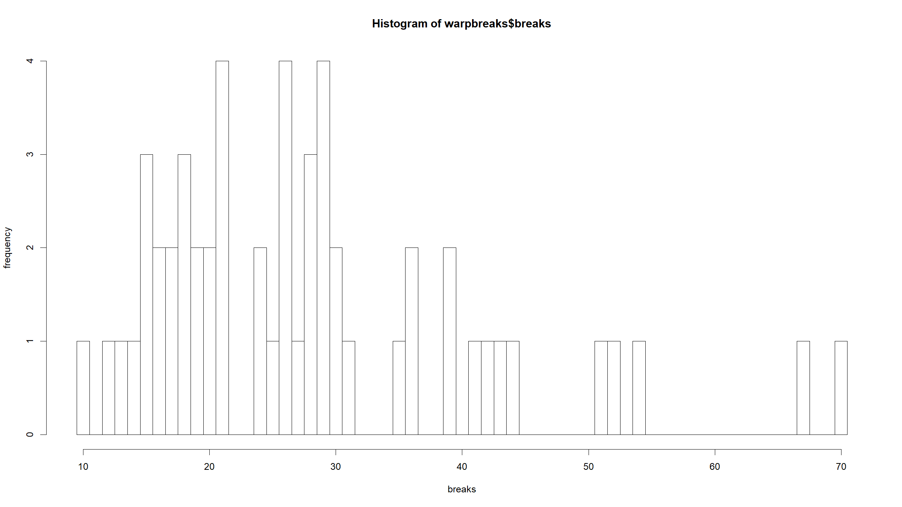

Slide 15
barplot(table(warpbreaks$wool),xlab="wool",ylab="frequency")

Slide 16
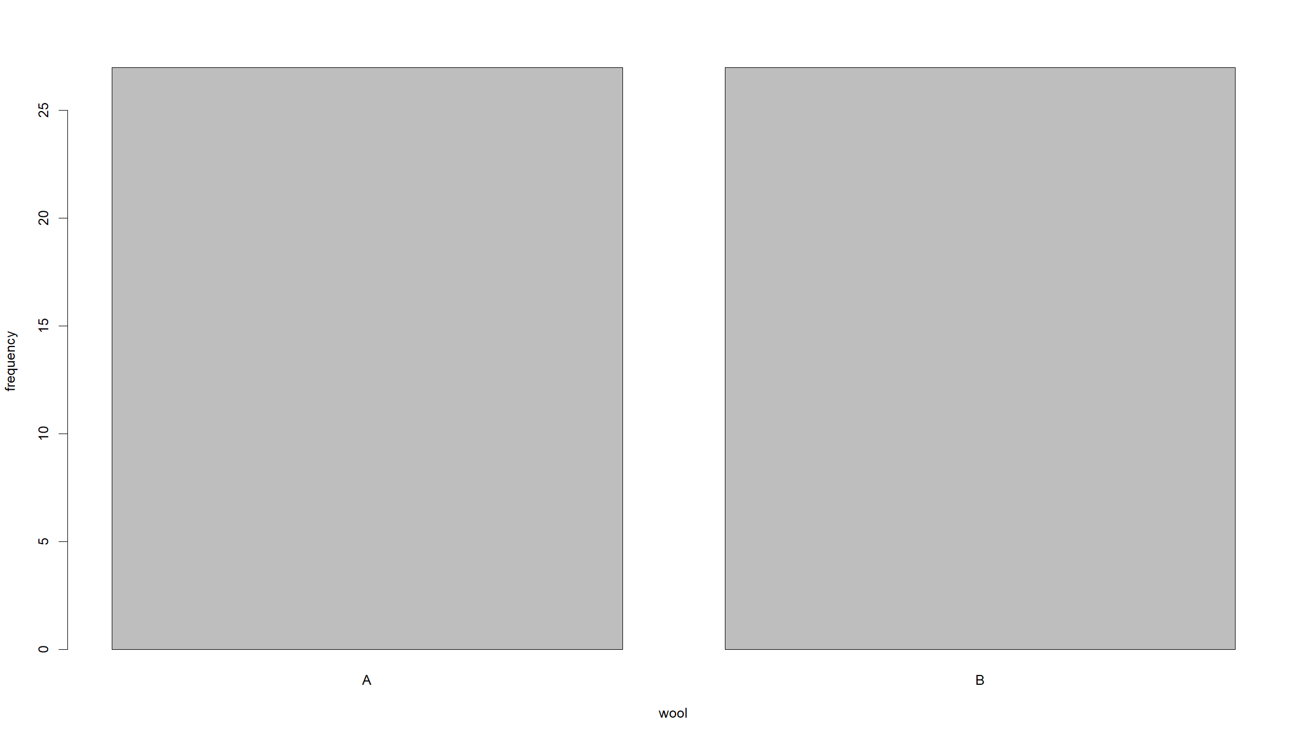

Slide 17
barplot(table(warpbreaks$tension),xlab="tension",ylab="frequency")

Slide 18
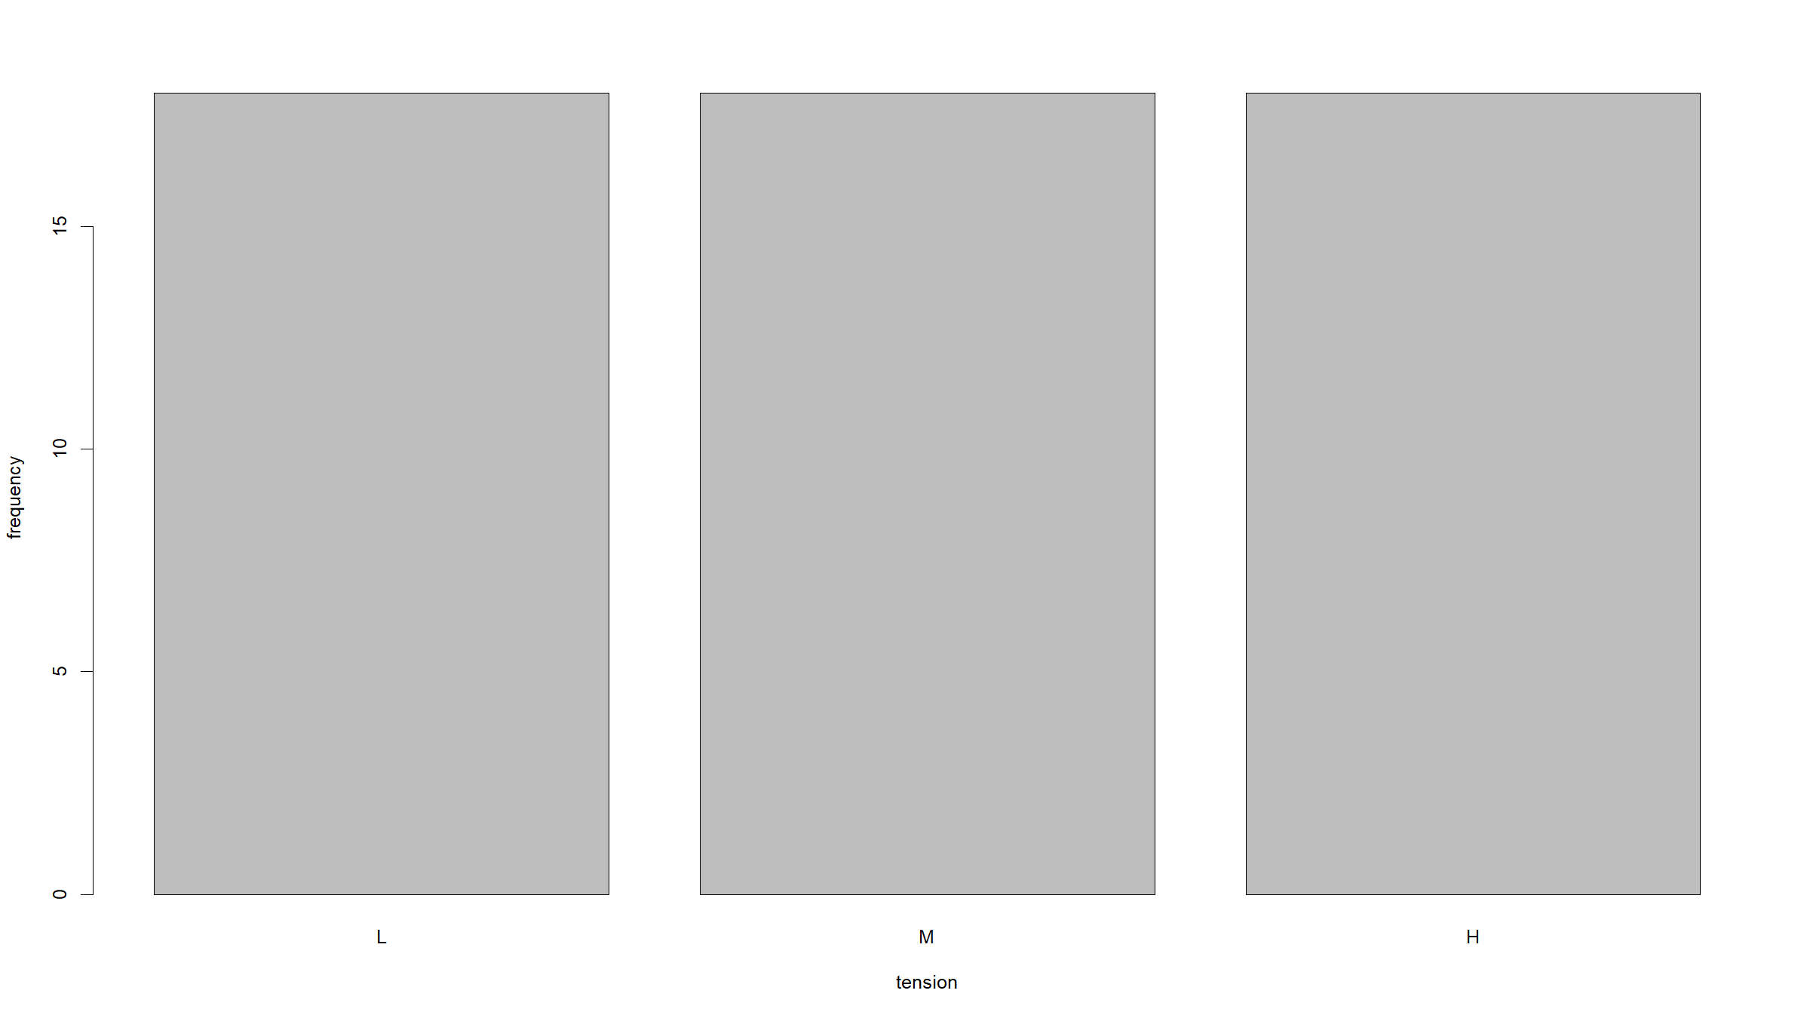

Slide 19
Exercise 4
Comparing the histogram for breaks to a theoretical Poisson distribution with MLW parameter (average number of breaks).
While the mode of the distribution seems to be reasonably well captured, this does not fit all that well: the data has a few much larger number of breaks than would be predicted under Poisson model.
Also we have more smaller number of breaks than predicted under the Poisson model.
avgBreaks<-mean(warpbreaks$breaks) hist(warpbreaks$breaks,breaks=9:70+0.5,xlab="breaks",ylab="frequency") xx<-10:70 yy<-dpois(xx,lambda=avgBreaks) scalingFactor<-nrow(warpbreaks) # number of trials points(xx,yy*scalingFactor,pch=19,col="red")

Slide 20
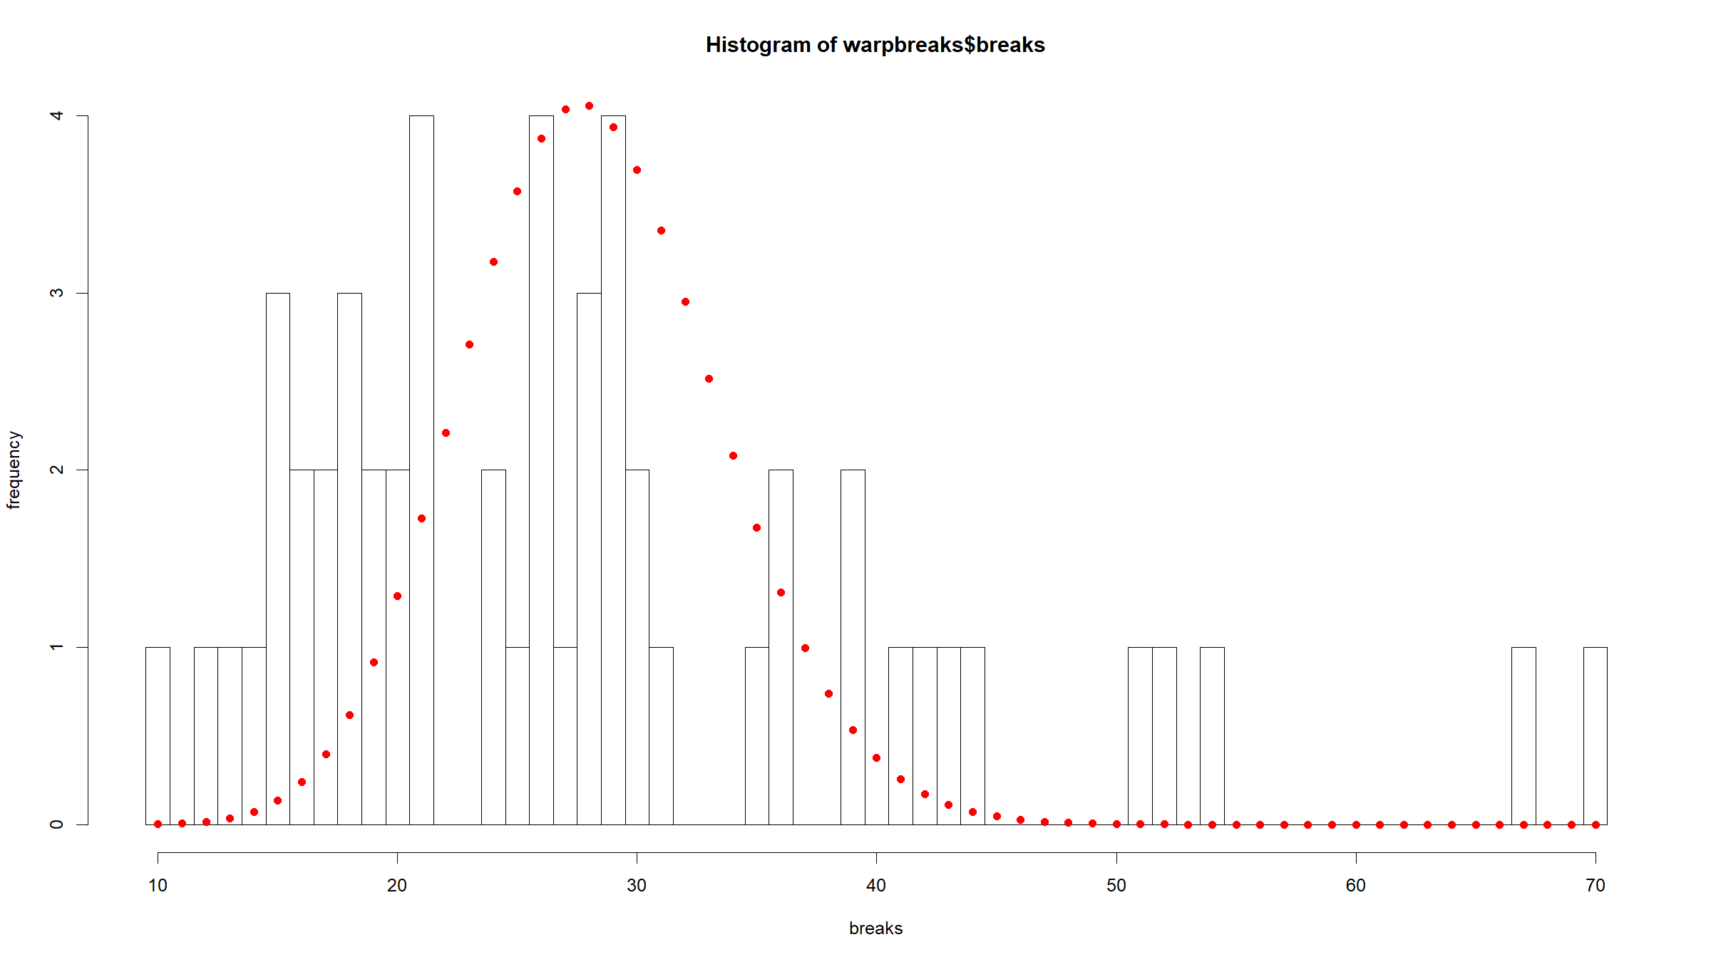

Slide 21
Exercise 4
Doing one such figure (see following slides) for every wool & tension combination now has fewer near impossible observations, but now there are too few data points for each combination to allow a meaningful combination.
We still seem to have too many small and large values though on most figures - this could indicate that a one-parameter Poisson distribution could struggle to fit well.
We can try to fit a Poisson model with rate parameter given by a linear combination of wool type and tension. We should assess model fit as it may be that the Poisson is not that great a model.

Slide 22
Exercise 4
par(mfrow=c(2,3)) for(w in levels(warpbreaks$wool)){ for(t in levels(warpbreaks$tension)){ tmpDat<-warpbreaks[warpbreaks$wool==w & warpbreaks$tension==t,] avgBreaks<-mean(tmpDat$breaks) hist(tmpDat$breaks,breaks=(min(tmpDat$breaks)-1):max(tmpDat$breaks)+0.5,xlab="breaks",ylab="frequency",main=paste(sep="","wool = ",w,", tension = ",t)) yy<-dpois(xx,lambda=avgBreaks) scalingFactor<-nrow(tmpDat) # number of trials points(xx,yy*scalingFactor,pch=19,col="red") } }

Slide 23
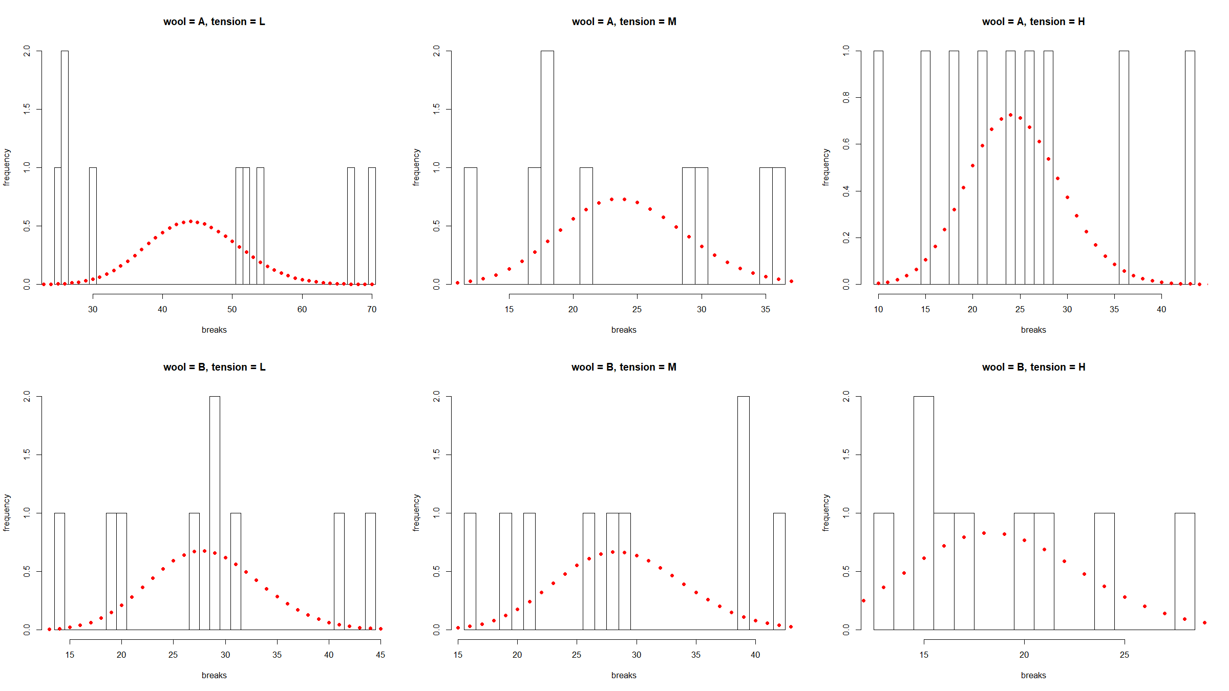

Slide 24
Exercise 4
Poisson regression model for breaks against wool.
modW <- glm(breaks ~ wool, data = warpbreaks, family = poisson) print(summary(modW)$coefficients) ## Estimate Std. Error z value Pr(>|z|) ## (Intercept) 3.4351812 0.03454407 99.443441 0.00000e+00 ## woolB -0.2059884 0.05157098 -3.994271 6.48937e-05 print(1 - pchisq(modW$deviance, df = modW$df.residual)) ## [1] 0
While the coefficient for woolB is highly significant, the deviance (281.33) is very large for the degrees of freedom (52) and highly significant, indicating a lot of unexplained variation and bad model fit.

Slide 25
Exercise 4
Poisson regression model for breaks against tension.
modT <- glm(breaks ~ tension, data = warpbreaks, family = poisson) print(summary(modT)$coefficients) ## Estimate Std. Error z value Pr(>|z|) ## (Intercept) 3.5942635 0.03907307 91.988254 0.000000e+00 ## tensionM -0.3213204 0.06026579 -5.331722 9.728581e-08 ## tensionH -0.5184885 0.06395938 -8.106528 5.208659e-16 print(1 - pchisq(modT$deviance, df = modT$df.residual)) ## [1] 0
While the coefficients for tensionM and tensionH are highly significant, the deviance (226.43) is very large for the degrees of freedom (51) and highly significant, indicating a lot of unexplained variation and bad model fit.
Note that the df=51 since we have 3 model parameters.

Slide 26
Exercise 4
Poisson regression model for breaks against wool and tension.
modWT <- glm(breaks ~ wool + tension, data = warpbreaks, family = poisson) print(summary(modWT)$coefficients) ## Estimate Std. Error z value Pr(>|z|) ## (Intercept) 3.6919631 0.04541069 81.301626 0.000000e+00 ## woolB -0.2059884 0.05157117 -3.994256 6.489775e-05 ## tensionM -0.3213204 0.06026580 -5.331721 9.728642e-08 ## tensionH -0.5184885 0.06395944 -8.106520 5.209021e-16 print(1 - pchisq(modWT$deviance, df = modWT$df.residual)) ## [1] 0
While the coefficients for woolB, tensionM and tensionH are highly significant, the deviance (210.39) is very large for the degrees of freedom (50) and highly significant, indicating a lot of unexplained variation and bad model fit. Note: the deviance is improving.

Slide 27
Exercise 4
Poisson regression model for breaks against wool, tension and their interaction term.
modWTint <- glm(breaks ~ wool + tension + wool:tension, data = warpbreaks, family = poisson) print(summary(modWTint)$coefficients) ## Estimate Std. Error z value Pr(>|z|) ## (Intercept) 3.7967368 0.04993753 76.029734 0.000000e+00 ## woolB -0.4566272 0.08019202 -5.694172 1.239721e-08 ## tensionM -0.6186830 0.08440012 -7.330357 2.295399e-13 ## tensionH -0.5957987 0.08377723 -7.111702 1.146202e-12 ## woolB:tensionM 0.6381768 0.12215312 5.224400 1.747203e-07 ## woolB:tensionH 0.1883632 0.12989529 1.450115 1.470263e-01 print(1 - pchisq(modWTint$deviance, df = modWTint$df.residual)) ## [1] 0
Individuals terms and one of the interaction terms are significant. The deviance has improved (182.31) but is still too large for the df (48).

Slide 28
Exercise 4
The largest, most complex model (individual terms + interaction terms) fits best: it has the best deviance and all terms achieve significance (even if only one of the interaction terms achieves significance, we should still add both). This means both wool and tension help to predict the number of breaks.
However the deviance is till to large and this indicates we either fail to explain substantial amounts of variation in the data through unmeasured characteristics of the different wools or the Poisson model is not the correct one.
In fact for this dataset it turns out that a negative binomial GLM fits better.

Slide 29
[end of ST6103 GLM Practical 3]

