Slide 1
ST6103 - GLM - Practical 1
Marc Henrion

Slide 2
Practical 1: Linear Model

Slide 3
Notation
$X,Y$ - random variables (here: X = predictor, Y = response)
$x,y$ - measured / observed values
$ϵ$ - random variable (here: error / residual)
$θ$ - a vector of parameters
$\overline{X}$, $\overline{Y}$ - sample mean estimators for X, Y
$\overline{x}$, $\overline{y}$ - sample mean estimates of X, Y
$\hat{T}$, $\hat{t}$ - given a statistic T, estimator and estimate of T
$P(A)$ - probability of an event A occuring
$f_{X}(.)$, $f_{Y}(.)$ - distribution mass / density functions of X, Y
$X∼F$ - X distributed according to distribution function F
$E[X]$, $E[Y]$, $E[T]$ - the expectation of X, Y, T respectively

Slide 4
Exercise 1
Recall that we have defined: TSS=i​(yi−y)2, RSS=i​(yi−y)2, $ESS=∑(y_{i}−{\hat{y}}_{i})^{2}$ where ${\hat{y}}_{i}={\hat{β}}_{0}+{\hat{β}}_{1}x_{i}$ are the model predictions. We also defined $R^{2}=\frac{RSS}{TSS}$ (the proportion of variation explained by the regression model) and recall that $ρ(x,y)=\frac{Cov(x,y)}{\sqrt{Var(x)Var(y)}}$.
Show / prove that:
TSS = RSS + ESS
RSS = $\frac{S_{xy}^{2}}{SS_{x}}$
$R^{2}=ρ(x,y)^{2}$ (in the case of a single predictor variable $X$)

Slide 5
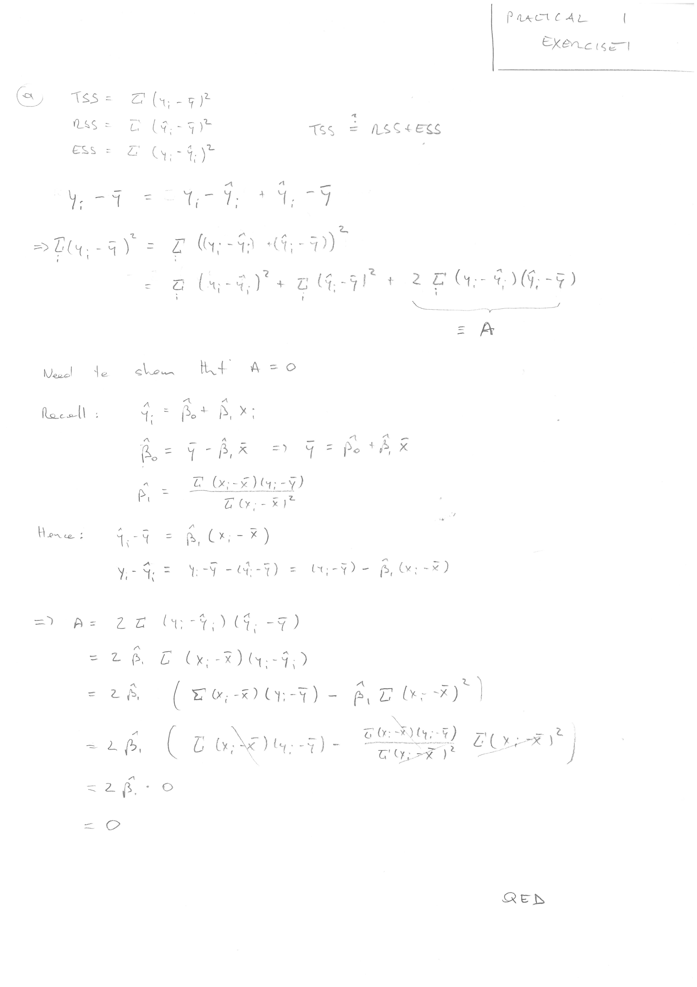
Exercise 1
Exercise 1a solution

Slide 6
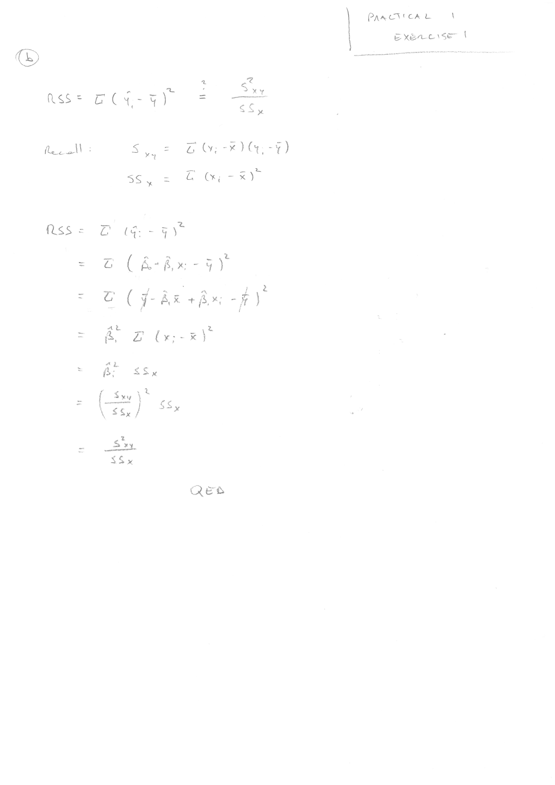
Exercise 1
Exercise 1b solution

Slide 7
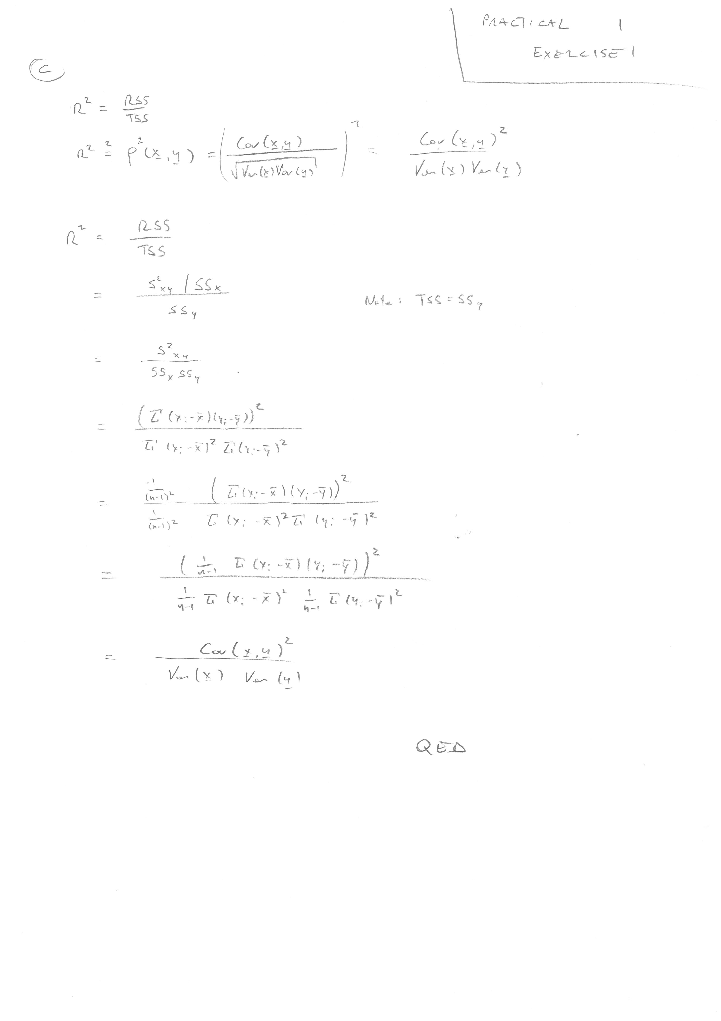
Exercise 1
Exercise 1c solution

Slide 8
Exercise 2
You are given the following data: $x=(−3,−1,0,2,5,6)^{T}$, $y=(12,9,11,9,9,6)^{T}$.
Calculate (by hand!) the estimates ${\hat{β}}_{0}$ and ${\hat{β}}_{1}$ for a linear regression model $Y=β_{0}+β_{1}X+ϵ$.
Describe the resulting regression line:
What is the relationship between variables $X$ and $Y$?
How much (on average) does $Y$ change when $X$ changes by 1?
What value does $Y$ take (on average) when $X=0$?
Does this seem to be a good model?
Compute (by hand!) the residuals $ϵ_{i}=y_{i}−{\hat{y}}_{i},i=1,…,6$.
Predict new values for X=-40.1, X=1, X=2.5, X=100. How confident are you of these predictions?

Slide 9
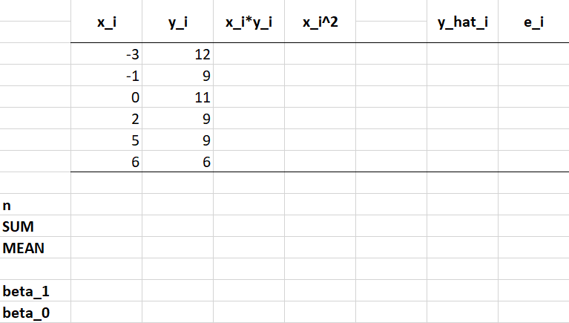
Template for manual calculation

Slide 10
Exercise 2
2a. Calculations
x<-c(-3,-1,0,2,5,6) y<-c(12,9,11,9,9,6) plot(x,y,pch=20,col="steelblue",cex=2)

Slide 11
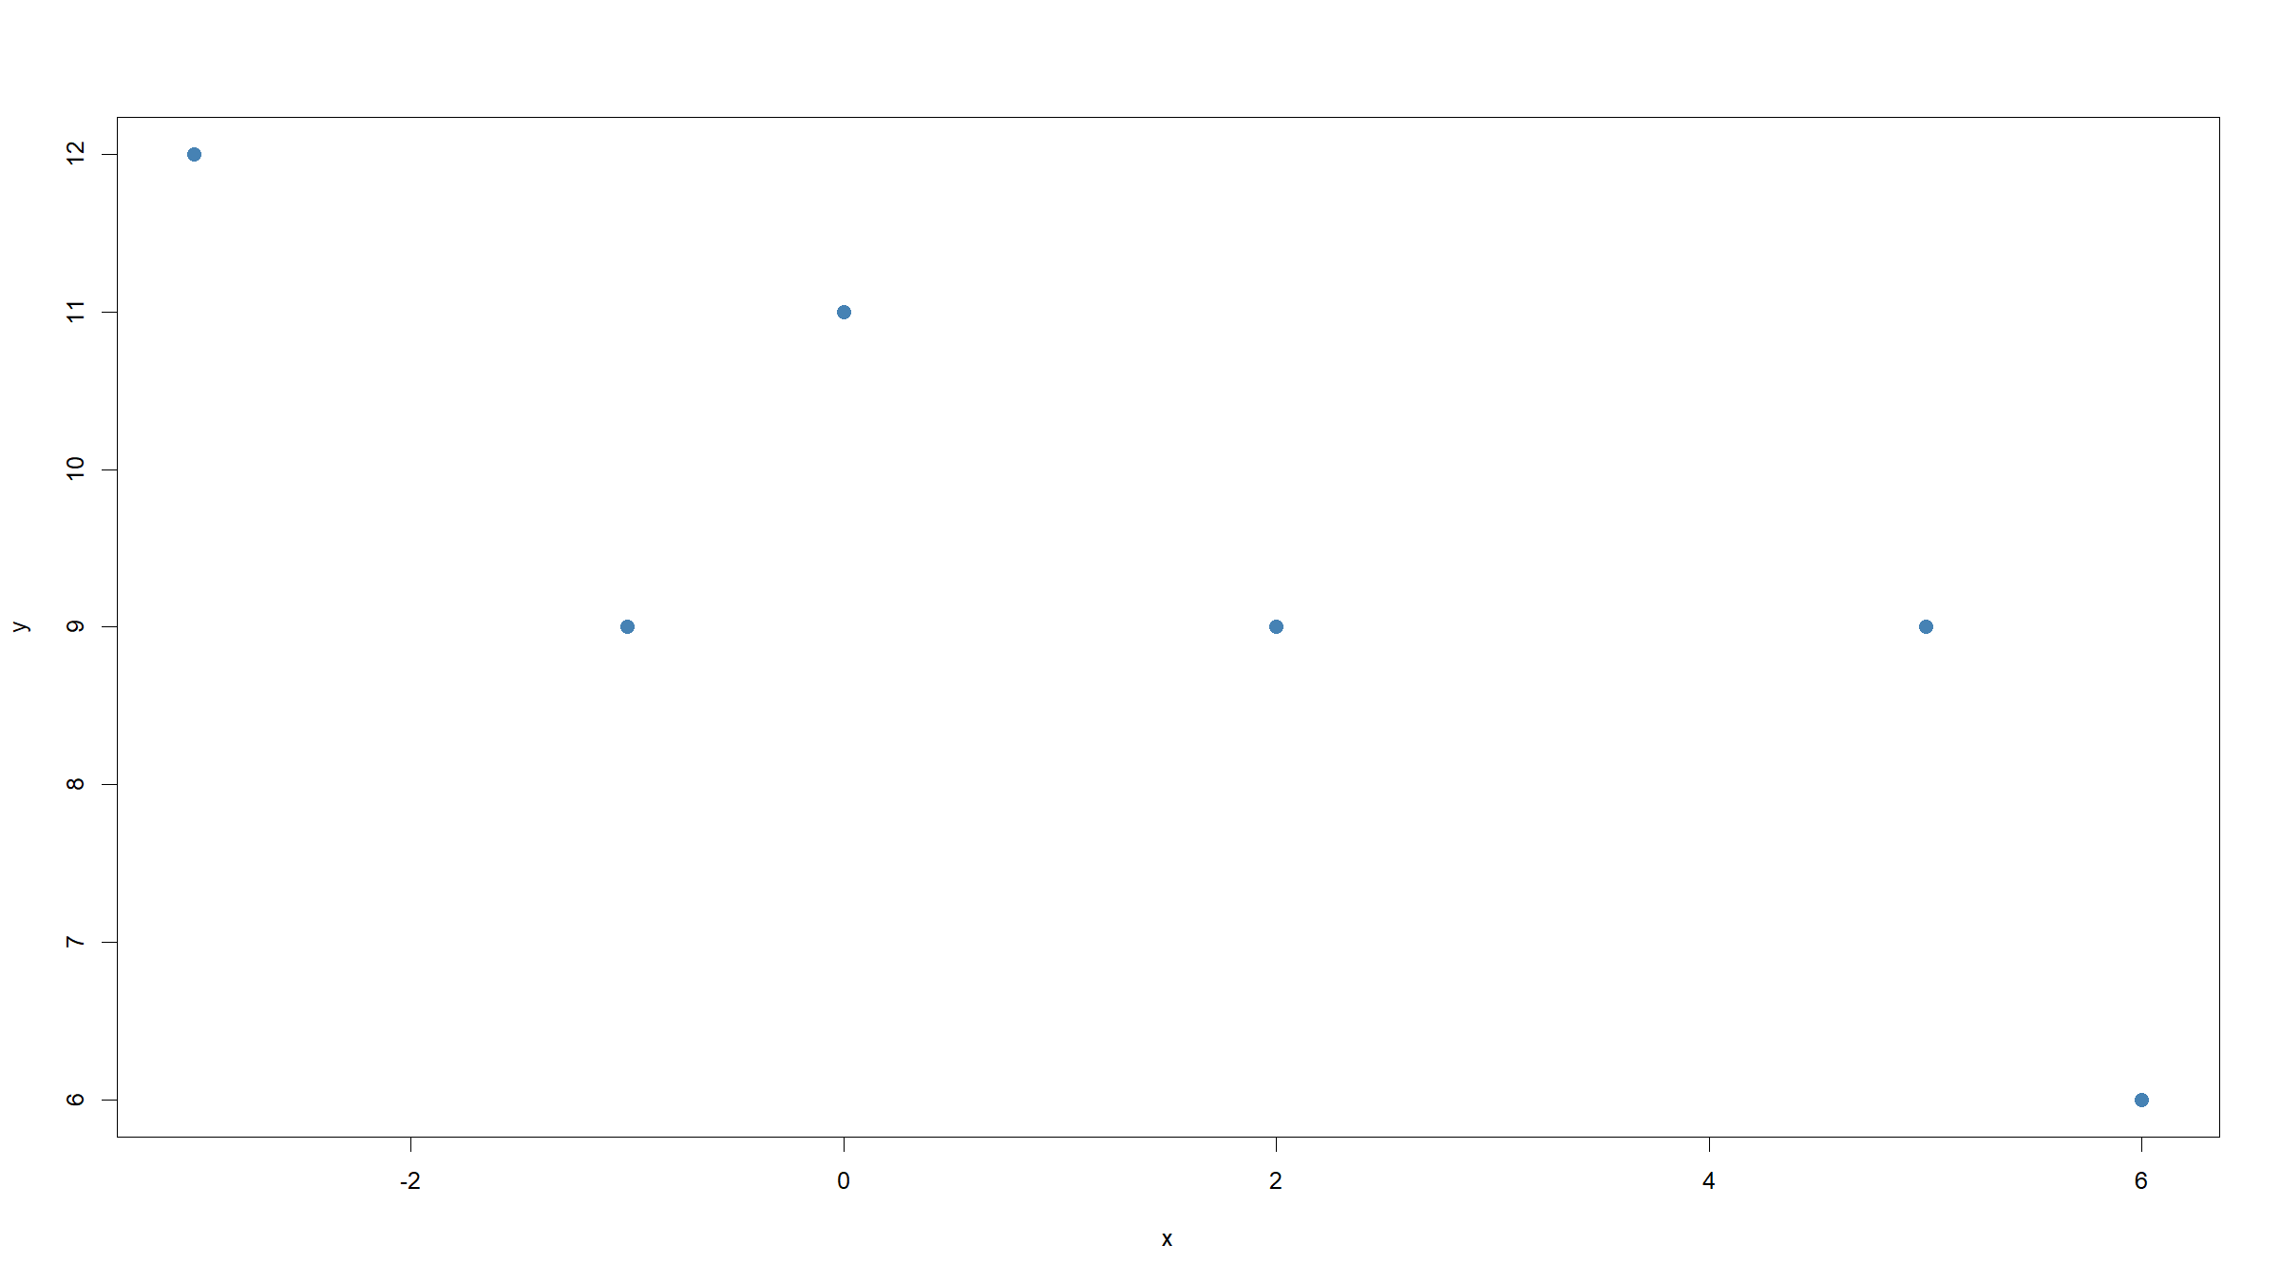

Slide 12
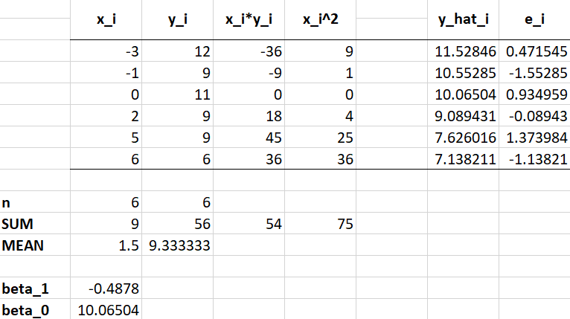
Exercise 2a & 2d solution

Slide 13
Exercise 2
2b. Relationship between the 2 variables.
Negative relationship between $X$ and $Y$. Linear model seems (visually) reasonable.
For every unit increase in $X$, $Y$ sdecreases, on average, but 0.49.
When $x=0$, $\hat{y}=10.06$
xx<-seq(-5,8,length=1000) yy<-10.0650-0.4878*xx plot(x,y,pch=20,col="steelblue",cex=2) lines(xx,yy,col="red",lwd=2)

Slide 14
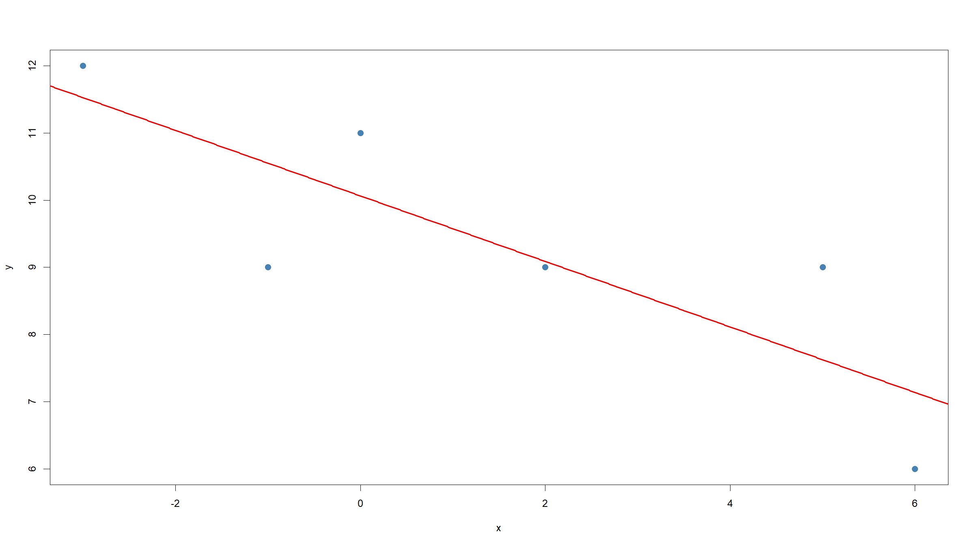

Slide 15
2c. Visually, yes. $R^{2}$=0.69. As for this linear regression model we do not make any assumptions about the distribution of the residuals $ϵ_{i}$, we do not need to check them for normality etc.
2e. Prediction
xNew<-c(-40.1,1,2.5,100) yHat<-10.0650-0.4878*xNew print(rbind(xNew,yHat))
## [,1] [,2] [,3] [,4] ## xNew -40.10000 1.0000 2.5000 100.000 ## yHat 29.62578 9.5772 8.8455 -38.715

Slide 16
Exercise 2
Some of the values (-40.1 and 100) are very far out of the range of x values we used for fitting the model. So probably not too confident here.
The best way to summarise our confidence is by giving a prediction confidence interval. We will cover this later in the module.

Slide 17
Exercise 3
For $p=1$, show that
$$\hat{β}={\left(x^{T}x\right)}^{−1}x^{T}y$$
is equivalent to writing
$${\hat{β}}_{1}=S_{xy}/SS_{x}$$
$${\hat{β}}_{0}=\overline{y}−{\hat{β}}_{1}\overline{x}$$

Slide 18
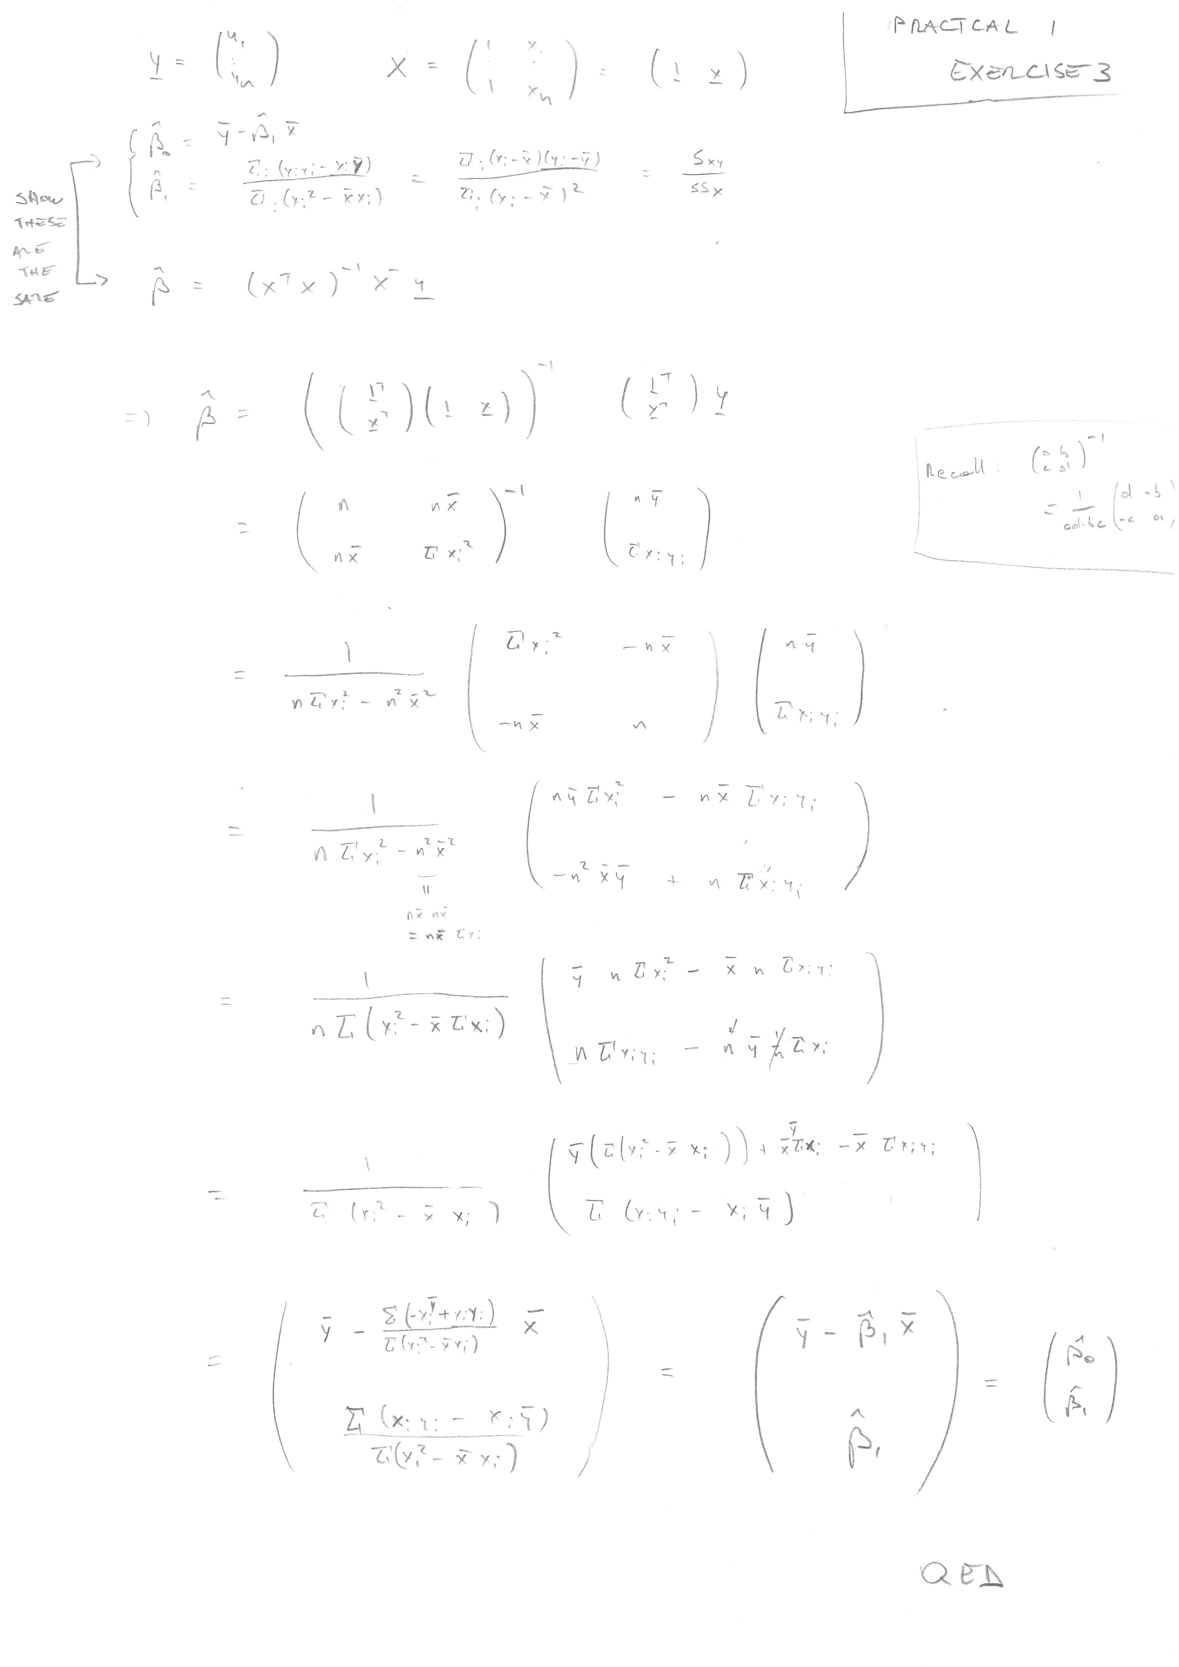
Exercise 3
Exercise 3 solution

Slide 19
Exercise 4
Show that the MSE is an unbiased estimator of $σ^{2}$.
Note: this exercise is harder and is not examinable.

Slide 20
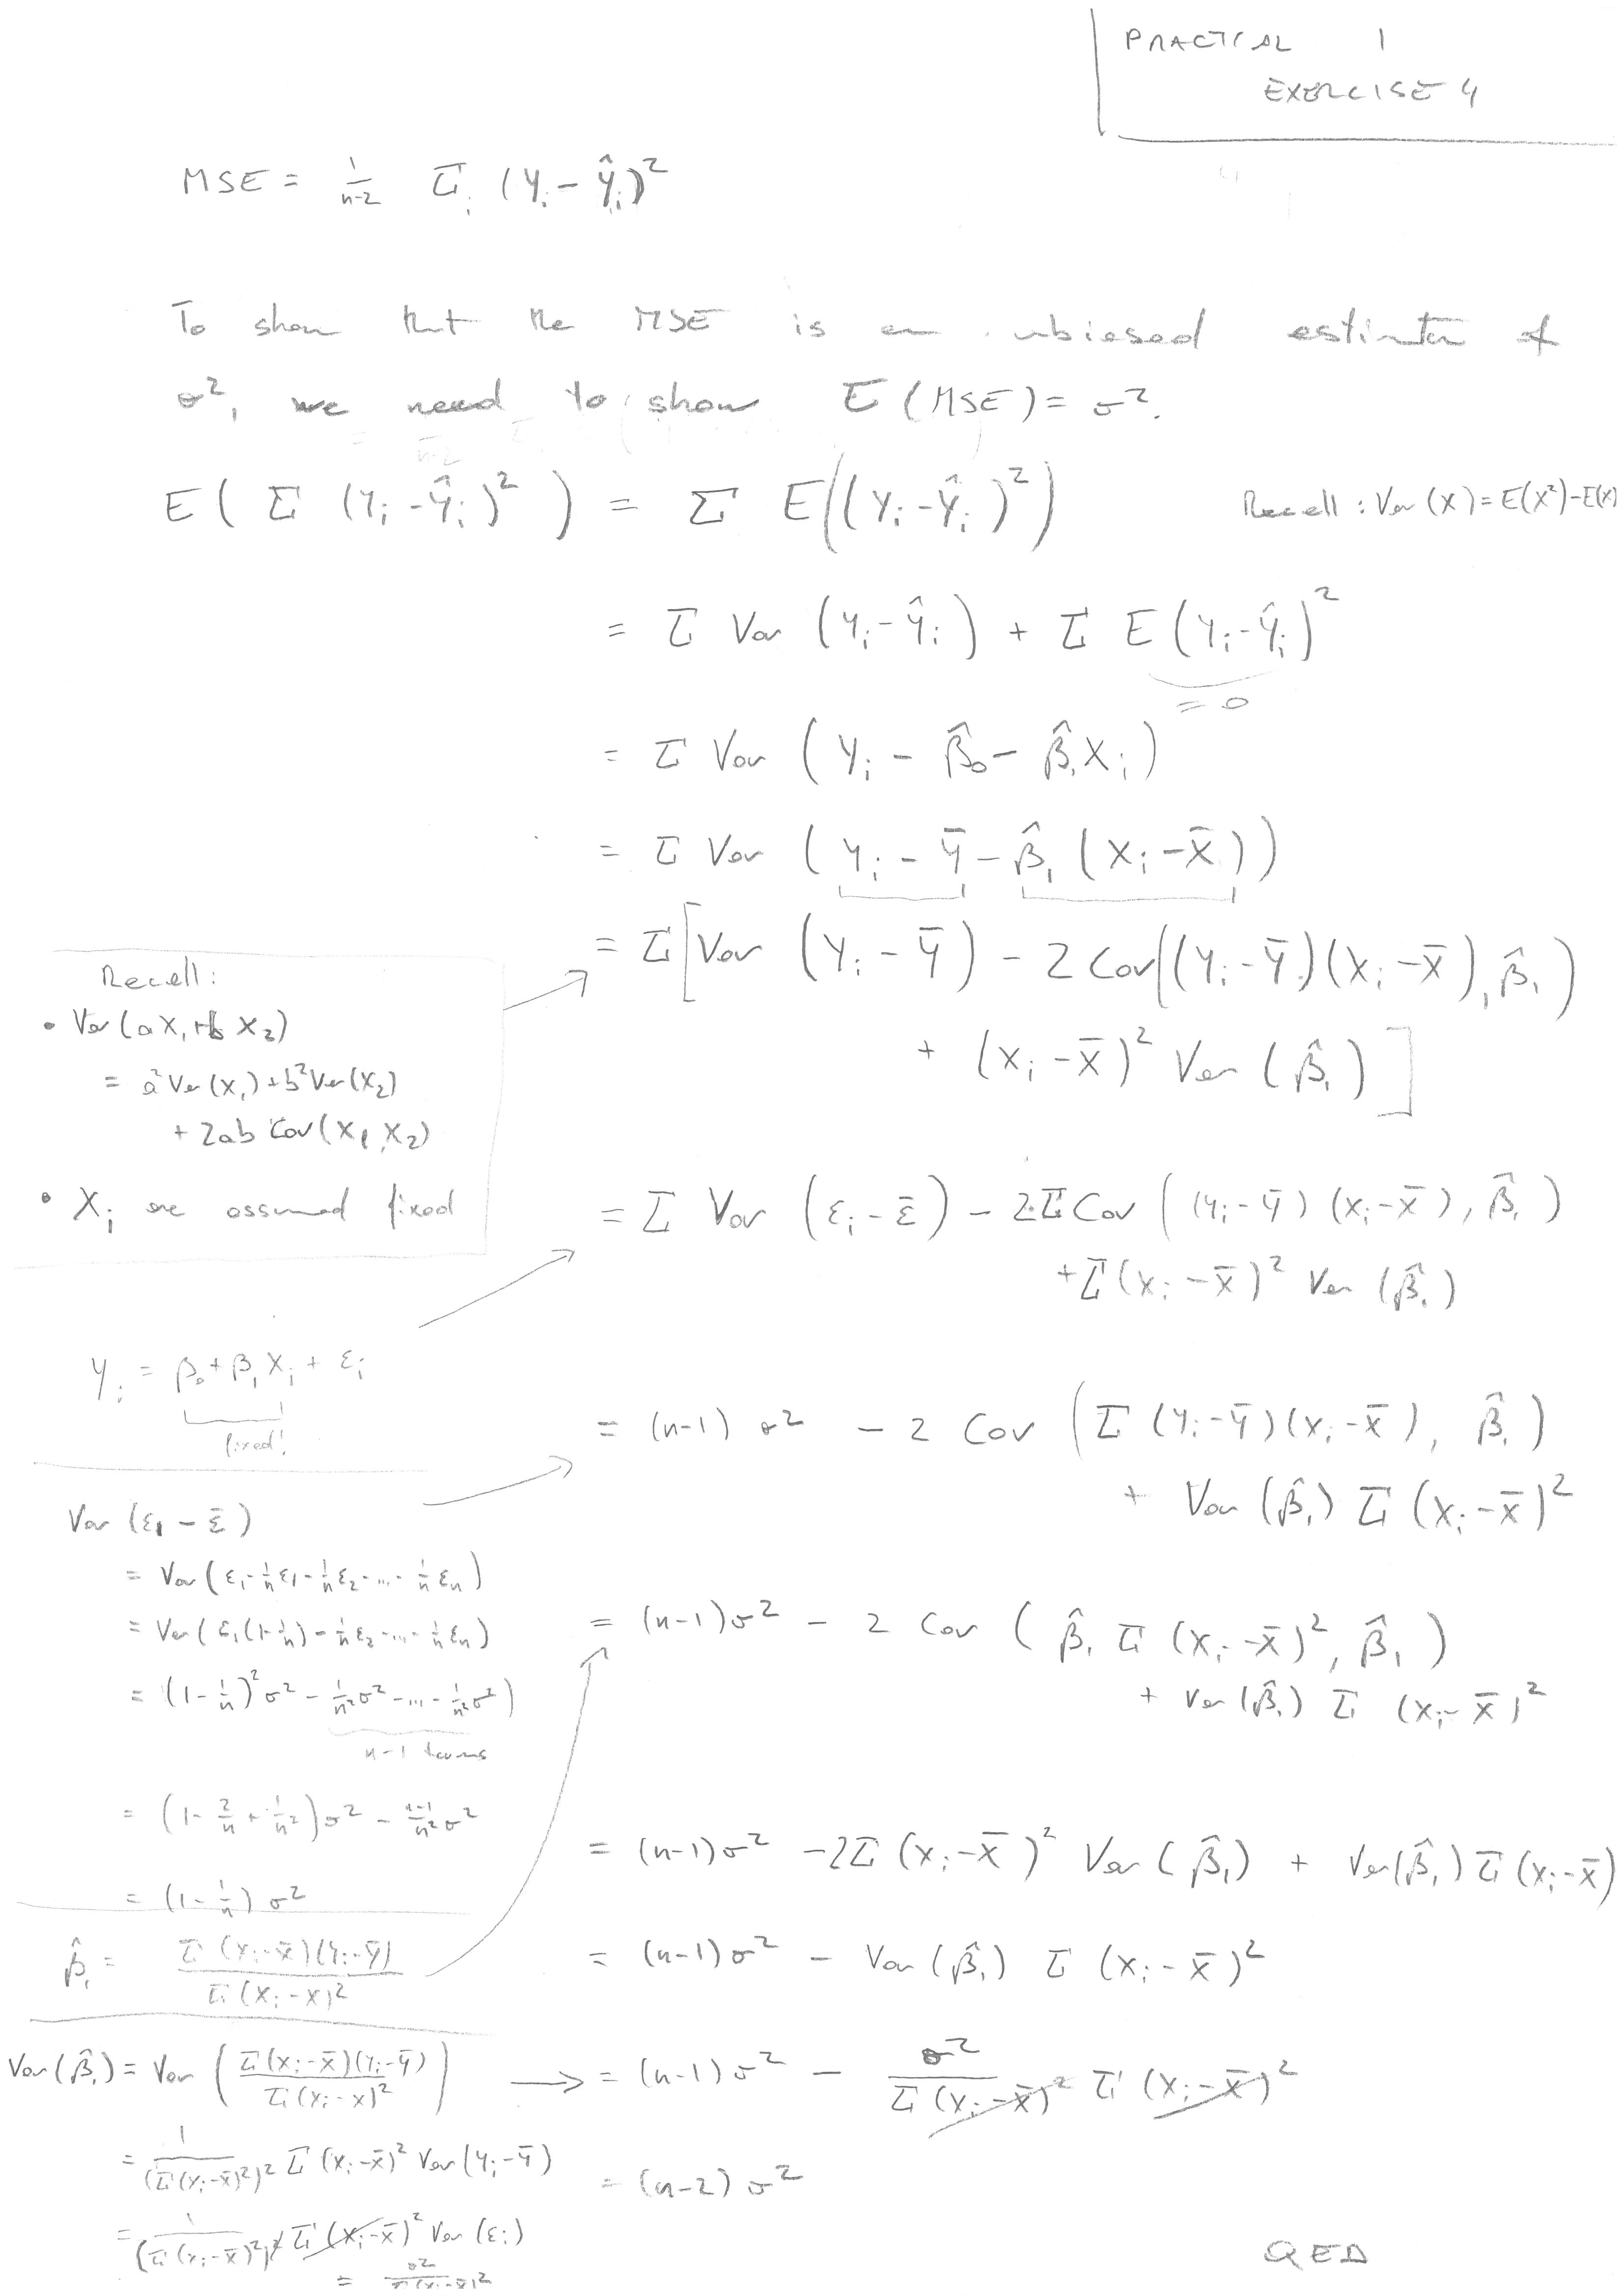
Exercise 4
Exercise 4 solution

Slide 21
[end of ST6103 GLM Practical 1]

