Slide 1
ST6103 - GLM - Session 1
Marc Henrion

Slide 2
Preliminaries
These notes were written in R markdown.
All examples / code in these notes is R.
You will NOT be assessed on R in the examination for this module, only on GLM theory. GLMs can be fitted with any other statistical programming package and it is straightforward to write your own fitting routine in any programming language. R / Stata / SAS / … will be useful if you plan a career in (bio)statistics. I highly recommend R.
BUT you will need to be able to read model output from a statistical package - whether R or some other software.
GitHub repository - will contain all course materials by the end of the week:
https://github.com/gitMarcH/Chanco_ST6103

Slide 3
Session 1: Linear Model
The definite reference for GLMs is:
McCullagh, P. and Nelder, J.A. (1989). “Generalized Linear Models”. $2^{nd}$ ed. Chapman & Hall / CRC.

Slide 4
Notation
$X,Y$ - random variables (here: X = predictor, Y = response)
$x,y$ - measured / observed values
$ϵ$ - random variable (here: error / residual)
$θ$ - a vector of parameters
$\overline{X}$, $\overline{Y}$ - sample mean estimators for X, Y
$\overline{x}$, $\overline{y}$ - sample mean estimates of X, Y
$\hat{T}$, $\hat{t}$ - given a statistic T, estimator and estimate of T
$P(A)$ - probability of an event A occuring
$f_{X}(.)$, $f_{Y}(.)$ - distribution mass / density functions of X, Y
$X∼F$ - X distributed according to distribution function F
$E[X]$, $E[Y]$, $E[T]$ - the expectation of X, Y, T respectively

Slide 5
Linear model
Generalised linear models form an important family of regression models.
Regression means describing some aspect of a dependent variable $Y$ as a function of some predictor or independent variables $X$ and parameters $θ$:
$$f_{1}(Y)=f_{2}(X;θ)$$
Here we focus on describing a function of the mean of $Y$ as a function of a linear predictor of $X$.
3 main reasons for fitting regression models: inference, prediction, adjustment.

Slide 6
Linear model
Let’s suppose we have some data:
set.seed(20190715) df<-tibble( x=runif(25,min=-5,max=5), y=1.5*x+rnorm(25,sd=2)+3.5 ) ggplot(data=df,aes(x=x,y=y)) + geom_point(size=3) + theme(text = element_text(size=20))

Slide 7
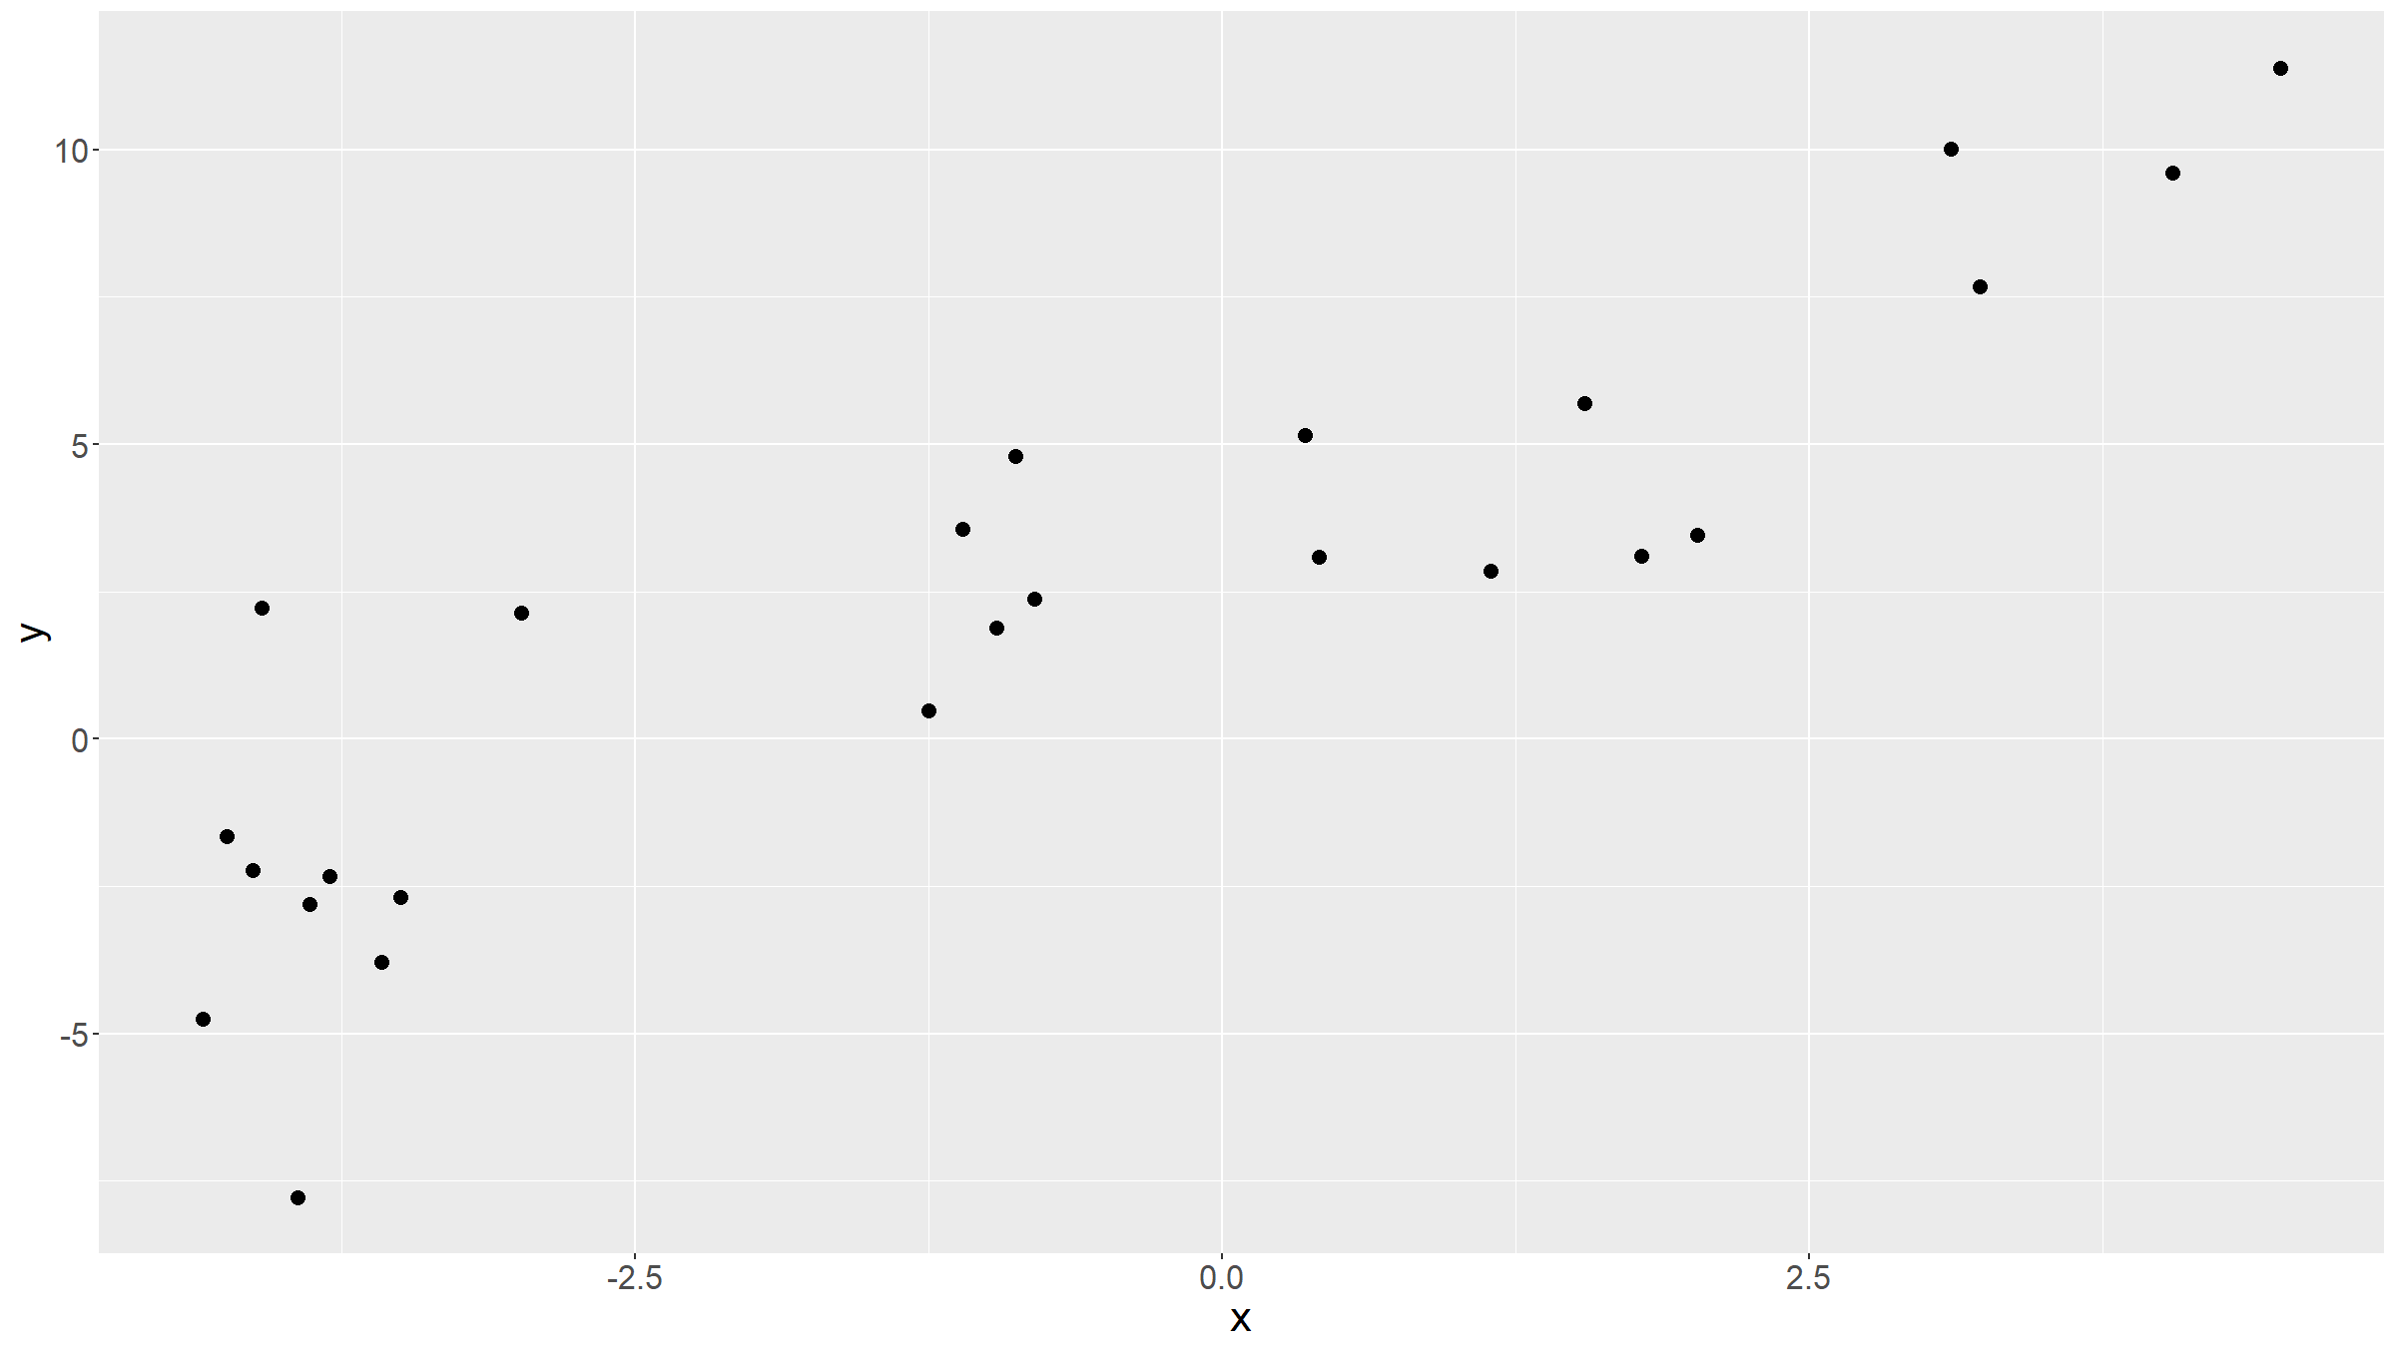

Slide 8
Linear model
Looks like there is a linear relationship between the 2 variables:
as $x↗$, so $y↗$
We can try to guess what that relationship is.
E.g. we can guess $y≈x+3$:
ggplot(data=df,aes(x=x,y=y)) + geom_abline(intercept=3,slope=1,colour="steelblue",lwd=1.5) + geom_point(size=3) + theme(text = element_text(size=20))

Slide 9
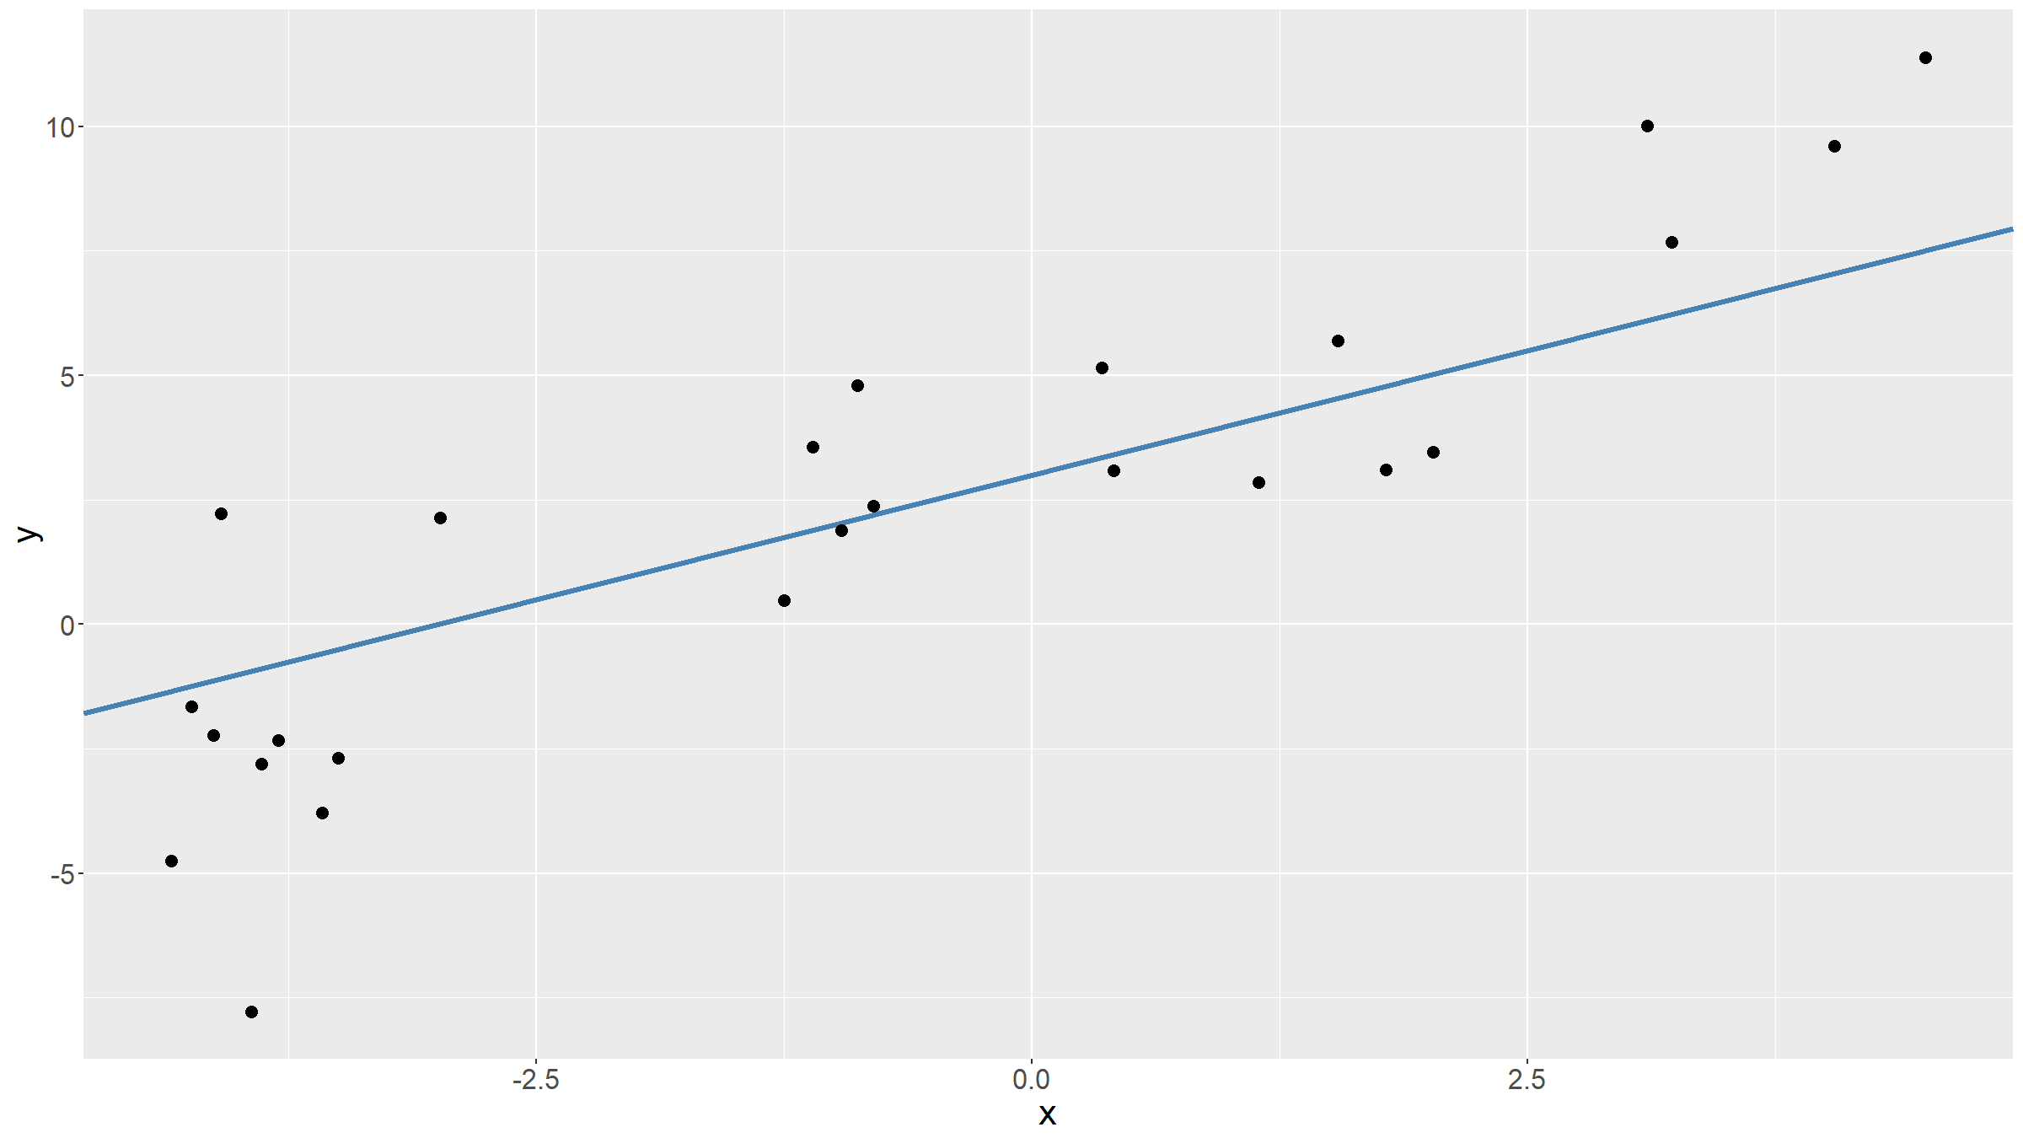

Slide 10
Linear model
Looks good? Maybe the slope should be a bit steeper, the intercept larger?
$y≈2x+4$
ggplot(data=df,aes(x=x,y=y)) + geom_abline(intercept=4,slope=2,colour="salmon",lwd=2) + geom_point(size=3) + theme(text = element_text(size=20))

Slide 11
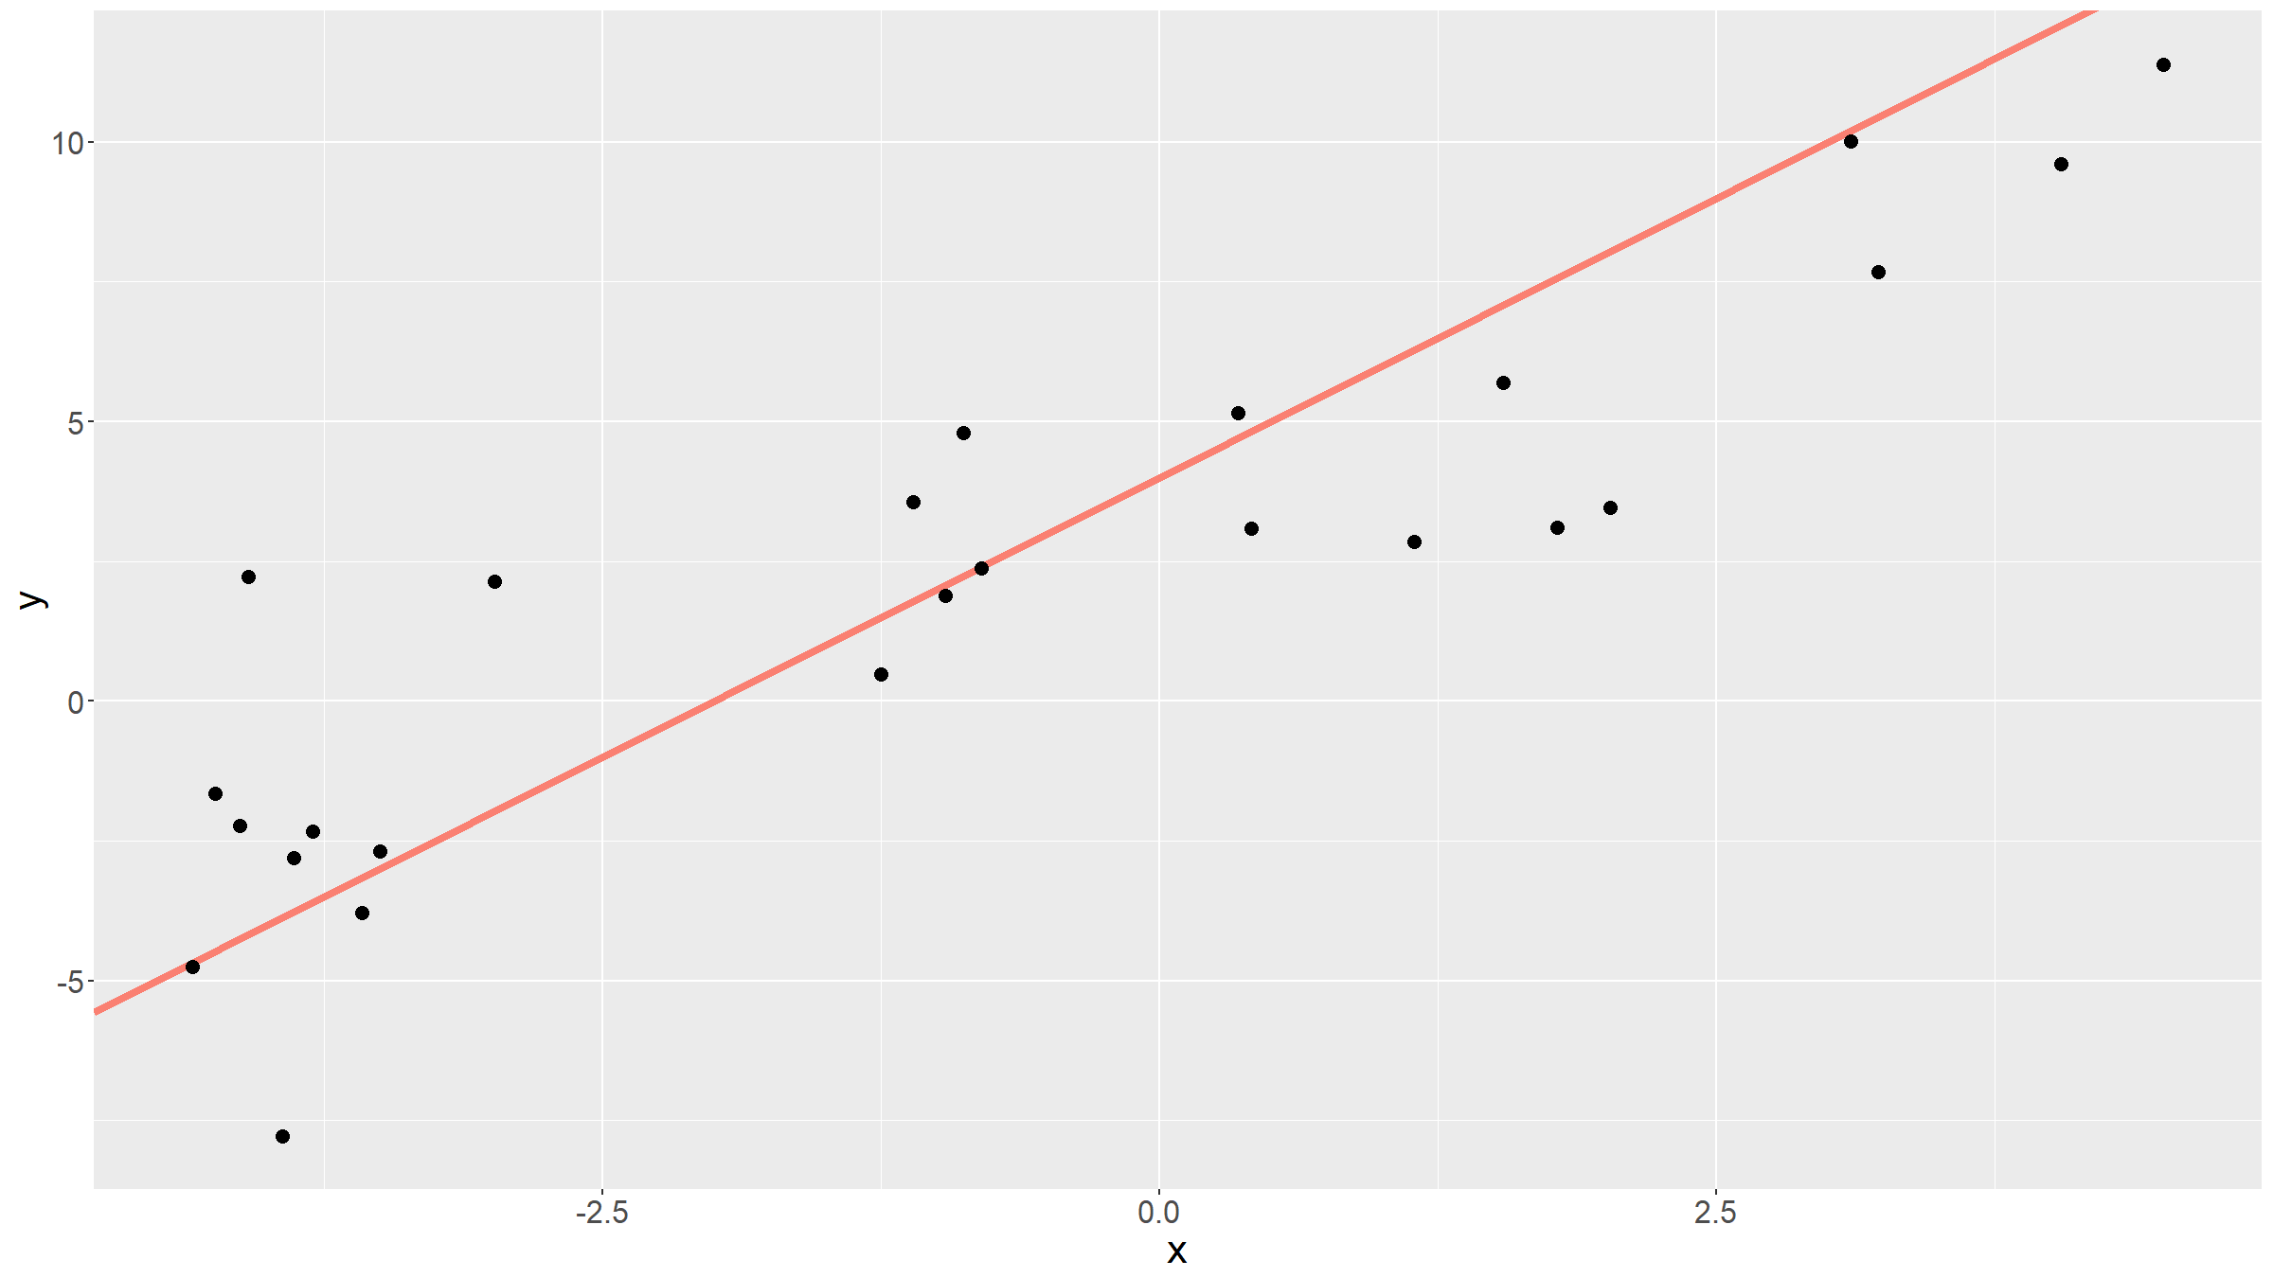

Slide 12
Linear model
Which line to pick?
ggplot(data=df,aes(x=x,y=y)) + geom_abline(intercept=3,slope=0.5,colour="darkgrey",lwd=2) + geom_abline(intercept=3.1,slope=1,colour="steelblue",lwd=2) + geom_abline(intercept=3.8,slope=1.25,colour="mediumorchid",lwd=2) + geom_abline(intercept=2.8,slope=1.75,colour="orange",lwd=2) + geom_abline(intercept=3.5,slope=2,colour="salmon",lwd=2) + geom_abline(intercept=4,slope=2.5,colour="greenyellow",lwd=2) + geom_point(size=3) + theme(text = element_text(size=20))

Slide 13
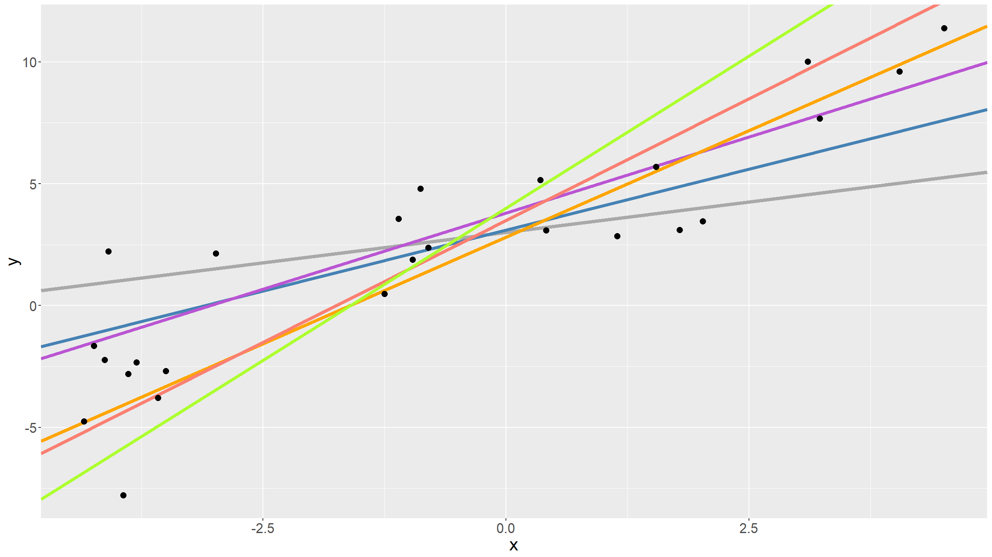

Slide 14
Linear model
We can try to minimize the errors, i.e. the deviations of the observed data from the line. Since these errors can be positive or negative, we minimise the sum of the squares.
This is the principle of ordinary least squares (OLS).
Let ${\hat{y}}_{i}=β_{0}+β_{1}x_{i}$.
We want to find values for $β_{0},β_{1}$ that minimise
SS=i​(yi−yi)2=i​(yi−β0−β1xi)2
$SS$ above is often also called the error or residual sum of squares (ESS).

Slide 15
Linear model
ggplot(data=df,aes(x=x,y=y)) + geom_abline(intercept=3,slope=1,colour="steelblue",lwd=2) + geom_segment(aes(x=x,xend=x,y=y,yend=x+3),colour="red",lwd=1.5) + geom_point(size=4) + theme(text = element_text(size=20))

Slide 16
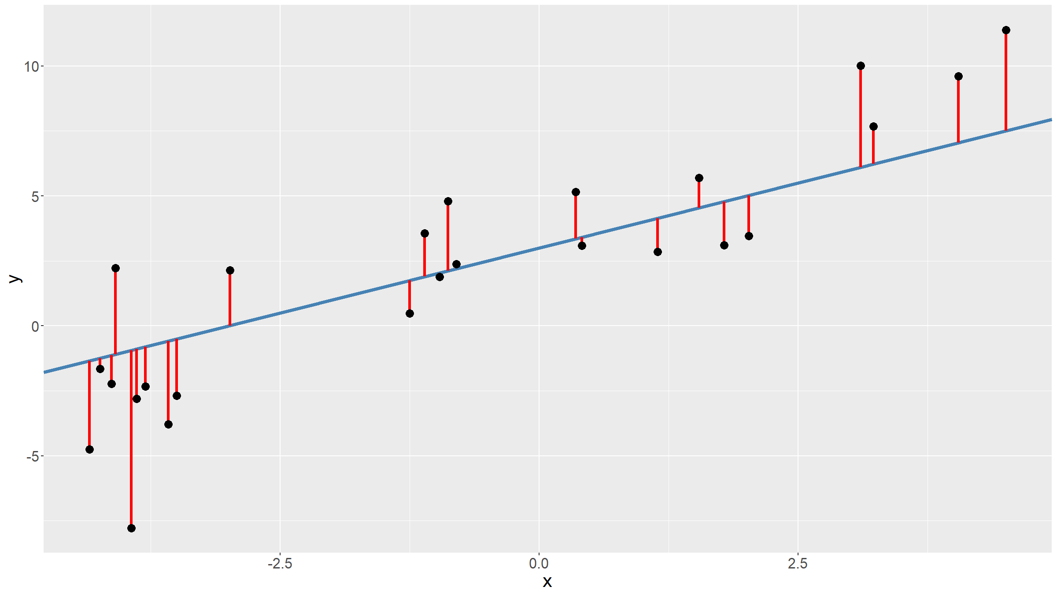

Slide 17
Linear model
We can write the sum of squares as a function in R:
sumSquares<-function(beta,dat=df){ return( sum( (dat$y - (beta[1]+beta[2]*dat$x))^2 ) ) }
We can then try this for several values, hoping to find the minimum:
sumSquares(c(0,0))
## [1] 659.98
sumSquares(c(0,1))
## [1] 370.6134
sumSquares(c(3,1.5))
## [1] 117.1584

Slide 18
Linear model
There are minimisation algorithms that can do this for us.
betaHat<-optim(fn=sumSquares,par=c(0,0)) print(betaHat$par)
## [1] 3.309937 1.466308
print(betaHat$value)
## [1] 114.0541
betaHat is a list object.
Check what else it reports by typing print(betaHat).
For more details about optim, type ?optim.

Slide 19
Linear model
What we have done, is fit a linear model.
$$y_{i}=β_{0}+β_{1}x_{i}+ϵ_{i}$$
In other words, for a dependent variable $Y$ and an independent variable $X$ we hypothesise there is a model
$$Y=β_{0}+β_{1}X+ϵ$$
where $ϵ$ is a random variable.
Note that by using least squares we only fit a function to data as best as we can. We don’t make any distributional assumptions about $Y$ or $ϵ$.

Slide 20
Linear model
We can fit this directly (without writing down the sum of squares function) by using the R function lm or glm.
mod<-lm(y~x,data=df) print(mod)
## ## Call: ## lm(formula = y ~ x, data = df) ## ## Coefficients: ## (Intercept) x ## 3.310 1.466

Slide 21
Linear model
We can get more information by typing summary(mod).
You get the same results by using glm rather than lm.

Slide 22
Linear model
Write $\overline{x}$, $\overline{y}$ for the sample means and define:
SSy=i​(yi−y)2
SSx=i​(xi−x)2
Sxy=i​(xi−x)(yi−y)
Note: $SS_{y}$ is also often called the total sum of squares (TSS).

Slide 23
Linear model
The LS estimates for the parameters $β_{0},β_{1}$ are:
$${\hat{β}}_{1}=S_{xy}/SS_{x}$$
$${\hat{β}}_{0}=\overline{y}−{\hat{β}}_{1}\overline{x}$$
For calculating this by hand, it is usally easier to write
Sxy=i​xiyi−nx y SSx=i​xi2−nx2
Exercise:
Prove that ${\hat{β}}_{0}$ and ${\hat{β}}_{1}$ are the OLS solution.

Slide 24
Linear model
Proof:
We require:
δδβ0i​(yi−β0−β1xi)2=0 (1)δδβ1i​(yi−β0−β1xi)2=0 (2)

Slide 25
Linear model
Proof:
From (1) we get:
i​(−2)(yi−β0−β1xi)=0
⇒i​yi−nβ0−β1i​xi=0
$⇒\overline{y}−\hat{β_{0}}−{\hat{β}}_{1}\overline{x}=0$
$⇒{\hat{β}}_{0}=\overline{y}−{\hat{β}}_{1}\overline{x} (3)$

Slide 26
Linear model
Proof:
From (2) we get:
i​(−2)xi(yi−β0−β1xi)=0
⇒i​(xiyi−β0xi−β1xi2)=0 (4)
Substituting (3) into (4):
i​(xiyi−xiy+β1xxi−β1xi2)=0
⇒i​(xiyi−xiy)−β1i​(xi2−xxi)=0
⇒β1=i​(xiyi−xiy)i​(xi2−xxi) (5)

Slide 27
Linear model
Proof:
Now, this can be simplified by noting that i​(x y−xyi)=0 and i​(x2−xxi)=0 and adding these terms to the numerator and denominator respectively of (5).
β1=i​(xiyi−xiy)+i​(x y−xyi)i​(xi2−xxi)+i​(x2−xxi)=i​(xi−x)(yi−y)i​(xi−x)2=SxySSx
QED

Slide 28
Linear model
For calculating by hand, the formulas most useful are
β1=i​xiyi−nx yi​xi2−nx2
$${\hat{β}}_{0}=\overline{y}−{\hat{β}}_{1}\overline{x}$$

Slide 29
Linear model
Example (to be calculated by hand):
x<-c(1,3,4,5,8,10) y<-c(1,5,10,11,19,18) n<-length(x) df<-data.frame(x=x,y=y,xy=NA,x2=NA) print(df)
## x y xy x2 ## 1 1 1 NA NA ## 2 3 5 NA NA ## 3 4 10 NA NA ## 4 5 11 NA NA ## 5 8 19 NA NA ## 6 10 18 NA NA

Slide 30
Linear model
Example (continued)
df$xy<-x*y df$x2=x^2 print(df)
## x y xy x2 ## 1 1 1 1 1 ## 2 3 5 15 9 ## 3 4 10 40 16 ## 4 5 11 55 25 ## 5 8 19 152 64 ## 6 10 18 180 100

Slide 31
Linear model
Example (continued)
Sxy<-sum(df$xy)-n*mean(x)*mean(y) SSx<-sum(df$x2)-n*mean(x)^2 beta1<-Sxy/SSx beta0<-mean(y)-beta1*mean(x) print(c(beta0,beta1))
## [1] 0.08206687 2.04863222
print(as.vector(coef(lm(y~x))))
## [1] 0.08206687 2.04863222
plot(x,y,cex=2) xx<-seq(0,10,length=100) yy<-beta0+beta1*xx lines(xx,yy,col="steelblue",lwd=2.5)

Slide 32
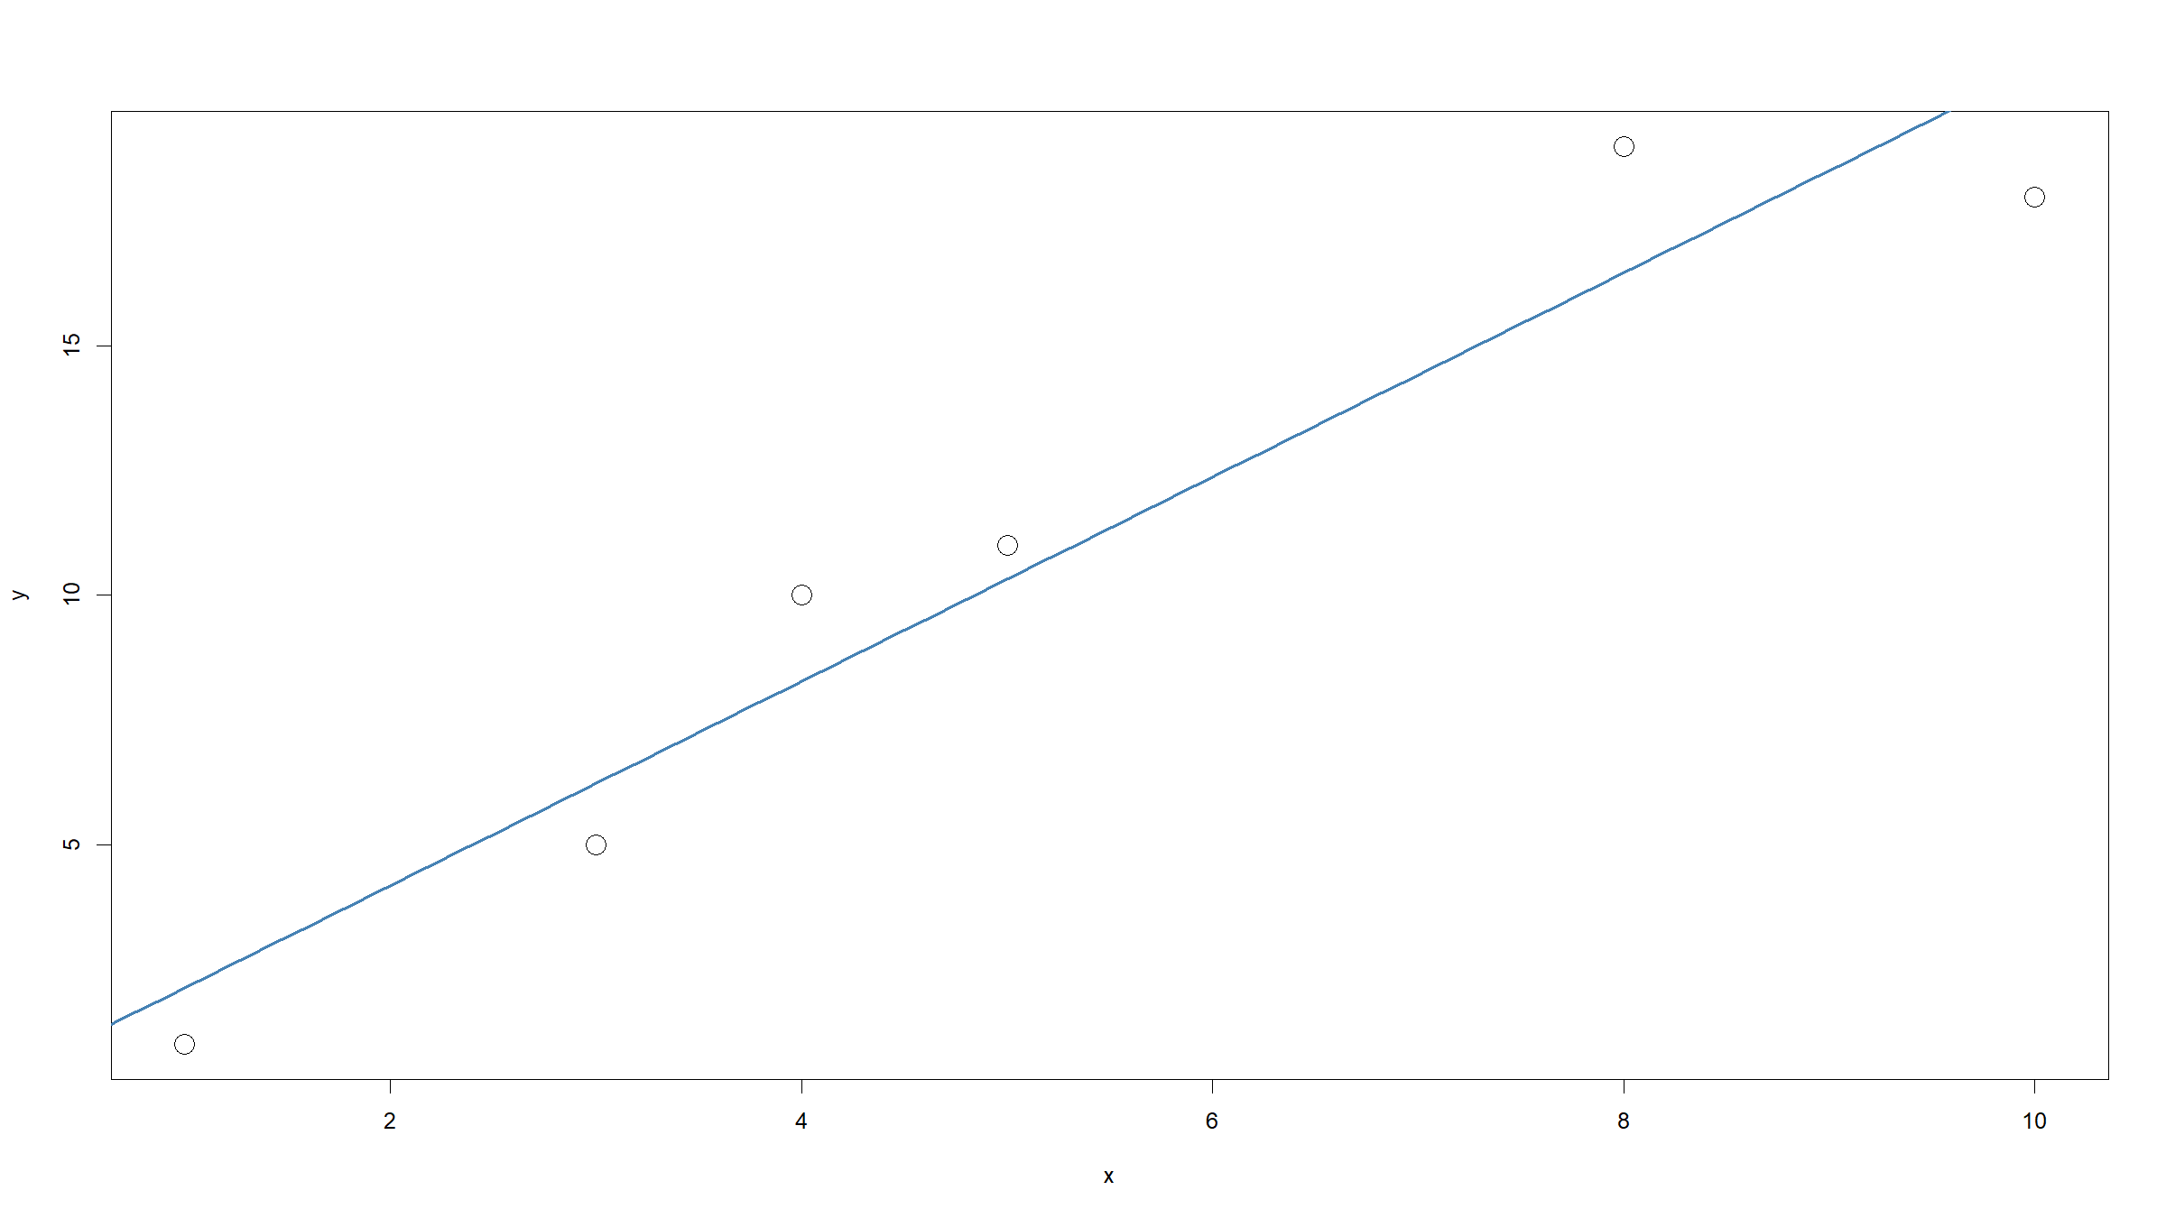

Slide 33
Linear model
Parameter interpretation:
${\hat{β}}_{0}$ is the estimated intercept of the fitted regression line; it is the value predicted for $Y$ when $X=0$
${\hat{β}}_{1}$ is the estimated slope of the fitted regression line; it gives by how much $Y$ changes, on average, for every increase in $X$ by 1

Slide 34
Linear model
The total variation (total sum of squares = TSS) in the data is $SS_{y}$ and you can show that this can be split into 2 components: TSS = RSS + ESS
the regression sum of squares RSS=i​(yi−y)2=Sxy2/SSx
the error / residual sum of squares ESS=i​(yi−yi)2=SSy−(Sxy2/SSx)
The coefficient of determination $R^{2}$ gives the proportion of the variation that is explained by the regression model.
$$R^{2}=\frac{RSS}{TSS}=\frac{S_{xy}^{2}}{SS_{x}SS_{y}}$$
In the case of a single predictor $X$, $R^{2}$ is also the squared sample correlation coefficient $ρ(y,x)$ between the observed $y$ and $x$.

Slide 35
Linear model
So far we just fitted a line. Implicitly we made the following assumptions:
The data used to fit the model are representative of the underlying population.
The true relationship between $X$ and $Y$ is linear.
If we want to make statistical inference about any of the parameters in the model, we need to make additional assumptions:
the random error $ϵ∼N(0,σ^{2})$ - specifically this implies that the residuals $ϵ_{i}$ are homoscedastic (have equal variance)
the observations $y_{i}$ are independent given the $x_{i}$ - in other words the residuals $ϵ_{i}$ are independent

Slide 36
Linear model
Once we have made these assumptions, we can do statistical tests:
test if $β_{1}=0$?
test if the population correlation parameter $ρ=0$
The above 2 tests are in fact equal.
($R^{2}=\frac{S_{xy}^{2}}{SS_{x}SS_{y}},{\hat{β}}_{1}=\frac{S_{xy}}{SS_{x}}⇒R^{2}={\hat{β}}_{1}\frac{SS_{x}}{SS_{y}}$ and $SS_{x}>0$ or both undefined).
We can also test if the intercept $β_{0}=0$ (or some other value), but this test is usually not sensible as $β_{0}$, the average value of $Y$ if $X=0$, has, in most situations, little more meaning than providing a numerical scale for the observed values.

Slide 37
Linear model
As in one-way ANOVA, the linear regression model relates an outcome $Y$ to a predictor $X$. In ANOVA $X$ is discrete, in linear regression $X$ is continuous (though the mathematics above work just as well if $X$ is binary).
We can produce an ANOVA-like table and define an $F$ statistic that can be used to test if $β_{1}=0$.

Slide 38
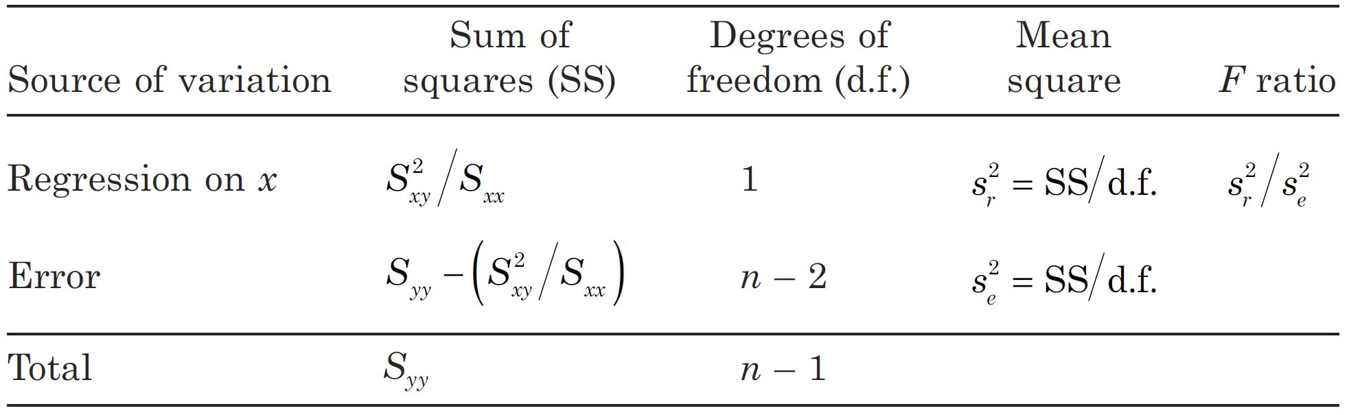
Analysis of variance table for the simple linear regression (Woodward, M., 2014, Epidemiology, 3rded., CRC Press). Note the slight change in notation for the sums of squares in the above table.

Slide 39
Linear model
By assuming $ϵ_{i}∼N(0,σ^{2})$, we can also compute the model likelihood:
L(β0,β1)=i​ϕ(yi−β0−β1xi|0,σ2)
where $ϕ(.|μ,σ^{2})$ is the probability density function for a normal distribution with mean $μ$ and variance $σ^{2}$.
We can find values ${\hat{β}}_{0}′$ and ${\hat{β}}_{1}′$ that maximise $L(β_{0},β_{1})$. This is the principle of maximum likelihood estimation (MLE).

Slide 40
Linear model
Exercise:
Show that the MLE estimators are equal to the OLS estimators, i.e. ${\hat{β}}_{0}′={\hat{β}}_{0}$ and ${\hat{β}}_{1}′={\hat{β}}_{1}$.
Note: this may be surprising, since we had to make additional assumptions to be able to write down the likelihood function.

Slide 41
Linear model
Proof:
Rather than maximising directly the likelihood, we can equivalently minimise the negative log likelihood $l(β_{0},β_{1})$.
l(β0,β1)=−i​log12πσ21/2exp−12σ2(yi−β0−β1xi)2=−n2log12πσ2+12σ2i​(yi−β0−β1xi)2

Slide 42
Linear model
Proof:
The first term is just a constant, so it suffises to minimise (with respect to $β_{0}$, $β_{1}$) the second term, i.e. minimise:
i​(yi−β0−β1xi)2
This is obviously just the sum of squares which we minimised in OLS - so this will yield the same solution.
QED

Slide 43
General linear model
For OLS, the variance of the errors ($σ^{2}$) is irrelevant as far as the optimisation is concerned. In MLE, while the likelihood does feature $σ^{2}$, this parameter drops out during the optimisation.
This means we do not have an OLS or MLE estimator for $σ^{2}$.
We can however estimate $σ^{2}$ by summing all the squared errors using the OLS/MLE estimates ${\hat{β}}_{0},{\hat{β}}_{1}$, then dividing by the corresponding degrees of freedom. Since we estimate 2 parameters ($β_{0},β_{1}$), the degrees of freedom are $n−2$.

Slide 44
General linear model
This estimator for $σ^{2}$ is the mean squared error (MSE):
σ2=MSE=i​(yi−yi)2n−2=i​(yi−β0−β1xi)2n−2
Note that the MSE is different from s2=i​(yi−y)2n−1 which is an estimate of the population variance of $Y$.
It can be shown that the MSE is an unbiased estimator of $σ^{2}$.

Slide 45
General linear model
What we have seen so far is the linear model also known as simple linear regression:
$$Y=β_{0}+β_{1}X+ϵ$$
where $ϵ∼N(0,σ^{2})$
This can be generalised:
multiple predictors, both numerical and/or categorical: general linear model
non-normal error + link function: generalised linear model (GLM)
The general linear model includes both simple and multiple linear regression as well as AN(C)OVA (with fixed effects only) models.

Slide 46
General linear model
Response $Y$, related to $p$ predictor variables $X_{1},…,X_{p}$:
$$Y=β_{0}+β_{1}X_{1}+…+β_{p}X_{p}+ϵ$$
with $ϵ∼N(0,σ^{2})$.
Note the model is linear in the parameters $β_{0},β_{1},…,β_{p}$.
E.g. $Y=β_{0}+β_{1}X+β_{2}X^{2}+ϵ$ is a general linear model but $Y=β_{0}X^{β_{1}}+ϵ$ is not.

Slide 47
General linear model
Easier to use matrix notation.
Let:
$$Y=(Y_{1},…,Y_{n})^{T}$$
$$X=\left(\begin{matrix}1 & X_{11} & … & X_{p1} \\ ⋮ & ⋮ & ⋮ & ⋮ \\ 1 & X_{1n} & … & X_{pn}\end{matrix}\right)$$
$$β=(β_{0},…,β_{p})^{T}$$
$$ϵ=(ϵ_{1}…ϵ_{n})^{T}$$

Slide 48
General linear model
Then we can write the general linear model as
$$Y=Xβ+ϵ$$
where $ϵ∼N(0,σ^{2}I)$.
This can also be written as:
$$\left\{\begin{matrix}E\left(Y|X\right)=Xβ \\ Var(Y−Xβ)=σ^{2}\end{matrix}\right.$$
$X$ is called the design matrix.
Dimensions: $Y$ is $n×1$, $X$ is $n×(p+1)$, $β$ is $(p+1)×1$, $ϵ$ is $n×1$.

Slide 49
General linear model
For observed data $y$ and $x$, the ML / LS estimates are given by
$$\hat{β}={\left(x^{T}x\right)}^{−1}x^{T}y$$
This requires $x^{T}x$ to be invertible (though general inverse could be used).

Slide 50
General linear model
Exercise:
For the $p=1$ case, show that ${\left(x^{T}x\right)}^{−1}x^{T}y$ gives the same ML / LS estimates that we previously derived for the simple linear regression.
[see Practical 1]

Slide 51
[end of ST6103 GLM Session 1]

