Slide 1
ST6103 - GLM - Session 2
Marc Henrion

Slide 2
Session 2: Generalised Linear Model

Slide 3
Notation
$X,Y$ - random variables (here: X = predictor, Y = response)
$x,y$ - measured / observed values
$ε$ - random variable (here: error / residual)
$θ$ - a vector of parameters
$\overline{X}$, $\overline{Y}$ - sample mean estimators for X, Y
$\overline{x}$, $\overline{y}$ - sample mean estimates of X, Y
$\hat{T}$, $\hat{t}$ - given a statistic T, estimator and estimate of T
$P(A)$ - probability of an event A occuring
$f_{X}(.)$, $f_{Y}(.)$ - distribution mass / density functions of X, Y
$X∼F$ - X distributed according to distribution function F
$E[X]$, $E[Y]$, $E[T]$ - the expectation of X, Y, T respectively

Slide 4
Generalised linear model
The GLM, formulated by John Nelder & Robert Wedderburn [1], relates the mean of an outcome variable $Y$ to predictor variables $X$ via
$$E(Y|X)=g^{−1}(Xβ)$$
Specifically the GLM consists of 3 things:
$Y∼F$ where $F$ is an exponential family distribution with mean $μ$
a linear predictor $η=Xβ$
a monotonic, differentiable link function g(), linking $μ$, $η$: $g(μ)=η$

Slide 5
Generalised linear model
Where
$$Y=(Y_{1},…,Y_{n})^{T}$$
$$X=\left(\begin{matrix}1 & X_{11} & … & X_{p1} \\ ⋮ & ⋮ & ⋮ & ⋮ \\ 1 & X_{1n} & … & X_{pn}\end{matrix}\right)$$
$$β=(β_{0},…,β_{p})^{T}$$
$$ε=(ε_{1}…ε_{n})^{T}$$
$X$ is called the design matrix.
Dimensions: $Y$ is $n×1$, $X$ is $n×(p+1)$, $β$ is $(p+1)×1$, $ε$ is $n×1$.

Slide 6
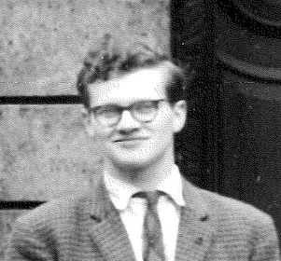
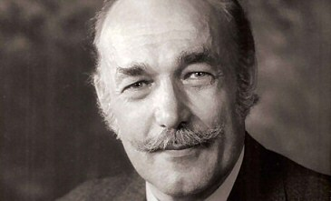
Generalised linear model
John Ashworth Nelder (public domain / Wikipedia)
Robert Wedderburn (public domain / Wikipedia)

Slide 7
Generalised linear model
An important special case is the general linear model (covered in Session 1):
$g(x)=x$
$Y∼𝒩(η,σ^{2})$
This can be written as:
$$Y=β_{0}+β_{1}X_{1}+…+X_{p}+ε$$
with $ε∼𝒩(0,σ^{2})$
A special case of this model: 2 categorical predictors only (two-way ANOVA).

Slide 8
Generalised linear model
Exercise:
Write in matrix notation:
$$log(E(Y_{i}|X_{i}))=β_{0}+β_{1}X_{i}+β_{2}X_{i}^{2}+β_{3}log(X_{i}) i=1,…,n$$

Slide 9
Generalised linear model
The linear predictor is linear in the coefficients $β_{i}$.
These are linear models:
$$Y=β_{0}+β_{1}X_{1}+β_{2}X_{1}^{2}+β_{3}X_{1}X_{2}+ε$$
$$Y=β_{0}e^{−X}+ε$$
$$Y=β_{0}+β_{1}log(X)+ε$$
These are non-linear models:
$$Y=β_{0}+β_{1}X^{β_{2}}+ε$$
$$Y=\frac{β_{0}}{1+(X/β_{1})^{2}}+ε$$
$$Y=\left\{\begin{matrix}β_{0}+β_{1}X & if x<x_{0} \\ β_{2}+β_{3}X & otherwise\end{matrix}\right.$$

Slide 10
Generalised linear model
Suppose we now observe data $D=\{y,x\}$ consisting of $n$ observations for 1 response and $p$ predictors. We can compute the probability density of observing these data:
$$L(D|θ)=\prod_{i=1}^{n}{f}(y_{i};μ_{i}=β_{0}+β_{1}x_{1i}+…,β_{p}x_{pi},θ′)$$
where $θ=(β_{0},…,β_{p},θ′)$, and $f(;μ,θ′)$ is the pdf of the exponential family distribution with mean $μ$ and other parameters $θ′$.
As before, the parameter values ${\hat{β}}_{0},{\hat{β}}_{1},…,{\hat{β}}_{k},\hat{θ}′$ that maximise the likelihood $L(D|θ)$ are known as the maximum likelihood estimates.

Slide 11
Generalised linear model
As we saw, it can be shown that for the general linear model case, the ML estimates are equal to the LS estimates.
In matrix and vector notation, the LS / ML estimates are given by:
$$\hat{β}=(x^{T}x)^{−1}x^{T}y$$
And we obtain an estimate of $σ^{2}$ through the MSE:
$${\hat{σ}}^{2}=\frac{\sum_{i}^{​}{(}y−x\hat{β})^{2}}{n−2}$$
In practice, for the generalised linear model with no identity link function and/or non-Gaussian errors, these are found by using iteratively reweighted least-squares (more later).

Slide 12
Generalised linear model
Exponential family distributions
A distribution with location parameter $θ$ and scale parameter $φ$ is said to be a member of the exponential familiy if its pdf $f(y|θ,φ)$ can be written in the form
$$f(y|θ,φ)=exp\left(\frac{yθ−b(θ)}{a(φ)}+c(y,φ)\right)$$
$θ$ is called the canonical parameter of the distribution.
Note that there are more general notation forms for the exponential family. The above is however a particularly useful form for deriving the estimation algorithm for GLMs.

Slide 13
Generalised linear model
Example: the normal distribution is an exponential family distribution since
$$f(y|μ,σ)=\frac{1}{\sqrt{2πσ^{2}}}exp\left(−\frac{(y−μ)^{2}}{2σ^{2}}\right)$$
$$=exp\left(\frac{yμ−μ^{2}/2}{σ^{2}}−\frac{y^{2}}{2σ^{2}}−\frac{1}{2}log(2πσ^{2})\right)$$
Setting $θ=μ$, $φ=σ$, $a(φ)=σ$, $b(θ)=μ^{2}/2$, $c(y,φ)=−\frac{y^{2}}{2σ^{2}}−\frac{1}{2}log(2πσ^{2})$, yields the exponential family form.

Slide 14
Generalised linear model
Recap
Independent observations, true relation between response and predictor(s) is linear: linear regression.
Normal distribution of errors / residuals, continuous & categorical predictors, linear predictor is linear in parameters (not necessarily in the predictors): general linear model.
Link function, exponential-family distribution for errors / residuals: generalised linear model.

Slide 15
Generalised linear model
How to choose a link function?
It depends on the data and the question you wish to answer!
However there are canonical link functions for different distributions. These are derived by choosing $g(.)$ such that $g(E(Y|X))=θ$, the canonical parameter.
E.g. for the normal distribution, we have shown that $θ=μ$ and we know that $E(Y|X)=μ$, hence the canonical link function for the normal distribution is the identity function: $g(μ)=μ$.

Slide 16
Generalised linear model
Data transformations are often used to address violations of model assumptions, such as linearity of the relationship or non-constant variance. One can transform either the response variable $Y$ or the independent variables $X_{1},…,X_{p}$ or both.
Here we briefly introduce two common tranformation methods. There are far more general methods for transforming both $Y$ and the predictors $X_{1},…,X_{p}$, such as Alternating Conditional Expectation (ACE), but this is beyond the scope of this lecture course and best considered within the framework of Generalised Additive Models (GAMs) which we will briefly introduce at the end of this module.
Box-Cox transform
Mosteller & Tukey’s ladder of powers / bulging rule

Slide 17
Generalised linear model
The Box-Cox transform.
George Box and David Cox [3] introduced this algorithm for transforming the response variable $Y$. This predated the GLMs, so is typically used in the case of the general linear model, i.e. Gaussian distribution and identity link.
The Box-Cox transform finds parameters $λ_{1},λ_{2}$ so that
$$Y_{BC}^{(λ)}=\left\{\begin{matrix}\frac{(Y+λ_{2})^{λ_{1}}−1}{λ_{1}} & if λ_{1}≠0 \\ ln(Y+λ_{2}) & if λ_{1}=0\end{matrix}\right.$$

Slide 18
Generalised linear model
The Box-Cox transform.
$λ_{1},λ_{2}$ are estimated using the profile likelihood function.
The Box-Cox transform assumes normality (in the case of the general linear model) in the transformed response variable.
Also note that we require $Y>λ_{2}$.

Slide 19
Generalised linear model
The Mosteller-Tukey ladder of powers (bulging rule).
This method allows to transform both the response $Y$ and the independent predictors $X_{1},…,X_{p}$.
Note that transforming $X$ will change the curvature of the data without affecting the variance of $Y$, whereas transforming $Y$ will affect both the shape of the data and the variance of the response variable.
For a general linear model, we will now fit
$$Y^{κ}=β_{0}+β_{1}X^{γ}+ε$$

Slide 20
Generalised linear model
The Mosteller-Tukey ladder of powers (bulging rule).
Mosteller & Tukey [4] propose a visual aid to select appropriate power $κ,γ$ (next slide), but profile likelihood methods could be used as well to estimate optimal parameters.
$$Z_{MT}^{(λ)}=\left\{\begin{matrix}Z^{λ} & if λ≠0 \\ ln(Z) & if λ=0\end{matrix}\right.$$
Note that $Z$ can be either the response variable or any of the predictors, with a different $λ$ parameter for each transformed variable. We require $Z>0$ if $λ≤0$ though one could introduce shift parameters ($λ_{2}$) as in the Box-Cox transform.

Slide 21
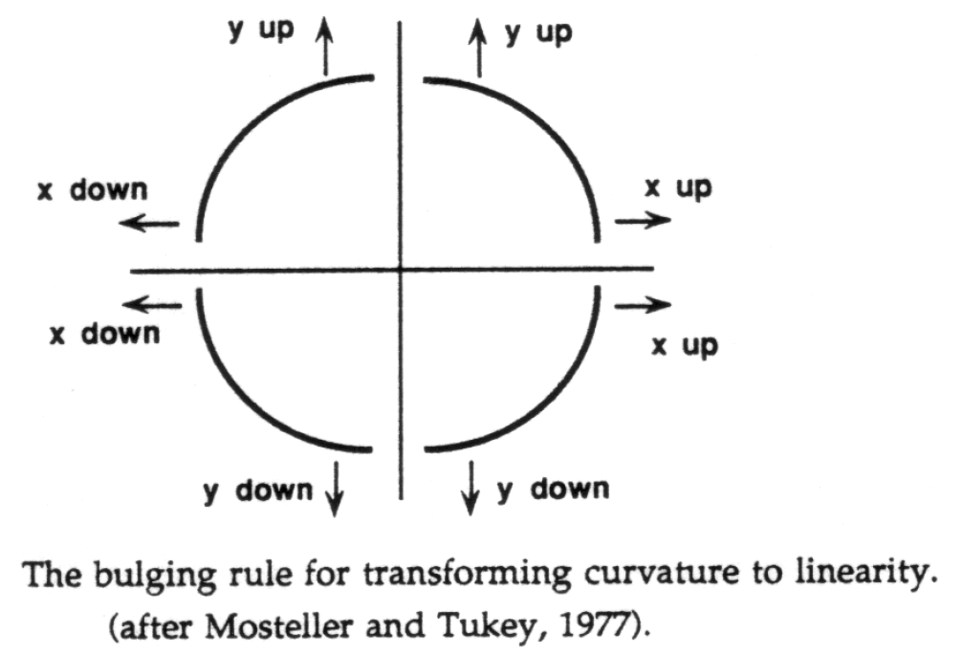
Generalised linear model
The Mosteller & Tukey (1977) ladder of powers / bulging rule

Slide 22
Generalised linear model
We may face a choice where we can either use a link function or transform the response variable.
In this case - what should you do?
It will depend on what the purpose of developing the statistical model is in the first place, but usually using a link function rather than transforming the data is preferrable.
The key difference is that by transforming $Y$, you affect both linearity and variance of the response: you change the distribution of your response variable, whereas a link function relates the mean of $Y$ to the predictors and does not affect the distribution of your response variable.

Slide 23
Generalised linear model
Example:
A log transform is often used to improve linearity and to remedy variance increasing with the mean.
In the case of a log transform, we model $log(Y)$:
$$log(Y)=β_{0}+β_{1}X_{1}+…+β_{p}X_{p}+ε$$
And so
$$E(log(Y)|X_{1},…,X_{p})=β_{0}+β_{1}X_{1}+…+β_{p}X_{p}$$
Since mean(log) $≠$ log(mean) in general, we cannot relate this back to the original data scale - an issue if some of our predictors are categorical and we wish to say something about subgroups.

Slide 24
Generalised linear model
Example:
Using a log link however, we model $Y$ directly, but relate the log of its mean to the predictors:
$$log(E(Y|X_{1},…,X_{p}))=β_{0}+β_{1}X_{1}+…+β_{p}X_{p}$$
And we can calculate the predicted average response of Y:
$$E(Y|X_{1},…,X_{p})=e^{β_{0}+β_{1}X_{1}+…+β_{p}X_{p}}$$

Slide 25
Generalised linear model
Exercise
Show that the binomial(m,$π$) is an exponential family distribution and that the canonical link is given by the logit function: $g(π)=log\left(\frac{π}{1−π}\right)$.

Slide 26
Generalised linear model
Solution
If $Y∼Bin(m,π)$, then its pdf is given by
$$f_{Y}(y)=\left({m \atop y}\right)π^{y}(1−π)^{1−y}=\left({m \atop y}\right){\left(\frac{π}{1−π}\right)}^{y}(1−π)^{m}$$
Writing this inside $exp()$:
$$f_{Y}(y)=exp\left(log\left({m \atop y}\right)+xlog\left(\frac{π}{1−π}\right)+mlog(1−π)\right)=exp\left(\frac{ylog\left(\frac{π}{1−π}\right)−(−mlog(1−π))}{1}+log\left({m \atop y}\right)\right)$$

Slide 27
Generalised linear model
Solution
Setting
$$\left\{\begin{matrix}θ & =xlog\left(\frac{p}{1−p}\right) \\ a(φ) & =1 \\ b(θ) & =−mlog(1−p) \\ c(y,φ) & =log\left({m \atop y}\right)\end{matrix}\right.$$
shows that this is an exponential family distribution.

Slide 28
Generalised linear model
Solution
When $Y|X∼Bin(m,π)$, we usually model $Y/m$:
$$g(E[Y/m|X])=Xβ$$
If $T∼Bin(m,π)$, then $E(T)=mπ$ and so $E(T/m)=π$.
Hence, in our case: $g(E[Y/m|X])=π$ and for the canonical link function we need to find $g()$ so that $g(E[Y/m|X])=θ=log\left(\frac{π}{1−π}\right)$.
Hence $g(π)=log\left(\frac{π}{1−π}\right)$ is the canonical link function.
In other words, for the binomial distribution, the canonical link function is the logit function.

Slide 29
Generalised linear model - estimation
A single algorithm can be derived for estimating the parameters $β$ of a GLM. For a full derivation see [2], pp. 40-43.
The likelihood of a GLM is given by the joint density for observations $y=(y_{1},…,y_{n})^{T}$, considered as a function of the parameters $θ=(θ_{1},…,θ_{n})^{T}$ and $φ$:
$$L(θ,φ|y)=\prod_{i=1}^{n}{e}xp\left(\frac{y_{i}θ_{i}−b(θ_{i})}{a_{i}(φ)}+c(y_{i},φ)\right)$$
Where we were able to write the joint density as a product over the observations since we assume the $\{y_{i}\}$ to be realisations of independent and identically distributed random variables $\{Y_{i}\}$.

Slide 30
Generalised linear model - estimation
As always, it will be more convenient to work with the log likelihood function:
$$l(θ,φ|y)=\sum_{i}^{​}{\left(\frac{y_{i}θ_{i}−b(θ_{i})}{a_{i}(φ)}+c(y_{i},φ)\right)}$$

Slide 31
Generalised linear model - estimation
As we did in the general linear model case, we turn the problem of maxising a likelihood to finding the roots of the partial derviatives of the log likelihood.
Because solving these score equations, yields the parameter estimates, they are also called the estimating equations.

Slide 32
Generalised linear model - estimation
To find the ML estimates, we need to solve the score equations:
$$s(β_{j})=\frac{δl}{δβ_{j}}=0 j=1,…,p+1$$
Using the chain rule, one can show that this leads to solving
$$\sum_{i}^{​}{\frac{y_{i}−μ_{i}}{a_{i}(φ)v(μ_{i})}}\frac{x_{ji}}{g′(μ_{i})}$$
where $μ_{i}=g^{−1}(η_{i})=g^{−1}(\sum_{j}^{​}{β_{j}}x_{ji})$ and $v(μ_{i})=b″(θ_{i})$.

Slide 33
Generalised linear model - estimation
Usually, $a_{i}(φ)=φ/α_{i}$ with $α_{i}$ a weight.
The score equations are usually solved using the iterative Fisher scoring algorithm, derived from a Taylor series expansion of $s(β)$.
In the $(r+1)^{th}$ iteration, new estimates $β^{(r+1)}$ are obtained from the previous estimates $β^{(r)}$ via
$$β^{(r+1)}=β^{(r)}−l″(β^{(r)})^{−1}l′(β^{(r)})$$

Slide 34
Generalised linear model - estimation
It turns out that these updates can be written as the score equations for a weighted least squares regression:
$$β^{(r+1)}=(X^{T}W^{(r)}X)^{−1}X^{T}W^{(r)}z^{(r)}$$
where $W^{(r)}=diag\left(w_{i}^{(r)}\right)$, $w_{i}^{(r)}=α_{i}/\left(v\left(μ_{i}^{(r)}\right){\left(g′\left(μ_{i}^{(r)}\right)\right)}^{2}\right)$, $z_{i}^{(r)}=η_{i}+\left(y_{i}−μ_{i}^{(r)}\right)g′\left(μ_{i}^{(r)}\right)$.

Slide 35
Generalised linear model - estimation
This means the GLM parameter estimates can be found using an iteratively weighted least squares (IWLS) algorithm:
Start with initial estimates $μ_{i}^{(r)}$.
Calculate working responses $z_{i}^{(r)}$ and working weights $w_{i}^{(r)}$.
Calculate $β^{(r)}$ by weighted least squares.
Repeat 2. and 3. until convergence.
For models with canonical link functions (see later), this is the Newton-Raphson method. For Gaussian errors with identity link, the Taylor series expansion is exact and the algorithm finishes in 1 iteration.
The IWLS algorithm for GLMs is so powerful because it works for the entire family of exponential distributions.

Slide 36
References
[1] Nelder, J. and Wedderburn, R. (1972). “Generalized Linear Models”. Journal of the Royal Statistical Society. Series A. 135 (3): 370-384. doi:10.2307/2344614
[2] McCullagh, P. and Nelder, J.A. (1989). “Generalized Linear Models”. $2^{nd}$ ed. Chapman & Hall / CRC.
[3] Box, G.E.P. and Cox, D.R. (1964). “An analysis of transformations”. Journal of the Royal Statistical Society, Series B. 26 (2): 211-252. JSTOR 2984418
[4] Mosteller, F. and Tukey, J.W. (1977). “Data Analysis and Regression”, p. 588, Addison-Wesley.

Slide 37
[end of ST6103 GLM Session 2]

