Slide 1
STA623 Bayesian Data Analysis
Session 2: Bayesian inference, prior distributions
Marc Henrion

Slide 2

Preliminaries
These notes were written in quarto.
All examples / code in these notes is R and NIMBLE / BUGS for Bayesian model specification.
GitHub repository - will contain all course materials by the end of the week.
https://github.com/gitMarcH/UNIMA_STA623_2025

Slide 3
Preliminaries
Some references for Bayesian statistics / data analysis are:
Hoff, P.D. (2009). “A First Course in Bayesian Statistical Methods.” Springer.
Gelman, A., Carlin, J.B., Stern, H.S., Dunson, D.B., Vehtari, A., Rubin, D.B. (2014). “Bayesian Data Analysis”. 3rd ed. CRC Press.
Ramoni, M., Sebastiani, P. (2007), ‘Bayesian Methods’, in Berthold, M., Hand, D.J. (eds.). “Intelligent Data Analysis”, 2nd ed., Springer, pp.131-168
Stone, J.V. (2013). “Bayes’ Rule: A Tutorial Introduction to Bayesian Analysis”. Sebtel Press.

Slide 4
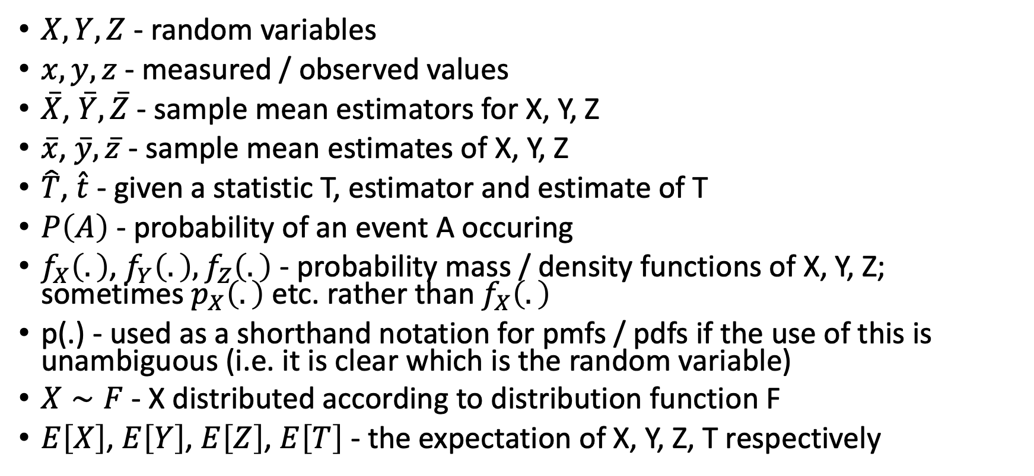
Notation
$X,Y,Z$ - random variables
$x,y,z$ - measured / observed values
$\overset{‾}{X}$, $\overset{‾}{Y},\overset{‾}{Z}$ - sample mean estimators for X, Y, Z
$\overset{‾}{x}$, $\overset{‾}{y},\overset{‾}{z}$ - sample mean estimates of X, Y, Z
$\hat{T}$, $\hat{t}$ - given a statistic T, estimator and estimate of T
$P\left(A\right)$ - probability of an event A occuring
$f_{X}\left(.\right)$, $f_{Y}\left(.\right),f_{Z}\left(.\right)$ - probability mass / density functions of X, Y, Z; sometimes $p_{X}\left(.\right)$ etc. rather than $f_{X}\left(.\right)$
p(.) - used as a shorthand notation for pmfs / pdfs if the use of this is unambiguous (i.e. it is clear which is the random variable)
$X∼F$ - X distributed according to distribution function F
$E\left[X\right]$, $E\left[Y\right]$, $E\left[Z\right]$, $E\left[T\right]$ - the expectation of X, Y, Z, T respectively

Slide 5
BAYESIAN INFERENCE: one-parameter models

Slide 6
Bayesian inference
Let’s start with an example (taken from Stone, J.V. (2013). “Bayes’ Rule: A Tutorial Introduction to Bayesian Analysis.”, Sebtel Press.).
You wake up one morning with spots all over your face. You are worried and go to the doctor. The doctor tells you that $90\%$ of people with smallpox present with spots on their face.
You are (naturally) very worried now as smallpox is a very serious disease (also: it has been eradicated since the 1980s).
However, more useful to know would be the probability of having smallpox.

Slide 7
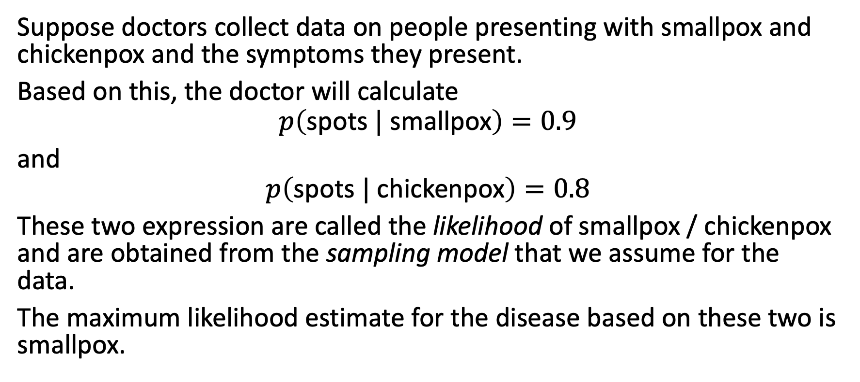
Bayesian inference
Suppose doctors collect data on people presenting with smallpox and chickenpox and the symptoms they present.
Based on this, the doctor will calculate
$$p\left(\text{spots} | \text{smallpox}\right)=0.9$$
and
$$p\left(\text{spots} | \text{chickenpox}\right)=0.8$$
These two expression are called the likelihood of smallpox / chickenpox and are obtained from the sampling model that we assume for the data.
The maximum likelihood estimate for the disease based on these two is smallpox.

Slide 8
Bayesian inference
However, smallpox is very rare and chickenpox more common.
The doctor also has the recorded prevalences for these two diseases; this is the prior knowledge:
$$p\left(\text{smallpox}\right)=0.001$$
and
$$p\left(\text{chickenpox}\right)=0.1$$
Further, the overall proportion of people with spots on their faces in the population, called the marginal likelihood or the evidence, is given by
$$p\left(\text{spots}\right)=0.081$$

Slide 9
Bayesian inference
Using Bayes’ Rule:
$$p\left(\text{smallpox} | \text{spots}\right)=\frac{p\left(\text{spots} | \text{smallpox}\right) p\left(\text{smallpox}\right)}{p\left(\text{spots}\right)}=\frac{0.9⋅0.001}{0.081}=0.0111$$
and
$$p\left(\text{chickenpox} | \text{spots}\right)=\frac{p\left(\text{spots} | \text{chickenpox}\right) p\left(\text{chickenpox}\right)}{p\left(\text{spots}\right)}=\frac{0.8⋅0.1}{0.081}=0.9877$$
While we cannot be certain, it is very likely that you have chickenpox, not smallpox and so you can relax.

Slide 10
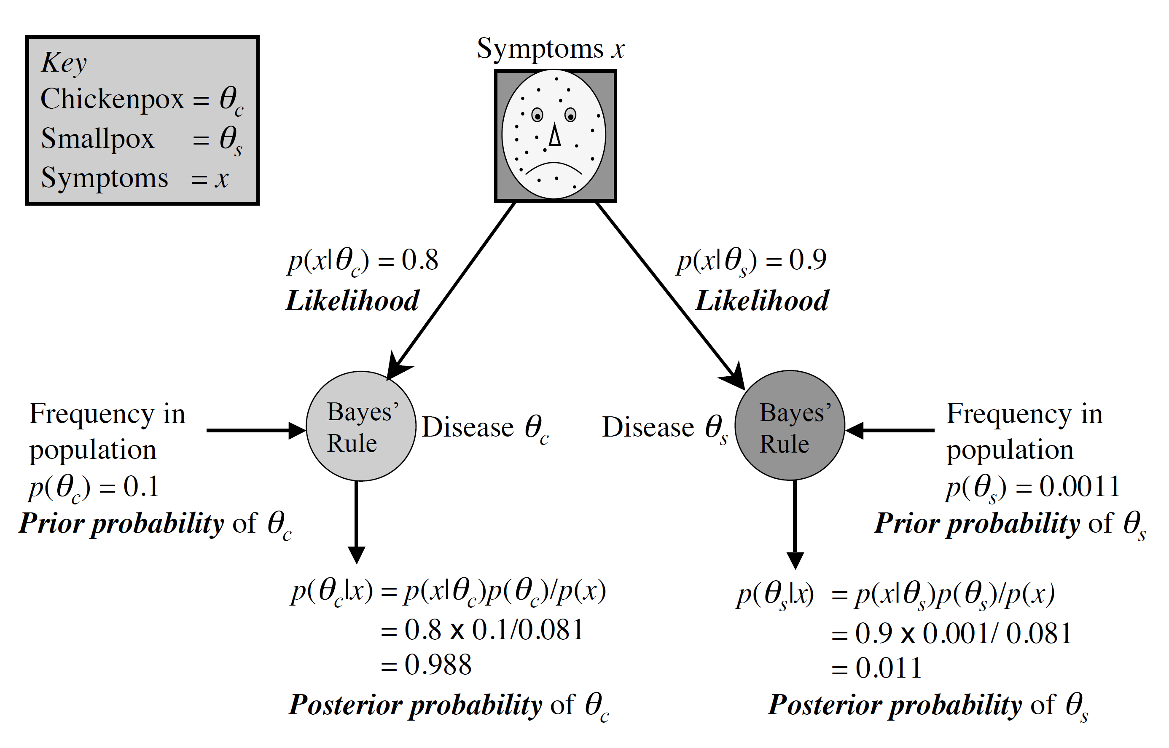
Bayesian inference
Reproduced from Stone, J.V. (2013). “Bayes’ Rule: A Tutorial Introduction to Bayesian Analysis”. Sebtel Press.

Slide 11
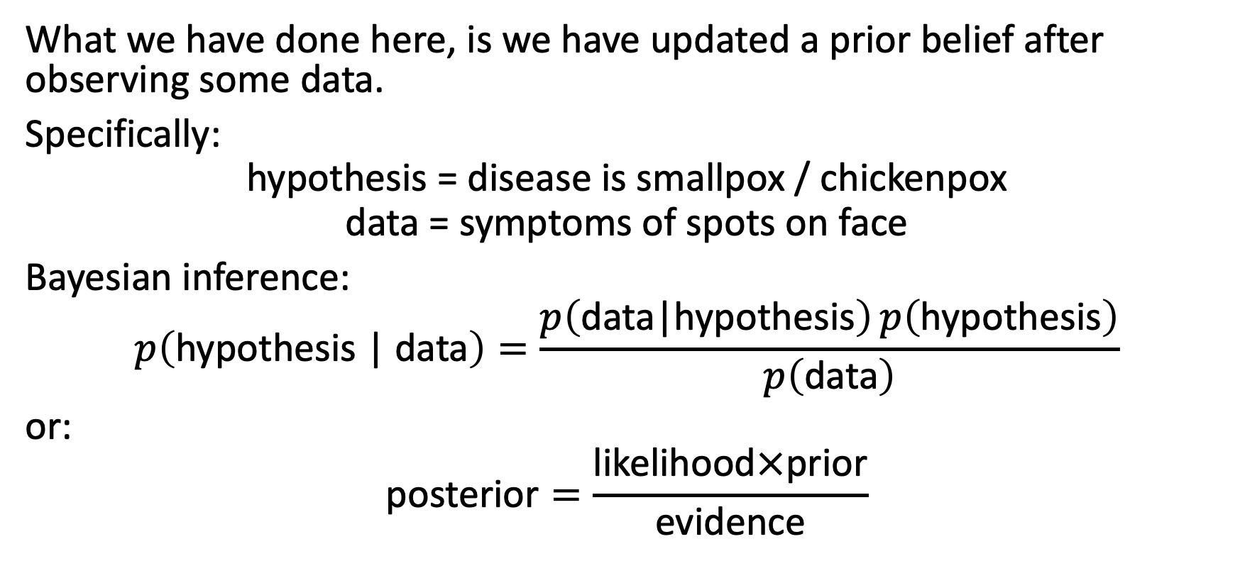
Bayesian inference
What we have done here, is we have updated a prior belief after observing some data.
Specifically:
$$\text{hypothesis}\text{ = }\text{disease} \text{is} \text{smallpox}\text{ / }\text{chickenpox}$$
$$\text{data}\text{ = }\text{symptoms} \text{of} \text{spots} \text{on} \text{face}$$
Bayesian inference:
$$p\left(\text{hypothesis}\text{ | }\text{data}\right)=\frac{p\left(\text{data}\text{|}\text{hypothesis}\right) p\left(\text{hypothesis}\right)}{p\left(\text{data}\right)}$$
or:
$$\text{posterior}=\frac{\text{likelihood}×\text{prior}}{\text{evidence}}$$

Slide 12
Bayesian inference
Often, the hypothesis can be framed as a statement about a parameter of interest $θ$. Writing $y$ for the data, we can write quite generally:
$$p\left(θ|y\right)=\frac{p\left(y|θ\right) p\left(θ\right)}{p\left(y\right)}$$
This leads to the probability density version of Bayes’ Rule, which underlies all of Bayesian statistics:
$$f_{Θ|Y=y}\left(θ|y\right)=\frac{f_{Y}\left(y|θ\right) f_{Θ}\left(θ\right)}{f_{Y}\left(y\right)}=\frac{f_{Y}\left(y|θ\right) f_{Θ}\left(θ\right)}{\int_{Ω_{θ}}^{​}{f_{Y|Θ=θ}}\left(y|θ\right) f_{Θ}\left(θ\right)dθ}$$

Slide 13
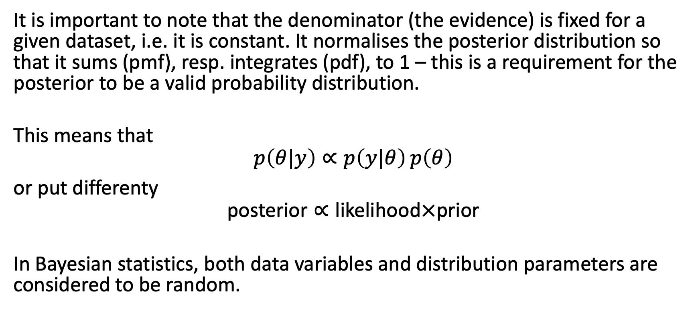
Bayesian inference
It is important to note that the denominator (the evidence) is fixed for a given dataset, i.e. it is constant. It normalises the posterior distribution so that it sums (pmf), resp. integrates (pdf), to 1 – this is a requirement for the posterior to be a valid probability distribution.
This means that
$$p\left(θ|y\right)∝p\left(y|θ\right) p\left(θ\right)$$
or put differenty
$$\text{posterior}∝\text{likelihood}×\text{prior}$$
In Bayesian statistics, both data variables and distribution parameters are considered to be random.

Slide 14
Example
Beta prior, binomial sampling model

Slide 15
Example (cont’d)
Suppose we interested in estimating the probability $π$ of heads of a particular coin.
As we have no reason to belief that the coin is biased, we may assume a prior distribution for $π$ which has maximum density at $π=0.5$.
One such distribution is the Beta(a=4,b=4) distribution.

Slide 16
Example (cont’d)
Recall that $Π∼\text{Beta}\left(a,b\right)$ for parameters $a>0,b>0$ if
$$p\left(π\right)=\left\{\begin{matrix}\frac{Γ\left(a+b\right)}{Γ\left(a\right)Γ\left(b\right)}π^{a−1}{\left(1−π\right)}^{b−1} & \text{if} π∈\left[0,1\right] \\ 0 & \text{otherwise}\end{matrix}\right.$$
where $Γ\left(α\right)=\int_{0}^{∞}{z^{α−1}}e^{−z}dz$ is the gamma function.
For simplicity, we will write $γ\left(a,b\right)=\frac{Γ\left(a,b\right)}{Γ\left(a\right)Γ\left(b\right)}$.

Slide 17
Example (cont’d)
Further, if $Π∼\text{Beta}\left(a,b\right)$:
$$E\left(Π\right)=\frac{a}{a+b}, Var\left(Π\right)=\frac{ab}{{\left(a+b\right)}^{2}\left(a+b+1\right)}$$
$$\text{mode}\left(Π\right)=\left\{\begin{matrix}\frac{a−1}{a+b−2} & \text{if} a>1,b>1 \\ \left[0,1\right]\text{ (}\text{any} \text{value}\text{)} & \text{if} a=b=1 \\ \{0,1\}\text{ (}\text{bimodal}\text{)} & \text{if} a<1,b<1 \\ 0 & \text{if} a≤1,b>1 \\ 1 & \text{if} a>1,b≤1\end{matrix}\right.$$

Slide 18
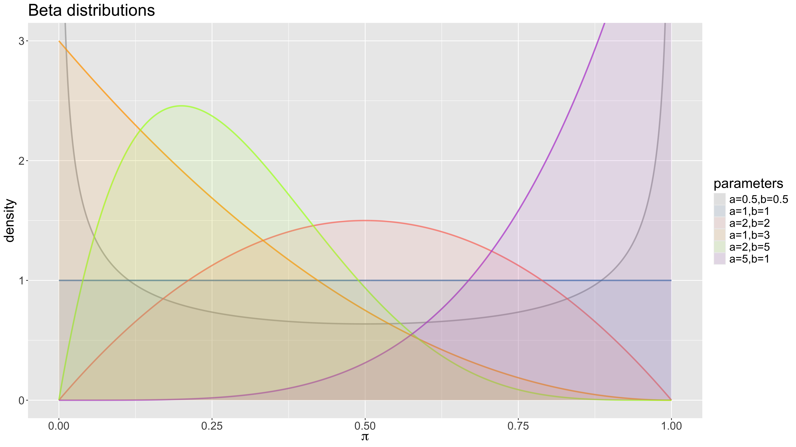
Example (cont’d)

Slide 19
Example (cont’d)
With $a=4$ and $b=4$, in our case the prior distribution becomes
$$p\left(π\right)=140⋅π^{3}⋅{\left(1−π\right)}^{3}$$
if $π∈\left[0,1\right]$ and $p\left(π\right)=0$ otherwise.

Slide 20
Example (cont’d)
Suppose the coin is flipped $n$ times and we observe $k$ heads.
The likelihood of observing these data, given $π$, is is obtained from the binomial distribution
Recall $Y∼\text{Bin}\left(n,π\right)$ for parameters $n∈\{0,1,2,…\}$ and $π∈\left[0,1\right]$ if
$$p\left(Y=k|π\right)=\left\{\begin{matrix}\left({n \atop k}\right)π^{k}{\left(1−π\right)}^{n−k} & \text{if} k∈\{0,1…,n\} \\ 0 & \text{otherwise}\end{matrix}\right.$$
And
$$E\left[Y|π\right]=nπ, Var\left(Y|π\right)=nπ\left(1−π\right), \text{mode}\left(Y|π\right)=⌊\left(n+1\right)p⌋$$

Slide 21
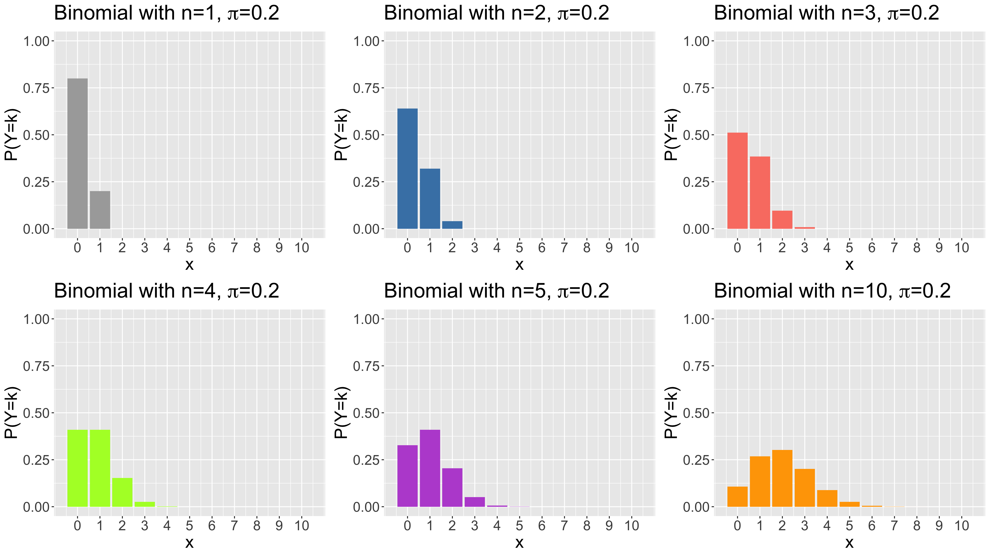
Example (cont’d)

Slide 22
Example (cont’d)
Suppose $n=6$, $k=2$, then the likelihood becomes
$$p\left(k=2|π\right)=\left({6 \atop 2}\right)π^{2}{\left(1−π\right)}^{4}$$

Slide 23
Example (cont’d)
Given the prior distribution
$$p\left(π\right)=140⋅π^{3}⋅{\left(1−π\right)}^{3}$$
and the likelihood
$$p\left(k=2|π\right)=\left({6 \atop 2}\right)⋅π^{2}⋅{\left(1−π\right)}^{4}$$
find the posterior distribution $p\left(π|k=2\right)$.

Slide 24
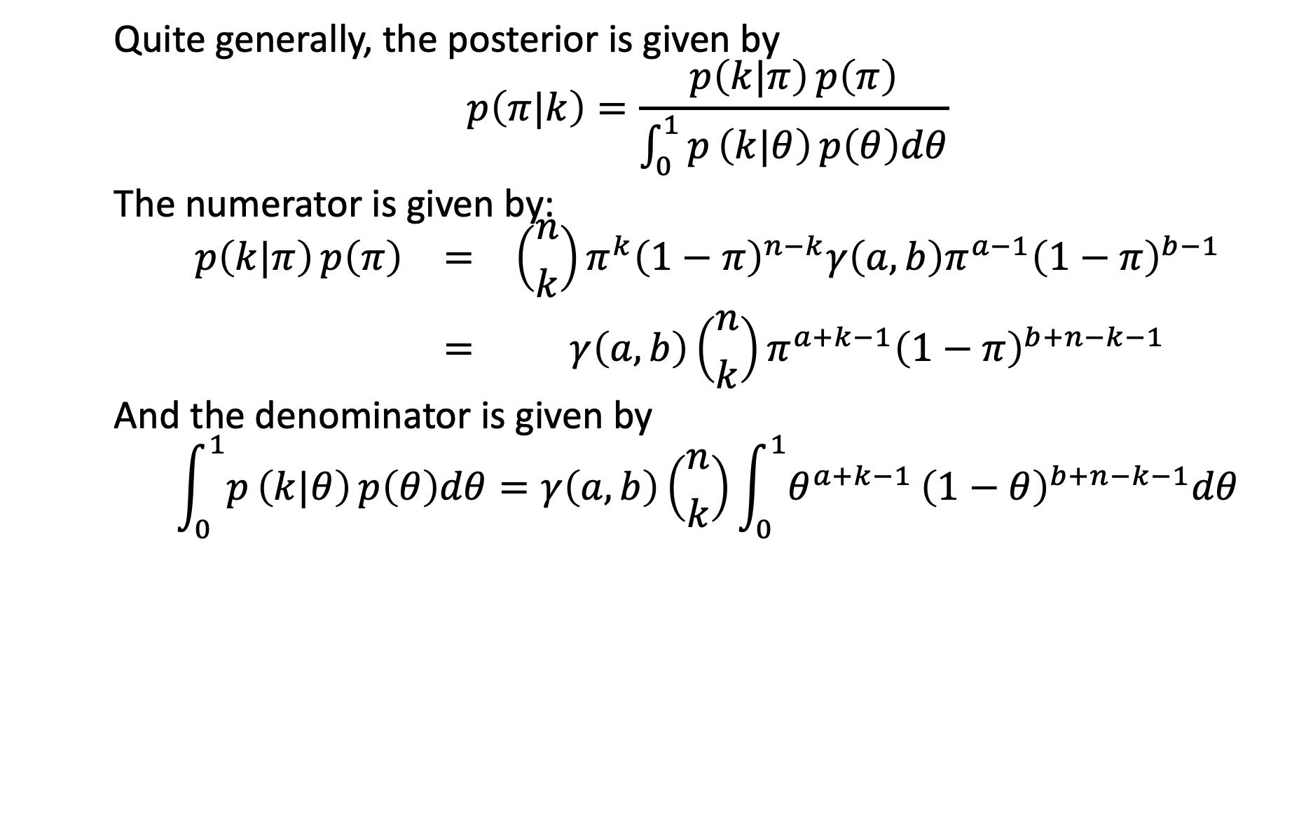
Example (cont’d)
Quite generally, the posterior is given by
$$p\left(π|k\right)=\frac{p\left(k|π\right) p\left(π\right)}{\int_{0}^{1}{p}\left(k|θ\right) p\left(θ\right)dθ}$$
The numerator is given by:
$$\begin{matrix}p\left(k|π\right) p\left(π\right) & = & \left({n \atop k}\right)π^{k}{\left(1−π\right)}^{n−k}γ\left(a,b\right)π^{a−1}{\left(1−π\right)}^{b−1} \\ & = & γ\left(a,b\right)\left({n \atop k}\right)π^{a+k−1}{\left(1−π\right)}^{b+n−k−1}\end{matrix}$$
And the denominator is given by
$$\int_{0}^{1}{p}\left(k|θ\right) p\left(θ\right)dθ=γ\left(a,b\right)\left({n \atop k}\right)\int_{0}^{1}{θ^{a+k−1}}{\left(1−θ\right)}^{b+n−k−1}dθ$$

Slide 25
Example (cont’d)
To solve this integral, make use of the fact that the Beta($α$,$β$) distribution needs to integrate to 1 for it to be a valid probability distribution:
$$\begin{matrix} & \int_{0}^{1}{\frac{Γ\left(α+β\right)}{Γ\left(α\right)Γ\left(β\right)}}θ^{α−1}{\left(1−θ\right)}^{β−1}dθ & = & 1 \\ ⇒ & \int_{0}^{1}{θ^{α−1}}{\left(1−θ\right)}^{β−1}dθ & = & \frac{Γ\left(α\right)Γ\left(β\right)}{Γ\left(α+β\right)}\end{matrix}$$
Writing $α=a+k$ and $β=b+n−k$, we see that
$$\int_{0}^{1}{θ^{a+k−1}}{\left(1−θ\right)}^{b+n−k−1}dθ=\frac{Γ\left(a+k\right)Γ\left(b+n−k\right)}{Γ\left(a+b+n\right)}$$

Slide 26
Example (cont’d)
Therefore, the posterior density for $π$ is given by
$$\begin{matrix}p\left(π|k\right) & = & \frac{γ\left(a,b\right)\left({n \atop k}\right)π^{a+k−1}{\left(1−π\right)}^{b+n−k−1}}{γ\left(a,b\right)\left({n \atop k}\right)\frac{Γ\left(a+k\right)Γ\left(b+n−k\right)}{Γ\left(a+b+n\right)}} \\ & & \\ & = & \frac{Γ\left(a+b+n\right)}{Γ\left(a+k\right)Γ\left(n−k+b\right)}π^{a+k−1}{\left(1−π\right)}^{b+n−k−1}\end{matrix}$$
which is a Beta($a+k$,$b+n−k$) distribution.

Slide 27
Example (cont’d)
Filling in $k=2$, $n=6$, $a=4$, $b=4$, we get a Beta(6,8) distribution:
$$p\left(π|k=2\right)=10296⋅π^{5}⋅{\left(1−π\right)}^{7}$$
for $π∈\left[0,1\right]$.
Note: Remember that $Γ\left(m\right)=\left(m−1\right)!$ for $m=0,1,2,…$ .

Slide 28
Example (cont’d)
So we see that
$$\left\{\begin{matrix}\text{prior} p\left(π\right) & =\text{Beta}\left(a,b\right) \\ & \\ \text{likelihood} p\left(k|π\right) & =\text{Bin}\left(n,π\right)\end{matrix}\right.$$
$$⇒\text{posterior} p\left(π|k\right)=\text{Beta}\left(a+k,b+n−k\right)$$

Slide 29
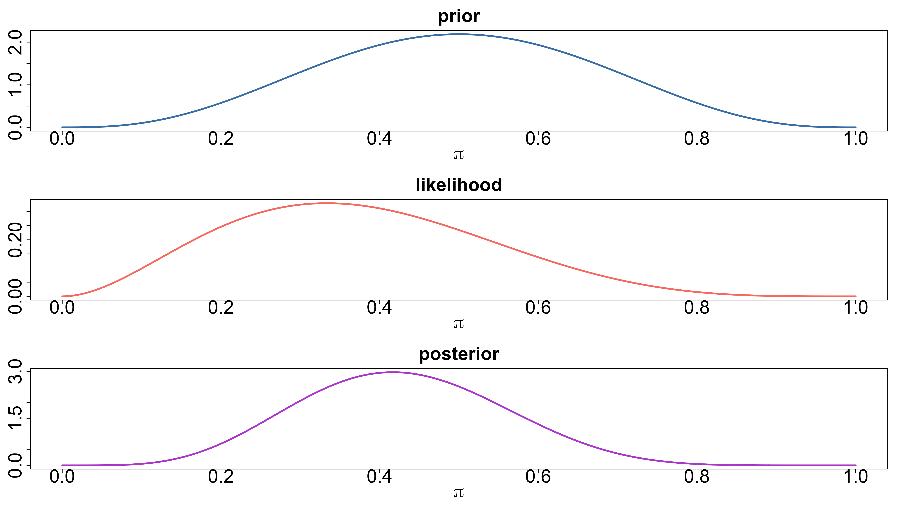
Example (cont’d)

Slide 30
Example (cont’d)
Unlike frequentist statistics, where we would have obtained a point estimate $\hat{π}$, Bayesian statistics yield a posterior distribution for $π$.
We can still come up with a point estimate by, e.g., finding the value of $π$ for which the posterior distribution achieves its maximum (assuming this exists and is unique). This is called maximum a posteriori (MAP) estimation.
There are other point estimators we could use: e.g. the expectation of the posterior distribution $E\left[p\left(π|k\right)\right]$.
We will get back to this later.

Slide 31
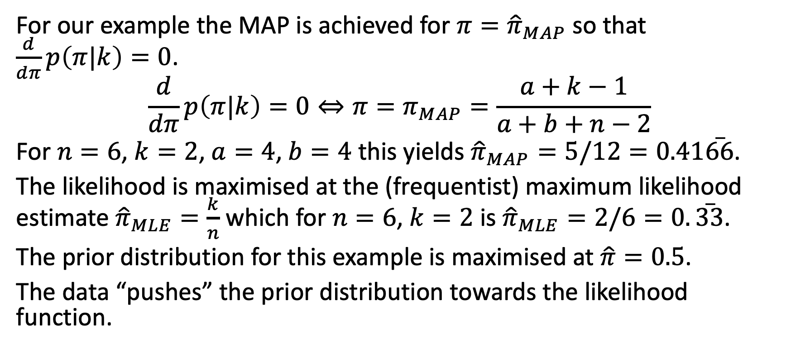
Example (cont’d)
For our example the MAP is achieved for $π={\hat{π}}_{MAP}$ so that $\frac{d}{dπ}p\left(π|k\right)=0$.
$$\frac{d}{dπ}p\left(π|k\right)=0⇔π=π_{MAP}=\frac{a+k−1}{a+b+n−2}$$
For $n=6$, $k=2$, $a=4$, $b=4$ this yields ${\hat{π}}_{MAP}=5/12=0.41\overset{‾}{66}$.
The likelihood is maximised at the (frequentist) maximum likelihood estimate ${\hat{π}}_{MLE}=\frac{k}{n}$ which for $n=6$, $k=2$ is ${\hat{π}}_{MLE}=2/6=0.\overset{‾}{33}$.
The prior distribution for this example is maximised at $\hat{π}=0.5$.
The data “pushes” the prior distribution towards the likelihood function.

Slide 32
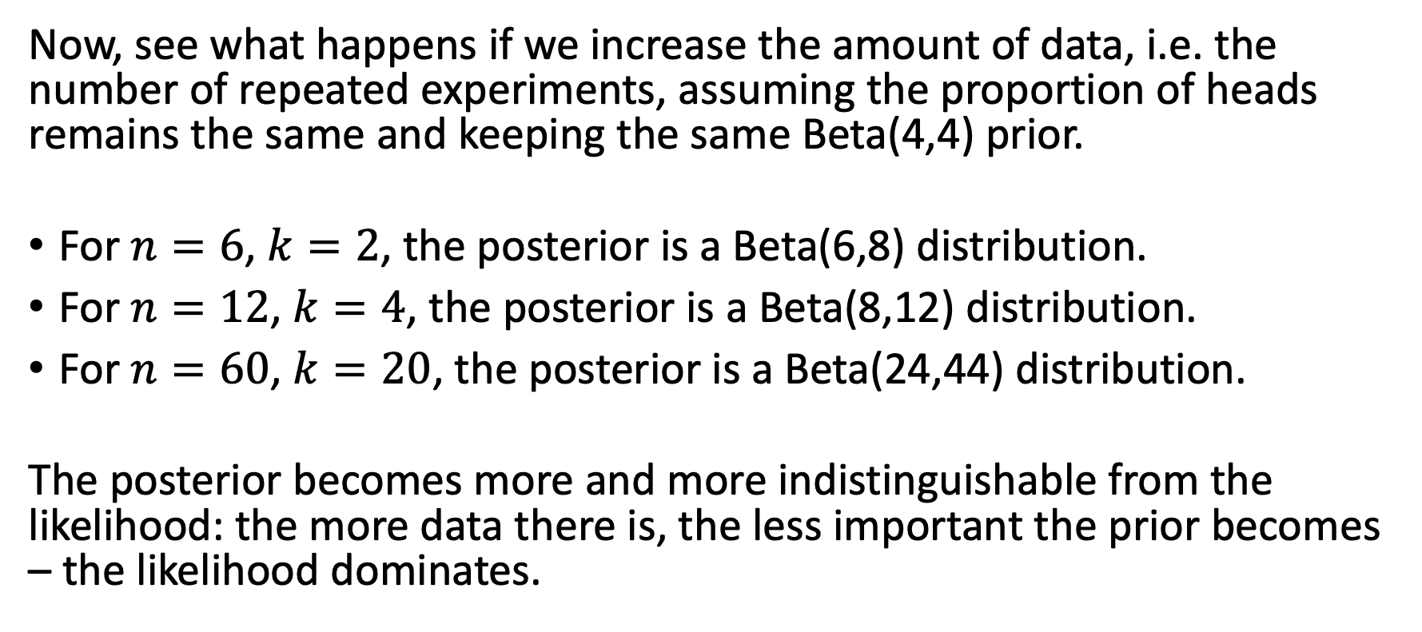
Example (cont’d)
Now, see what happens if we increase the amount of data, i.e. the number of repeated experiments, assuming the proportion of heads remains the same and keeping the same Beta(4,4) prior.
For $n=6$, $k=2$, the posterior is a Beta(6,8) distribution.
For $n=12$, $k=4$, the posterior is a Beta(8,12) distribution.
For $n=60$, $k=20$, the posterior is a Beta(24,44) distribution.
The posterior becomes more and more indistinguishable from the likelihood: the more data there is, the less important the prior becomes – the likelihood dominates.

Slide 33
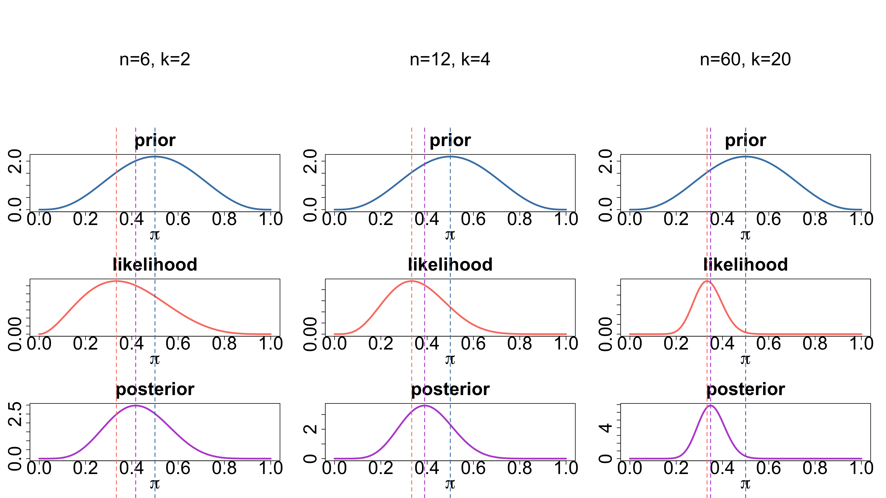
Example (cont’d)

Slide 34
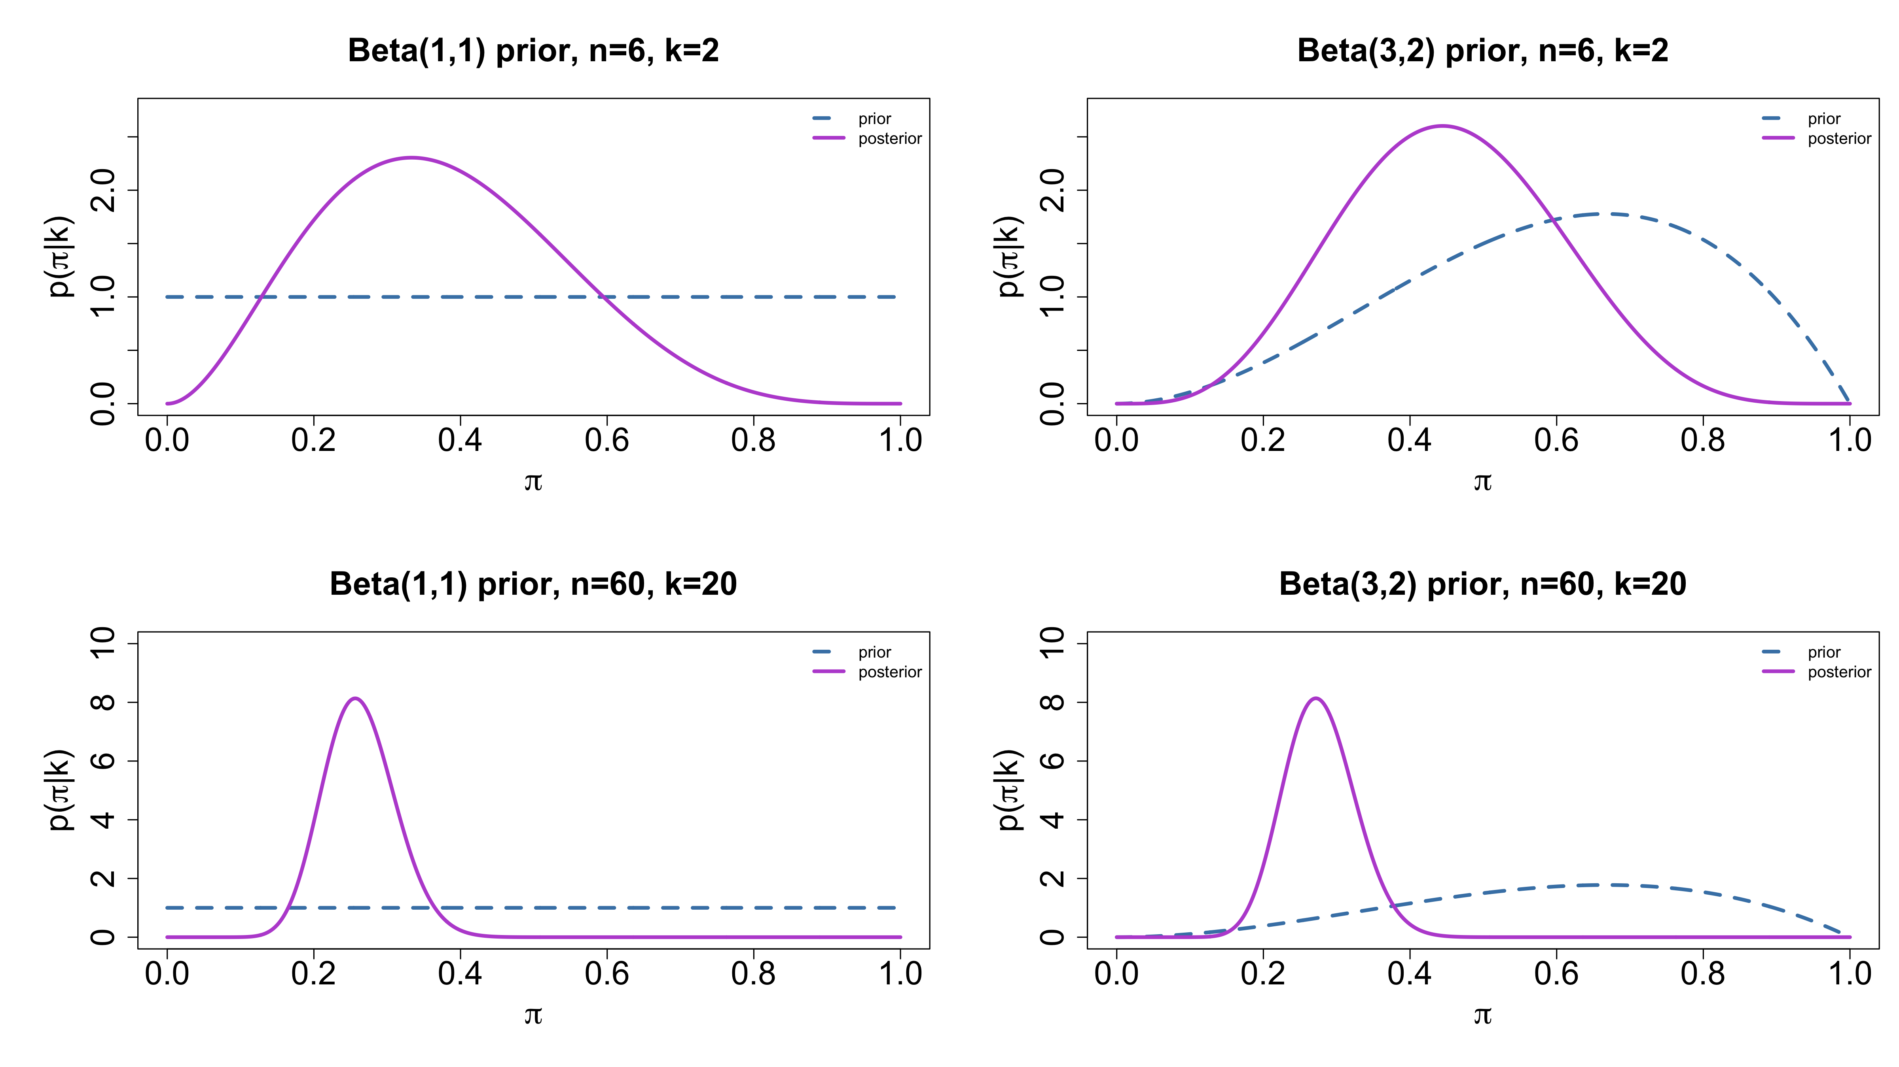
Example (cont’d): posteriors for 4 different prior & sample size combinations

Slide 35
Example
Discrete prior, binomial sampling model

Slide 36
Example (cont’d)
That the likelihood dominates the prior for large datasets is not fully true: where the prior distribution (whether it’s a pdf or a pmf) is zero, the posterior distribution is also zero – no matter how much data. This follows from
$$p\left(θ|y\right)∝p\left(y|θ\right) p\left(θ\right)$$
Among others, this means that a discrete prior leads to a discrete posterior distribution.

Slide 37
Example (cont’d)
Let’s return to the same coin throwing experiment. Suppose that rather than a Beta(a,b) prior, we know that the coin used for the experiment can only be one of 6 coins: 3 are biased towards heads with $π=P\left(\text{heads}\right)=0.8$, 2 are biased towards tails with $π=0.3$ and 1 coin is fair with $π=0.5$. Assuming each coin to be equally likely to be picked, this gives the following prior distribution for $π$:
$$p\left(π\right)=\left\{\begin{matrix}1/3=0.\overset{‾}{33} & \text{if} π=0.3 \\ 1/6=0.1\overset{‾}{66} & \text{if} π=0.5 \\ 1/2=0.5 & \text{if} π=0.8\end{matrix}\right.$$

Slide 38
Example (cont’d)
The likelihood is still given by the binomial distribution:
$$p\left(k|π\right)=\left({n \atop k}\right)π^{k}{\left(1−π\right)}^{n−k}$$
Here we have $n=6$ and $k=2$.
This can be written down / computed using tables.

Slide 39
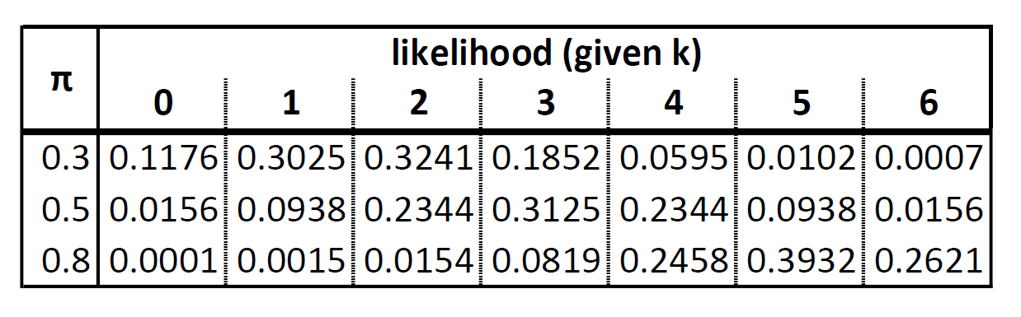
Example (cont’d)

Slide 40
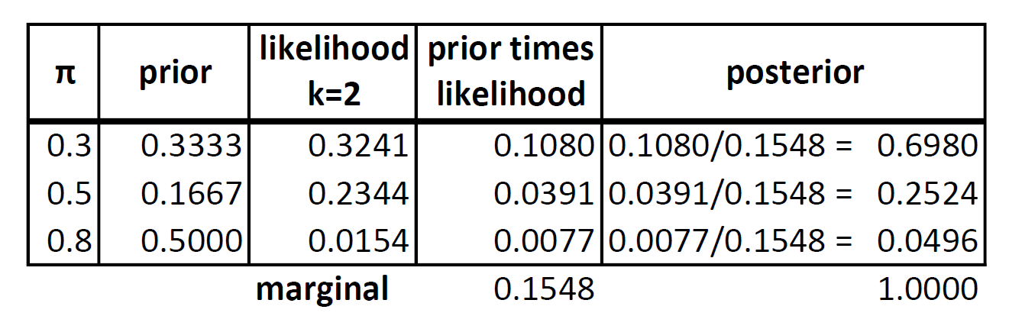
Example (cont’d)

Slide 41
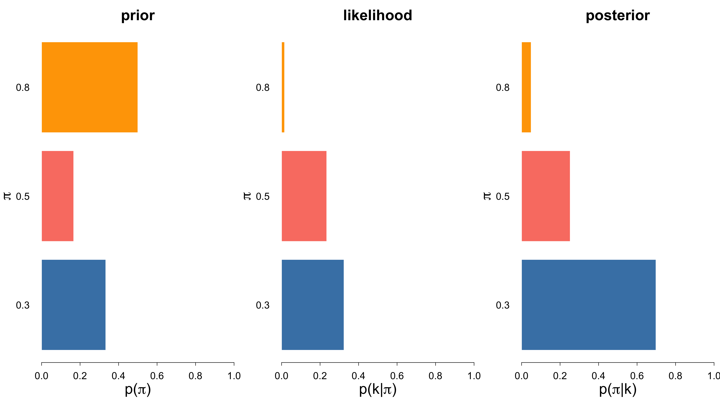
Example (cont’d)

Slide 42
Binomial = sum of n iid Bernoulli experiments
Recall that the binomial distribution results from $n$ independent trials of binary experiments with probability parameter $π$.
The coin toss example was in fact based on repeated binary / Bernoulli experiments.
We used the binomial distribution, because the sum of successes is a sufficient statistic for $π$, i.e. it contains all the information we need to make inference about $π$.

Slide 43
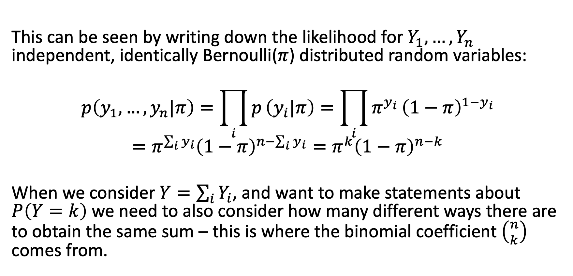
Binomial = sum of n iid Bernoulli experiments
This can be seen by writing down the likelihood for $Y_{1},…,Y_{n}$ independent, identically Bernoulli($π$) distributed random variables:
$$p\left(y_{1},…,y_{n}|π\right)=\prod_{i}^{​}{p}\left(y_{i}|π\right)=\prod_{i}^{​}{π^{y_{i}}}{\left(1−π\right)}^{1−y_{i}}=π^{\sum_{i}^{​}{y_{i}}}{\left(1−π\right)}^{n−\sum_{i}^{​}{y_{i}}}=π^{k}{\left(1−π\right)}^{n−k}$$
When we consider $Y=\sum_{i}^{​}{Y_{i}}$, and want to make statements about $P\left(Y=k\right)$ we need to also consider how many different ways there are to obtain the same sum – this is where the binomial coefficient $\left({n \atop k}\right)$ comes from.

Slide 44
Example (beta prior, binomial sampling model)
Let’s return the the example where $π∼\text{Beta}\left(a,b\right)$ and $k|π∼\text{Bin}\left(n,π\right)$.
The posterior distribution $p\left(π|k\right)$ allows us to make inference about $π$ after observing the data $Y=\sum_{i}^{​}{Y_{i}}=k$.
However we can also make inference about future data ${\tilde{Y}}_{n+1}$.
For this we need to derive the posterior predictive distribution $p\left({\tilde{Y}}_{n+1}|k\right)=p\left({\tilde{Y}}_{n+1}|y_{1},…,y_{n}\right)$.

Slide 45
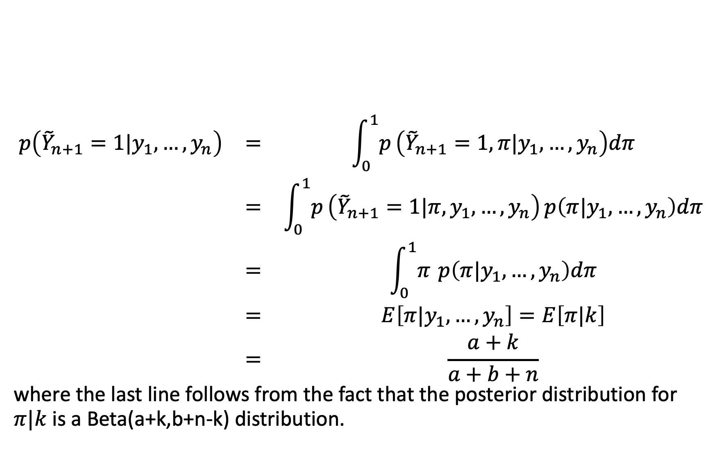
Example (cont’d)
$$\begin{matrix}p\left({\tilde{Y}}_{n+1}=1|y_{1},…,y_{n}\right) & = & \int_{0}^{1}{p}\left({\tilde{Y}}_{n+1}=1,π|y_{1},…,y_{n}\right)dπ \\ & = & \int_{0}^{1}{p}\left({\tilde{Y}}_{n+1}=1|π,y_{1},…,y_{n}\right) p\left(π|y_{1},…,y_{n}\right)dπ \\ & = & \int_{0}^{1}{π} p\left(π|y_{1},…,y_{n}\right)dπ \\ & = & E\left[π|y_{1},…,y_{n}\right]=E\left[π|k\right] \\ & = & \frac{a+k}{a+b+n}\end{matrix}$$
where the last line follows from the fact that the posterior distribution for $π|k$ is a Beta(a+k,b+n-k) distribution.

Slide 46
Example (cont’d)
It follows that
$$\begin{matrix}p\left({\tilde{Y}}_{n+1}=0|y_{1},…,y_{n}\right) & = & 1−p\left({\tilde{Y}}_{n+1}=1|y_{1},…,y_{n}\right) \\ & & \\ & = & \frac{b+n−k}{a+b+n}\end{matrix}$$

Slide 47
Example (cont’d)
Note that
The posterior predictive distribution does not depend on any unknown quantities (otherwise we would not be able to use it to make predictions).
The posterior predictive distribution depends on observed data. This may seem to violate the exchangeability condition. But this is for future data. The past data $y_{1},…,y_{n}$ provide information about $π$ and this in turn provides information about ${\tilde{Y}}_{n+1}$. If this was not the case, we would not be able to infer anything about the unsampled population given the sampled cases.

Slide 48
PRIOR DISTRIBUTIONS

Slide 49
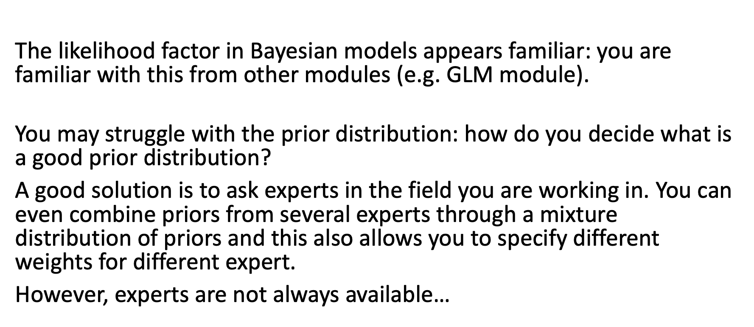
Prior distributions
The likelihood factor in Bayesian models appears familiar: you are familiar with this from other modules (e.g. GLM module).
You may struggle with the prior distribution: how do you decide what is a good prior distribution?
A good solution is to ask experts in the field you are working in. You can even combine priors from several experts through a mixture distribution of priors and this also allows you to specify different weights for different expert.
However, experts are not always available…

Slide 50
Prior distributions: informative & weakly informative priors
In the first coin toss experiment we used a Beta(4,4) distribution. We argued this was appropriate since it had highest density at $π=0.5$ which reflected our prior belief that there is little reason to assume the coin is not well balanced.
Clearly this was informative: the prior distribution the prior expressed specific, definite information about $π$ and favoured $π=0.5$.
But a Beta(2,2) and a Beta(8,8) would also have had highest density at $π=0.5$.

Slide 51
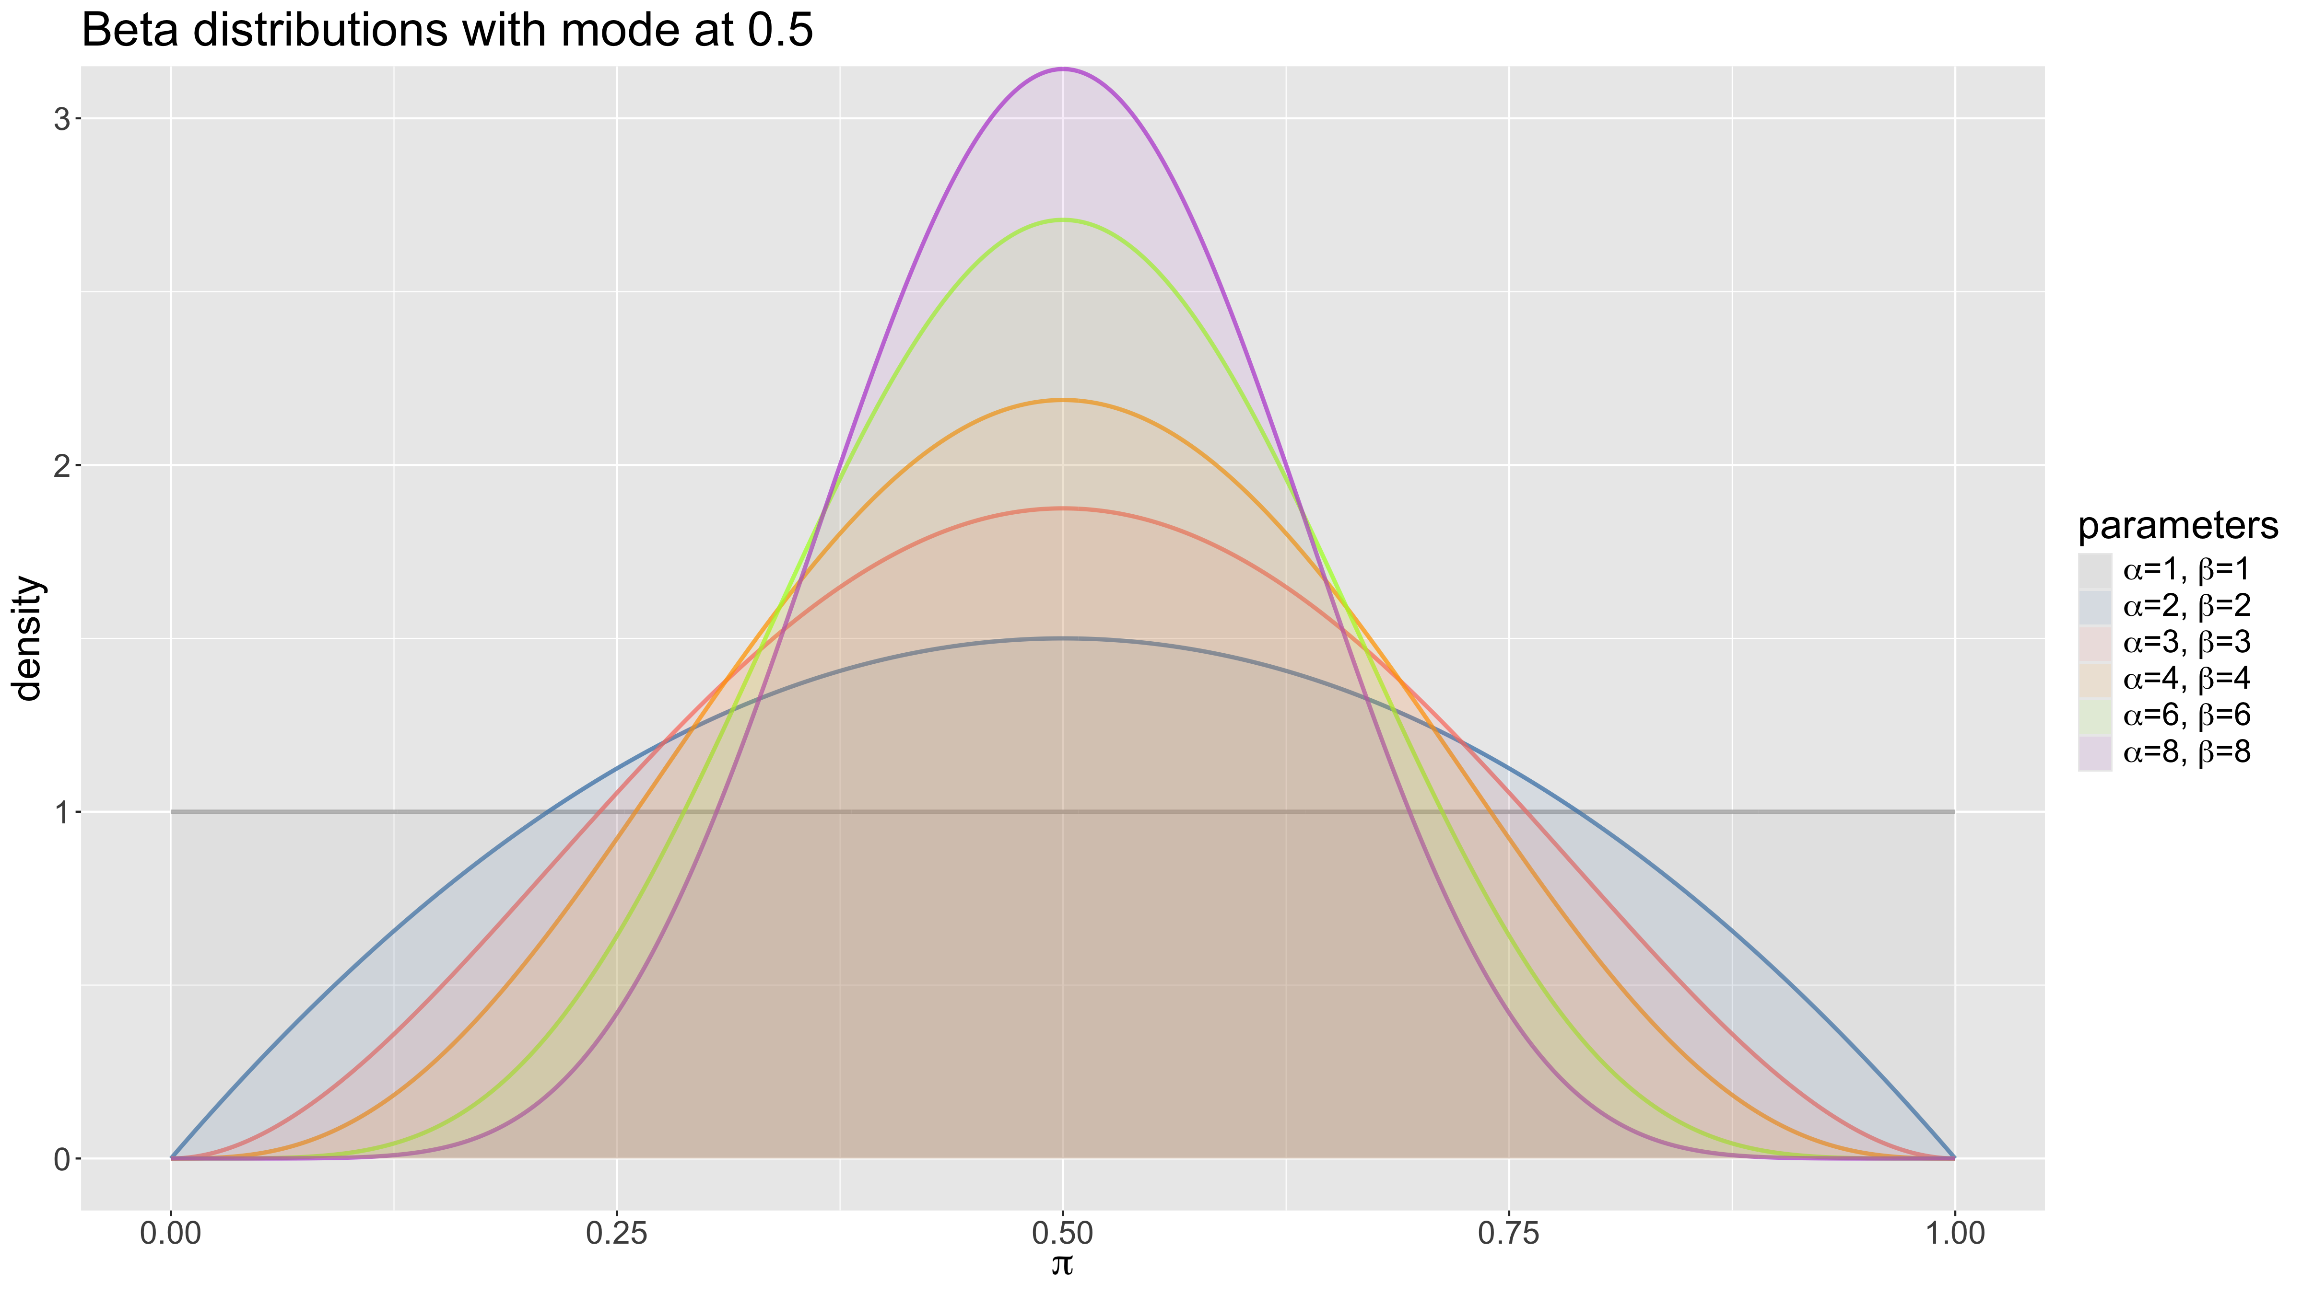
Prior distributions: informative & weakly informative priors

Slide 52
Prior distributions: informative & vague priors
Depending on how sure we are, we can go for a more peaked distribution.
If we have no prior knowledge at all, you could also argue that all values of $π$ are equally likely. This would justify a uniform(0,1) distribution.
A prior distribution which expresses only general or vague information about a parameter is called weakly informative, vague or diffuse prior.
Note that assuming all possible values for a parameter to be equally likely is not, strictly speaking, equivalent to being completely ignorant.
Note: Beta(1,1) = Uniform(0,1).

Slide 53
Prior distributions: informative & vague priors
How do you come up with a vague prior?
Easy in the case of the discrete or continuous uniform distribution, but this does not work for discrete distributions with an infinity of possible values or a continuous distributions over an open-ended interval.
Solution: choose priors with an objective mean / median and large variance, e.g. $𝒩\left(0,10\right)$.
Such priors are called weakly informative and are very useful for regularisation, i.e. to keep inferences in a reasonable range.

Slide 54
Prior distributions: Jeffreys prior
Sir Harold Jeffreys devised a general rule for generating an objective or vague priors for a sampling model $p\left(y|θ\right)$. The Jeffreys prior is given by
$$p_{J}\left(θ\right)∝\sqrt{I\left(θ\right)}$$
where $I\left(θ\right)=−E\left[\left.\frac{δ^{2}}{δθ^{2}}log p\left(X|θ\right)\right|θ\right]$ is the Fisher information.
This can lead to prior distributions which are not actually probability distributions. These are called improper priors (see practical).
An important property of Jeffreys priors is that they are invariant under transformation.

Slide 55
Prior distributions: Jeffreys prior
Example
Let $Y∼Bin\left(n,θ\right)$. Derive $p_{J}\left(θ\right)$.

Slide 56
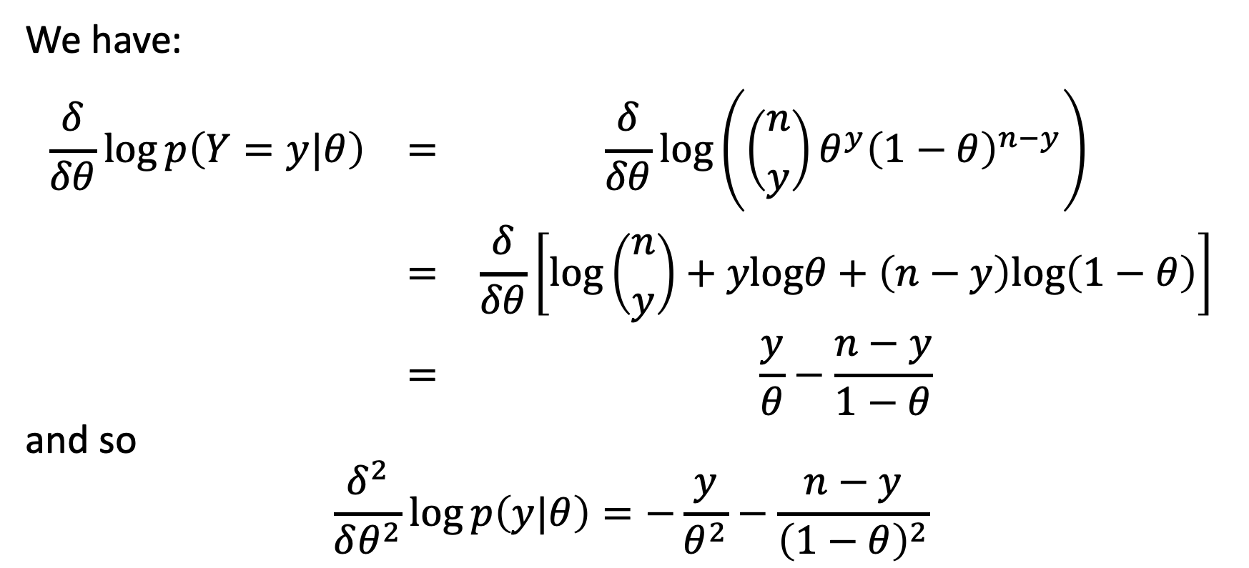
Prior distributions: Jeffreys prior
We have:
$$\begin{matrix}\frac{δ}{δθ}log p\left(Y=y|θ\right) & = & \frac{δ}{δθ}log\left(\left({n \atop y}\right)θ^{y}{\left(1−θ\right)}^{n−y}\right) \\ & = & \frac{δ}{δθ}\left[log\left({n \atop y}\right)+ylogθ+\left(n−y\right)log\left(1−θ\right)\right] \\ & = & \frac{y}{θ}−\frac{n−y}{1−θ}\end{matrix}$$
and so
$$\frac{δ^{2}}{δθ^{2}}log p\left(y|θ\right)=−\frac{y}{θ^{2}}−\frac{n−y}{{\left(1−θ\right)}^{2}}$$

Slide 57
Prior distributions: Jeffreys prior
Hence:
$$J\left(θ\right)=−E\left[−\frac{y}{θ^{2}}−\frac{n−y}{1−θ}\right]=\frac{E\left[Y|θ\right]}{θ^{2}}+\frac{n−E\left[Y|θ\right]}{{\left(1−θ\right)}^{2}}$$
Note that $Y∼Bin\left(n,θ\right)⇒E\left[Y|θ\right]=nθ$:
$$J\left(θ\right)=\frac{nθ}{θ^{2}}+\frac{n−nθ}{{\left(1−θ\right)}^{2}}=\frac{n}{θ}+\frac{n}{1−θ}=\frac{n}{θ\left(1−θ\right)}$$

Slide 58
Prior distributions: Jeffreys prior
Therefore:
$$p_{J}\left(θ\right)∝\sqrt{\frac{n}{θ\left(1−θ\right)}}$$
In other words:
$$p_{J}\left(θ\right)∝θ^{−1/2}{\left(1−θ\right)}^{−1/2}$$
If $θ∼\text{Beta}\left(\frac{1}{2},\frac{1}{2}\right)$, then $p\left(θ\right)=\frac{Γ\left(1\right)}{Γ\left(\frac{1}{2}\right)Γ\left(\frac{1}{2}\right)}θ^{−1/2}{\left(1−θ\right)}^{−1/2}$.
Therefore, if $X∼Bin\left(n,θ\right)$, then the Jeffreys prior distribution for $θ$ is a Beta$\left(\frac{1}{2},\frac{1}{2}\right)$ distribution. This prior is proper.

Slide 59
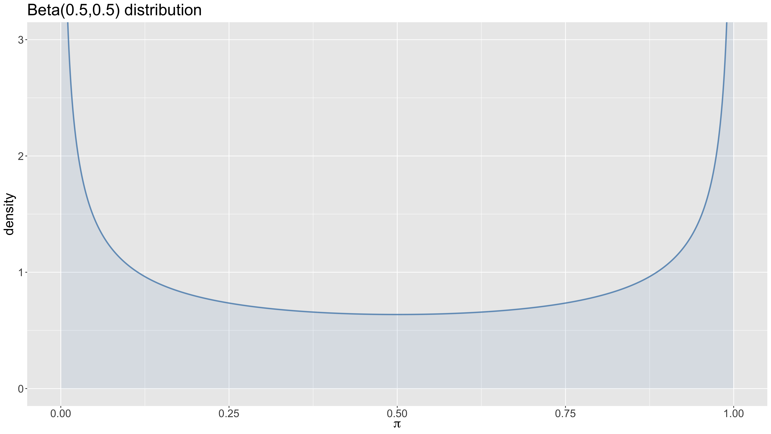
Prior distributions: Jeffreys prior

Slide 60
Prior distributions: Conjugate priors
We can also choose a family of prior distribution for mathematical simplicity.
We saw earlier that
$$\text{beta} \text{prior} + \text{binomial} \text{sampling} \text{model} ⇒ \text{beta} \text{posterior}$$
This is called conjugacy: the beta distribution is the conjugate distribution for a binomial sample model.

Slide 61
Prior distributions: Conjugate priors
Formally we can define:
A class $𝒫$ of prior probability distributions is called conjugate for a sampling model $p\left(y|θ\right)$ if
$$p\left(θ\right)∈𝒫 ⇒ p\left(θ|y\right)∈𝒫$$

Slide 62
Example
Gamma prior, Poisson sampling model

Slide 63
Example (cont’d)
Recall that if $Y∼\text{Pois}\left(λ\right)$, then
$$\left\{\begin{matrix}P\left(Y=k|λ\right) & =\frac{λ^{k}e^{−λ}}{k!} & \text{if} k=0,1,2… \text{and}\text{ 0 }\text{otherwise} \\ E\left[Y|λ\right] & =λ & \\ Var\left(Y|λ\right) & =λ & \end{matrix}\right.$$

Slide 64
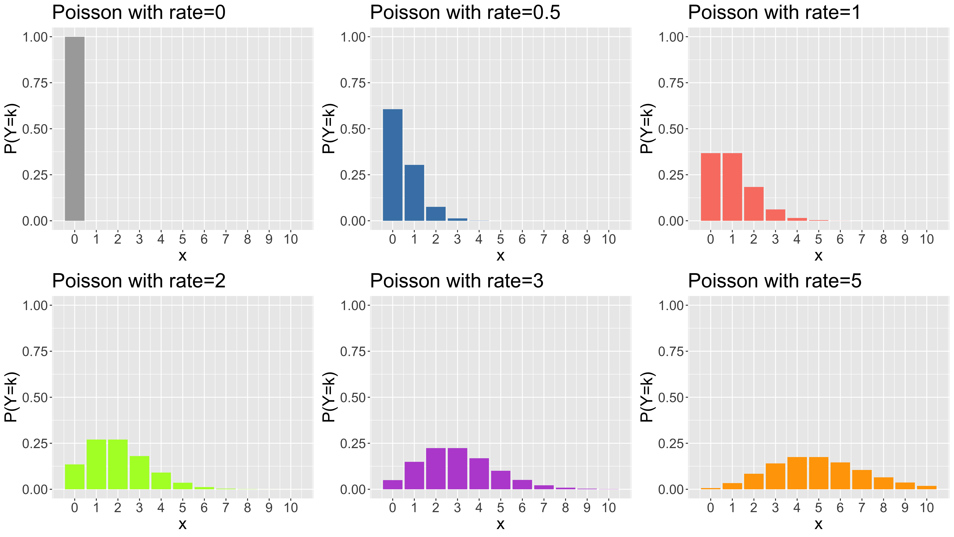
Example (cont’d)

Slide 65
Example (cont’d)
Suppose $Y_{i}∼_{\text{iid}}\text{Pois}\left(λ\right)$, $i=1,…,n$ and we observe data $y_{1},…,y_{n}$.
The joint pdf of the data is given by
$$\begin{matrix}p\left(y_{1},…,y_{n}|λ\right) & = & \prod_{i=1}^{n}{p}\left(y_{i}|λ\right) \\ & = & \prod_{i=1}^{n}{\frac{1}{y_{i}!}}λ^{y_{i}}e^{−λ} \\ & = & \frac{1}{\prod_{i}^{​}{y_{i}}!}λ^{\sum_{i}^{​}{y_{i}}}e^{−nλ}\end{matrix}$$

Slide 66
Example (cont’d)
The factor $\frac{1}{\prod_{i}^{​}{y_{i}}!}$ is constant for each dataset. So if we compare densities for different values of $λ$, this factor will cancel out. All information about $λ$ is therefore contained in $\sum_{i}^{​}{y_{i}}$ (as was the case for the i.i.d. binary data).
$\sum_{i}^{​}{y_{i}}$ is a sufficient statistic for the parameter $λ$ in the Poisson sampling model.

Slide 67
Example (cont’d)
Posterior density
If we assume a prior distribution $p\left(λ\right)$, then the posterior density for $λ$ given the data is given by
$$\left\{\begin{matrix}p\left(λ|y_{i},…,y_{n}\right) & ∝ & p\left(λ\right) p\left(y_{1},…,y_{n}|λ\right) \\ & ∝ & p\left(λ\right) λ^{∑y_{i}}e^{−nλ}\end{matrix}\right.$$
If we want $p\left(λ\right)$ to be conjugate for the Poisson sampling model, i.e. we want $p\left(λ|y_{1},…,y_{n}\right)$ to be in the same family of distributions as $p\left(λ\right)$, then the above implies that $p\left(λ\right)$ needs to include terms of the form $λ^{c_{1}}e^{−c_{2}λ}$.

Slide 68
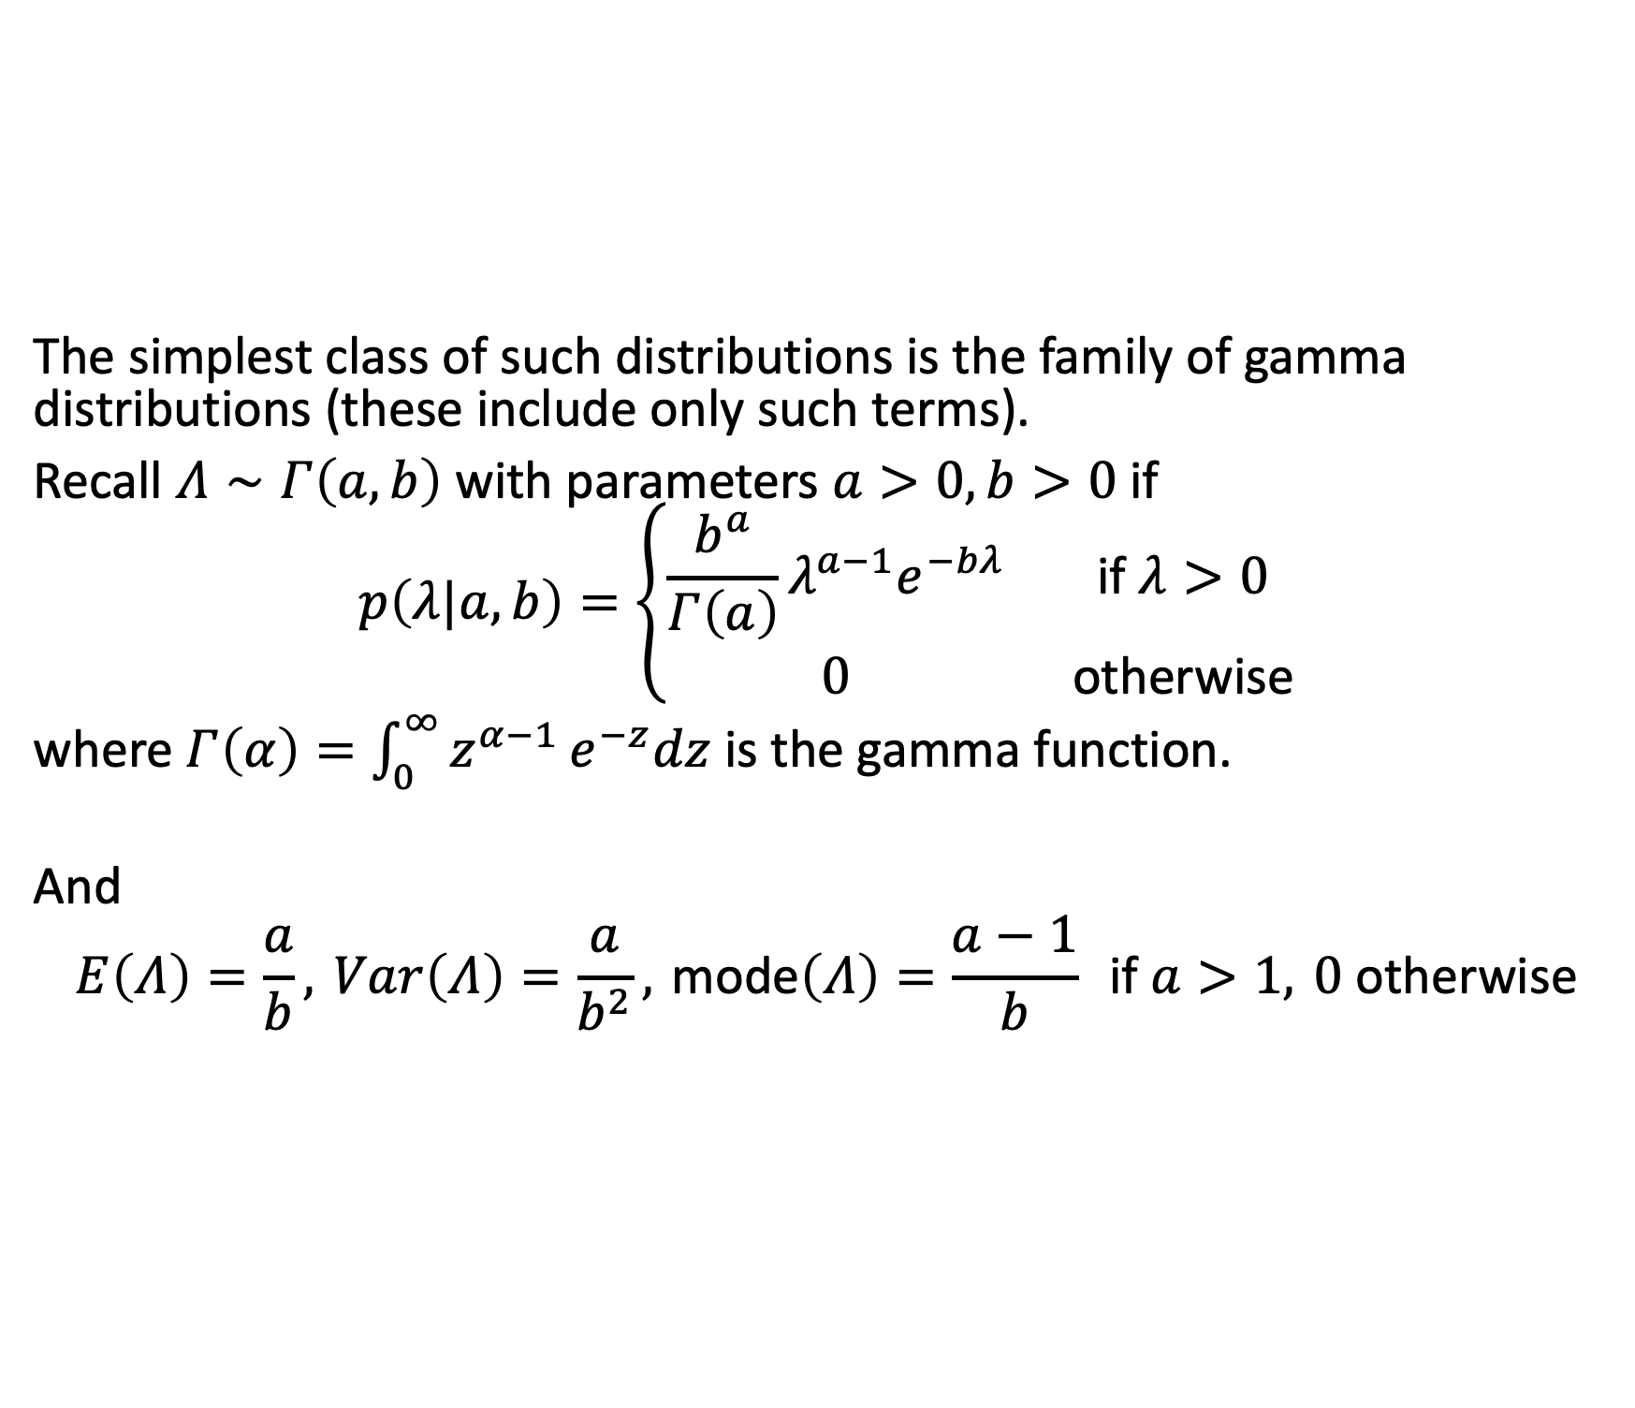
Example (cont’d)
The simplest class of such distributions is the family of gamma distributions (these include only such terms).
Recall $Λ∼Γ\left(a,b\right)$ with parameters $a>0,b>0$ if
$$p\left(λ|a,b\right)=\left\{\begin{matrix}\frac{b^{a}}{Γ\left(a\right)}λ^{a−1}e^{−bλ} & \text{if} λ>0 \\ 0 & \text{otherwise}\end{matrix}\right.$$
where $Γ\left(α\right)=\int_{0}^{∞}{z^{α−1}}e^{−z}dz$ is the gamma function.
And
$$E\left(Λ\right)=\frac{a}{b}, Var\left(Λ\right)=\frac{a}{b^{2}}, \text{mode}\left(Λ\right)=\frac{a−1}{b} \text{if} a>1, 0 \text{otherwise}$$

Slide 69
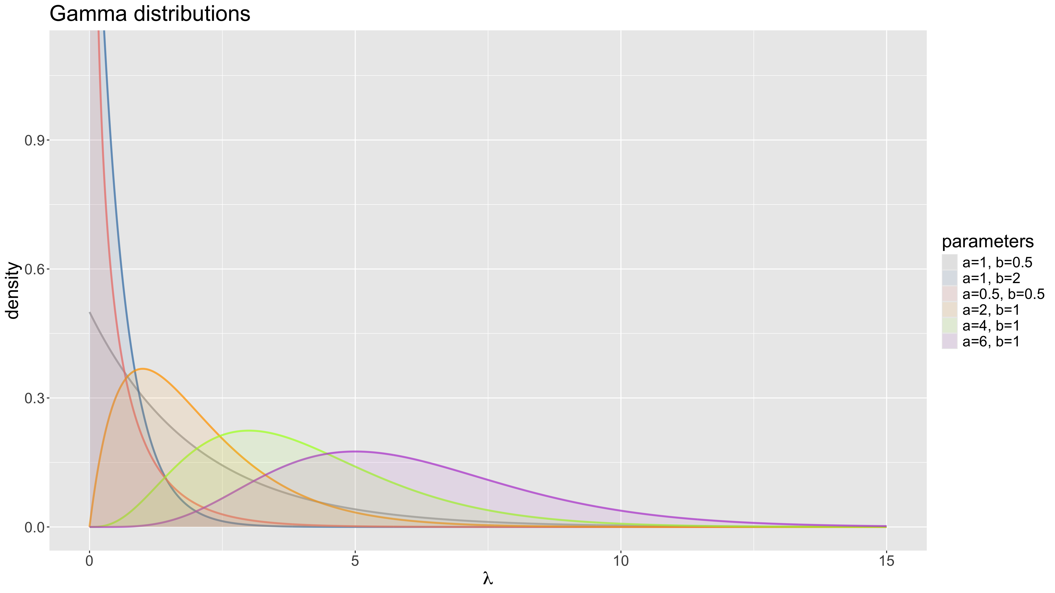
Example (cont’d)

Slide 70
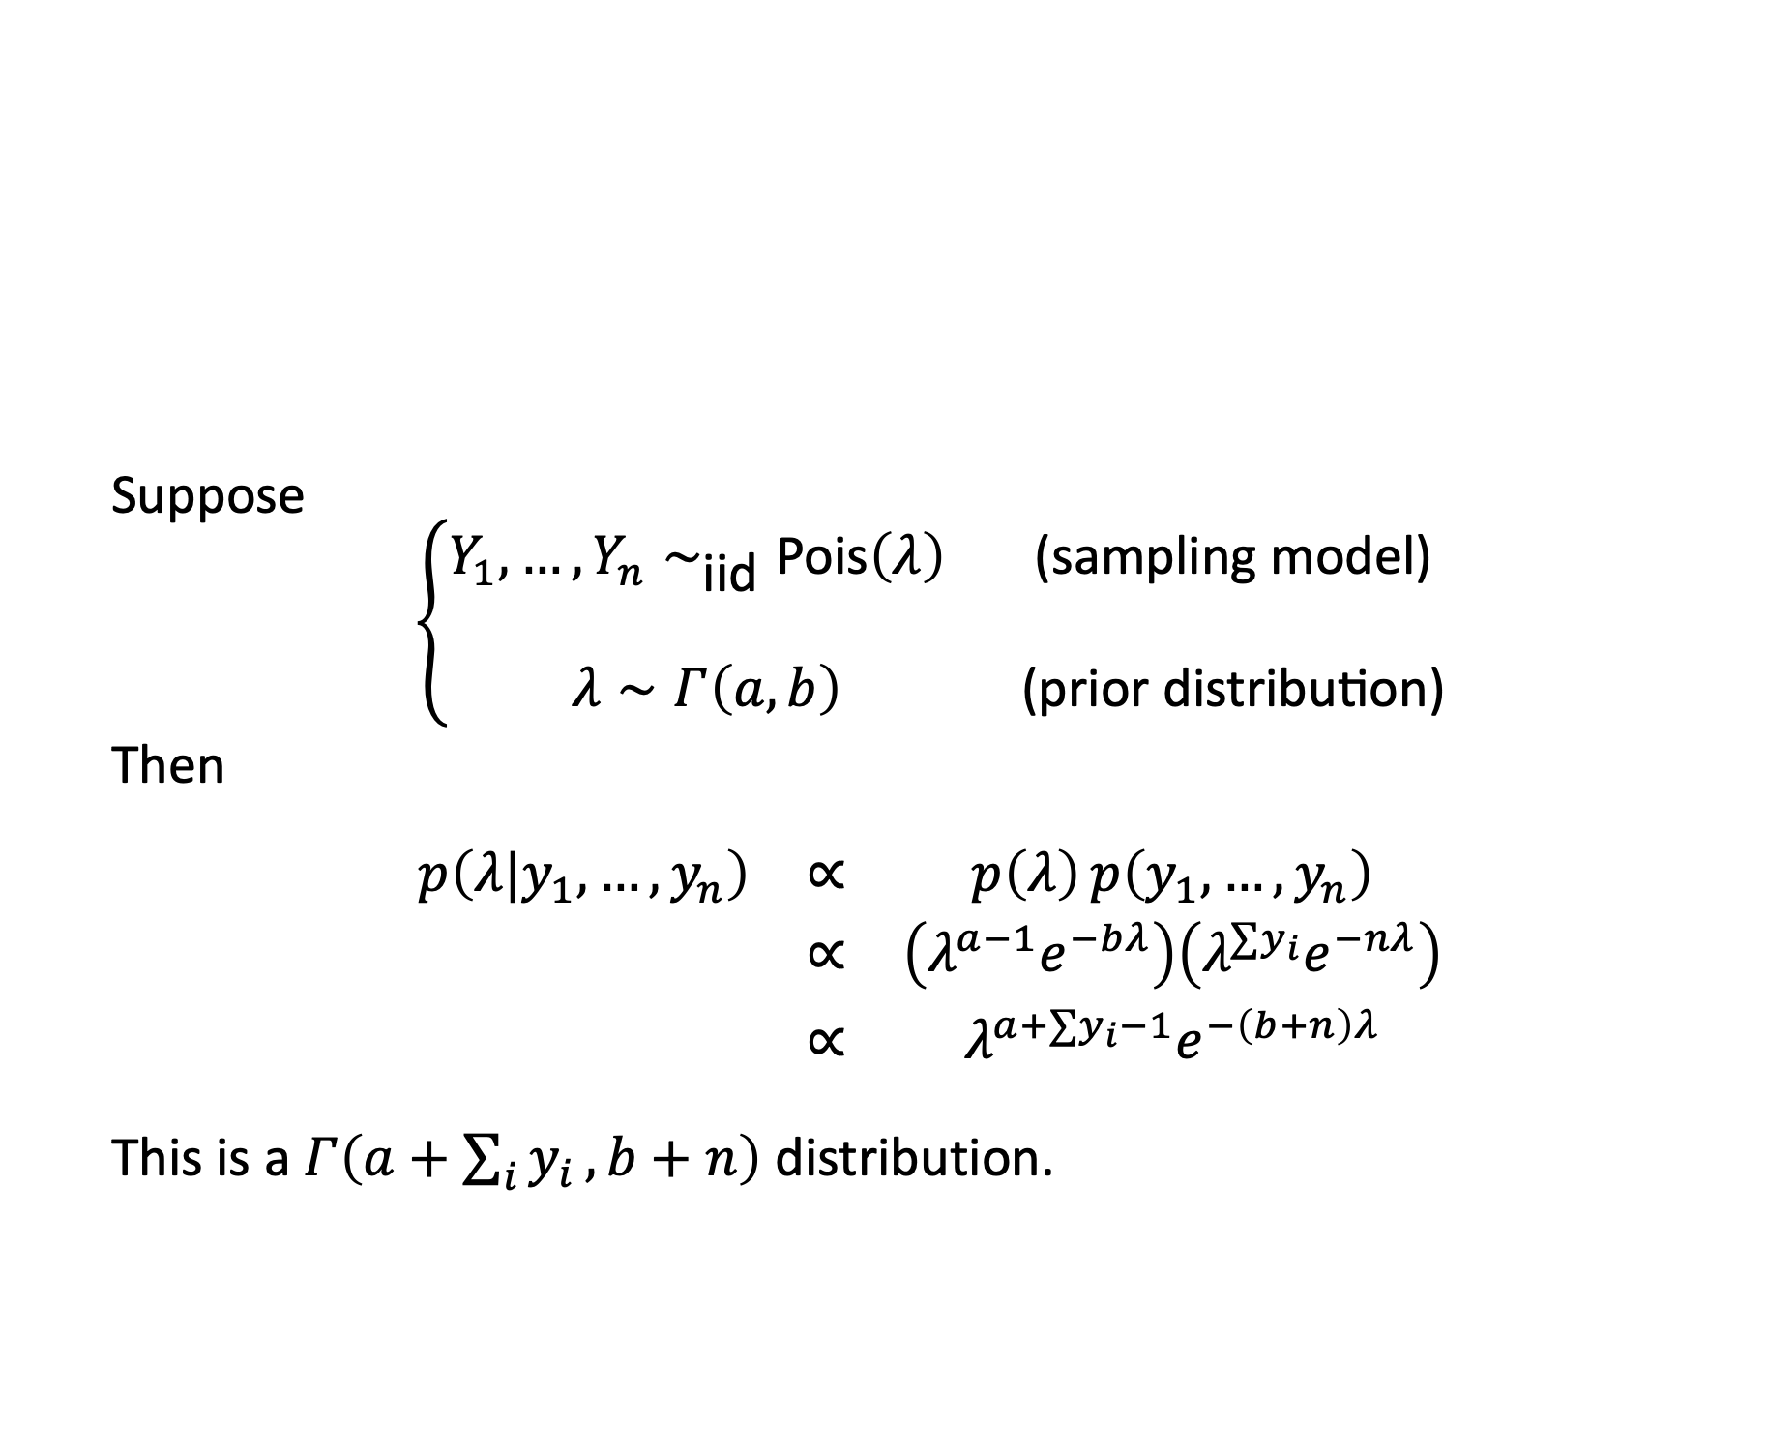
Example (cont’d)
Suppose
$$\left\{\begin{matrix}Y_{1},…,Y_{n}∼_{\text{iid}}\text{Pois}\left(λ\right) & \text{(}\text{sampling} \text{model}\text{)} \\ & \\ λ∼Γ\left(a,b\right) & \text{(}\text{prior} \text{distribution}\text{)}\end{matrix}\right.$$
Then
$$\begin{matrix}p\left(λ|y_{1},…,y_{n}\right) & ∝ & p\left(λ\right) p\left(y_{1},…,y_{n}\right) \\ & ∝ & \left(λ^{a−1}e^{−bλ}\right)\left(λ^{∑y_{i}}e^{−nλ}\right) \\ & ∝ & λ^{a+∑y_{i}−1}e^{−\left(b+n\right)λ}\end{matrix}$$
This is a $Γ\left(a+\sum_{i}^{​}{y_{i}},b+n\right)$ distribution.

Slide 71
Example (cont’d)
So we see that
$$\left\{\begin{matrix}\text{prior} p\left(λ\right) & =Γ\left(a,b\right) \\ & \\ \text{likelihood} p\left(y_{i},…,y_{n}|λ\right) & =\text{Pois}\left(λ\right)\end{matrix}\right.$$
$$⇒\text{posterior} p\left(λ|y_{1},…,y_{n}\right)=Γ\left(a+\sum_{i}^{​}{y_{i}},b+n\right)$$

Slide 72
Conjugate priors for exponential family distributions
The binomial and Poisson sampling models we have seen so far are examples of one-parameter exponential family distributions.
A one-parameter exponential family distribution is any distribution whose density (or mass) function can be expressed under the form
$$p\left(y|θ\right)=h\left(y\right)c\left(θ\right)e^{θt\left(y\right)}$$
where $θ$ is the unknown parameter and $t\left(y\right)$ is the sufficient statistic for the sampling model.

Slide 73
Conjugate priors for exponential family distributions
A general conjugate prior for a one-parameter exponential family sampling model is given by
$$p\left(θ|n_{0},t_{0}\right)=κ\left(n_{0},t_{0}\right)c{\left(θ\right)}^{n_{0}}e^{n_{0}t_{0}θ}$$

Slide 74
Conjugate priors for exponential family distributions
Given observed data for i.i.d. variables $Y_{1},…,Y_{n}$, the posterior is then
$$\begin{matrix}p\left(θ|y_{1},…,y_{n}\right) & ∝ & p\left(θ\right)p\left(y_{1},…,y_{n}|θ\right) \\ & ∝ & c{\left(θ\right)}^{n_{0}+n}exp\left(θ⋅\left[n_{0}t_{o}+\sum_{i=1}^{n}{t}\left(y_{i}\right)\right]\right) \\ & ∝ & p\left(θ|n_{0}+n,n_{0}t_{o}+\sum_{i}^{​}{t}\left(y_{i}\right)\right)\end{matrix}$$
Note: $n_{0}≈$ “prior sample size”, $t_{0}≈$ “prior guess of $t\left(Y\right)$”.

Slide 75
Conjugate priors for exponential family distributions
As an aside, recall from the GLM module:
Two-parameter (location $θ$ and scale $φ$) exponential family distributions
$$f\left(y|θ,φ\right)=exp\left(\frac{yθ−b\left(θ\right)}{a\left(φ\right)}+c\left(y,φ\right)\right)$$
Convince yourself this is the same thing!

Slide 76
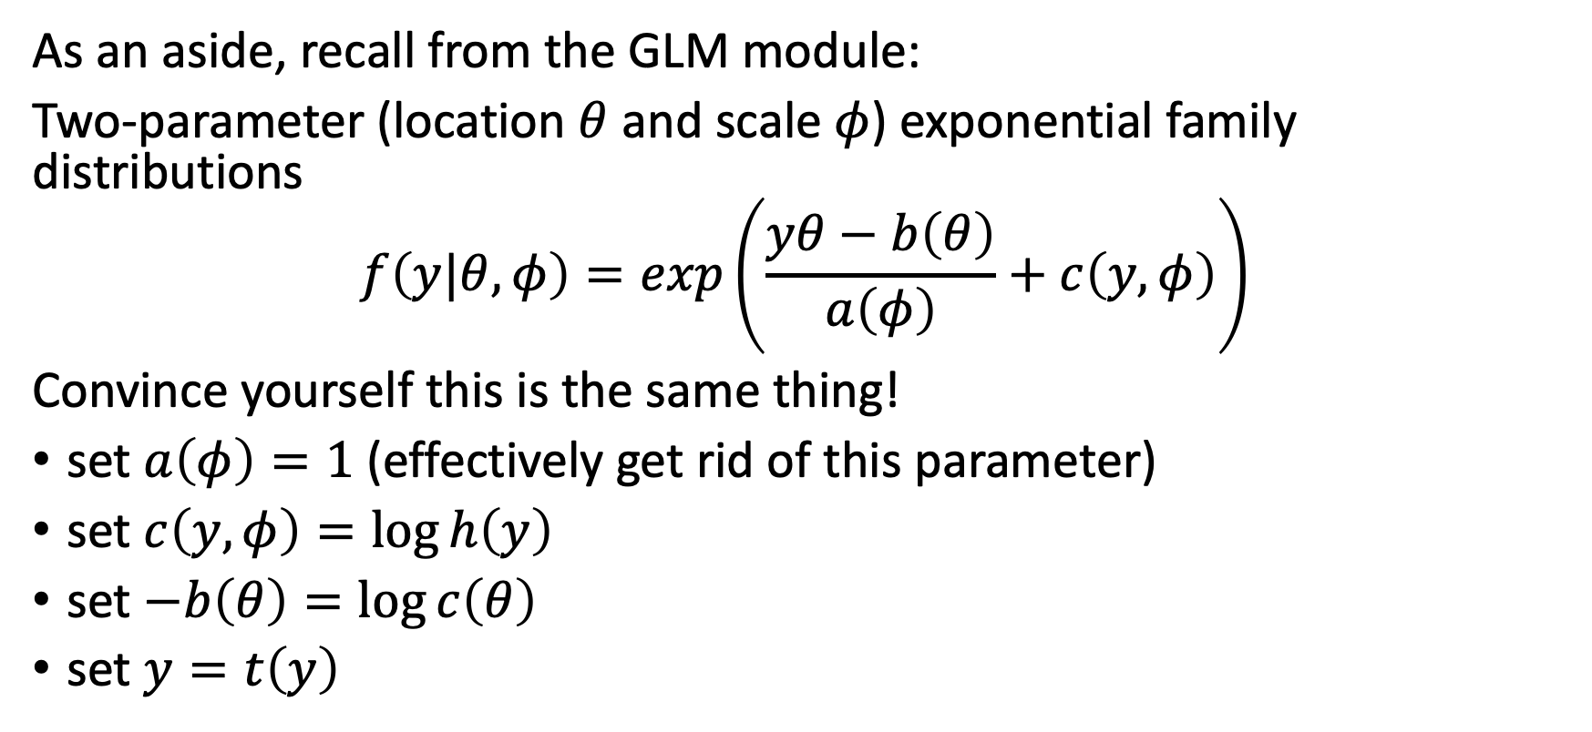
Conjugate priors for exponential family distributions
As an aside, recall from the GLM module:
Two-parameter (location $θ$ and scale $φ$) exponential family distributions
$$f\left(y|θ,φ\right)=exp\left(\frac{yθ−b\left(θ\right)}{a\left(φ\right)}+c\left(y,φ\right)\right)$$
Convince yourself this is the same thing!
set $a\left(φ\right)=1$ (effectively get rid of this parameter)
set $c\left(y,φ\right)=log h\left(y\right)$
set $−b\left(θ\right)=log c\left(θ\right)$
set $y=t\left(y\right)$

Slide 77
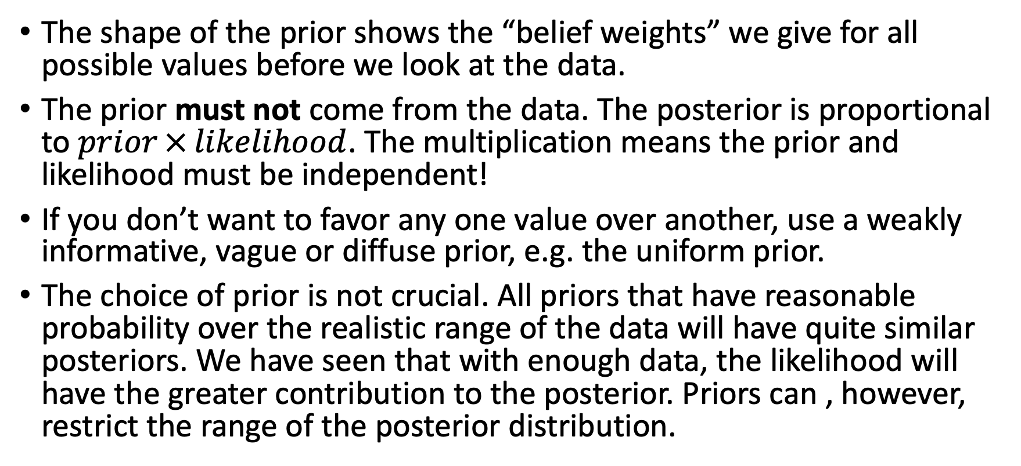
Priors - how to choose them
The shape of the prior shows the “belief weights” we give for all possible values before we look at the data.
The prior must not come from the data. The posterior is proportional to $prior × likelihood$. The multiplication means the prior and likelihood must be independent!
If you don’t want to favor any one value over another, use a weakly informative, vague or diffuse prior, e.g. the uniform prior.
The choice of prior is not crucial. All priors that have reasonable probability over the realistic range of the data will have quite similar posteriors. We have seen that with enough data, the likelihood will have the greater contribution to the posterior. Priors can , however, restrict the range of the posterior distribution.

Slide 78
Priors - how to choose them (cont’d)
Conjugate priors simplify calculations greatly as the posterior will be of the same family.
So identify the family of conjugate priors for your sampling model, then pick the one with a distribution function whose shape matches your beliefs closest.

Slide 79
[end of STA623 Bayesian Data analysis Session 2]

