Slide 1
STA623 Bayesian Data Analysis
Session 1: Bayesian reasoning: prior, likelihood, posterior
Marc Henrion

Slide 2
Preliminaries

Slide 3
How this course is organised
The course is built around one idea: a Bayesian analysis is a posterior distribution, and in practice we obtain posterior distributions by computing, not by integrating by hand. Mathematics is kept to what you need to understand what the computer is doing and why it can go wrong.
Longer derivations (conjugate posteriors, Jeffreys priors, the full normal model, loss functions) are in the appendices. You might be asked to derive a sonjugate prior in the exam, but for the other derivations, while they are useful for understanding and for self-study, you are not expected to be able to reproduce them in the exam.

Slide 4
How this course is organised
Lecture | Topic | Main computational tool | Practical
1 | Bayesian reasoning: prior, likelihood, posterior | Grid approximation | 1
2 | Priors, conjugate models, posterior summaries & prediction | Exact formulae + simulation | 2
3 | Monte Carlo and Markov chain Monte Carlo | Hand-written Metropolis & Gibbs samplers in R | 3
4 | MCMC in practice: NIMBLE and convergence diagnostics | NIMBLE, posterior | 4
5 | Bayesian regression, model checking, comparison, hierarchical models | NIMBLE, loo | 5

Slide 5

Code notes
These notes have been prepared using quarto - qmd shared on GitHub.
All code is R; Bayesian models are specified in NIMBLE (a dialect of BUGS).
R packages used: tidyverse, gridExtra, HDInterval, nimble, coda, posterior, loo (plus MCMCvis optionally). Install them all before the first practical: NIMBLE needs a working C++ compiler (Rtools on Windows, Xcode command line tools on macOS).
Course materials: https://github.com/gitMarcH/UNIMA_STA623_2026

Slide 6
License
The quarto code is subject to an MIT license (Marc Henrion).
The compiled html is subject to a CC BY 4.0 license (Marc Henrion).

Slide 7
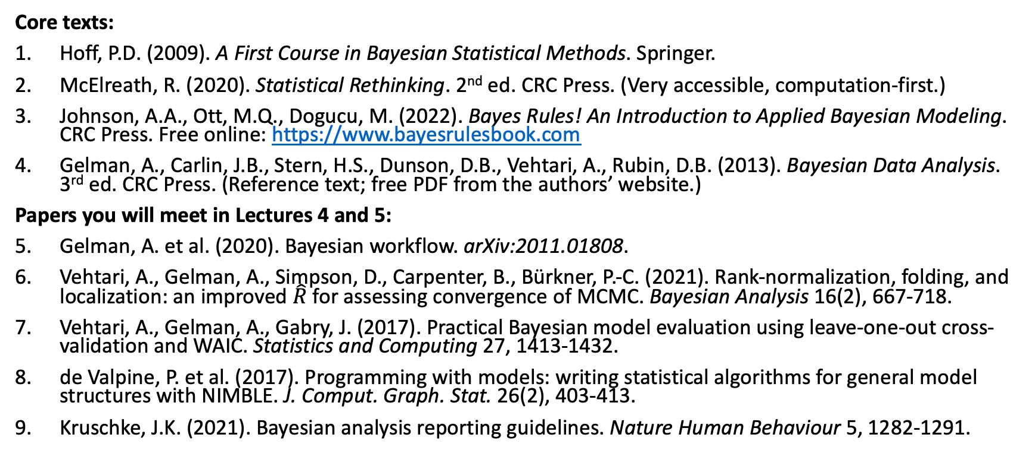
References
Core texts:
Hoff, P.D. (2009). A First Course in Bayesian Statistical Methods. Springer.
McElreath, R. (2020). Statistical Rethinking. 2nd ed. CRC Press. (Very accessible, computation-first.)
Johnson, A.A., Ott, M.Q., Dogucu, M. (2022). Bayes Rules! An Introduction to Applied Bayesian Modeling. CRC Press. Free online: https://www.bayesrulesbook.com
Gelman, A., Carlin, J.B., Stern, H.S., Dunson, D.B., Vehtari, A., Rubin, D.B. (2013). Bayesian Data Analysis. 3rd ed. CRC Press. (Reference text; free PDF from the authors’ website.)
Papers you will meet in Lectures 4 and 5:
Gelman, A. et al. (2020). Bayesian workflow. arXiv:2011.01808.
Vehtari, A., Gelman, A., Simpson, D., Carpenter, B., Bürkner, P.-C. (2021). Rank-normalization, folding, and localization: an improved $\hat{R}$ for assessing convergence of MCMC. Bayesian Analysis 16(2), 667-718.
Vehtari, A., Gelman, A., Gabry, J. (2017). Practical Bayesian model evaluation using leave-one-out cross-validation and WAIC. Statistics and Computing 27, 1413-1432.
de Valpine, P. et al. (2017). Programming with models: writing statistical algorithms for general model structures with NIMBLE. J. Comput. Graph. Stat. 26(2), 403-413.
Kruschke, J.K. (2021). Bayesian analysis reporting guidelines. Nature Human Behaviour 5, 1282-1291.

Slide 8
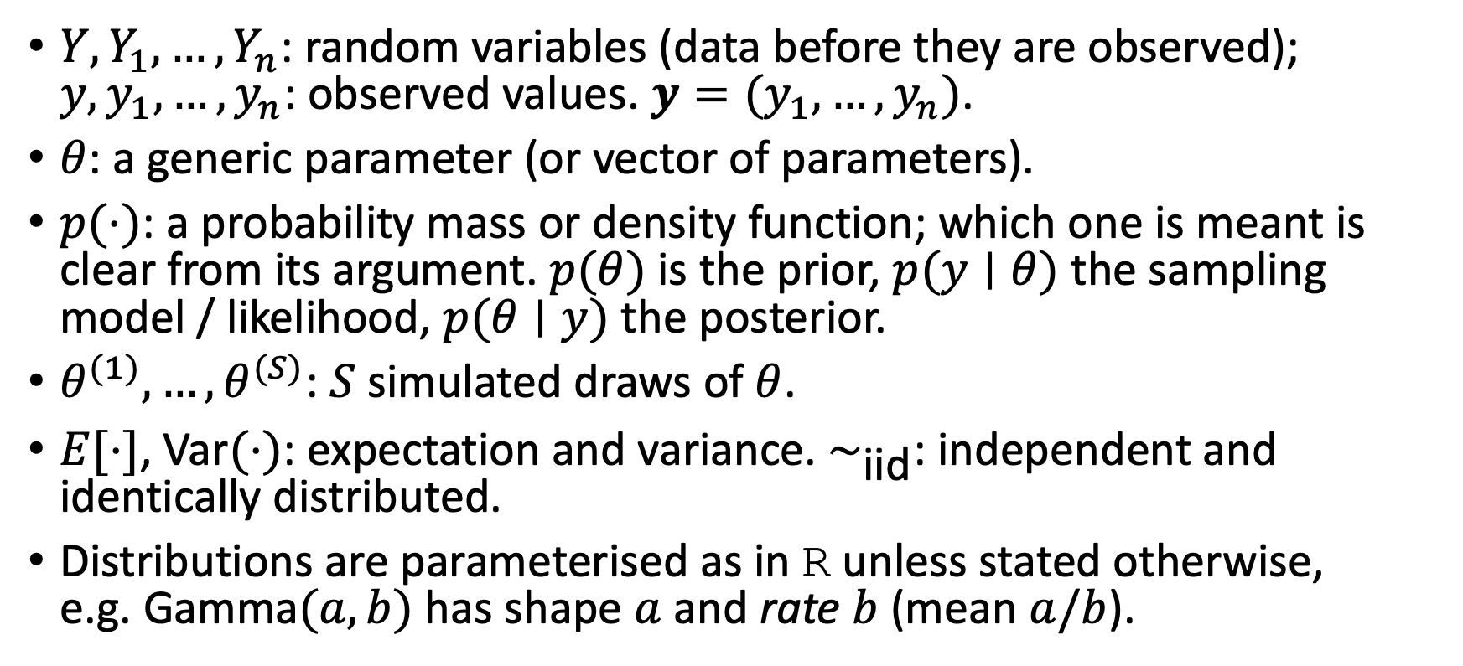
Notation
$Y,Y_{1},…,Y_{n}$: random variables (data before they are observed); $y,y_{1},…,y_{n}$: observed values. $y=(y_{1},…,y_{n})$.
$θ$: a generic parameter (or vector of parameters).
$p(⋅)$: a probability mass or density function; which one is meant is clear from its argument. $p(θ)$ is the prior, $p(y∣θ)$ the sampling model / likelihood, $p(θ∣y)$ the posterior.
$θ^{(1)},…,θ^{(S)}$: $S$ simulated draws of $θ$.
$E[⋅]$, $\text{Var}(⋅)$: expectation and variance. $∼_{\text{iid}}$: independent and identically distributed.
Distributions are parameterised as in R unless stated otherwise, e.g. $\text{Gamma}(a,b)$ has shape $a$ and rate $b$ (mean $a/b$).

Slide 9
Morning quiz

Slide 10
Introduction

Slide 11
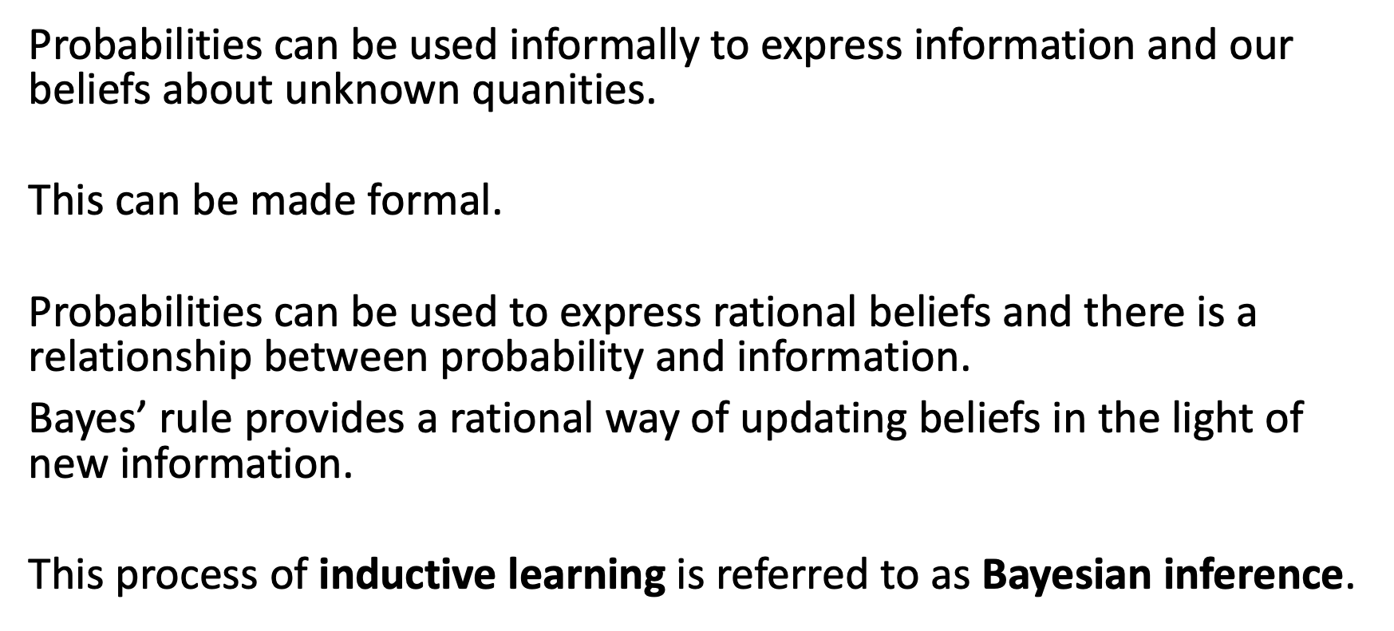
Introduction
Probabilities can be used informally to express information and our beliefs about unknown quanities.
This can be made formal.
Probabilities can be used to express rational beliefs and there is a relationship between probability and information.
Bayes’ rule provides a rational way of updating beliefs in the light of new information.
This process of inductive learning is referred to as Bayesian inference.

Slide 12
Bayesian reasoning

Slide 13
Bayesian reasoning
Bayesian methods provide
Statistical estimators with desirable properties.
Parsimonious descriptions of data.
A computational framework for model estimation, selection and validation.

Slide 14
Two ways of thinking about the unknown
 | Frequentist | Bayesian
Parameter θ | Fixed, unknown | Uncertain: has a distribution
Probability | Long-run frequency | Degree of belief
Result | Estimate + SE, CI, p-value | Posterior p(θ | y)
95% interval | 95% of such intervals cover θ | P(l ≤ θ ≤ u | y) = 0.95
Prior knowledge | Informal | Formal, via p(θ)

Slide 15
Two ways of thinking about the unknown
Both are legitimate; they answer different questions. In large samples with vague priors, they often give numerically similar answers. The Bayesian approach becomes especially attractive when:
We want direct probability statements about parameters (“what is the probability that the new regimen reduces mortality?”);
Data are sparse and genuine prior information exists;
Models are complex (hierarchical, spatial, missing data, measurement error), where Bayesian computation is often easier than maximum likelihood.

Slide 16
The only probability rules you need
For events $A$ and $B$ (see Appendix A for the full refresher):
Conditional probability: $P(A∣B)=P(A∩B)/P(B)$, for $P(B)>0$.
Multiplication rule: $P(A∩B)=P(A∣B)P(B)$.
Law of total probability: if $B_{1},…,B_{k}$ partition the outcome space, $P(A)=\sum_{j}^{​}{P}(A∣B_{j})P(B_{j})$.
Combining the three gives Bayes’ rule:
$$P(B_{i}∣A)=\frac{P(A∣B_{i}) P(B_{i})}{\sum_{j}^{​}{P}(A∣B_{j}) P(B_{j})}.$$

Slide 17
Example: a malaria rapid diagnostic test
A malaria RDT has
Sensitivity $P(T∣D)=0.95$ and
Specificity $P(\overset{‾}{T}∣\overset{‾}{D})=0.90$.
What is the probability that a child with a positive test actually has malaria, $P(D∣T)$?

Slide 18
Example: a malaria rapid diagnostic test
We can write, using Bayes’ Rule:
$$P(D∣T)=\frac{P(T∣D)P(D)}{P(T∣D)P(D)+P(T∣\overset{‾}{D})P(\overset{‾}{D})}.$$
The answer depends on the prior probability $P(D)$, i.e. the prevalence where the child lives. Rather than computing one number, let us compute it for every prevalence:

Slide 19
Example: a malaria rapid diagnostic test
sens <- 0.95
spec <- 0.90
ppv <- function(prev) sens * prev / (sens * prev + (1 - spec) * (1 - prev))
tibble(prevalence = seq(0.001, 0.6, length = 500)) |>
mutate(ppv = ppv(prevalence)) |>
ggplot(aes(prevalence, ppv)) +
geom_line(linewidth = 1, colour = "steelblue") +
geom_vline(xintercept = c(0.02, 0.30), linetype = 2, colour = "grey50") +
labs(x = "prior probability P(D) (prevalence)",
y = "posterior probability P(D | T+)")

Slide 20
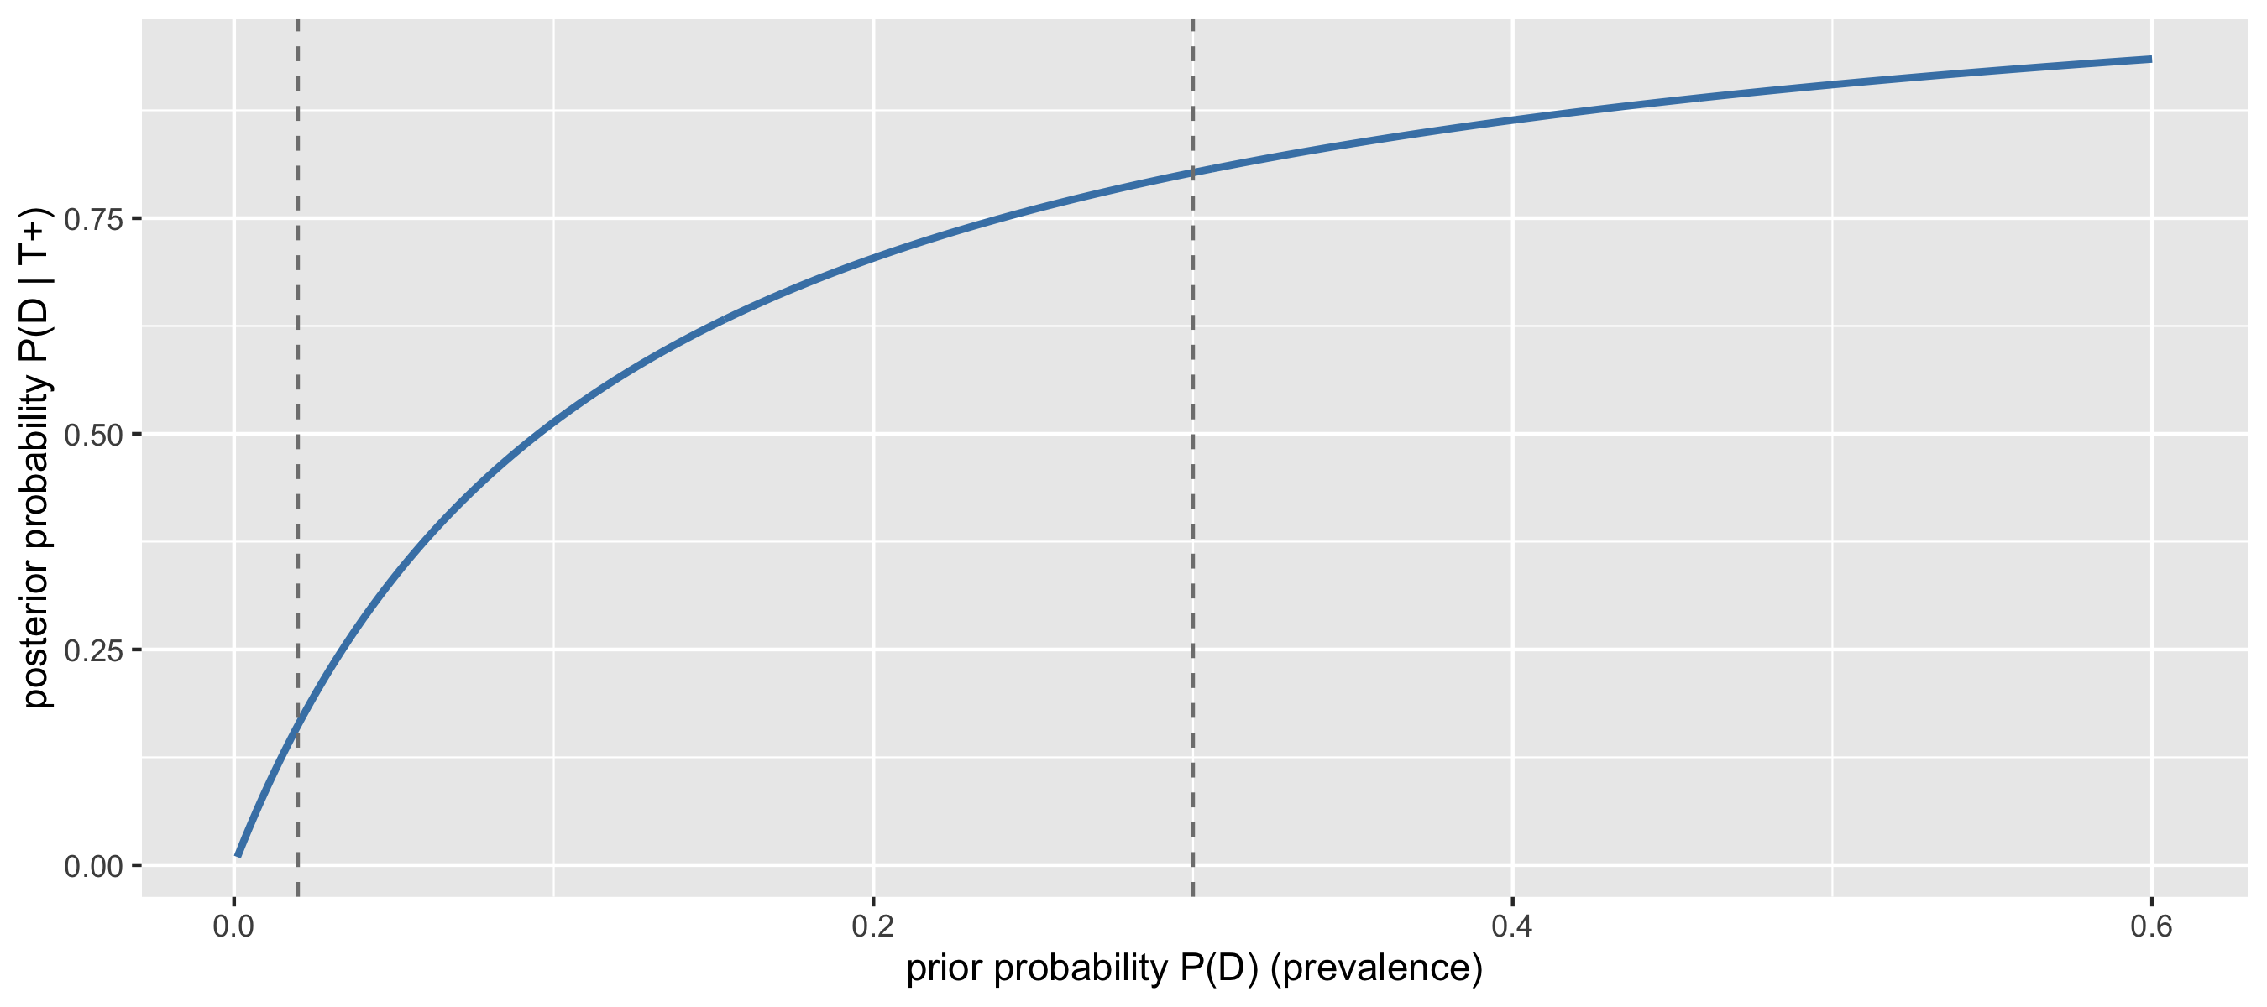
Example: a malaria rapid diagnostic test

Slide 21
Example: a malaria rapid diagnostic test
In a low-transmission setting (2% prevalence) a positive result gives only a 16% probability of malaria; in a high-transmission setting (30%) it gives 80%.
Same test & data, different prior $⇒$ different conclusion.
This is Bayesian inference in miniature:
$$\begin{matrix}P(D∣T) & ∝ & P(T∣D) & × & P(D) \\ \text{posterior} & ∝ & \text{likelihood} & × & \text{prior}\end{matrix}$$
The denominator $P(T)$ does not depend on the hypothesis; it just makes the posterior probabilities add up to 1.

Slide 22
From hypotheses to parameters
Usually the “hypotheses” are the possible values of a parameter $θ$, and the “evidence” is a dataset $y$. Bayes’ rule for densities is
$$p(θ∣y)=\frac{p(y∣θ) p(θ)}{p(y)}, p(y)=∫p(y∣θ) p(θ) dθ,$$
and since $p(y)$ is a constant once the data are observed,
$$\boxed{ p(θ∣y) ∝ p(y∣θ) p(θ) } \text{posterior}∝\text{likelihood}×\text{prior}.$$

Slide 23
Bayesian analysis
Everything in this course follows from this line. The ingredients are:
The sampling model $p(y∣θ)$: how data are generated if we knew $θ$. Viewed as a function of $θ$ for fixed data it is the likelihood, the same object you use in GLMs;
The prior $p(θ)$: what we know about $θ$ before seeing these data;
The posterior $p(θ∣y)$: what we know after seeing the data;
The marginal likelihood or evidence $p(y)$: the normalising constant. It is usually the hard part to compute, and most computational methods in this course are designed to avoid computing it.

Slide 24
A first computational method: grid approximation

Slide 25
Grid approximation
Example.
A district health team wants to estimate the prevalence $π$ of malaria parasitaemia among under-fives in a village. They test $n=30$ children and find $k=9$ positive.
A survey two years ago in a neighbouring village suggested prevalence around 20-30%.
What is the sampling model?
How would you encode a prior based on the previous survey?

Slide 26
Grid approximation
Example.
Sampling model: $Y∣π∼\text{Bin}(n=30,π)$.
Prior: $π∼\text{Beta}(2,5)$, which has mean $2/7≈0.29$ and is fairly wide.
We do not need any integration to find the posterior. We can evaluate $\text{likelihood}×\text{prior}$ on a fine grid of values for $π$ and normalise numerically.

Slide 27
Grid approximation
n <- 30; k <- 9
a <- 2; b <- 5
grid <- tibble(pi = seq(0, 1, length = 1001)) |>
mutate(prior = dbeta(pi, a, b),
likelihood = dbinom(k, size = n, prob = pi),
unnorm = likelihood * prior,
posterior = unnorm / sum(unnorm * 0.001)) # 0.001 = grid spacing
grid |>
mutate(likelihood = likelihood / sum(likelihood * 0.001)) |> # scaled for plotting only
pivot_longer(c(prior, likelihood, posterior), names_to = "curve") |>
mutate(curve = factor(curve, levels = c("prior", "likelihood", "posterior"))) |>
ggplot(aes(pi, value, colour = curve)) +
geom_line(linewidth = 1) +
scale_colour_manual(values = c("steelblue", "salmon", "mediumorchid")) +
labs(x = expression(pi), y = "density", colour = NULL)

Slide 28
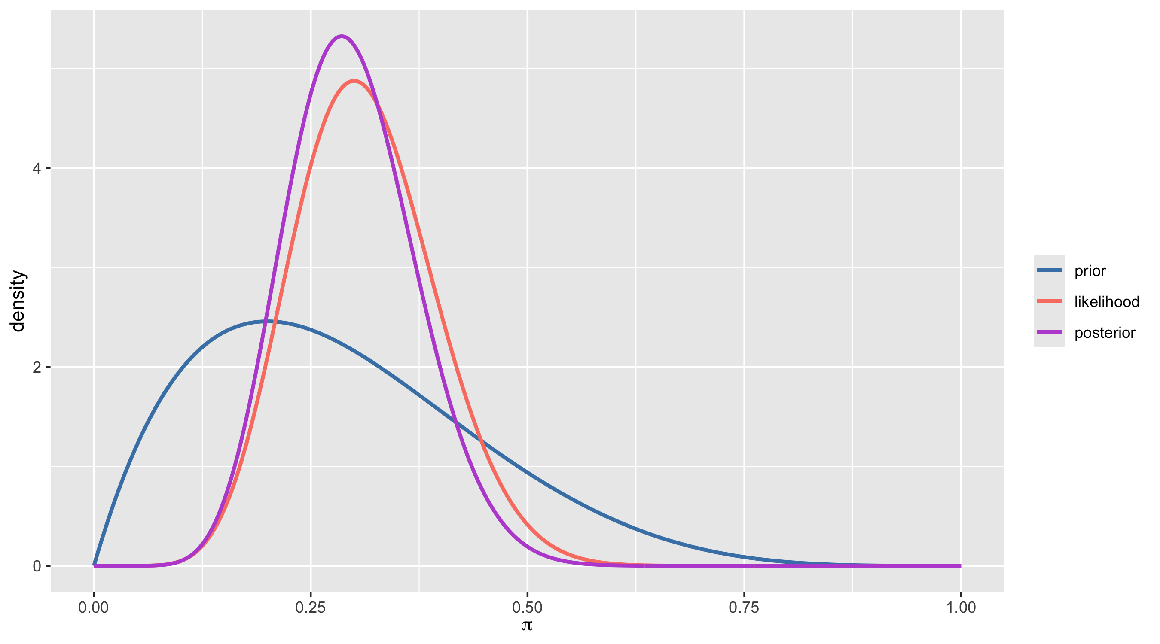
Grid approximation

Slide 29
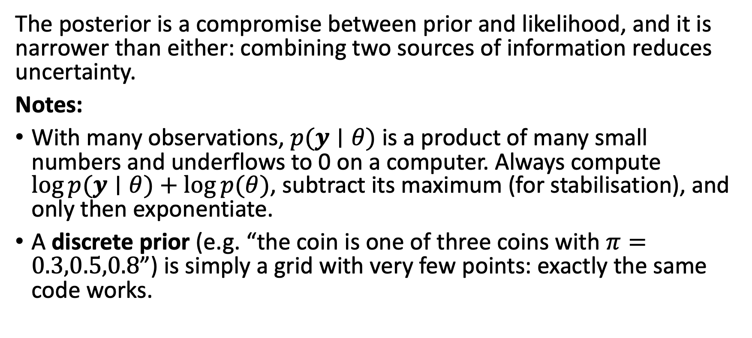
The posterior is a compromise between prior and likelihood, and it is narrower than either: combining two sources of information reduces uncertainty.
Notes:
With many observations, $p(y∣θ)$ is a product of many small numbers and underflows to 0 on a computer. Always compute $log p(y∣θ)+log p(θ)$, subtract its maximum (for stabilisation), and only then exponentiate.
A discrete prior (e.g. “the coin is one of three coins with $π=0.3,0.5,0.8$”) is simply a grid with very few points: exactly the same code works.

Slide 30
Summarising a grid posterior by sampling
Once we have the posterior on a grid, the easiest way to summarise it is to draw samples from it. This idea (replace a distribution by a large sample from it) is the foundation of everything in Lectures 3-5.
Posterior mean, standard deviation, median, 95% credible interval, and, for example, the probability that prevalence exceeds 40%: all of this can be obtained with a single line of code each, and no calculus.

Slide 31
Summarising a grid posterior by sampling
draws <- sample(grid$pi, size = 1e5, replace = TRUE, prob = grid$posterior)
c(post_mean = mean(draws),
post_sd = sd(draws),
quantile(draws, c(0.025, 0.5, 0.975)),
P_above_0.4 = mean(draws > 0.4))
post_mean post_sd 2.5% 50% 97.5% P_above_0.4
0.29711721 0.07414671 0.16300000 0.29300000 0.45200000 0.08868000

Slide 32
The exact answer: conjugacy
For this particular prior/likelihood pair we can also get the posterior exactly. Keeping only factors that depend on $π$:
$$\begin{aligned}p(π∣k)&∝&\text{likelihood}&×\text{prior} \\ &∝&p(k∣pi)& p(π) \\ &∝&π^{k}(1−π)^{n−k}& π^{a−1}(1−π)^{b−1} \\ &=&π^{a+k−1}& (1−π)^{b+n−k−1}\end{aligned}$$

Slide 33
The exact answer: conjugacy
We can recognise this as the kernel of a $\text{Beta}(a+k, b+n−k)$ density. No integral is needed: the normalising constant must be whatever makes a Beta density integrate to 1. (The full derivation is in Appendix B.1. of the revision document on GitHub.)
When prior and posterior belong to the same family, the prior is called conjugate for the sampling model. We can check that the grid agrees with the exact result.

Slide 34
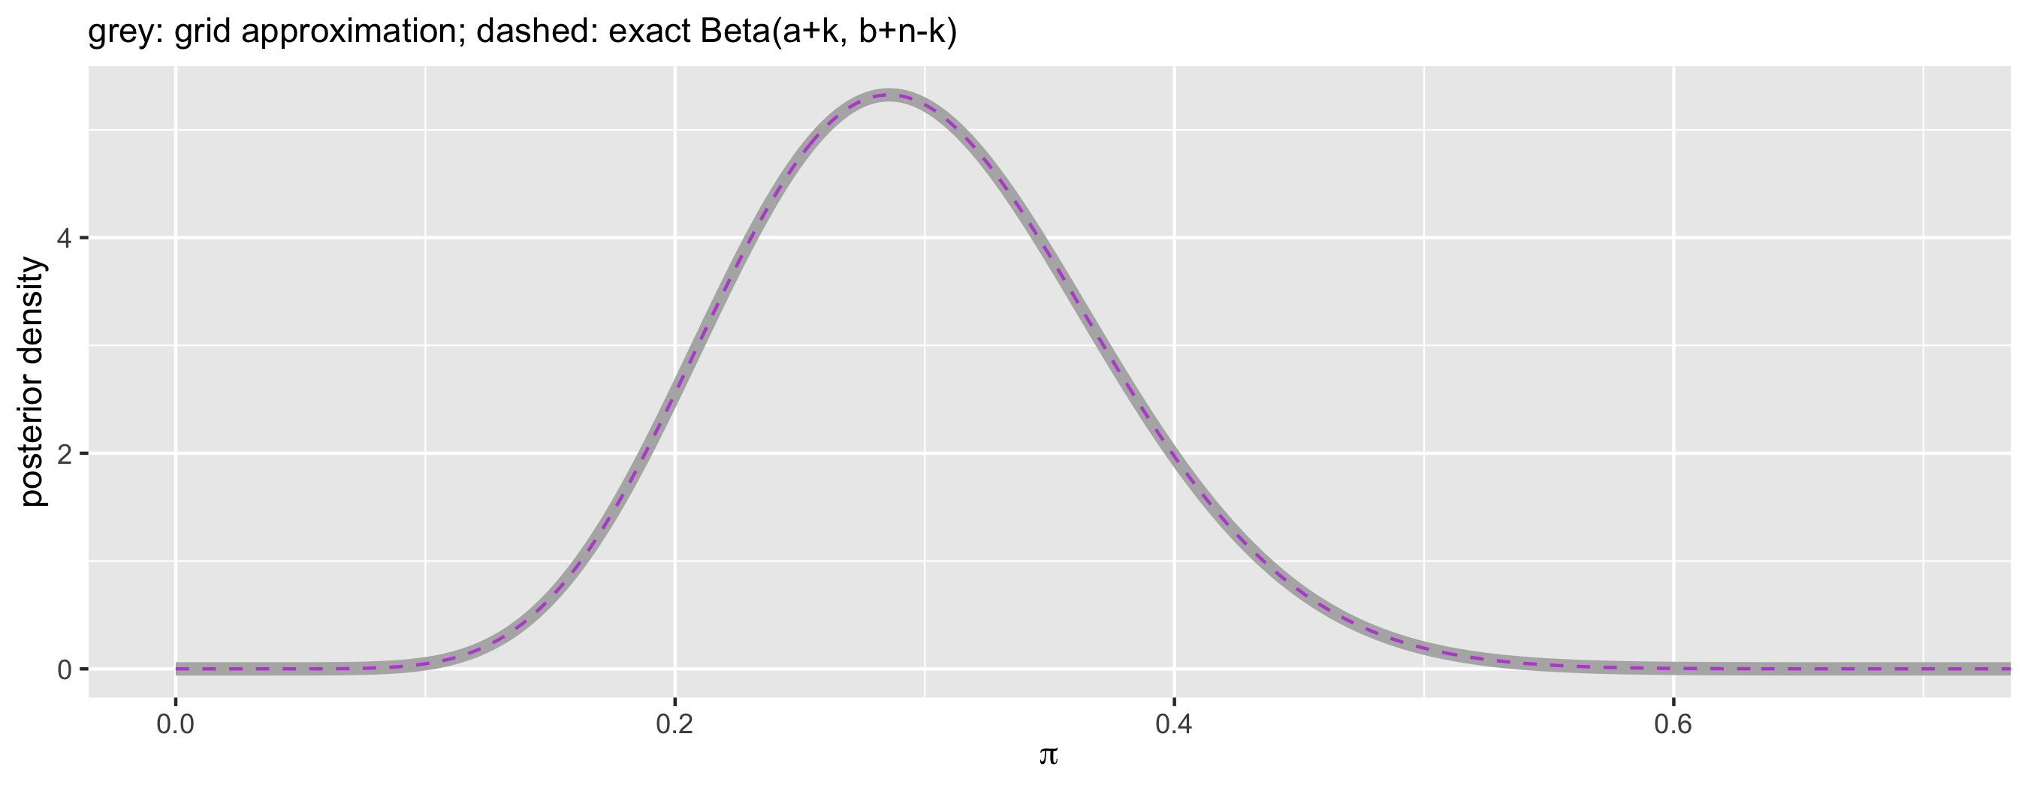
The exact answer: conjugacy
ggplot(grid, aes(pi, posterior)) +
geom_line(linewidth = 2, colour = "grey70") +
geom_line(aes(y = dbeta(pi, a + k, b + n - k)), colour = "mediumorchid", linetype = 2) +
coord_cartesian(xlim = c(0, 0.7)) +
labs(x = expression(pi), y = "posterior density",
subtitle = "grey: grid approximation; dashed: exact Beta(a+k, b+n-k)")

Slide 35
The exact answer: conjugacy
The posterior mean is a weighted average of the prior mean and the sample proportion:
$$E[π∣k]=\frac{a+k}{a+b+n}=\underset{\text{weight on prior}}{\underset{​}{\frac{a+b}{a+b+n}}}⋅\frac{a}{a+b}+\underset{\text{weight on data}}{\underset{​}{\frac{n}{a+b+n}}}⋅\frac{k}{n}$$
So $a+b$ behaves like a prior sample size: the Beta(2,5) prior carries the information of about 7 children, the data carry 30.

Slide 36
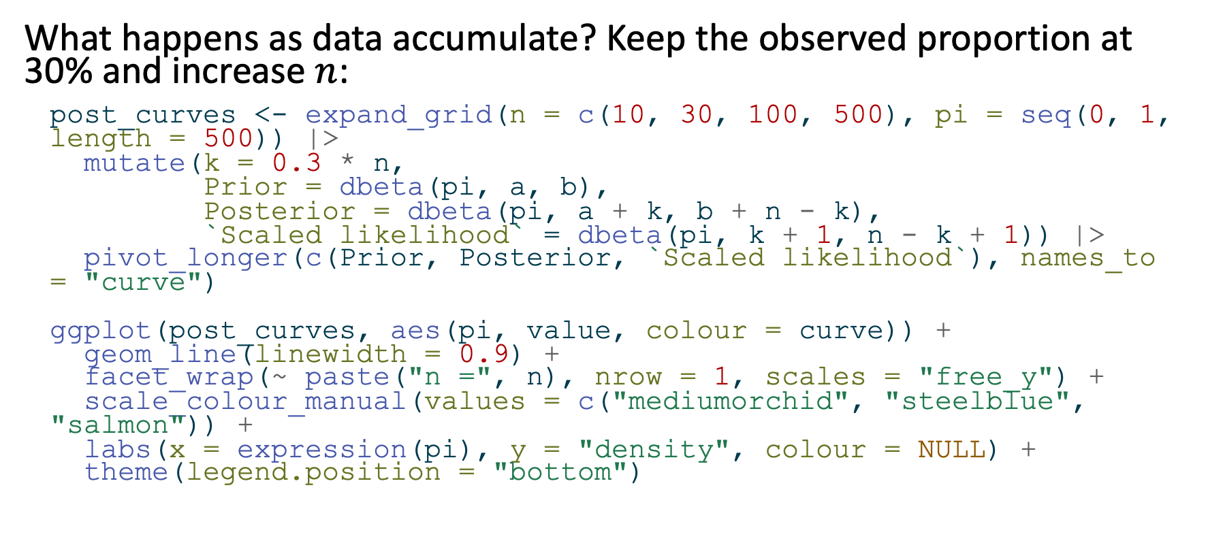
Prior versus data
What happens as data accumulate? Keep the observed proportion at 30% and increase $n$:
post_curves <- expand_grid(n = c(10, 30, 100, 500), pi = seq(0, 1, length = 500)) |>
mutate(k = 0.3 * n,
Prior = dbeta(pi, a, b),
Posterior = dbeta(pi, a + k, b + n - k),
`Scaled likelihood` = dbeta(pi, k + 1, n - k + 1)) |>
pivot_longer(c(Prior, Posterior, `Scaled likelihood`), names_to = "curve")
ggplot(post_curves, aes(pi, value, colour = curve)) +
geom_line(linewidth = 0.9) +
facet_wrap(~ paste("n =", n), nrow = 1, scales = "free_y") +
scale_colour_manual(values = c("mediumorchid", "steelblue", "salmon")) +
labs(x = expression(pi), y = "density", colour = NULL) +
theme(legend.position = "bottom")

Slide 37
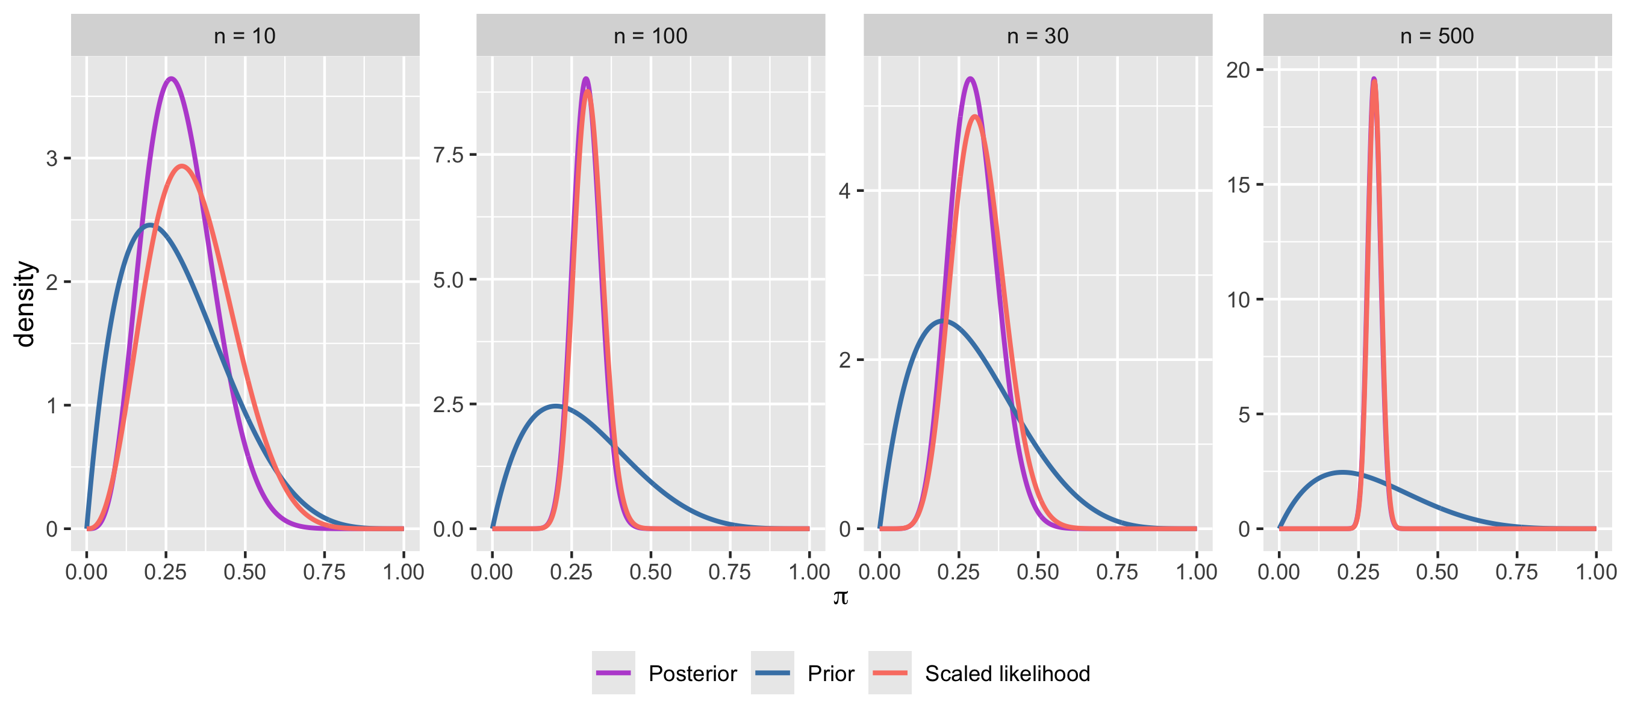
Prior versus data

Slide 38
Prior versus data
With more data the posterior concentrates and the likelihood dominates: different reasonable priors lead to practically the same conclusions.
One exception: if the prior gives zero probability to a region, so does the posterior, no matter how much data we collect (because posterior $∝$ likelihood $×$ 0). Never put zero prior probability on values that are physically possible.

Slide 39
Sequential updating
Today’s posterior is tomorrow’s prior.
If the team tests another 20 children and finds 4 positive, then starting from the $\text{Beta}(11,26)$ posterior gives a $\text{Beta}(15,42)$ posterior, which is exactly the same as analysing all 50 children at once with the original $\text{Beta}(2,5)$ prior.
Bayesian inference is coherent in this sense.

Slide 40
Exchangeability
Why is it reasonable to treat $Y_{1},…,Y_{n}$ as i.i.d. given $π$? If the labels of the children carry no information (we would assign the same joint probability to the data in any order), the $Y_{i}$ are exchangeable.
De Finetti’s theorem says that (for an infinite exchangeable sequence) this is equivalent to assuming
$$Y_{1},…,Y_{n}∣θ∼_{\text{iid}}p(y∣θ), θ∼p(θ).$$

Slide 41
Exchangeability
So the familiar “i.i.d. given a parameter, plus a prior” set-up is a consequence of a simple symmetry judgement. When the labels do carry information (children from different villages, patients before and after a power cut), exchangeability fails and the model must account for this. We will return to this with hierarchical models in Lecture 5.

Slide 42
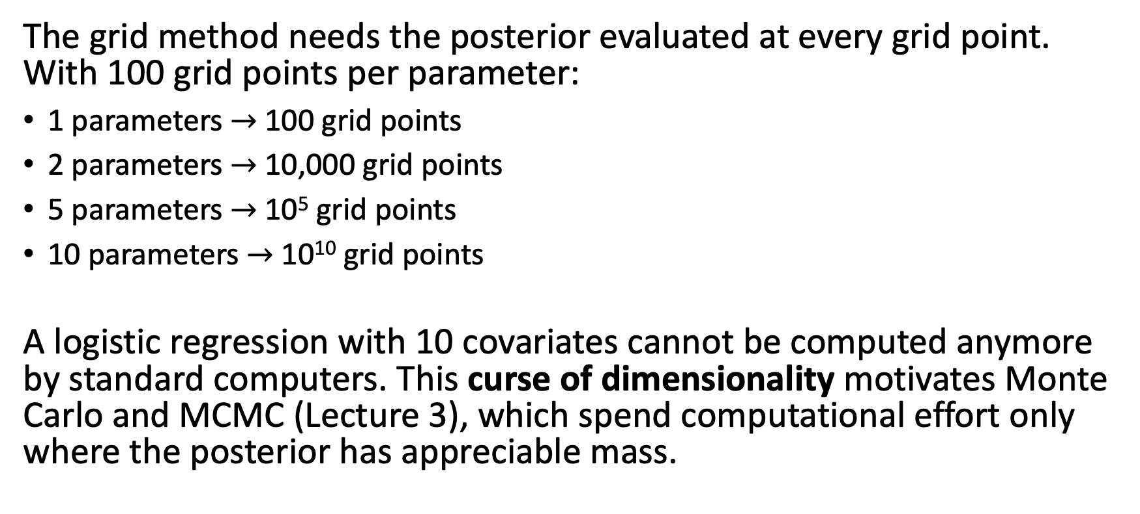
Why grids are not enough
The grid method needs the posterior evaluated at every grid point. With 100 grid points per parameter:
1 parameters $→$ 100 grid points
2 parameters $→$ 10,000 grid points
5 parameters $→$ 10⁵ grid points
10 parameters $→$ 10¹⁰ grid points
A logistic regression with 10 covariates cannot be computed anymore by standard computers. This curse of dimensionality motivates Monte Carlo and MCMC (Lecture 3), which spend computational effort only where the posterior has appreciable mass.

Slide 43
[end of STA623 Bayesian Data analysis Session 1]

