Slide 1
STA623 Bayesian Data Analysis
Session 3: Monte Carlo and Markov chain Monte Carlo
Marc Henrion

Slide 2
Preliminaries

Slide 3

Code notes
These notes have been prepared using quarto - qmd shared on GitHub.
All code is R; Bayesian models are specified in NIMBLE (a dialect of BUGS).
R packages used: tidyverse, gridExtra, HDInterval, nimble, coda, posterior, loo (plus MCMCvis optionally). Install them all before the first practical: NIMBLE needs a working C++ compiler (Rtools on Windows, Xcode command line tools on macOS).
Course materials: https://github.com/gitMarcH/UNIMA_STA623_2026

Slide 4
License
The quarto code is subject to an MIT license (Marc Henrion).
The compiled html is subject to a CC BY 4.0 license (Marc Henrion).

Slide 5
Morning Quiz

Slide 6
Monte Carlo

Slide 7
Monte Carlo integration
Almost every posterior quantity we care about is an expectation:
$$E[g(θ)∣y]=∫g(θ) p(θ∣y) dθ.$$
The mean ($g(θ)=θ$), variance, probabilities ($g(θ)=I(θ∈A)$), and predictive probabilities are all of this form.

Slide 8
Monte Carlo integration
If we can draw $θ^{(1)},…,θ^{(S)}∼_{\text{iid}}p(θ∣y)$, then by the law of large numbers
$${\overset{‾}{g}}_{S}=\frac{1}{S}\sum_{s=1}^{S}{g}(θ^{(s)}) → E[g(θ)∣y] \text{as }S→∞,$$
and by the central limit theorem the error is approximately normal with
$$\text{MCSE}({\overset{‾}{g}}_{S})=\frac{\text{sd}(g(θ))}{\sqrt{S}}.$$

Slide 9
Monte Carlo SE
The Monte Carlo standard error (MCSE) tells us how many digits of a simulation result we can trust. It shrinks like $1/\sqrt{S}$, independently of the dimension of $θ$: this is why simulation beats grids.
Keep two kinds of uncertainty apart. The posterior SD describes uncertainty about $θ$ and does not shrink as we simulate more. The MCSE describes numerical error in our summary and goes to 0 as $S→∞$.
Report posterior summaries; make sure the MCSE is small enough not to matter.

Slide 10
Example: comparing two groups
In the General Social Survey (Practical 2), the numbers of children of 40-year-old women without / with a college degree gave posteriors $θ_{1}∣y∼\text{Gamma}(219,112)$ and $θ_{2}∣y∼\text{Gamma}(68,45)$.
Questions about functions of several parameters, which would need double integrals, become code one-liners:

Slide 11
Example: comparing two groups
S <- 1e5
theta1 <- rgamma(S, 219, 112)
theta2 <- rgamma(S, 68, 45)
prob <- mean(theta1 > theta2)
ratio <- theta1 / theta2
c(`P(theta1 > theta2)` = prob,
MCSE = sqrt(prob * (1 - prob) / S),
`median rate ratio` = median(ratio),
quantile(ratio, c(0.025, 0.975)))
P(theta1 > theta2) MCSE median rate ratio 2.5%
0.9725700000 0.0005165036 1.2978675504 0.9943761174
97.5%
1.7147492710

Slide 12
Example: comparing two groups
Once we have draws, every function of the parameters has a posterior distribution for free: rate ratios, risk differences, numbers needed to treat, predicted probabilities, rankings.
Just compute the function for each draw.

Slide 13
Example: comparing two groups
tibble(S = round(10^seq(1, 5, length = 60))) |>
mutate(estimate = map_dbl(S, ~ mean(rgamma(.x, 219, 112) > rgamma(.x, 68, 45))),
mcse = sqrt(estimate * (1 - estimate) / S)) |>
ggplot(aes(S, estimate)) +
geom_ribbon(aes(ymin = estimate - 2 * mcse, ymax = estimate + 2 * mcse), fill = "grey85") +
geom_line(colour = "steelblue") +
geom_hline(yintercept = prob, linetype = 2) +
scale_x_log10() +
labs(x = "number of Monte Carlo draws S (log scale)", y = "estimate of P(theta1 > theta2)")

Slide 14
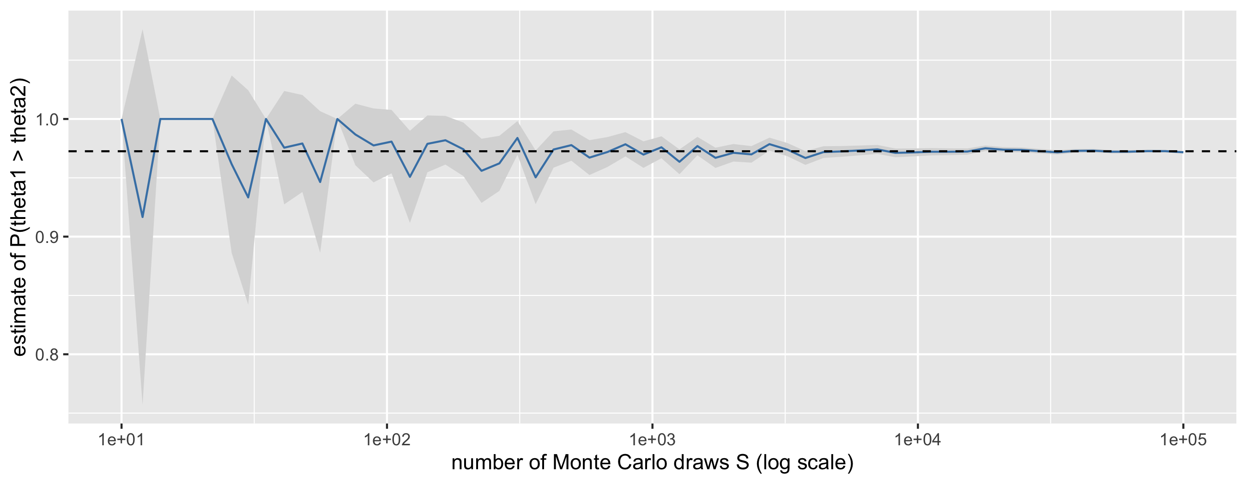
Example: comparing two groups

Slide 15
Markov Ccain Monte Carlo (MCMC)

Slide 16
Why we need MCMC
Monte Carlo needs independent draws from the posterior. We can get them when the posterior is a standard distribution, but usually all we can do is evaluate the unnormalised posterior
$$\tilde{p}(θ∣y)=p(y∣θ) p(θ),$$
pointwise, because the normalising constant $p(y)$ is an intractable integral.

Slide 17
Why we need MCMC
Markov chain Monte Carlo constructs a sequence $θ^{(1)},θ^{(2)},…$ in which each value depends only on the previous one (a Markov chain), designed so that its long-run distribution (its stationary distribution) is the posterior.
The price: the draws are dependent and the chain needs time to reach the posterior from its starting point.
The payoff: we only ever need $\tilde{p}$, never $p(y)$, since the constant cancels in ratios.

Slide 18
A non-conjugate example
Return to the malaria-episodes data but now put the prior on the log rate, which is natural if we later want to add covariates (Poisson regression):
$$Y_{i}∣λ∼_{\text{iid}}\text{Pois}(λ), λ=e^{θ}, θ∼𝒩(0,{1.5}^{2}).$$
This prior is not conjugate; the posterior of $θ$ has no standard form.

Slide 19
A non-conjugate example
But its log is trivial to evaluate:
log_post <- function(theta) {
sum(dpois(y, lambda = exp(theta), log = TRUE)) + dnorm(theta, 0, 1.5, log = TRUE)
}

Slide 20
A non-conjugate example
For reference (and only because this is one-dimensional) we can also compute a grid answer:
theta_grid <- seq(-1, 2, length = 2001)
lp <- sapply(theta_grid, log_post)
grid_post <- exp(lp - max(lp))
grid_post <- grid_post / sum(grid_post * diff(theta_grid)[1])

Slide 21
The Metropolis algorithm
Starting from some $θ^{(0)}$, repeat for $s=1,2,…,S$:
Propose $θ^{∗}∼𝒩(θ^{(s−1)},δ^{2})$ (a random-walk step of size $δ$).
Compute the acceptance ratio $r=\frac{\tilde{p}(θ^{∗}∣y)}{\tilde{p}(θ^{(s−1)}∣y)}$; the unknown $p(y)$ cancels.
Draw $u∼\text{Unif}(0,1)$. If $u<r$ accept, $θ^{(s)}=θ^{∗}$; otherwise reject, $θ^{(s)}=θ^{(s−1)}$.

Slide 22
The Metropolis algorithm
Moves uphill (towards higher posterior density) are always accepted.
Moves downhill are accepted with probability $r$.
The chain therefore spends time in each region in proportion to its posterior probability.
On the log scale step 3 becomes:
accept if $logu<log\tilde{p}(θ^{∗})−log\tilde{p}(θ^{(s−1)})$.

Slide 23
The Metropolis algorithm
metropolis <- function(log_target, n_iter, init, step) {
theta <- numeric(n_iter)
theta[1] <- init
lp_current <- log_target(init)
n_accept <- 0
for (s in 2:n_iter) {
proposal <- rnorm(1, mean = theta[s - 1], sd = step)
lp_proposal <- log_target(proposal)
if (log(runif(1)) < lp_proposal - lp_current) {
theta[s] <- proposal; lp_current <- lp_proposal; n_accept <- n_accept + 1
} else {
theta[s] <- theta[s - 1]
}
}
list(theta = theta, acceptance_rate = n_accept / (n_iter - 1))
}

Slide 24
The Metropolis algorithm
That is the whole algorithm: sixteen lines of R. Does it work?
set.seed(1)
run <- metropolis(log_post, n_iter = 20000, init = -1, step = 0.3)
run$acceptance_rate
[1] 0.5134257

Slide 25
The Metropolis algorithm
keep <- run$theta[-(1:1000)] # discard the first 1000 iterations (burn-in)
ggplot() +
geom_histogram(aes(x = keep, y = after_stat(density)), bins = 60,
fill = "steelblue", colour = "white") +
geom_line(aes(theta_grid, grid_post), colour = "salmon", linewidth = 1) +
coord_cartesian(xlim = c(0, 1.3)) +
labs(x = expression(theta == log(lambda)), y = "density",
subtitle = "Histogram: Metropolis draws; line: grid approximation")
c(post_mean_lambda = mean(exp(keep)), quantile(exp(keep), c(0.025, 0.975)))

Slide 26
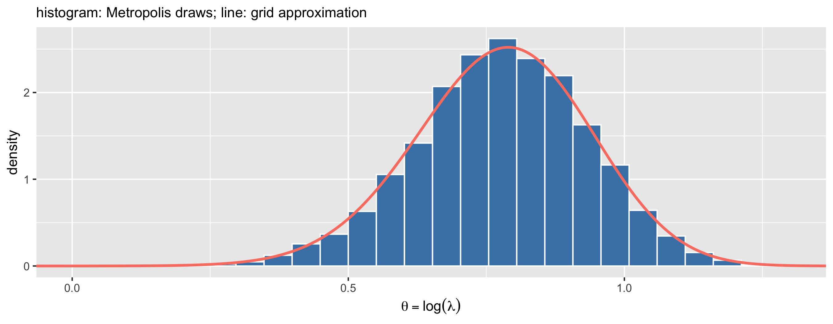
The Metropolis algorithm

Slide 27
post_mean_lambda 2.5% 97.5%
2.204286 1.576547 2.911583

Slide 28
Tuning the step size
The algorithm is correct for any step size $δ>0$, but its efficiency depends strongly on $δ$:
set.seed(2)
runs <- map_dfr(c(0.02, 0.3, 5), function(d) {
r <- metropolis(log_post, n_iter = 2000, init = -1, step = d)
tibble(step = paste0("step = ", d, " (acceptance ", round(100 * r$acceptance_rate), "%)"),
iteration = seq_along(r$theta), theta = r$theta)
})
ggplot(runs, aes(iteration, theta)) +
geom_line(colour = "steelblue", linewidth = 0.3) +
facet_wrap(~step, ncol = 1) +
labs(y = expression(theta))

Slide 29
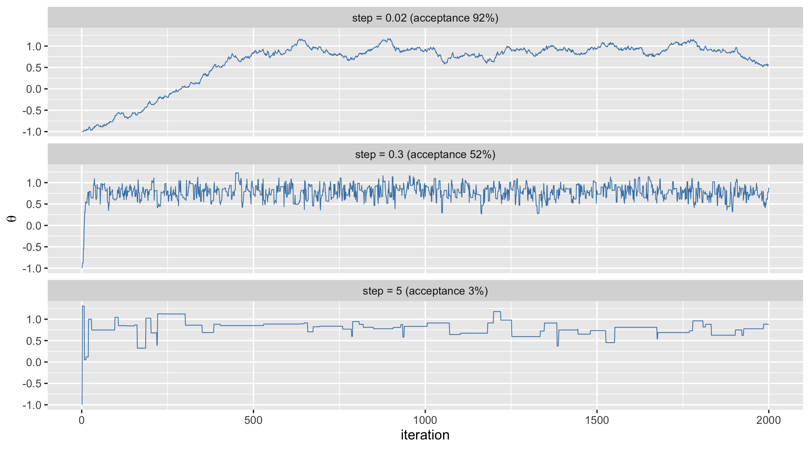
Tuning the step size

Slide 30
Tuning the step size
Too small: nearly every proposal is accepted but the chain crawls; it takes hundreds of iterations to leave the (bad) starting value and successive draws are almost identical.
Too large: most proposals land in the tails and are rejected; the chain sticks for long stretches.
About right: the trace looks like a “hairy caterpillar”. For random-walk Metropolis, acceptance rates of roughly 20-50% are a good target (about 44% in one dimension, decreasing towards 23% in many dimensions).
Software such as NIMBLE tunes $δ$ automatically during an adaptation phase.

Slide 31
Metropolis-Hastings
If the proposal distribution $q(θ^{∗}∣θ)$ is not symmetric (for example, proposals on the log scale for a positive parameter), the ratio needs a correction:
$$r=\frac{\tilde{p}(θ^{∗}∣y) q(θ^{(s−1)}∣θ^{∗})}{\tilde{p}(θ^{(s−1)}∣y) q(θ^{∗}∣θ^{(s−1)})}.$$
This is the Metropolis-Hastings algorithm. For a symmetric proposal the $q$ terms cancel and we recover Metropolis. The correction ensures detailed balance, $p(θ)T(θ→θ^{∗})=p(θ^{∗})T(θ^{∗}→θ)$, which guarantees that the posterior is the stationary distribution of the chain.

Slide 32
The Gibbs sampler
When the parameter is a vector $φ=(φ_{1},…,φ_{p})$ and every full conditional $p(φ_{j}∣\text{all other parameters},y)$ is a distribution we can sample from, update one component at a time, always conditioning on the most recent values:
$$\begin{aligned}φ_{1}^{(s)}&∼p\left(φ_{1}∣φ_{2}^{(s−1)},φ_{3}^{(s−1)},…,φ_{p}^{(s−1)},y\right) \\ φ_{2}^{(s)}&∼p\left(φ_{2}∣φ_{1}^{(s)},φ_{3}^{(s−1)},…,φ_{p}^{(s−1)},y\right) \\ & ⋮ \\ φ_{p}^{(s)}&∼p\left(φ_{p}∣φ_{1}^{(s)},φ_{2}^{(s)},…,φ_{p−1}^{(s)},y\right)\end{aligned}$$

Slide 33
The Gibbs sampler
Gibbs sampling is a special case of Metropolis-Hastings in which
the proposal is the full conditional itself,
every proposal is accepted ($r=1$).

Slide 34
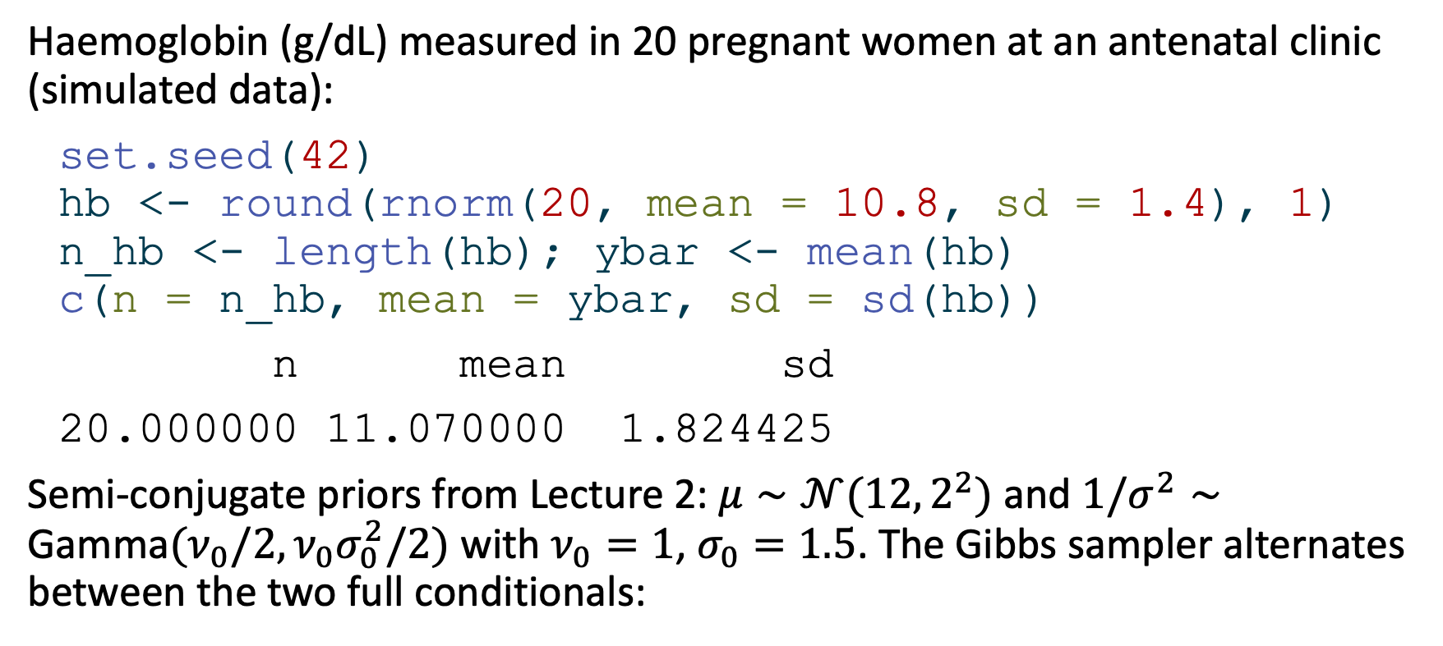
Example: haemoglobin with unknown mean and variance
Haemoglobin (g/dL) measured in 20 pregnant women at an antenatal clinic (simulated data):
set.seed(42)
hb <- round(rnorm(20, mean = 10.8, sd = 1.4), 1)
n_hb <- length(hb); ybar <- mean(hb)
c(n = n_hb, mean = ybar, sd = sd(hb))
n mean sd
20.000000 11.070000 1.824425
Semi-conjugate priors from Lecture 2: $μ∼𝒩(12,2^{2})$ and $1/σ^{2}∼\text{Gamma}(ν_{0}/2,ν_{0}σ_{0}^{2}/2)$ with $ν_{0}=1$, $σ_{0}=1.5$. The Gibbs sampler alternates between the two full conditionals:

Slide 35
Example: haemoglobin with unknown mean and variance
gibbs_normal <- function(y, S, mu_init, sigma2_init,
mu0 = 12, tau0_2 = 4, nu0 = 1, sigma0_2 = 1.5^2) {
n <- length(y); ybar <- mean(y)
mu <- sigma2 <- numeric(S)
mu[1] <- mu_init; sigma2[1] <- sigma2_init
for (s in 2:S) {
# 1. mu | sigma2, y ~ Normal
tau_n2 <- 1 / (1 / tau0_2 + n / sigma2[s - 1])
mu_n <- tau_n2 * (mu0 / tau0_2 + n * ybar / sigma2[s - 1])
mu[s] <- rnorm(1, mu_n, sqrt(tau_n2))
# 2. 1/sigma2 | mu, y ~ Gamma (uses the NEW value mu[s])
shape <- (nu0 + n) / 2
rate <- (nu0 * sigma0_2 + sum((y - mu[s])^2)) / 2
sigma2[s] <- 1 / rgamma(1, shape = shape, rate = rate)
}
tibble(iteration = 1:S, mu = mu, sigma = sqrt(sigma2))
}

Slide 36
Example: haemoglobin with unknown mean and variance
set.seed(3)
gs <- gibbs_normal(hb, S = 5000, mu_init = 6, sigma2_init = 20) # deliberately poor start
p1 <- ggplot(gs[1:30, ], aes(mu, sigma)) +
geom_path(colour = "grey50") + geom_point(colour = "salmon") +
geom_density_2d(data = gs[-(1:500), ], colour = "steelblue") +
labs(title = "first 30 Gibbs steps", x = expression(mu), y = expression(sigma))
p2 <- gs |> pivot_longer(c(mu, sigma)) |>
ggplot(aes(iteration, value)) + geom_line(linewidth = 0.2, colour = "steelblue") +
facet_wrap(~name, ncol = 1, scales = "free_y") + labs(title = "trace plots", y = NULL)
gridExtra::grid.arrange(p1, p2, ncol = 2)
gs[-(1:500), ] |>
summarise(across(c(mu, sigma), list(mean = mean, lo = ~quantile(.x, 0.025), hi = ~quantile(.x, 0.975))))

Slide 37
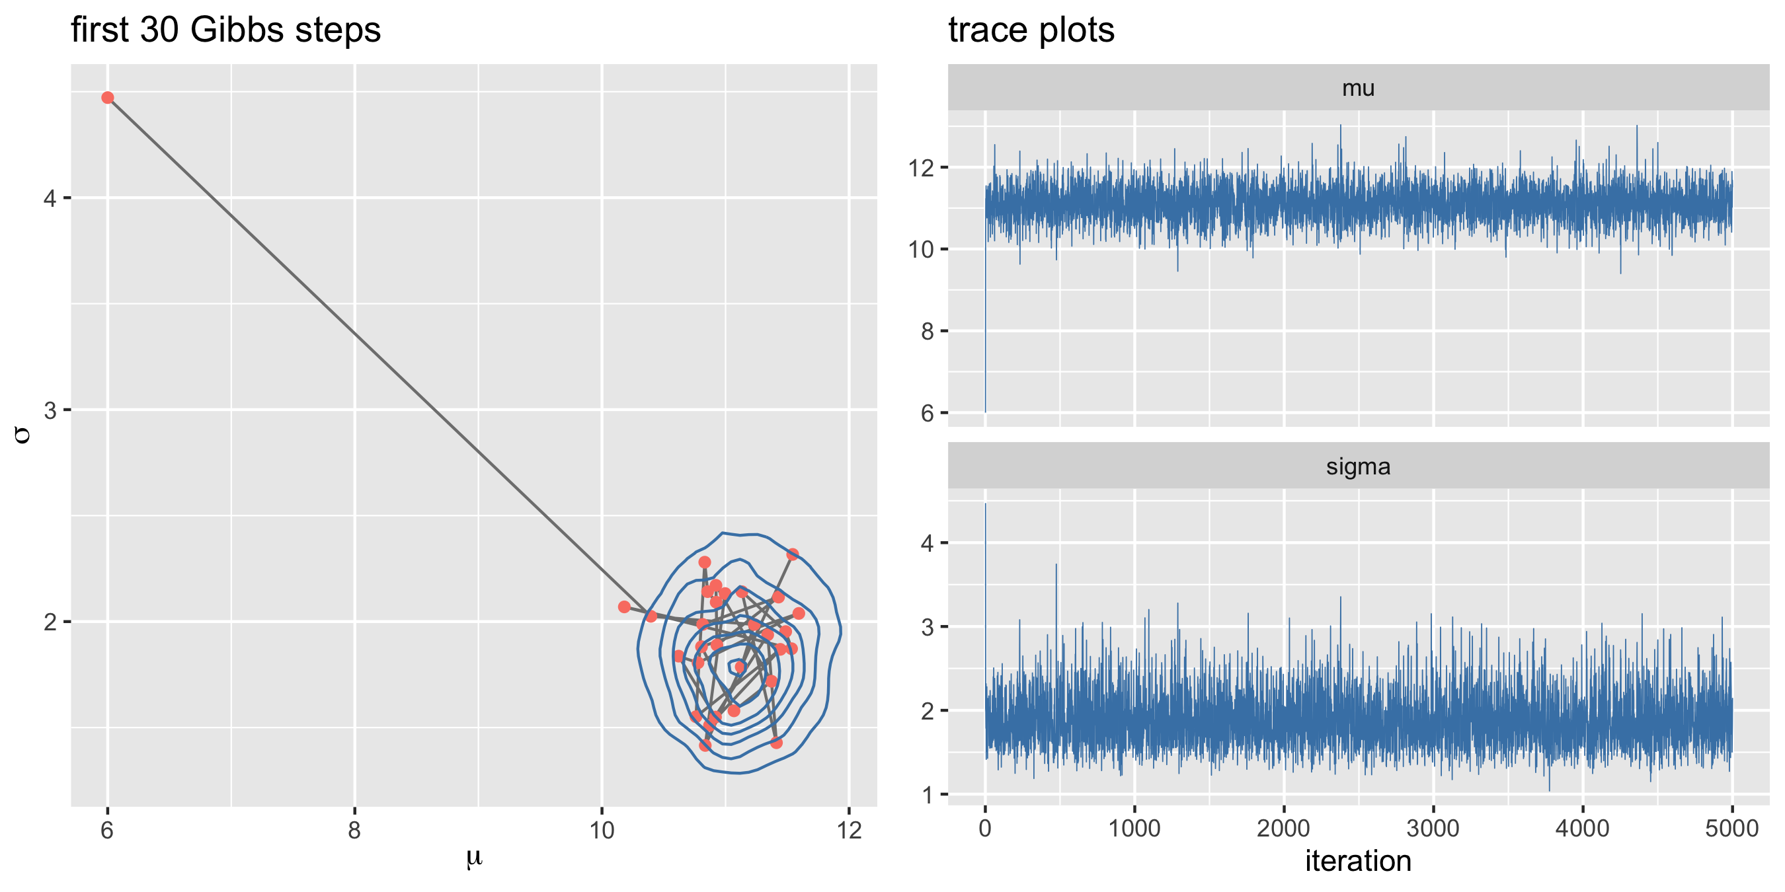
Example: haemoglobin with unknown mean and variance

Slide 38
# A tibble: 1 × 6
mu_mean mu_lo mu_hi sigma_mean sigma_lo sigma_hi
<dbl> <dbl> <dbl> <dbl> <dbl> <dbl>
1 11.1 10.3 11.9 1.88 1.37 2.64

Slide 39
Example: haemoglobin with unknown mean and variance
The path moves in axis-parallel steps (one parameter at a time), quickly leaves the poor starting point, and then wanders around the posterior.
Note how the first few iterations are clearly not representative of the posterior: they should be discarded as burn-in (also called warm-up).

Slide 40
Beyond Metropolis and Gibbs
Real software combines and extends these building blocks:
Metropolis-within-Gibbs: update each parameter (or block of parameters) in turn, by a Gibbs step if its full conditional is standard, by a Metropolis step otherwise. This is essentially what NIMBLE and JAGS do by default.
Block updating: update strongly correlated parameters jointly (e.g. all regression coefficients), with a multivariate random-walk or slice sampler. One-at-a-time updates move very slowly along narrow diagonal ridges.

Slide 41
Beyond Metropolis and Gibbs
Hamiltonian Monte Carlo (HMC) and its adaptive version NUTS use the gradient of $log\tilde{p}$ to propose distant moves that are still likely to be accepted. They scale much better to high dimensions and correlated posteriors. HMC/NUTS is the engine of Stan (and brms), and is available in NIMBLE through the nimbleHMC package.
Approximate methods that avoid sampling altogether (integrated nested Laplace approximation, INLA; variational inference) are fast for particular model classes, at the cost of being approximations.

Slide 42
When MCMC struggles
Things to watch for (they motivate the diagnostics of Lecture 4):
Starting values far from the posterior: need a longer burn-in; use several chains from dispersed starting values.
Strong posterior correlation between parameters, e.g. intercept and slope when a covariate is not centred: one-at-a-time samplers mix slowly.
Multimodality: a chain can get stuck in one mode; different chains may find different modes.
Weakly identified parameters (vague priors + little data): the chain drifts over huge ranges.
“Funnels” in hierarchical models (Lecture 5): the scale of some parameters depends strongly on another parameter.

Slide 43
[end of STA623 Bayesian Data analysis Session 3]

