Slide 1
STA623 Bayesian Data Analysis
Session 4: MCMC in practice: NIMBLE and convergence diagnostics
Marc Henrion

Slide 2
PRELIMINARIES

Slide 3
Code notes

Slide 4

These notes have been prepared using quarto - qmd shared on GitHub.
All code is R; Bayesian models are specified in NIMBLE (a dialect of BUGS).
R packages used: tidyverse, gridExtra, HDInterval, nimble, coda, posterior, loo (plus MCMCvis optionally). Install them all before the first practical: NIMBLE needs a working C++ compiler (Rtools on Windows, Xcode command line tools on macOS).
Course materials: https://github.com/gitMarcH/UNIMA_STA623_2026

Slide 5
License

Slide 6
The quarto code is subject to an MIT license (Marc Henrion).
The compiled html is subject to a CC BY 4.0 license (Marc Henrion).

Slide 7
Morning quiz

Slide 8
Software for Bayesian computation

Slide 9
Software for Bayesian computation
Software | Model language | Samplers | Notes
NIMBLE | BUGS dialect, in R | Gibbs, Metropolis, slice, block; HMC | Used in this course
Stan (rstan, cmdstanr) | Own language | HMC / NUTS | State of the art; no discrete parameters
brms, rstanarm | R formulas | Stan | Fastest route from a GLMM to a Bayesian fit
JAGS | BUGS | Gibbs, slice | Very similar code to NIMBLE
R-INLA | R formulas | Not MCMC | Fast for latent Gaussian models

Slide 10
The concepts (model specification, priors, diagnostics, checking) transfer directly between these tools. Knowing BUGS/NIMBLE code also helps you read a large body of published epidemiological models.

Slide 11
NIMBLE

Slide 12
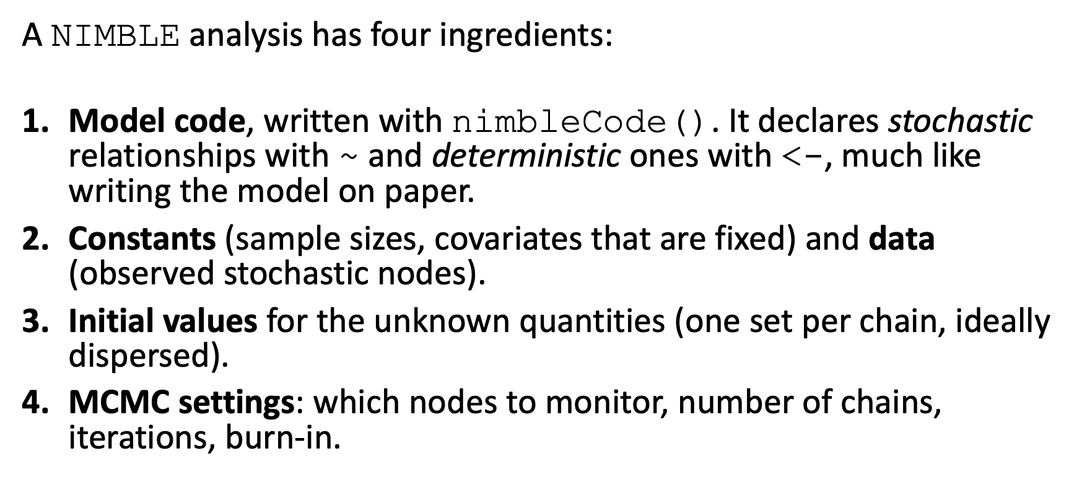
The NIMBLE workflow
A NIMBLE analysis has four ingredients:
Model code, written with nimbleCode(). It declares stochastic relationships with ~ and deterministic ones with <-, much like writing the model on paper.
Constants (sample sizes, covariates that are fixed) and data (observed stochastic nodes).
Initial values for the unknown quantities (one set per chain, ideally dispersed).
MCMC settings: which nodes to monitor, number of chains, iterations, burn-in.

Slide 13
Example: the non-conjugate Poisson model of Lecture 3
y <- c(1, 3, 2, 3, 0, 2, 6, 4, 4, 1, 1, 3, 2, 3, 1, 1, 3, 0)
pois_code <- nimbleCode({
# sampling model
for (i in 1:N) {
y[i] ~ dpois(lambda)
}
lambda <- exp(theta) # deterministic node
# prior
theta ~ dnorm(0, sd = 1.5)
})

Slide 14
Example: the non-conjugate Poisson model of Lecture 3
The quickest way to run it is the one-line interface nimbleMCMC():
pois_fit <- nimbleMCMC(
code = pois_code,
constants = list(N = length(y)),
data = list(y = y),
inits = function() list(theta = rnorm(1, 0, 1)), # a function: new draw for each chain
monitors = c("theta", "lambda"),
nchains = 4,
niter = 6000,
nburnin = 1000,
setSeed = TRUE,
progressBar = FALSE,
samplesAsCodaMCMC = TRUE
)

Slide 15
Example: the non-conjugate Poisson model of Lecture 3
The result is an mcmc.list (one matrix of draws per chain), which the coda and posterior packages understand:
summarise_draws(as_draws(pois_fit))
# A tibble: 2 × 10
variable mean median sd mad q5 q95 rhat ess_bulk ess_tail
<chr> <dbl> <dbl> <dbl> <dbl> <dbl> <dbl> <dbl> <dbl> <dbl>
1 lambda 2.20 2.18 0.351 0.347 1.66 2.81 1.00 4341. 4765.
2 theta 0.777 0.780 0.160 0.159 0.505 1.03 1.00 4341. 4765.
Compare with your own Metropolis sampler from Lecture 3: the posterior summaries should agree up to Monte Carlo error.

Slide 16
The step-by-step workflow
nimbleMCMC() wraps several steps. Doing them explicitly gives more control, in particular over which sampler is used for which parameter:
pois_model <- nimbleModel(pois_code, constants = list(N = length(y)),
data = list(y = y), inits = list(theta = 0))
pois_conf <- configureMCMC(pois_model, monitors = c("theta", "lambda"))
pois_conf$printSamplers() # NIMBLE chose an adaptive random-walk Metropolis sampler for theta

Slide 17
The step-by-step workflow
pois_mcmc <- buildMCMC(pois_conf)
c_model <- compileNimble(pois_model) # translate to C++ and compile
c_mcmc <- compileNimble(pois_mcmc, project = pois_model)
pois_fit2 <- runMCMC(c_mcmc, niter = 6000, nburnin = 1000, nchains = 4,
inits = function() list(theta = rnorm(1, 0, 1)),
setSeed = TRUE, progressBar = FALSE, samplesAsCodaMCMC = TRUE)
Between configureMCMC() and buildMCMC() you can remove, replace and add samplers (we will do this below). A compiled model can be re-run with different data or settings without recompiling.

Slide 18
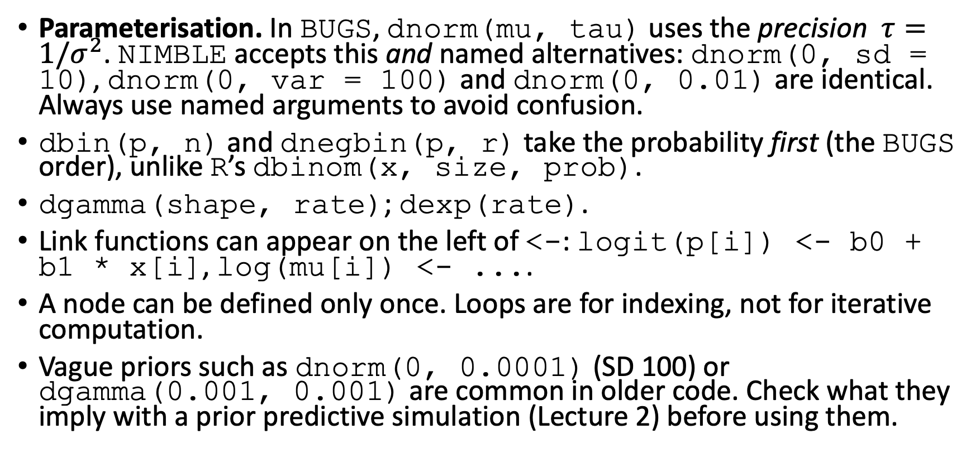
NIMBLE / BUGS code: common pitfalls
Parameterisation. In BUGS, dnorm(mu, tau) uses the precision $τ=1/σ^{2}$. NIMBLE accepts this and named alternatives: dnorm(0, sd = 10), dnorm(0, var = 100) and dnorm(0, 0.01) are identical. Always use named arguments to avoid confusion.
dbin(p, n) and dnegbin(p, r) take the probability first (the BUGS order), unlike R’s dbinom(x, size, prob).
dgamma(shape, rate); dexp(rate).
Link functions can appear on the left of <-: logit(p[i]) <- b0 + b1 * x[i], log(mu[i]) <- ....
A node can be defined only once. Loops are for indexing, not for iterative computation.
Vague priors such as dnorm(0, 0.0001) (SD 100) or dgamma(0.001, 0.001) are common in older code. Check what they imply with a prior predictive simulation (Lecture 2) before using them.

Slide 19
Convergence diagnostics
MCMC gives correct answers eventually.
Diagnostics ask: is our finite run long enough, and have the chains forgotten their starting values?
We can never prove convergence, but we can often detect non-convergence.
Always run at least 4 chains from dispersed starting values.

Slide 20
Trace plots
trace_plot(pois_fit, "theta")

Slide 21
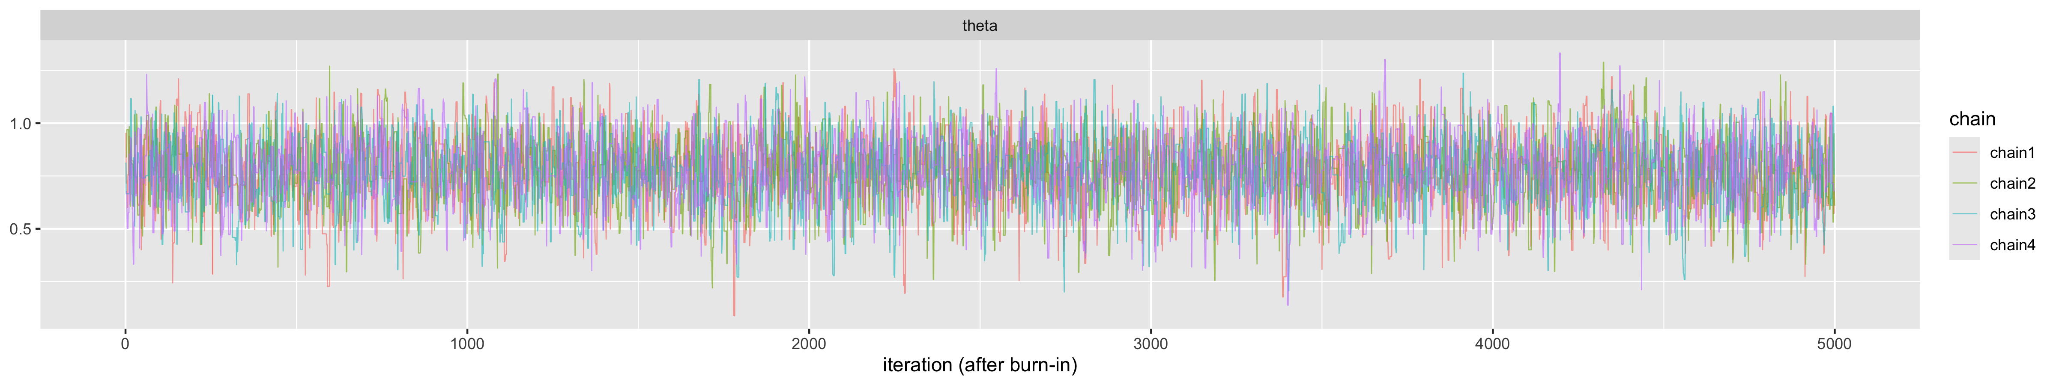
Trace plots

Slide 22
Trace plots
Good: all chains overlap and look like stationary noise (“hairy caterpillars”).
Bad: trends, chains in different places, long flat stretches, occasional excursions.

Slide 23
$\hat{R}$ (potential scale reduction factor)
$\hat{R}$ compares the variation between chains with the variation within chains. If all chains sample the same distribution these agree and $\hat{R}≈1$. The modern, rank-normalised version (Vehtari et al., 2021, computed by the posterior package) also detects differences in the tails and in scale.
Rule of thumb: $\hat{R}<1.01$ for every parameter of interest. (Older texts use 1.1; that threshold is too lax.) coda::gelman.diag() gives the original version.

Slide 24
Autocorrelation and effective sample size
MCMC draws are autocorrelated, so $S$ correlated draws carry less information than $S$ independent ones. The effective sample size
$$\text{ESS}=\frac{S}{1+2\sum_{t=1}^{∞}{ρ_{t}}},$$
where $ρ_{t}$ is the lag-$t$ autocorrelation, is the number of independent draws with the same Monte Carlo precision. The MCSE of a posterior mean is $\text{sd}/\sqrt{\text{ESS}}$.

Slide 25
Autocorrelation and effective sample size
posterior reports two versions: bulk-ESS (reliability of means and medians) and tail-ESS (reliability of 2.5% and 97.5% quantiles, i.e. credible intervals). Rule of thumb: both above 400 (100 per chain with 4 chains) before trusting summaries; more if you need precise tail probabilities.
summarise_draws(as_draws(pois_fit), "mean", "sd", "rhat", "ess_bulk", "ess_tail", "mcse_mean")
# A tibble: 2 × 7
variable mean sd rhat ess_bulk ess_tail mcse_mean
<chr> <dbl> <dbl> <dbl> <dbl> <dbl> <dbl>
1 lambda 2.20 0.351 1.00 4341. 4765. 0.00531
2 theta 0.777 0.160 1.00 4341. 4765. 0.00244

Slide 26
Burn-in, thinning, run length
Burn-in / warm-up: discard the initial part of each chain (and the part during which samplers adapt their step sizes). Inspect trace plots from the very first iteration if in doubt; NIMBLE’s default of 0 burn-in is rarely appropriate.
Thinning (keeping every $k$-th draw) reduces the information in the run. Use it only to save memory for very long runs of many parameters.
Run length: increase niter until $\hat{R}$ and ESS criteria are met. If this needs millions of iterations, fix the model or sampler instead (next section).

Slide 27
Case study: a sampler that mixes badly, and how to fix it

Slide 28
Case study
Simulated data for a linear regression with three covariates, one of which ($x_{3}$, a count with mean 20) is far from zero:
$$Y_{i}=β_{0}+β_{1}x_{1i}+β_{2}x_{2i}+β_{3}x_{3i}+ε_{i}, ε_{i}∼𝒩(0,σ^{2}).$$

Slide 29
Case study
set.seed(1309)
N <- 50
reg_df <- tibble(x1 = rexp(N, rate = 2),
x2 = rnorm(N, mean = -2, sd = 0.5),
x3 = rpois(N, lambda = 20)) |>
mutate(y = 5 + x1 + 0.1 * x3 + rnorm(N, 0, 0.75))

Slide 30
Case study
lm_code <- nimbleCode({
for (i in 1:N) {
y[i] ~ dnorm(mu[i], sd = sigma)
mu[i] <- b0 + b1 * x1[i] + b2 * x2[i] + b3 * x3[i]
}
b0 ~ dnorm(0, sd = 10)
b1 ~ dnorm(0, sd = 10)
b2 ~ dnorm(0, sd = 10)
b3 ~ dnorm(0, sd = 10)
sigma ~ dexp(1)
})
lm_inits <- function() list(b0 = rnorm(1, 0, 3), b1 = rnorm(1), b2 = rnorm(1), b3 = rnorm(1), sigma = runif(1, 0.5, 2))

Slide 31
Case study
lm_fit_raw <- nimbleMCMC(
code = lm_code, constants = list(N = N),
data = list(y = reg_df$y, x1 = reg_df$x1, x2 = reg_df$x2, x3 = reg_df$x3),
inits = lm_inits, monitors = c("b0", "b1", "b2", "b3", "sigma"),
nchains = 4, niter = 3000, nburnin = 1000, setSeed = TRUE,
progressBar = FALSE, samplesAsCodaMCMC = TRUE)

Slide 32
Case study
trace_plot(lm_fit_raw)
summarise_draws(as_draws(lm_fit_raw), "mean", "sd", "rhat", "ess_bulk", "ess_tail")

Slide 33
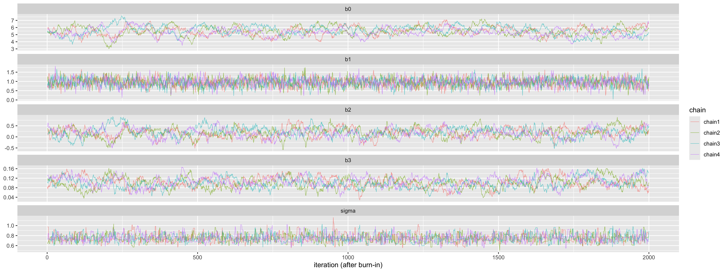
Case study

Slide 34
# A tibble: 5 × 6
variable mean sd rhat ess_bulk ess_tail
<chr> <dbl> <dbl> <dbl> <dbl> <dbl>
1 b0 5.47 0.632 1.03 185. 415.
2 b1 0.950 0.226 1.00 1963. 3981.
3 b2 0.186 0.222 1.01 241. 410.
4 b3 0.102 0.0223 1.03 200. 459.
5 sigma 0.752 0.0791 1.00 1673. 1647.

Slide 35
Case study
The traces for $β_{0}$, $β_{2}$ and $β_{3}$ wander slowly and the ESS values are far below those of $β_{1}$ and $σ$.
The reason is visible in a scatterplot of the draws:
as_tibble(as.matrix(lm_fit_raw)) |>
ggplot(aes(b3, b0)) + geom_point(alpha = 0.1, size = 0.5, colour = "steelblue") +
labs(title = "posterior draws of intercept vs slope of x3")
round(cor(as.matrix(lm_fit_raw))[1:4, 1:4], 2)

Slide 36
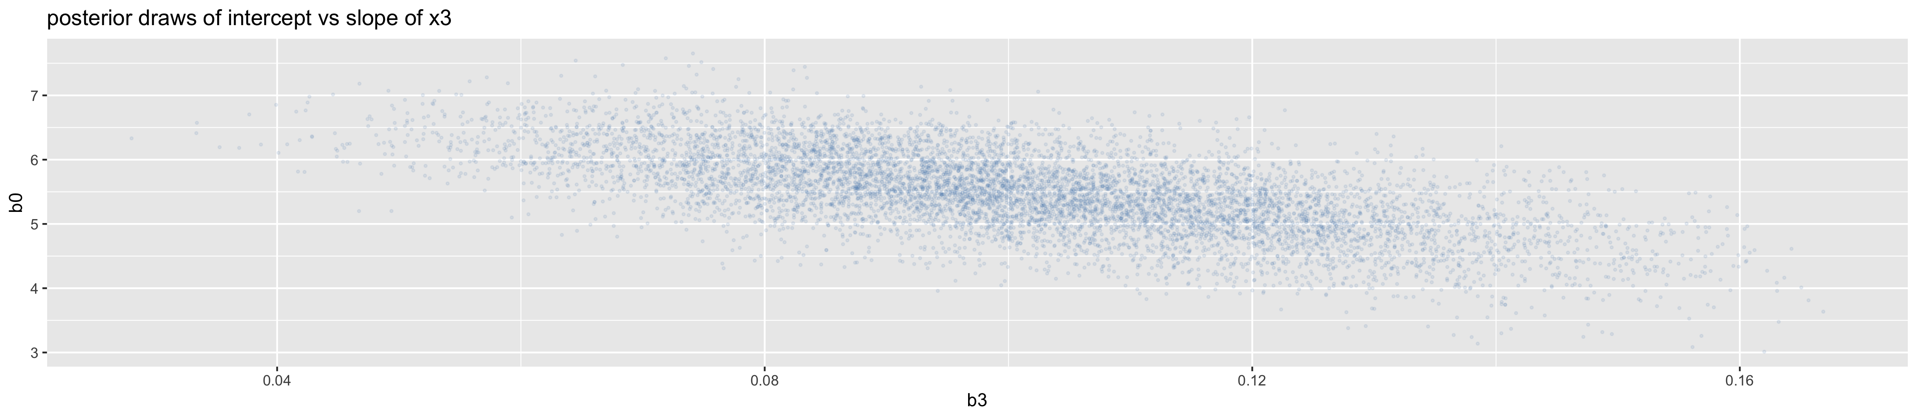
Case study

Slide 37
b0 b1 b2 b3
b0 1.00 -0.27 0.63 -0.65
b1 -0.27 1.00 -0.11 0.00
b2 0.63 -0.11 1.00 0.13
b3 -0.65 0.00 0.13 1.00

Slide 38
Case study
Because $x_{2}$ and $x_{3}$ are far from 0, the intercept (the expected outcome at $x_{2}=x_{3}=0$, far outside the data) is tightly linked to the slopes: whenever $β_{3}$ goes up, $β_{0}$ must go down to keep the fitted line through the data, and similarly for $β_{2}$.
Jointly, the posterior of $(β_{0},β_{2},β_{3})$ is a narrow ridge.
NIMBLE’s default samplers here are exact conjugate Gibbs updates, but they update one coefficient at a time, holding the others fixed, and so can only take small steps along the ridge.

Slide 39
Case study
Fix 1: centre the covariates.
With $x_{j}−{\overset{‾}{x}}_{j}$ the intercept becomes the expected outcome at average covariate values, and the correlation largely disappears. (Scaling covariates to unit SD also helps and makes priors easier to set.)

Slide 40
Case study
reg_c <- reg_df |> mutate(across(c(x1, x2, x3), ~ .x - mean(.x)))
lm_fit_c <- nimbleMCMC(
code = lm_code, constants = list(N = N),
data = list(y = reg_c$y, x1 = reg_c$x1, x2 = reg_c$x2, x3 = reg_c$x3),
inits = lm_inits, monitors = c("b0", "b1", "b2", "b3", "sigma"),
nchains = 4, niter = 3000, nburnin = 1000, setSeed = TRUE,
progressBar = FALSE, samplesAsCodaMCMC = TRUE)

Slide 41
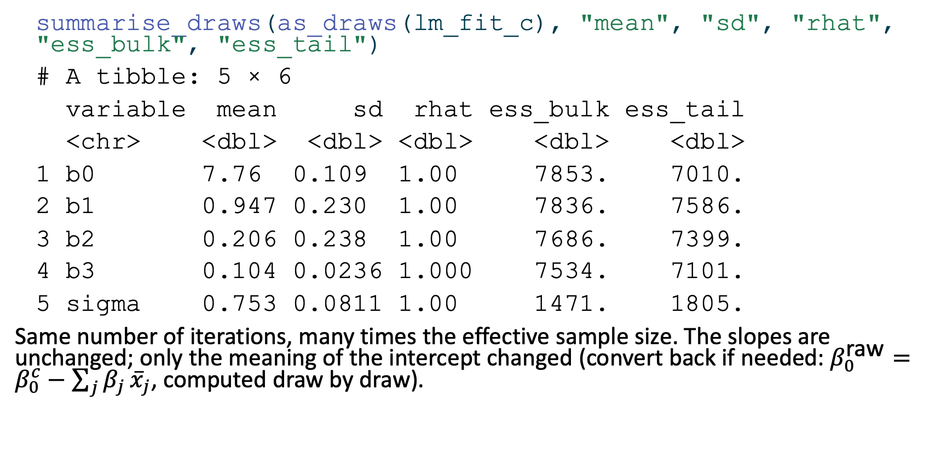
Case study
summarise_draws(as_draws(lm_fit_c), "mean", "sd", "rhat", "ess_bulk", "ess_tail")
# A tibble: 5 × 6
variable mean sd rhat ess_bulk ess_tail
<chr> <dbl> <dbl> <dbl> <dbl> <dbl>
1 b0 7.76 0.109 1.00 7853. 7010.
2 b1 0.947 0.230 1.00 7836. 7586.
3 b2 0.206 0.238 1.00 7686. 7399.
4 b3 0.104 0.0236 1.000 7534. 7101.
5 sigma 0.753 0.0811 1.00 1471. 1805.
Same number of iterations, many times the effective sample size. The slopes are unchanged; only the meaning of the intercept changed (convert back if needed: $β_{0}^{\text{raw}}=β_{0}^{c}−\sum_{j}^{​}{β_{j}}{\overset{‾}{x}}_{j}$, computed draw by draw).

Slide 42
Case study
Fix 2: change the sampler.
Keep the original parameterisation but update all four coefficients jointly, with a sampler that learns the correlation structure of the posterior. NIMBLE’s automated factor slice sampler (AF_slice) does this well:

Slide 43
Case study
lm_model <- nimbleModel(lm_code, constants = list(N = N),
data = list(y = reg_df$y, x1 = reg_df$x1, x2 = reg_df$x2, x3 = reg_df$x3),
inits = lm_inits())
lm_conf <- configureMCMC(lm_model, monitors = c("b0", "b1", "b2", "b3", "sigma"))
lm_conf$removeSamplers(c("b0", "b1", "b2", "b3"))
lm_conf$addSampler(target = c("b0", "b1", "b2", "b3"), type = "AF_slice")
c_lm <- compileNimble(lm_model)
c_lm_mcmc <- compileNimble(buildMCMC(lm_conf), project = lm_model)
lm_fit_block <- runMCMC(c_lm_mcmc, niter = 3000, nburnin = 1000, nchains = 4,
inits = lm_inits, setSeed = TRUE, progressBar = FALSE,
samplesAsCodaMCMC = TRUE)

Slide 44
Case study
summarise_draws(as_draws(lm_fit_block), "mean", "sd", "rhat", "ess_bulk", "ess_tail")
# A tibble: 5 × 6
variable mean sd rhat ess_bulk ess_tail
<chr> <dbl> <dbl> <dbl> <dbl> <dbl>
1 b0 5.46 0.676 1.00 8079. 5871.
2 b1 0.951 0.230 1.00 7137. 5685.
3 b2 0.208 0.237 1.00 8172. 6593.
4 b3 0.104 0.0233 1.00 7452. 6782.
5 sigma 0.755 0.0823 1.00 1548. 1821.

Slide 45
Case study
Same model, same number of iterations, and again an effective sample size close to the number of draws. Not every alternative sampler helps automatically: a random-walk block sampler (RW_block) is also available, but it needs a long adaptation phase before it becomes efficient, so its diagnostics must be checked just as carefully.
Finally, a sanity check: with vague priors and a simple model the posterior means should be close to the least-squares estimates.

Slide 46
Case study
cbind(bayes_posterior_mean = colMeans(as.matrix(lm_fit_c))[c("b0", "b1", "b2", "b3")],
least_squares = coef(lm(y ~ x1 + x2 + x3, data = reg_c)))
bayes_posterior_mean least_squares
b0 7.7574584 7.7573153
b1 0.9465793 0.9484755
b2 0.2063927 0.2087201
b3 0.1035333 0.1039762

Slide 47
What to do when diagnostics fail

Slide 48
What to do when diagnostics fail
In roughly this order:
Look at trace and pair plots to see which parameters mix badly and why (trends? correlations? stuck chains?).
Check the model code and data for errors (wrong parameterisation, precision instead of SD, data mis-coded). Many convergence problems are bugs.
Reparameterise: centre and scale covariates; use non-centred parameterisations for hierarchical models (Lecture 5); sample on unconstrained scales.
Use more informative (weakly informative) priors where parameters are poorly identified by the data.
Change samplers: block samplers for correlated parameters, slice samplers, HMC (nimbleHMC or Stan).
Run longer. This is the last resort, not the first.

Slide 49
[end of STA623 Bayesian Data analysis Session 4]

