Slide 1
STA623 Bayesian Data Analysis
Session 5: Bayesian regression, model checking, comparison, hierarchical models
Marc Henrion

Slide 2
Preliminaries

Slide 3

Code notes
These notes have been prepared using quarto - qmd shared on GitHub.
All code is R; Bayesian models are specified in NIMBLE (a dialect of BUGS).
R packages used: tidyverse, gridExtra, HDInterval, nimble, coda, posterior, loo (plus MCMCvis optionally). Install them all before the first practical: NIMBLE needs a working C++ compiler (Rtools on Windows, Xcode command line tools on macOS).
Course materials: https://github.com/gitMarcH/UNIMA_STA623_2026

Slide 4
License
The quarto code is subject to an MIT license (Marc Henrion).
The compiled html is subject to a CC BY 4.0 license (Marc Henrion).

Slide 5
Morning Quiz

Slide 6
A Bayesian workflow

Slide 7
A Bayesian workflow
Fitting a model is one step in an iterative process (Gelman et al., 2020):
Formulate a sampling model from subject-matter knowledge and the study design.
Choose priors and check them with prior predictive simulation.
Fit the model (MCMC) and check the computation ($\hat{R}$, ESS, trace plots).
Check the model against the data: posterior predictive checks.
Compare / expand models where checks reveal problems; compare by predictive performance (LOO, WAIC).
Summarise and report posterior quantities that answer the scientific question, with sensitivity analyses.
This lecture goes through the loop with three examples typical of biostatistics.

Slide 8
Logistic regression

Slide 9
Example (simulated)
In a household survey, 300 children aged 6 months to 5 years were tested for anaemia. We want the association with bed-net use, adjusted for age.
The model:
$$\begin{aligned}&Y_{i}∼\text{Bernoulli}(p_{i}), \\ &\text{logit}(p_{i})=β_{0}+β_{\text{age}} ({\text{age}}_{i}−\overline{\text{age}})+β_{\text{net}} {\text{net}}_{i}.\end{aligned}$$

Slide 10
Example (simulated)
set.seed(2025)
N_c <- 300
anaemia_df <- tibble(age = runif(N_c, 0.5, 5),
net = rbinom(N_c, 1, 0.6)) |>
mutate(anaemia = rbinom(N_c, 1, plogis(-0.5 - 0.4 * (age - 2.75) - 0.8 * net)),
age_c = age - mean(age))
anaemia_df |> group_by(net) |> summarise(n = n(), prevalence = mean(anaemia))
# A tibble: 2 × 3
net n prevalence
<int> <int> <dbl>
1 0 125 0.408
2 1 175 0.274

Slide 11
Priors, checked on interpretable scales
The model has two kinds of coefficient, on different scales, so they get different priors and different checks.
The intercept. $β_{0}$ is the log-odds of anaemia for a child of average age without a net. We know anaemia is common but not universal in this population, and we want a prior that allows any plausible prevalence. The quantity to check is therefore the implied prevalence, ${\text{logit}}^{−1}(β_{0})$. We compare $β_{0}∼N(0,{1.5}^{2})$ with the “vague” $N(0,{100}^{2})$ often seen in older code:

Slide 12
Priors, checked on interpretable scales
S <- 1e4
tibble(`weakly informative: N(0, 1.5^2)` = plogis(rnorm(S, 0, 1.5)),
`"vague": N(0, 100^2)` = plogis(rnorm(S, 0, 100))) |>
pivot_longer(everything()) |>
ggplot(aes(value)) + geom_histogram(bins = 40, fill = "steelblue", colour = "white") +
facet_wrap(~name,nrow=2) +
labs(x = "prior predictive prevalence (average age, no net)", y = "count")

Slide 13
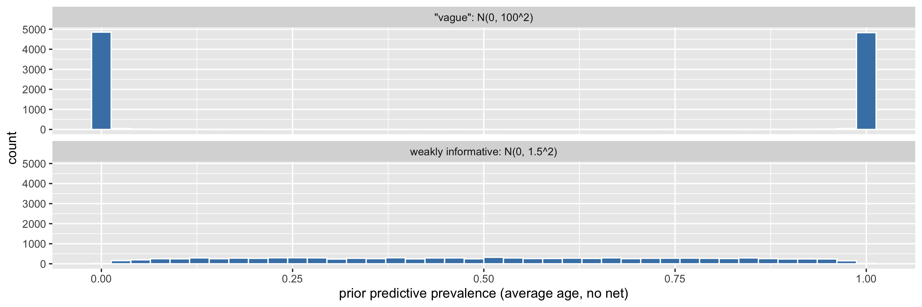
Priors, checked on interpretable scales

Slide 14
Priors, checked on interpretable scales
$N(0,{1.5}^{2})$ spreads prevalence across the whole range without piling up at the extremes. The “vague” prior claims that prevalence is almost certainly either close to 0% or close to 100%: it is anything but uninformative.
The slopes. $β_{\text{net}}$ and $β_{\text{age}}$ are log odds ratios: differences in log-odds. Here the question is how large an effect is plausible, so the quantity to check is the implied odds ratio $e^{β}$. We use $N(0,1)$:
quantile(exp(rnorm(S, 0, 1)), c(0.025, 0.5, 0.975)) # implied prior for an odds ratio
2.5% 50% 97.5%
0.1348073 0.9904853 7.1473704

Slide 15
Priors, checked on interpretable scales
This gives odds ratios between about 0.14 and 7 with 95% prior probability, which comfortably covers realistic effects of an exposure such as bed-net use while ruling out absurd ones (an odds ratio of 1000).
The slopes get a smaller SD than the intercept because effects are usually more constrained than baselines: prevalence could plausibly be anywhere from 5% to 90%, but an exposure that multiplies the odds by 20 is rare.

Slide 16
Priors, checked on interpretable scales
$N(0,{1.5}^{2})$ for the slopes would be equally defensible. With 300 children the choice hardly matters: the standard error of $β_{\text{net}}$ is about 0.25, so its posterior mean is shrunk towards 0 by roughly 6% under $N(0,1)$ and 3% under $N(0,{1.5}^{2})$. What matters is avoiding $N(0,{100}^{2})$, which puts most of its mass on odds ratios above ${10}^{20}$ or below ${10}^{−20}$.
$β_{\text{age}}$ is per year of age, so across the 4.5-year age range the $N(0,1)$ prior still allows a very large cumulative age effect. If covariates are on very different scales, standardise them first so that one prior SD makes sense for all slopes.

Slide 17
Fitting the model
logit_code <- nimbleCode({
for (i in 1:N) {
anaemia[i] ~ dbern(p[i])
logit(p[i]) <- b0 + b_age * age_c[i] + b_net * net[i]
}
b0 ~ dnorm(0, sd = 1.5)
b_age ~ dnorm(0, sd = 1)
b_net ~ dnorm(0, sd = 1)
})

Slide 18
Fitting the model
logit_fit <- nimbleMCMC(
code = logit_code,
constants = list(N = N_c, age_c = anaemia_df$age_c, net = anaemia_df$net),
data = list(anaemia = anaemia_df$anaemia),
inits = function() list(b0 = rnorm(1), b_age = rnorm(1, 0, 0.5), b_net = rnorm(1, 0, 0.5)),
monitors = c("b0", "b_age", "b_net"),
nchains = 4, niter = 6000, nburnin = 1000, setSeed = TRUE,
progressBar = FALSE, samplesAsCodaMCMC = TRUE)

Slide 19
Fitting the model
summarise_draws(as_draws(logit_fit), "mean", "sd", ~quantile(.x, c(0.025, 0.975)), "rhat", "ess_bulk", "ess_tail")
# A tibble: 3 × 8
variable mean sd `2.5%` `97.5%` rhat ess_bulk ess_tail
<chr> <dbl> <dbl> <dbl> <dbl> <dbl> <dbl> <dbl>
1 b0 -0.370 0.181 -0.729 -0.0212 1.00 1517. 2864.
2 b_age -0.319 0.0958 -0.507 -0.133 1.00 4682. 4410.
3 b_net -0.659 0.245 -1.13 -0.160 1.00 1537. 2763.

Slide 20
Answering questions on interpretable scales
From the draws, any quantity is one line away: the odds ratio for bed nets, the probability that nets are protective, and the risk difference at a given age.
dr <- as.matrix(logit_fit)
or_net <- exp(dr[, "b_net"])
age_ref <- 2 - mean(anaemia_df$age) # a 2-year-old
p_no_net <- plogis(dr[, "b0"] + dr[, "b_age"] * age_ref)
p_net <- plogis(dr[, "b0"] + dr[, "b_age"] * age_ref + dr[, "b_net"])

Slide 21
Answering questions on interpretable scales
rbind(`odds ratio (net)` = quantile(or_net, c(0.5, 0.025, 0.975)),
`risk difference, age 2 (pp)` = 100 * quantile(p_no_net - p_net, c(0.5, 0.025, 0.975)))
50% 2.5% 97.5%
odds ratio (net) 0.5164705 0.3224355 0.8525431
risk difference, age 2 (pp) 15.5575111 3.7939897 26.3455871
c(`P(OR < 1 | data)` = mean(or_net < 1),
`P(risk difference > 10 pp | data)` = mean(p_no_net - p_net > 0.10))
P(OR < 1 | data) P(risk difference > 10 pp | data)
0.99625 0.83510

Slide 22
Answering questions on interpretable scales
Predicted prevalence by age, with 95% credible bands:
pred <- expand_grid(age = seq(0.5, 5, by = 0.1), net = 0:1) |>
mutate(draws = map2(age, net, ~ plogis(dr[, "b0"] + dr[, "b_age"] * (.x - mean(anaemia_df$age)) +
dr[, "b_net"] * .y)),
mean = map_dbl(draws, mean),
lo = map_dbl(draws, ~ quantile(.x, 0.025)),
hi = map_dbl(draws, ~ quantile(.x, 0.975)),
net = factor(net, labels = c("no net", "net")))
ggplot(pred, aes(age, mean, colour = net, fill = net)) +
geom_ribbon(aes(ymin = lo, ymax = hi), alpha = 0.2, colour = NA) +
geom_line(linewidth = 1) +
labs(x = "age (years)", y = "predicted prevalence of anaemia", colour = NULL, fill = NULL)

Slide 23
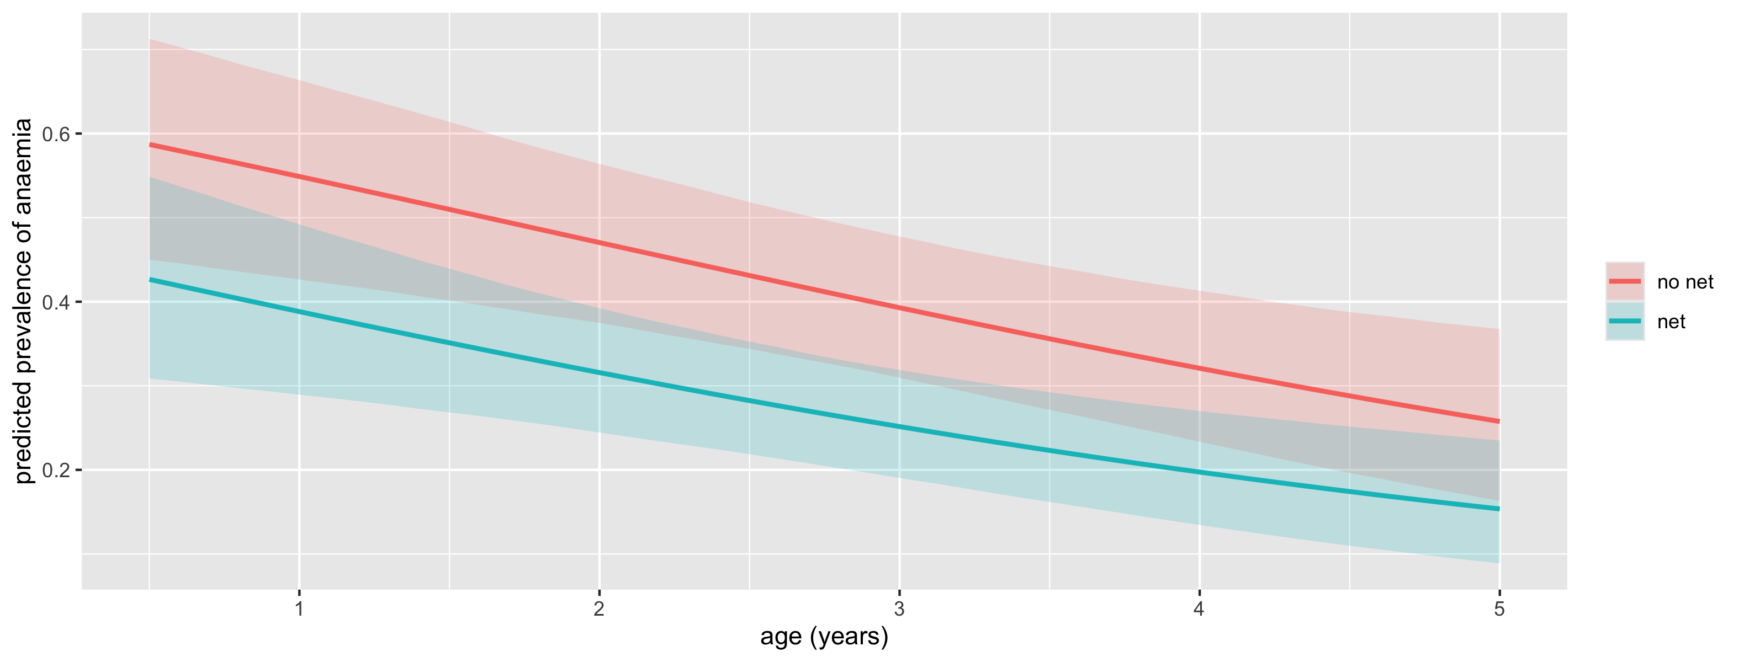
Answering questions on interpretable scales

Slide 24
Posterior predictive checks
A model can fit perfectly in the MCMC sense (great $\hat{R}$, great ESS) and still be a poor description of the data.
Posterior predictive checks compare the observed data with data replicated from the fitted model.

Slide 25
Posterior predictive checks
For $s=1,…,S$: take a posterior draw $θ^{(s)}$ and simulate a full replicated dataset $y^{\text{rep}(s)}∼p(y∣θ^{(s)})$ of the same size and covariates as the observed data.
Choose test statistics $T(y)$ that capture features the model should reproduce and that matter for the question (proportion of zeros, variance, maximum, number of runs, group differences…).
Compare $T(y)$ with the distribution of $T(y^{\text{rep}(s)})$. The posterior predictive p-value $P\left(T(y^{\text{rep}})≥T(y)∣y\right)$ close to 0 or 1 flags a misfit.

Slide 26
Posterior predictive checks
Step 1 must use a different parameter draw for each replicated dataset.
Simulating all replicates from a single point estimate (e.g. the posterior mean) ignores parameter uncertainty and makes the check too severe.

Slide 27
Over-dispersed counts

Slide 28
Example (simulated)
Malaria episodes per child in one year, for 200 children, by whether their household has an insecticide-treated net (ITN) (simulated data):
set.seed(7)
N_k <- 200
malaria_df <- tibble(itn = rbinom(N_k, 1, 0.5)) |>
mutate(episodes = rnbinom(N_k, size = 1.2, mu = exp(0.6 - 0.5 * itn)))
malaria_df |> group_by(itn) |>
summarise(n = n(), mean = mean(episodes), variance = var(episodes), zeros = mean(episodes == 0))
# A tibble: 2 × 5
itn n mean variance zeros
<int> <int> <dbl> <dbl> <dbl>
1 0 95 1.8 6.84 0.4
2 1 105 1.12 2.11 0.457

Slide 29
Models
We fit a Poisson regression and a negative binomial regression.
The negative binomial has an extra dispersion parameter $ϕ$ with $\text{Var}(Y)=μ+ϕμ^{2}$; $ϕ→0$ recovers the Poisson.

Slide 30
Models
pois_reg_code <- nimbleCode({
for (i in 1:N) {
y[i] ~ dpois(mu[i])
log(mu[i]) <- a0 + a1 * itn[i]
}
a0 ~ dnorm(0, sd = 1.5)
a1 ~ dnorm(0, sd = 1)
})
nb_reg_code <- nimbleCode({
for (i in 1:N) {
y[i] ~ dnegbin(prob[i], r) # NIMBLE/BUGS order: probability first, then size
prob[i] <- r / (r + mu[i])
log(mu[i]) <- a0 + a1 * itn[i]
}
a0 ~ dnorm(0, sd = 1.5)
a1 ~ dnorm(0, sd = 1)
phi ~ dexp(1) # over-dispersion; phi -> 0 is the Poisson model
r <- 1 / phi
})

Slide 31
Nimble MCMC fitting
count_consts <- list(N = N_k, itn = malaria_df$itn)
count_data <- list(y = malaria_df$episodes)
pois_reg_fit <- nimbleMCMC(pois_reg_code, constants = count_consts, data = count_data,
inits = function() list(a0 = rnorm(1, 0, 0.5), a1 = rnorm(1, 0, 0.5)),
monitors = c("a0", "a1"), nchains = 4, niter = 6000, nburnin = 1000,
setSeed = TRUE, progressBar = FALSE, samplesAsCodaMCMC = TRUE)
nb_reg_fit <- nimbleMCMC(nb_reg_code, constants = count_consts, data = count_data,
inits = function() list(a0 = rnorm(1, 0, 0.5), a1 = rnorm(1, 0, 0.5), phi = runif(1, 0.2, 2)),
monitors = c("a0", "a1", "phi"), nchains = 4, niter = 6000, nburnin = 1000,
setSeed = TRUE, progressBar = FALSE, samplesAsCodaMCMC = TRUE)

Slide 32
Nimble MCMC fitting
summarise_draws(as_draws(pois_reg_fit), "mean", "sd", ~quantile(.x, c(0.025, 0.975)), "rhat", "ess_bulk")
# A tibble: 2 × 7
variable mean sd `2.5%` `97.5%` rhat ess_bulk
<chr> <dbl> <dbl> <dbl> <dbl> <dbl> <dbl>
1 a0 0.580 0.0761 0.426 0.725 1.00 1950.
2 a1 -0.465 0.117 -0.699 -0.236 1.00 1952.
summarise_draws(as_draws(nb_reg_fit), "mean", "sd", ~quantile(.x, c(0.025, 0.975)), "rhat", "ess_bulk")
# A tibble: 3 × 7
variable mean sd `2.5%` `97.5%` rhat ess_bulk
<chr> <dbl> <dbl> <dbl> <dbl> <dbl> <dbl>
1 a0 0.575 0.133 0.315 0.835 1.00 1676.
2 a1 -0.447 0.190 -0.817 -0.0750 1.00 1726.
3 phi 1.15 0.217 0.767 1.61 1.00 4677.
Both models give similar point estimates of the ITN rate ratio $e^{a_{1}}$, but the Poisson model’s credible interval is narrower. Is that extra certainty justified? A posterior posterior predictive check can tell us.

Slide 33
Posterior predictive check
ppc_counts <- function(fit, model, n_rep = 1000) {
dr <- as.matrix(fit)
idx <- sample(nrow(dr), n_rep)
map_dfr(idx, function(s) { # one posterior draw per replicate
mu <- exp(dr[s, "a0"] + dr[s, "a1"] * malaria_df$itn)
y_rep <- if (model == "Poisson") rpois(N_k, mu) else rnbinom(N_k, size = 1 / dr[s, "phi"], mu = mu)
tibble(`proportion of zeros` = mean(y_rep == 0),
`variance / mean` = var(y_rep) / mean(y_rep),
`maximum` = max(y_rep))
}) |> mutate(model = model)
}

Slide 34
Posterior predictive check (cont’d)
set.seed(11)
ppc <- bind_rows(ppc_counts(pois_reg_fit, "Poisson"), ppc_counts(nb_reg_fit, "Negative binomial")) |>
pivot_longer(-model, names_to = "statistic")
observed <- tibble(`proportion of zeros` = mean(malaria_df$episodes == 0),
`variance / mean` = var(malaria_df$episodes) / mean(malaria_df$episodes),
`maximum` = max(malaria_df$episodes)) |>
pivot_longer(everything(), names_to = "statistic", values_to = "observed")
ggplot(ppc, aes(value)) +
geom_histogram(bins = 30, fill = "grey70", colour = "white") +
geom_vline(data = observed, aes(xintercept = observed), colour = "salmon", linewidth = 1) +
facet_grid(model ~ statistic, scales = "free") +
labs(x = "test statistic in replicated datasets (grey) vs observed (red)", y = NULL)
ppc |> left_join(observed, by = "statistic") |>
group_by(model, statistic) |>
summarise(`posterior predictive p-value` = mean(value >= observed), .groups = "drop")

Slide 35
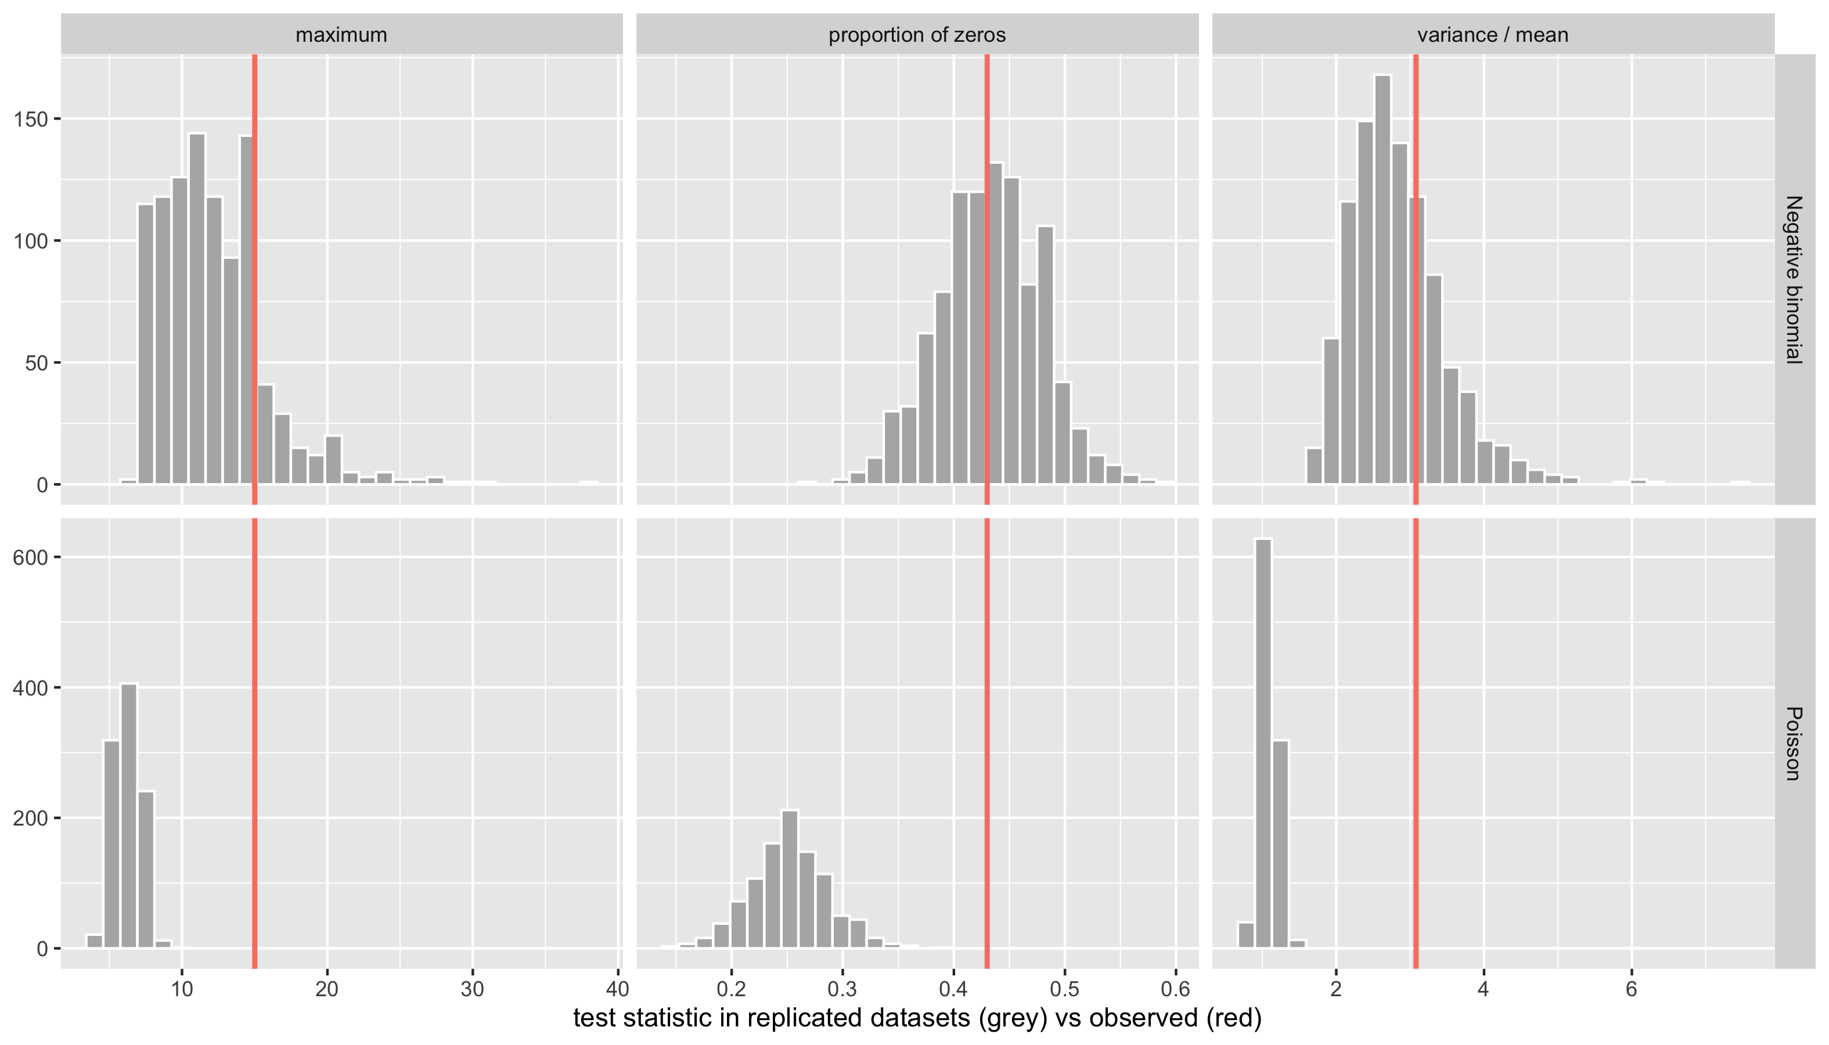
Posterior predictive check (cont’d)

Slide 36
# A tibble: 6 × 3
model statistic `posterior predictive p-value`
<chr> <chr> <dbl>
1 Negative binomial maximum 0.211
2 Negative binomial proportion of zeros 0.538
3 Negative binomial variance / mean 0.29
4 Poisson maximum 0
5 Poisson proportion of zeros 0
6 Poisson variance / mean 0

Slide 37
Posterior predictive check (cont’d)
The Poisson model cannot reproduce the number of children with no episodes, nor the spread of the data: its posterior predictive p-values are essentially 0. The negative binomial reproduces all three features.
Conclusion: the Poisson model is over-confident about the ITN effect, and the negative binomial model should be used.

Slide 38
Choosing between adequate models

Slide 39
Comparing models by predictive accuracy
Posterior predictive checks tell us whether a model is inadequate and how. To choose between adequate models we ask which predicts new data best.
The expected log predictive density for a new observation can be estimated by leave-one-out cross-validation (LOO), without refitting the model $n$ times, using Pareto-smoothed importance sampling (Vehtari et al., 2017).
WAIC is an asymptotically equivalent, slightly less robust alternative (NIMBLE can compute it with WAIC = TRUE).
Both need the pointwise log-likelihood $logp(y_{i}∣θ^{(s)})$ for every draw $s$ and observation $i$, which is easy to compute from the draws.

Slide 40
Comparing models by predictive accuracy
loglik_counts <- function(fit, model) {
dr <- as.matrix(fit)
mu <- exp(dr[, "a0"] + outer(dr[, "a1"], malaria_df$itn)) # S x N matrix
Y <- matrix(malaria_df$episodes, nrow = nrow(dr), ncol = N_k, byrow = TRUE)
ll <- if (model == "Poisson") dpois(Y, mu, log = TRUE) else
dnbinom(Y, size = 1 / dr[, "phi"], mu = mu, log = TRUE)
matrix(ll, nrow = nrow(dr))
}
loo_from_ll <- function(ll, nchains = 4) {
chain_id <- rep(seq_len(nchains), each = nrow(ll) / nchains)
loo(ll, r_eff = relative_eff(exp(ll), chain_id = chain_id))
}
loo_pois <- loo_from_ll(loglik_counts(pois_reg_fit, "Poisson"))
loo_nb <- loo_from_ll(loglik_counts(nb_reg_fit, "Negative binomial"))
lc <- loo_compare(list(Poisson = loo_pois, `Negative binomial` = loo_nb))
lc
elpd_diff se_diff
Negative binomial 0.0 0.0
Poisson -57.0 19.9

Slide 41
Comparing models by predictive accuracy
elpd_diff is the difference in expected log predictive density relative to the best model, with its standard error.
Here the Poisson model is about 57 units of elpd worse, 2.9 standard errors: clear evidence in favour of the negative binomial model.
Also look at the Pareto $k$ diagnostics printed by loo(); values above 0.7 flag observations for which the LOO estimate is unreliable (often influential outliers).
Model comparison is not a substitute for thinking. Prefer the model that is scientifically justified and passes predictive checks; use LOO to arbitrate between such models or to decide whether added complexity pays for itself.

Slide 42
Hierarchical models: the natural home of Bayesian methods

Slide 43
Hierarchical models
Example (illustrative data).
In-hospital mortality among children admitted with severe malaria at eight district hospitals:

Slide 44
Hierarchical models
hosp <- tibble(hospital = LETTERS[1:8],
n = c(45, 120, 32, 210, 18, 76, 150, 9),
deaths = c( 6, 11, 5, 17, 4, 7, 12, 3))
hosp |> mutate(raw_rate = deaths / n)
# A tibble: 8 × 4
hospital n deaths raw_rate
<chr> <dbl> <dbl> <dbl>
1 A 45 6 0.133
2 B 120 11 0.0917
3 C 32 5 0.156
4 D 210 17 0.0810
5 E 18 4 0.222
6 F 76 7 0.0921
7 G 150 12 0.08
8 H 9 3 0.333

Slide 45
Hierarchical models
Hospital H has 3 deaths in 9 admissions (33%). Is it really the worst hospital, or just the smallest? Three modelling options:
Complete pooling: one common mortality for all hospitals. Ignores genuine differences.
No pooling: a separate, unrelated estimate for each hospital. Small hospitals get extreme, very uncertain estimates.
Partial pooling (hierarchical model): hospital-specific mortalities that are related, drawn from a common population distribution whose spread is estimated from the data.

Slide 46
Hierarchical models
Concretely, the partial-pooling model we will fit is
$$\begin{aligned}{\text{deaths}}_{j}∣p_{j}&∼\text{Bin}(n_{j},p_{j}), \\ η_{j}&=\text{logit}(p_{j}), \\ η_{j}∣μ,σ&∼N(μ,σ^{2}), \\ μ&∼N(−2,1^{2}), \\ σ&∼\text{Exp}(1),\end{aligned}$$
for hospitals $j=1,…,8$.

Slide 47
Hierarchical models
Here $η_{j}$ is hospital $j$’s true log-odds of death; $μ$ is the typical log-odds across district hospitals (the prior is centred on ${\text{logit}}^{−1}(−2)≈12\%$); and $σ$ is the between-hospital SD on the log-odds scale. The other two options are limiting cases: complete pooling is $σ=0$, and no pooling corresponds roughly to $σ→∞$.
Complete pooling is clearly too strong: the hospitals differ in staffing, case mix and access.
But why should partial pooling be legitimate? Why should data from hospital A change our estimate for hospital H?
The answer is exchangeability.

Slide 48
Exchangeability
A set of unknown quantities $η_{1},…,η_{J}$ is exchangeable if their joint distribution does not change when the labels are permuted:
$$p(η_{1},…,η_{J})=p(η_{ρ(1)},…,η_{ρ(J)})$$
for every permutation $ρ$ of $1,…,J$.

Slide 49
Exchangeability
In words: before seeing the data, we have no information that distinguishes one from another. If someone secretly swapped the hospital names, our beliefs would be the same. Here the $η_{j}=\text{logit}(p_{j})$ are the hospitals’ true log-odds of death.
Exchangeable does not mean independent. If we learned that hospital A has 20% mortality, that would reasonably change what we expect for hospital H: it tells us something about the level of mortality in district hospitals generally. That is exactly the kind of dependence partial pooling uses.

Slide 50
De Finetti’s theorem
Informally, de Finetti’s theorem says that if a sequence $η_{1},η_{2},…$ is exchangeable (and could in principle be extended indefinitely, e.g. to hospitals we have not sampled), then its joint distribution can always be written as
$$p(η_{1},…,η_{J})=∫\prod_{j=1}^{J}{p}(η_{j}∣ϕ) p(ϕ) dϕ.$$
That is: the $η_{j}$ are independent and identically distributed given some parameter $ϕ$, and $ϕ$ itself is unknown and has a distribution. Exchangeability, a simple symmetry judgement, forces this structure.

Slide 51
We have used this twice in the course
Level | Exchangeable quantities | Resulting model
Data (Lecture 1) | Test results of the 30 children | Bernoulli(π) per child, prior on π
Parameters (today) | Log-odds of death at the 8 hospitals | N(μ, σ²) per hospital, priors on μ and σ

Slide 52
De Finetti’s theorem
So the hierarchical model is not an ad hoc device: it is what exchangeability of the hospitals implies.
Two caveats:
The theorem guarantees the structure (i.i.d. given $ϕ$, plus a prior on $ϕ$), not the shape; choosing a normal distribution for $η_{j}∣μ,σ$ is our modelling decision, and can be checked like any other.
And for a finite set of hospitals that could not be extended the representation holds only approximately, which in practice is rarely a concern.

Slide 53
Exchangeable but dependent
We can see the dependence directly by simulating from the prior of the model above: draw $μ∼N(−2,1^{2})$ and $σ∼\text{Exp}(1)$, then two hospitals’ log-odds independently from $N(μ,σ^{2})$.
S <- 5000
mu_s <- rnorm(S, -2, 1)
sigma_s <- rexp(S, 1)
eta_A <- rnorm(S, mu_s, sigma_s)
eta_H <- rnorm(S, mu_s, sigma_s)
ggplot(tibble(eta_A, eta_H), aes(eta_A, eta_H)) +
geom_point(alpha = 0.15, size = 0.6, colour = "steelblue") +
coord_cartesian(xlim = c(-8, 4), ylim = c(-8, 4)) +
labs(x = "log-odds of death, hospital A", y = "log-odds of death, hospital H",
subtitle = "draws from the hierarchical prior")
cor(eta_A, eta_H)

Slide 54
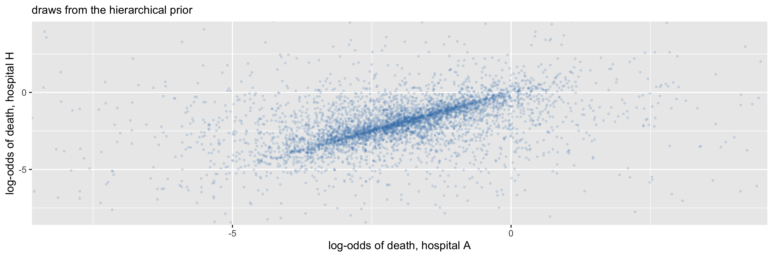
Exchangeable but dependent

Slide 55
[1] 0.3330657

Slide 56
Exchangeable but dependent
The two hospitals are exchangeable (the plot is symmetric about the diagonal) but positively correlated a priori, because they share the unknown $μ$. This correlation is what makes data from hospital A informative about hospital H.
The correlation can be derived exactly by conditioning on $(μ,σ)$ and using the laws of total variance and total covariance (Appendix A). Given $(μ,σ)$, $η_{A}$ and $η_{H}$ are independent, each with mean $μ$ and variance $σ^{2}$.

Slide 57
Exchangeable but dependent
$$\begin{aligned}\text{Var}(η_{j})&=E\left[\text{Var}(η_{j}∣μ,σ)\right]+\text{Var}\left(E[η_{j}∣μ,σ]\right) \\ &=E[σ^{2}]+\text{Var}(μ), \\ \text{Cov}(η_{A},η_{H})&=E\left[\text{Cov}(η_{A},η_{H}∣μ,σ)\right]+\text{Cov}\left(E[η_{A}∣μ,σ],E[η_{H}∣μ,σ]\right) \\ &=0+\text{Cov}(μ,μ) \\ &=\text{Var}(μ).\end{aligned}$$
With $μ∼N(−2,1^{2})$, $\text{Var}(μ)=1$. With $σ∼\text{Exp}(1)$, $E[σ]=1$ and $\text{Var}(σ)=1$, so $E[σ^{2}]=\text{Var}(σ)+E[σ]^{2}=2$. Hence $\text{Var}(η_{j})=1+2=3$, $\text{Cov}(η_{A},η_{H})=1$, and the prior correlation is $1/3$.
The formula also shows what drives the pooling: the more uncertain the shared level $μ$ is, relative to the spread $σ$ between hospitals, the more strongly the hospitals are linked.

Slide 58
Exchangeable but dependent
The three modelling options are then three beliefs about the hospitals:
Complete pooling ($σ=0$): the hospitals are identical. Stronger than exchangeability, and implausible.
No pooling (independent, vague priors on each $η_{j}$, roughly $σ→∞$): data from seven hospitals tell us nothing about the eighth. Also implausible.
Partial pooling: the hospitals are exchangeable, and the data decide through $σ$ how similar they are.

Slide 59
When exchangeability fails
Exchangeability is a judgement made before seeing the data, and it can be wrong. Suppose hospital H is a referral centre that receives the sickest children, or two of the hospitals have paediatric high-dependency units. Then we can tell the hospitals apart in a way that matters for mortality, and pooling H’s estimate towards the district average would be a mistake.
The remedy is conditional exchangeability: the hospitals are exchangeable given the relevant covariates. Put the information in the model,
$$η_{j}∣μ,β,σ∼N(μ+β x_{j}, σ^{2}),$$
for example with $x_{j}=1$ for referral centres.

Slide 60
When exchangeability fails
Each hospital’s estimate is then pooled towards the value predicted for hospitals like it, not towards the overall mean. The same logic applies at the data level: patients admitted before and after a power cut, or children from different villages, are not exchangeable, and the model must say so (for example with a covariate or a village-level random effect).
A useful question to ask before fitting any hierarchical model: before seeing the outcome data, is there anything I know that distinguishes these groups and plausibly affects the outcome? If yes, it belongs in the model.

Slide 61
Fitting the model
For fitting, we write the same model in an equivalent form, with $η_{j}=μ+σz_{j}$:
$$\begin{aligned}{\text{deaths}}_{j}∣p_{j}&∼\text{Bin}(n_{j},p_{j}), \\ \text{logit}(p_{j})&=μ+σz_{j}, \\ z_{j}&∼N(0,1), \\ μ&∼N(−2,1^{2}), \\ σ&∼\text{Exp}(1).\end{aligned}$$

Slide 62
Fitting the model
If $z_{j}∼N(0,1)$, then $μ+σz_{j}∼N(μ,σ^{2})$, so this is the same model as before.
It is exactly a logistic regression with a random intercept for hospital (a GLMM), estimated by MCMC.
Writing $\text{logit}(p_{j})=μ+σz_{j}$ with standard normal $z_{j}$ (rather than $\text{logit}(p_{j})∼N(μ,σ^{2})$) is the non-centred parameterisation.
It is mathematically equivalent but avoids the “funnel” geometry that makes samplers struggle when groups are small and $σ$ is poorly determined.

Slide 63
The hierarchical model
hier_code <- nimbleCode({
for (j in 1:J) {
deaths[j] ~ dbin(p[j], n[j])
logit(p[j]) <- mu + sigma * z[j]
z[j] ~ dnorm(0, sd = 1)
}
mu ~ dnorm(-2, sd = 1)
sigma ~ dexp(1)
})

Slide 64
The hierarchical model
hier_fit <- nimbleMCMC(hier_code,
constants = list(J = nrow(hosp), n = hosp$n),
data = list(deaths = hosp$deaths),
inits = function() list(mu = rnorm(1, -2, 0.5), sigma = runif(1, 0.1, 1), z = rnorm(nrow(hosp))),
monitors = c("mu", "sigma", "p", "z"), nchains = 4, niter = 11000, nburnin = 1000,
setSeed = TRUE, progressBar = FALSE, samplesAsCodaMCMC = TRUE)

Slide 65
The hierarchical model
summarise_draws(as_draws(hier_fit), "median", ~quantile(.x, c(0.025, 0.975)), "rhat", "ess_bulk", "ess_tail")
# A tibble: 18 × 7
variable median `2.5%` `97.5%` rhat ess_bulk ess_tail
<chr> <dbl> <dbl> <dbl> <dbl> <dbl> <dbl>
1 mu -2.16 -2.50 -1.70 1.00 2283. 2491.
2 p[1] 0.106 0.0701 0.185 1.00 5745. 9166.
3 p[2] 0.0980 0.0639 0.138 1.00 9543. 10918.
4 p[3] 0.108 0.0710 0.204 1.00 4693. 7839.
5 p[4] 0.0930 0.0618 0.125 1.00 8730. 14240.
6 p[5] 0.110 0.0726 0.245 1.00 3784. 5450.
7 p[6] 0.0992 0.0619 0.148 1.00 8247. 10966.
8 p[7] 0.0942 0.0601 0.129 1.00 8496. 11224.
9 p[8] 0.111 0.0720 0.286 1.00 3570. 4729.
10 sigma 0.208 0.00931 0.828 1.00 1941. 2592.
11 z[1] 0.162 -1.61 1.90 1.00 8022. 9190.
12 z[2] -0.248 -1.88 1.48 1.00 5990. 9070.
13 z[3] 0.248 -1.62 2.01 1.00 8162. 9511.
14 z[4] -0.492 -2.06 1.28 1.00 4831. 7738.
15 z[5] 0.386 -1.54 2.19 1.00 7649. 8878.
16 z[6] -0.191 -1.84 1.54 1.00 7237. 9286.
17 z[7] -0.434 -2.03 1.44 1.00 4854. 7740.
18 z[8] 0.447 -1.61 2.34 1.00 6951. 9160.

Slide 66
The hierarchical model
dr_h <- as.matrix(hier_fit)
p_draws <- dr_h[, paste0("p[", 1:nrow(hosp), "]")]
hosp_summ <- hosp |>
mutate(raw = deaths / n,
partial = apply(p_draws, 2, median),
lo = apply(p_draws, 2, quantile, 0.025),
hi = apply(p_draws, 2, quantile, 0.975),
`P(mortality > 15%)` = colMeans(p_draws > 0.15),
label = paste0(hospital, " (n=", n, ")"),
label = fct_reorder(label, n))
ggplot(hosp_summ, aes(y = label)) +
geom_vline(xintercept = sum(hosp$deaths) / sum(hosp$n), linetype = 2, colour = "grey50") +
geom_linerange(aes(xmin = lo, xmax = hi), colour = "steelblue", linewidth = 1) +
geom_point(aes(x = partial, colour = "hierarchical (median, 95% CrI)"), size = 3) +
geom_point(aes(x = raw, colour = "raw proportion (no pooling)"), size = 3, shape = 4, stroke = 1.5) +
scale_colour_manual(values = c("steelblue", "salmon")) +
labs(x = "in-hospital mortality", y = NULL, colour = NULL,
caption = "dashed line: complete pooling") +
theme(legend.position = "bottom")
hosp_summ |> select(hospital, n, raw, partial, `P(mortality > 15%)`) |> kable(digits = 3)

Slide 67
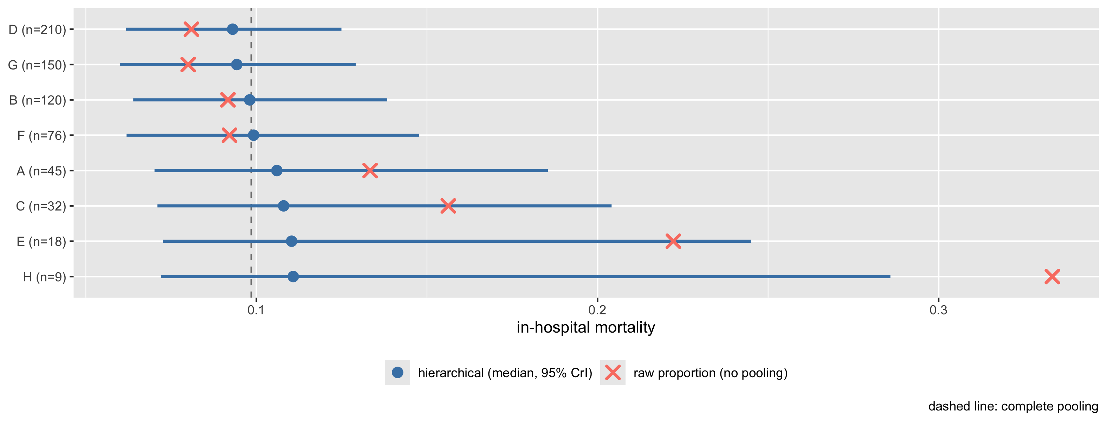
The hierarchical model

Slide 68
hospital | n | raw | partial | P(mortality > 15%)
A | 45 | 0.133 | 0.106 | 0.095
B | 120 | 0.092 | 0.098 | 0.009
C | 32 | 0.156 | 0.108 | 0.129
D | 210 | 0.081 | 0.093 | 0.001
E | 18 | 0.222 | 0.110 | 0.181
F | 76 | 0.092 | 0.099 | 0.021
G | 150 | 0.080 | 0.094 | 0.002
H | 9 | 0.333 | 0.111 | 0.206

Slide 69
The hierarchical model
Estimates are shrunk towards the overall mean, and small hospitals are shrunk the most, because their own data carry the least information. Hospital H’s estimate moves a long way towards the average and its interval stays wide: the data do not support singling it out. Large hospitals barely move. The amount of shrinkage is not chosen by the analyst; it is learned from the data through $σ$.
Hierarchical models extend naturally to: multi-centre trials, repeated measurements on patients, small-area estimation, meta-analysis (studies as groups), and spatial models for disease mapping. In all of these the Bayesian formulation (with MCMC or INLA) is often the most practical way to fit the model and propagate all sources of uncertainty.

Slide 70
Why the non-centred parameterisation?
The same model can be written in the centred parameterisation, with the hospital log-odds $θ_{j}$ as parameters:
$$\text{logit}(p_{j})=θ_{j}, θ_{j}∼N(μ,σ^{2}).$$
Why the non-centred parameterisation?
hier_code_c <- nimbleCode({
for (j in 1:J) {
deaths[j] ~ dbin(p[j], n[j])
logit(p[j]) <- theta[j]
theta[j] ~ dnorm(mu, sd = sigma)
}
mu ~ dnorm(-2, sd = 1)
sigma ~ dexp(1)
})
hier_fit_c <- nimbleMCMC(hier_code_c,
constants = list(J = nrow(hosp), n = hosp$n),
data = list(deaths = hosp$deaths),
inits = function() list(mu = rnorm(1, -2, 0.5), sigma = runif(1, 0.1, 1), theta = rnorm(nrow(hosp), -2, 0.3)),
monitors = c("mu", "sigma", "theta"), nchains = 4, niter = 11000, nburnin = 1000,
setSeed = TRUE, progressBar = FALSE, samplesAsCodaMCMC = TRUE)

Slide 71
Why the non-centred parameterisation?
Same data, same priors, same number of iterations:
bind_rows(
`non-centred` = summarise_draws(subset_draws(as_draws(hier_fit), variable = "sigma"), "median", "rhat", "ess_bulk", "ess_tail"),
centred = summarise_draws(subset_draws(as_draws(hier_fit_c), variable = "sigma"), "median", "rhat", "ess_bulk", "ess_tail"),
.id = "parameterisation")
# A tibble: 2 × 6
parameterisation variable median rhat ess_bulk ess_tail
<chr> <chr> <dbl> <dbl> <dbl> <dbl>
1 non-centred sigma 0.208 1.00 1941. 2592.
2 centred sigma 0.233 1.04 130. 192.
$σ$ mixes far worse in the centred version. A pair plot of $logσ$ against the effect of the smallest hospital, H, shows why.

Slide 72
Why the non-centred parameterisation?
dr_nc <- as.matrix(hier_fit); dr_c <- as.matrix(hier_fit_c)
bind_rows(
tibble(parameterisation = "centred: theta[H] vs log(sigma)",
effect = dr_c[, "theta[8]"], log_sigma = log(dr_c[, "sigma"])),
tibble(parameterisation = "non-centred: z[H] vs log(sigma)",
effect = dr_nc[, "z[8]"], log_sigma = log(dr_nc[, "sigma"]))) |>
ggplot(aes(effect, log_sigma)) +
geom_point(alpha = 0.05, size = 0.4, colour = "steelblue") +
facet_wrap(~parameterisation, scales = "free") +
labs(x = "hospital H effect", y = expression(log(sigma)))

Slide 73
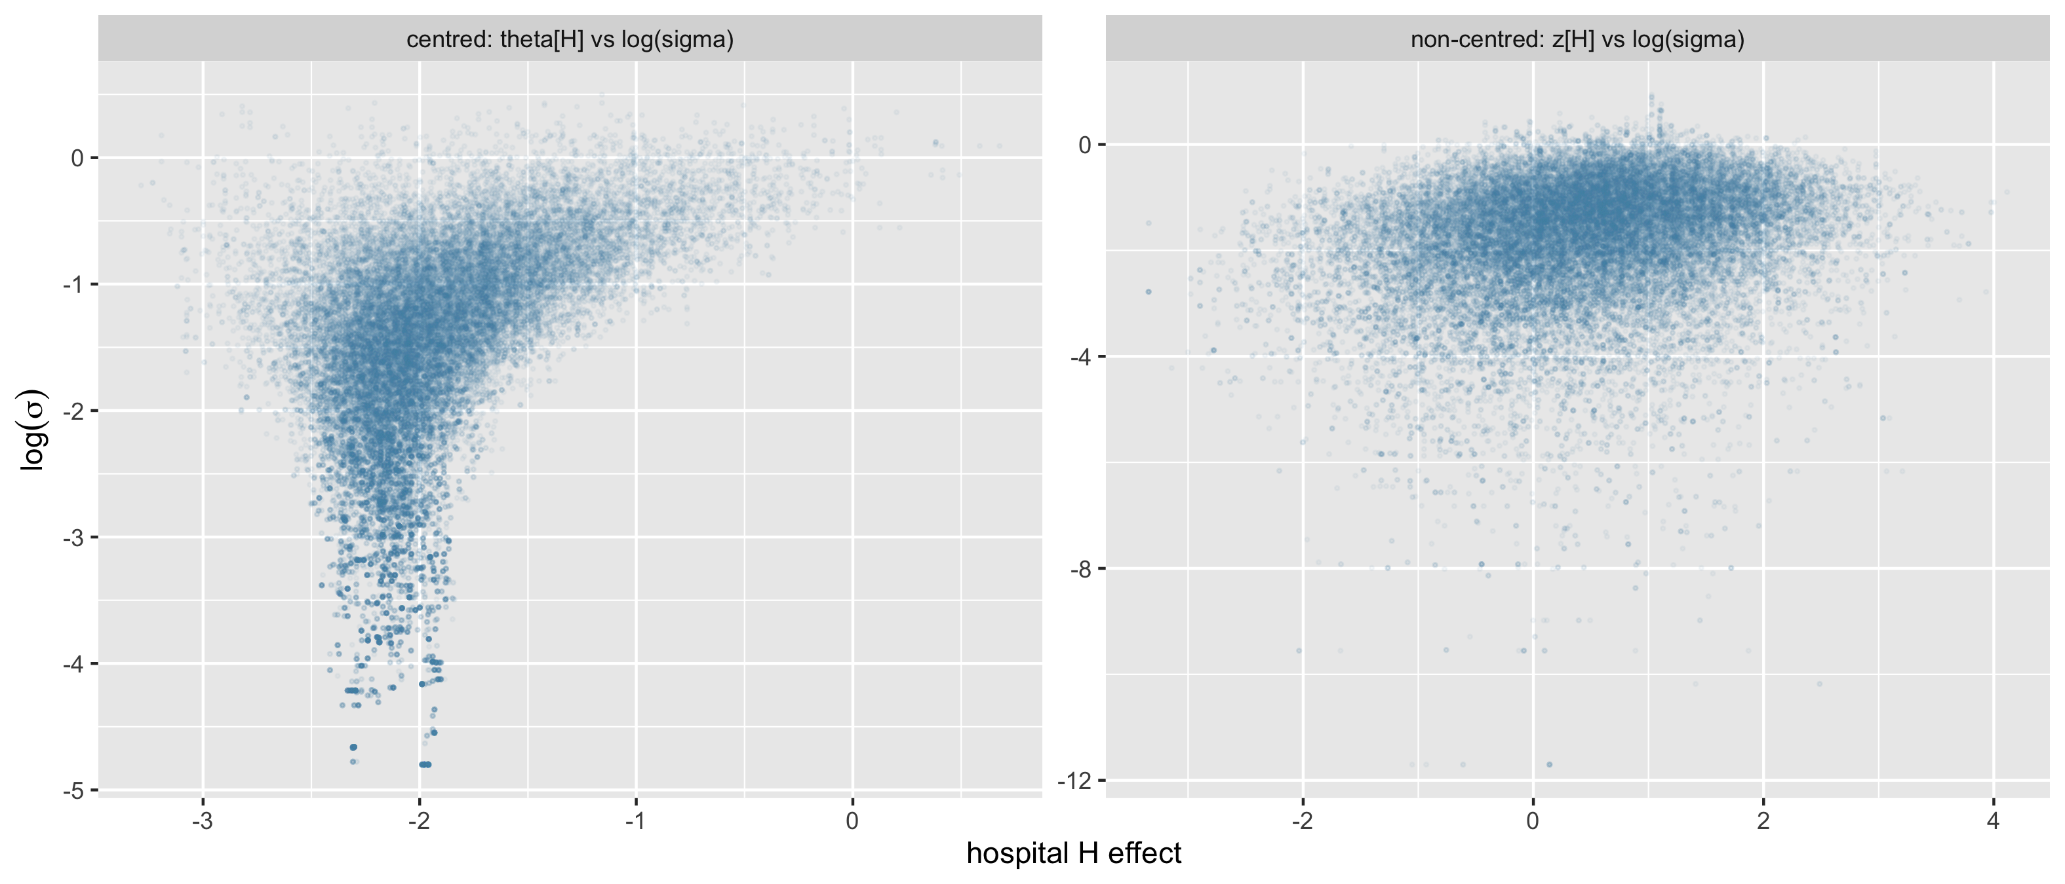
Why the non-centred parameterisation?

Slide 74
Why the non-centred parameterisation?
In the centred version the draws form a funnel. When $σ$ is large, $θ_{H}$ can vary widely; when $σ$ is small, every $θ_{j}$ is forced close to $μ$, and the neck of the funnel becomes very narrow. A sampler whose step sizes suit the wide top of the funnel cannot get far into the neck, so small values of $σ$ are visited rarely and in long, sticky stretches: this is what the low ESS and high $\hat{R}$ for $σ$ are signalling. In the non-centred version, $z_{j}$ and $σ$ are independent in the prior, the pair plot is a shapeless cloud, and the sampler moves freely, including to very small values of $σ$.
Which parameterisation samples better depends on how much information the data carry about each group. With small groups, or a small $σ$, as here, the non-centred version is usually better; with large, informative groups the centred version can be better (Practical 5). The pair plot, not a rule of thumb, tells you which situation you are in.

Slide 75
Reporting a Bayesian analysis

Slide 76
Reporting a Bayesian analysis
Following the Bayesian Analysis Reporting Guidelines (Kruschke, 2021), a report should include:
The model (sampling model and all priors), with a justification of the priors and a prior predictive check where priors matter;
The computation: software and version, samplers if non-default, number of chains, iterations, burn-in, and convergence diagnostics ($\hat{R}$, ESS);
Posterior summaries on interpretable scales: medians or means, credible intervals (say which type), and posterior probabilities of clinically meaningful events;
Model checks (posterior predictive checks) and, where relevant, model comparison (LOO);
A sensitivity analysis to the priors and to key modelling choices;
Code and data (or simulated data) to reproduce the analysis.

Slide 77
[end of STA623 Bayesian Data analysis Session 5]

