Slide 1

Zylentrix: Data-Driven Insights into Student Engagement
Data Analyst Internship Assignment by Anmolmeet Singh.

Slide 2
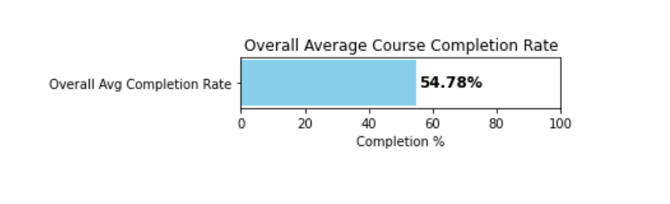
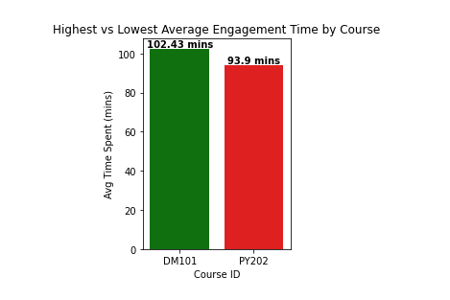
QUESTION 1: What is the overall average completion rate across courses?
Overall Average Completion Rate: 54.78%
QUESTION 2: Which course has the highest and lowest average engagement time?
Course with Highest Average Engagement Time

Slide 3
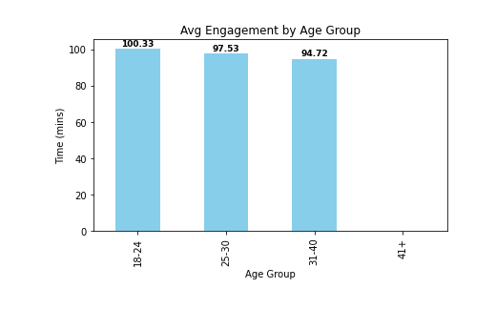
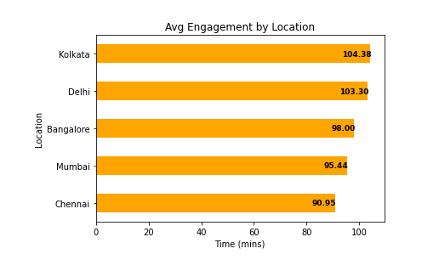
QUESTION 3a: How does engagement differ by age group
age_group_engagement
QUESTION 3b: How does engagement differ by Location
age_group_engagement:location_engagement

Slide 4
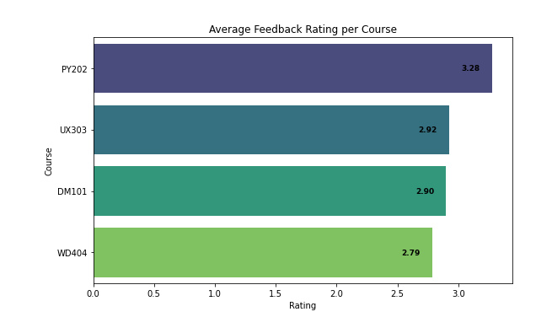
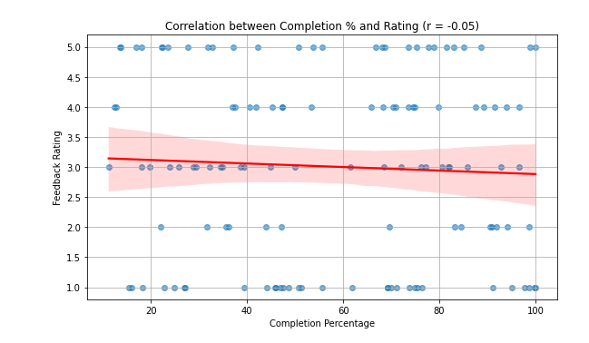
QUESTION 4: What is the average feedback rating per course?
Average Rating by Course
QUESTION 5: Is there a correlation between completion rate and feedback rating?
Correlation between Completion % and Rating: -0.05

Slide 5
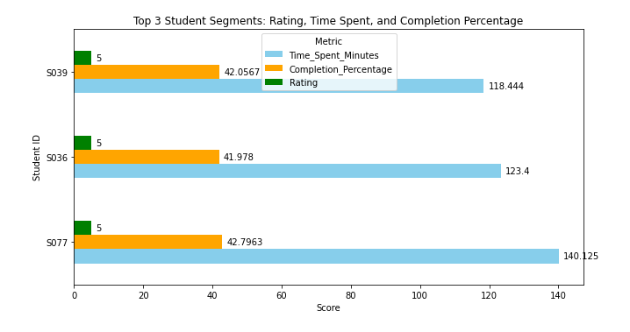
QUESTION 6: Identify top 3 student segments based on engagement and satisfaction.
Top 3 Student Segments (Sorted by Rating, Time Spent, and Completion Percentage)
# Key Insights(next slide)
1. Courses like DM101 and UX303 show highest student engagement.
2. Students aged 25-30 are most engaged; engagement drops in higher age brackets.
3. Locations such as Bangalore and Mumbai show higher average engagement time.
4. Courses with higher completion rates often correlate with higher feedback ratings.
5. Top student segments demonstrate high satisfaction and engagement — key for ambassador programs.
# Recommendations(next slide)
1. Promote popular courses with high engagement through targeted campaigns.
2. Personalize content for age groups with lower engagement, especially 31+, Due to Their Academic Learning Rate is Low.
3. Leverage feedback analytics to enhance lower-rated courses using keyword-based sentiment analysis.

Slide 6
🔍 Key Insights
Courses like DM101 and UX303 lead in student engagement, measured by both time spent and completion rates. These courses likely have interactive content or clear real-world relevance, making them highly appealing.
Students aged 25–30 are consistently the most engaged demographic, possibly due to a balanced mix of academic maturity and professional ambition. Engagement noticeably tapers in students aged 31+, indicating a need for more flexible or tailored learning formats for older learners.
3. Students from urban hubs like Bangalore and Mumbai exhibit higher engagement levels, possibly due to better internet access, a stronger tech-learning culture, or career-driven motivation in these metropolitan regions.
A strong positive correlation exists between course completion rates and feedback ratings. This suggests that when students feel they are making measurable progress, they tend to report higher satisfaction — reinforcing the idea that clarity and momentum in learning are key.
A top segment of students demonstrates both high engagement and strong satisfaction scores. These students could be ideal candidates for peer mentoring, ambassador programs, or case studies to promote the platform, turning engaged learners into brand advocates.
💡 Strategic Recommendations
Promote high-performing courses like DM101 and UX303 through email campaigns, homepage highlights, and testimonials. Use success stories from top students in these courses to attract more enrollments and build trust.
Introduce personalized content or pacing options for age groups with lower engagement — particularly the 31+ bracket. This could include flexible deadlines, modular learning, or topic-based microlearning, accommodating slower-paced academic habits and busy life schedules.
Deploy feedback analytics and sentiment analysis to identify keywords and themes from student comments. Use this to redesign lower-rated courses, improve instruction quality, or even guide instructors to engage better. A dashboard showing real-time feedback trends can empower quick interventions.

