Slide 1


AARMS VALUE CHAIN PVT LTD
WE FOCUS THE UNFOCUSED TO CREATE VALUE CHAIN

Slide 2
AARMS VALUE CHAIN PVT LTD are promoted with a vision to establish an INTEGRATED SUPPLY CHAIN SOLUTIONS, to B2B Customers. The integrated solution to a client happens, by way of Planning for Inbound & Outbound delivery, Document Management solutions, Accounts Receivables Management, C-form & other concessional forms collection and completing the assessment.
The Company which was promoted as an individual, in 2004, by G.Jagannathan, has established as a leading service provider, for almost 75 large companies Pan India. The employee strength has grown to about 80. The new verticals with focus on SLA adherence, transparent system, and Work flow Process using innovative technology & concepts have been launched.
Participation in the Power of Ideas initiative by Economic Times, also greatly helped in conceptualizing the Innovative Process.

Slide 3
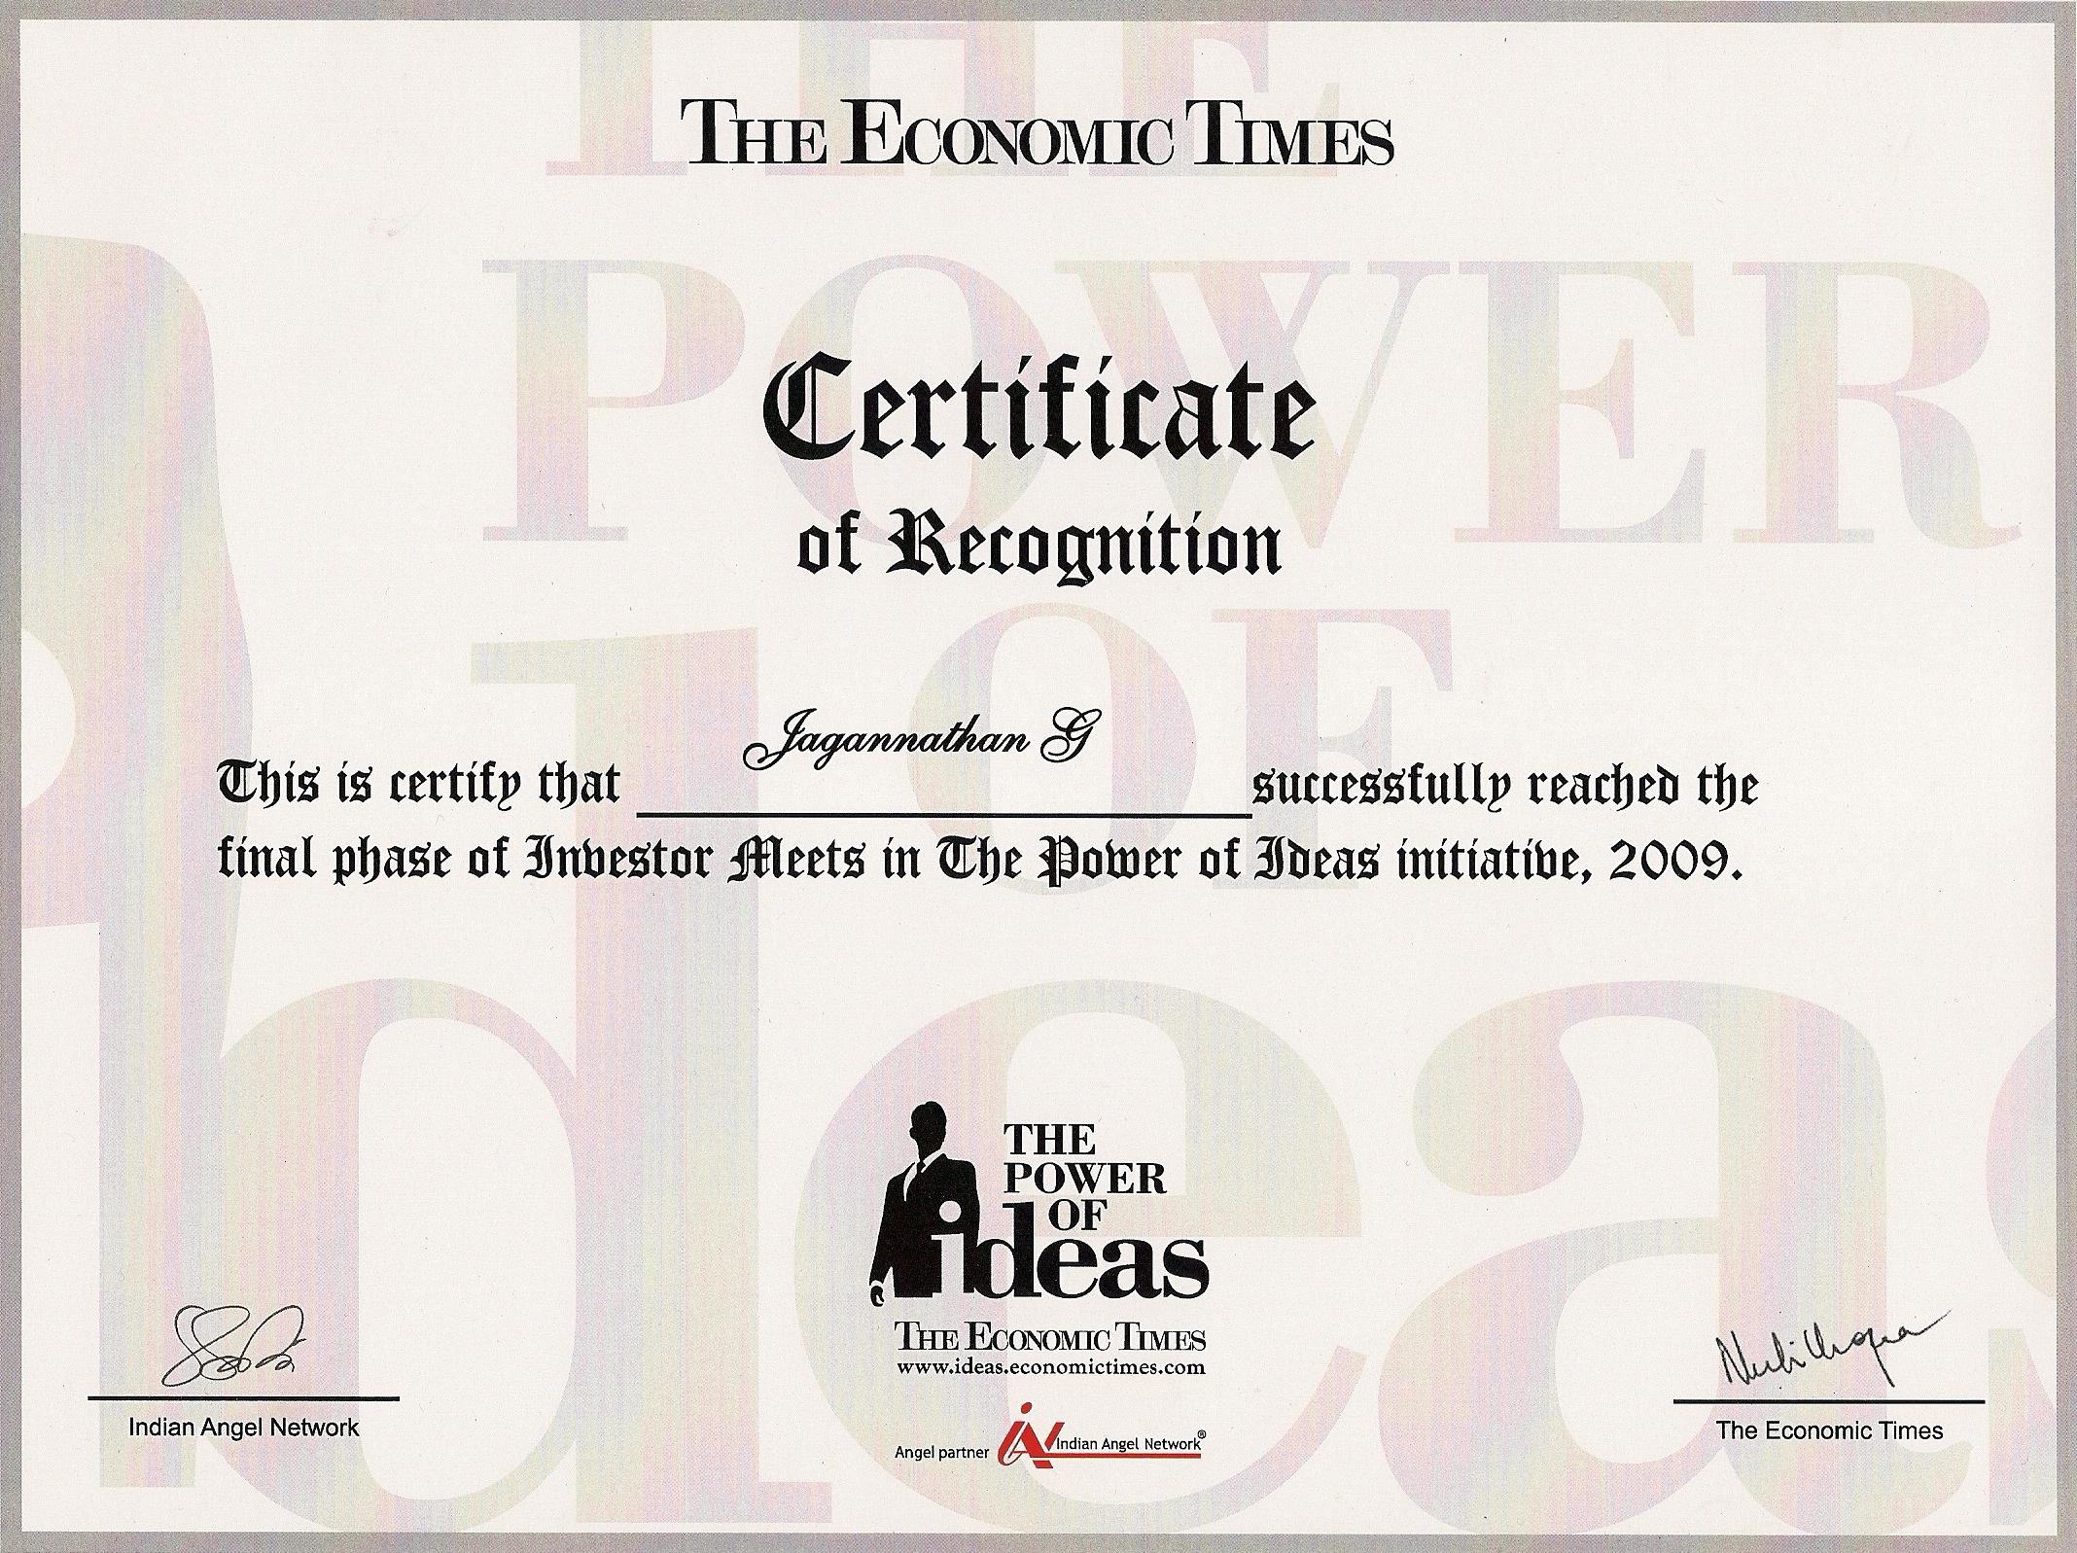

Slide 4
CORPORATE MISSION STATEMENT
“TO PROVIDE TOP-CLASS, COST EFFECTIVE INTEGRATED END TO END SUPPLY CHAIN SOLUTIONS FOR B2B CLIENTS WITH ROBUST & PROVEN TECHNOLOGY, LEADING TO MAXIMISING PROFITS, MINIMISING LIABILITY BY PROCESS IMPROVEMENT AND ENHANCED PRODUCTIVITY “
TO FACILITATE A PLATFORM WHERE CLIENTS CAN ACCESS INDUSTRY INFORMATION, PRODUCT & SERVICES CONSOLIDATIONS & CONNECTIVITY, ON REAL-TIME ENABLING TO FOCUS ON THEIR CORE BUSINESS, RESULTING IN ENHANCED PRODUCTIVITY”
IN OUR SAFE AARMS.

Slide 5

SUPPLY CHAIN VERTICALS
SCM JUNCTION is a portal which connects all the Transport Companies,
Logistic Providers, Logistics Consultants etc.
Transporters can register Online for free.
RFQ `s is mailed online everyday to all the registered Transporters.
BID online
Acceptance of BID can be done online.
Post vehicles availability and Vehicles required to any route online by vendors
Participate in freight Auctions / freight Bids online.
Customer Support
Revenue model is by monthly subscription.
Agreement with Customers directly.
New Marketing leads, Submit Bills, POD, and follow-up for payment.
Online MIS for all transactions
Consolidated Transporters Bills Management & AR Focus , aimed at reducing
Bill Submissions and Faster Realization process.

Slide 6

SCM BIZCONNECT is a b2b Logistics portal, which allows the
Companies to post RFQ and get online Bids from the Registered
Transport providers. It also allows the End to End Workflow
Process to manage the complete Logistic activity. The Features &
value Proposition is:
BIDDING
  Online E-Bidding Process.
  Reverse Auctioning & Online Bids.
  RFQ`s are posted as Ads and Auto mailed to all registered Transporters.
  Online access by Transporters for Quoting.
  Rebid expected Price, and obtain Acceptance.
  Agreement with the shortlisted Transporters.
  MIS, Reports can be customized.

Slide 7
VEHICLE MANAGEMENT
Registered Transporters are updated in Database.
Fleet Master is updated in the database.
Route Master
Route Price Master
Document Check list.
Request for placement of vehicle is selected in the calendar
Auto mail is sent to the entire contracted Transporter.
Confirmation with Mobile no. vehicle no and the Driver name is entered by transporter.
Assignment to Transporter on First In First Out.
On confirmation of assignment, an Auto generated PO no is displayed
The generated order has to be shown at the Gate along with vehicle.
Entry time is entered and compared with agreement time.
Loading of goods time is updated in the system.
After all document checklist material, LR details of the consignment is updated in system
Out entry is entered.
Vehicle tracking through mobile commences.
Online View of vehicle tracking is displayed in the website or through mobile SMS. On delivery of the goods, the time of delivery is captured
Rating is done for transit time and Safe Delivery.,
Bills and POD is collected and submitted by AARMS VALUE CHAIN PVT LTD.
Vehicle Optimization can be conceptualized.
MIS ADDED FEATURES CAN BE CONCEPTUALISED.

Slide 8

Register Online.
AARMS VALUE CHAIN PVT LTD, brings in an extremely powerful Value Added Tracking
mechanism, with various combinations, and lowest Capex and Opex cost.
MOBILE TRACKING – WITH GPS
Lowest Capex for Android Mobile with GPS
Equipment cost at affordable rates.
AAUM CONNECT program is installed to the Mobile.
Out of the two SIM cards, one can be the drivers own, and the
Other Sim slot can be dedicated Non Voice Sim.
On a set frequency the Position of the vehicle is flashed to
The AARMS database.
Map view and the location are captured.
Route Plan & deviation from the Route plan can be alerted.
Vehicle position can be obtained on mobile by sending query.
Vehicle Logs and Performance indicators can be reported.
Mobile Tracking – without GPS
Zero Capital Cost. Operating cost can be as low as Rs. 300/- pm.
Useful for long distance Transports.
Can be tracked based on the existing Mobile of the driver.

Slide 9
VALUE PROPOSITION :
Mobile Tracking can help the companies to monitor the Sales & the Field Staff, and direct them more productively.
Mobile Tracking can help the Transport companies to track the Vehicles on real time
And enhance Business Planning and Productivity.
AARMS can play a Pro-active role in providing the Market Leads for placement of vehicle to the nearest customer needs.
Cost Effective Solution, will reduce human intervention in locating the vehicles .

Slide 10
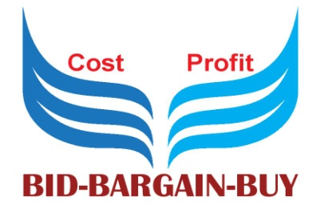
BID2SKY.COM
This Innovative website, is a value added Software, that connects the Vendors, Service Providers & Professionals with the Corporate who need to Source Components, RM, Services. This operates on RFQ, Bids and Rebids, which creates a market place for a wider choice of Supply and minimizes cost by increased Competition. The software follows the Workflow Process and can be customized to the individual B2b Customer needs.
SKU Master can be uploaded.
BOM can be created
RFQ for materials can be posted as Ads.
Vendors can register and search for RFQ`s
Alerts for RFQ postings can be initiated by SMS, Mails , Chats.
BIDS can be posted online against RFQ
Digital Ads will enhance publicity and can direct to the Website.
Indirect Tax Savings can be suggested
AARMS can Minimize the Dispatch cost by posting RFQ in scmjunction.com
Savings can be tracked
continued……..

Slide 11

Product Quality, Due Diligence and the KPI of the Vendors
Can be evaluated online.
Customer Support, Complaints, Product Promotions can be monitored through B2BCUSTOMERSUPPORT.COM
Vendor bills, Payables can be Digitized and managed as AP Process by AARMS.
New Product Introductions, Trial items, Vendor Management can be sourced from the registered vendors.
Online Customer Support through the vendor base.
Value propositions for Minimizing cost and maximizing profits to Manufacturing companies, Builders, Infrastructure projects, New customer penetration for Vendors, Architects, Builders, Service Providers etc.

Slide 12




Other Services :
AR FOCUSED: Dedicated website for Accounts Receivables.
Focused Collection of Past Dues, Current Dues.
Obtaining Confirmation of Balances
Online Accounts Reconciliations.
Total AR management for all Transporters, Logistic Companies.
C-form Management Website which helps the Collection and issue of C-forms and Concessional Forms. The Switchover to Goods and Services Tax era will be implemented by AARMS.
Over 75 Satisfied Customers.
Average of around 800crores Collections managed per month.
Professional Services.

Slide 13

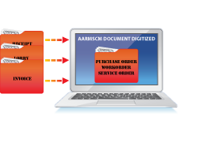

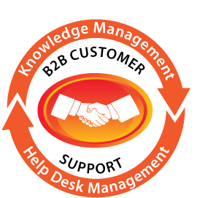
3.0 www. documentsdigitised.com: is a value added Website which digitizes all the documents, which can be retrieved online. The documents which have a parent/child relationship are integrated and scanned. The documents can be retrieved using the Advanced Search options. Value proposition is to reduce cost of storing and accuracy of Retrieval. Supports AR, AP, Secretarial, Legal and other processes.
B2bcustomer Support.com is the Website, which allows the customers to request for product enquiries, log product, service, commercial complaints and initiates actions for the complaints. Market research, Customer Satisfaction Index and other KPI parameters can be captured and would ensure Business relationships.

Slide 14



W2W CONNECT
Objective:
  Empowerment of Woman
  Free and fearless expression of concerns
  Support for creativity & Entreneurship
  Buy and get Exclusive Discounts
  Organize Online Interactive Sessions with Doctors, Lawyers, Educationists etc.
  Generate Funds through Product Ads, and Buys
  Connect NGO's, Social Service organisations in one platform.
Benefits:
  Woman can get connected with other woman across the world
  Express freely, since confidentiality will be maintained
  Can report harassments, abuses, raggings without fear online
  Request for career supports
  Advice for New projects, ideas.
  Showcase personal Talents
  Get Interactive advices from Woman Doctors, Lawyers, NGO's etc.
  Get discounts for purchases from Advertisers
  Personal Satisfaction for Social Cause, since the Revenues will be utilized for Social cause.

Slide 15
AARMS VALUE CHAIN PVT LTD ROADMAP AHEAD
SUPPLYCHAIN TRAINING centre for Skilled Training of Drivers, Mid level Managers and other SCM specialized Education system. Database of trained Drivers, will enhance placement and support the Transport companies.
RFID research centre for inventory management, Product Shelf life management, Tyre pressure Tracking, and Asset based tracking managements.
WAREHOUSE Sourcing, & Management software.
Online Spot bidding and placement of Vehicles for FTLs, ODC & other vehicles.
Part loads, Parcels and Tran-shipment tracking software.
Bidding and Auctioning process for Exports and Imports
GST management
NON-VOICE BASED BPO DEDICATED TO RECEIVABLES MANAGEMENT FOR INTERNATIONAL
CLIENTS.

Slide 16
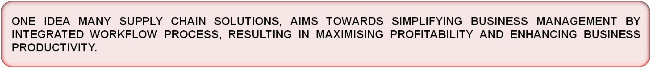
CONTACT US :
AARMS VALUE CHAIN PVT LTD
#211,3rd Floor, Temple Street,
9th Main Road, BEML 3rd Stage,
Rajarajeshwarinagar, Bangalore - 560098
Tel:+91 80 67187065
MOB: 9845497950
g.jagan@aarmsvaluechain.com
Website: www.aarmsvaluechain.com

