Slide 1

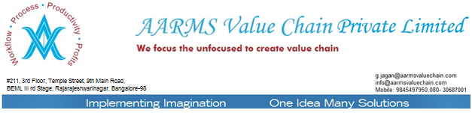
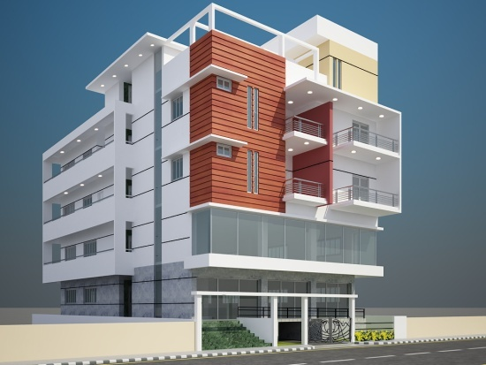
AARMS VALUE CHAIN PVT LTD
WE FOCUS THE UNFOCUSED TO CREATE VALUE CHAIN

Slide 2


Launching
www.bid2sky.com
SUPPLY CHAIN LOGISTICS, BIDDING, REVERSE AUCTIONING, FTL MANAGEMENT-
- www.scmjunction.com and www.scmbizconnect.com
VEHICLE TRACKING THROUGH GPS, MOBILE, GPRS. www.aaumconnect.com
AR MANAGEMENT – PAST DUES, CURRENT DUES, RECONCILIATION, CONFIRMATION OF BALANCES, www.arfocused.com
AP MANAGEMENT
CONSOLIDATED BILL PROCESSING CENTRE FOR ALL TRANSPORTATIONS (new)
C-FORM MANAGEMENT – COLLECTION OF C-FORMS, ISSUE OF C-FORMS, VAT AUDIT, BUSINESS AUDIT ETC . www.gstworkflow.com
WCT – TDS, IT TDS MANAGEMENT
DOCUMENT SCANNING – DIGITIZED, AND ONLINE SECURED SEARCH OF DOCS
www.documentsdigitized.com
CUSTOMER SUPPORT – WEB BASED ONLINE SUPPORT MANAGEMENT.
www.b2bcustomersupport.com

Slide 3

OPTIMISATION & WORKFLOW
SKU Master capturing the Packing Details, Size, Wt of the Material
Dispatch Plan with facility to Upload from Excel / Entry.
E-bid for Taurus, 32Ft Single Axle, double Axle, Triple Axle, Closed Containers,
Link the Dispatch Plan with the Optimization Plan.
Online Vehicle Request based on the Optimization Plan.
Vehicle Loading Time, Detention Time captured.
All Warehouses and facilities will be connected and the Receiving time can be updated in the System.
E-SIGNATURE for authentication of the workflow.
TARGET FOR A MINIMUM OF 10% SAVINGS BASED ON THE PAST 3 MONTHS LOAD FACTOR AND COST PER MT.
ONLINE MIS and Control of all Information, for each Facility and Warehouse.
Online Bill matching mechanism.
PERFORMANCE ANALYSIS OF THE TRANSPORTER ONLINE.
CUSTOMISE THE SOFTWARE REQUIREMENT

Slide 4
VALUE PROPOSITION
REVERSE AUCTIONING FOR ROUTE-WISE BOTH INBOUND AND OUTBOUND LOGISTICS.
TARGET FOR 25% MORE LOADABILITY, AND 10% SAVINGS OF FREIGHT COST.
OPITIMISATION PLAN WITH A FOCUS TO REDUCE PER M.T COST BY ECONOMIES TO SCALE LOADABILITY
IMPLEMENT A SYSTEMATIC WORKFLOW WEB BASED SOFTWARE, INTEGRATING VEHICLE REQUIREMENT
BASED ON THE OPTIMISATION PROGRAM.
IMPLEMENT WORKFLOW BASED AUDIT TRAIL AND TRANSPARENT MIS SYSTEM.
CUSTOMISE METRICS AND DASHBOARD BASED REPORTING, PERFORMANCE OF TRANSPORTERS AND OTHER KPI S
ONLINE AUDIT OF TRANSPORTERS BILLS, AND CERTIFY FOR PAYMENT.
ENSURE PROCESS FOR DOCUMENT CHECKLIST.
DIGITISED LR & BILLS MANAGEMENT, ENSURING BETTER TRANSACTION CLOSURE.

Slide 5
SCM BENEFITS
Cost Saving:
Plan Optimization
Reverse Loads to Locations
Cross Logistics for other Clients
Reverse Auctioning
Target for 10% savings on the Baseline existing Cost.
Process Improvement :
E-bid – transparent
Integrate all Facilities, Warehouses, C&F.
Web Based Workflow Software.
Savings Tracking online.
Vehicle Tracking
Introduce RFID
Performance MIS
Metrics, Dashboard
Transport Bill Matching & Audit
Transport Performance Measurement
AARMS Edge
End to End solutions.
Workflow based software
Dedicated support
Share Best practices.
Customized Software
Remuneration based on %age of Savings.
Introduce Alerts .
Transporter bill matching
Transporter Performance evaluation
Integrates other services.
Suggest Best Practices
AARMS – first Company with an Integrated Approach & Complete Software

Slide 6
SCM Clientele
Implemented
Marico Industries.
Thermax Limited
Godrej Industries
Kirloskar Oil Engines
Finolex Cables
FL Smidth
Greensol
Expected
GSK Pharma
3M Ltd
Piramal Limited
Reckit Beckinser
Motherson Sumi
Zydus Cadila
Fosroc Chemicals
Ambuja Cements
TI Cycles
Visteon Automotives
Saint Gobain Gyproc
Saint Gobain Glass
Only Company with an Integrated Approach & Complete Software

Slide 7
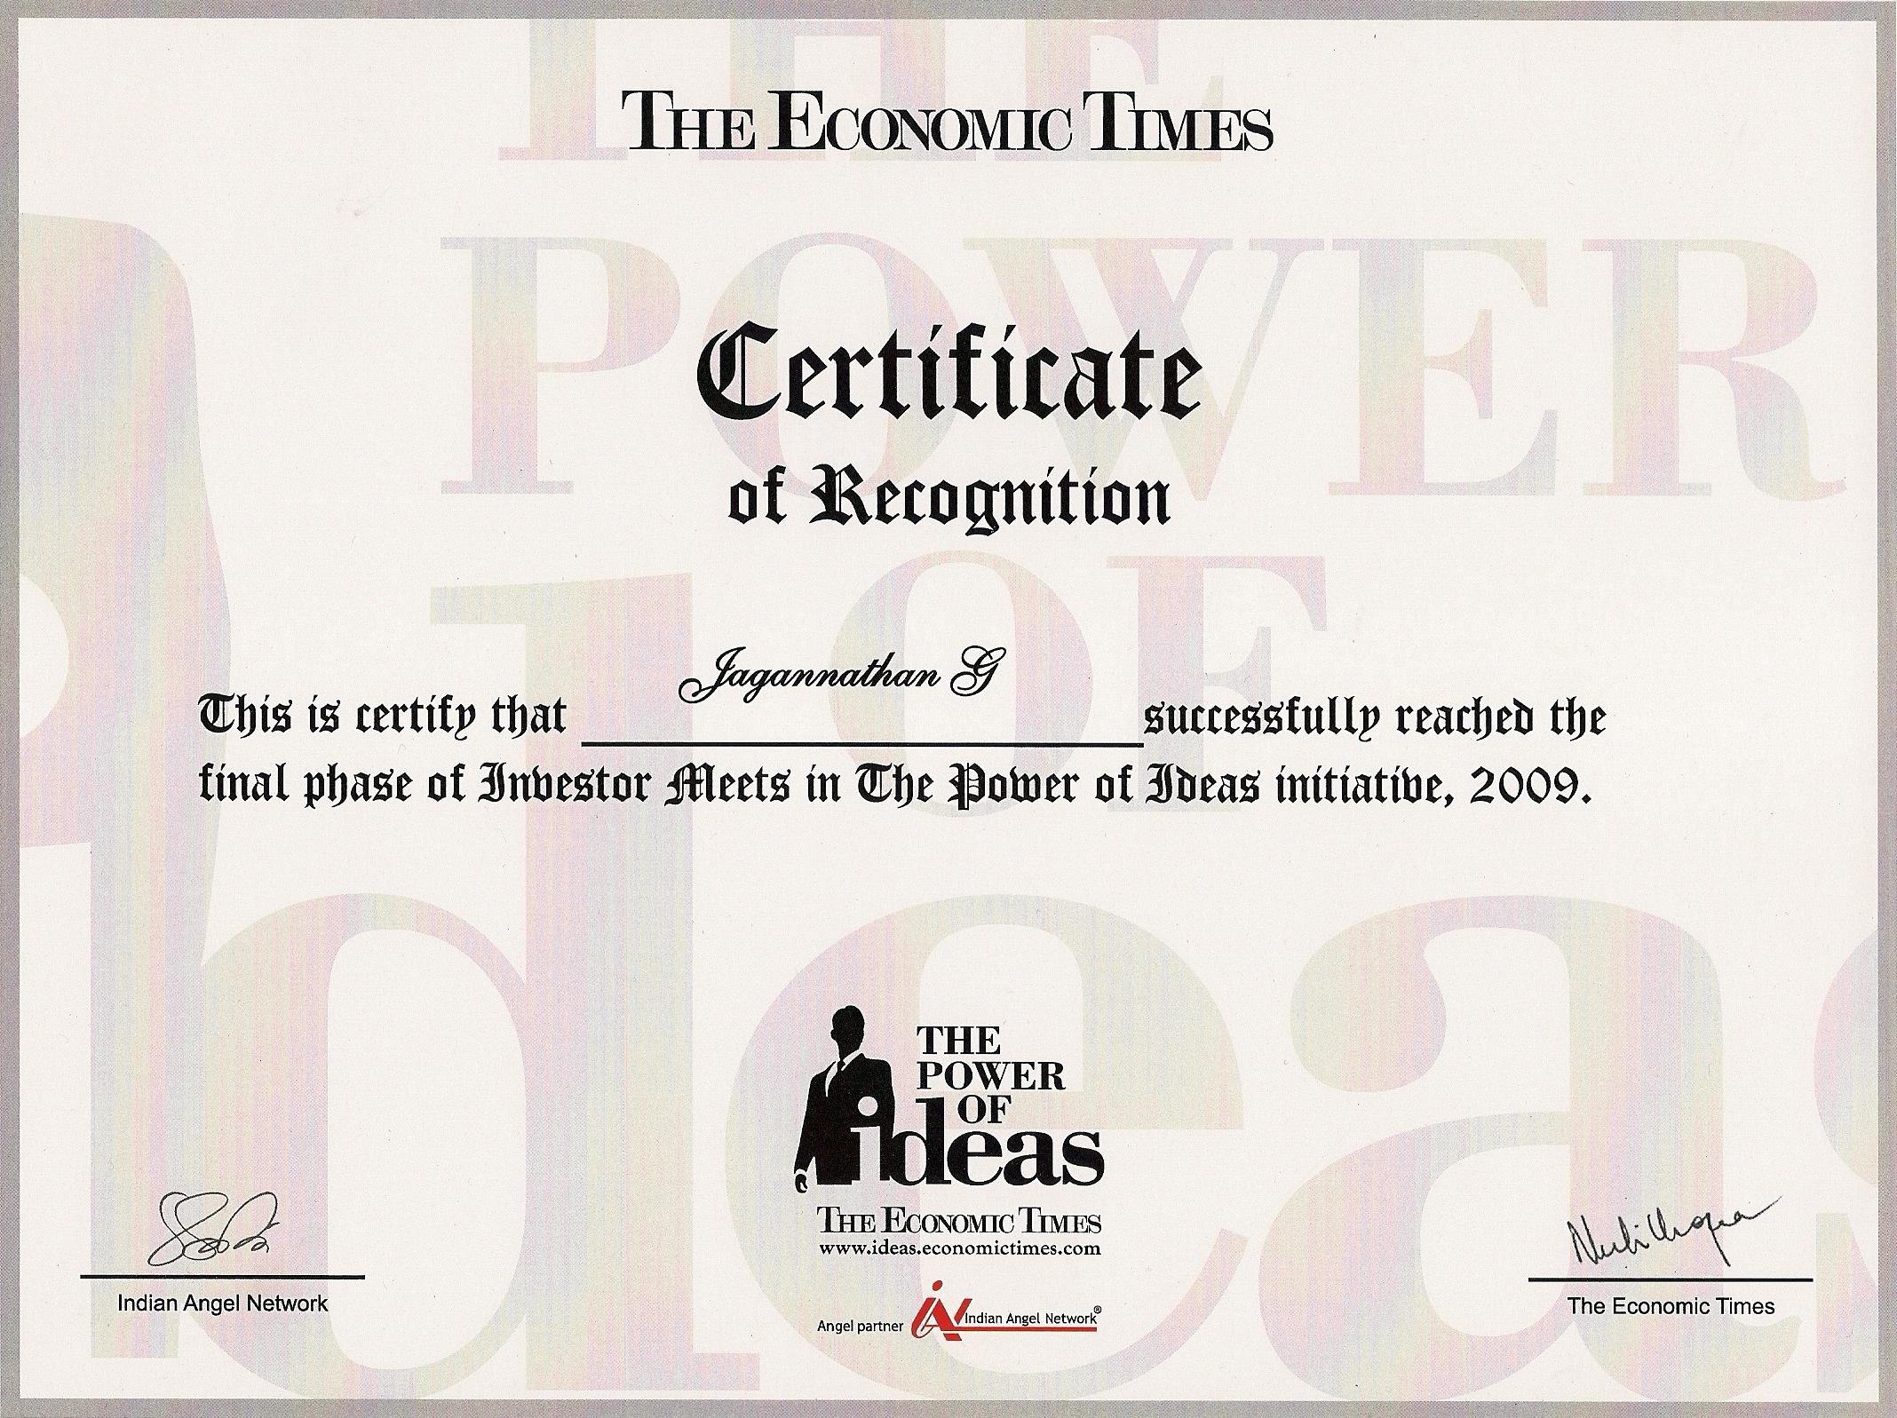

Slide 8
When Can we start the Trial ?

