Slide 1
FOODWISE
Making healthy food affordability visible
A public-data concept and mini-prototype for Kenya
[Your name] | [Email / phone]
01

Slide 2
The problem | Healthy diets remain out of reach
43.5–43.9M
KSh 189–582
9.5%
people, about 76–77%, cannot afford a healthy diet*
estimated daily cost of a healthy diet, depending on method*
annual food and non-alcoholic beverages inflation, Sep 2026
*FAO figures supplied for this concept; confirm edition, year and method before publication.
KNBS reports 9.5% year-on-year inflation for Food and Non-Alcoholic Beverages in September 2026.
FOODWISE | Healthy food should not be a luxury.
02

Slide 3
Why affordability breaks down
PRICE
Staple and nutritious food prices vary by place and month.
BUDGET
Households face trade-offs between food, housing, transport and other essentials.
INFORMATION
A price alone does not show the cost of a nutritious basket or the household's pressure.
FOODWISE | Healthy food should not be a luxury.
03

Slide 4
The solution | Three connected modules
1. Price Intelligence
Tracks market prices of staple and nutritious foods across counties using WFP + KNBS data.
2. Household Pressure Score
Estimates how much of a household’s income is needed for a healthy diet and flags when the share becomes dangerous (>50–60%).
3. Diet Gap Analysis
Compares the cost of the cheapest calorie diet vs a healthy diet and highlights the most expensive nutrients (usually iron, calcium, vitamin B12, zinc).
FOODWISE | Healthy food should not be a luxury.
04

Slide 5
How it works | Ingest → Analyse → Visualise → Recommend
INGEST
ANALYSE
VISUALISE
RECOMMEND
→
→
→
WFP market prices
KNBS CPI
Clean units
Compare trends
Price signals
Household pressure
Pilot priorities
County action
The first prototype uses public WFP observations; KNBS CPI provides national inflation context.
FOODWISE | Healthy food should not be a luxury.
05

Slide 6
Who benefits
Households
Counties
NGOs & partners
Understand how food costs compare with income and where prices are moving.
See market-level signals that can inform monitoring and pilot targeting.
Use a shared evidence base to focus nutrition and livelihood support.
Next step: co-design a county-level pilot with local price and nutrition partners.
FOODWISE | Healthy food should not be a luxury.
06

Slide 7
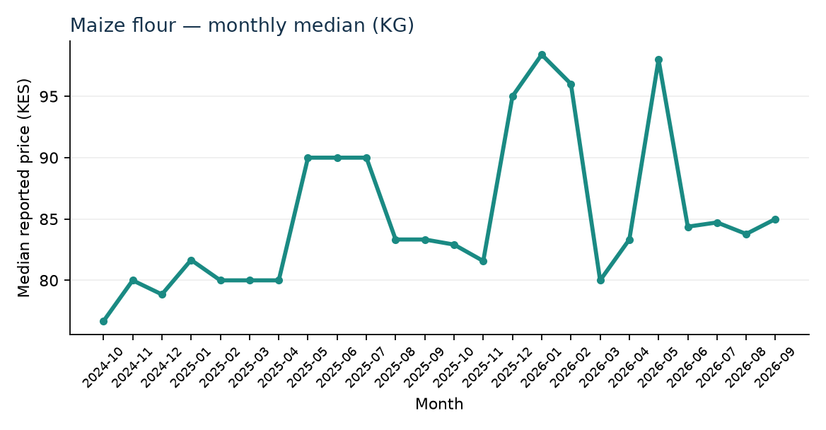
Where we are | Concept + prototype
WFP price trends (monthly median by item; reported markets)
Live spreadsheet prototype
• Price trends from WFP Kenya data
• Editable household basket
• Income-share pressure signal
Coverage is uneven; recent multi-item examples include camp markets, not Nairobi or Nyeri.
Prototype ready; next: validate the basket, add county coverage and run a pilot.
FOODWISE | Healthy food should not be a luxury.
07

Slide 8
Healthy food should not be a luxury.
FOODWISE makes the barriers visible so we can act on them.
Seeking county partners, nutrition mentors and a pilot opportunity.
[Your name] | [Email] | [Phone]
FOODWISE | Healthy food should not be a luxury.
08

