Slide 1
KENYA · PUBLIC-DATA CONCEPT
FOODWISE
Making healthy-food affordability visible
Real market-price signals. Transparent household scenarios. Honest data limits.
[Presenter name] · [Email / phone]
01

Slide 2
01 / THE CASE
The affordability challenge is real—and measurable.
43.5–43.9M
KSh 189–582
9.5%
People unable to afford a healthy diet
Estimated daily healthy-diet cost
Food & Non-Alcoholic Beverages inflation
FAO briefing figures · exact series/year to confirm
FAO / CoAHD briefing range · method-dependent
KNBS · year-on-year · September 2026
The build starts from public data—not from pretending these sources are interchangeable.
KNBS CPI is a national index. WFP provides market observations. FAO CoAHD uses its own diet-cost method.
FAO figures above are included from the project brief; confirm the exact dataset, year and denominator before public claims.
FOODWISE | Public-data concept · Kenya · October 2026
02

Slide 3
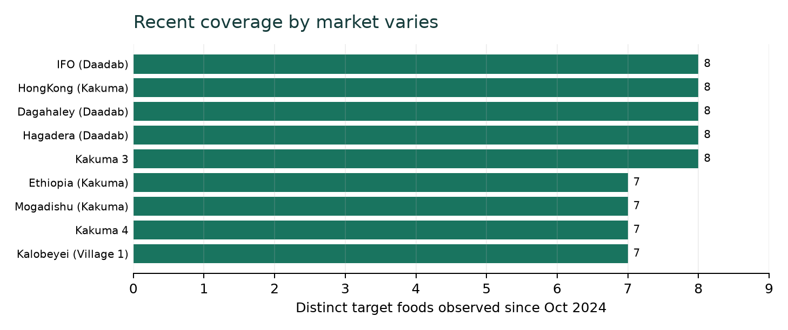
02 / EVIDENCE BASE
The prototype is built on a real WFP Kenya price file.
27,897
2006–2026
1,689
15 Sep 2026
WFP source rows
Recorded date range
Recent target-food rows since Oct 2024
Latest WFP source date
What the chart means
Coverage counts distinct target foods in recent retail observations. It is a snapshot of data availability—not evidence that one county is more expensive or more food insecure.
Current WFP coverage includes markets in Garissa and Turkana, including refugee-camp markets.
Not a Nairobi/Nyeri or county-representative retail panel.
FOODWISE | Public-data concept · Kenya · October 2026
03

Slide 4
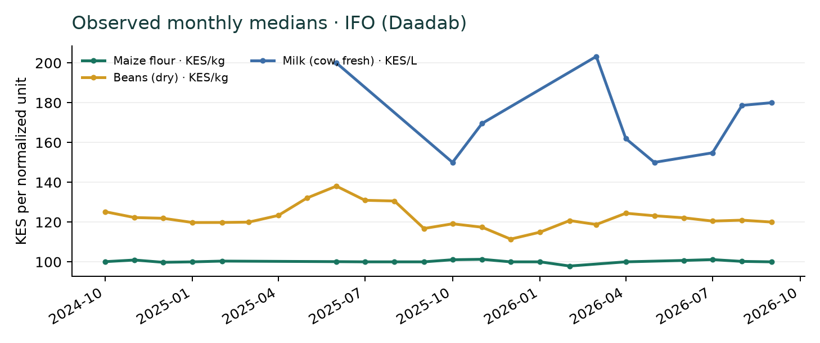
03 / PRICE INTELLIGENCE
Price signals move by food, month and market.
Monthly median
Uses reported WFP Retail observations; explicit package units normalized per kg / litre.
One market example
IFO (Daadab) · a source market, not a proxy for all households.
Interpret with care
Markets and record counts vary over time; this is not KNBS CPI or a causal diet outcome.
Series shown: maize flour, dry beans and fresh cow milk. Exact dates, units and flags are available in the app.
FOODWISE | Public-data concept · Kenya · October 2026
04

Slide 5
04 / THE PRODUCT
Three linked modules turn prices into questions people can act on.
01 Price Intelligence
02 Household Pressure Scenario
03 Diet Gap Readiness
Browse food prices by market and month. Compare like-for-like units. Export the filtered source observations.
Change the basket quantities, household size and income. See the priced-item cost share and the observations behind it.
Use expert-reviewed nutrient composition and population-specific references—without fabricating nutrient data from prices.
The key design choice: missing values remain visible as missing.
No silent zero prices · no invented nutrient scores · no CPI/market-price conflation
FOODWISE | Public-data concept · Kenya · October 2026
05

Slide 6
05 / HOUSEHOLD SIMULATOR
A household scenario is now interactive—not a claimed healthy-diet cost.
KSh 708
KSh 12,308
49.2%
Weekly scenario per person
Monthly household scenario
Share of KSh 25,000 monthly income
7 of 7 items priced · 1 observation(s) older than 90 days
4 people · illustrative quantities
Prototype calculation · not a validated risk band
Editable in the app
Why the caveat matters
Food quantities · market · household size · income · watch / critical thresholds.
The basket is a demonstration scenario. It is not an official FAO CoAHD basket or nutrition recommendation.
One or more source prices are more than 90 days older than the selected cutoff; check each date in the app.
FOODWISE | Public-data concept · Kenya · October 2026
06

Slide 7
06 / RESPONSIBLE SCOPE
Diet-gap analysis requires nutrition data—not just price.
1
Choose foods & quantities
Same scenario inputs used by the household calculator.
2
Provide sourced composition
Nutrient amounts per kg / litre / source unit, matched to foods.
3
Set a population reference
Expert-selected age / life-stage reference and source year.
4
Compare transparently
Estimate contribution and remaining amount; show sources.
No composition dataset is bundled today; the interface waits for reviewed inputs rather than inventing outputs.
FOODWISE | Public-data concept · Kenya · October 2026
07

Slide 8
07 / HOW IT WORKS
From official public files to an auditable live prototype.
INGEST
VALIDATE
ANALYSE
SHARE
WFP price CSV
WFP market coordinates
KNBS CPI reference
Required fields
KES & positive values
Comparable units
Monthly medians
Latest market price
Editable scenarios
Interactive Streamlit app
Filtered CSV export
PowerPoint showcase
›
›
›
Auditable methods live in the project: source CSVs · unit conversions · tests · limitations · reproducible setup.
Run locally with Python + Streamlit. The app bundles the data and can filter an updated WFP-style CSV.
FOODWISE | Public-data concept · Kenya · October 2026
08

Slide 9
08 / NEXT 30–60 DAYS
The next step is a validated county pilot—not a bigger claim.
01 · Validate
02 · Co-design
03 · Pilot
04 · Decide
County / market coverage
Nutrition expert reviews basket
Confirm CoAHD benchmarks
Agree household groups
Agree reference period
Define usable outputs
Collect matched local prices
Test with households & partners
Measure coverage and usability
Document limits and learnings
Prioritize additional markets
Scale only if evidence supports it
Pilot partners needed: one county team · a nutrition reviewer · trusted market-price enumerators.
Success starts with credible local coverage and a validated basket, not dashboard complexity.
FOODWISE | Public-data concept · Kenya · October 2026
09

Slide 10
HEALTHY FOOD SHOULD NOT BE A LUXURY.
FOODWISE makes the barriers visible so we can act on them.
Seeking county partners · nutrition mentors · a pilot opportunity
[Presenter name] · [Email] · [Phone]
10

