Slide 2
Read the data
Sort the data
Join the data
Using Readfile
Using Pandas
Using Quicksort
Using merge/heapsort

Slide 3
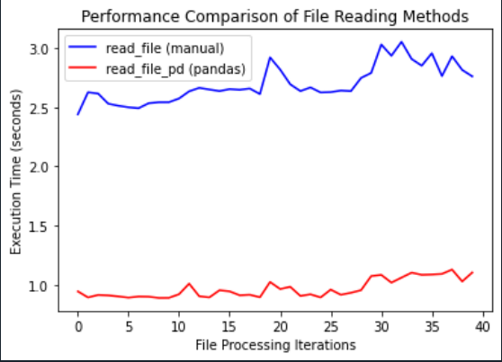
Reading the data::
Reading using pandas is better as it is taking around 1 sec.

Slide 4
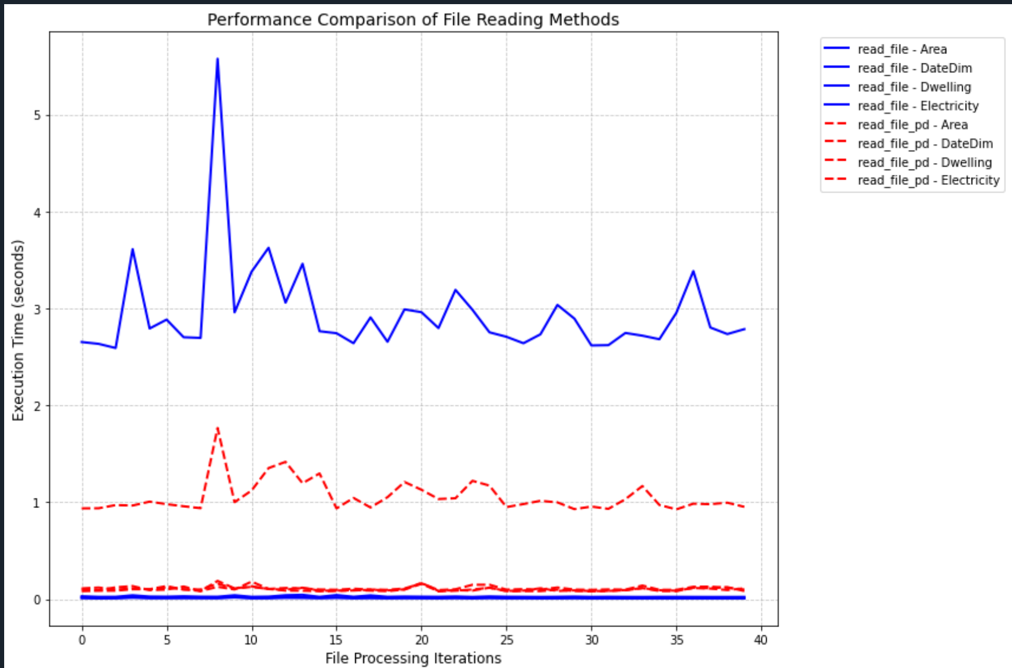
Significant difference when the data point increases, each data is read 100 times for a single iteration and process is repeated 40 times

Slide 5
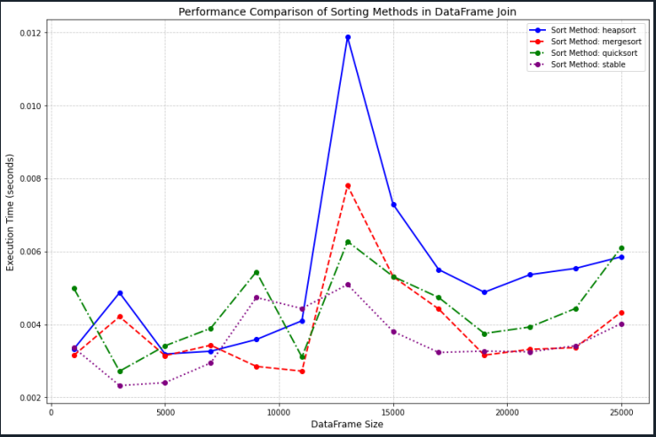
Pandas for sort: stable sort and heap sort are behaving in the same manner

Slide 6
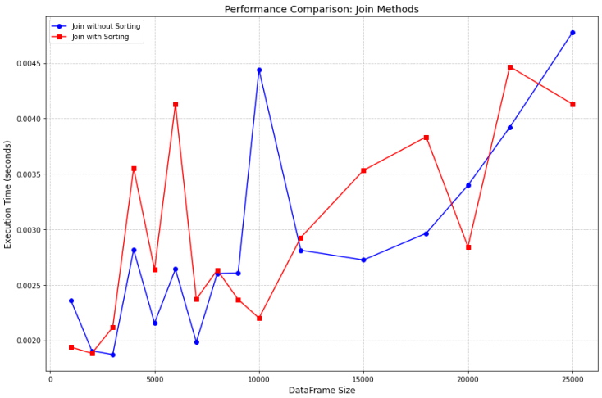
Which one to consider? Both are like….. Same?

