Slide 1
Neural Networks:
Backpropagation algorithm

Slide 2

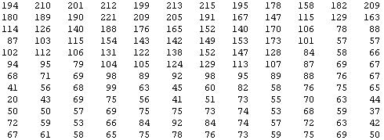
What is this?
You see this:
But the camera sees this:

Slide 3
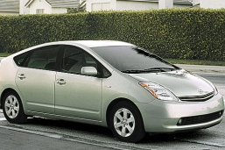
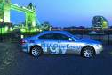
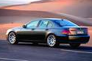
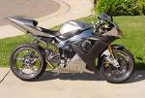
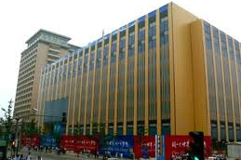




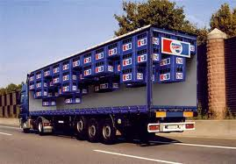
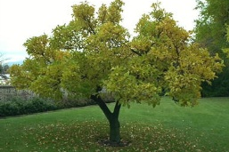
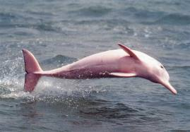

Computer Vision: Car detection
Cars
Not a car
Testing:
What is this?

Slide 4

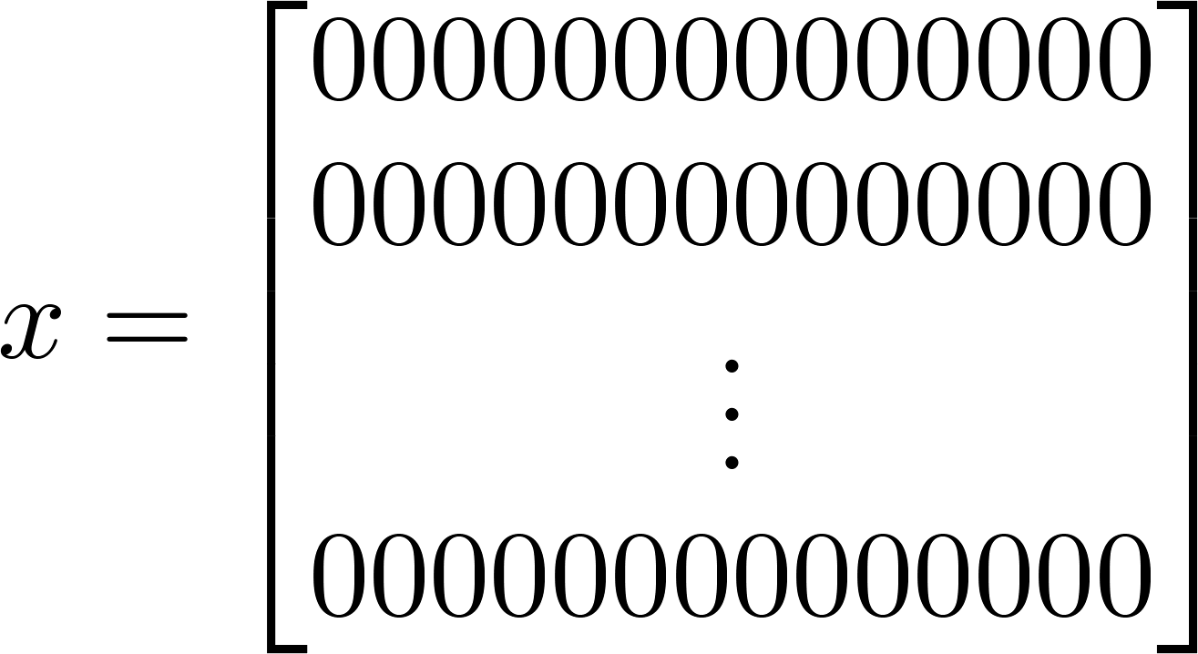

pixel 1
Learning Algorithm
pixel 2
Raw image
50 x 50 pixel images→ 2500 pixels
(7500 if RGB)
pixel 2
pixel 1 intensity
pixel 2 intensity
pixel 2500 intensity
Cars
pixel 1
Quadratic features ( ): ≈3 million features
“Non”-Cars

Slide 5
Neural Networks
Origins: Algorithms that try to mimic the brain
Was very widely used in 80s and early 90s; popularity diminished in late 90s.
Recent resurgence: State-of-the-art technique
for many applications

Slide 6
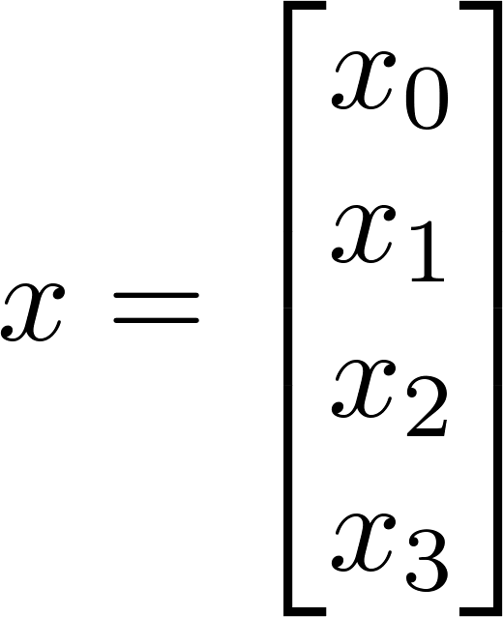
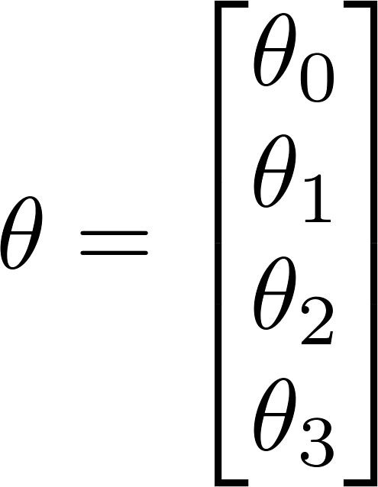






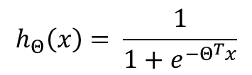
Neuron model: Logistic unit
$x_{0}=1$ “bias unit”
“output”
“weights” - parameters
$$h_{Θ}\left(x\right)= \frac{1}{1+e^{−Θ^{T}x}}$$
“input wires”
$$g\left(z\right)= \frac{1}{1+e^{−z}}$$
Sigmoid (logistic) activation function.

Slide 7


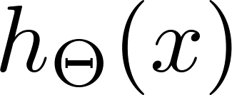




Neural Network
“bias unit”
Layer 1
Layer 2
Layer 3
“input layer”
“hidden layer”
“output layer”

Slide 8








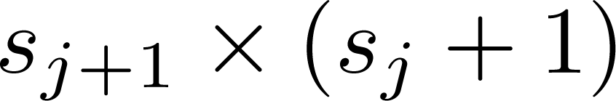
Neural Network
“activation” of unit in layer
matrix of weights controlling function mapping from layer to layer
If network has units in layer , units in layer , then
will be of dimension .

Slide 9
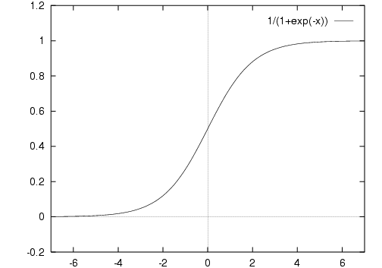

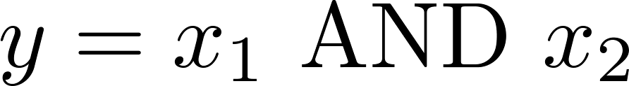






Simple example: AND
-30
+20
0 | 0
0 | 1
1 | 0
1 | 1
$$g(−30)≈0$$
$$g(−10)≈0$$
$$g(−10)≈0$$
$$g(10)≈1$$
+20
$$h_{Θ}\left(x\right)=g(−30+20x_{1}+20x_{2})$$
$$h_{Θ}\left(x\right)≈x_{1} AND x_{2}$$

Slide 10
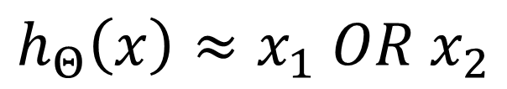


Example: OR function
-10
0 | 0
0 | 1
1 | 0
1 | 1
+20
$$g(−10)≈0$$
$$g(10)≈1$$
$$g(10)≈1$$
$$g(30)≈1$$
+20
$$h_{Θ}\left(x\right)=g(−10+20x_{1}+20x_{2})$$
$$h_{Θ}\left(x\right)≈x_{1} OR x_{2}$$

Slide 11
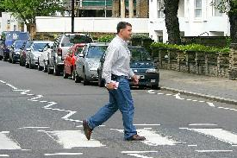

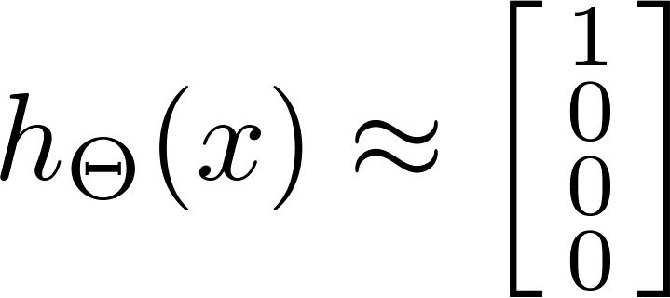

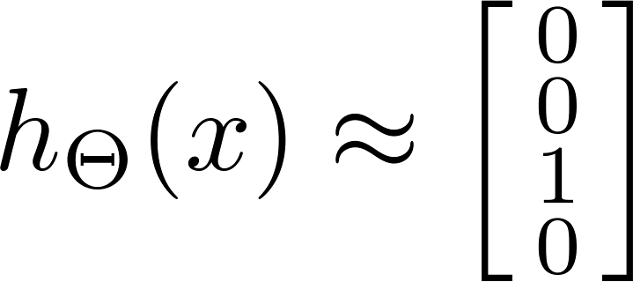
Multiple output units: One-vs-all.
Pedestrian
Car
Motorcycle
Truck
Want ,
,
, etc.
when pedestrian
when car
when motorcycle

Slide 12








Neural Network (Classification)
total no. of layers in network
no. of units (not counting bias unit) in layer
Layer 1
Layer 2
Layer 3
Layer 4
Binary classification
1 output unit
Multi-class classification (K classes)
K output units
E.g. , , ,
pedestrian car motorcycle truck

Slide 13

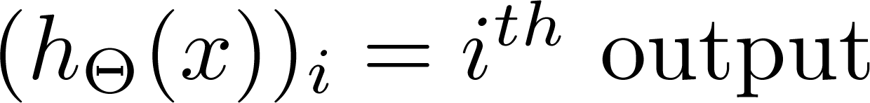
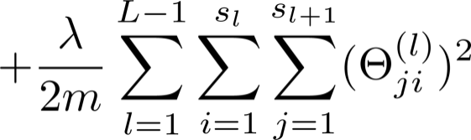
Cost function
Logistic regression:
Neural network:

Slide 14
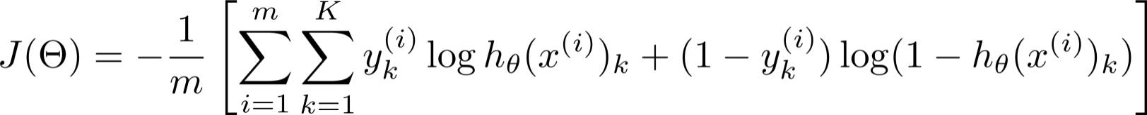
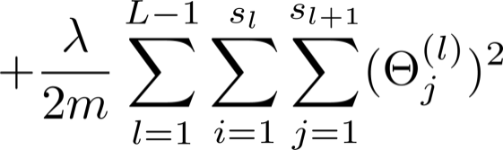


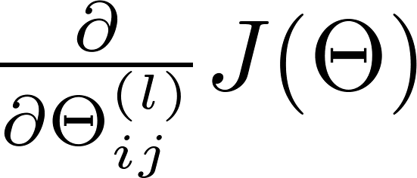
Gradient computation
Our goal is to minimize the cost function
Need code to compute:

Slide 15


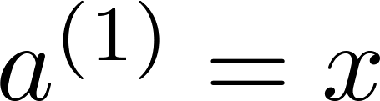
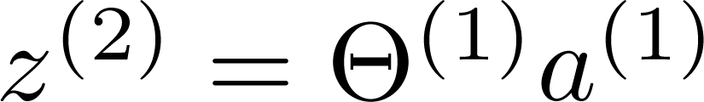
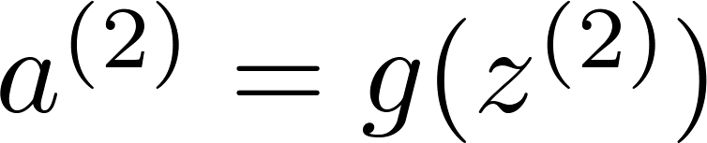
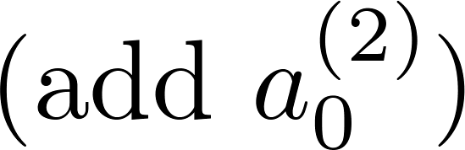
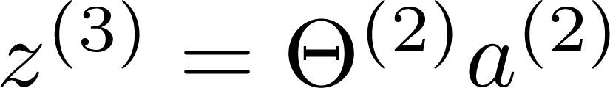
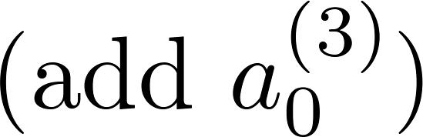
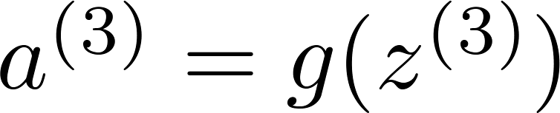
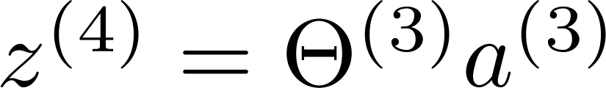
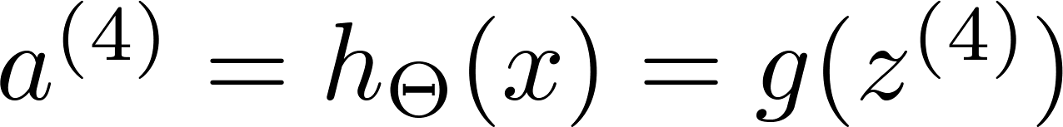




Backpropagation algorithm
Given one training example ( , ):
$$a^{\left(1\right)}$$
$$a^{\left(2\right)}$$
$$a^{\left(3\right)}$$
$$a^{\left(4\right)}$$
Forward propagation:
Layer 1
Layer 2
Layer 3
Layer 4
23.12.2011. Miroslav Tišma 16/21

Slide 16
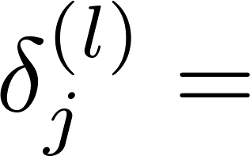

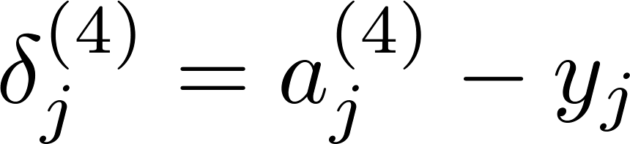




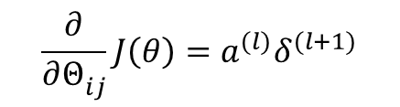

Backpropagation algorithm
Intuition: “error” of node in layer .
element-wise multiplication operator
For each output unit (layer L = 4)
$$δ^{\left(2\right)}$$
$$δ^{\left(3\right)}$$
$$δ^{\left(4\right)}$$
$${\left(h_{θ}\left(x\right)\right)}_{j}$$
Layer 1
Layer 2
Layer 3
Layer 4
$$\frac{∂}{∂Θ_{ij}^{}}J\left(θ\right)=a^{(l)}δ_{}^{(l+1)}$$
the derivate of activation function
can be written as
$$a^{(l)}.∗(1−a^{\left(l\right)})$$
23.12.2011. Miroslav Tišma 17/21

Slide 17
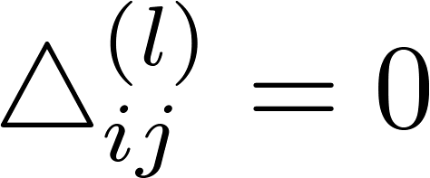


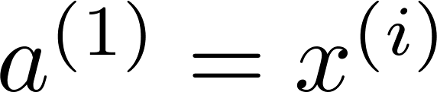

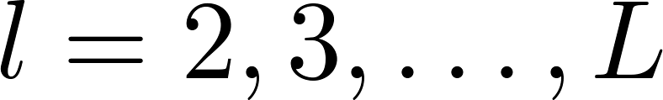

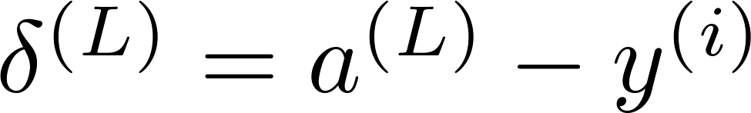
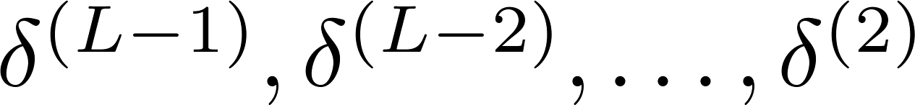
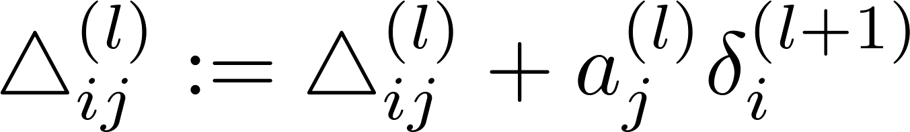
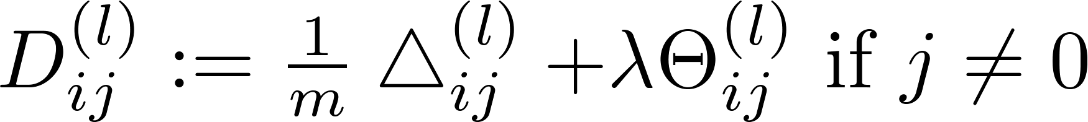
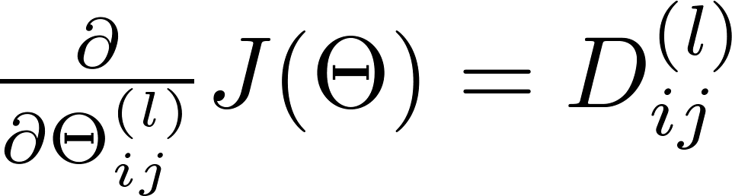
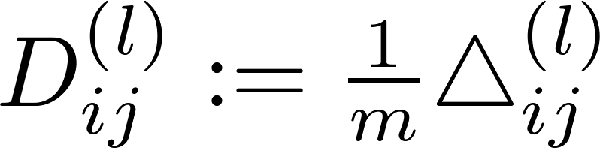


Backpropagation algorithm
Training set
Set (for all ).
used to compute $\frac{∂}{∂Θ_{ij}^{}}J\left(θ\right)$
For
Set
Perform forward propagation to compute for
Using , compute
Compute

Slide 18
Advantages:
Relatively simple implementation
Standard method and generally wokrs well
Many practical applications:
* handwriting recognition, autonomous driving car
Disadvantages:
Slow and inefficient
Can get stuck in local minima resulting in sub-optimal solutions

