Slide 1
Regression
Anuj Kumar Jain

Slide 2
Learning Objectives
Describe the Linear Regression Model
State the Regression Modeling Steps
Explain Ordinary Least Squares
Compute Regression Coefficients
Understand and check model assumptions
Predict Response Variable
Notes:
As a result of this class, you will be able to...

Slide 3
What is Regression
“Regression analysis is a form of predictive modeling technique which investigates the relationship between a dependent and a independent variable.”
It involve graphing a line over a set of data point that most closely fit overall data.

Slide 4
Uses of Regression
Three major uses for regression analysis are:
Determining the strength of prediction
Forecasting an effect and impact
Trend forecasting

Slide 5
Regression Selection Criteria
Classification and Regression Capabilities
Data Quality
Computational Complexity
Comprehensible and transparent

Slide 6
Where is Linear Regression used?
Evaluating Trends and Sales Estimates
Analysis the Impact of Price Changes
Assessment of risk in financial Services and Insurance domain

Slide 7
Understand the Linear Regression Algorithm
Y
Y=mX+b
Change in Y axis
m = Slope of line
Change in X axis
b= intersection of Y
X
© 1984-1994 T/Maker Co.
Notes:
28

Slide 8
Contd..
Regression line (+Re)
Dependent Variable
Independent Variable

Slide 9
Contd..
Dependent Variable
Regression line (-Re)
Independent Variable

Slide 10
Understand the Linear Regression Algorithm
Relationship Between Variables Is a Linear Function
Population Y-Intercept
Population Slope
Random Error
Y
=
β
+
β
X
+
ε
i
0
1
i
i
Dependent (Response) Variable
Independent (Explanatory) Variable

Slide 11

Understand the Linear Regression Algorithm
Y
Observed Value
$$\hat{Y_{i}}=\hat{β_{0}}+\hat{β_{1}}X_{i}$$
Dependent Variable
Random Error
Independent Variable
X

Slide 12
Estimating Parameters: Least Means Squares Method

Slide 13
Thinking Challenge
Y
Dependent Variable
Independent Variable
X

Slide 14
Thinking Challenge
How would you draw a line through the points? How do you determine which line ‘fits best’?
Y
Dependent Variable
Independent Variable
X

Slide 15
Thinking Challenge
How would you draw a line through the points? How do you determine which line ‘fits best’?
Y
Dependent Variable
Independent Variable
X

Slide 16
Thinking Challenge
How would you draw a line through the points? How do you determine which line ‘fits best’?
Y
Dependent Variable
Independent Variable
X

Slide 17
Thinking Challenge
How would you draw a line through the points? How do you determine which line ‘fits best’?
Y
Dependent Variable
Independent Variable
X

Slide 18
Least Mean Squares
‘Best Fit’ Means Difference Between Actual Y Values & Predicted Y Values Are a Minimum. But Positive Differences Off-Set Negative. So square errors!
LS Minimizes the Sum of the Squared Differences (errors) (SSE)
Notes:
51

Slide 19
Coefficient Equations
Prediction equation
Sample slope
Sample Y - intercept

Slide 20
Parameter Estimation Example
What is the relationship between Mother’s Estriol level & Birthweight using the following data?
Estriol (mg/24h) | Birthweight (g/1000)
1 | 1
2 | 1
3 | 2
4 | 2
5 | 4

Slide 21
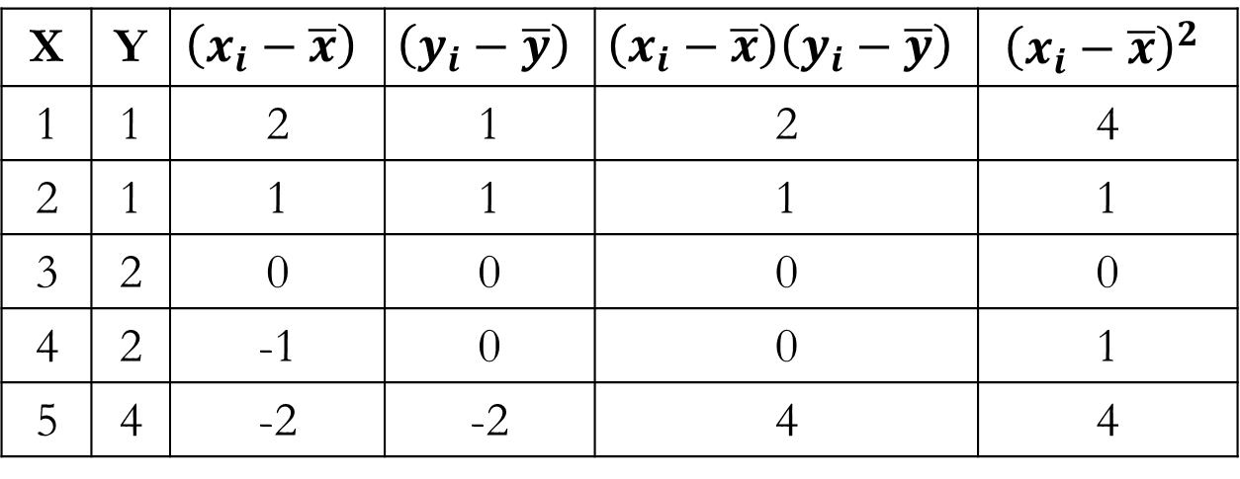


X | Y | $$\left(x_{i}−\overline{x}\right)$$ | $$\left(y_{i}−\overline{y}\right)$$ | $$\left(x_{i}−\overline{x}\right)\left(y_{i}−\overline{y}\right)$$ | $${\left(x_{i}−\overline{x}\right)}^{2}$$
1 | 1 | 2 | 1 | 2 | 4
2 | 1 | 1 | 1 | 1 | 1
3 | 2 | 0 | 0 | 0 | 0
4 | 2 | -1 | 0 | 0 | 1
5 | 4 | -2 | -2 | 4 | 4
$$\overline{x}=\frac{\sum{x_{i}}}{n}=\frac{15}{5}=3$$
$$\overline{y}=\frac{\sum{y_{i}}}{n}=\frac{10}{5}=2$$

Slide 22
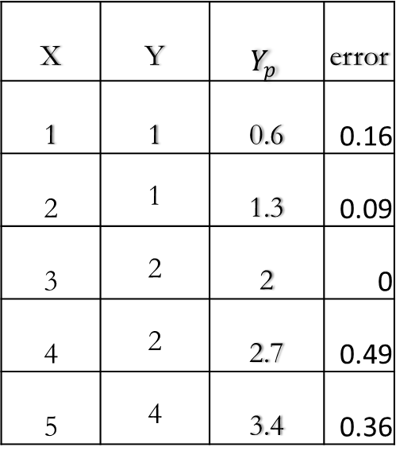
Least Mean Square Error
Error
X | Y | $$Y_{p}$$ | error
1 | 1 | 0.6 | 0.16
2 | 1 | 1.3 | 0.09
3 | 2 | 2 | 0
4 | 2 | 2.7 | 0.49
5 | 4 | 3.4 | 0.36
Error
Error
Error
1.1

Slide 23
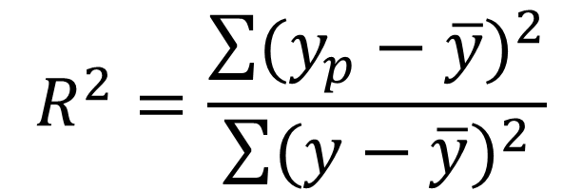
What is R Square value
R Squared value is a statistical measure of how close the data are to filtered regression line.
It is also known as coefficient of determination, or the coefficient of multiple determination
Distance actual value –mean
Vs
Distance predicted value -mean
$$R^{2}=\frac{\sum{{(y_{p}−\overline{y})}^{2}}}{\sum{{(y−\overline{y})}^{2}}}$$

Slide 24
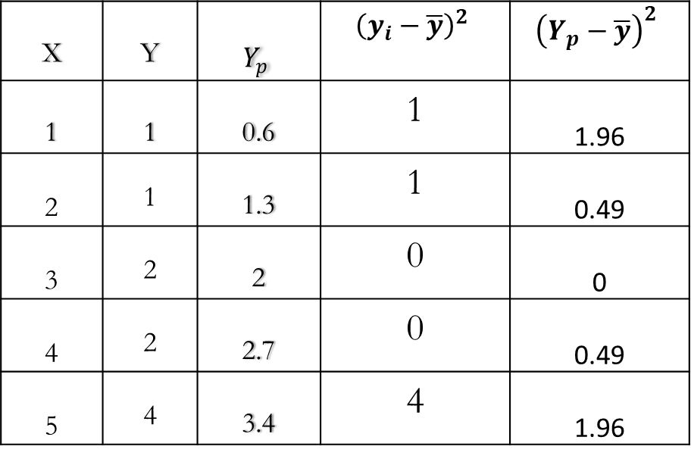
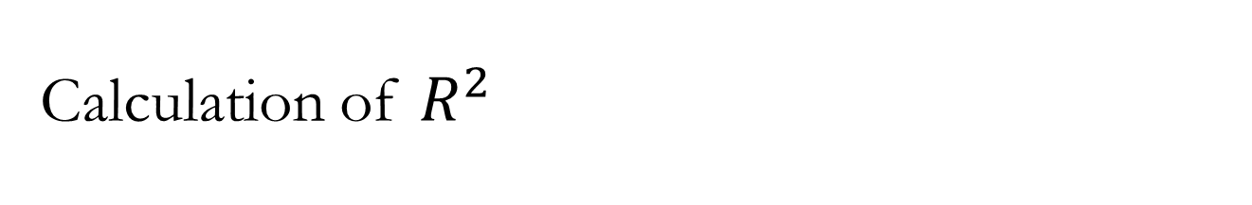

Calculation of $R^{2}$
X | Y | $$Y_{p}$$ | $${\left(y_{i}−\overline{y}\right)}^{2}$$ | $${\left(Y_{p}−\overline{y}\right)}^{2}$$
1 | 1 | 0.6 | 1 | 1.96
2 | 1 | 1.3 | 1 | 0.49
3 | 2 | 2 | 0 | 0
4 | 2 | 2.7 | 0 | 0.49
5 | 4 | 3.4 | 4 | 1.96
$R^{2}=\frac{\sum{{(y_{p}−\overline{y})}^{2}}}{\sum{{(y−\overline{y})}^{2}}}=\frac{4.9}{6}$=0..81

