Slide 1

Aspects of Microservice Interactions
This Photo by Unknown Author is licensed under CC BY

Slide 2
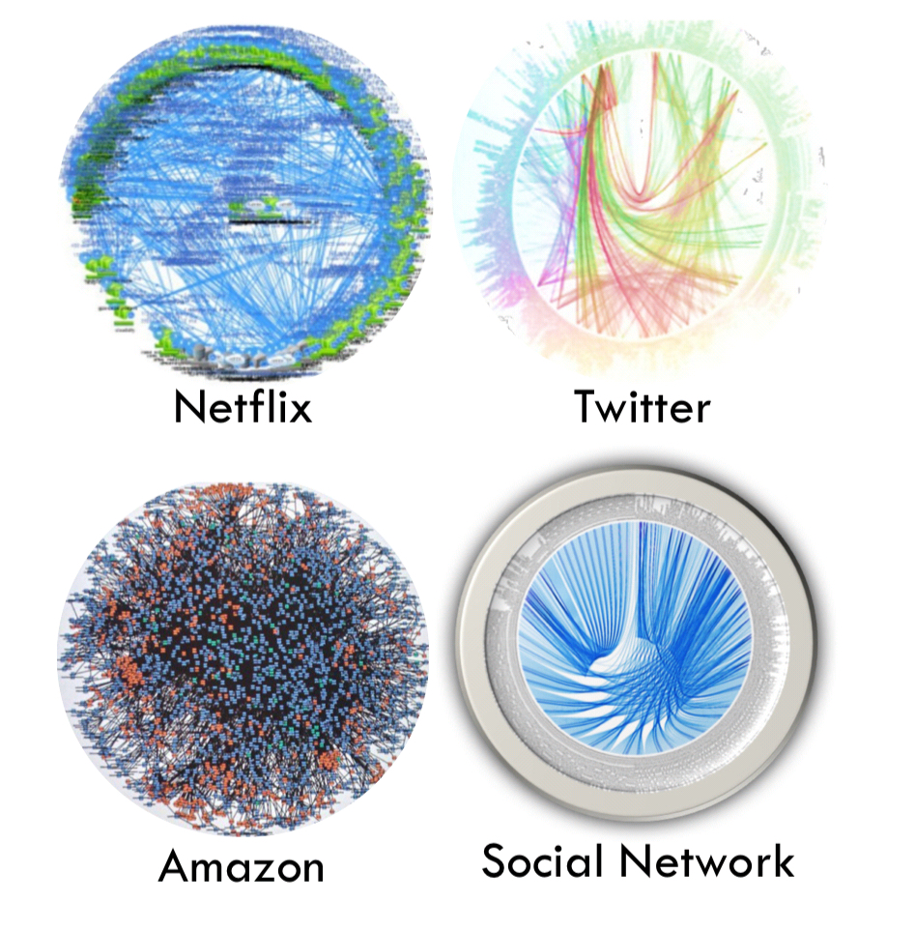

Slide 3

WHY?

Slide 4
Characteristics
Independently Deployable
Polyglot
Autonomous

Slide 5

NETWORK CALL
Notes:
No SRP, no microservice size, etc…

Slide 6
Rules & Laws => Effects, Driving Forces
Availability
Reliability – Leaky Abstraction (TCP)
Latency
Queuing Theory
Conway’s Law

Slide 7
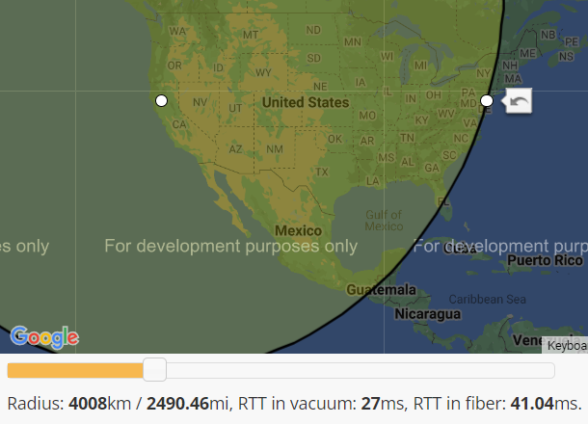
Latency
Notes:
Fiber is 1.5x slower
Eventual Consistency
Pressure increasing replication latency leads to increase of replication lag

Slide 8
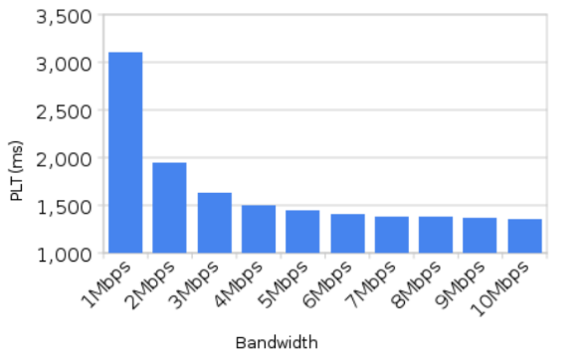
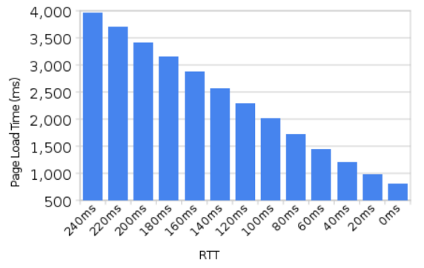
Latency
Notes:
https://tech-lagoon.com/imagechef/en/white-to-transparent.html

Slide 9
Latency Numbers Every Programmer Should Know

Slide 10
Availability
96%
99%
99%
CPU
RAM
99%
Network
Disk
99%

Slide 11
88.5%
99%
99%
99%
99%
99%
99%
99%
99%
99%
99%
99%
99%
CLIENT
SERVER
DB

Slide 12
Reliability
CPU
RAM
CPU
RAM
Network
Network
Disk
Disk
CLIENT
SERVER
Notes:
TCP leaky abstraction
CAP theorem

Slide 13
Fallacies of Distributed Computing
The network is reliable;
Latency is zero;
Bandwidth is infinite;
The network is secure;
Topology doesn't change;
There is one administrator;
Transport cost is zero;
The network is homogeneous.
Notes:
Sun Microsystems
- CAP theorem

Slide 14

Conway’s Law

Slide 15

Conway’s Law

Slide 16
Conway’s Law

Slide 17
TACTICS

Slide 18
EXAMPLES

Slide 19
References
Notes:
https://www.igvita.com/2012/07/19/latency-the-new-web-performance-bottleneck/
https://gist.github.com/jboner/2841832
https://blog.bytebytego.com/p/ep22-latency-numbers-you-should-know
https://docs.google.com/a/chromium.org/viewer?a=v&pid=sites&srcid=Y2hyb21pdW0ub3JnfGRldnxneDoxMzcyOWI1N2I4YzI3NzE2
https://www.cloudping.co/
https://aws-latency-test.com/
https://en.wikipedia.org/wiki/Fallacies_of_distributed_computing
https://d1.awsstatic.com/architecture-diagrams/ArchitectureDiagrams/unreal-engines-pixel-streaming-on-aws-ra.pdf?did=wp_card&trk=wp_card

Slide 20

Colors

