Slide 1

HOW TO MAKE TECHNICAL DECISIONS?

Slide 2
Examples
MongoDB
MySQL
Hibernate
JDBC
Maven
Gradle
implement
reuse

Slide 3

your WORST technical decision here

Slide 4
… let me help
own persistency layer
in PHP
2
non-compatible components
~ 300 dependencies each

Slide 5
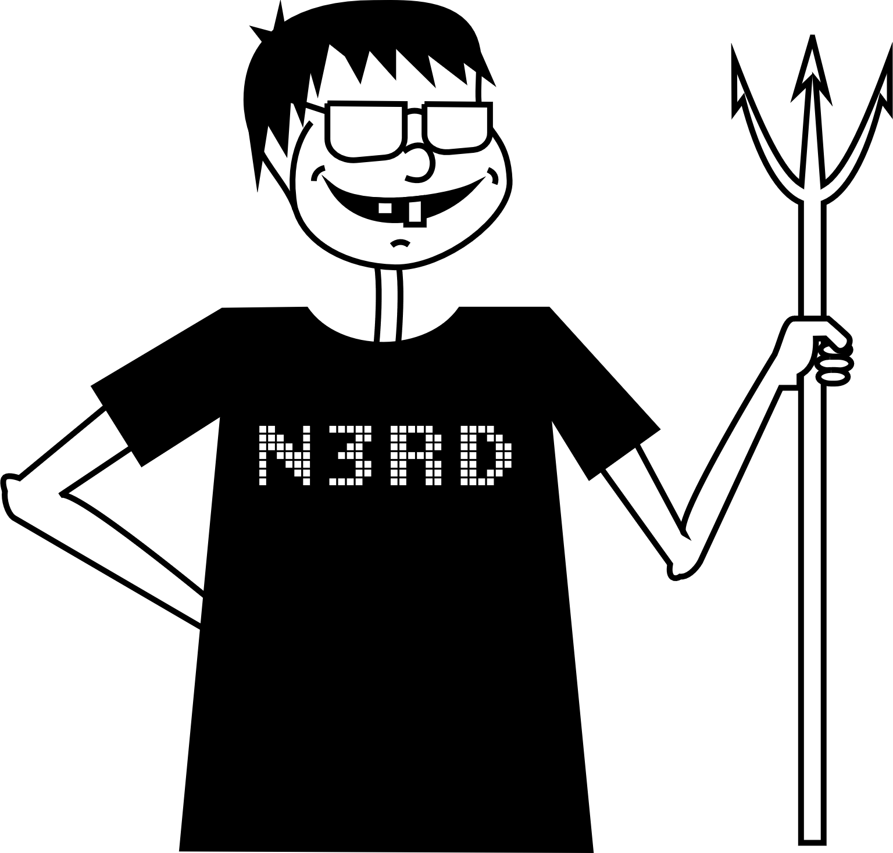
We all have war stories
implemented his own
framework & wants to
use it in the project

Slide 6
COST OF A BAD DECISION

