Slide 1
Introduction to Microservices
Oresztész Margaritisz
CONFIDENTIAL | © 2020 EPAM Systems, Inc.

Slide 2
Monoliths vs microservices

Slide 3



FAMOUS MONOLITHS
Perl
C++ - 3400 KLOC
Monorail - Ruby on Rails
MySQL
C++
Perl and Mason

Slide 4
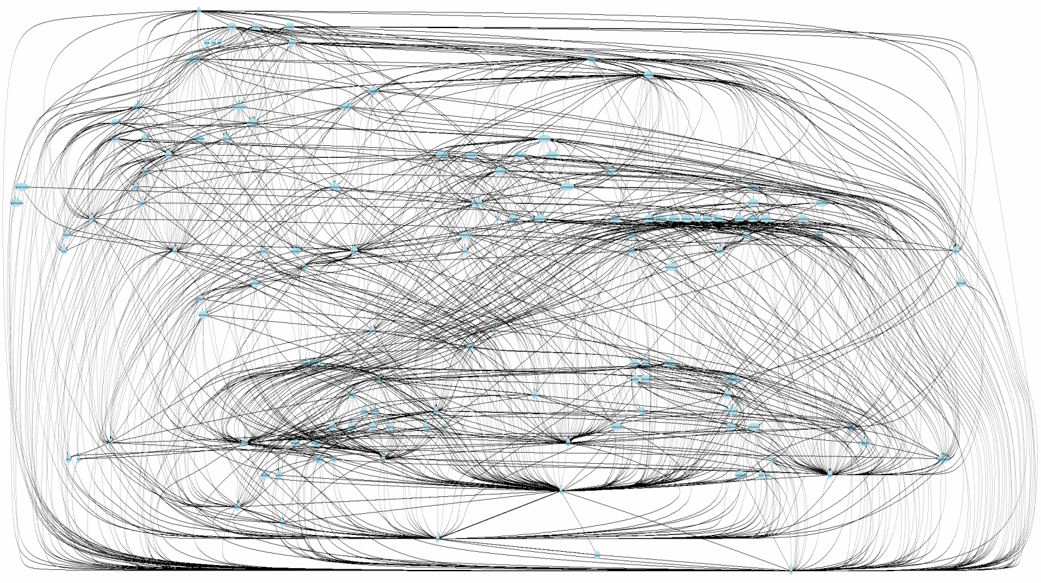
ISSUES
SCALING
DEPLOYMENT
POLYGLOT
AGILE & TEAMS
COMPLEXITY

Slide 5


Slide 6

HOW SMALL?

Slide 7
Single Responsibility
Principle

Slide 8
“... a given method/class/component should have a single reason to
Change.”
Robert C. Martin – Clean Code

Slide 9







Slide 10

TWO-PIZZA TEAM
3-12 people
DEV, QA, OPS

Slide 11

2 WEEKS

Slide 12
AUTONOMOUS
NETWORK CALL

Slide 13
Benefits

Slide 14
SCALING

Slide 15
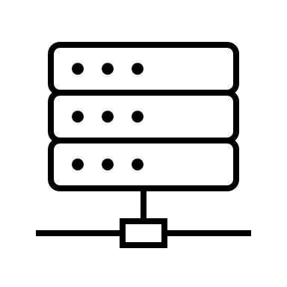
SCALING - MONOLITH
VERTICAL SCALING

Slide 16


SCALING - MONOLITH
HORIZONTAL SCALING

Slide 17
SCALING - MICROSERVICES
?
HORIZONTAL SCALING

Slide 18



SCALING - MICROSERVICES
Cloud
AUTOSCALE

Slide 19
POLYGLOT

Slide 20







POLYGLOT - MONOLITH
commons-text 1.1.2
guava 13.0.1

Slide 21



POLYGLOT - MICROSERVICES
NoSQL
Polyglot

Slide 22
DEPLOYMENTS

Slide 23

DEPLOYMENTS - MONOLITH

Slide 24
DEPLOYMENTS - MICROSERVICES
Continuous
Delivery

Slide 25
DEPLOYMENTS - MICROSERVICES
Cloud
DevOps

Slide 26
COMMUNICATION

Slide 27
COMMUNICATION - MONOLITH
27

Slide 28
COMMUNICATION - MONOLITH
28

Slide 29
COMMUNICATION - MICROSERVICES
NETWORK CALL
Polyglot
29

Slide 30



COMMUNICATION - MICROSERVICES
REST
Thrift
HTTP

Slide 31




COMMUNICATION - MICROSERVICES
Polyglot

Slide 32
RESILIENCE

Slide 33
RESILIENCE - MONILITH

Slide 34
RESILIENCE - MICROSERVICES

Slide 35

RESILIENCE - MICROSERVICES

Slide 36
Drawbacks

Slide 37
INFRASTRUCTURE COMPLEXITY

Slide 38

OBSERVABILITY
Logs
Metrics
Tracing

Slide 39
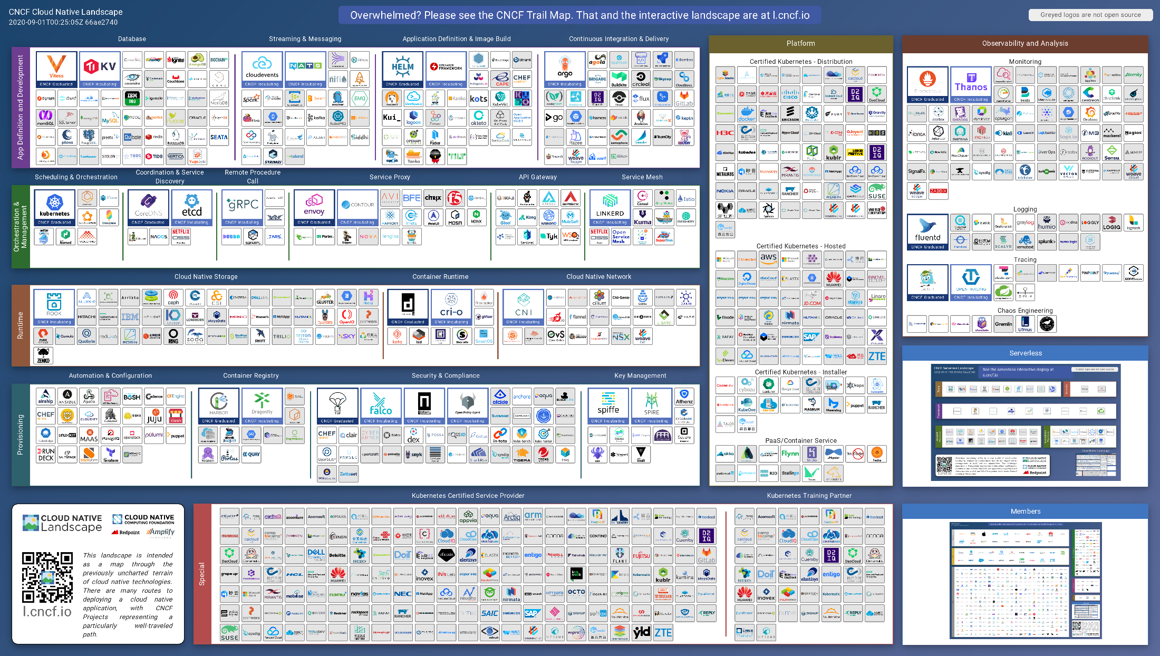

Slide 40
NETWORK PERFORMANCE

Slide 41
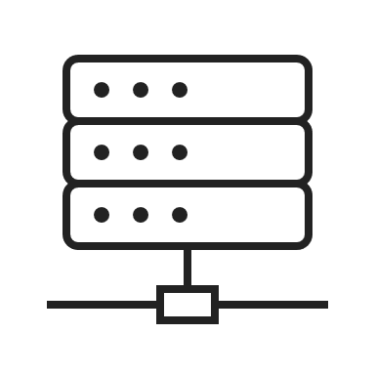
NETWORK PERFORMANCE

Slide 42
DISTRIBUTED SYSTEMS

Slide 43
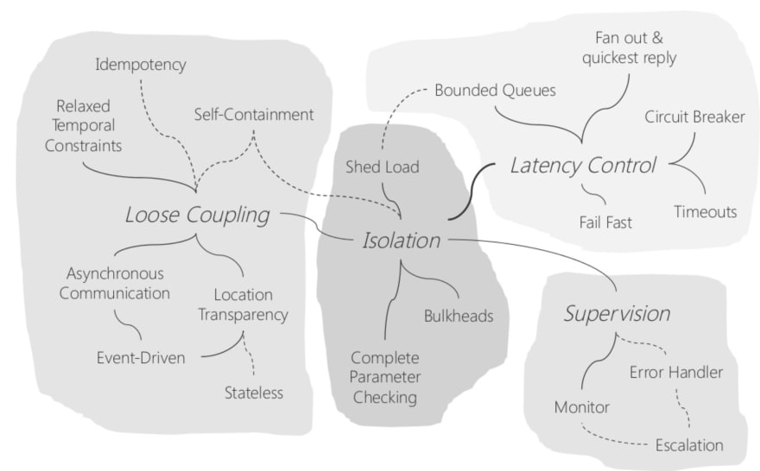
Uwe Friedrichsen – Patterns of resilience

Slide 44
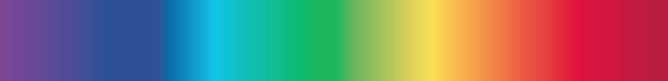
CONSISTENCY SPECTRUM
Stronger
Eventual
Sequential
Faster
Read & Write

Slide 45
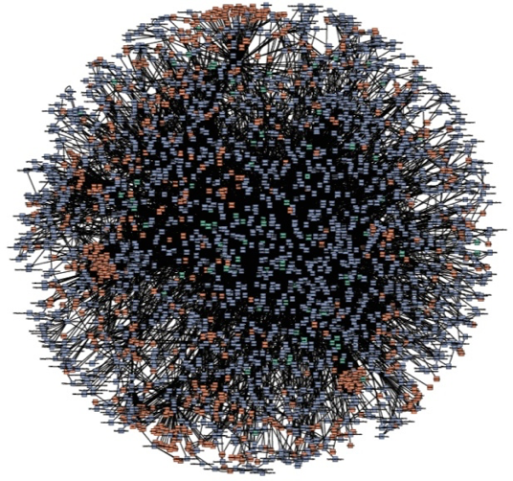
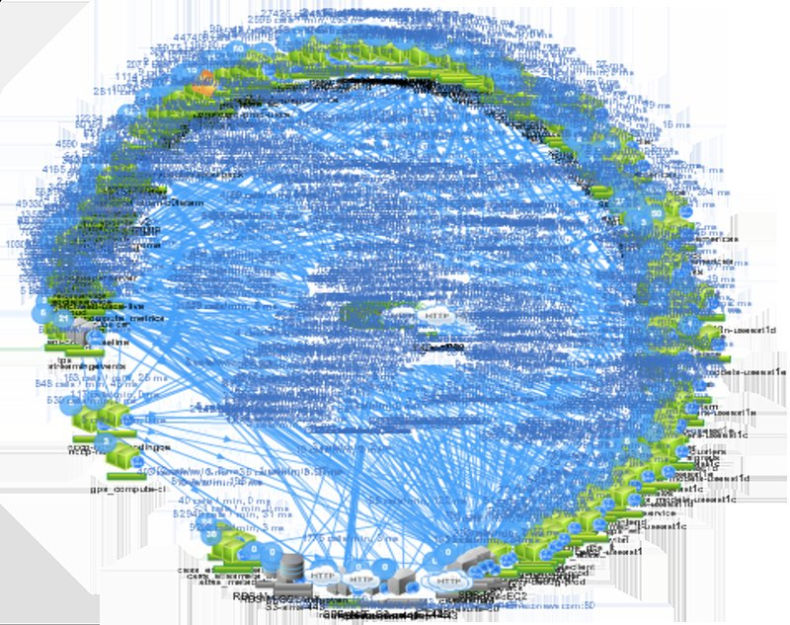
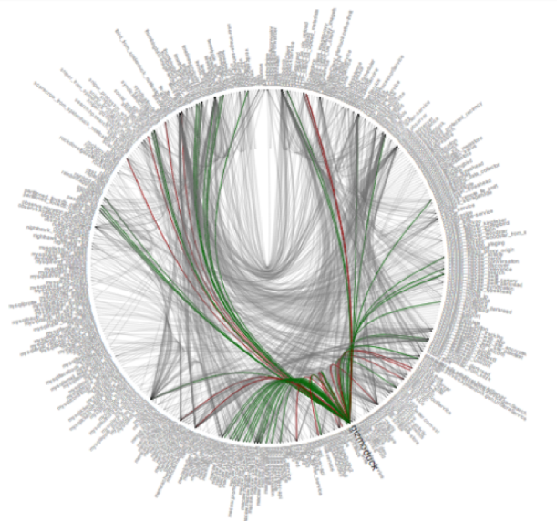



DEATH STAR ARCHITECTURE

