Slide 1
Introduction to Microservices
Oresztész Margaritisz
CONFIDENTIAL | © 2020 EPAM Systems, Inc.

Slide 2
Monoliths vs microservices

Slide 3



FAMOUS MONOLITHS
Perl
C++ - 3400 KLOC
Monorail - Ruby on Rails
MySQL
C++
Perl and Mason

Slide 4
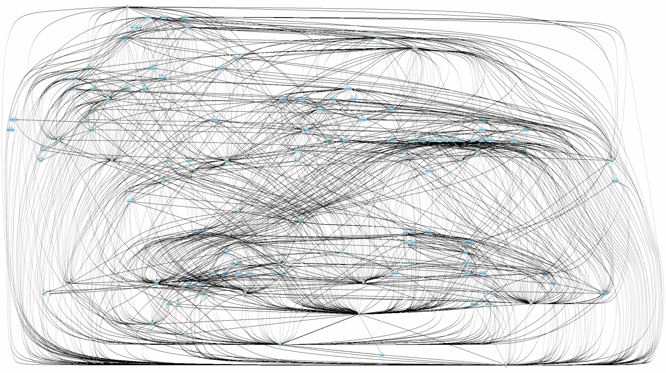
ISSUES
SCALING
DEPLOYMENT
POLYGLOT
AGILE & TEAMS
COMPLEXITY

Slide 5


Slide 6

HOW SMALL?

Slide 7
Single Responsibility
Principle

Slide 8
“... a given method/class/component should have a single reason to
Change.”
Robert C. Martin – Clean Code

Slide 9







Slide 10

TWO-PIZZA TEAM
3-12 people
DEV, QA, OPS

Slide 11

2 WEEKS

Slide 12
AUTONOMOUS
NETWORK CALL

Slide 13
Benefits

Slide 14
SCALING

Slide 15
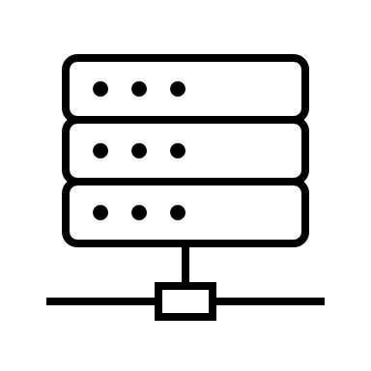
SCALING - MONOLITH
VERTICAL SCALING

Slide 16
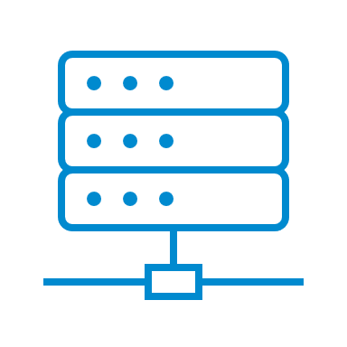

SCALING - MONOLITH
HORIZONTAL SCALING

Slide 17
SCALING - MICROSERVICES
?
HORIZONTAL SCALING

Slide 18



SCALING - MICROSERVICES
Cloud
AUTOSCALE

Slide 19
POLYGLOT

Slide 20







POLYGLOT - MONOLITH
commons-text 1.1.2
guava 13.0.1

Slide 21



POLYGLOT - MICROSERVICES
NoSQL
Polyglot

Slide 22
DEPLOYMENTS

Slide 23

DEPLOYMENTS - MONOLITH

Slide 24
DEPLOYMENTS - MICROSERVICES
Continuous
Delivery

Slide 25
DEPLOYMENTS - MICROSERVICES
Cloud
DevOps

Slide 26
COMMUNICATION

Slide 27
COMMUNICATION - MONOLITH
27

Slide 28
COMMUNICATION - MONOLITH
28

Slide 29
COMMUNICATION - MICROSERVICES
NETWORK CALL
Polyglot
29

Slide 30



COMMUNICATION - MICROSERVICES
REST
Thrift
HTTP

Slide 31




COMMUNICATION - MICROSERVICES
Polyglot

Slide 32
RESILIENCE

Slide 33
RESILIENCE - MONILITH

Slide 34
RESILIENCE - MICROSERVICES

Slide 35

RESILIENCE - MICROSERVICES

Slide 36
Drawbacks

