Slide 1
Introduction to Microservices
Oresztész Margaritisz
CONFIDENTIAL | © 2020 EPAM Systems, Inc.

Slide 2
PATTERNS

Slide 3
COMMUNICATION

Slide 4
COMMUNICATION
NETWORK CALL

Slide 5
COMMUNICATION - API

Slide 6
COMMUNICATION - API
Backward compatible
Technology independent
Hiding implementation
Simple

Slide 7
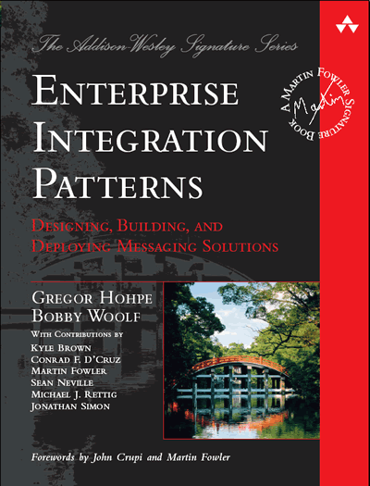

COMMUNICATION – SHARED DATABASE
ANTI-PATTERN

Slide 8



COMMUNICATION - SYNCHRONOUS
Thrift
REST

Slide 9
COMMUNICATION - SYNCHRONOUS
TIMEOUT
WRITE

Slide 10
COMMUNICATION - SYNCHRONOUS

Slide 11
COMMUNICATION - SYNCHRONOUS
http://service/v2/...
http://service/v1/...
Notes:
Versioning
(Page 62).

Slide 12





COMMUNICATION - ASYNCHRONOUS
Notes:
Implementing Asynchronous Event-Based Collaboration
(Page 55).

Slide 13
COMMUNICATION - ASYNCHRONOUS

Slide 14
COMMUNICATION - ASYNCHRONOUS

Slide 15
COMMUNICATION - ASYNCHRONOUS
topic.v1
topic.v2

Slide 16
DEPENDENCIES

Slide 17
DEPENDENCIES – SHARED LIBRARY
ANTI-PATTERN
Notes:
DRY and the Perils of Code Reuse in a Microservice World
(Page 59).

Slide 18
DEPENDENCIES – TECHNICAL BOUNDARY
ANTI-PATTERN
Notes:
The Technical Boundary
(Page 36).

Slide 19
DEPENDENCIES – INTEGRAITION

Slide 20
CONSISTENCY

Slide 21
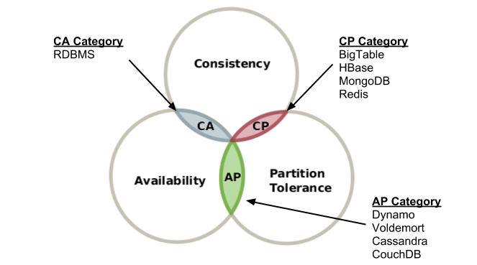
CAP THEOREM
Notes:
The Technical Boundary
(Page 36).

Slide 22
TWO-PHASE COMMIT
Prepare
Resource
Coordinator
Prepare
Prepare
Resource
Resource
ANTI-PATTERN

Slide 23
TWO-PHASE COMMIT
Commit
Resource
Coordinator
Commit
Commit
Resource
Resource
ANTI-PATTERN

Slide 24
TWO-PHASE COMMIT
Commit
Coordinator
Commit
Commit
Resource
Resource
ANTI-PATTERN

Slide 25

TWO-PHASE COMMIT
Commit
Commit
Resource
Resource
ANTI-PATTERN

Slide 26
EVENTUAL CONSISTENCY
Version: 3
Name: Bob
Version: 2
Name: Joe
Version: 2
Name: Joe

Slide 27
EVENT SOURCING
Id: 3
Name: Bob
E-Mail: bob@gmail.com
Notes:
Idempotence

Slide 28
IDEMPOTENCE
Id: 3
Name: Bob
E-Mail: bob@gmail.com
Id: 3
Name: Bob
E-Mail: bob@gmail.com
Notes:
Idempotence

Slide 29
SCALING

