Slide 1
Introduction to Microservices
Oresztész Margaritisz
CONFIDENTIAL | © 2020 EPAM Systems, Inc.

Slide 2
PATTERNS

Slide 3
COMMUNICATION

Slide 4
COMMUNICATION
NETWORK CALL

Slide 5
COMMUNICATION - API

Slide 6
COMMUNICATION - API
Backward compatible
Technology independent
Hiding implementation
Simple

Slide 7


COMMUNICATION – SHARED DATABASE
ANTI-PATTERN

Slide 8



COMMUNICATION - SYNCHRONOUS
Thrift
REST

Slide 9
COMMUNICATION - SYNCHRONOUS
TIMEOUT
WRITE

Slide 10
COMMUNICATION - SYNCHRONOUS

Slide 11
COMMUNICATION - SYNCHRONOUS
http://service/v2/...
http://service/v1/...
Notes:
Versioning
(Page 62).

Slide 12





COMMUNICATION - ASYNCHRONOUS
Notes:
Implementing Asynchronous Event-Based Collaboration
(Page 55).

Slide 13
COMMUNICATION - ASYNCHRONOUS

Slide 14
COMMUNICATION - ASYNCHRONOUS

Slide 15
COMMUNICATION - ASYNCHRONOUS
topic.v1
topic.v2

Slide 16
DEPENDENCIES

Slide 17
DEPENDENCIES – SHARED LIBRARY
ANTI-PATTERN
Notes:
DRY and the Perils of Code Reuse in a Microservice World
(Page 59).

Slide 18
DEPENDENCIES – TECHNICAL BOUNDARY
ANTI-PATTERN
Notes:
The Technical Boundary
(Page 36).

Slide 19
DEPENDENCIES – INTEGRAITION

Slide 20
CONSISTENCY

Slide 21
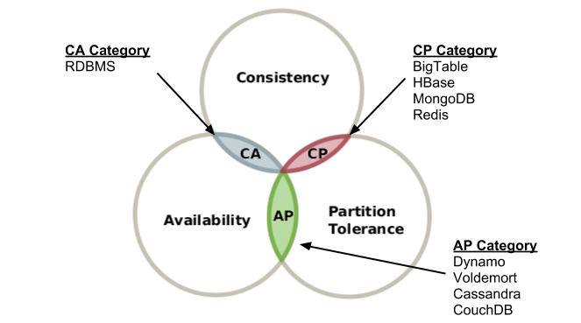
CAP THEOREM
Notes:
The Technical Boundary
(Page 36).

Slide 22
TWO-PHASE COMMIT
Prepare
Resource
Coordinator
Prepare
Prepare
Resource
Resource
ANTI-PATTERN

Slide 23
TWO-PHASE COMMIT
Commit
Resource
Coordinator
Commit
Commit
Resource
Resource
ANTI-PATTERN

Slide 24
TWO-PHASE COMMIT
Commit
Coordinator
Commit
Commit
Resource
Resource
ANTI-PATTERN

Slide 25

TWO-PHASE COMMIT
Commit
Commit
Resource
Resource
ANTI-PATTERN

Slide 26
EVENTUAL CONSISTENCY
Version: 3
Name: Bob
Version: 2
Name: Joe
Version: 2
Name: Joe

Slide 27
EVENT SOURCING
Id: 3
Name: Bob
E-Mail: bob@gmail.com
Notes:
Idempotence

Slide 28
IDEMPOTENCE
Id: 3
Name: Bob
E-Mail: bob@gmail.com
Id: 3
Name: Bob
E-Mail: bob@gmail.com
Notes:
Idempotence

Slide 29
SCALING

Slide 30

?
HORIZONTAL SCALING

Slide 31
LOAD BALANCERS

Slide 32

HTTP LOAD BALANCERS

Slide 33

HTTP LOAD BALANCERS
HTTP
HTTPS

Slide 34

SERVICE REGISTRY
192.168.1.100:32768

Slide 35
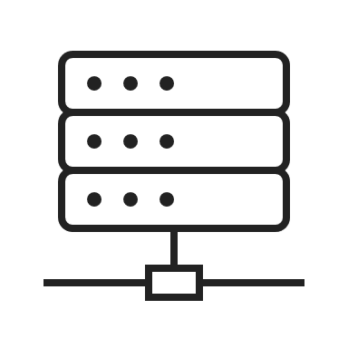
API GATEWAY
http://.../cart?id=12345
http://.../search?q=books

Slide 36
DEPLOYMENT

Slide 37
BLUE-GREEN
Notes:
CONS: Array of new services
PROS: Fast traffic shifting

Slide 38
CANARY RELEASE
Notes:
CONS: Array of new services
PROS: Fast traffic shifting

Slide 39

CONTAINERIZATION
Application
JVM
Libraries
Entry point

Slide 40





CONTAINER ORCHESTRATOR

Slide 41
OBSERVABILITY

Slide 42

OBSERVABILITY
Logs
Metrics
Tracing

Slide 43

OBSERVABILITY
Logs
Metrics
Tracing
Notes:
Aggregate
Specify by teams
Secure
Store & Collect
Layer-by-layer troubleshooting

Slide 44
TRACING
Trace ID
Trace ID

Slide 45
RESILIENCE

Slide 46
TIMEOUTS
TIMEOUT

Slide 47

CIRCUIT BREAKERS

Slide 48
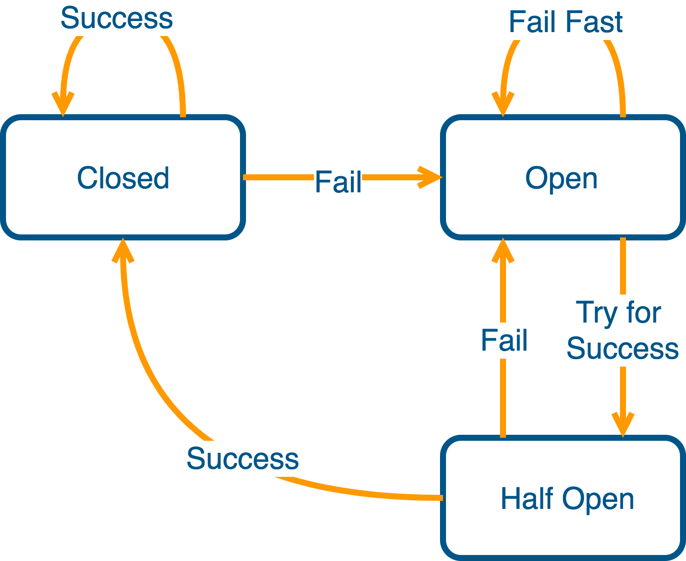
CIRCUIT BREAKERS

Slide 49
HEALTH CHECKS

Slide 50
DEFAULTS & FALLBACK
DEFAULT

Slide 51

RATE LIMITING

