Slide 1
Introduction to Microservices
Oresztész Margaritisz
CONFIDENTIAL | © 2020 EPAM Systems, Inc.

Slide 2
history

Slide 3
?
MICROSERVICES
Notes:
Give you context

Slide 4

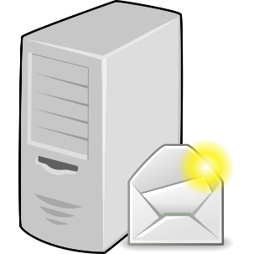
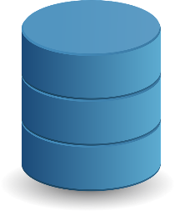
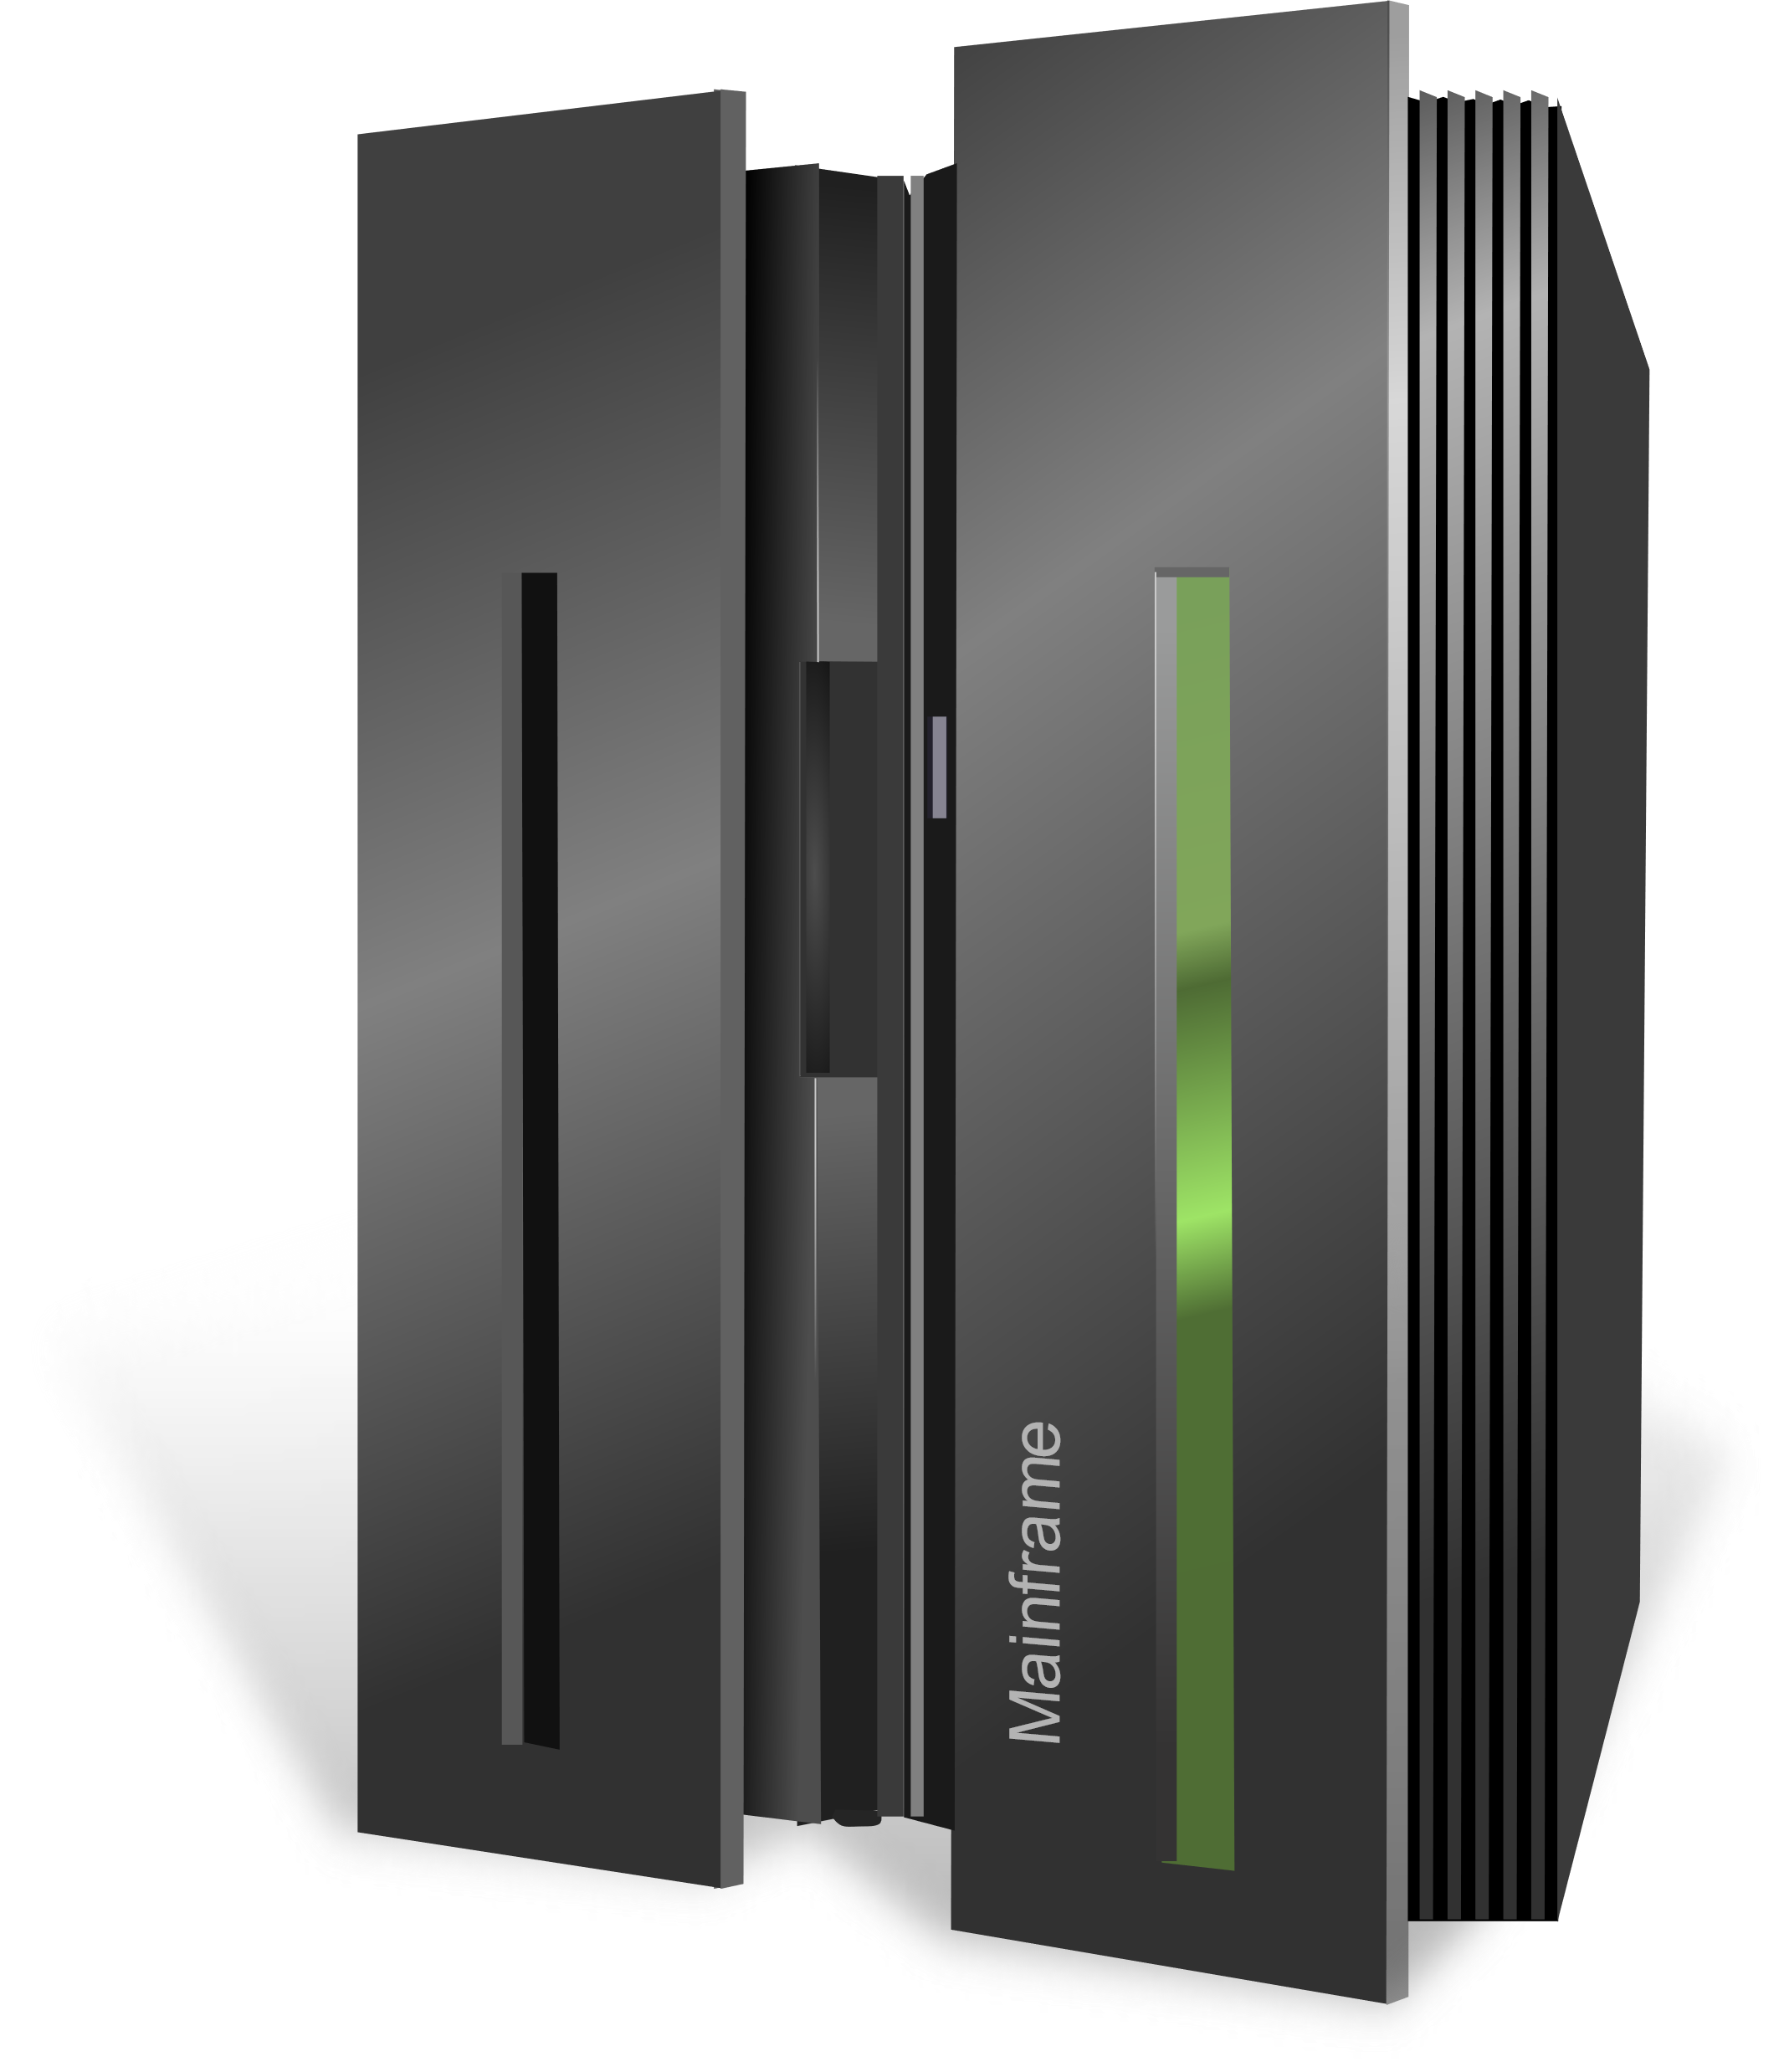
ENTERPRISE INTEGRATION
Application A
Integration Service C
Application B
Integration Service A
Integration Service B

Slide 5
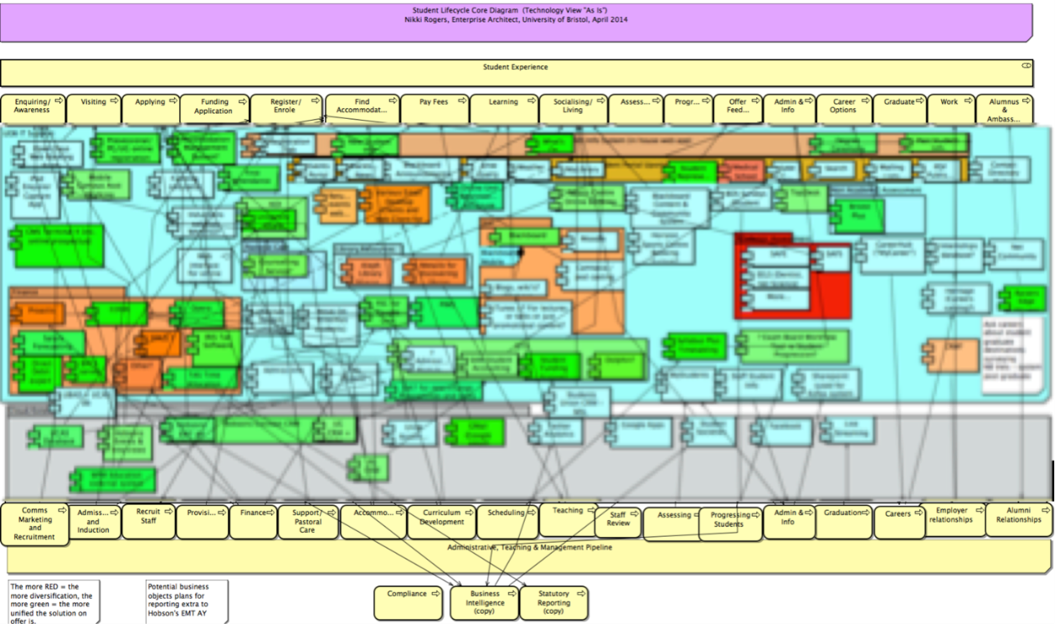
SPAGHETTI SYSTEM

Slide 6
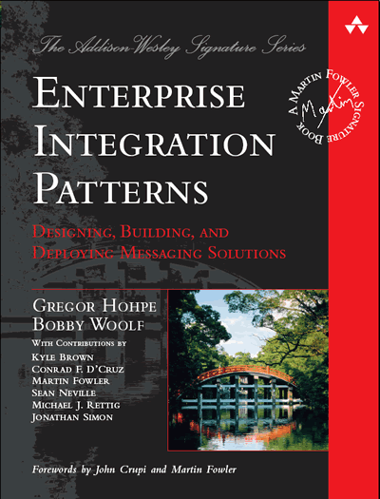
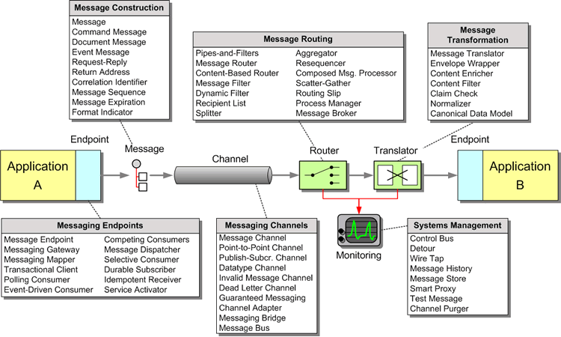
ENTERPRISE INTEGRATION PATTERNS

Slide 7
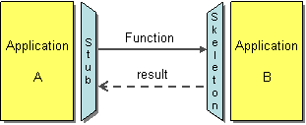
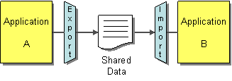
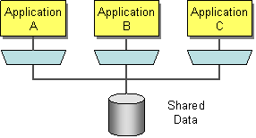
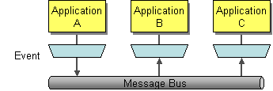

Slide 8




MONOLITH

Slide 9


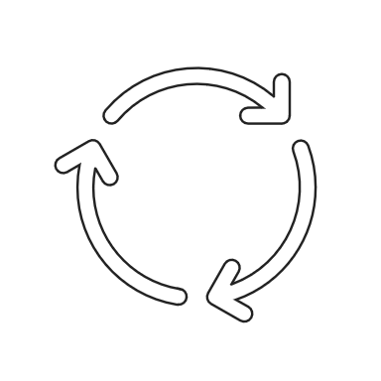

DEPLOYMENT

Slide 10



Slide 11




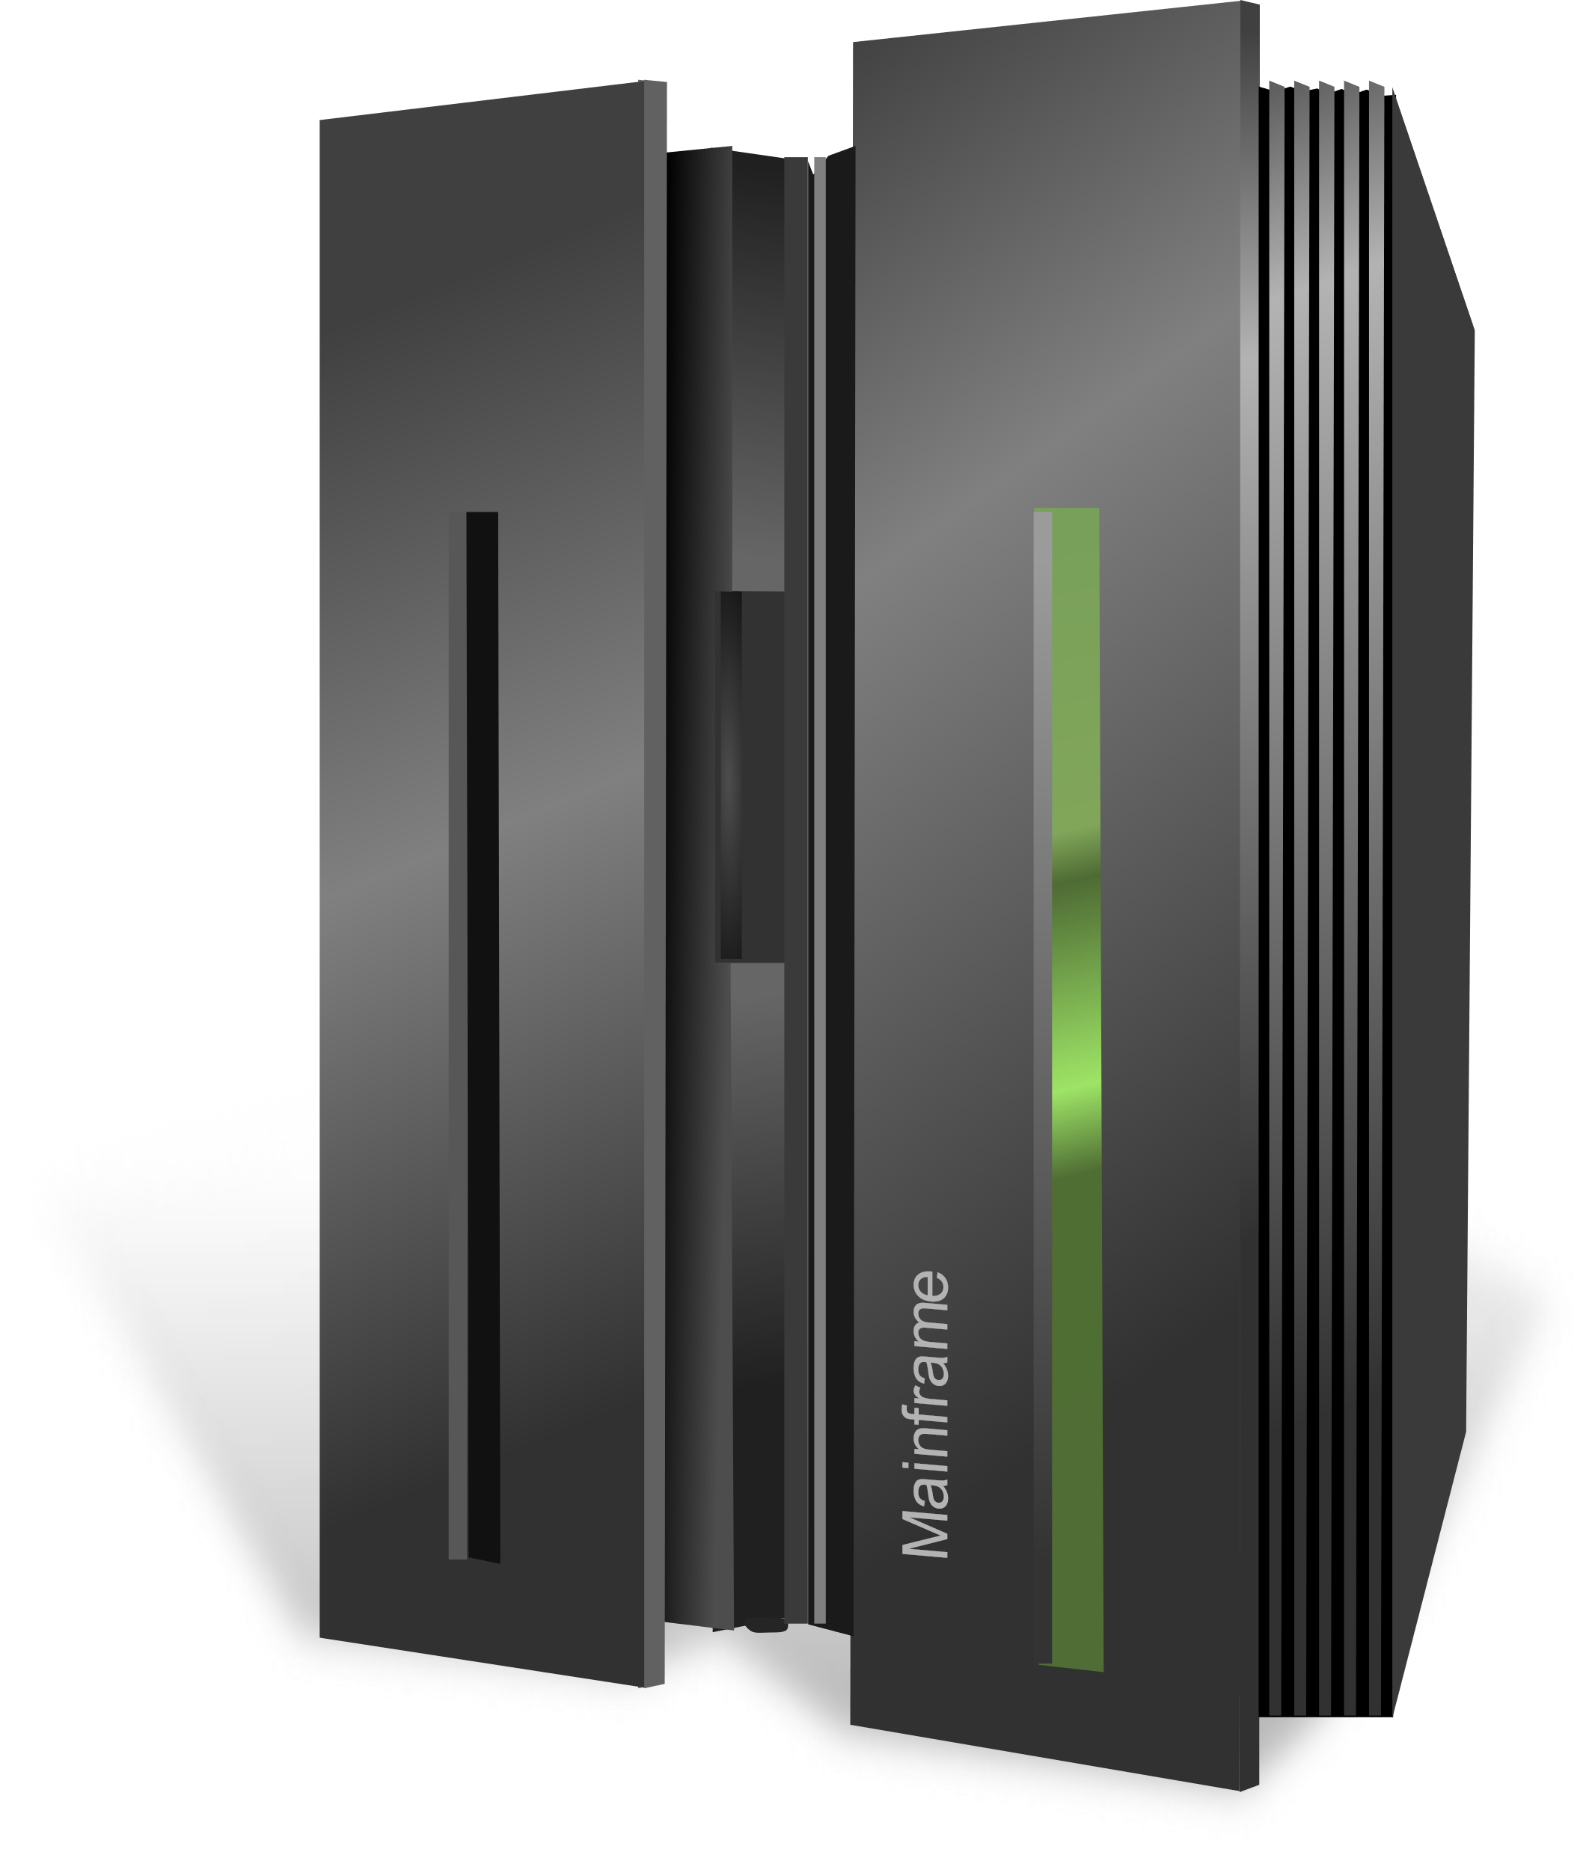
NoSQL
Continuous
Delivery
DevOps
MICROSERVICES
Polyglot
Cloud

