Slide 1
Introduction to Microservices
Oresztész Margaritisz
CONFIDENTIAL | © 2020 EPAM Systems, Inc.

Slide 2
Monoliths vs microservices

Slide 3



FAMUS MONOLITHS
Perl
C++ - 3400 KLOC
Monorail - Ruby on Rails
MySQL
C++
Perl and Mason

Slide 4
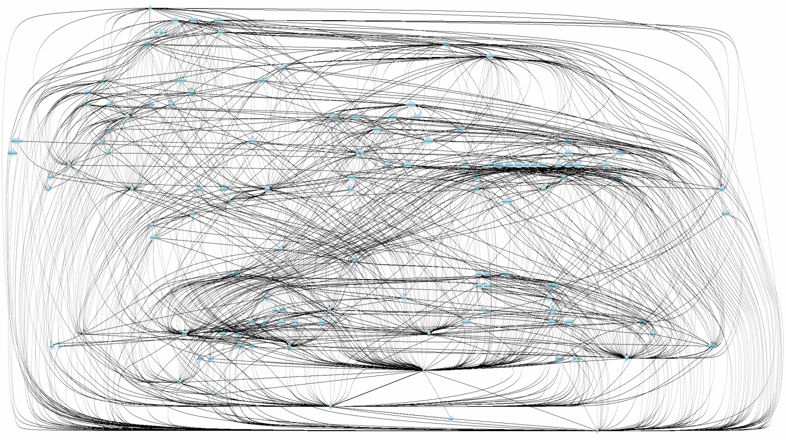
ISSUES
SCALING
DEPLOYMENT
POLYGLOT
AGILE & TEAMS
COMPLEXITY

Slide 5


Slide 6

HOW SMALL?

Slide 7
Single Responsibility
Principle

Slide 8
“... a given method/class/component should have a single reason to
Change.”
Robert C. Martin – Clean Code

Slide 9







Slide 10

TWO-PIZZA TEAM
3-12 people
DEV, QA, OPS

Slide 11

2 WEEKS

