Slide 1
Local LLMs
bottom-up approach

Slide 2
Hardware

Slide 3
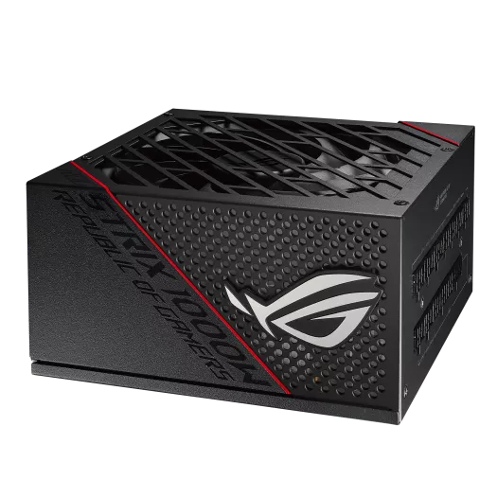
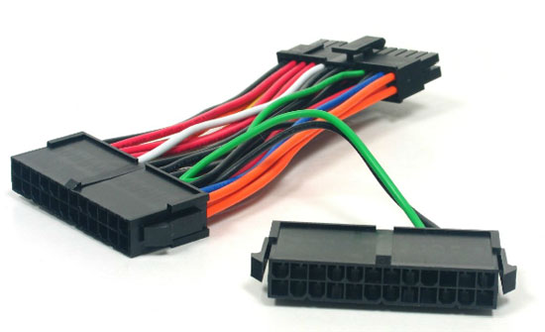
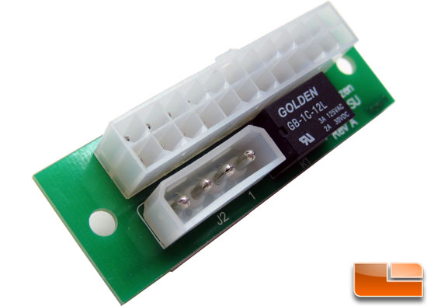
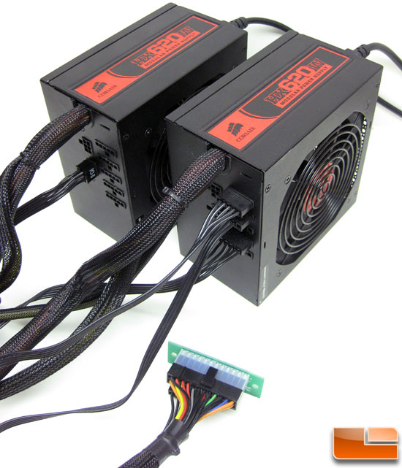
PSU and Power
Add2PSU – daisy chain
1000W – good quality
https://www.legitreviews.com/add2psu-daisy-chain-power-supply-adapter-review_1698

Slide 4
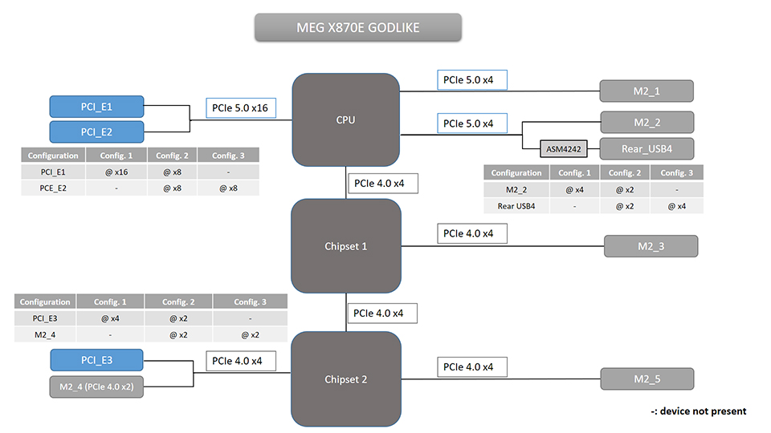
PCIE Bifurcation
https://us.msi.com/blog/pcie-lane-bifurcation-and-bandwidth-sharing-on-msi-x870e-x870-motherboards

Slide 5
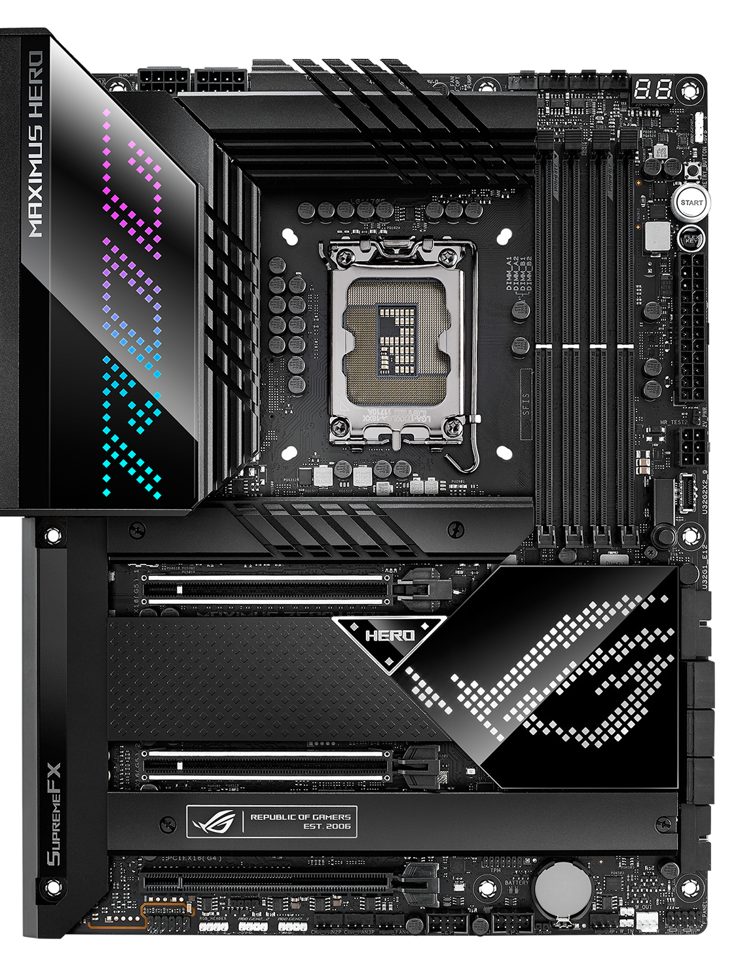
Motherboard
M.2 NVMe slot 0 issues
Offers PCIe 5.0 x8 bifurcation

Slide 6


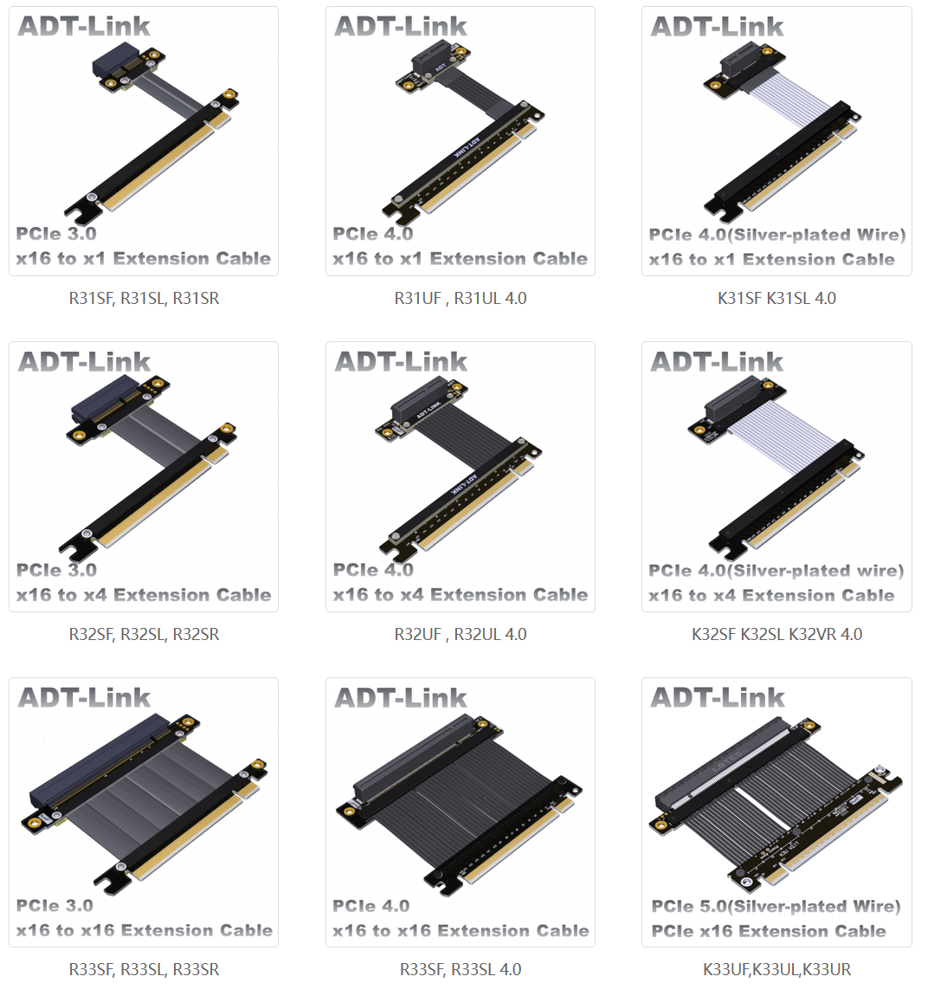
PCIE x16 – flexible cables
https://www.adtlink.com/product/K33Ux-T.html

Slide 7
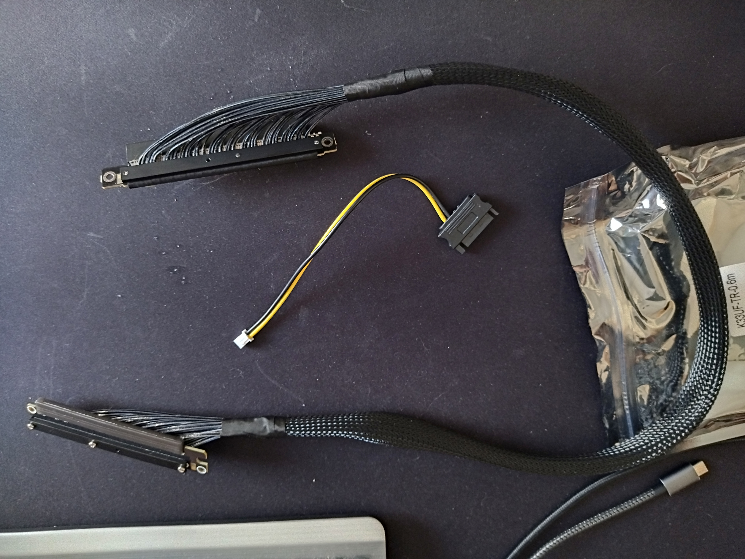
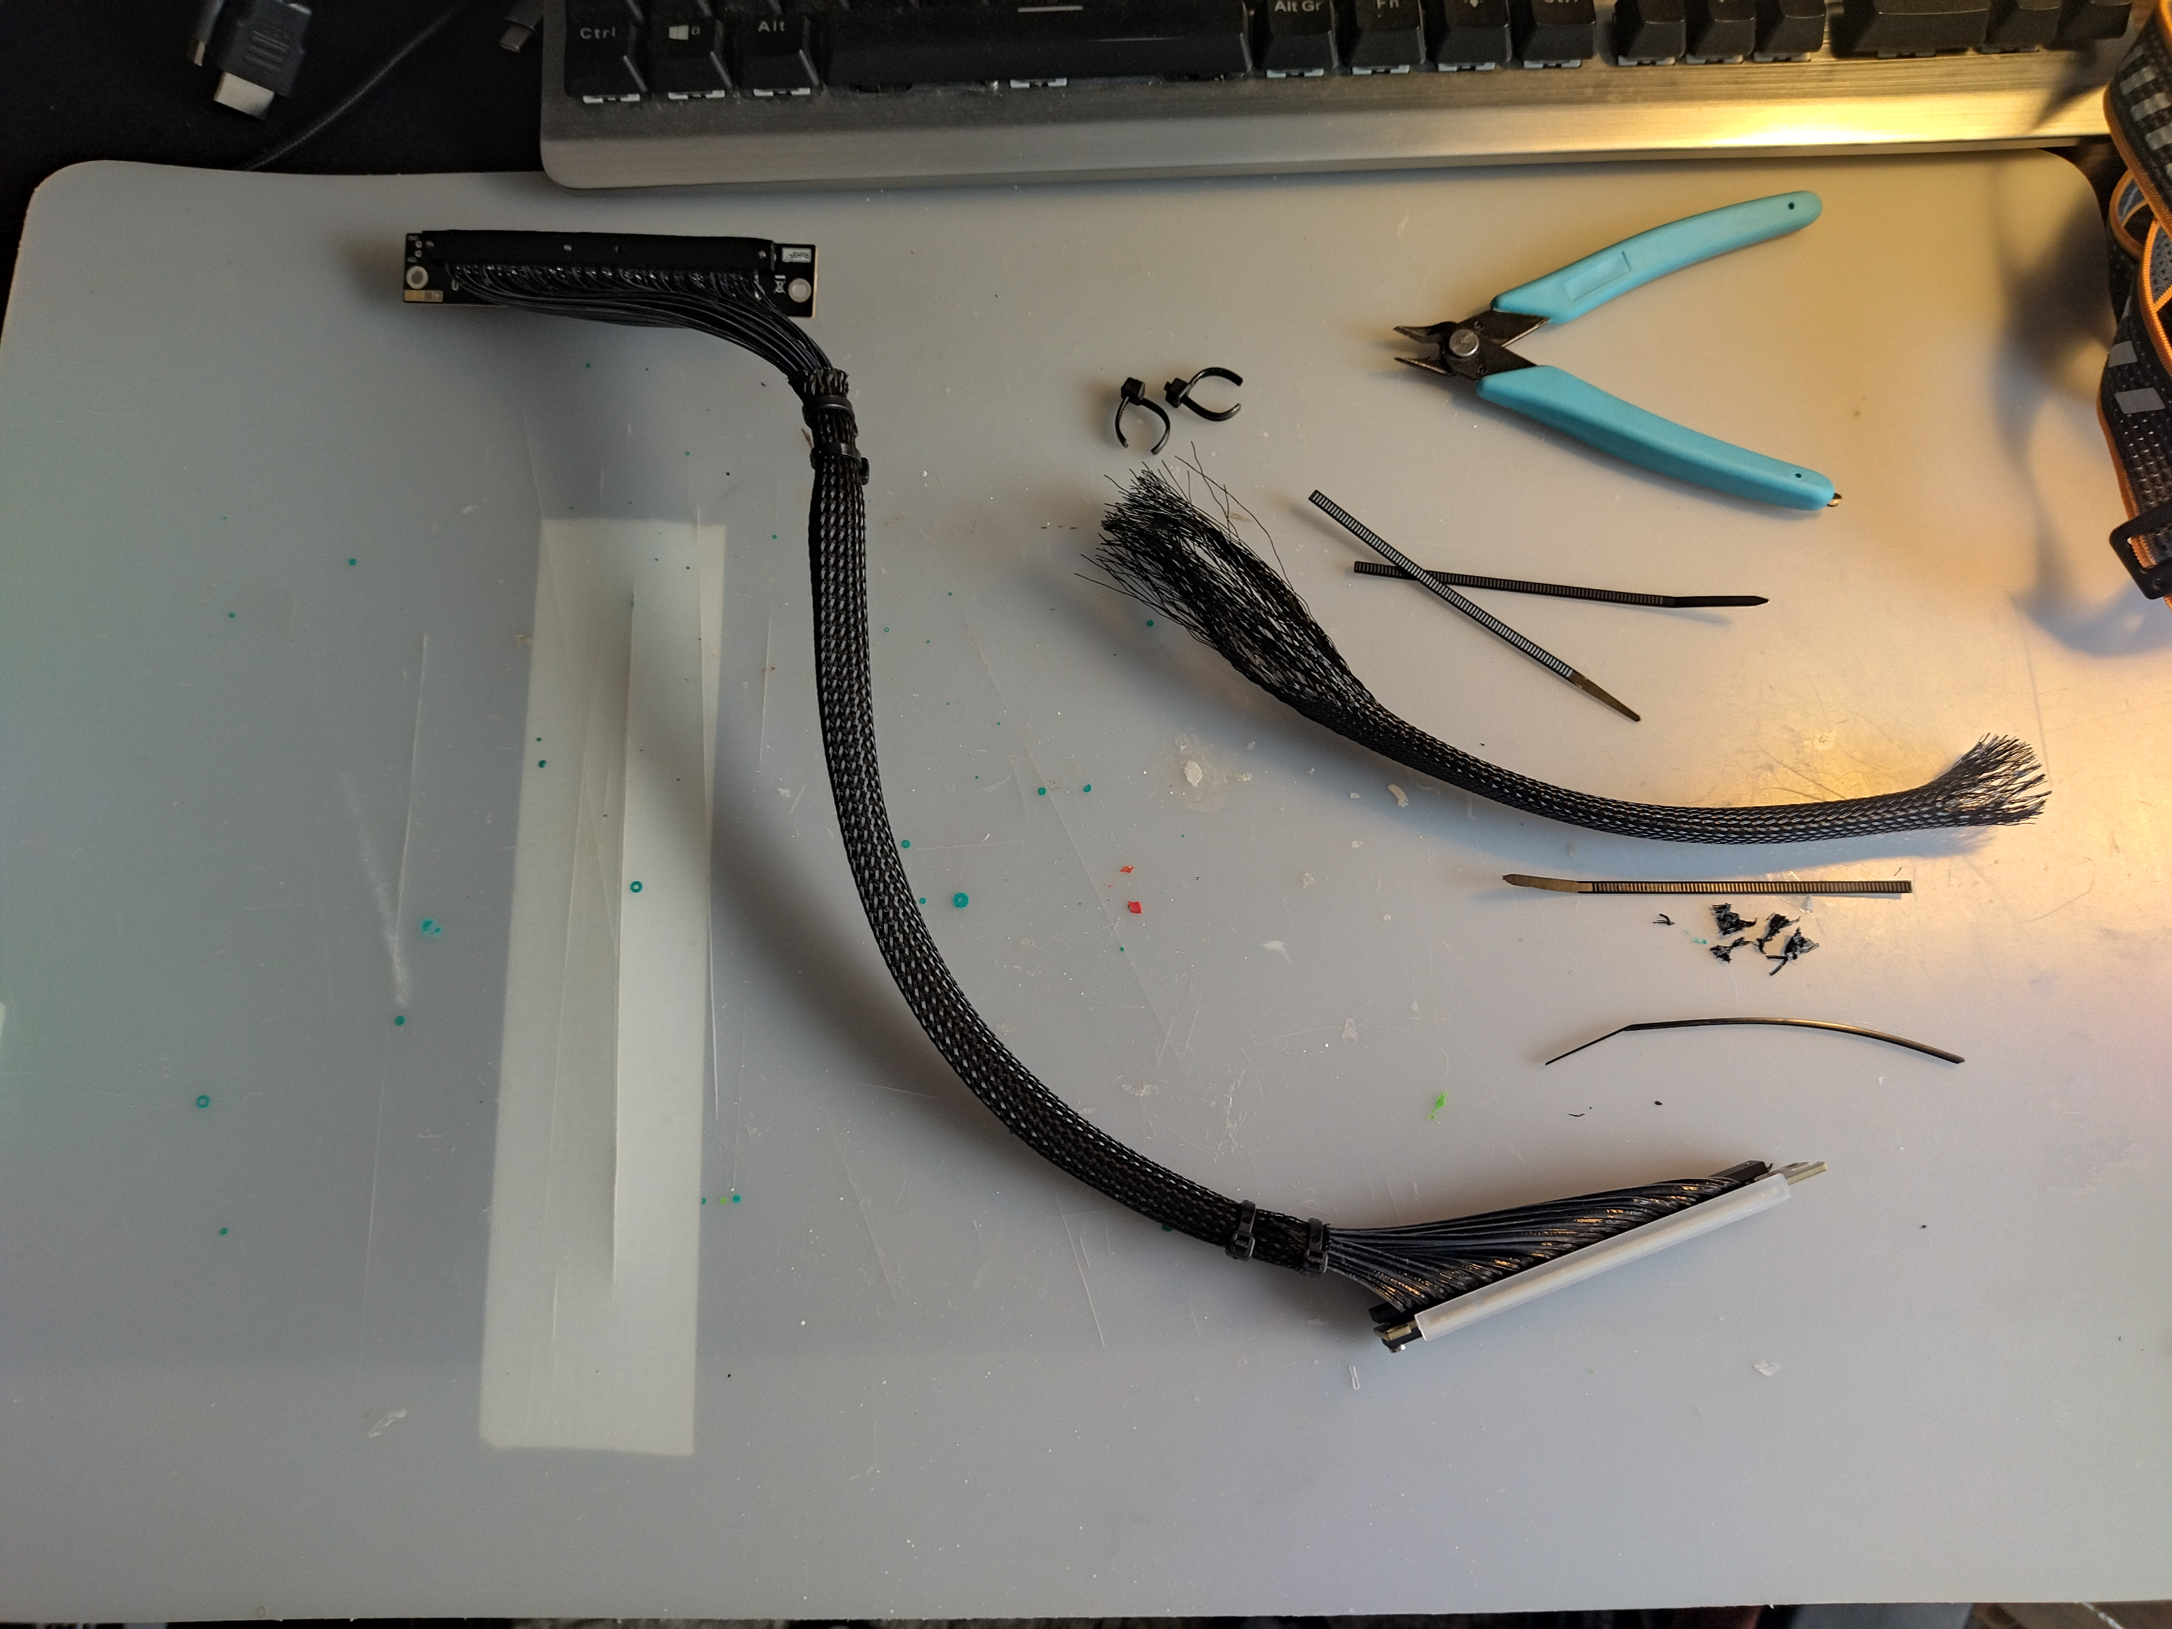
PCIE x16 – flexible cables

Slide 8
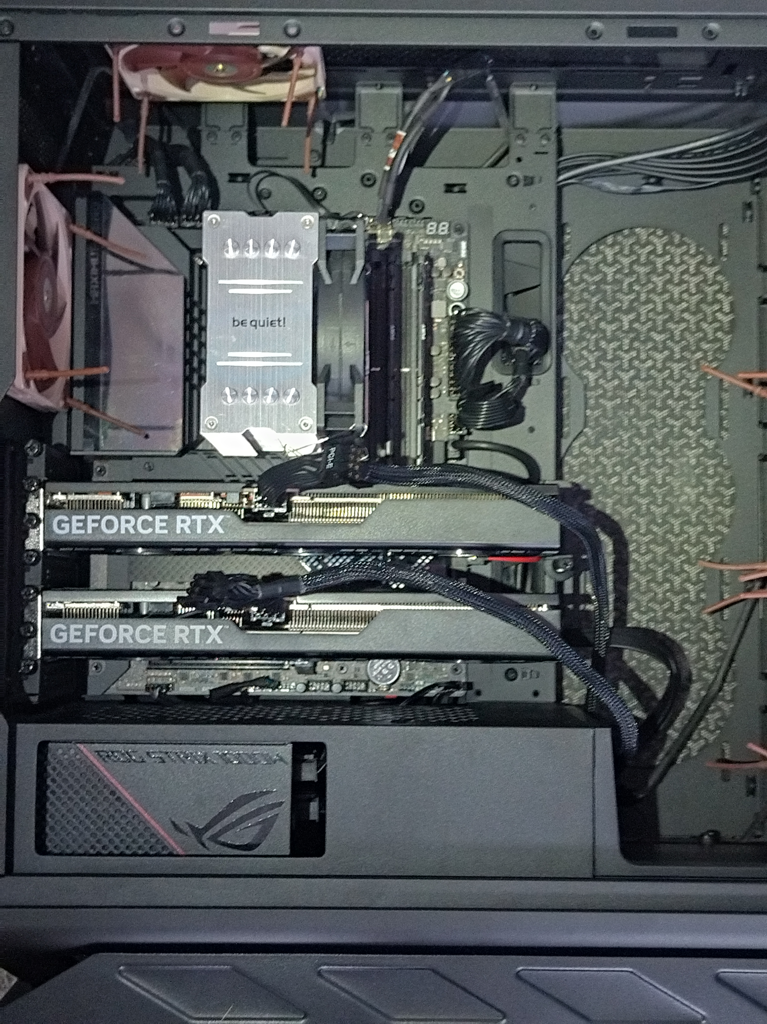
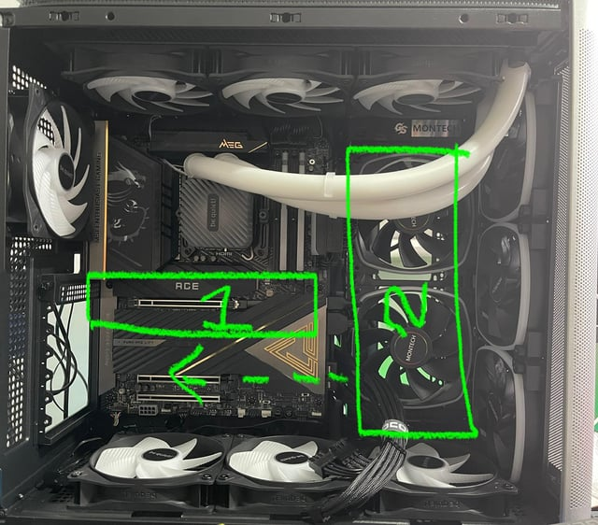
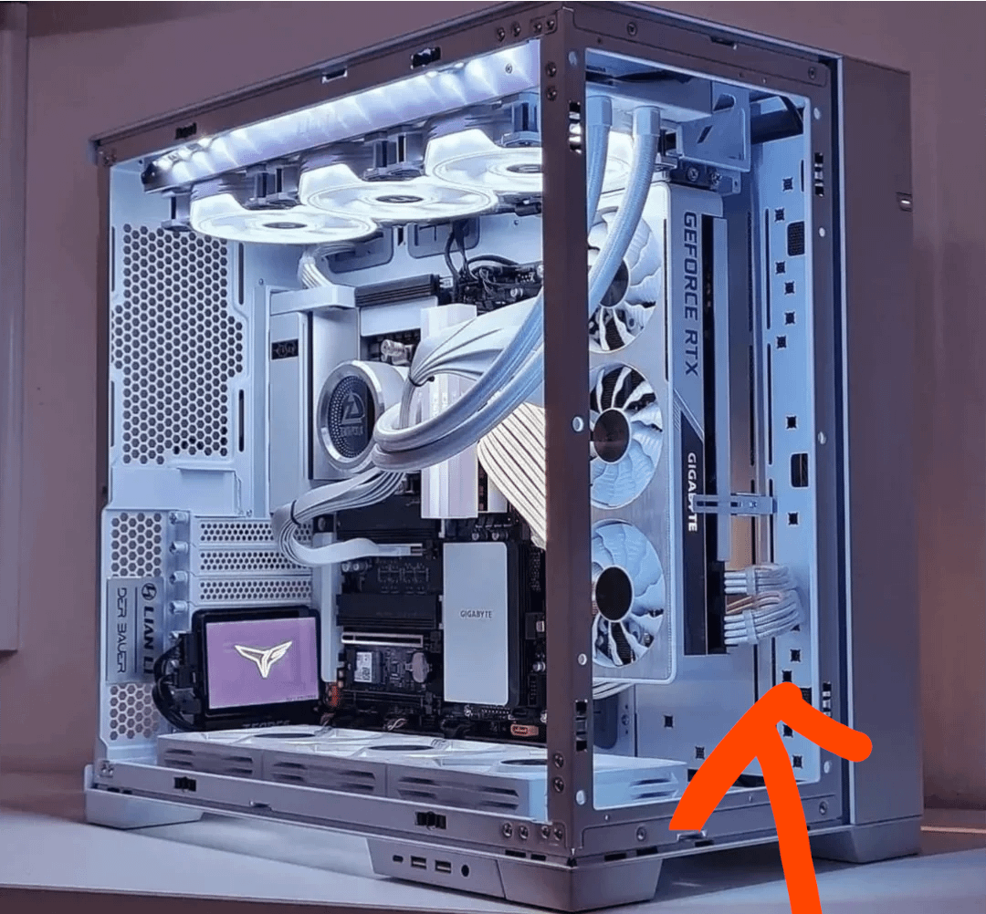
Laying Down Two GPUs

Slide 9
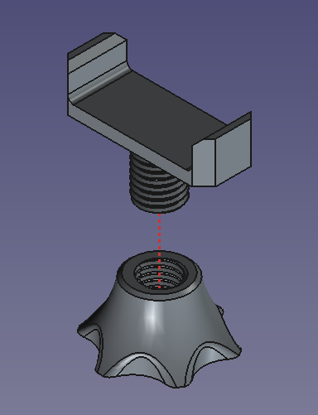
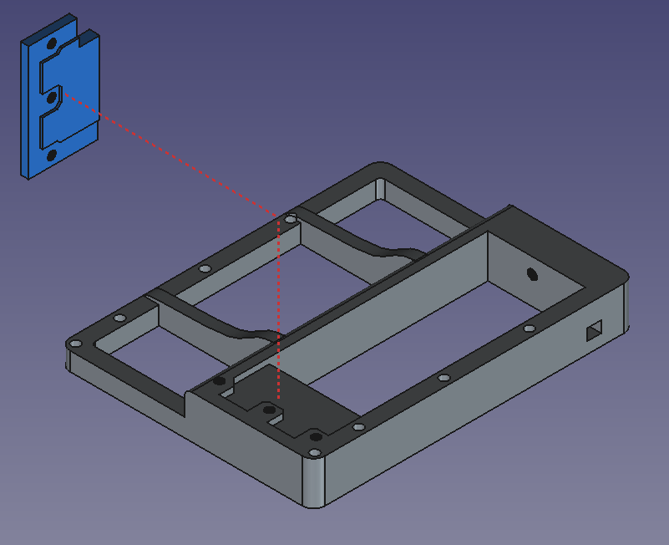
Laying Down Two GPUs

Slide 10
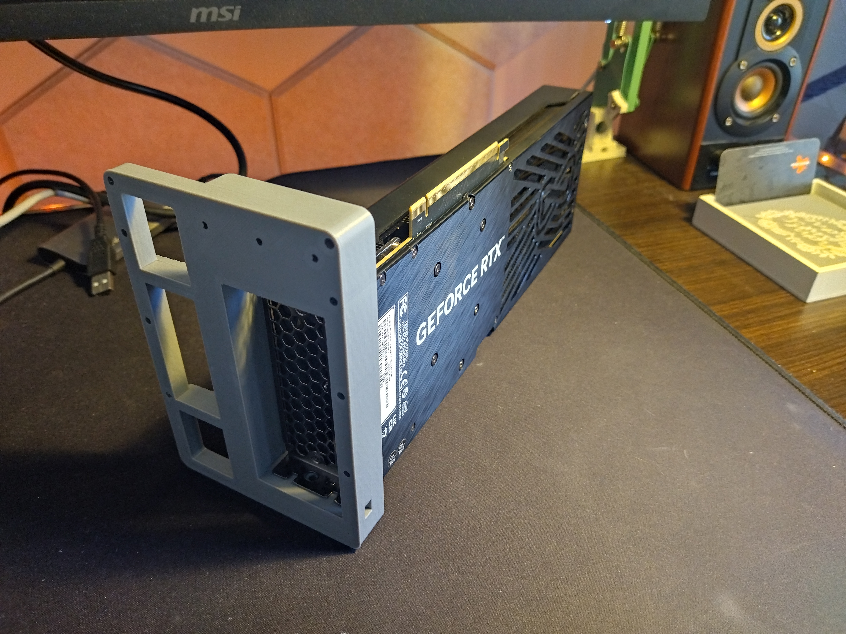
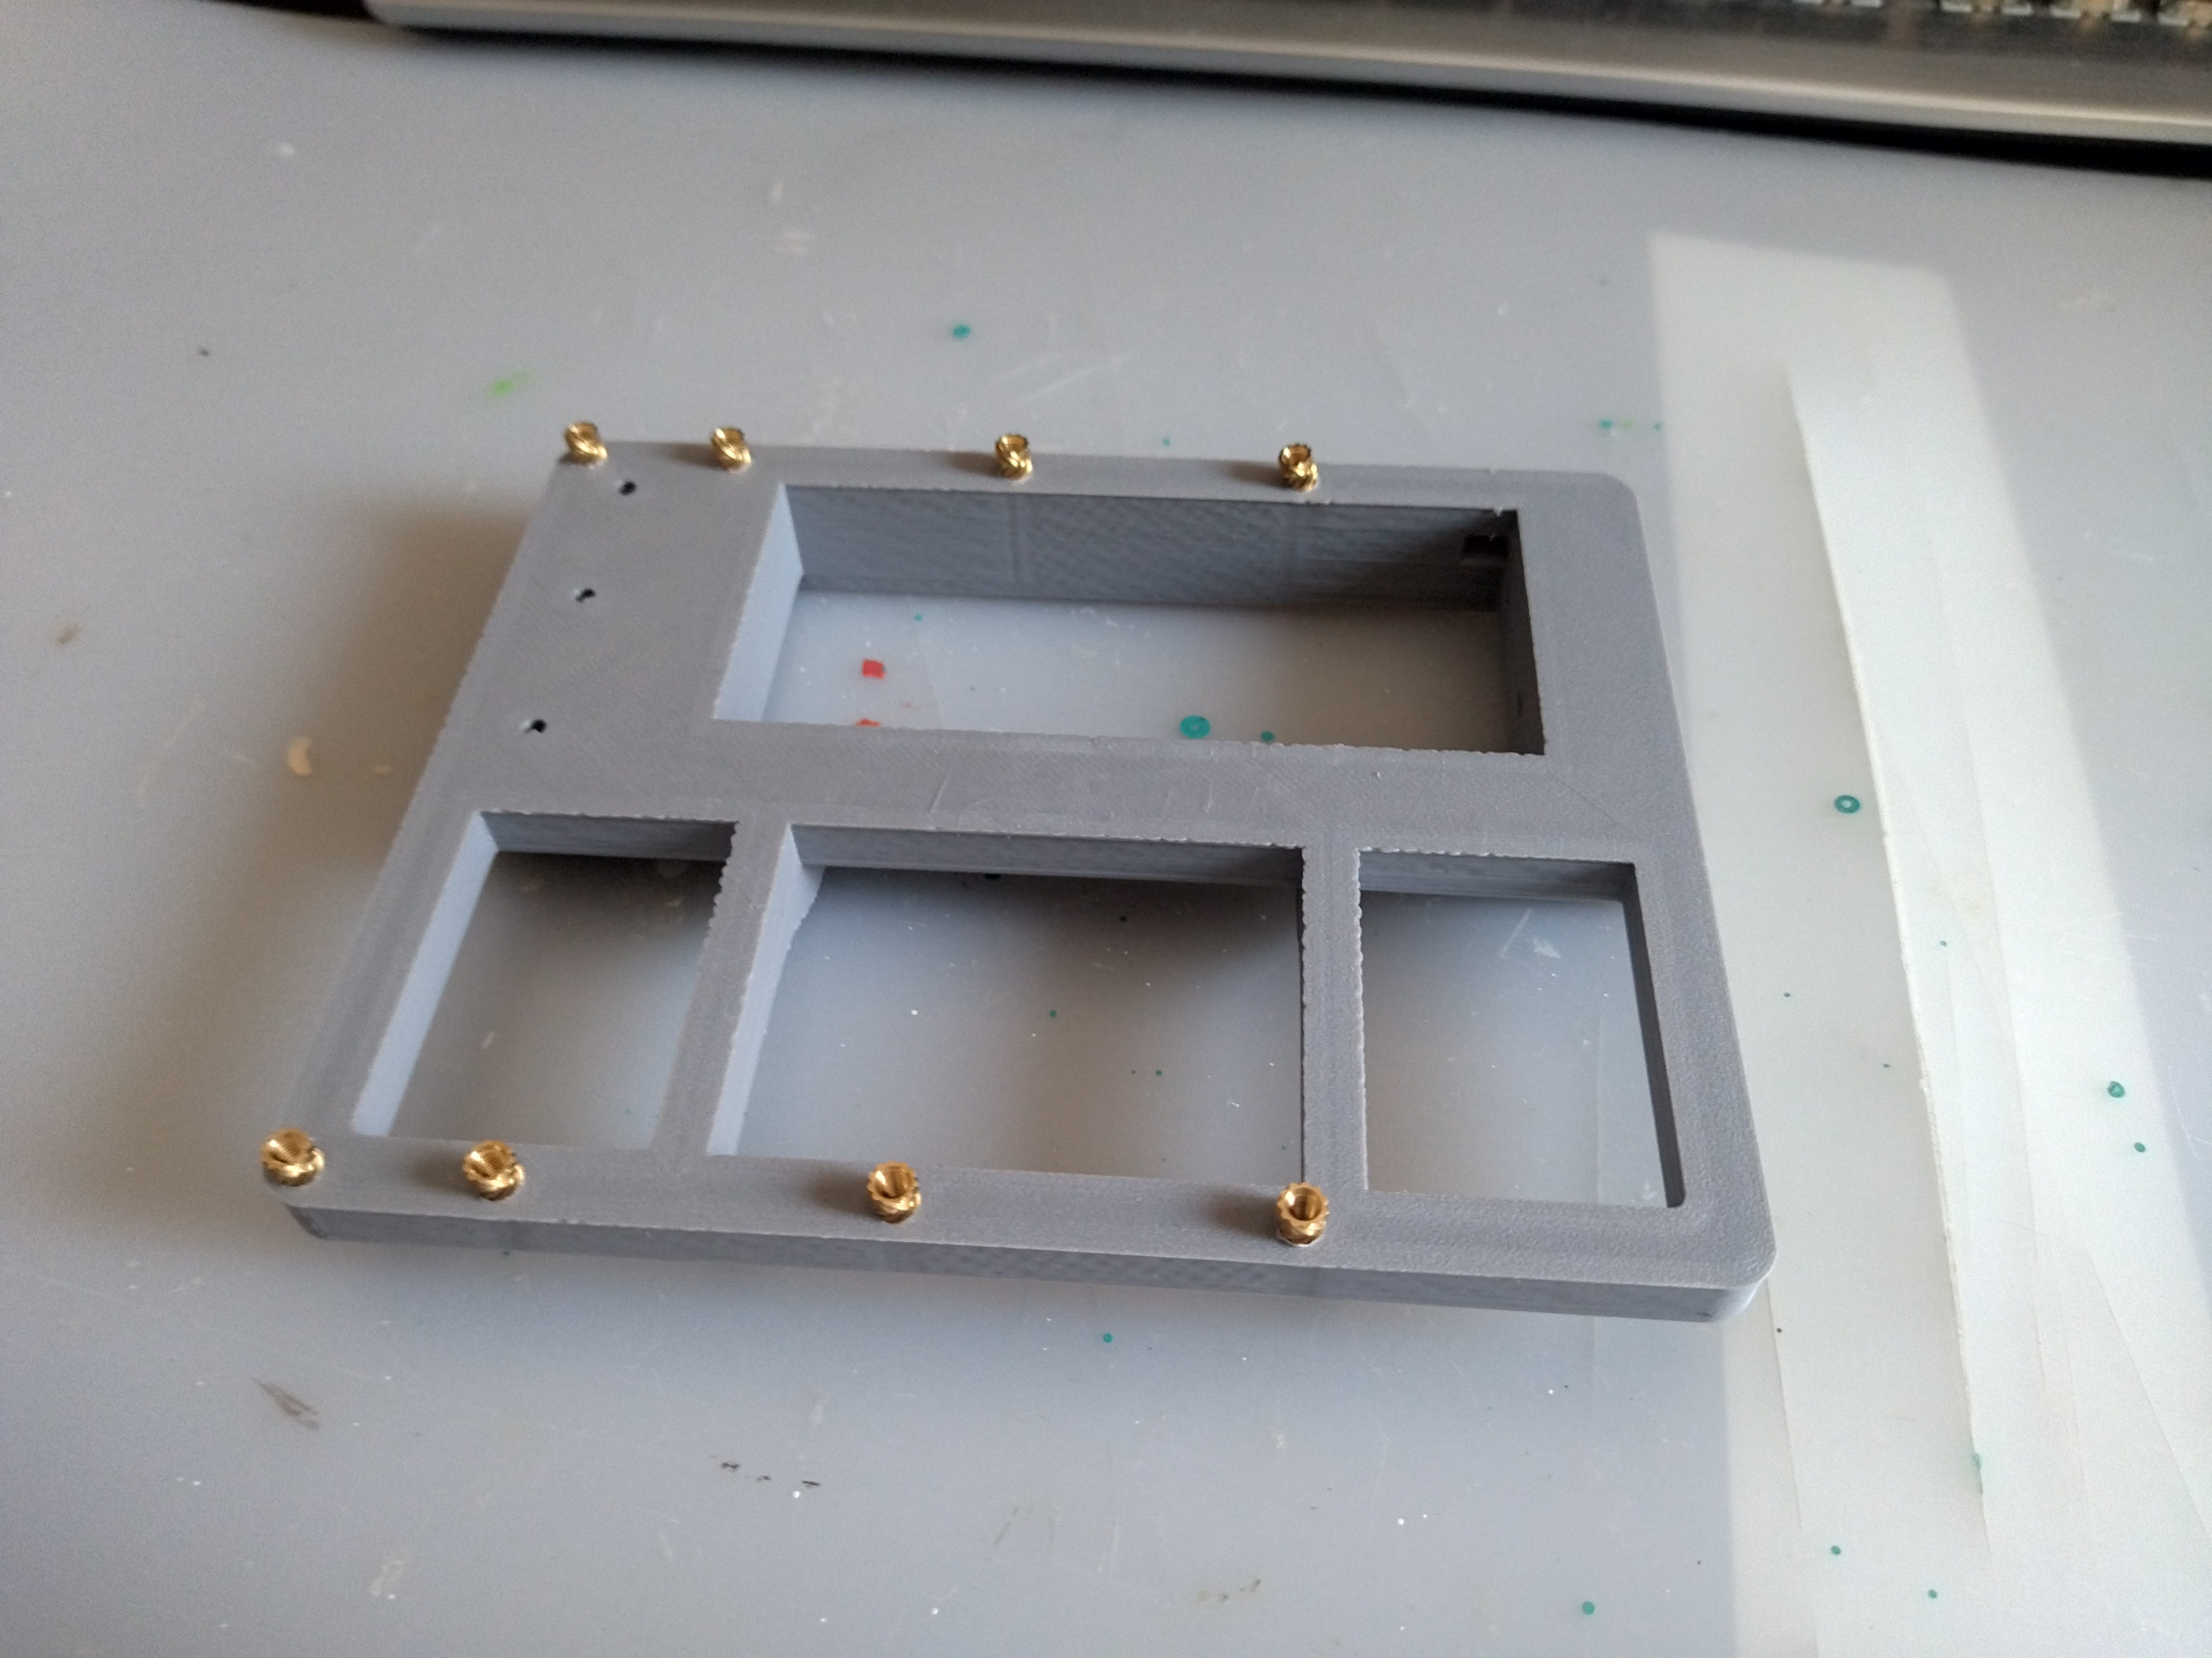
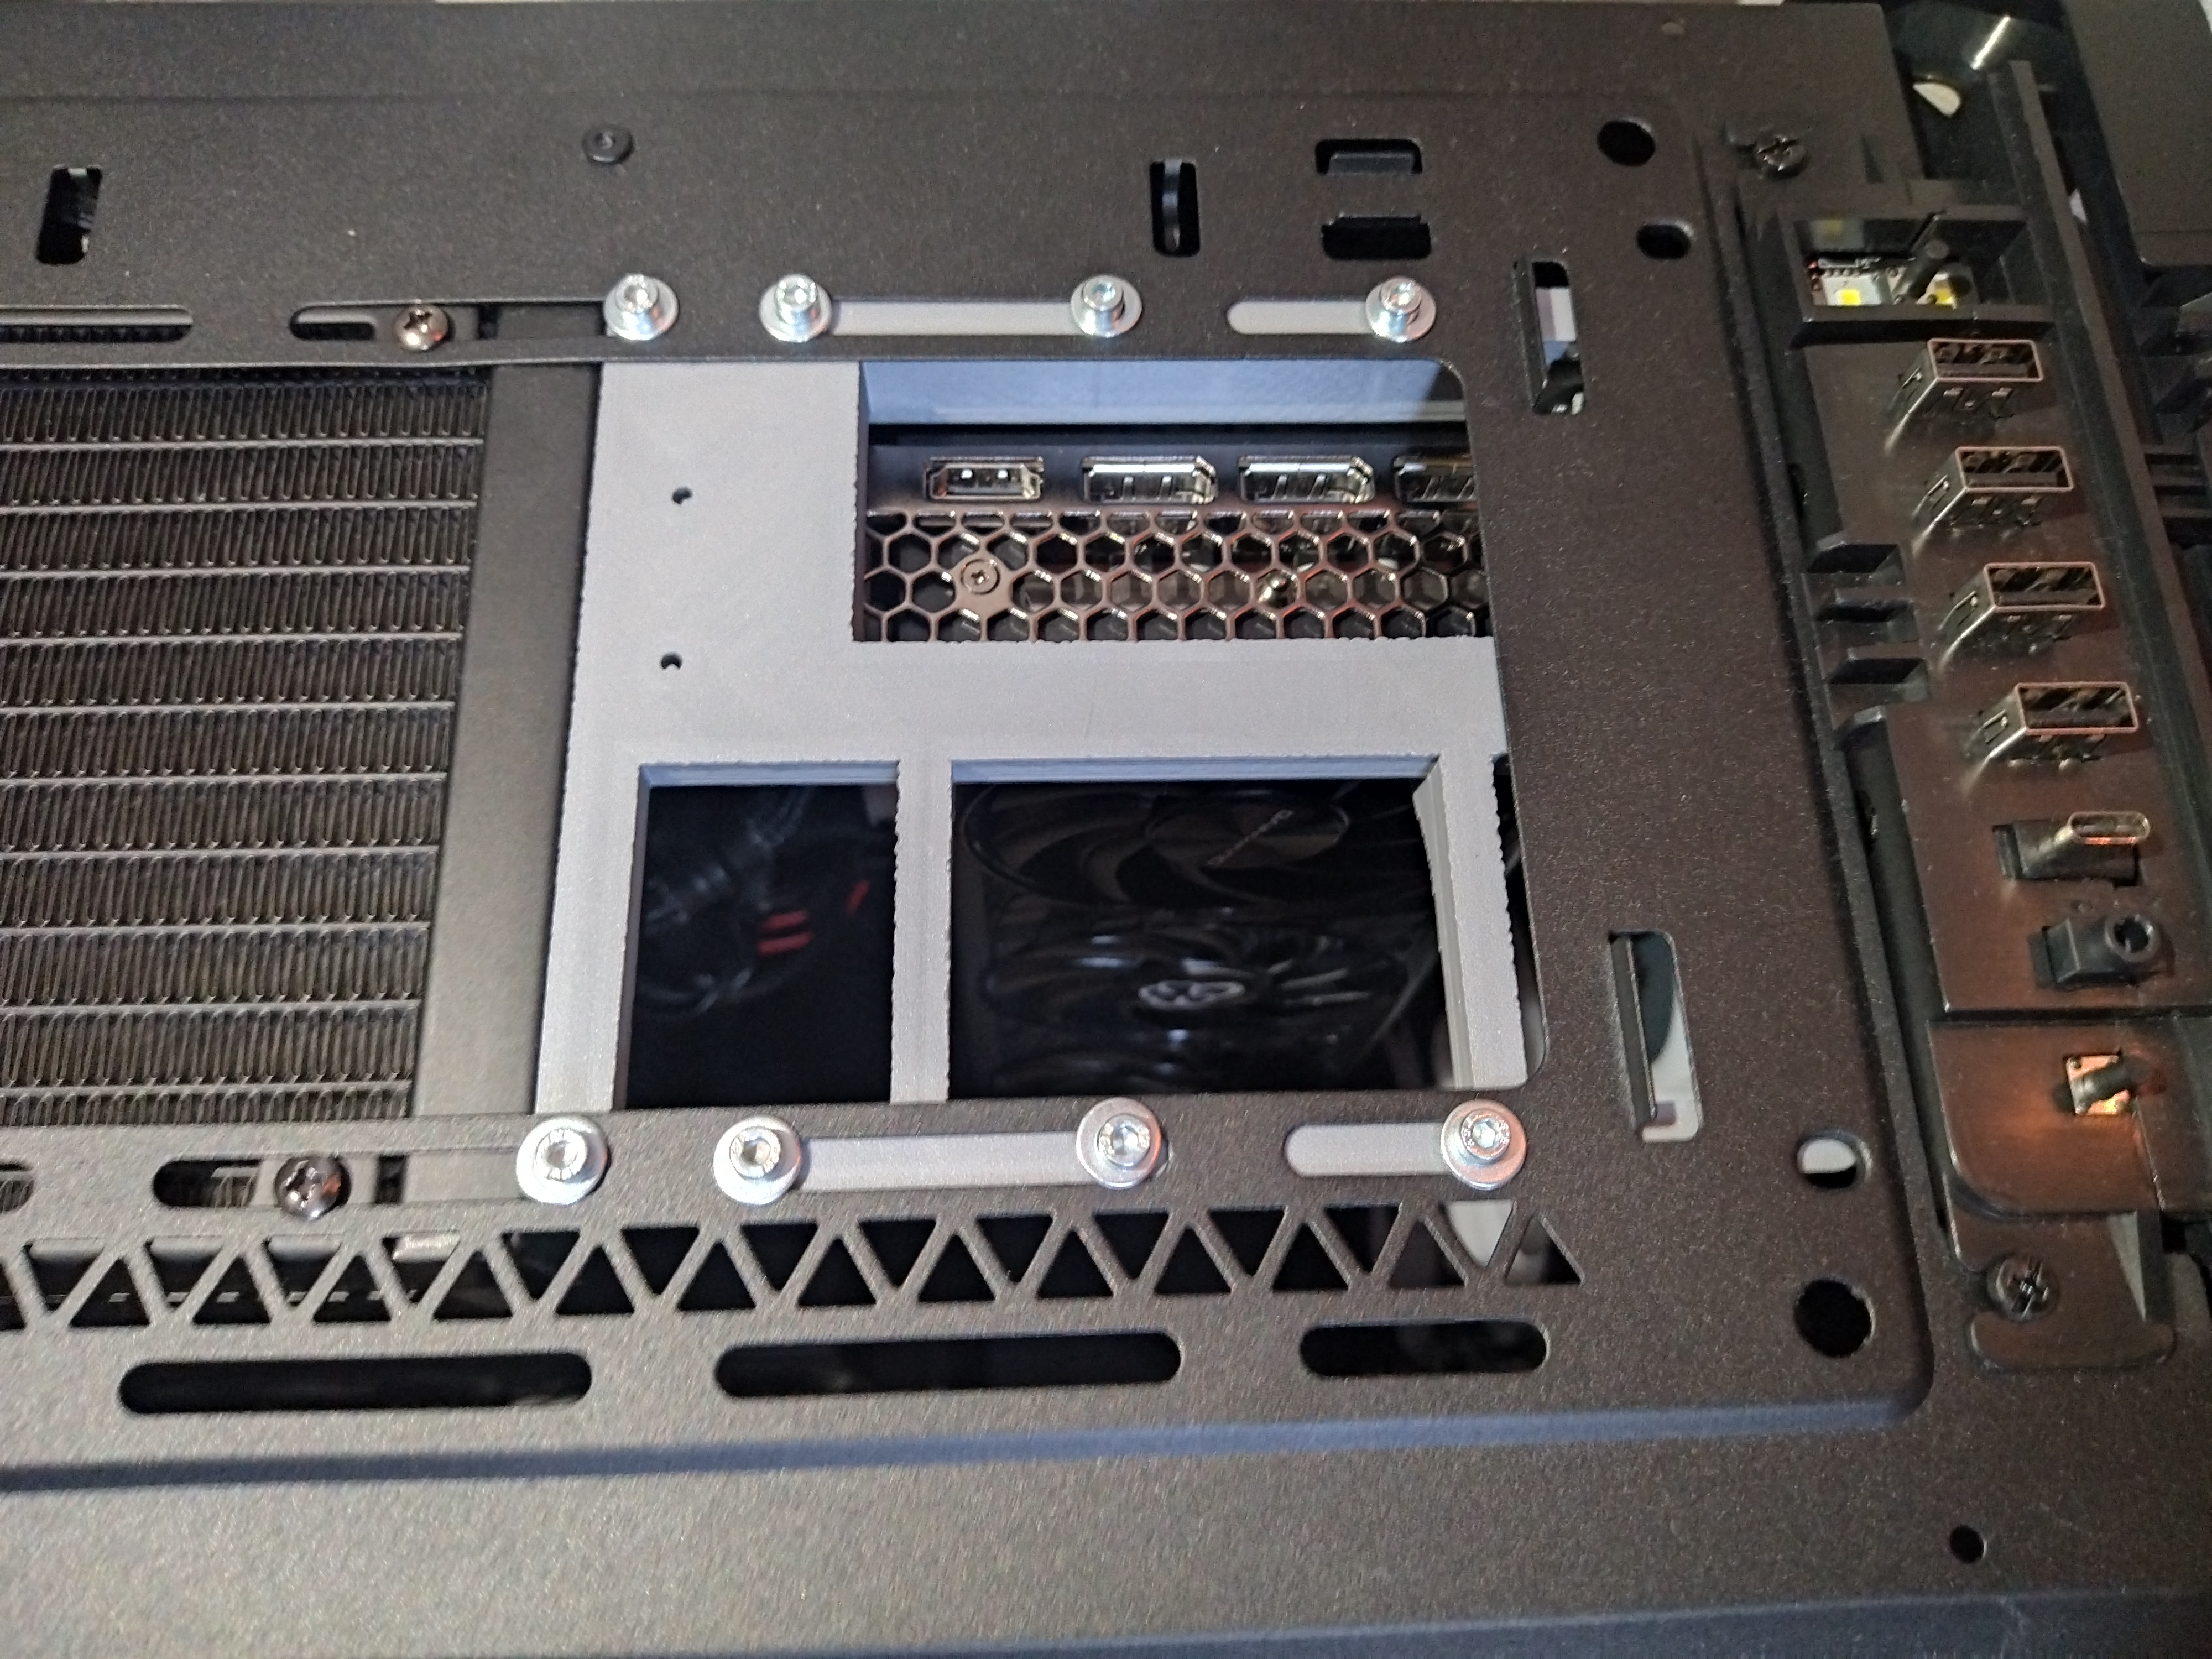
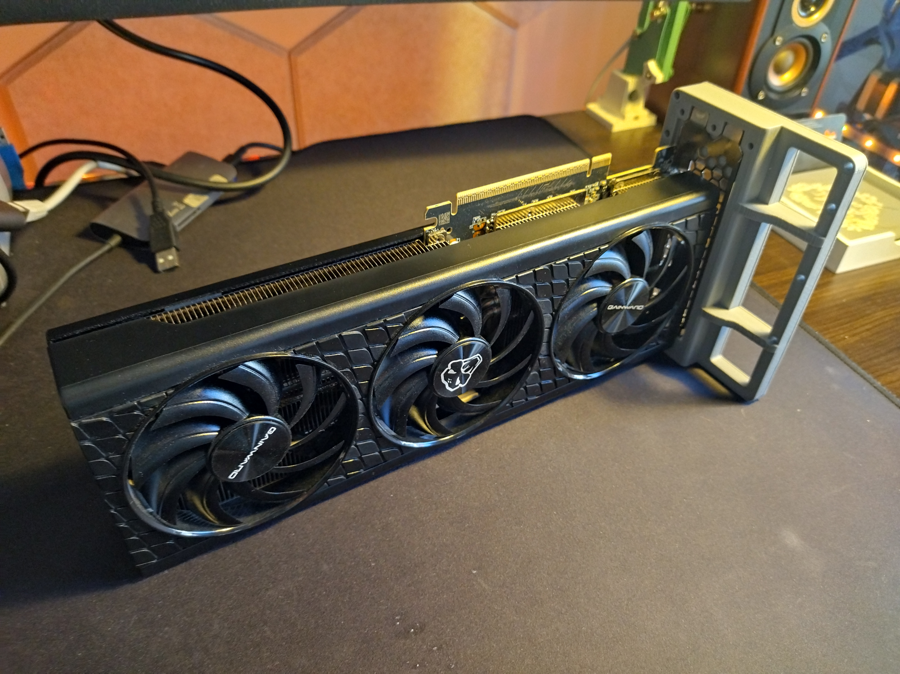
Laying Down Two GPUs

Slide 11
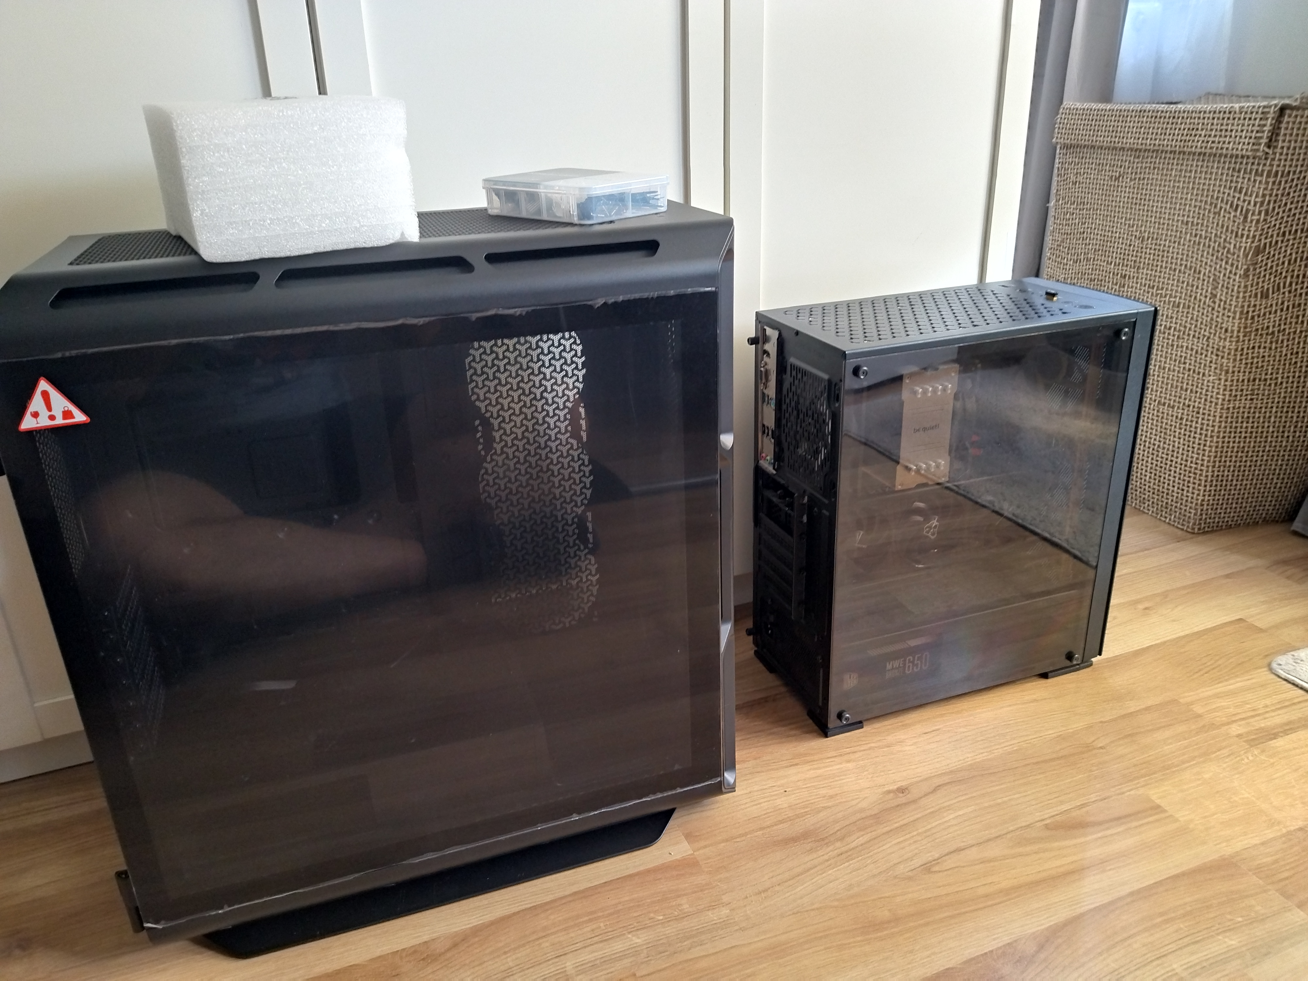
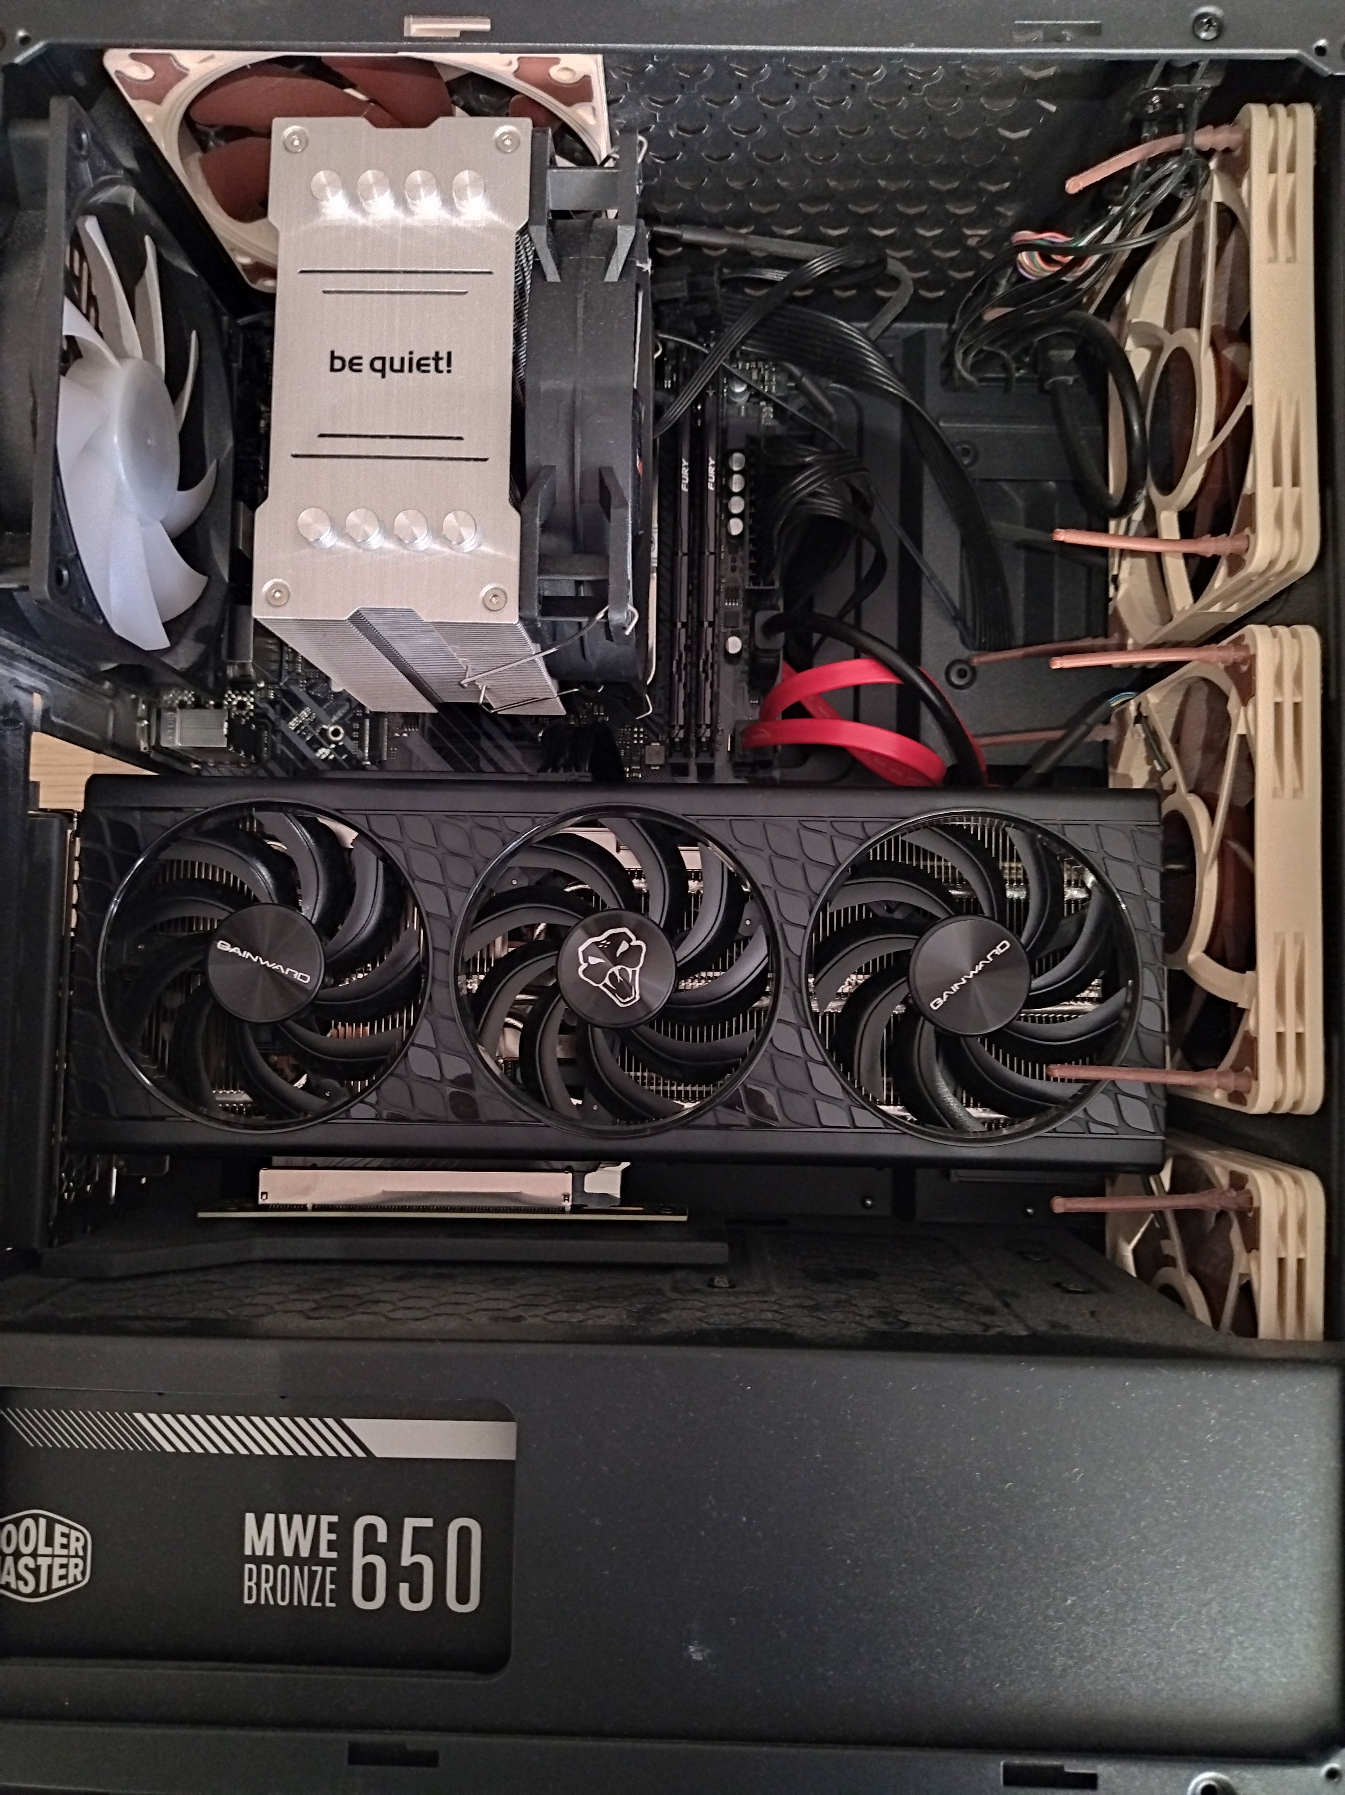
Laying Down Two GPUs

Slide 12
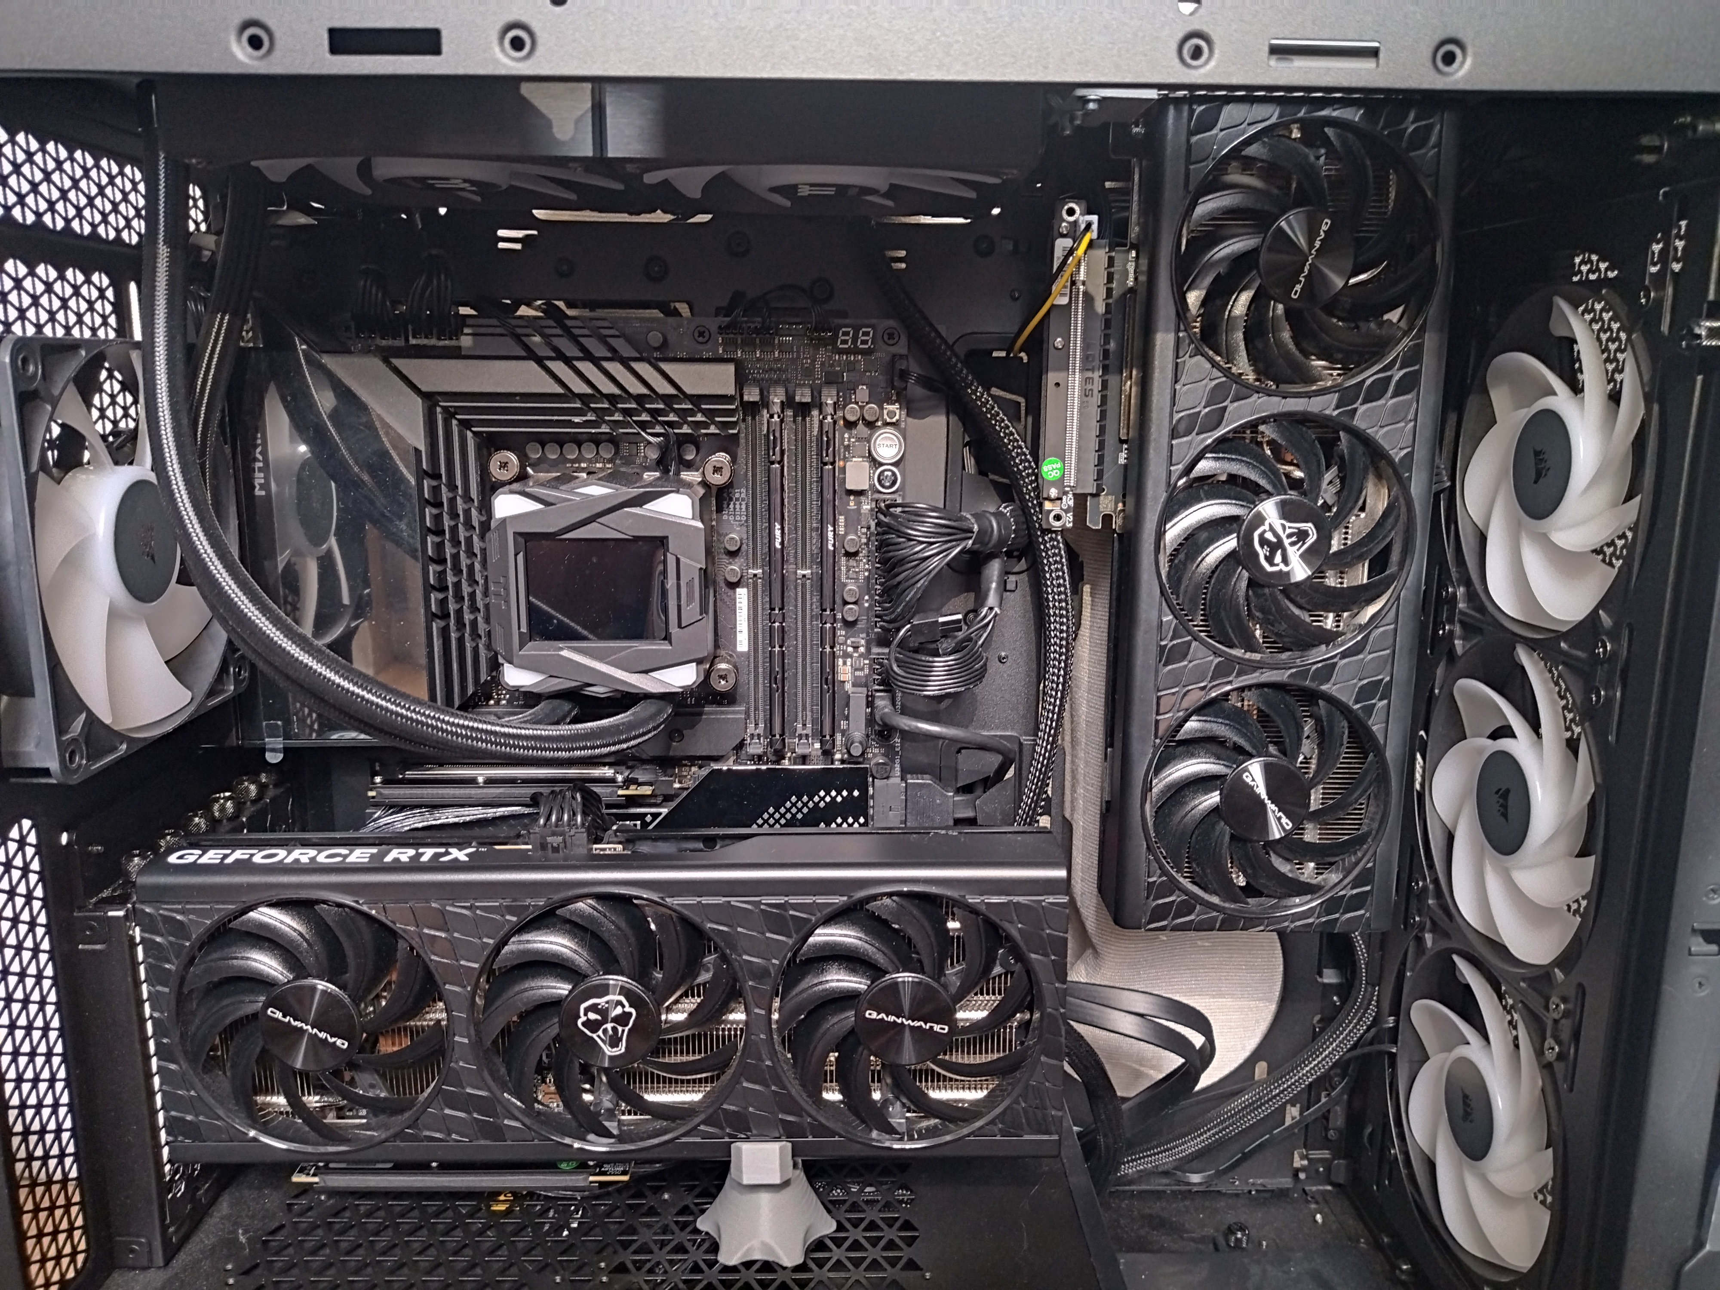
Laying Down Two GPUs

Slide 13
Running

Slide 14

nvbandwidth
~44GB/s bidirectional
theoretical maximum: 63GB/s
https://github.com/gitaroktato/local-llm/blob/main/benchmakrs/pcie_benchmarks.md

Slide 15
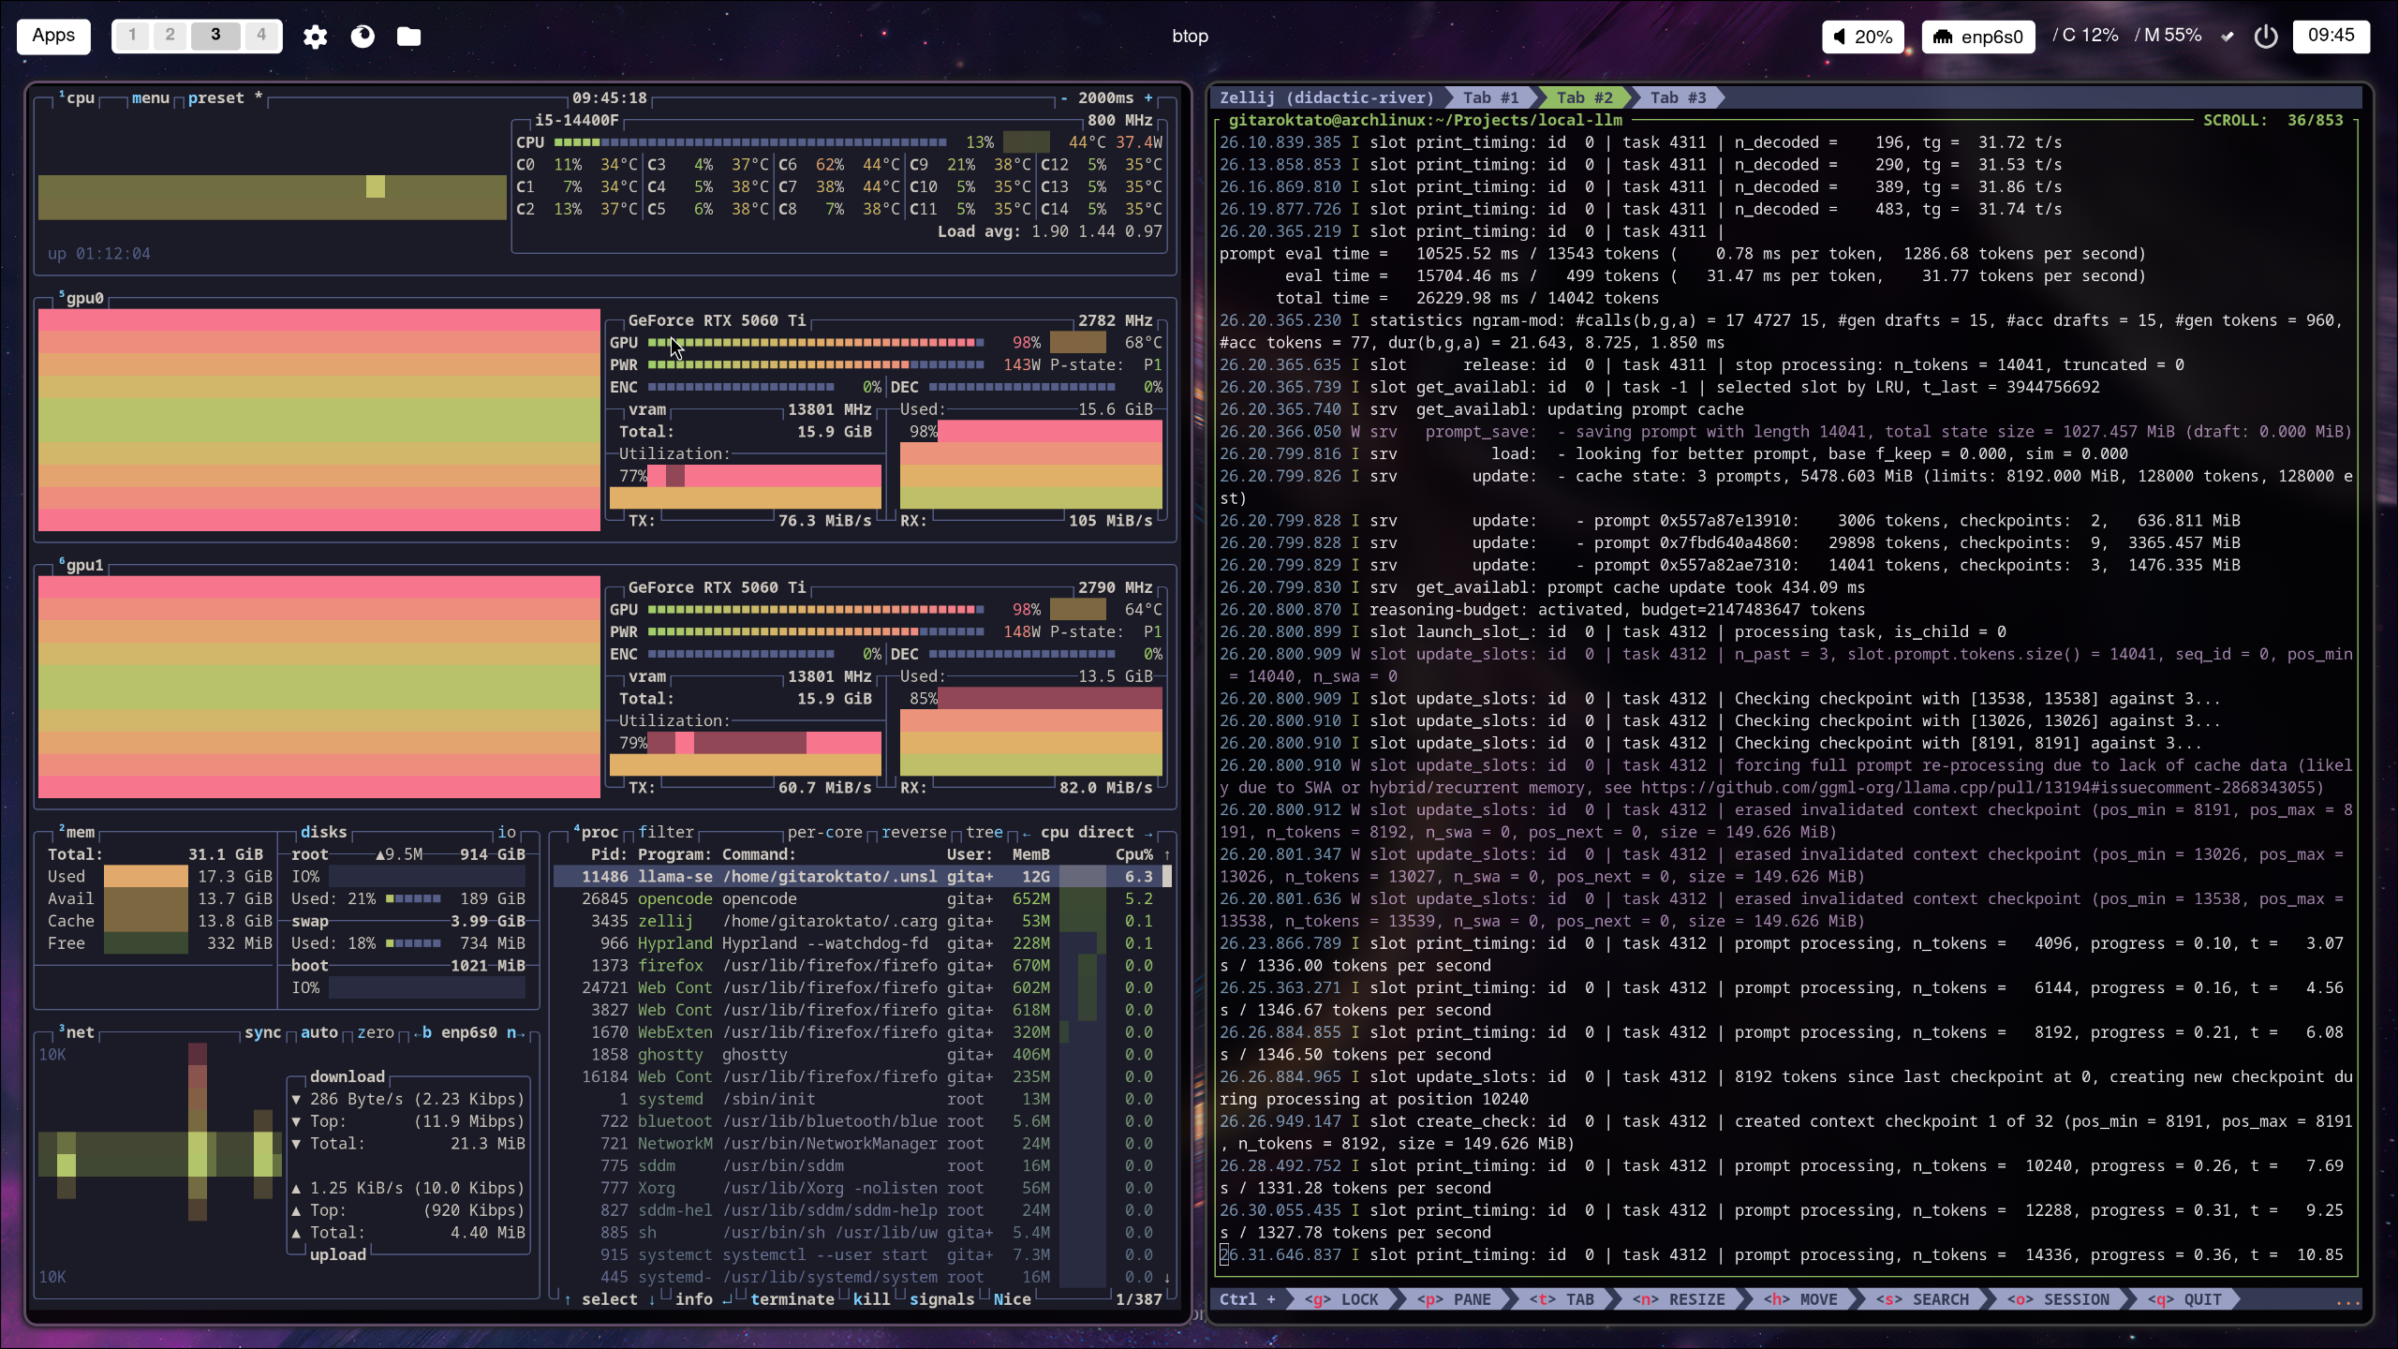
Benchmark

Slide 16
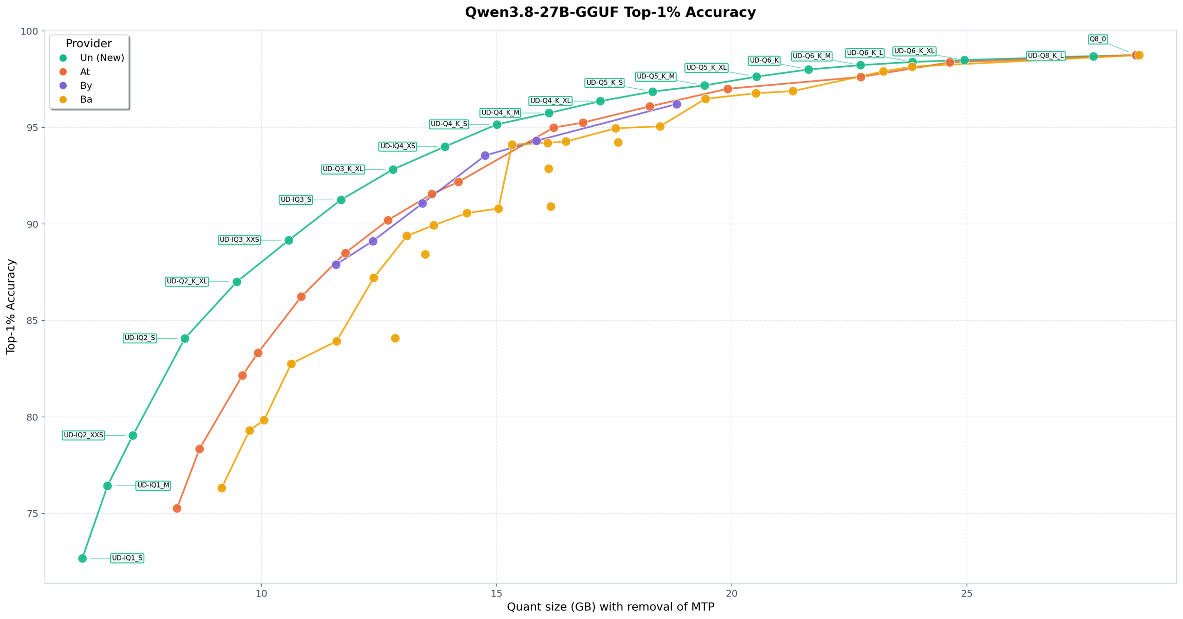
Qwen 3.8
https://unsloth.ai/docs/models/qwen3.8#run-qwen3.8-guide

Slide 17
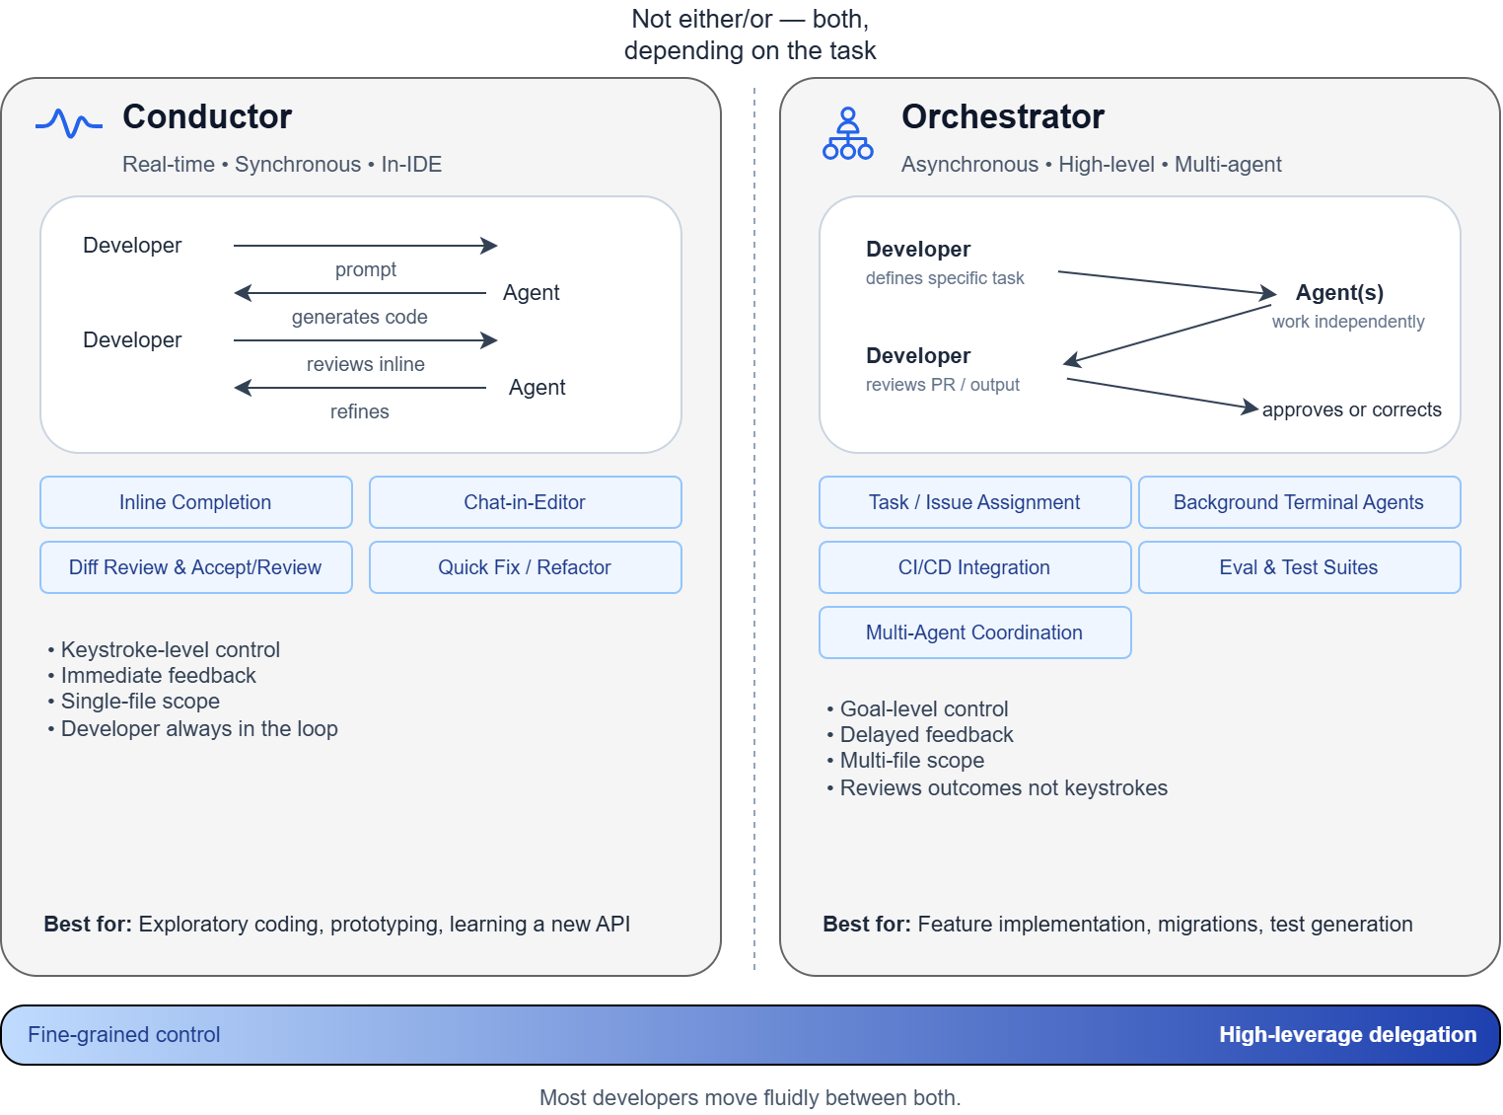

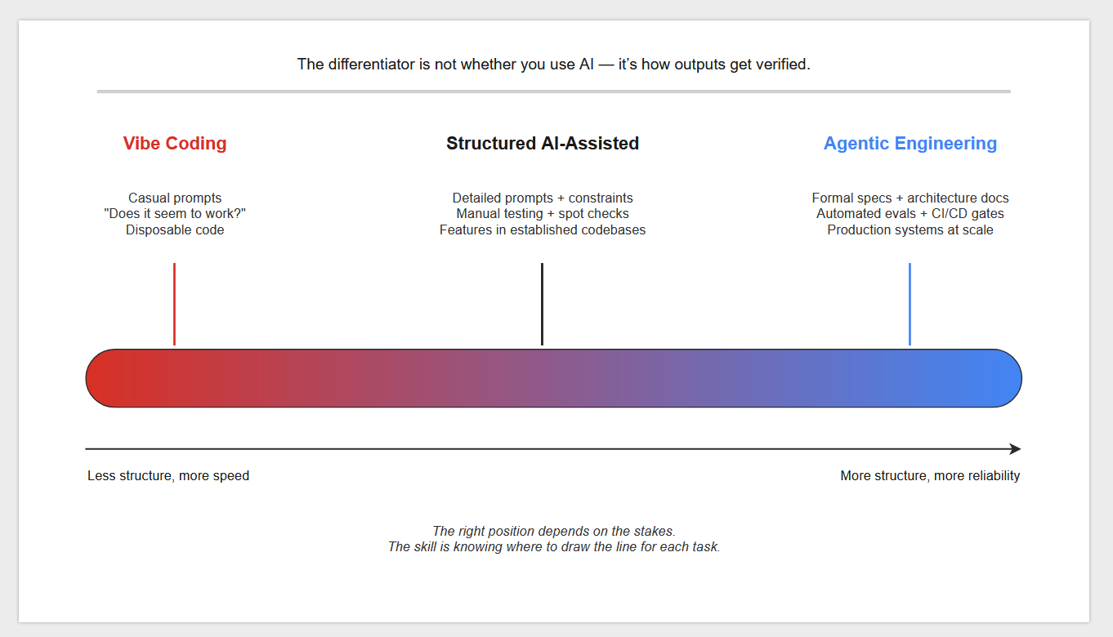
Qwen 3.8 Performance
DrawIO
PPTX

Slide 18
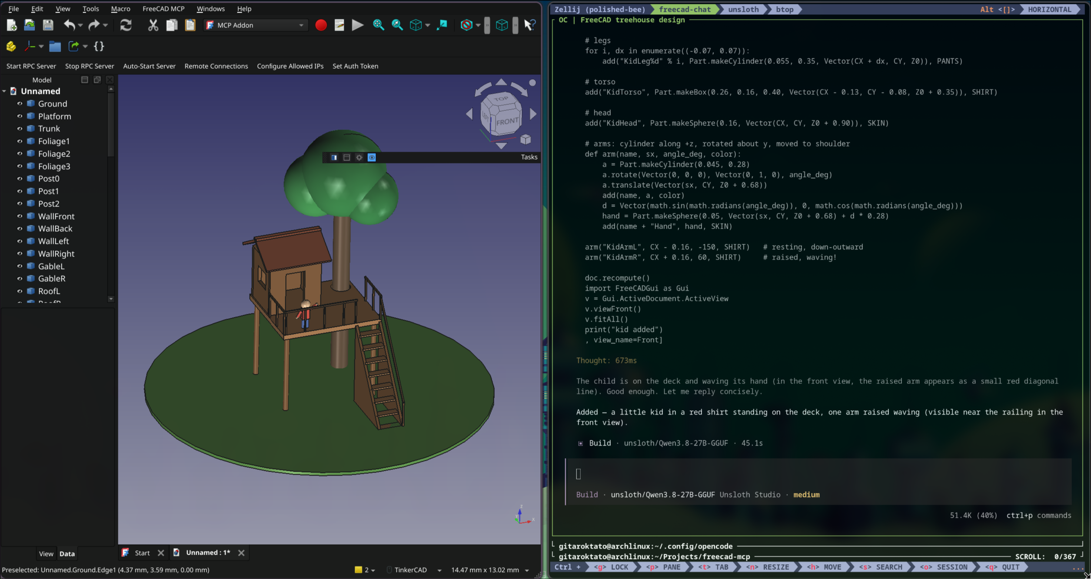
Qwen 3.8 Performance - FreeCAD
FreeCAD

Slide 19
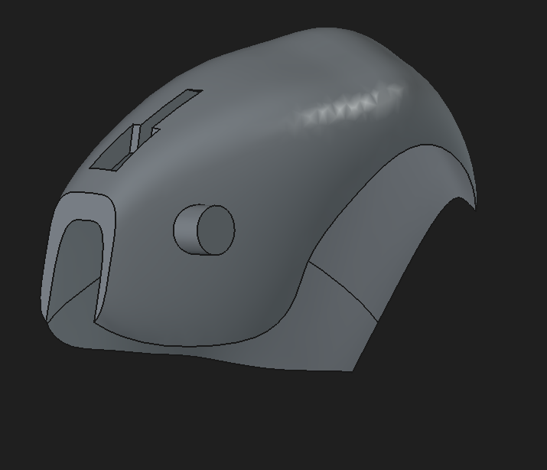
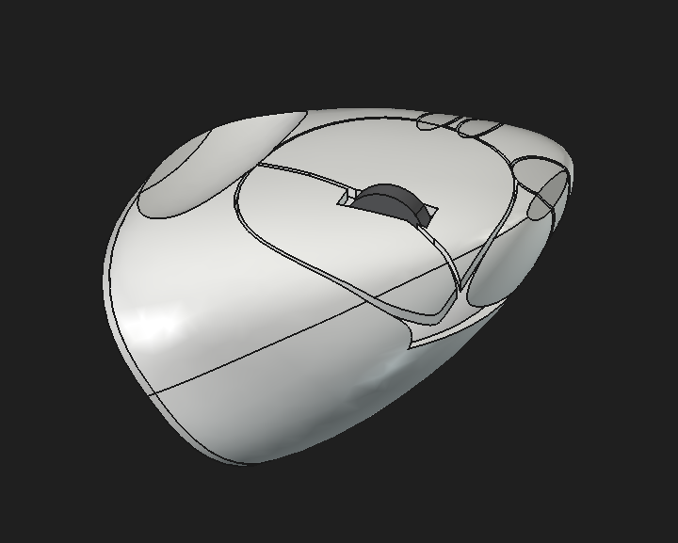
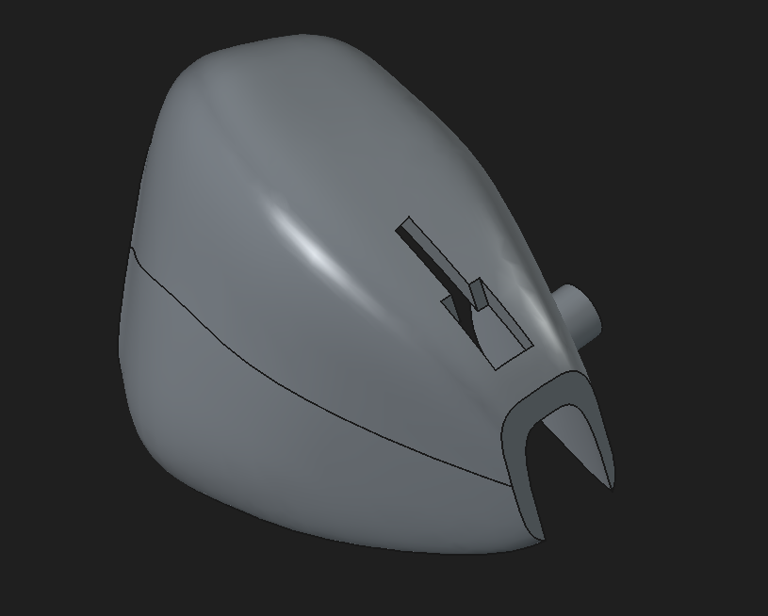
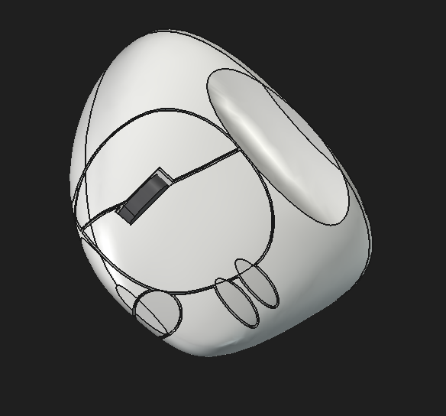
Qwen 3.8 Performance - FreeCAD
Qwen 3.8
Opus 5

Slide 20
Giving it a spin!

Slide 21
TY

