Slide 1

PROTECT YOUR INVARIANTS
A practical TDD session

Slide 2

BOWLING GAME

Slide 3
TDD Rules

Slide 4
STRIKE
SPARE
PINS
FRAME
BOWLING GAME

Slide 6

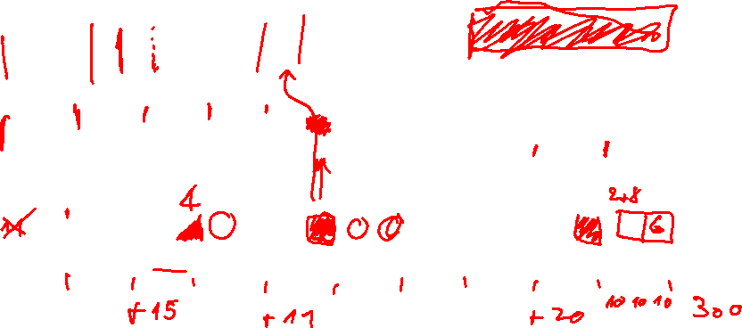










Slide 7
























Slide 8


















GAME

Slide 9




Thank You!
ORESZTESZ MARGARITISZ
@gitaroktato
gitaroktato
https://www.linkedin.com/in/oresztesz
CHIEF SOFTWARE ENGINEER
Notes:
References
Release It!
Agenda
Envoy – proxy
Quarkus ⬄ Spring boot identical (??)

Slide 10
Links to the exercise
Coding Stories example:
Similar ending as the currently presented:
Where to start if you want to do it yourself?
link
link
link
Notes:
References
Release It!
Agenda
Envoy – proxy
Quarkus ⬄ Spring boot identical (??)

