Slide 1
PROTECT YOUR INVARIANTS
A practical TDD session

Slide 2





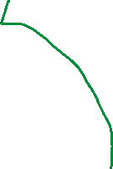










RULES OF TDD
GREEN
RED
REFACTOR

Slide 3






SPARE
PINS
STRIKE
FRAME
BOWLING GAME

Slide 4


Slide 8










10 PINS
2/3 ROLLS
Σ ROLLS = 10
10 FRAMES

Slide 9



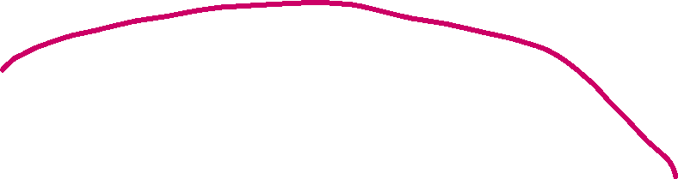













10 PINS
VIEW
2/3 ROLLS
Σ ROLLS = 10
10 FRAMES
CONTROLLER
REQUEST
MODEL

Slide 10












FRAME
GAME
10 PINS
INTERMEDIATE
FRAME
TENTH FRAME
2/3 ROLLS
Σ ROLLS = 10
10 FRAMES

Slide 11




Thank You!
ORESZTESZ MARGARITISZ
@gitaroktato
gitaroktato
https://www.linkedin.com/in/oresztesz
CHIEF SOFTWARE ENGINEER
Notes:
References
Release It!
Agenda
Envoy – proxy
Quarkus ⬄ Spring boot identical (??)

Slide 12
Links to the exercise
Coding Stories example:
Similar ending as the currently presented:
Where to start if you want to do it yourself?
link
link
link
Notes:
References
Release It!
Agenda
Envoy – proxy
Quarkus ⬄ Spring boot identical (??)

