Slide 1
Online Multiplayer Game
M. Awais adnan
Hurarah bashir
Mir humayun
Asad manzoor

Slide 2
Framework and libraries
Express.js (Server side)
Phaser (client side: runs on the browser of players)
Socket.io(client server communication)

Slide 3
What is socket.io?
Socket.io is a real time event-driven, bidirectional JS library.
It has two parts:
A client-side library that runs on the browser
A server-side library for Node.js
It primarily uses WebSocket protocol and provides features such as broadcasting to multiple sockets, storing data and asynchronous IO.
It can be installed with NPM tool (Node installed).

Slide 4
Why Socket.io?
Disconnection-detection: It allows both the server and the client to know when the other one is not responding anymore.
Auto-reconnect support: Unless mentioned explicitly in the code, the client library will try to reconnect forever, until the server is available again.
Multiplexing support: It allows to have several communication channels on a same underlying connection.
Binary streaming support: It also allows emitting any serializable binary data like Array Buffer, Blobs, etc.
Reliability: It can establish connection even in the presence of proxies, load-balancers, personal firewalls, and antivirus-softwares.

Slide 5
Sending and receiving objects:
Socket.io is very efficient for creating an interactive experience in our game as:
Instead of making HTTP/HTTPs requests (which are slower and have larger packet size due to many header files), it uses sockets to send and receive data.
Sockets are faster as they are capable of sending only the required data.
This helps keep the experience interactive

Slide 6
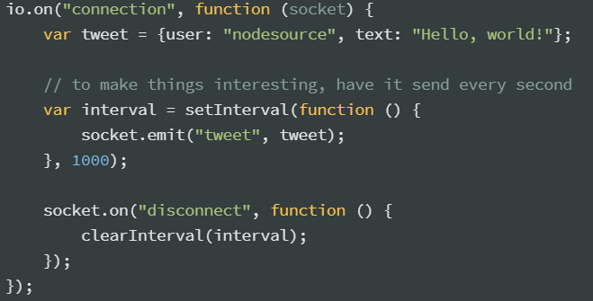
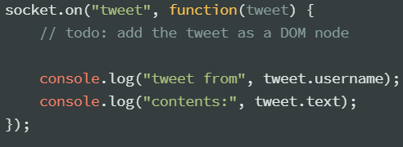
Sending and receiving objects:
Both sender and receiver use socket objects as event-emitters so we can listen for events in bidirection.
Server side
Client Side

Slide 7
What is Phaser?
Phaser is a free 2D game framework for making HTML5 games for desktops and mobiles.
It uses both canvas and WebGL and can internally switch according to the browser support providing fast performance. It also has following features:
Rendering: Uses canvas and WebGL renderer
Physics: It ships with Arcade Physics system, Ninja Physics and P2.JS,full body physics system.
Animation and Audio: It has support for animations and audio.
Scripting: Games can either be made in Javascript or Typescript

Slide 8
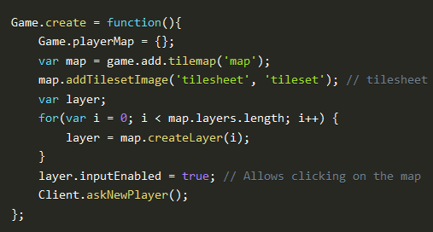

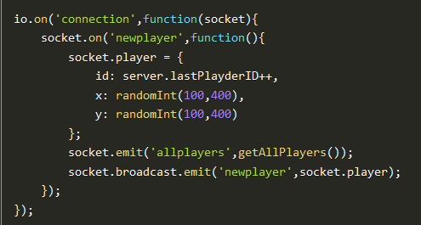
Adding and Displaying the connected players

Slide 9
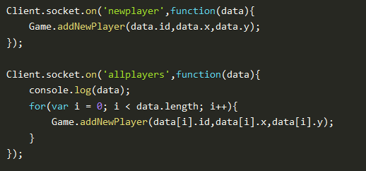

Adding and Displaying the connected players

Slide 10



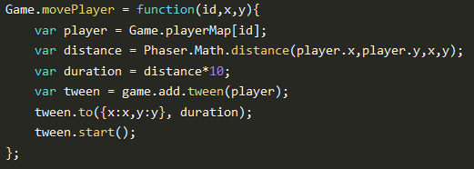
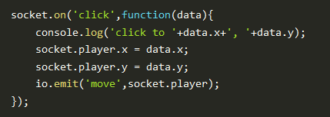
Moving The Players

Slide 11


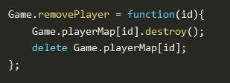
Removing The Disconnected Players

Slide 12
THANK YOU
ANY QUESTIONS?

