Slide 1
AI & ML PROJECT REPORTS · MODULES 1,2, 4 & 5
Regression, CNN and LLM
Project Reports
Regression Analysis · CNN Image Classification · LLM Fine-Tuning
MODULE 1 and 2
Regression analysis on the UCI Bike Sharing dataset: simple, multiple and polynomial models
MODULE 4
CNN design study and occlusion-sensitivity analysis for image classification (Mini-ImageNet task)
MODULE 5
Fine-tuning DistilGPT-2 with LoRA as a customer-support FAQ assistant
Presenter: Gitarani Mohanty | Date: 16th August 2026
1

Slide 2
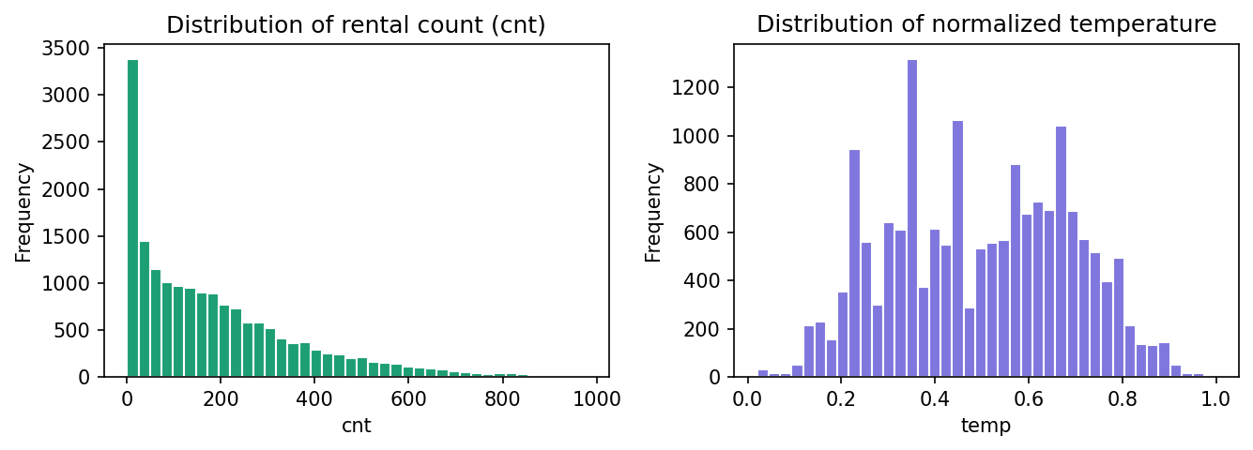
SLIDE 2 / DATA
Dataset Overview
17,379 hourly bike-rental records from Washington, D.C., published by the UCI Machine Learning Repository.
Data source
FIGURE 1 · FEATURE DISTRIBUTIONS
Hourly Bike Sharing dataset, UCI ML Repository; two years of rental activity in Washington, D.C.
Target variable
'cnt' — total count of rented bikes in a given hour.
Predictors used
'temp' (temperature), 'atemp' (feels-like temperature), 'hum' (humidity), 'windspeed' — all pre-normalized to roughly [0, 1].
Rental count is right-skewed (most hours see low demand), while normalized temperature is roughly bell-shaped — consistent with typical seasonal weather patterns.
Data quality
No missing values across modeling columns; no additional scaling required before fitting.
Modeling: OLS (scikit-learn LinearRegression), 80/20 train-test split, fixed random seed for reproducibility.
Regression Analysis on the Bike Sharing Dataset | Gitarani Mohanty
2

Slide 3
SLIDE 3 / METHOD
Methodology & Modeling Workflow
Three regression models of increasing complexity, each evaluated on a held-out test set.
Weather
Features
→
Preprocess
→
Fit Model
(OLS)
→
Predict on
Test Set
→
Evaluate
(R², MSE)
Simple Linear
Multiple Linear
Nonlinear (Polynomial)
y_hat = β0 + β1·temp
y_hat = β0 + β1·temp + β2·atemp
+ β3·hum + β4·windspeed
y_hat = β0 + β1·temp + β2·temp²
Baseline using temperature alone as the sole predictor.
Extends the predictor set to temperature, apparent temperature, humidity, and windspeed.
Engineers a squared temperature term to trace a curve rather than a straight line.
Evaluation: R-squared (variance explained) for all models; MSE and a residual plot additionally computed for the multiple linear model to diagnose unexplained structure.
Regression Analysis on the Bike Sharing Dataset | Gitarani Mohanty
3

Slide 4
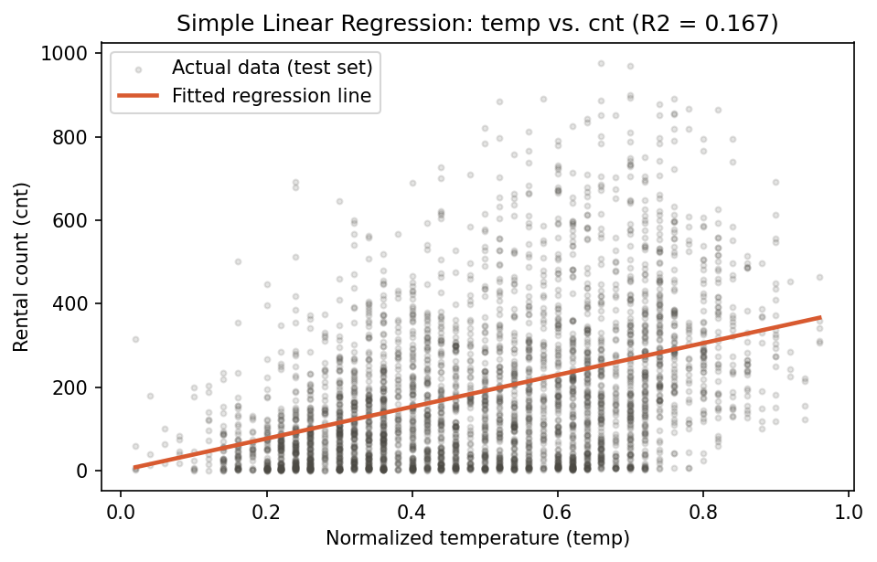
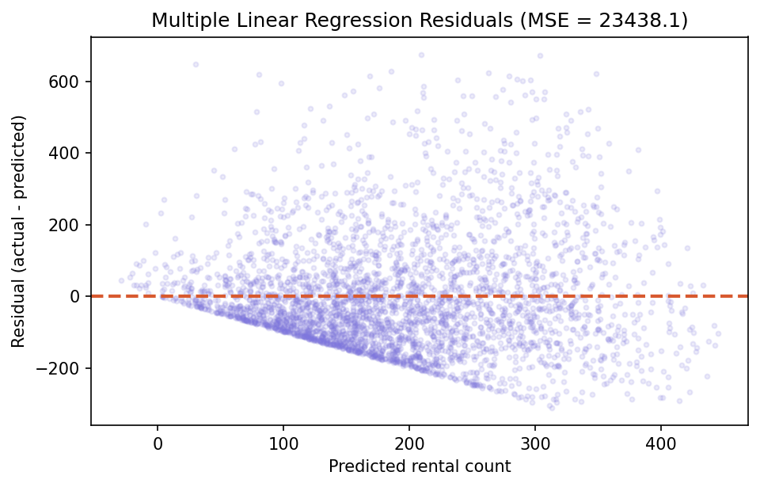
SLIDE 4 / EVIDENCE
Results: Simple & Multiple Linear Regression
Adding relevant weather features improved fit substantially more than the baseline single-feature model.
FIGURE 2 · SIMPLE LINEAR FIT
MULTIPLE LINEAR REGRESSION
R² = 0.2598 MSE (test) = 23,438.1
Adding 'atemp', 'hum', and 'windspeed' raised R-squared from 0.167 to 0.260 — the largest single improvement across all three models.
Feature | Coefficient
temp | 117.16
atemp | 276.29
hum | -277.36
windspeed | 34.46
Intercept | 168.10
Apparent temperature has the strongest positive association with rentals — even larger than temperature itself — while humidity shows a clear negative association, holding other features constant.
FIGURE 3 · RESIDUALS
cnt_hat = 1.11 + 380.91 · temp → R² = 0.1674
Funnel shape motivates the nonlinear test
Regression Analysis on the Bike Sharing Dataset | Gitarani Mohanty
4

Slide 5
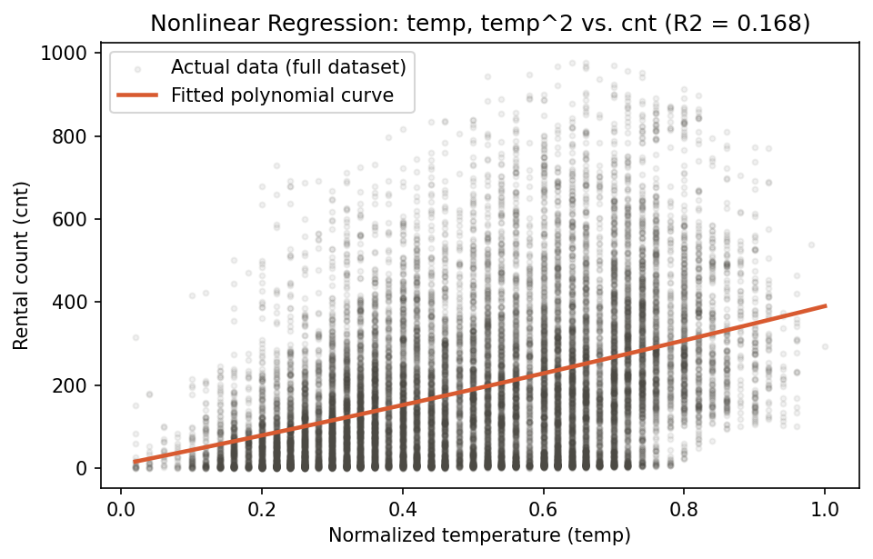
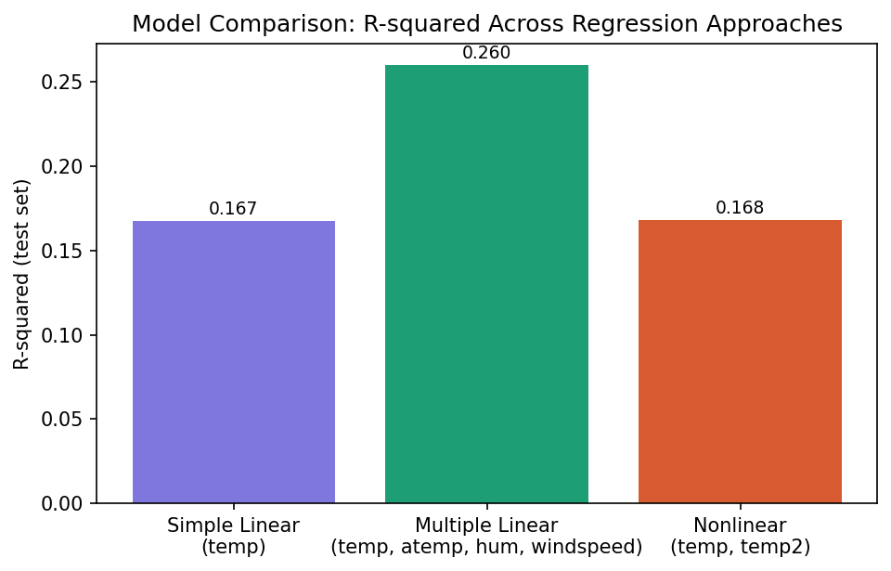
SLIDE 5 / EVIDENCE
Results: Nonlinear Regression & Model Comparison
Curvature alone barely improved on the baseline — breadth of predictors mattered more than nonlinearity.
FIGURE 4 · QUADRATIC FIT (TEMP, TEMP²)
FIGURE 5 · R-SQUARED ACROSS ALL MODELS
cnt_hat = 9.35 + 341.85·temp + 39.32·temp²
R² = 0.1679 MSE = 26,347.4
Model | R² | MSE (test)
Simple Linear (temp) | 0.1674 | —
Multiple Linear (temp, atemp, hum, windspeed) | 0.2598 | 23,438.1
Nonlinear (temp, temp²) | 0.1679 | 26,347.4
Regression Analysis on the Bike Sharing Dataset | Gitarani Mohanty
5

Slide 6
SLIDE 6 / CLOSE
Conclusion & Key Takeaways
Breadth of relevant predictors mattered more than modeling curvature in a single feature.
MAIN FINDING
INTERPRETATION
Adding weather features (multiple linear) raised R² from 0.167 to 0.260 — far more than adding a squared temperature term (0.167 → 0.168).
The temperature–demand relationship is close to linear over the observed range; feature breadth matters more than curvature in this dataset.
LIMITATIONS
NEXT STEPS
A substantial share of variance remains unexplained by weather alone — time of day, day of week, and holidays were outside this analysis' scope.
Incorporate temporal features (hour, weekday, holiday) and interaction terms; consider regularized or tree-based models for comparison.
Regression Analysis on the Bike Sharing Dataset | Gitarani Mohanty
6

Slide 7
SLIDE 7 / MODULE 4 · SETUP
Module 4: CNN Design Study & Occlusion Sensitivity
Which network parameters drive image-classification accuracy, and does the model really look at the object?
TASK & DATA
PART A · FACTORS STUDIED
Classify 84×84 RGB images (Mini-ImageNet task). The run used a 20-class synthetic stand-in dataset: 1,200 images, split 959 / 121 / 120 for train / validation / test.
Conv layers
FC layers
Filters per layer
Max-pooling
NETWORK FAMILY
Conv (3×3) → BatchNorm → ReLU stages with optional 2×2 max-pooling, then fully connected layers. Baseline: 3 conv layers (32-64-128 filters), 1 hidden FC layer (256), 0.62 M parameters.
Stride
Epochs
PART B · OCCLUSION SENSITIVITY
PROTOCOL
On the best model, hide an N×N window of gray pixels at every position and record the true-class confidence. The resulting map shows which regions the decision depends on.
One factor changed at a time (AdamW, 15 epochs, seed 42, no augmentation). Checkpoint chosen on validation accuracy; the test set is used only for reporting.
Module 4: CNN Design Study & Occlusion Sensitivity | Gitarani Mohanty
7

Slide 8
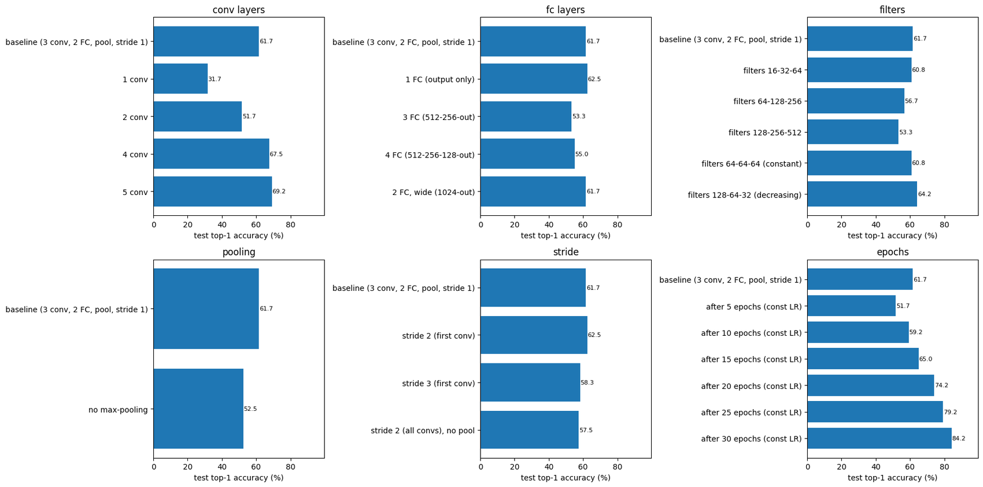
SLIDE 8 / MODULE 4 · EVIDENCE
Part A: Effect of Network Parameters
Depth and training time moved accuracy the most; wider layers and extra FC layers did not help.
31.7% → 69.2%
test top-1 accuracy, 1 → 5 conv layers
51.7% → 84.2%
test top-1 accuracy, 5 → 30 epochs
Depth: accuracy rises with every extra conv layer, with diminishing returns after 4.
FC layers & filters: no gain; extra FC layers trained slower and wider layers scored lower (within noise).
Pooling & stride: max-pooling gave +9 points and 2.7× faster training; stride 2 on the first layer cost nothing.
Caution: the test set has 120 images, so gaps below about 5–9 points are within noise.
FIGURE 6 · TEST TOP-1 ACCURACY PER FACTOR baseline included in each panel
Improved candidates (deeper VGG-style nets, augmentation, label smoothing, 40 epochs) reached 59–73% test accuracy and were still under-fitting; the best model by validation accuracy was the 3-conv baseline trained for 30 epochs.
Module 4: CNN Design Study & Occlusion Sensitivity | Gitarani Mohanty
8

Slide 9
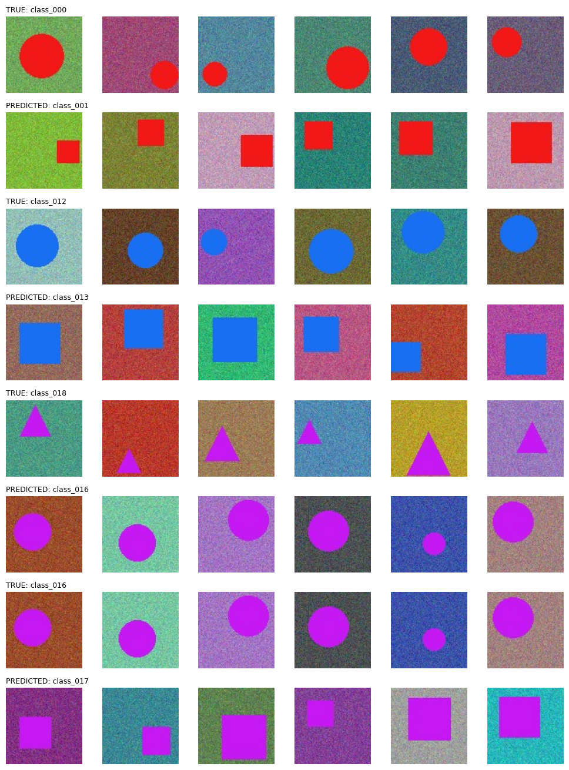
SLIDE 9 / MODULE 4 · EVIDENCE
Best Model & Error Analysis
Errors are mostly shape confusions between classes that share the same colour.
86.7%
99.2%
0.62 M
test top-1 accuracy
test top-5 accuracy
parameters (3 conv + 2 FC)
BEST MODEL
3 conv layers (32-64-128) with max-pooling, FC 256, trained 30 epochs at constant learning rate. Selected by validation accuracy (78.5%) over all runs; it beat the deeper augmented models.
MIS-CLASSIFICATIONS
16 of 120 test images are wrong, and for 15 of them the true class is still in the top 5. The top confusions are circle ↔ square and triangle → circle in the same colour, often with small or border-clipped objects.
FIGURE 7 · TRUE vs PREDICTED CLASS
Rows alternate true / predicted: 000→001, 012→013, 018→016, 016→017
Module 4: CNN Design Study & Occlusion Sensitivity | Gitarani Mohanty
9

Slide 10
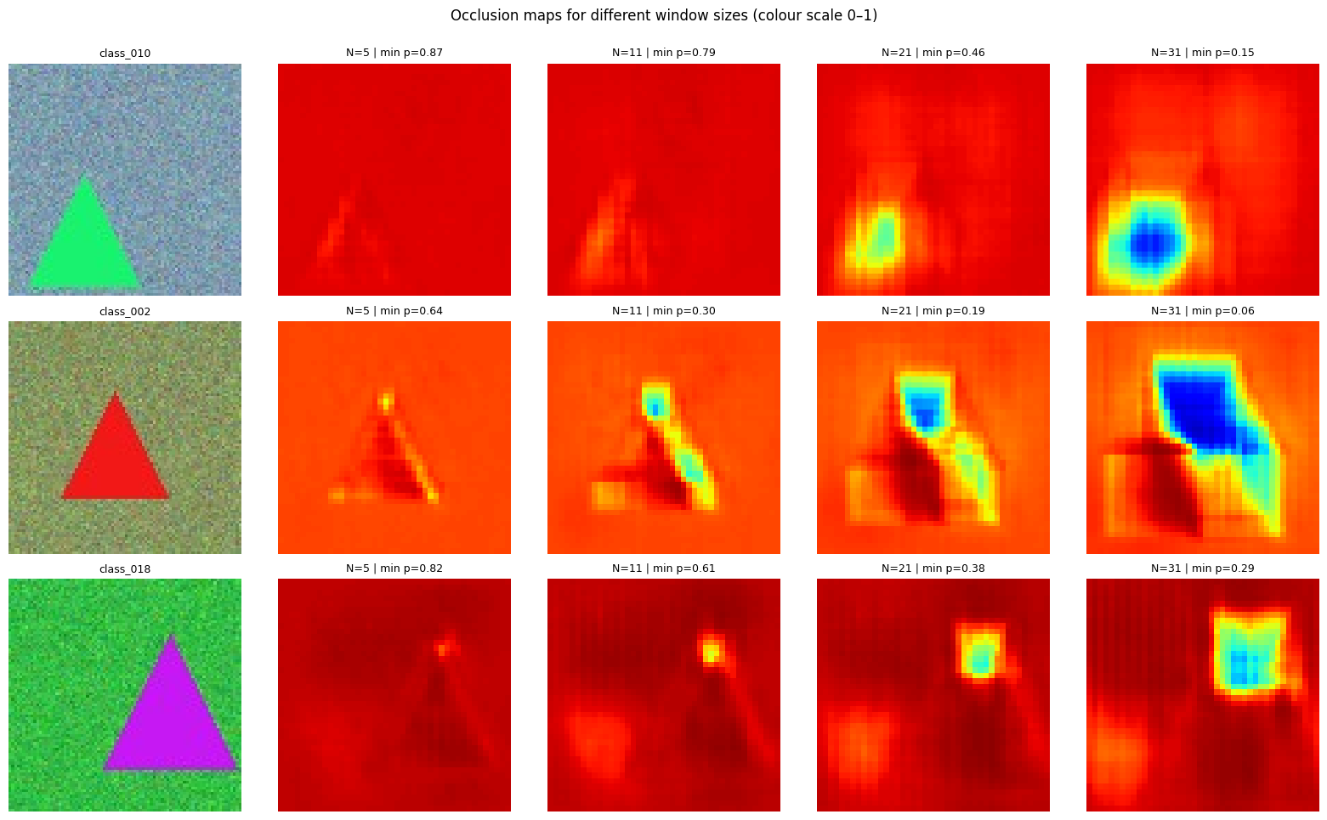
SLIDE 10 / MODULE 4 · EVIDENCE
Part B: Occlusion Sensitivity
The model relies on the object's corners and edges, not on the background.
1
Gray N×N window (N = 11) centred at every pixel position (i, j)
2
Pass the modified image through the best model
3
Store p(true class) as confidence(i, j) and plot it as a map
Where it looks: confidence drops only on or next to the object (triangle apexes, square edges, stripes), never on the background.
Window size: N = 5 is too small, N = 21/31 blur into blobs, so N = 11 localises best.
Robustness: only 0.3% of positions halve the confidence; very confident images barely react.
Caveat: backgrounds in the synthetic data are pure noise, so context dependence must be re-tested on real photos.
FIGURE 8 · CONFIDENCE MAPS BY WINDOW SIZE colour scale 0–1, blue = key region
Module 4: CNN Design Study & Occlusion Sensitivity | Gitarani Mohanty
10

Slide 11
SLIDE 11 / MODULE 5 · METHOD
Module 5: Fine-Tuning a Small LLM for Customer-Support FAQs
Teach DistilGPT-2 a store's policies with LoRA, then compare it with the untouched base model.
FAQ pairs
(JSONL)
Clean &
split 80/10/10
DistilGPT-2
+ LoRA
Trainer + early
stopping
Evaluate base
vs fine-tuned
→
→
→
→
DATASET
MODEL
TRAINING
837 synthetic ShopEase Q&A pairs from 56 policy topics (returns, shipping, payments, accounts). Split 671 / 85 / 81, grouped by question so paraphrases never leak into the test set.
DistilGPT-2 (81.9 M parameters) with LoRA rank 32 on c_attn, c_proj and c_fc: 2.36 M trainable weights (2.8%). Loss is computed on answer tokens only.
Hugging Face Trainer: 5 epochs, batch size 8, learning rate 5e-4 (cosine), fp16, early stopping on validation loss. Total training time: 34 seconds on a T4.
Minimal-compute strategy: Colab T4, model under 125 M parameters, LoRA with mixed precision. 8-bit / 4-bit quantisation was provided as an option but does not apply to GPT-2's Conv1D layers.
Module 5: Fine-Tuning a Small LLM for Customer-Support FAQs | Gitarani Mohanty
11

Slide 12
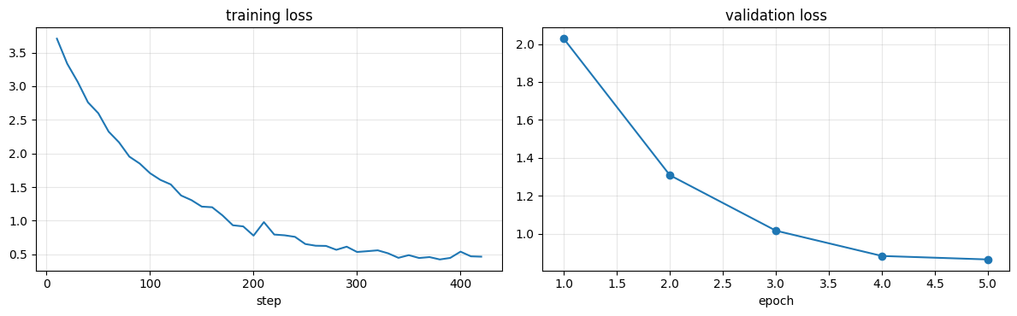
SLIDE 12 / MODULE 5 · EVIDENCE
Training & Automated Evaluation
Fine-tuning cuts the loss on store answers sharply; word-overlap scores stay moderate.
41.1 → 2.48
34 s
perplexity on reference answers
LoRA training time (T4)
Learned: the style, vocabulary and clean endings of ShopEase answers.
Plateau: validation loss flattens by epoch 5 and early stopping never triggered; train loss (about 0.5) sits below validation (about 0.86).
Caution: base answers were mostly empty (first-line truncation), so the BLEU and ROUGE gaps are overstated. Loss and perplexity are unaffected.
FIGURE 9 · LEARNING CURVES best validation loss 0.864 at epoch 5
Metric (81 test questions) | Base | Fine-tuned
BLEU | 0.00 | 14.70
ROUGE-L (F) | 0.006 | 0.267
Embedding cosine similarity | 0.067 | 0.517
Perplexity of reference answers | 41.1 | 2.48
Module 5: Fine-Tuning a Small LLM for Customer-Support FAQs | Gitarani Mohanty
12

Slide 13
SLIDE 13 / MODULE 5 · EVIDENCE
Manual Evaluation on 10 Queries
Fine-tuned model: 4 correct, 1 partly correct, 5 wrong. The base model returned empty output for all 10.
# | Query | Fine-tuned answer (shortened) | Verdict
1 | Can I return a product after 30 days? | Items must be unused, in original packaging, with tags attached… | Partly: no 30-day limit
2 | How do I track my order? | …the tracking details are back in your spam folder. | Wrong: invented
3 | My package arrived broken, what should I do? | Report within 48 hours with a photo… free replacement or refund. | Correct
4 | Do you ship to Canada? | We deliver to over 50 countries… takes 3-5 business days. | Wrong: facts (40+, 7–14 days)
5 | I forgot my password, help! | Click Forgot Password… we will send a reset link. | Correct
6 | Is there free delivery? | Standard orders can go to a PO box. Express needs a street address. | Wrong: other topic
7 | Can I pay with PayPal? | We accept Visa, MasterCard, American Express, PayPal, Apple Pay… | Correct
8 | How long will it take to get my money back after a return? | Return shipping costs $4.99 and arrives within 3-5 business days. | Wrong: mixes policies
9 | What is the capital of France? | Free size and colour exchanges within 30 days of delivery… | Wrong: no refusal
10 | Can I change my delivery address after placing the order? | Edit the address in My Orders before the order ships… | Correct
Module 5: Fine-Tuning a Small LLM for Customer-Support FAQs | Gitarani Mohanty
13

Slide 14
SLIDE 14 / MODULE 5 · CLOSE
Module 5 Conclusion & Key Takeaways
LoRA taught the style quickly, but a small model on little data is unreliable about the facts.
WHAT WORKED
FAILURE MODES
Perplexity of the reference answers fell from 41.1 to 2.48 in 34 seconds of training. Answers are concise, use store vocabulary, and 4 of 10 manual queries were fully correct.
Wrong-topic answers, blended or invented numbers (for example “over 50 countries”), and no refusal of out-of-scope questions such as the capital of France.
LIMITATIONS
NEXT STEPS
Synthetic template data with about a dozen training pairs per topic, 81 test questions from about 33 base questions, a single seed, and a base-model baseline that was mostly empty.
Train longer or with a higher rank, try gpt2 or OPT-125M with 4-bit QLoRA, add more paraphrases and refusal examples, and retrieve the matching FAQ entry to ground each answer.
Module 5: Fine-Tuning a Small LLM for Customer-Support FAQs | Gitarani Mohanty
14

Slide 15
SLIDE 15 / SUMMARY
Overall Summary Across the Three Projects
Regression, convolutional networks and LLM fine-tuning: what each project showed.
MODULE 2 · REGRESSION
MODULE 4 · CNN
MODULE 5 · LLM
R² 0.167 → 0.260
86.7% test top-1
PPL 41.1 → 2.48
multiple vs simple linear regression
best CNN, 99.2% top-5 (synthetic data)
DistilGPT-2 + LoRA, 34 s training
Relevant features helped far more than curvature (quadratic R² 0.168).
Test MSE of the multiple model: 23,438.
Weather alone leaves most variance unexplained: add hour, weekday and holiday.
Depth and training time mattered most; FC width and filter count did not.
Max-pooling added about 9 points; errors were mostly same-colour shape confusions.
Occlusion maps: the model uses object corners and edges, not the background.
Style and vocabulary were learned quickly, but only 4 of 10 answers were correct.
BLEU and ROUGE gaps are inflated by empty base outputs; perplexity is the reliable gain.
Next: more data and epochs, and retrieval to ground the answers.
Common thread: the gains came from giving the model better information or more training, not from extra complexity in one place. Small test sets (the CNN and LLM projects) call for caution when comparing close results.
AI/ML Batch 7 Project Reports | Gitarani Mohanty
15

