Slide 1
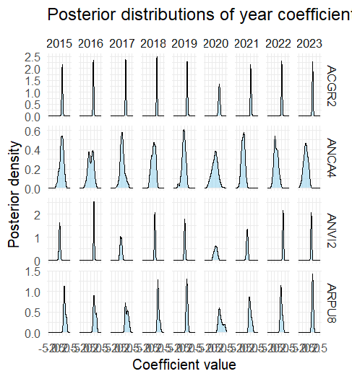
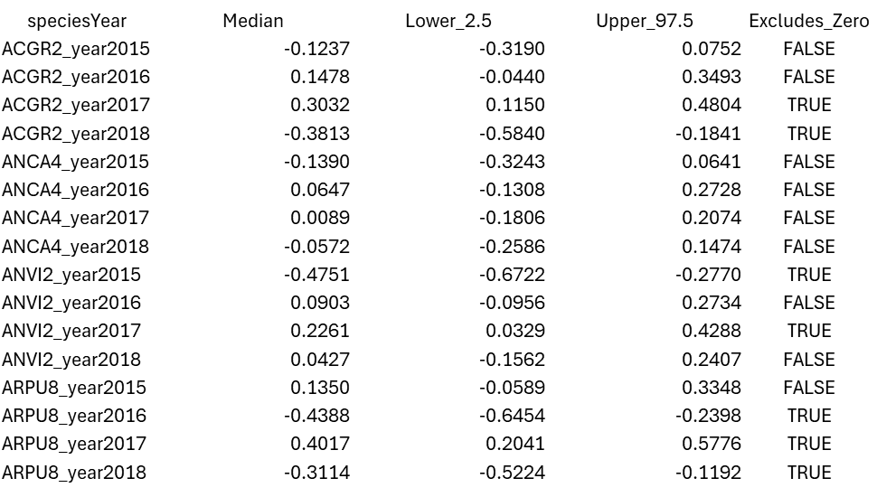
formula <- ~ year + nlcdClass
Posterior distributions of year coefficient
Is the abundance of species X in Y significantly different from 2014 (the reference year)?

Slide 2
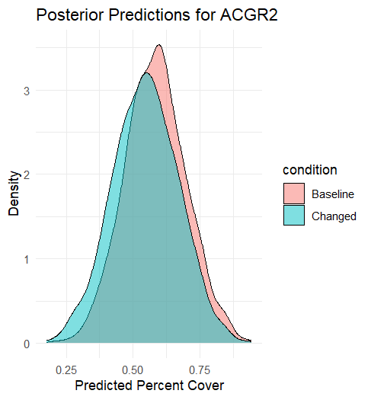
2014
2015

Slide 3
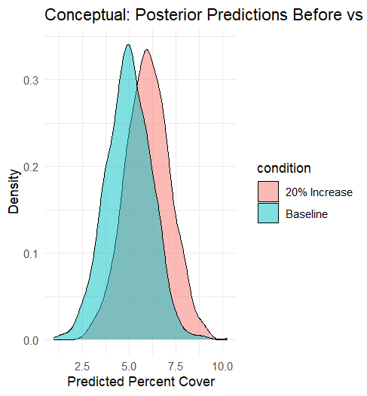
Conceptual: Posterior Predictions Before vs After 20% Abundance Increase

Slide 4
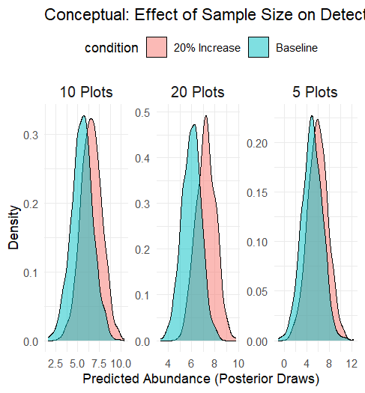
Conceptual: Effect of Sample Size on Detectability of 20% Abundance Change

Slide 5
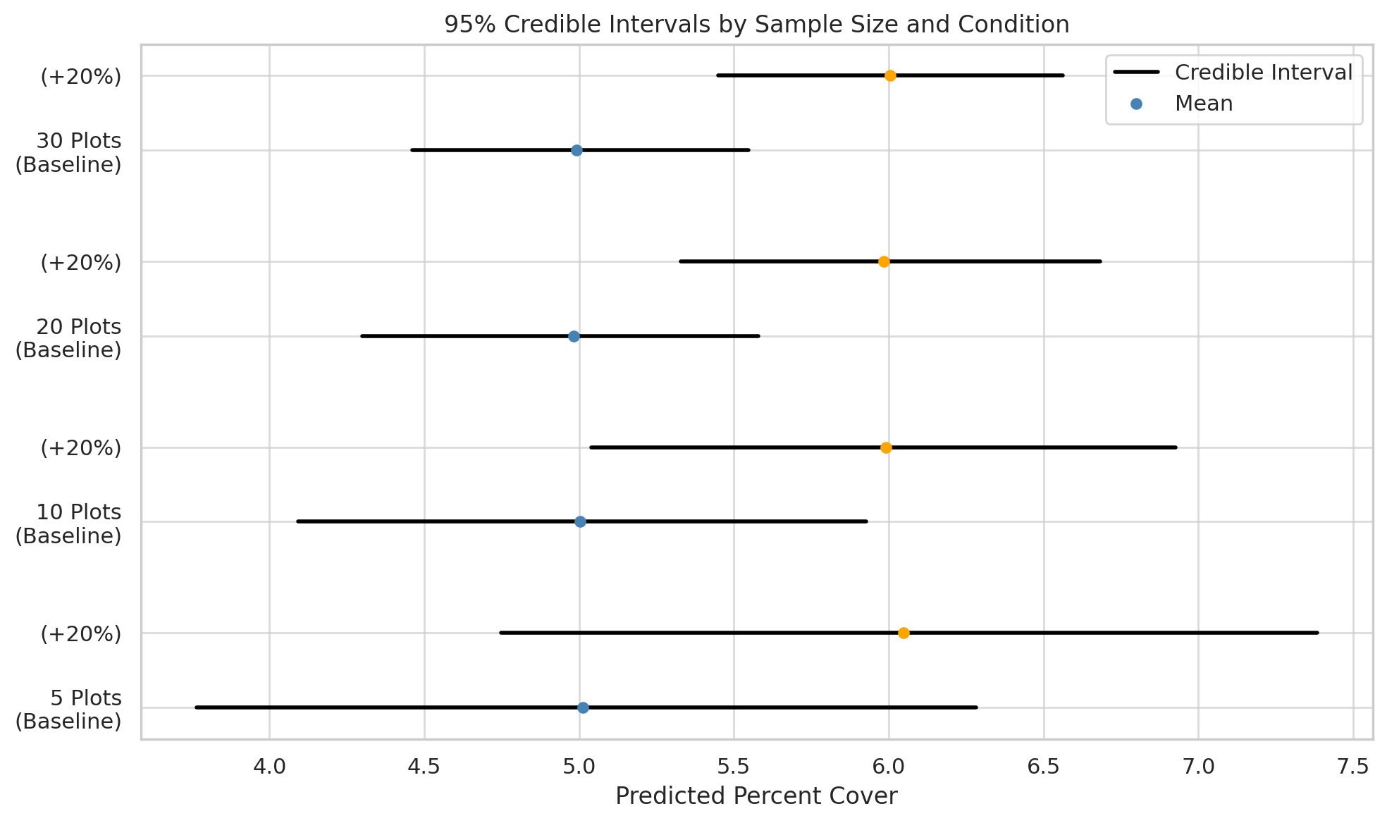

Slide 6
