Slide 1
Great outdoors
- Shreyash

Slide 2
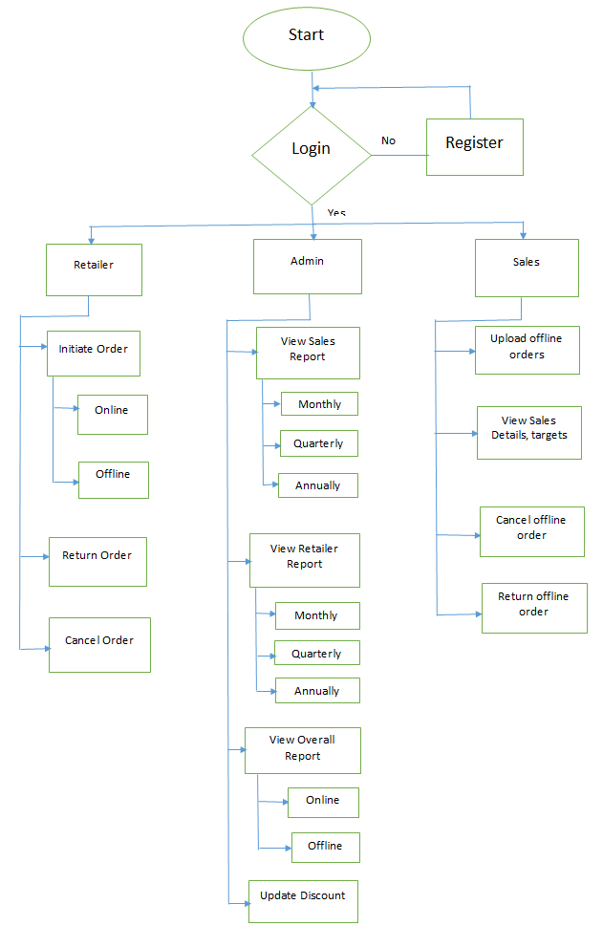
Flow Diagram

Slide 3
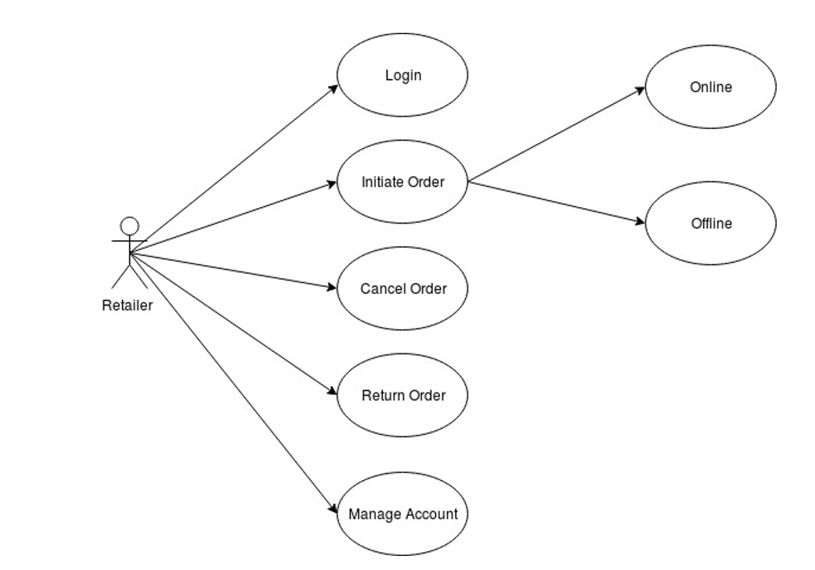
Use Case Diagram Retailer:

Slide 4
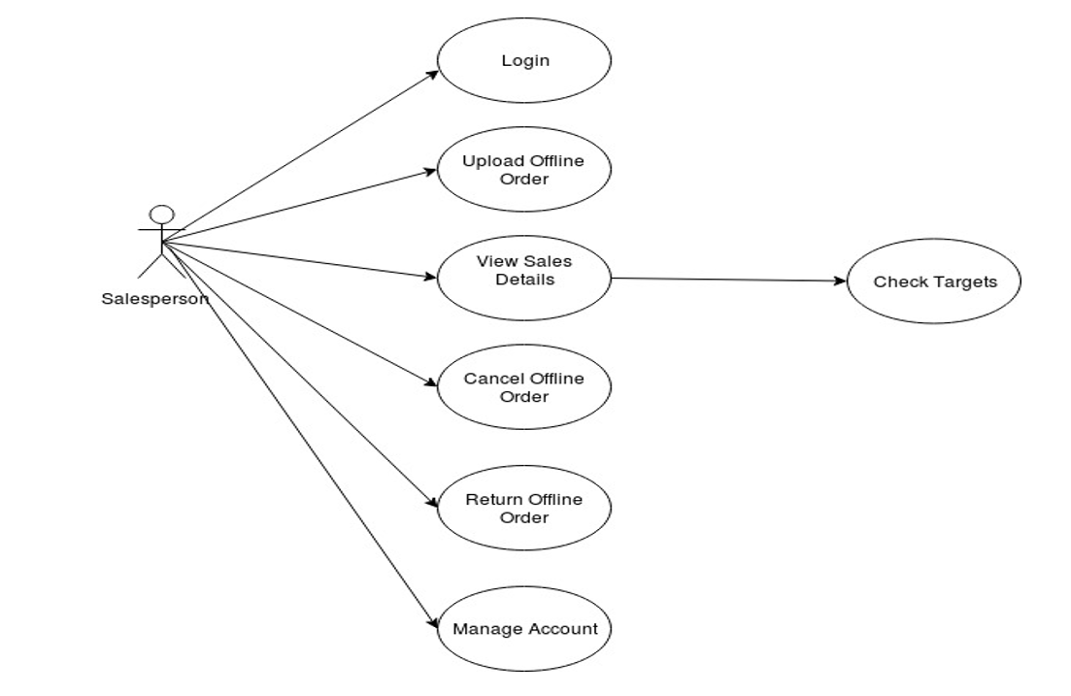
Salesman:

Slide 5
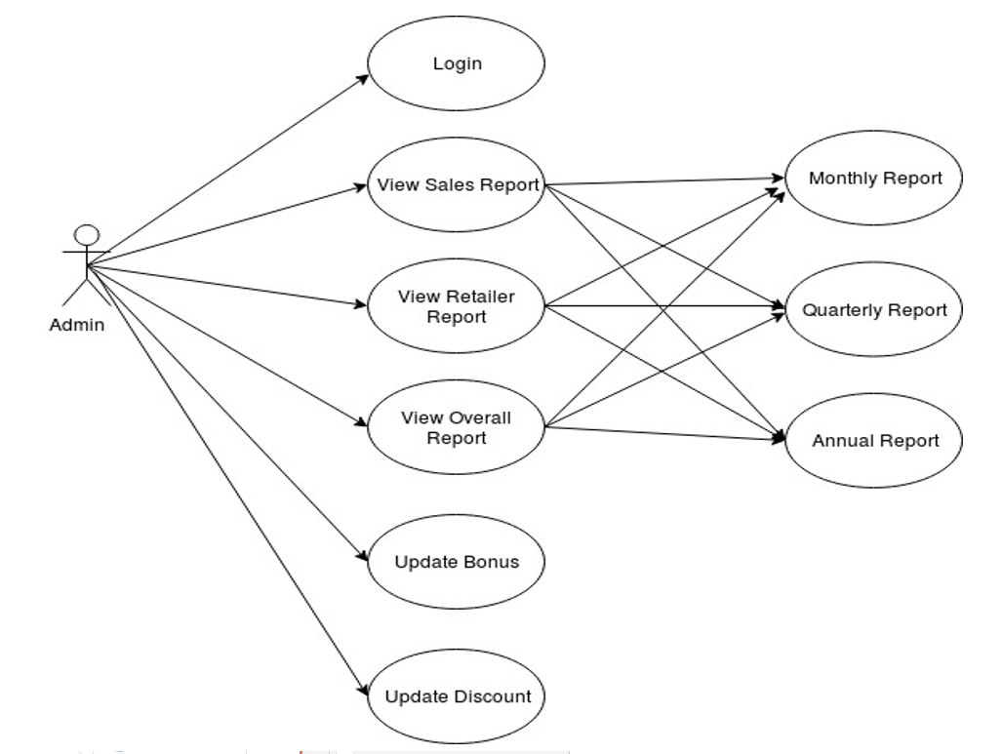
Admin:

Slide 6
Epic : Retailer working on addresses
User Story
Retailer should be able to Add addresses.
Retailer should be able to Update address.
Retailer should be able to view all addresses.
Retailer should be able to Delete addresses.

Slide 7
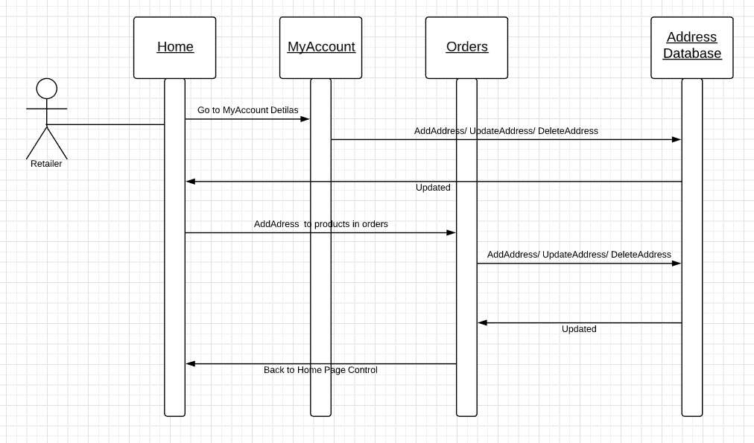
Address Sequence Diagram

Slide 8
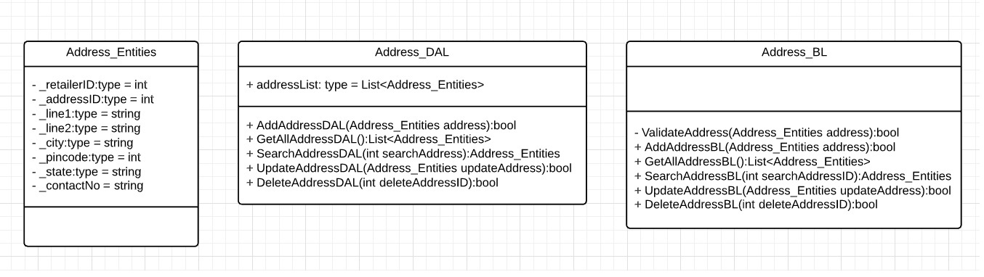
Address Class Diagram

Slide 9
Epic: Admin working on discounts
User Story
Admin should be able to Add Discount.
Admin should be able to Update Discount.
Admin should be able to view all Discount.
Admin should be able to Delete Discount.

Slide 10
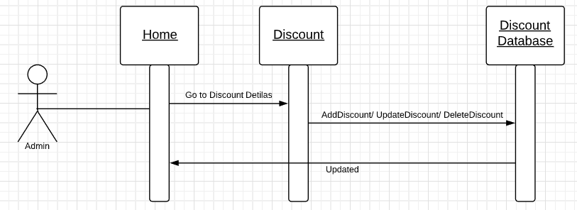
Discount Sequence Diagram

Slide 11
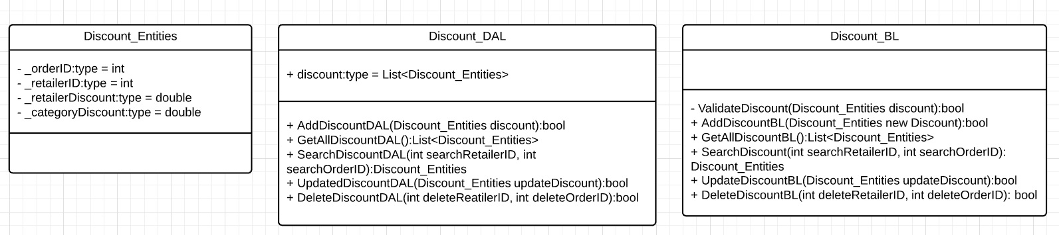
Discount Class Diagram

