Slide 1
GREAT OUTDOORS
Madhuri Vemulapaty
Group A

Slide 2
TEAM A
Madhuri Vemulapaty
Ankush Agrawal
Shreyash Pandey
Sourav Maji
Sarthak Lav

Slide 3
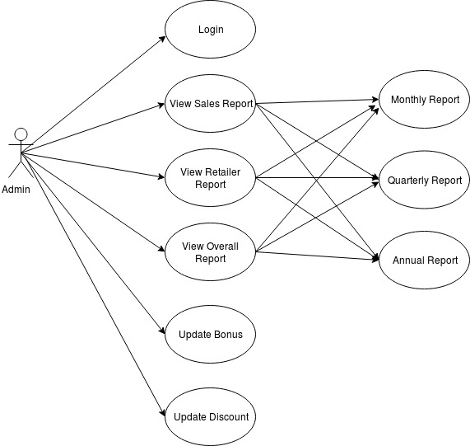
Use Case Diagram - Admin

Slide 4
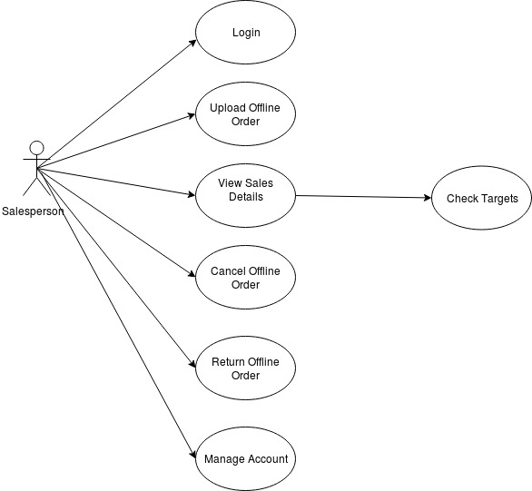
Use Case Diagram – Salesperson

Slide 5
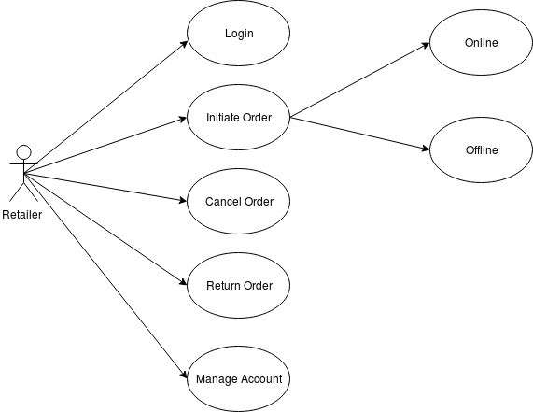
Use Case Diagram - Retailer

Slide 6
EPIC – Salesman should accept offline orders
User Stories:
Salesman should be able to view a list of active offline orders
Salesman should be able to select an order for visit.
Salesman should be able to confirm order after visit and modify the order details if required.
Salesman should be able to confirm the final order.

Slide 7
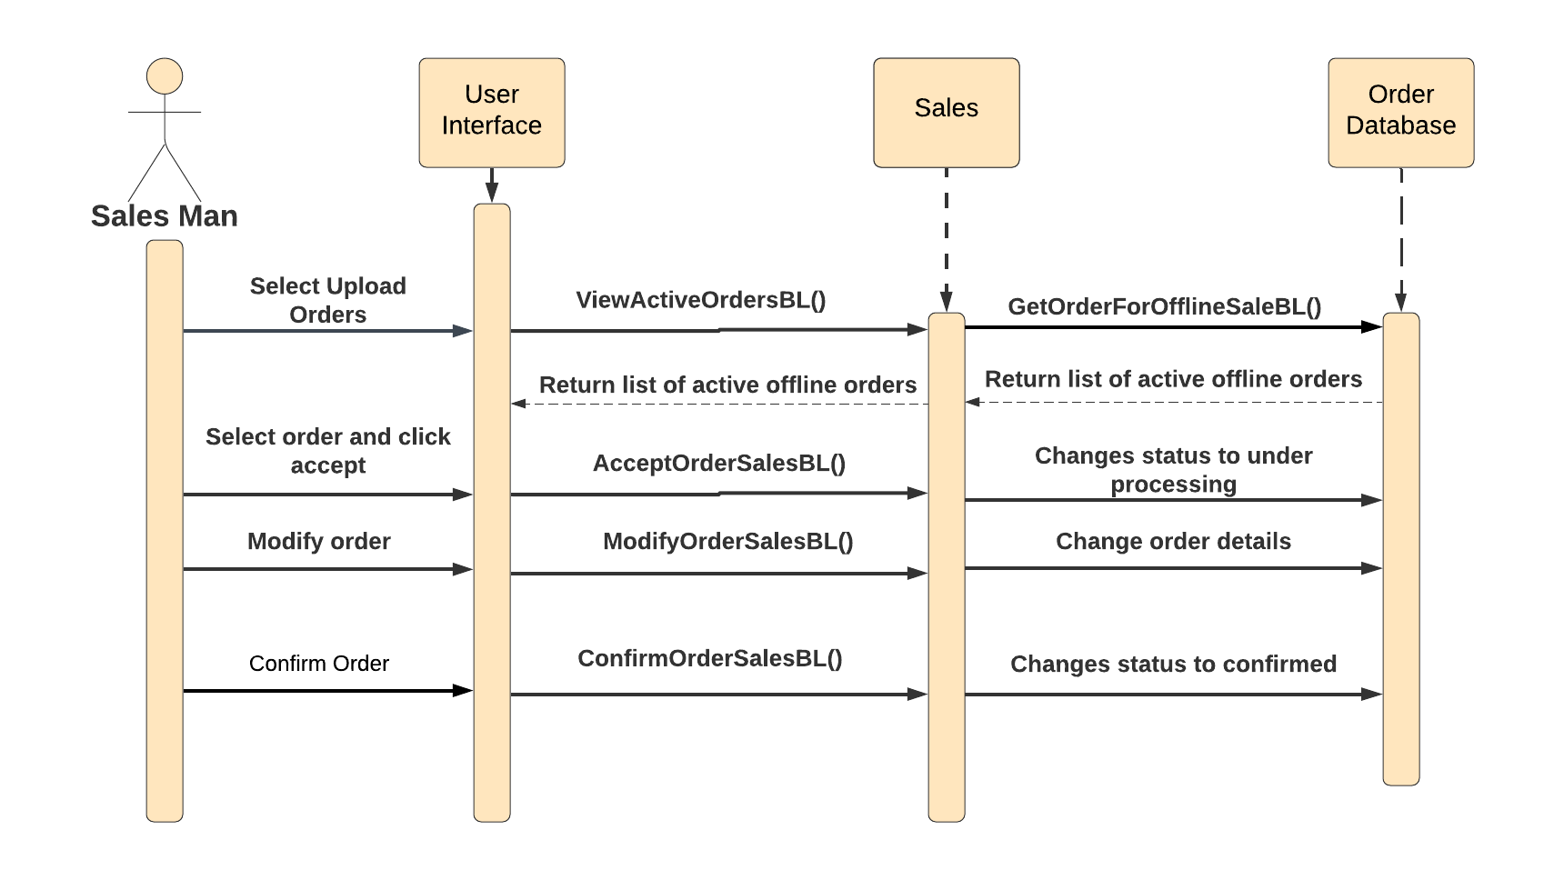
Sequence Diagram for Salesman to accept offline orders

Slide 8
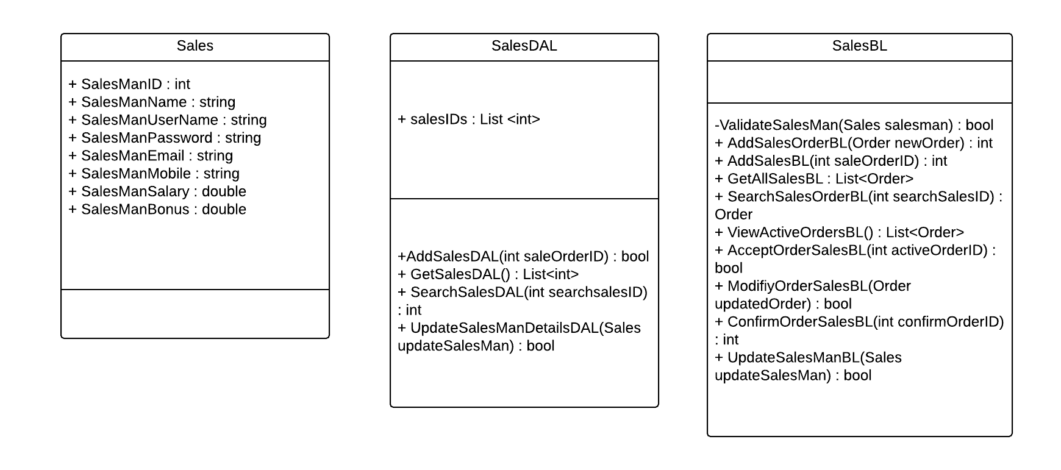
Class Diagram - Sales

Slide 9
EPIC – Salesman should upload offline orders
User Stories:
Salesman should be able to upload order details like product ID, name and quantity along with discount and total price.
Salesman should be able to update his sales list using the order ID from the previous task.
Salesman should be able to view uploaded sales.

Slide 10
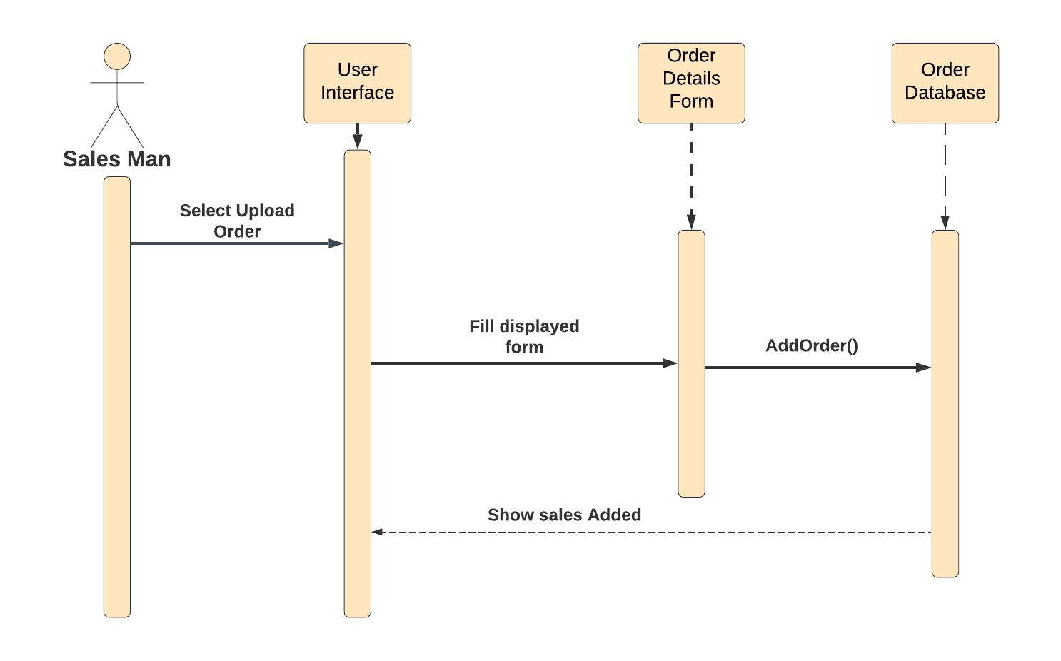
Sequence Diagram for Salesman to upload offline orders

Slide 11
Thank you

