Slide 1
Work Breakdown Structure (WBS)
1. Planning
1.1 Project Charter
1.1.1 Draft project scope and objectives
1.1.2 Identify stakeholders and team roles
1.1.3 Approve budget and timeline
1.2 Requirements Document
1.2.1 Gather user stories (e.g., activity tracking, social sharing)
1.2.2 Define technical requirements (iOS/Android compatibility)
1.2.3 Finalize requirements with stakeholder sign-off
2. Design
2.1 UI/UX Design
2.1.1 Create wireframes for 5 core screens
2.1.2 Design mockups
2.1.3 Finalize color scheme and typography
2.2 System Architecture
2.2.1 Design database schema (user data, activity logs)
2.2.2 Map API endpoints (Google Fit/Apple Health sync)
2.2.3 Validate architecture with DevOps team
3. Development
3.1 Backend Development
3.1.1 Set up AWS cloud server and MongoDB database
3.1.2 Develop OAuth user authentication
3.1.3 Build API endpoints for activity tracking
3.2 Frontend Development
3.2.1 Code activity tracking interface
3.2.2 Implement social sharing features
3.2.3 Integrate backend APIs with frontend
4. Testing
4.1 QA Testing
4.1.1 Unit testing for authentication module
4.1.2 Integration testing for APIs
4.1.3 Stress testing server infrastructure
4.2 User Testing
4.2.1 Find testers
4.2.2 Collect UI/UX feedback and bug reports
4.2.3 Prioritize critical bugs for fixes
5. Deployment
5.1 App Store Submission
5.1.1 Prepare metadata (descriptions, screenshots)
5.1.2 Submit to Apple App Store and Google Play
5.1.3 Address review feedback
6. Post-Launch
6.1 Monitoring & Updates
6.1.1 Track user feedback via Firebase
6.1.2 Release v1.1 bug-fix patch
6.1.3 Plan feature updates (e.g., sleep tracking)
In the Work Breakdown Structure (WBS), tasks were grouped into phases: Planning, Design, Development, Testing, Deployment, and Post-Launch, to create a clear and logical workflow. Tasks were organized based on dependencies, such as completing wireframes before mockups or backend setup before API integration, to simulate real-world project management.
For this hypothetical project, I assumed resource availability to handle overlapping tasks when needed. Key deliverables included completed designs, functional APIs, and a ready-to-launch app, with milestones like finalizing requirements, completing testing, and app submission to track progress effectively. This structure ensured tasks aligned with project goals and maintained a smooth flow.

Slide 2
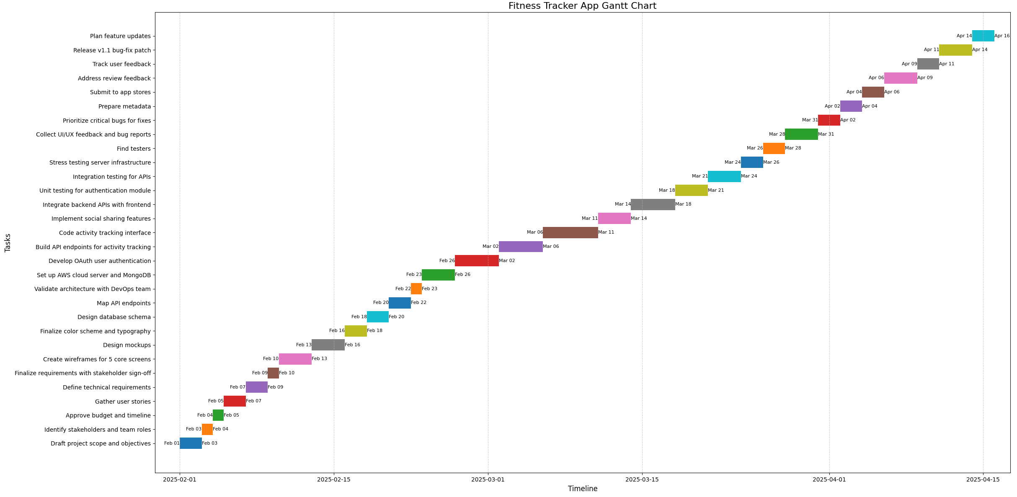
Gantt Chart Fitness Tracking App Timeline
I was able to organize the project tasks for this hypothetical application project using a Kanban board and Gantt chart, which helped me simulate timelines, progress, and task dependencies. Key tasks, like "Design Mockups," were prioritized based on their importance and reliance on earlier tasks, such as "Wireframes." I also identified potential delays, such as stakeholder approvals, to show how these could affect progress in a real project.
Resource constraints, like limited team availability for specialized tasks such as API development, were simulated to reflect real-world challenges. To address this, I prioritized critical tasks, like backend development and design, to keep the simulated project on track. I also accounted for tasks with external dependencies, like app store submissions, and built in enough time to avoid delays. This approach demonstrated how to effectively manage workload and maintain steady progress in a project environment.

Slide 3
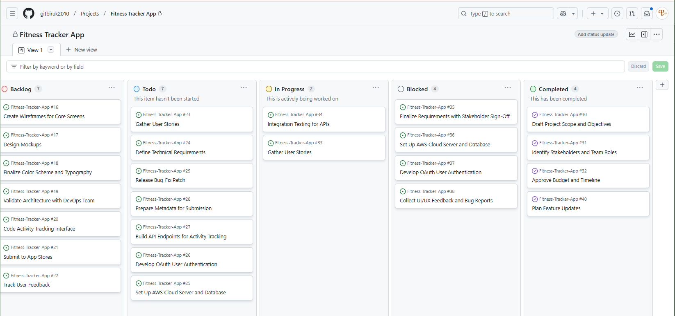
Fitness Tracker App Project Kanban Board
A Kanban board shows all the work in a project and where it stands. It organizes tasks into columns like Backlog, To-Do, In Progress, Blocked, and Completed, so we can quickly see what needs to be done, what is being worked on, and what is completed. It also helps us spot problems, like tasks that are stuck or taking too long, and ensures everyone knows the progress of the project. This makes it easy to manage work, focus on priorities, and keep things moving smoothly.

