Slide 1
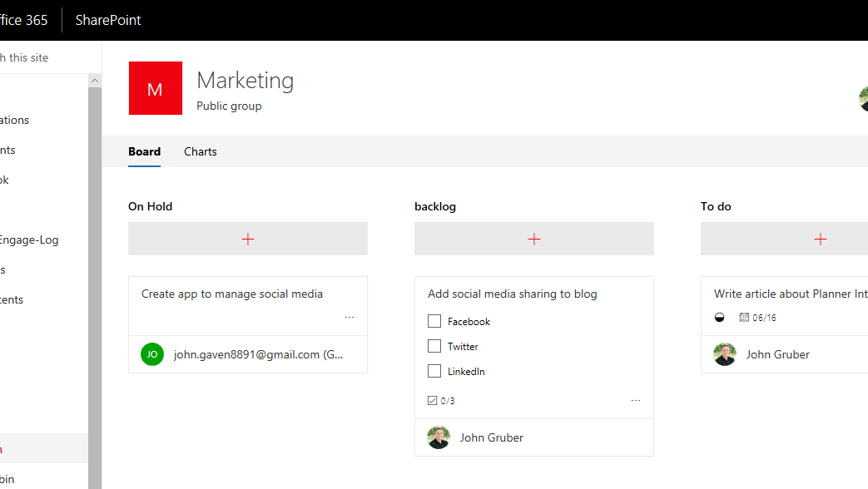

SharePoint + Planner
Microsoft Rolling out new Update to Integrate SharePoint with Planner

