Slide 1
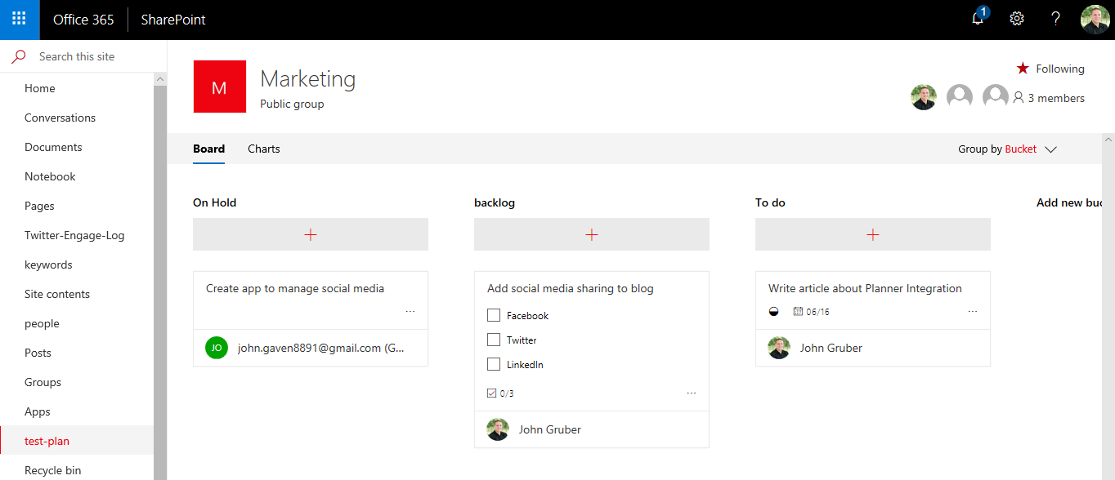

SharePoint + Planner
Microsoft Rolling out SharePoint/Planner Integration

