Slide 1
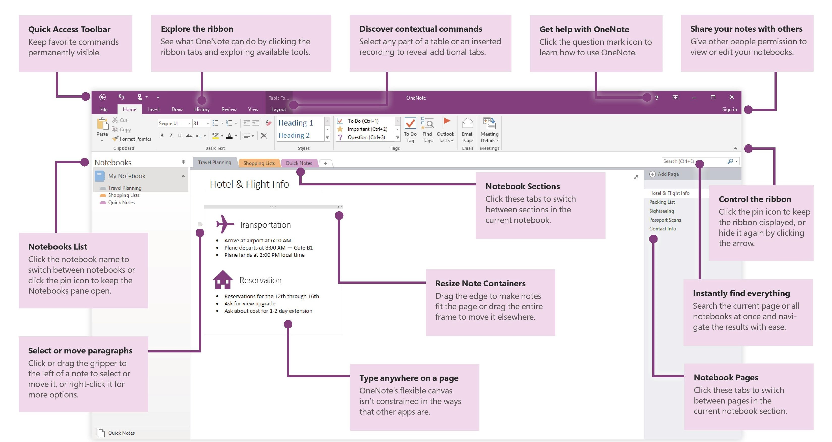

11 Tips for Improving Productivity using OneNote

