Slide 1


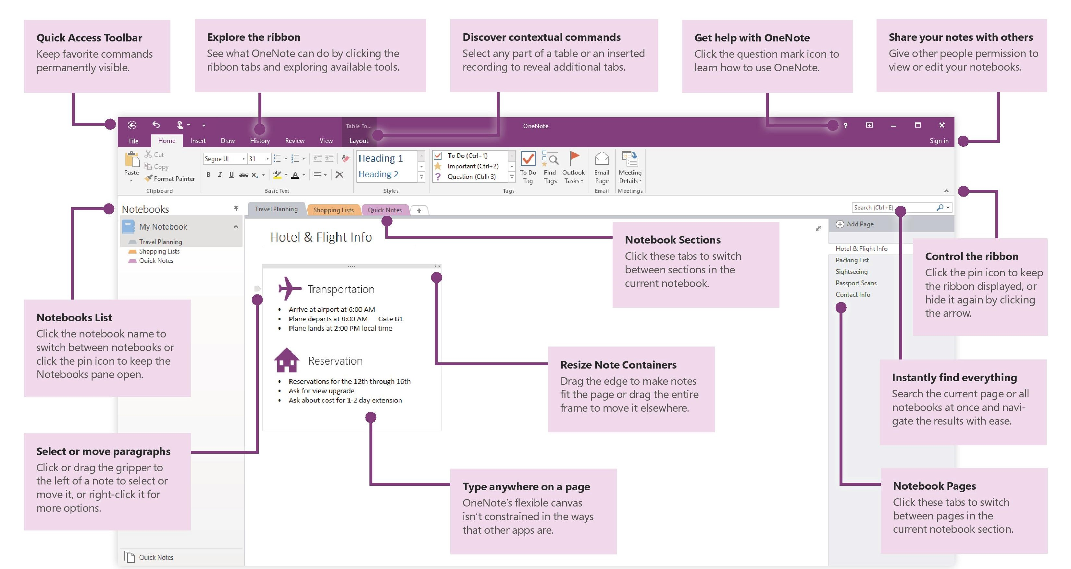
11 Tips for Improving Productivity using OneNote

