Slide 1
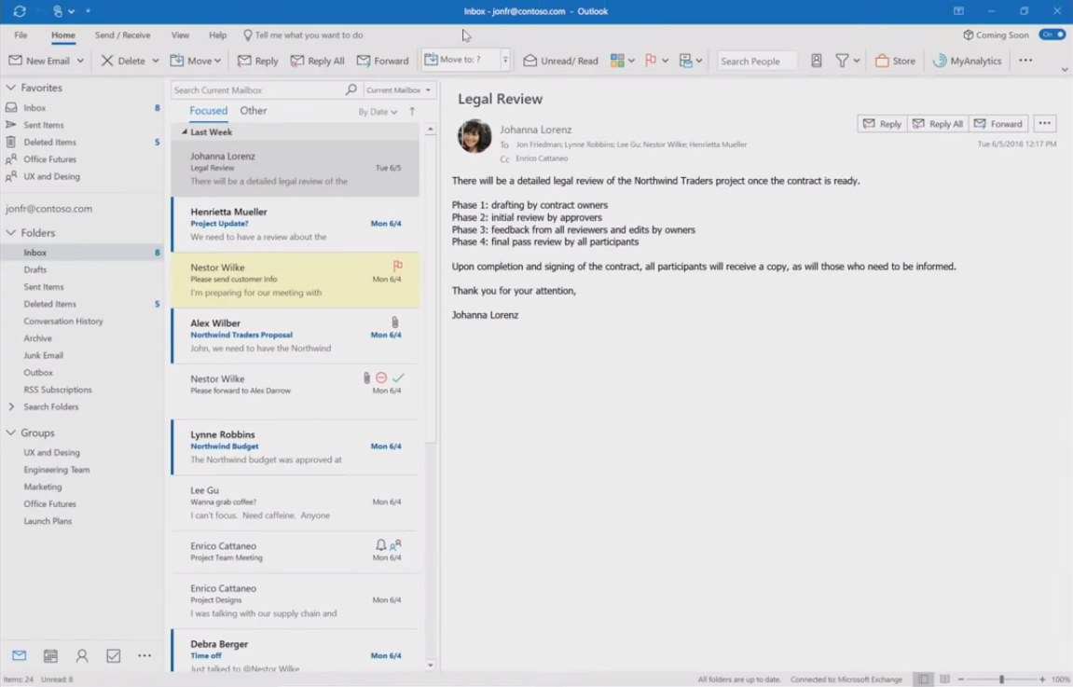

Microsoft Office is getting a new look. The updates are part of Microsoft’s new Fluent UI design.

