Slide 1
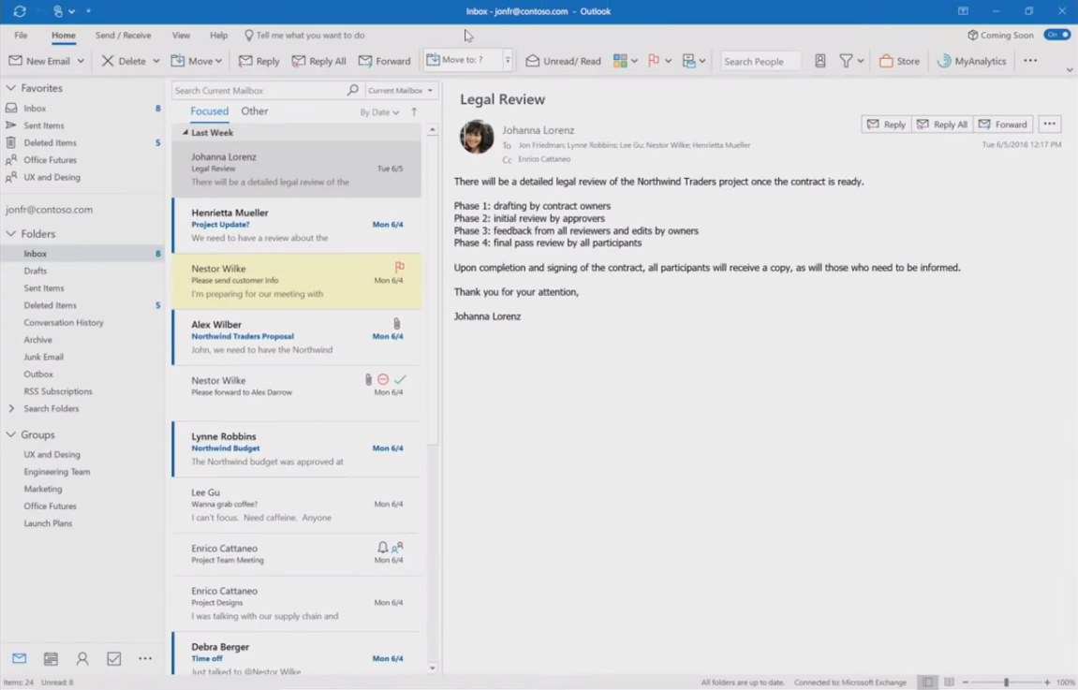

First Look at New Office Suite

