Slide 1
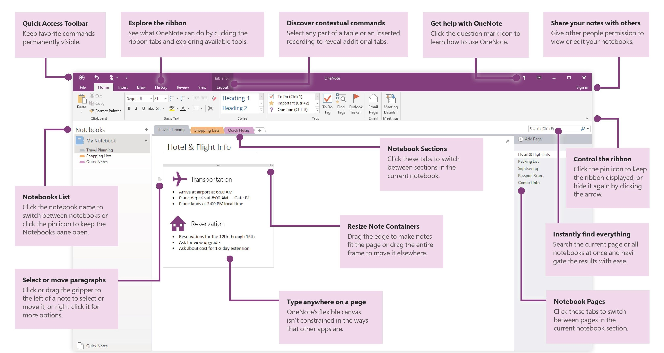


12 Tips for Improving Productivity using OneNote

