Slide 1
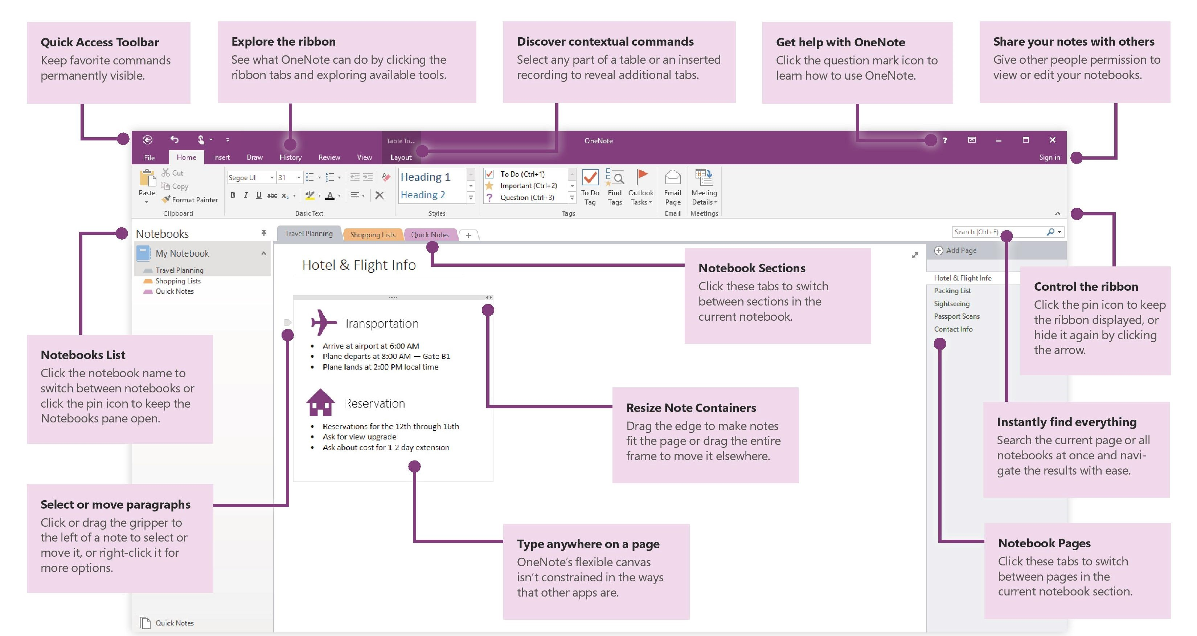

12 Tips for Improving Productivity using OneNote

