Slide 1

Sales Performance EDA Project
• Python EDA:
Tools Used: Python (Pandas, NumPy, Matplotlib, Seaborn), Jupyter Notebook.
• Power BI:
Power BI (KPIs, slicers, charts), GitHub, PowerPoint.

Slide 2
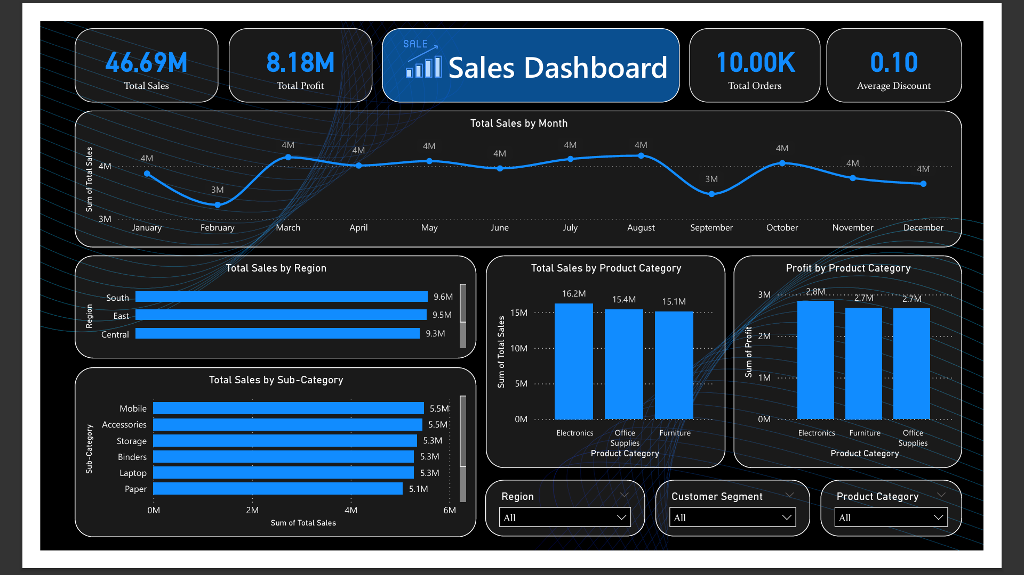
Power BI — Sales Dashboard

Slide 3
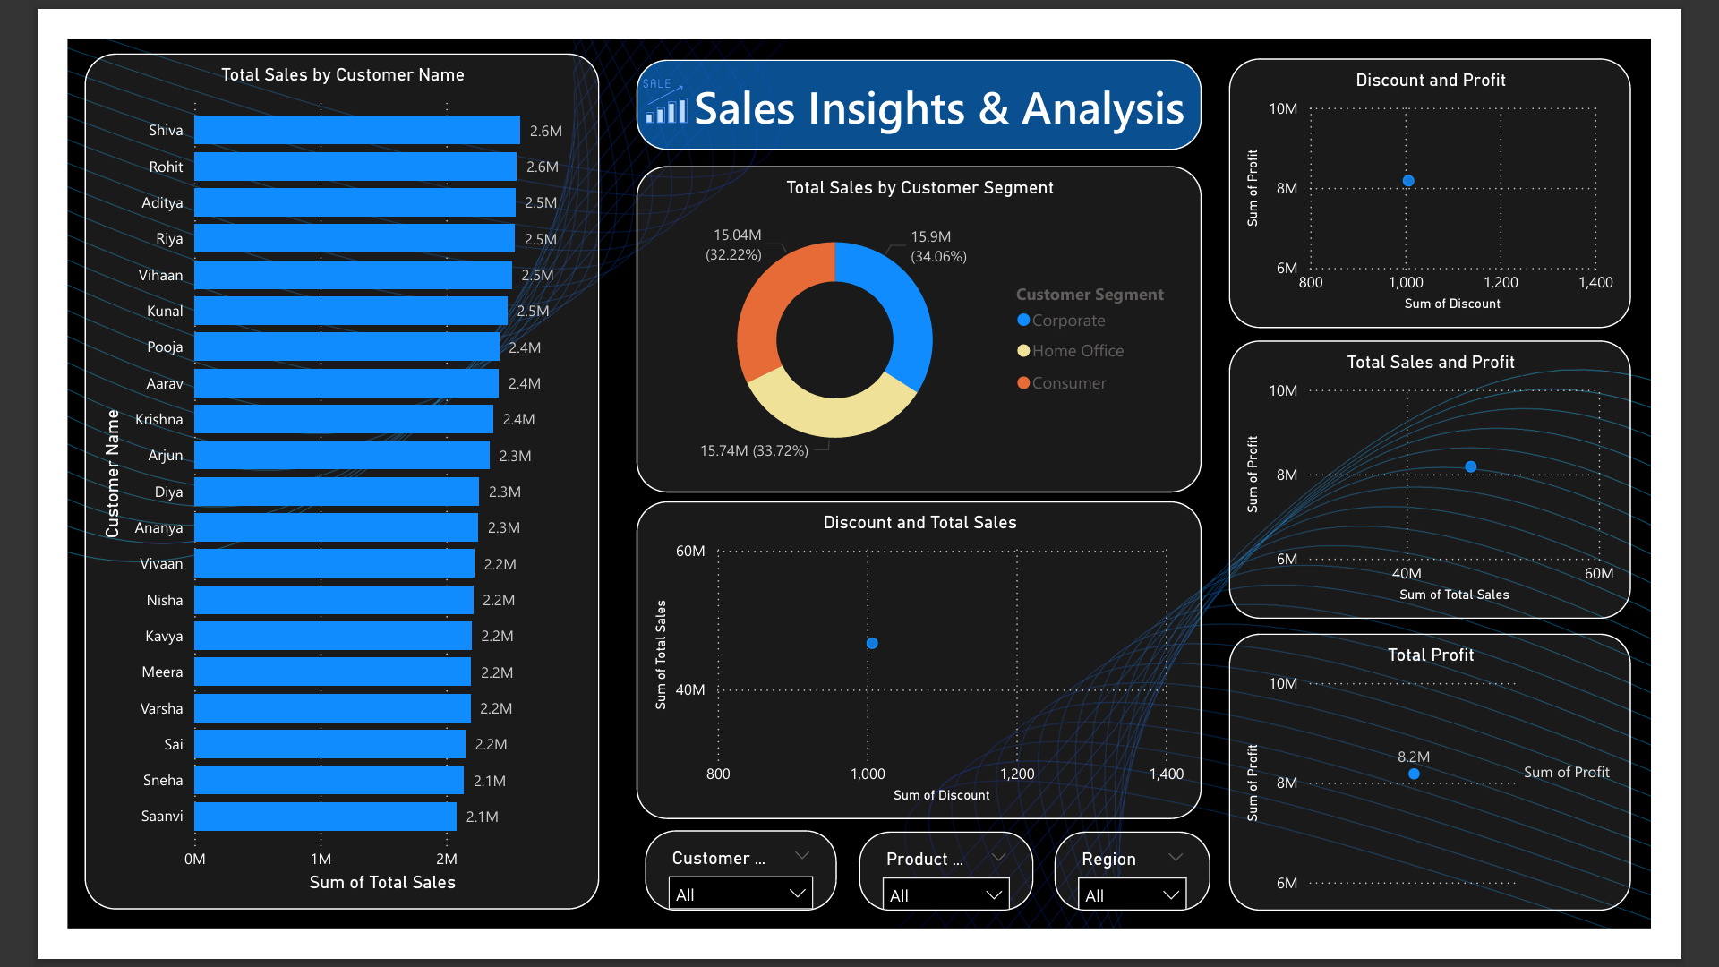
Power BI — Insights & Analysis

Slide 4
Key Insights Summary
• Electronics is the top-performing category
• Consumer segment contributes maximum revenue
• South & East regions dominate sales performance
• Higher discounts boost sales but reduce profits
• Profit spikes observed in March, July, November

Slide 5
Thank You
Project by: S Bharath Kumar

