Slide 1

GALLSTONE ULTRASOUND DATASET
Data Preprocessing Pipeline
How a messy, multi-hospital collection of ultrasound scans was cleaned, de-identified, and labeled into one training-ready dataset.

Slide 2
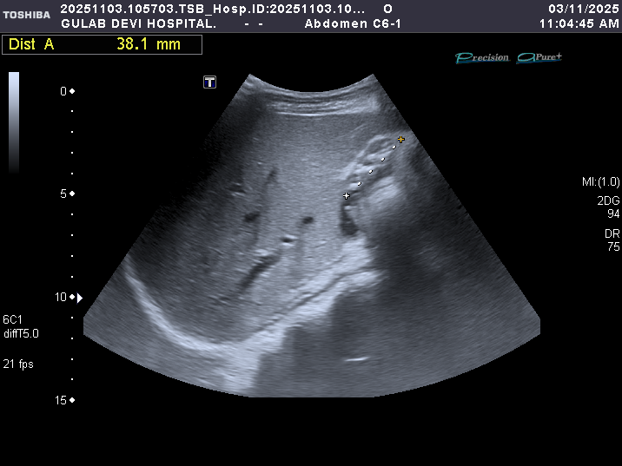
DATA SOURCE 1 OF 2
Gulab Devi Hospital
Images were organized by date and by patient — not by diagnosis.
The folders contain a mix of single-pane and dual-pane ultrasound images.
Example scan — Gulab Devi dataset
GALLSTONE ULTRASOUND DATASET
02 / 45

Slide 3
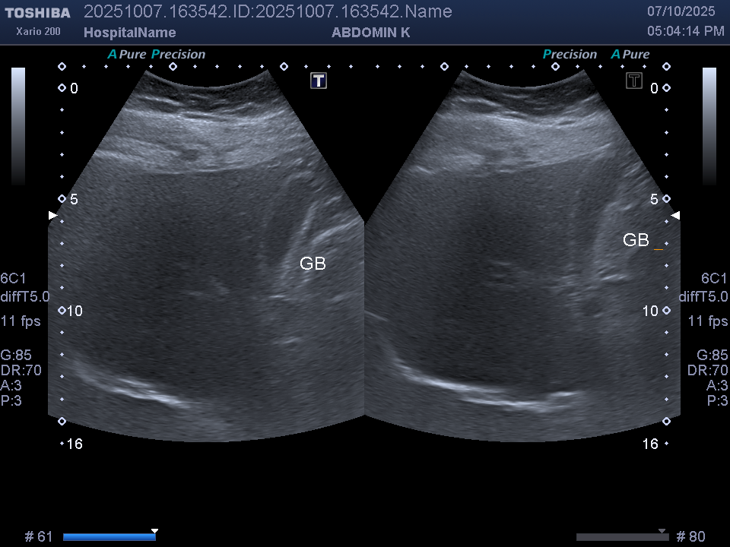
DATA SOURCE 2 OF 2
Chughtai Lab
Already sorted by diagnosis into two folders: "GB Normal" and "GB Stones".
This machine always outputs dual-pane images.
Example scan — Chughtai dataset
GALLSTONE ULTRASOUND DATASET
03 / 45

Slide 4



BEFORE CLEANING
Three Problems With the Raw Data
Wrong Organs
Burned-In Identifiers
Inconsistent Files
Images covered kidney, liver, spleen, bladder, and gallbladder. Only a minority actually show a gallbladder — the rest are unusable.
Every image had patient information and caliper markings burned directly into the pixels.
Raw BMP and TIFF files at inconsistent sizes, with no consistent naming.
GALLSTONE ULTRASOUND DATASET
04 / 45

Slide 5


GETTING TO GROUND TRUTH
The Labelling Problem
Chughtai Lab
Gulab Devi
Already sorted into "Gallbladder Stones" and "Normal" folders.
No additional labelling work was required.
Folders carried no diagnosis on their own.
Most held a phone photo of the typed radiology report — used to confirm the finding.
No report photo → labeled "unknown" and excluded, unless the folder name itself was explicit (e.g. "normal gb").
52 report photos in the index — evidence behind the labels, not training data.
7 patients still have no confirmed diagnosis and remain unresolved.
GALLSTONE ULTRASOUND DATASET
05 / 45

Slide 6
SINGLE SOURCE OF TRUTH
The Metadata Manifest
Before a single image was preprocessed, everything was catalogued into one CSV file — one row per image, 15 columns. Nothing reads the image folders directly; every script reads this manifest.
290
238
194
136
Total rows in the manifest
Ultrasound images catalogued
Usable for stones-vs-normal training
Unique patients represented
GALLSTONE ULTRASOUND DATASET
06 / 45

Slide 7
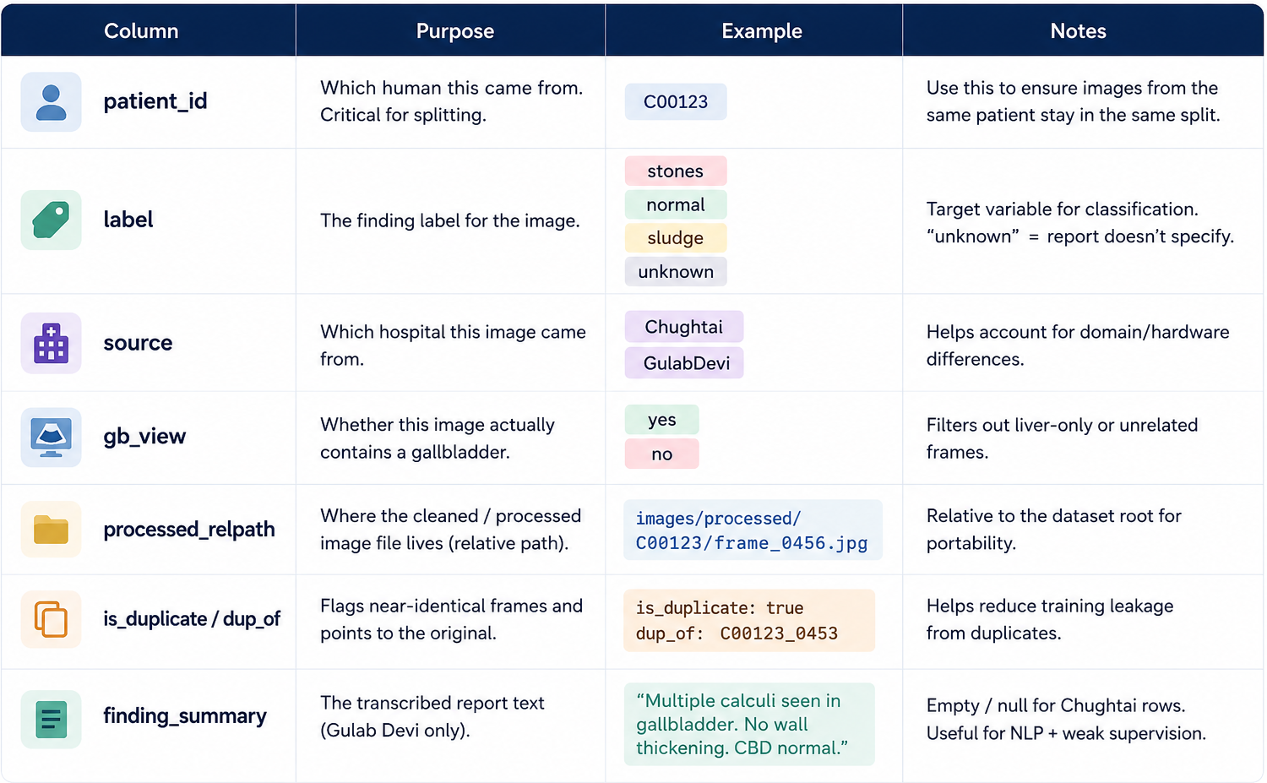
DATA DICTIONARY
What's Inside the Manifest
GALLSTONE ULTRASOUND DATASET
07 / 45

Slide 8


STAGE 0 · STEP 1 OF 3
Removing Non-Gallbladder Images
Chughtai
Gulab Devi
Straightforward — the organ name is printed directly on the image.
No printed label — each frame was identified by anatomy instead.
GALLSTONE ULTRASOUND DATASET
08 / 45

Slide 9



STAGE 0 · STEP 2 OF 3
Finding and Cropping the Scan Fan
Every image had identifying text burned in. Here is how the ultrasound fan was isolated:
Threshold the image
Convert to grayscale and threshold, separating bright pixels from the dark background.
1
Clean up speckle
Apply a morphological open, then a close, to remove small speckle noise.
2
Find the fan
Locate the largest connected blob — this is the ultrasound fan itself.
3
Crop tightly
Crop the image tightly to that blob's bounding box.
4
GALLSTONE ULTRASOUND DATASET
09 / 45

Slide 10
STAGE 0 · STEP 3 OF 3
Cropping Removes the Identifiers
The patient name and MRN sit in the black margin outside the fan — cropping to the fan removes them automatically.
For dual-pane Chughtai images, the right half was isolated first, since the gallbladder consistently sits in the right pane on their machine.
Output: one PNG per gallbladder frame, saved to the processed/ folder.
GALLSTONE ULTRASOUND DATASET
10 / 45

Slide 11
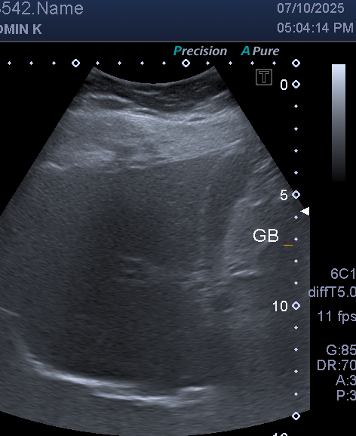
RESULT · STAGE 0
Before & After: Fan Cropping
BEFORE
AFTER
GALLSTONE ULTRASOUND DATASET
11 / 45

Slide 12

DATA QUALITY
Handling Near-Duplicate Frames
The Problem
Frames of the same patient taken a few seconds apart can end up in both the training and testing sets, causing the model to overfit on that patient.
The Method
Each image gets a 64-bit fingerprint: it's shrunk to 32×32, transformed to capture its rough light-and-dark structure, and reduced to 64 yes/no bits. Two images are called near-identical if their fingerprints differ by 6 bits or fewer.
The Policy
Flagged, not deleted. Duplicates are kept for training only — never used for validation or testing.
GALLSTONE ULTRASOUND DATASET
12 / 45

Slide 13
STAGE 1
Removing the Chughtai Text Strips
Every Chughtai image kept two bands of burned-in text that survived the fan crop:
~14%
~20%
of image HEIGHT
of image WIDTH
Top Strip
Right Strip
Partial patient name, timestamp, and machine mode.
Depth scale numbers, the organ label "GB", frame rate, gain, and probe settings.
Both strips were removed from every Chughtai image.
GALLSTONE ULTRASOUND DATASET
13 / 45

Slide 14
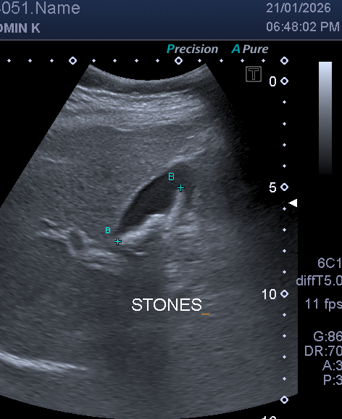
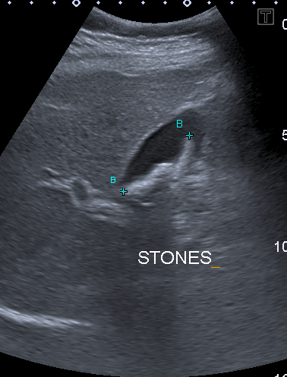
RESULT · STAGE 1
Before & After: Text Strip Removal
BEFORE
AFTER
GALLSTONE ULTRASOUND DATASET
14 / 45

Slide 15

STAGE 2
Erasing the Calipers
Calipers sit inside the fan, so cropping alone can't remove them. Instead:
Find the markers
Threshold in HSV colour space to find both white markers (high brightness, low saturation) and coloured marker lines (high saturation).
1
Filter out anatomy
Discard any blob larger than 300 pixels, since those are anatomy rather than annotation.
2
Widen the mask
Dilate the mask slightly so marker edges are fully covered.
3
Inpaint the gaps
Run OpenCV TELEA inpainting, which reconstructs the covered pixels by extrapolating inward from the surrounding texture.
4
GALLSTONE ULTRASOUND DATASET
15 / 45

Slide 16
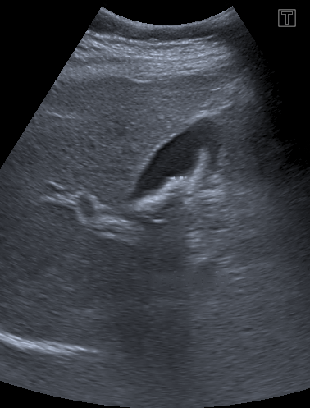
RESULT · STAGE 2
Before & After: Caliper Removal
BEFORE
AFTER
GALLSTONE ULTRASOUND DATASET
16 / 45

Slide 17


STAGE 3 · FINAL PASS
Fan Masking
What it does
How it was built
Everything outside the ultrasound dome is blacked out entirely — removing, in one move, any remaining corner markers, stray depth digits, dot rows, and machine artifacts hiding at the edges.
One representative image per unique pixel size was exported. All 28 polygons were hand-drawn in VGG Image Annotator, then converted into reusable mask files keyed by image dimensions.
GALLSTONE ULTRASOUND DATASET
17 / 45

Slide 18
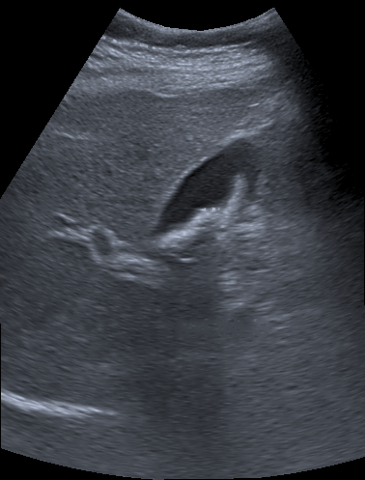
RESULT · STAGE 3 · FINAL
Before & After: Fan Masking
BEFORE
AFTER
GALLSTONE ULTRASOUND DATASET
18 / 45

Slide 19
PREPROCESSING · STEP 1 OF 3
Every Image a Different Size
Cropping to the fan gave every frame its own dimensions. The model needs them all identical, and the two hospitals do not even agree on orientation.
28
472 x 577
533 x 364
distinct image sizes
Chughtai — portrait
Gulab Devi — landscape
Each fan crop produced its own bounding box, so almost no two frames match.
Taller than wide. Dual-pane machine, cropped to the right pane.
Wider than tall. The opposite problem, same dataset.
THE FIX, APPLIED IDENTICALLY TO TRAIN, VALIDATION AND TEST
Pad the shorter side with black to make a square → resize to 224 x 224 → convert to tensor (0-255 becomes 0.0-1.0) → normalize with ImageNet statistics
GALLSTONE ULTRASOUND DATASET
19 / 45

Slide 20
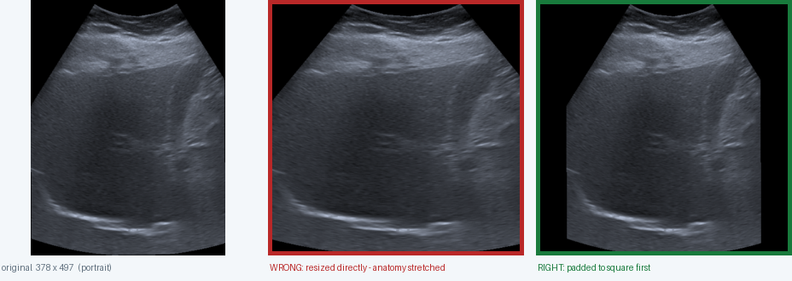
PREPROCESSING · STEP 2 OF 3
Why Padding Comes First
Resizing a portrait image straight into a square stretches the anatomy. A round gallbladder becomes an oval and the acoustic shadow tilts, distorting the exact cues the model reads.
Black padding is safe here: the fan crops already have black edges, so nothing unfamiliar is introduced. After padding, the resize scales both axes equally and proportions survive.
GALLSTONE ULTRASOUND DATASET
20 / 45

Slide 21
PREPROCESSING · STEP 3 OF 3
Three Deliberate Design Decisions
Each exists to protect the pretrained weights we are borrowing.
1
2
3
224 x 224
Keep 3 channels
ImageNet statistics
The size pretrained models expect
Do not convert to grayscale
mean .485 .456 .406 / std .229 .224 .225
ResNet, EfficientNet and DINOv2 were all trained at this resolution. Anything else forces the network to relearn its spatial weights from scratch, defeating the point of starting pretrained.
Converting to one channel means reinitialising the first convolutional layer, which holds the universal edge and texture detectors, then relearning it from 194 frames.
Measurements of the photographs the backbone originally learned from. Feeding data on the same scale keeps activations in the range every downstream weight expects.
GALLSTONE ULTRASOUND DATASET
21 / 45

Slide 22
AUGMENTATION · 1 OF 10
Why We Augment At All
194 images is very few. Augmentation shows the model the same scan under conditions that genuinely vary in real scanning, so it learns the anatomy rather than one fixed picture of it. Applied to training images only, never to validation or test.
Horizontal flip
Rotation up to 10°
Probe placement genuinely varies left to right
Small probe angle variation between sonographers
Random crop and resize
Brightness jitter
Different framing and zoom
Gain settings differ by machine and operator
Contrast jitter
Gaussian noise
Display settings differ between departments
Meant to simulate ultrasound speckle
The next slides show each one on its own, at the strongest setting the model ever sees.
GALLSTONE ULTRASOUND DATASET
22 / 45

Slide 23
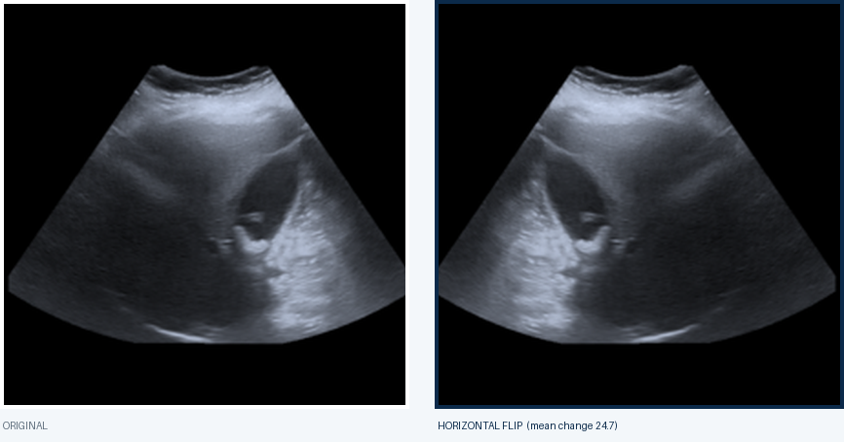
AUGMENTATION · 2 OF 10
Horizontal Flip
The strongest transform we use. A sonographer can approach the gallbladder from either side, so a mirrored scan is entirely realistic.
Anatomy is preserved, only the orientation changes. Physically valid, so it is always allowed.
GALLSTONE ULTRASOUND DATASET
23 / 45

Slide 24
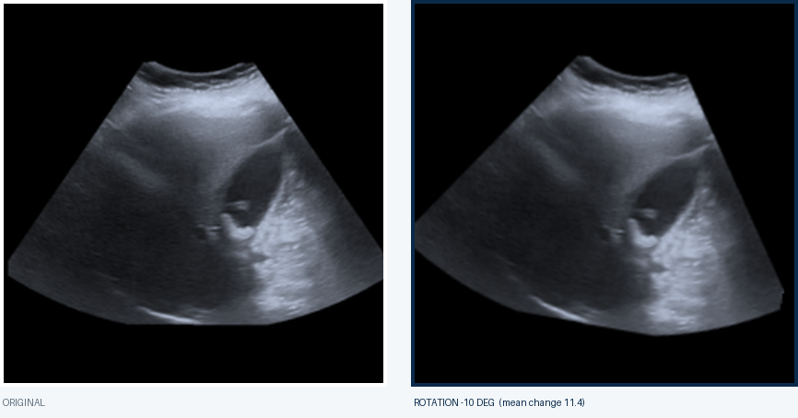
AUGMENTATION · 3 OF 10
Rotation
Up to 10 degrees either way. The probe is held by hand, so a small tilt is normal between operators and between scans.
Kept small deliberately: beyond about 15 degrees, black corners get dragged in from the fan boundary.
GALLSTONE ULTRASOUND DATASET
24 / 45

Slide 25
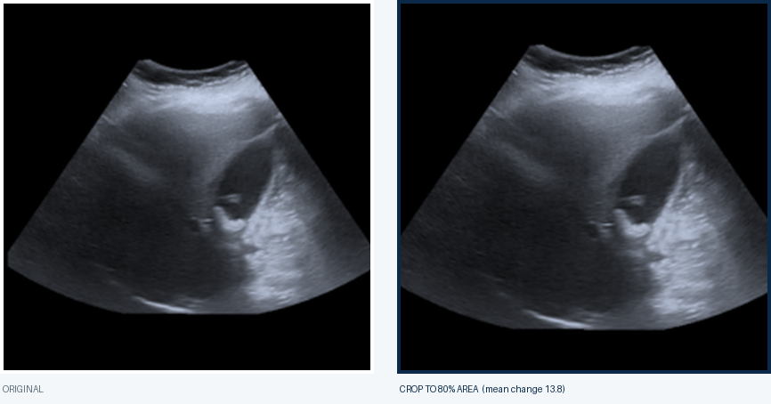
AUGMENTATION · 4 OF 10
Random Crop and Resize
Keeps between 80% and 100% of the image area, then resizes back to 224. Mimics how much of the field a sonographer chooses to capture.
Teaches the model that the gallbladder will not always sit in the same place or at the same scale.
GALLSTONE ULTRASOUND DATASET
25 / 45

Slide 26
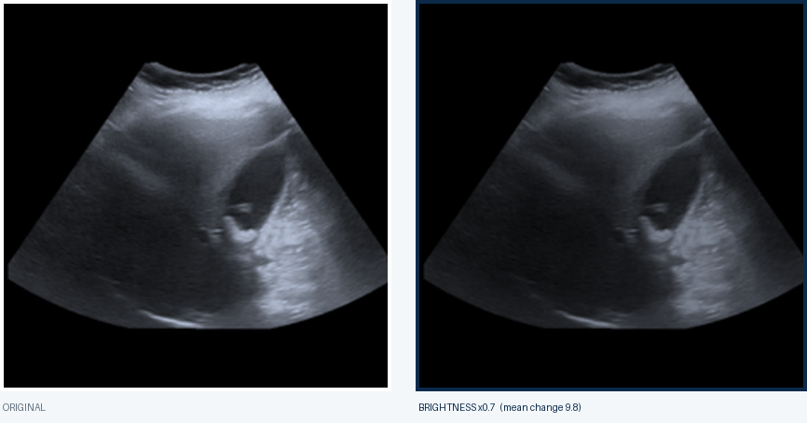
AUGMENTATION · 5 OF 10
Brightness Jitter
Scaled between 0.7x and 1.3x. Ultrasound gain is set by hand on every machine, so overall image brightness genuinely varies scan to scan.
Stops the model using overall brightness as a shortcut, since gain is an operator choice, not a finding.
GALLSTONE ULTRASOUND DATASET
26 / 45

Slide 27
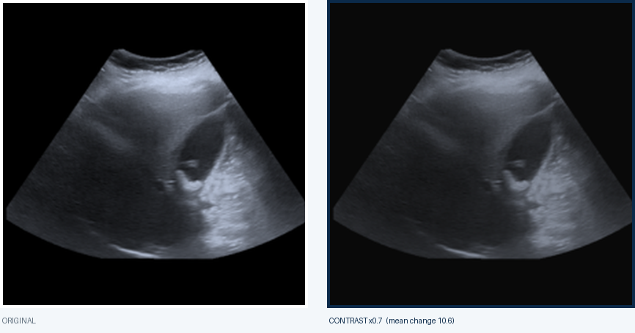
AUGMENTATION · 6 OF 10
Contrast Jitter
Also scaled between 0.7x and 1.3x. Different departments and display settings produce visibly different contrast on the same anatomy.
Reducing contrast is the stronger direction here, flattening the difference between tissue and shadow.
GALLSTONE ULTRASOUND DATASET
27 / 45

Slide 28
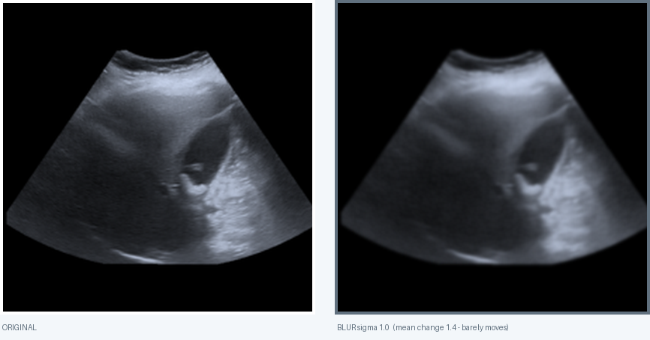
AUGMENTATION · 7 OF 10
Gaussian Blur
Sigma between 0.1 and 1.0, with a 3-pixel kernel. Intended to mimic slightly out-of-focus or lower-resolution captures.
Even at maximum strength this barely moves the image: mean change 1.4, roughly 17x weaker than a flip.
GALLSTONE ULTRASOUND DATASET
28 / 45

Slide 29

AUGMENTATION · 8 OF 10
Gaussian Noise — A Finding
Meant to simulate the speckle inherent to ultrasound. It is added AFTER normalization, so std=0.02 works out to about 1.2 pixel levels out of 255.
Effectively a no-op: mean change 0.6, the weakest transform by far. Worth testing std=0.05 or 0.1 instead.
GALLSTONE ULTRASOUND DATASET
29 / 45

Slide 30
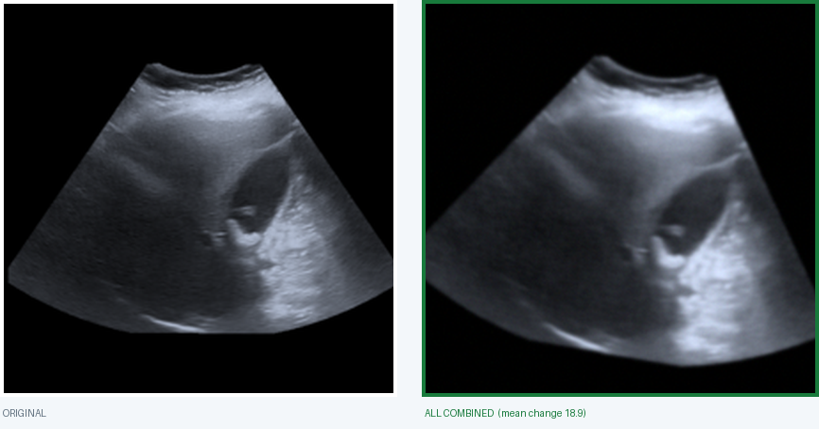
AUGMENTATION · 9 OF 10
Everything Combined
What the model actually receives during training: all transforms sampled randomly and applied together, differently on every epoch.
The same gallbladder, seen a different way each time. The anatomy survives; the incidental details do not.
GALLSTONE ULTRASOUND DATASET
30 / 45

Slide 31
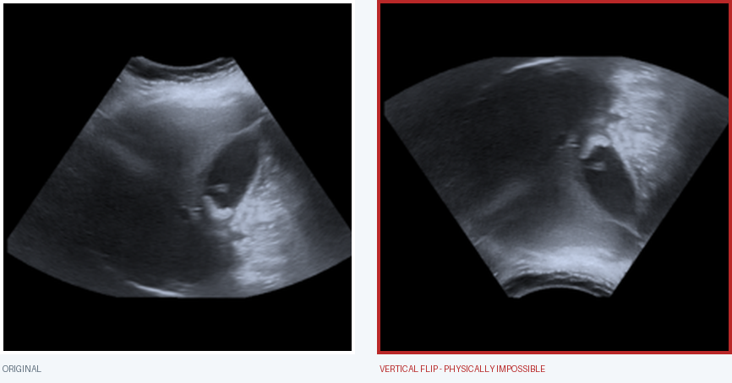
AUGMENTATION · 10 OF 10
The One Thing We Never Do
A gallstone casts an acoustic shadow: a dark cone extending BELOW it, because the stone blocks sound from travelling deeper. That shadow is a primary diagnostic cue.
Flipping vertically puts the shadow above the stone. No ultrasound machine can produce this image.
GALLSTONE ULTRASOUND DATASET
31 / 45

Slide 32
SPLITTING RULES · 1 OF 2
Split by Patient, Never by File
Two rules, both about stopping the model from scoring well for the wrong reason.
All of one patient's frames stay together
1
If a patient has four frames and three go to training while one goes to test, the model has already seen that gallbladder and the score is inflated. Fiddly in practice: some first names repeat across dates and belong to different people, so they must not be merged.
Duplicates train, but are never tested on
2
35 of the 194 frames are flagged as near-identical twins. They carry real training signal, so they stay in the training split, and are dropped from validation and test to keep the measurement clean.
Never split by filename. The unit of separation is the patient, not the image.
GALLSTONE ULTRASOUND DATASET
32 / 45

Slide 33
SPLITTING RULES · 2 OF 2
The Cross-Site Test
A second, harder split: train entirely on one hospital and test entirely on the other. This is the only split that reveals whether the model learned anatomy or simply learned to recognise hospital style. It is mandatory, not optional.
MIXED SPLIT
CROSS-SITE
AUC 0.95
AUC 0.36 – 0.47
Both hospitals appear in training and testing. Looks excellent.
Trained on one hospital, tested on the other. At or below random guessing.
WHY THE GAP MATTERS
96% of normal frames come from Chughtai and 79% of stone frames from Gulab Devi. The two machines leave different texture and grain even after every overlay is removed, so "which hospital is this" is very nearly a shortcut to the right answer. No amount of image cleaning fixes that.
GALLSTONE ULTRASOUND DATASET
33 / 45

Slide 34
MODEL SELECTION · 1 OF 5
Name Check: DINOv2, Not V-Net
Worth getting right before anything goes into a report. These are two completely different architectures that are easy to conflate, and the mistake is the kind a supervisor or reviewer will flag immediately.
WHAT WE ACTUALLY USED
WHAT IT IS NOT
DINOv2
V-Net
A self-supervised Vision Transformer from Meta, trained on 142 million unlabelled images. It produces general-purpose image features. We use it frozen, as a fixed feature extractor, for CLASSIFICATION.
A 3D fully-convolutional network in the U-Net family, built for volumetric medical image SEGMENTATION. Different task, different data shape, different training regime. Unrelated to this project.
Segmentation draws an outline around an organ. Classification answers one question about the whole image. We are doing the second, so V-Net was never a candidate.
GALLSTONE ULTRASOUND DATASET
34 / 45

Slide 35
MODEL SELECTION · 2 OF 5
One Number Decided It: 194
A model learns by adjusting parameters. If it has far more parameters than training examples, the cheapest way to reduce its error is to memorise the training set rather than learn anything general.
With 194 images, essentially every modern vision architecture is thousands of times too large.
So the question was never "which architecture is best?" It was "how do I use a big model without letting it memorise?"
1
2
3
The risk
The lever
The result
More parameters than examples means memorising is easier than learning. Test scores look perfect and mean nothing on a scan the model has not seen.
Freeze the pretrained backbone completely. It becomes a fixed function that turns an image into numbers, and only a tiny classifier trains on top of it.
385 trainable parameters against 194 images. Roughly two parameters per image, which is the size of a logistic regression.
GALLSTONE ULTRASOUND DATASET
35 / 45

Slide 36
MODEL SELECTION · 3 OF 5
The Four Options, By Free Parameters
Two were ruled out on arithmetic alone, before a single training run.
CNN trained from scratch
REJECTED
Needs 10,000+ images minimum. Would memorise 194 instantly.
trainable parameters: millions
Fully fine-tune ResNet-50 or ViT
REJECTED
Same memorisation problem, just from a better starting point.
trainable parameters: tens of millions
EfficientNet-B0, last 2 blocks unfrozen
BASELINE
A reasonable middle road. Run in full as the comparison model.
trainable parameters: ~1 million
DINOv2 frozen + linear head
CHOSEN
Backbone never changes. Only a 384-to-1 linear layer trains.
trainable parameters: 385
That last row is the whole argument.
GALLSTONE ULTRASOUND DATASET
36 / 45

Slide 37
MODEL SELECTION · 4 OF 5
What "Frozen Backbone" Actually Means
Three lines from train.py carry the entire design decision.
self.backbone = torch.hub.load("facebookresearch/dinov2", "dinov2_vits14")
self.backbone.requires_grad_(False) # 21M params, all frozen
self.head = nn.Linear(384, 1) # 385 params, the only thing that trains
THE ARITHMETIC
WHO DOES THE WORK
385 trainable parameters against 194 images is about two per image. That is the size of a logistic regression. It physically cannot memorise 194 ultrasounds.
The 21-million-parameter backbone still does all the visual work, but as a fixed function that turns an image into 384 numbers.
You are not training a vision model. You are training a tiny classifier on top of a very good, unchangeable one.
GALLSTONE ULTRASOUND DATASET
37 / 45

Slide 38
MODEL SELECTION · 5 OF 5
Why DINOv2 Won
Both models were run on identical data and the same patient-level split.
METRIC
EFFICIENTNET
DINOV2
SELF-SUPERVISED FEATURES
Mixed-split test AUC
1.000
0.952
DINOv2 learned from 142 million images with no labels, so its features describe general visual structure. An ImageNet-supervised backbone was optimised to tell dogs from cars, which shapes its features toward a goal unrelated to ultrasound.
Validation AUC plateau
0.77 - 0.79
0.88
Gulab Devi to Chughtai
0.469
0.568
Chughtai to Gulab Devi
0.325
0.396
READ THE TABLE CAREFULLY
EfficientNet's perfect 1.000 is not a win. On a 26-image test set a perfect score is what overfitting looks like, and its validation AUC never passed 0.79. DINOv2's validation curve sits ten points higher and it beat EfficientNet in both cross-site directions, because a frozen backbone cannot adapt to machine-specific texture the way unfrozen blocks can.
GALLSTONE ULTRASOUND DATASET
38 / 45

Slide 39
RESULTS · 1 OF 7
Four Runs, One Story
Every recorded run, not just the best one. The differences between them are where the useful lessons sit.
RUN — AUC-ROC
MIXED SPLIT
GD to CH
CH to GD
1a EfficientNet baseline (95 frames)
0.83
0.44
0.86
1b DINOv2 baseline (95 frames)
0.94
0.50
0.69
2 EfficientNet post-expansion
1.000
0.469
0.325
3 DINOv2 post-expansion
0.958
0.568
0.396
4 DINOv2 improved (current best)
0.952
0.475
0.358
TEST SET SIZES, IDENTICAL FOR EVERY POST-EXPANSION RUN
Mixed split: 26 images (14 stones, 12 normal). Gulab Devi to Chughtai: 95 images (16 stones, 79 normal). Chughtai to Gulab Devi: 64 images (60 stones, 4 normal).
GALLSTONE ULTRASOUND DATASET
39 / 45

Slide 40
RESULTS · 2 OF 7
Run 1: Before the Dataset Grew
The original 95 frames: 83 stones against just 12 normal, across 59 patients. A 6.9-to-1 imbalance, with a 70/15/15 patient-level split.
EFFICIENTNET
DINOV2
Mixed 0.83
Mixed 0.94
GD to CH 0.44 CH to GD 0.86 That 0.86 is the best cross-site number ever recorded here. It did not survive the expansion.
GD to CH 0.50 CH to GD 0.69 Led on the mixed split from the very first run, with a clean rising validation curve.
WHY THAT 0.86 SHOULD NOT BE TRUSTED
That split contained only 3 Chughtai stone patients. The number collapsed to 0.325 the moment real Chughtai stone data was added, which is what noise does and what a genuine capability does not. It is listed here because hiding a flattering-then-vanishing number would misrepresent how the project actually progressed.
GALLSTONE ULTRASOUND DATASET
40 / 45

Slide 41
RESULTS · 3 OF 7
Run 2: EfficientNet, Expanded Data
194 frames, 136 patients. Two phases: 30 epochs frozen, then 15 epochs with the last two blocks unfrozen at lr=1e-4.
METRIC
MIXED SPLIT
GD to CH
CH to GD
AUC-ROC
1.0000
0.4691
0.3250
Sensitivity
0.6429
0.0000
0.0000
Specificity
1.0000
0.9114
1.0000
Spec at Sens >= 0.90
1.0000
0.0633
0.2500
F1
0.7826
0.0000
0.0000
Accuracy
0.8077
0.7579
0.0625
THE PERFECT SCORE IS THE PROBLEM, NOT THE ACHIEVEMENT
On 26 test images, 1.000 is what overfitting looks like. Validation AUC never left 0.77 to 0.79. Cross-site sensitivity is exactly 0.000 in both directions: it never called a single stone case correctly on an unseen hospital.
GALLSTONE ULTRASOUND DATASET
41 / 45

Slide 42
RESULTS · 4 OF 7
Run 3: DINOv2, Expanded Data
Same data and split. Frozen backbone, 30 epochs, no fine-tuning phase.
METRIC
MIXED SPLIT
GD to CH
CH to GD
AUC-ROC
0.9583
0.5676
0.3958
Sensitivity
0.2857
0.7500
0.2167
Specificity
1.0000
0.4177
0.7500
Spec at Sens >= 0.90
0.9167
0.0886
0.0000
F1
0.4444
0.3243
0.3514
Accuracy
0.6154
0.4737
0.2500
SENSITIVITY 0.286 WAS A RED HERRING
Only 4 of 14 stones caught at threshold 0.5, yet Spec at Sens>=0.90 is 0.917: at some other threshold the model catches 90% of stones and still clears 92% of normals. The information was there. The threshold was wrong, and so was a stale class weight left over from the old dataset.
GALLSTONE ULTRASOUND DATASET
42 / 45

Slide 43
RESULTS · 5 OF 7
Run 4: DINOv2 Improved, Current Best
Every metric, at both the default threshold and the one chosen from validation data.
METRIC
MIXED SPLIT
GD to CH
CH to GD
AUC-ROC
0.9524
0.4747
0.3583
Sensitivity at 0.50
0.7857
0.8750
0.7833
Specificity at 0.50
1.0000
0.1646
0.0000
Spec at Sens >= 0.90
1.0000
0.0633
0.0000
F1 at 0.50
0.8800
0.2917
0.8468
Accuracy at 0.50
0.8846
0.2842
0.7344
Optimal threshold
0.2344
0.2863
0.4391
Sensitivity at opt
0.9286
1.0000
0.8500
Specificity at opt
0.5000
0.0506
0.0000
F1 at opt
0.7879
0.2991
0.8870
Accuracy at opt
0.7308
0.2105
0.7969
Correcting one stale class weight lifted mixed sensitivity from 0.286 to 0.786, with no change to the data or the architecture. It was the largest single gain in the project.
GALLSTONE ULTRASOUND DATASET
43 / 45

Slide 44
RESULTS · 6 OF 7
Accuracy, Split by Class
A single accuracy figure hides which class the model is failing. Split it apart and the picture changes completely. Accuracy on stones IS sensitivity; accuracy on normals IS specificity.
AT THE DEFAULT THRESHOLD OF 0.50
STONES CAUGHT
NORMALS CLEARED
OVERALL
Mixed split
11 of 14 = 78.6%
12 of 12 = 100.0%
23 of 26 = 88.5%
Gulab Devi to Chughtai
14 of 16 = 87.5%
13 of 79 = 16.5%
27 of 95 = 28.4%
Chughtai to Gulab Devi
47 of 60 = 78.3%
0 of 4 = 0.0%
47 of 64 = 73.4%
AT THE OPTIMAL THRESHOLD
STONES CAUGHT
NORMALS CLEARED
OVERALL
Mixed split
13 of 14 = 92.9%
6 of 12 = 50.0%
19 of 26 = 73.1%
Gulab Devi to Chughtai
16 of 16 = 100.0%
4 of 79 = 5.1%
20 of 95 = 21.1%
Chughtai to Gulab Devi
51 of 60 = 85.0%
0 of 4 = 0.0%
51 of 64 = 79.7%
Read the CH to GD row: 79.7% overall accuracy looks respectable, but it comes entirely from stones. The model cleared 0 of 4 normals. With 60 stones against 4 normals, guessing "stones" every time would already score 93.8%.
GALLSTONE ULTRASOUND DATASET
44 / 45

Slide 45
RESULTS · 7 OF 7
What All Four Runs Show
1
Expanding the data fixed imbalance, not the confound
95 to 194 frames took the class ratio from 6.9:1 to 1.06:1. Cross-site scores did not improve, because the new data was almost all Chughtai stones and the normal side stayed at 4 Gulab Devi frames.
2
A frozen backbone generalises better than a fine-tuned one
DINOv2 beat EfficientNet in both cross-site directions. Unfrozen blocks can adapt to machine-specific texture and so they do; a frozen backbone can only reweight features that existed before it saw this data.
3
Calibration mattered more than architecture
The largest single gain in usable performance came from correcting one stale constant, not from changing models or collecting more data.
4
Mixed-split AUC has never predicted cross-site performance
It sat between 0.83 and 1.00 in all four runs while cross-site stayed at or below random. Quoting it alone would misrepresent every run in this project.
Every number above rests on a 26-image test set, fails cross-site, and is unverified by GradCAM.
GALLSTONE ULTRASOUND DATASET
45 / 45

