Slide 1
Telling a Story The Storyboard & Executing Text
James R. Bradley

Slide 2
Storyboard Structure
General storyboard structure
Introduction
Tell them what you’re going to tell them (abridged)
Summarize your conclusions/recommendation
People will be anxious, combative if they don’t know
Body
Tell them
Convince them with arguments, evidence for position
Conclusion
Tell them what you told them (abridged)
Make explicit recommendations

Slide 3
Storyboard Structure
No surprises
Affected parties must know about the results before the presentation
Involve interested parties in the analysis or, at least debrief before the presentation

Slide 4
Crafting the Story
Plan your story before you craft the presentation
What critical discoveries did you make?
What will you recommend?
Create an outline
What data & analysis support the recommendations?
How can you clearly communicate the analysis?
What progression of data/results is most convincing?

Slide 5
Crafting Text
Fewer words are better
Don’t worry about complete sentences
Use pictures when you can rather than words
Consistent structure
Margins, font size, typeface, colors
Don’t get carried away with colors
Use black text if there isn’t a reason for a particular color
“Branding” is an acceptable use of color

Slide 6
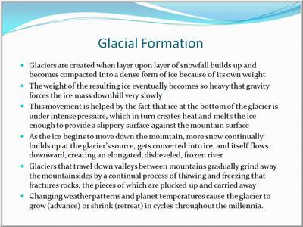
Crafting Text

Slide 7
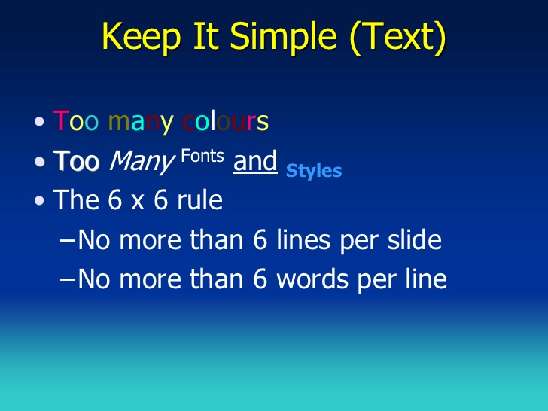

Slide 8
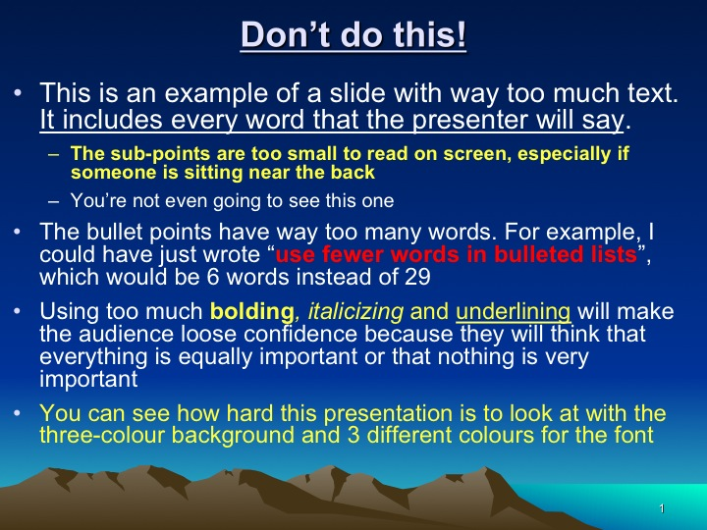

Slide 9
Crafting Text
Minimize clutter
Nothing on the slide without a purpose
No redundancy
Do not explain the unsuccessful analyses
Slides that are not essential, but which might address a likely question, should be included as backup at the end of the presentation
Number slides, … except for the title slide
Easy for viewers to ask a question that revisits a slide
“Please go back to Slide X…”

Slide 10
Iterative Review
Having worked extensively on a presentation, you are biased & blinded
You have already convinced yourself
… but you will be presenting to people much less familiar with the content than you
Your attention will be on the point you are making
…but you may not have constructed your slide to draw a viewer’s attention there
Have an uninformed person view your slides
A fresh audience may see it differently
Easy for them to see clarity, clutter, consistency

Slide 11
An Example
Let’s view an example of a “pretty good” presentation

